Slide 1
Bank Customer churn Prediction
Project by group number - 8
Rutuja Khadake , Amit bhatt , akshay jagtap , sahil jagtap

Slide 2
Problem Statement
No Banks & Business can thrive without its customer’s. On the flip side, Customers leaving the Banks is a nightmare that every bank dreads
In fact one of the key to measure a Banks Success is measure by its Customer churn rate – The lower churn rate the more the bank is loved
Typically every user of the bank services is assigned a prediction value that estimates the state of churn at any given time.
So we need to predict the churning that weather a coustomer is going to exit the bank or not so that the bank can lower it’s churning rate

Slide 3
Objectives
Importing Libraries
Loading Dataset
Displaying Dataset
Preprocessing of Dataset
Visualizing Dataset
Feature Scaling
Handling imbalance Data
Applying Different ML algorithms
Conclusion

Slide 4
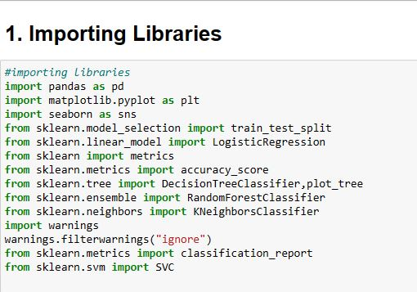
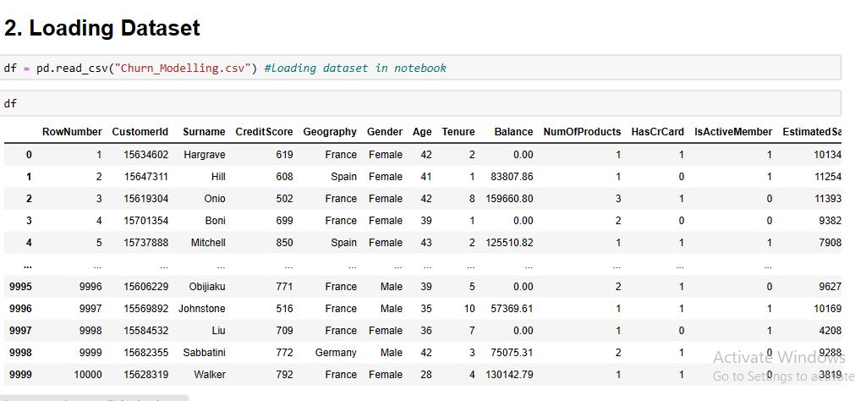
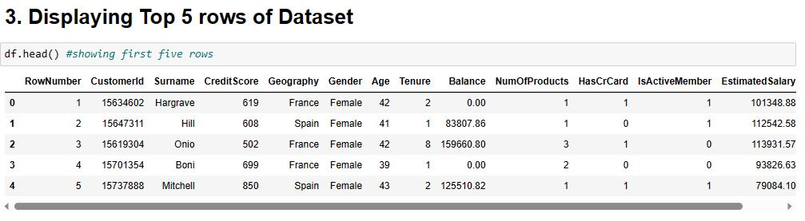
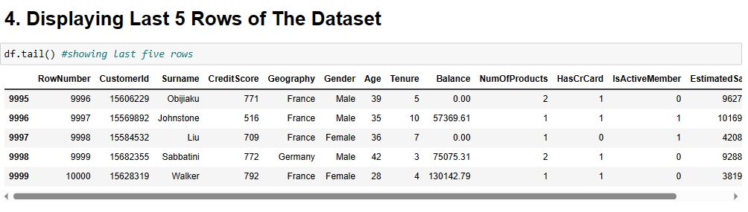

Slide 5
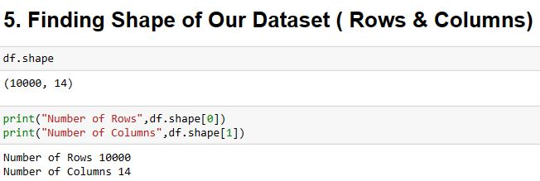
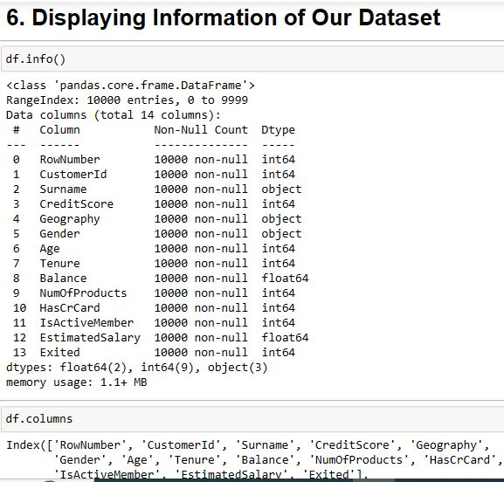
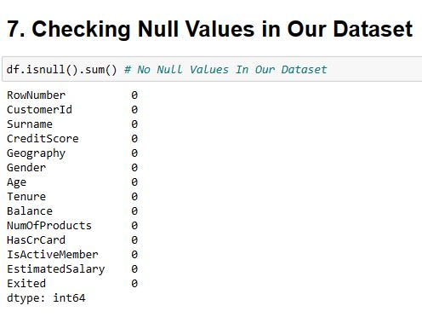
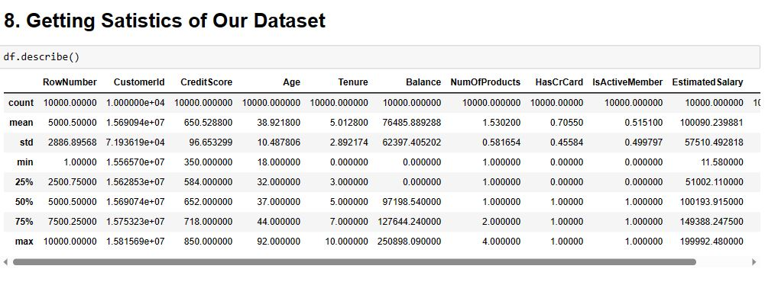
E D A

Slide 6
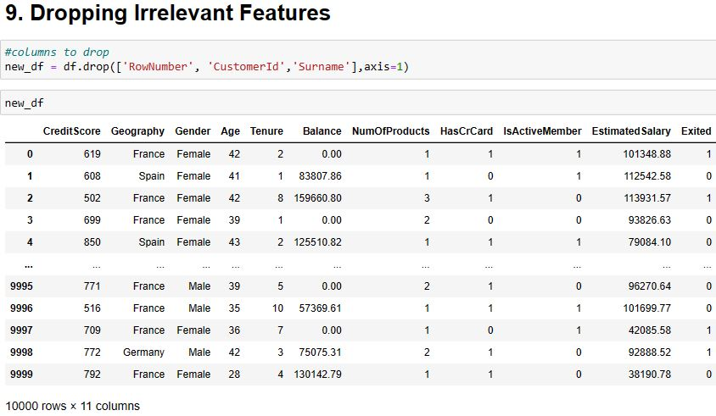
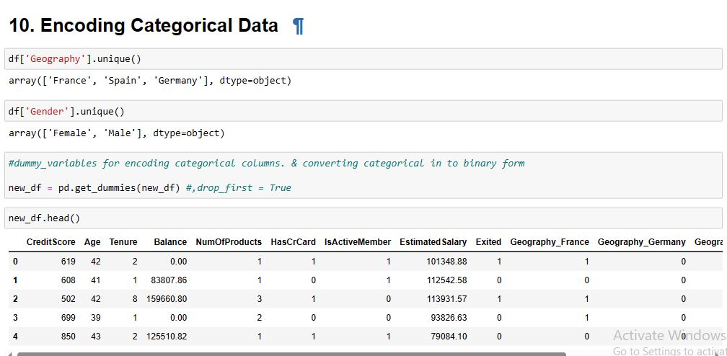
Encoding categorical data using dummies -
- Dropping Irrelevant features

Slide 7
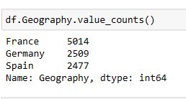
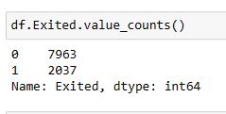
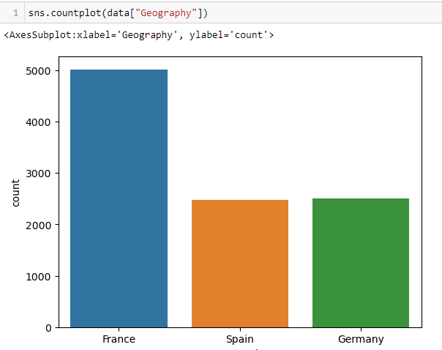
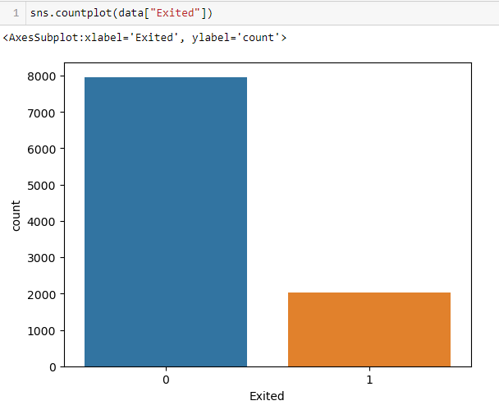
visualization of geography & coustomers exited

Slide 8
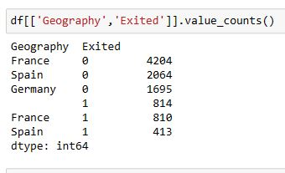
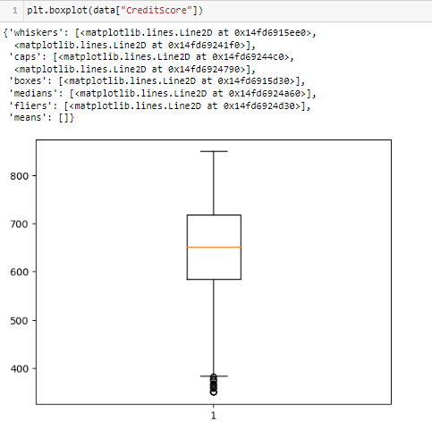
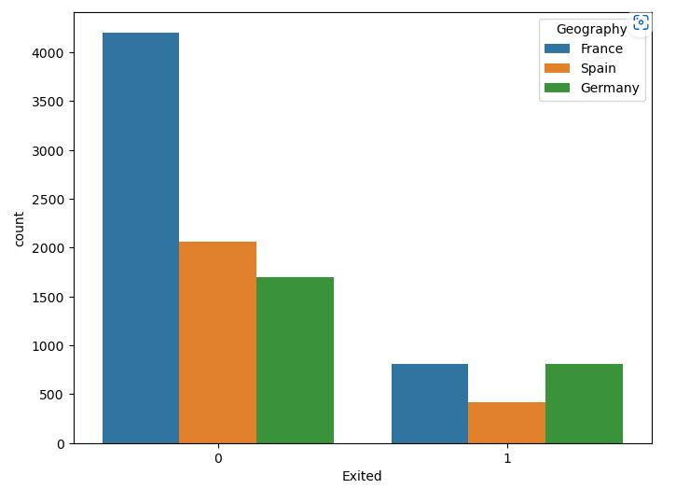
visualization of Credit score & Customer’s exited from different countries

Slide 9
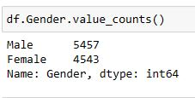
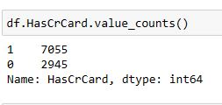
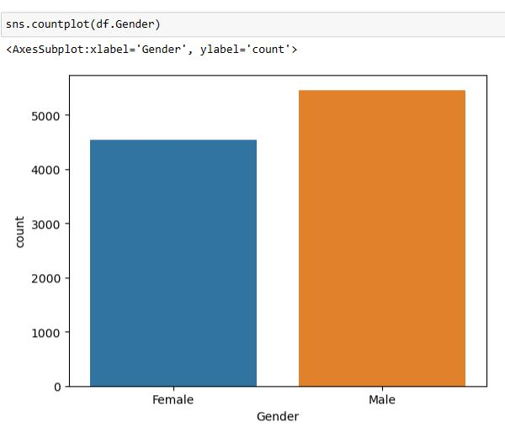
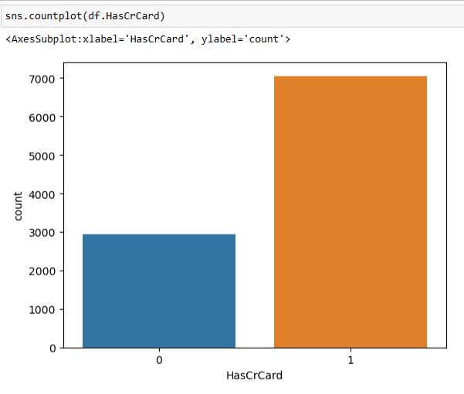
visualization OF GENDER & no of coustomer who have credit card

Slide 10
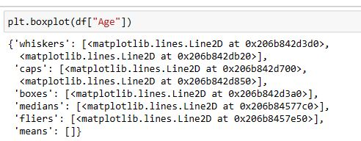
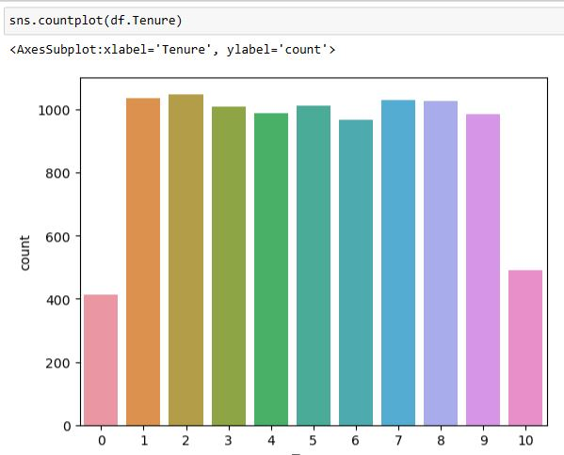
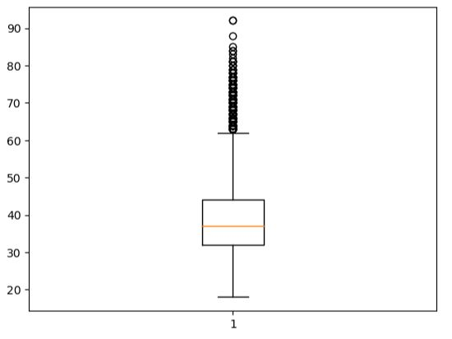
visualization OF Age & Tenure of the coustomer

Slide 11
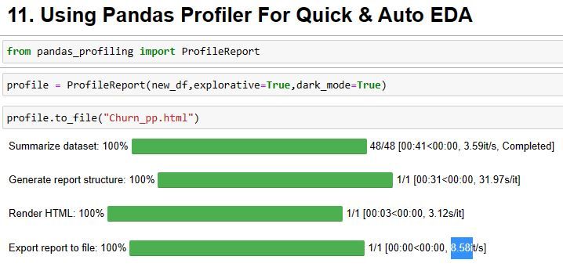
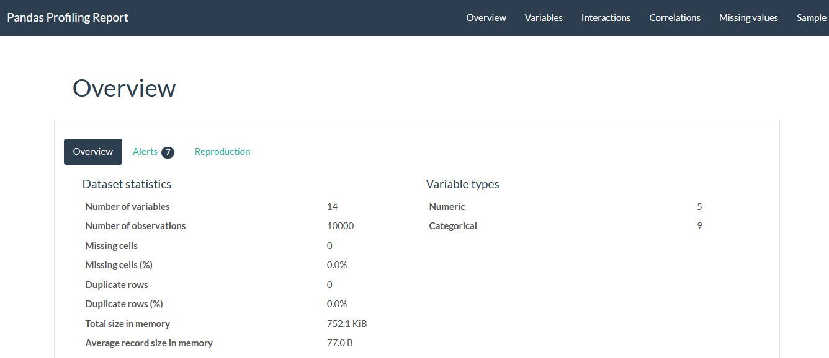
Using Pandas profiler
For quick &
Auto eda

Slide 12
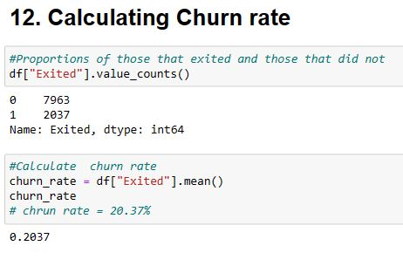
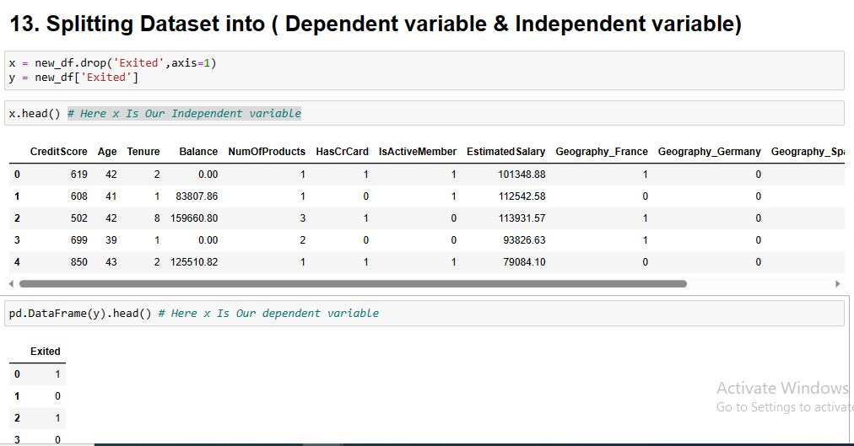
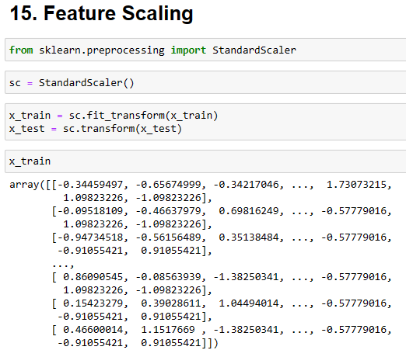
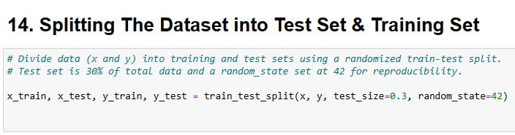

Slide 13
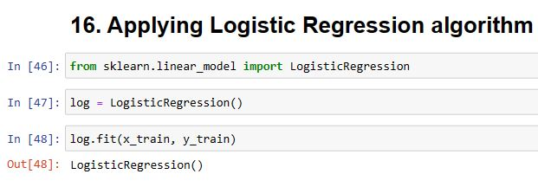
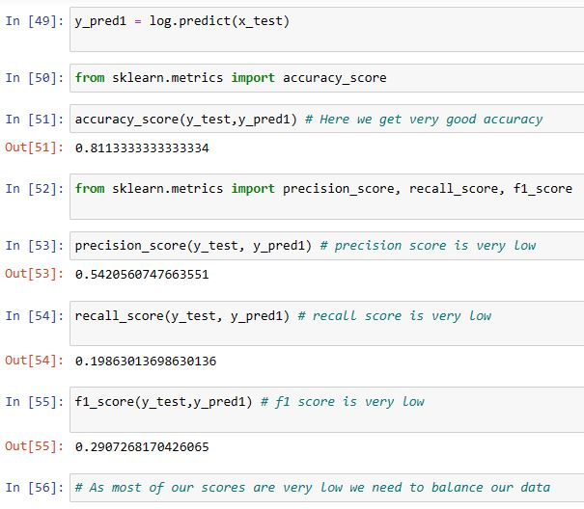
logistic regression
Logistic regression is a supervised machine learning algorithm mainly used for classification tasks where the goal is to predict the probability that an instance of belonging to a given class or not. It is a kind of statistical algorithm, which analyze the relationship between a set of independent variables and the dependent binary variables. It is a powerful tool for decision-making.
Finding accuracy & Other classifications

Slide 14
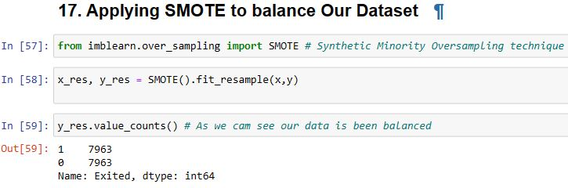
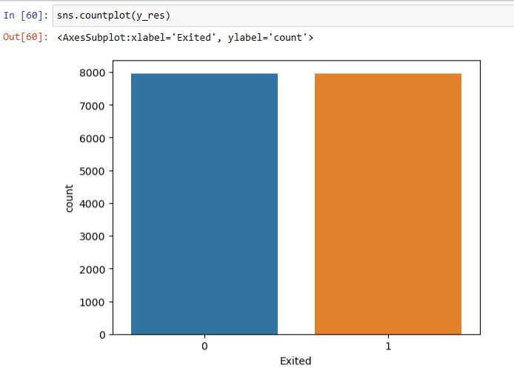
applying smote to balance data
SMOTE (synthetic minority oversampling technique) is one of the most commonly used oversampling methods to solve the imbalance problem.
It aims to balance class distribution by randomly increasing minority class examples by replicating them.
And the data is been balanced

Slide 15
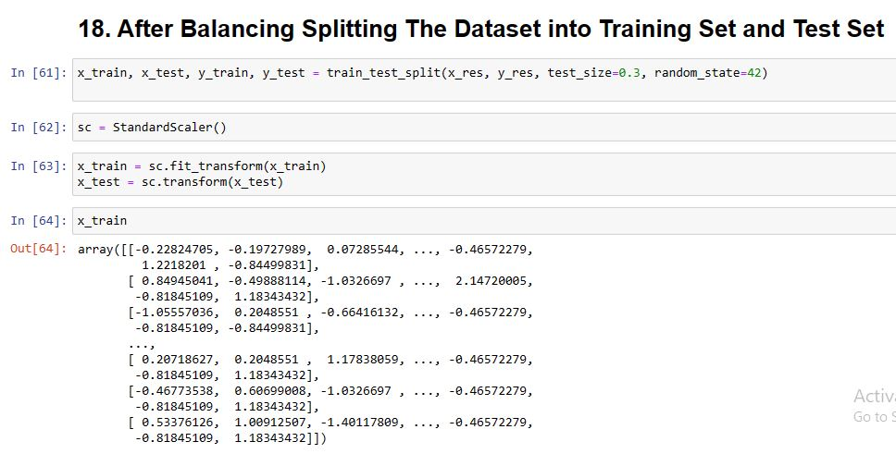
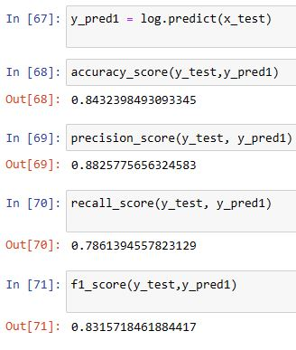
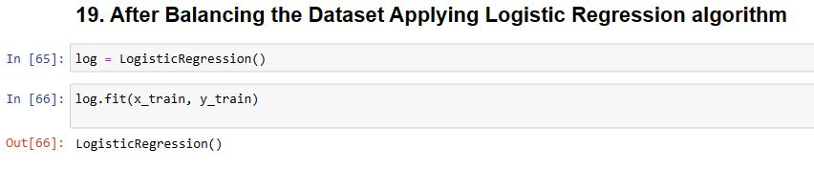
because of balancing accuracy and other classification is increased

Slide 16
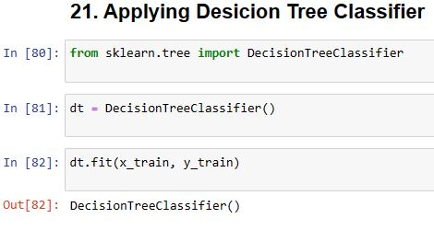
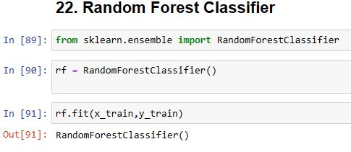
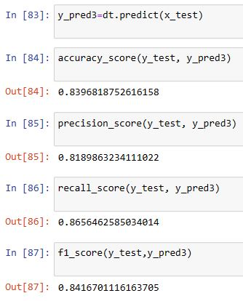
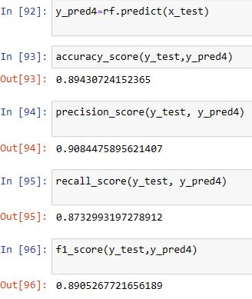
DECISION TREE
random forest
Decision Tree is a Supervised learning technique that can be used for both classification and Regression problems, but mostly it is preferred for solving Classification problems.
Random Forest is a classifier that contains a number of decision trees on various subsets of the given dataset and takes the average to improve the predictive accuracy of that dataset.

Slide 17
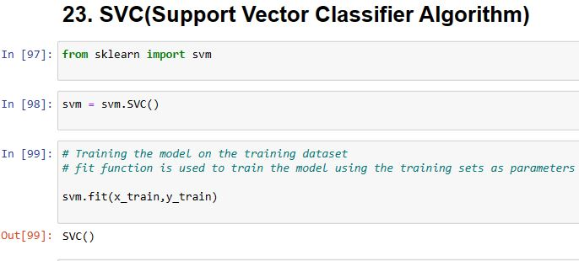
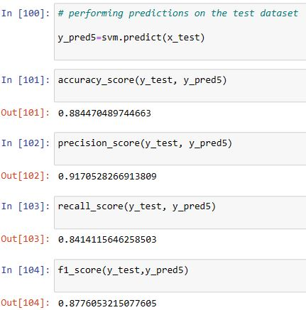
svm classifier
Support Vector Machine(SVM) is a supervised machine learning algorithm used for both classification and regression. Though we say regression problems as well it’s best suited for classification. The objective of the SVM algorithm is to find a hyperplane in an N-dimensional space that distinctly classifies the data points. The dimension of the hyperplane depends upon the number of features. If the number of input features is two, then the hyperplane is just a line. If the number of input features is three, then the hyperplane becomes a 2-D plane. It becomes difficult to imagine when the number of features exceeds three.

Slide 18
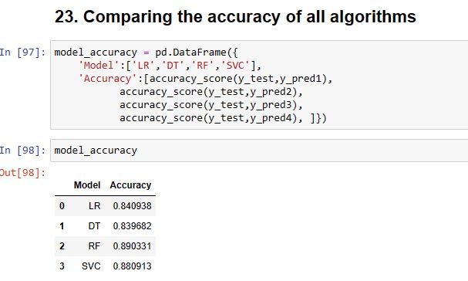
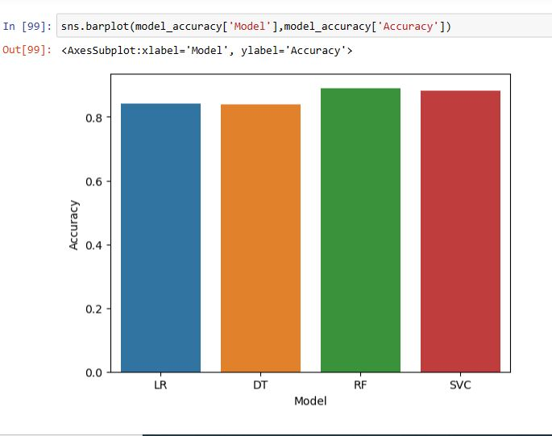
Comparing Accuracy Of All Applied Algorithms To Chose One With Maximum Accuracy For Prediction of Chrun

Slide 19
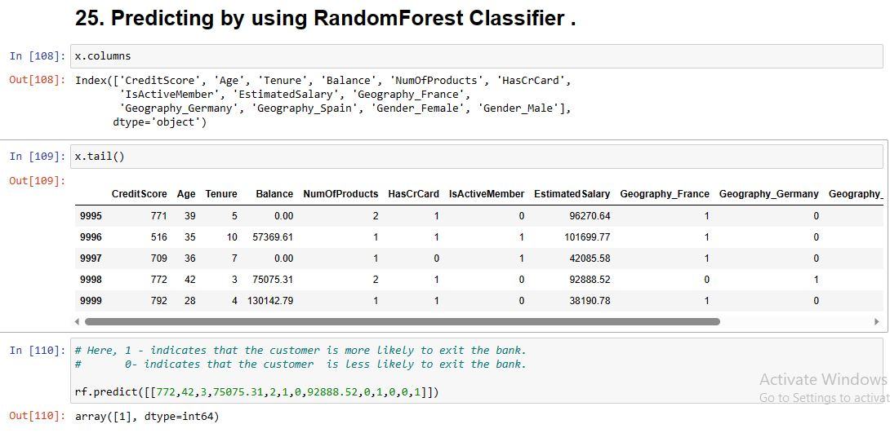
Predicting Using Random Forest Classifier Which Is With Maximum Accuracy Compared To Other applied Algorithms

Slide 20
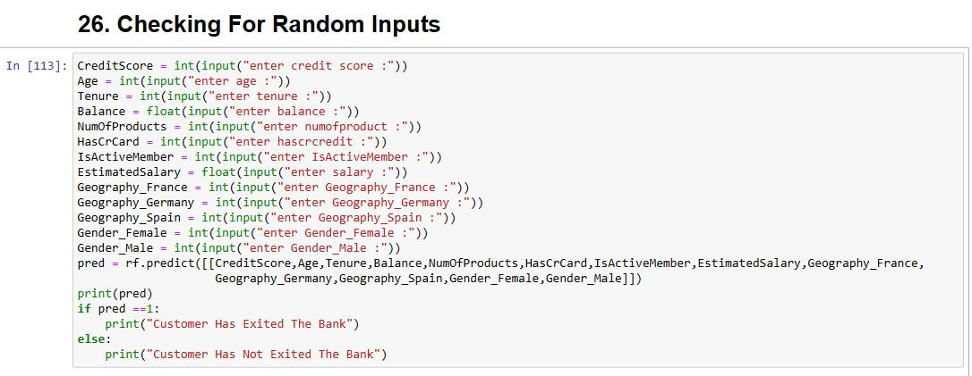
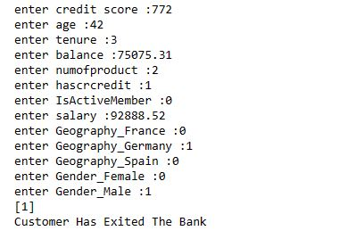
Checking for random inputs

Slide 21
conclusion
The churn variable had imbalanced data. So we balanced the data using smote
We have to change the data types on the Country and Gender column from string to integer using dummies so the Machine Learning model can read and predict the dataset
Random Forest is the best algorithms to predict Bank Customer Churn since they have the highest accuracy of 89.43 %
With machine learning and deep analysis for customer churn prediction, the bank will be able to increase customer retention rate, save up on retention costs and even protect the future revenue from churning users.

Slide 22


