Slide 1
Travelling Salesman Problem using Ant Colony Optimization
An implementation of Swarm Intelligence

Slide 2
By
A.Akshay - 15B81A0513
V.Bhanu Sree - 15B81A0533
R.Goutham - 15B81A0554
Guidance By
Ch. Ram Mohan

Slide 3
Agenda
To find out the solution for Travelling Salesman Problem using Matlab code.
It is an implementation of Ant Colony Optimization (ACO) algorithm using the Swarm Intelligence technique.

Slide 4
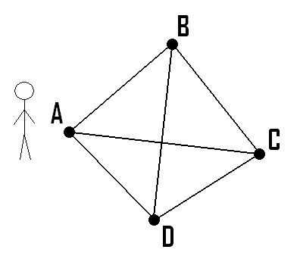
Introduction
The Travelling Salesman problem mainly focuses on optimization.
TSP is a typical combinatorial optimization problem. It is often used to validate a certain algorithm, making the comparison with other algorithms an easy work.

Slide 5
Some applications of Travelling Salesman Problem are:
Drilling holes for electrical circuits for flat machines
Starlight interferometer satellite positioning
Applications in crystallography
Chain diagram optimization
Computer motherboard components layout
Industrial robot control;

Slide 6
Ant Colony Optimization
In computer science and operations research, the ant colony optimization algorithm (ACO) is a probablistic technique for solving computational problems which can be reduced to finding good paths through graphs.
The pheromone-based communication of biological ants is often the predominant paradigm used.

Slide 7
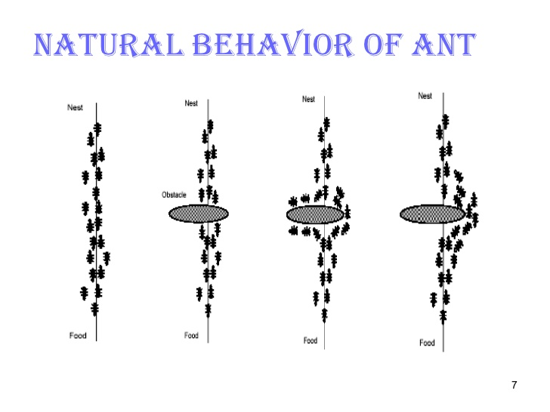

Slide 8
The general algorithm is relatively simple and based on a set of ants, each making one of the possible round-trips along the cities. At each stage, the ant chooses to move from one city to another according to some rules:
It must visit each city exactly once;
A distant city has less chance of being chosen (the visibility);
The more intense the pheromone trail laid out on an edge between two cities, the greater the probability that that edge will be chosen;
Having completed its journey, the ant deposits more pheromones on all edges it traversed, if the journey is short;
After each iteration, trails of pheromones evaporate.

Slide 9
The algorithm proceeds in the following manner:
while score_not_good_enough
for ant_k in colony
place ant_k at random city
while ant has not visited all cities
with probabily q_0, ant_k will move to the city with best tau and eta
otherwise, ant_k will move to a random city based on p_k
end
for edge in edge_set
if (edge is traversed)
tau(edge) = (1 - rho) * tau(edge) + delta-tau
else
tau(edge) = (1 - rho) * tau(edge)
end
end
If there is a score higher than currMax, update
end
end

Slide 10

Formulas Used:
$s=\left\{\begin{aligned}argmax_\{u \backslash nin M_k\} \{ tau\left(r,u\right)∗ eta{\left(r,u\right)}^{\left\{beta\right\}};if q < q_0 \\ s ;otherwise \end{aligned}\right.$
$p_{k}=\left\{\begin{aligned}\frac{tau(r,s) ∗ eta(r,s)^\{beta\}}{sum_\{u \backslash nin m_k\} (tau(r,u) ∗ eta(r,u))^\{beta\}};if s \backslash nin M_k \\ 0 ;otherwise\end{aligned}\right.$

Slide 11
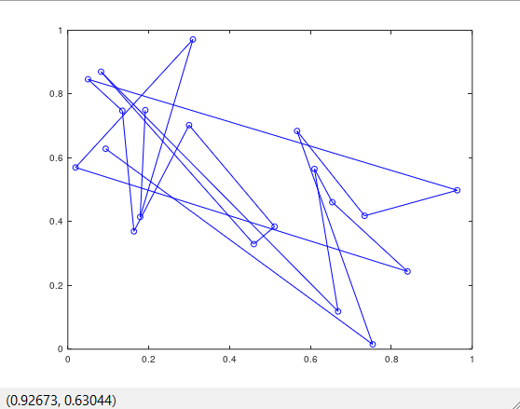
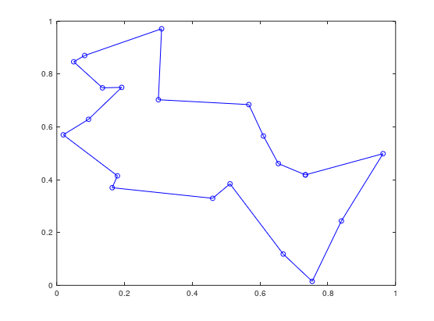
Sample Output:
Random Path
Shortest Path

Slide 12
THANK YOU

