Slide 1
Instacart Market-Basket Analysis

Slide 2
Dataset Overview
Number of Users – 200,000
Number of Grocery Orders – 3 Million (spread across all the users)

Slide 3
Orders_Products
Order ID
Products in that order
Cart Order (when it is added in the cart)
Reordered or not

Slide 4
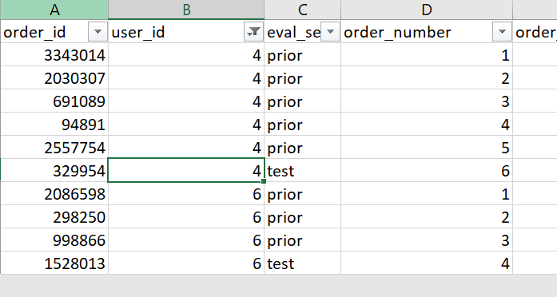
Orders
OrderID
UserID
Order_number
Eval_set (prior or test)
Need to merge prior order_id with the order_products dataset

Slide 5
Products
Product_id
Product_Name
Aisle_id
Department_id

Slide 6
Aisle and Department
Aisle ID (134) and Aisle Name
Department ID and Department Name

Slide 7
UserID, OrderID1, ProductID1, Add_to_card_order, Reorder
UserID, OrderID1, ProductID2, Add_to_card_order,Reorder
USerID, OrderID, ProductID3, Add_to_card_order, Reorder

