Slide 1
00:00–01:30 Nikhil
The next two hours
T2D Glucose Digital Twin
A synthetic subject. A two-hour forecast. An explicit uncertainty.
Akshaya R
BGS College of Engineering and Technology
Nikhil VS
East West Institute of Technology
Synthetic research only. No clinical validation claimed.
01
Notes:
TIME 00:00–01:30
PRESENTER Nikhil
SCREEN: Slide 1. Both presenters on camera for the first 20 seconds, then slide full screen. Do not show a fabricated patient or pretend this opening is a clinical case.
Imagine a researcher looking at a glucose reading. The number is clear. The next two hours are much less clear. Is the trajectory rising? How uncertain is that prediction? And what information would make us stop trusting it?
Those questions are the starting point for our T2D Glucose Digital Twin. Over the next twenty-one minutes, we will follow one synthetic subject through a forecasting workflow. We will show the context that enters the model, the forecast that reaches the screen, and the evidence behind the result. We will also show where our evidence ends.
I am Nikhil VS, from East West Institute of Technology. My teammate is Akshaya R, from BGS College of Engineering and Technology. We use T2D Digital Twin Team as a descriptive name for our project.
This is a research prototype using synthetic data. It has no live wearable connection, and we do not present it as a medical device or a treatment recommendation. The story you are about to see is a software demonstration, not a real patient's clinical history. Akshaya will begin with the problem we chose to investigate.
SOURCE BASELINE: 1ab28f31fcc0954cf417bb10aafd4c785364e280
https://github.com/AkshayAlgoX/T2D-Glucose-Digital-Twin./blob/1ab28f31fcc0954cf417bb10aafd4c785364e280/README.md
Screenshots are supplied recorded evidence, not independently reproduced. EW-01 status comes from supplied project record.

Slide 2
01:30–03:00 Akshaya
A reading needs context
What may happen next?
Which context shaped the estimate?
When should the result be withheld?
Synthetic research only. No clinical validation claimed.
02
Notes:
TIME 01:30–03:00
PRESENTER Akshaya
SCREEN: Slide 2. Point to the three questions one at a time. Leave the final question visible during the handoff.
A glucose reading describes a moment. A forecast asks what may happen after that moment. The healthcare use case we chose is Type 2 Diabetes research, where interpreting a trajectory also requires understanding the information available about the person and the quality of their measurements.
Our prototype asks whether a physiological prior and a learned forecasting model can present that future in a form a researcher can inspect. The intended interaction is straightforward: select a subject, examine the current reading, look at the predicted trajectory, then ask how much confidence the surrounding evidence supports.
The interface should help someone distinguish a high predicted risk from a reliable input stream. Those are different questions. A low risk estimate does not prove that a person is safe. A fresh-looking screen does not prove that the model has recent data.
So our design makes the timestamp, model mode and input quality visible beside the result. We are not claiming that this workflow improves clinical outcomes or gives a guaranteed amount of warning. We are presenting a concrete way to examine those questions before any clinical use. To understand the demonstration, we first need to understand who our subject actually is.
SOURCE BASELINE: 1ab28f31fcc0954cf417bb10aafd4c785364e280
https://github.com/AkshayAlgoX/T2D-Glucose-Digital-Twin./blob/1ab28f31fcc0954cf417bb10aafd4c785364e280/src/components/digital-twin/PatientWorkspace.tsx
https://github.com/AkshayAlgoX/T2D-Glucose-Digital-Twin./blob/1ab28f31fcc0954cf417bb10aafd4c785364e280/README.md
Screenshots are supplied recorded evidence, not independently reproduced. EW-01 status comes from supplied project record.

Slide 3
03:00–04:30 Akshaya
Our subject is synthetic
293 active synthetic subjects
205 training / 44 validation / 44 test
Demonstration: training subject only
Replay is not a live wearable feed
Synthetic research only. No clinical validation claimed.
03
Notes:
TIME 03:00–04:30
PRESENTER Akshaya
SCREEN: Slide 3. Explain the cohort counts without opening any held-out files. P0003 is the planned training-partition demo subject; confirm it in rehearsal. Never select a test-partition subject for this recording.
Our subject comes from the existing synthetic cohort shipped with the project. There is no real patient behind the identifier we will use. The served run records 293 active synthetic subjects. Its manifest records a split of 205 training subjects, 44 validation subjects and 44 test subjects.
For this demonstration we plan to use P0003, a synthetic Type 2 subject in the training partition. That selection keeps the recording separate from held-out evaluation. We are replaying existing data, not collecting new data or generating a new cohort for this video.
The model receives glucose history and structured context. The dashboard can display fields such as age, HbA1c and medication classes when the response includes them. These are synthetic attributes. A medication class is descriptive context, not a prescription. A model estimate of physiological state is not a measured laboratory result.
Replay also changes the meaning of time on screen. The browser can receive an update every few seconds while the displayed synthetic timestamp advances by five minutes. We will read that recorded timestamp rather than confuse it with the clock on our computer. Nikhil will now show how those inputs reach the workspace.
SOURCE BASELINE: 1ab28f31fcc0954cf417bb10aafd4c785364e280
https://github.com/AkshayAlgoX/T2D-Glucose-Digital-Twin./blob/1ab28f31fcc0954cf417bb10aafd4c785364e280/runs/pr_tft_ablation_arm_d/run_manifest.json
https://github.com/AkshayAlgoX/T2D-Glucose-Digital-Twin./blob/1ab28f31fcc0954cf417bb10aafd4c785364e280/backend/serve_pr_tft.py
Screenshots are supplied recorded evidence, not independently reproduced. EW-01 status comes from supplied project record.

Slide 4
04:30–06:00 Nikhil
The forecasting path
01 Existing synthetic CGM and EHR
02 UKF physiological prior
03 PR-TFT forecast and risk
04 FastAPI versioned contract
05 Next.js validation and workspace
Synthetic research only. No clinical validation claimed.
04
Notes:
TIME 04:30–06:00
PRESENTER Nikhil
SCREEN: Slide 4. Read the five numbered stages from left to right / top to bottom. This is the architecture slide, not a running terminal. No commands or credentials on screen.
There are five stages in this path. First, the existing synthetic records provide the observable input history and context. Second, the physiological twin produces a prior trajectory. Third, the PR-TFT model produces forecasts and risk estimates using its learned representation. Fourth, the FastAPI service packages those outputs into the versioned response contract. Finally, the Next.js application validates and presents the response.
The implementation uses Python, PyTorch and Lightning for the model workflow, with FastAPI for serving. The interface uses Next.js 16, React and TypeScript, with D3 for the visualizations. Zod validation checks responses in the web application.
That separation matters when interpreting a demonstration. A screenshot proves that a screen existed. A connected recording can show that a particular input reached the serving path and produced an observable update. Neither of those observations, on its own, reproduces training or establishes clinical effectiveness.
The version we prepared for this recording is pinned in the accompanying notes. We keep the checkpoint and its manifest together rather than replacing artifacts to make a demo look successful. The next question is why the model combines a physiological component with a learned one.
SOURCE BASELINE: 1ab28f31fcc0954cf417bb10aafd4c785364e280
https://github.com/AkshayAlgoX/T2D-Glucose-Digital-Twin./blob/1ab28f31fcc0954cf417bb10aafd4c785364e280/backend/serve_pr_tft.py
https://github.com/AkshayAlgoX/T2D-Glucose-Digital-Twin./blob/1ab28f31fcc0954cf417bb10aafd4c785364e280/package.json
https://github.com/AkshayAlgoX/T2D-Glucose-Digital-Twin./blob/1ab28f31fcc0954cf417bb10aafd4c785364e280/src/hooks/useRealtimeTelemetry.ts
Screenshots are supplied recorded evidence, not independently reproduced. EW-01 status comes from supplied project record.

Slide 5
06:00–07:30 Akshaya
A prior and a learned correction
UKF prior: a simplified physiological trajectory
PR-TFT: learned forecasting from observable context
Checkpoint identity does not prove clinical validity
Training manifest records a dirty working tree
Synthetic research only. No clinical validation claimed.
05
Notes:
TIME 06:00–07:30
PRESENTER Akshaya
SCREEN: Slide 5. Point to the two model descriptions, then the checkpoint statement. Avoid saying the twin is a validated replica of a real person.
The physiological component represents a simplified glucose process. In the served configuration, the project uses a UKF twin prior in S3 mode. The learned component is a physiology-regularized Temporal Fusion Transformer, which we call PR-TFT.
The motivation is to combine a structured model of the process with patterns learned from the available histories. That motivation should not be confused with a proof that physiology makes every prediction correct. Both components have assumptions, and the synthetic data limit what we can conclude about their behavior in real people.
At serving time, the software loads the existing checkpoint, configuration, normalization and calibration artifacts. It also uses the canonical state artifacts associated with the run. Hashes let us check whether we are discussing the same files. They do not establish that the experiment has been independently repeated.
There is another important qualification in the manifest: the training run records a working tree with uncommitted changes. We keep that provenance visible instead of describing the training run as a perfectly clean reproduction. For the viewer, the practical output of this model is a trajectory with uncertainty and a separate estimate of spike-onset risk. Let us look at how to read those outputs.
SOURCE BASELINE: 1ab28f31fcc0954cf417bb10aafd4c785364e280
https://github.com/AkshayAlgoX/T2D-Glucose-Digital-Twin./blob/1ab28f31fcc0954cf417bb10aafd4c785364e280/backend/serve_pr_tft.py
https://github.com/AkshayAlgoX/T2D-Glucose-Digital-Twin./blob/1ab28f31fcc0954cf417bb10aafd4c785364e280/runs/pr_tft_ablation_arm_d/run_manifest.json
Screenshots are supplied recorded evidence, not independently reproduced. EW-01 status comes from supplied project record.

Slide 6
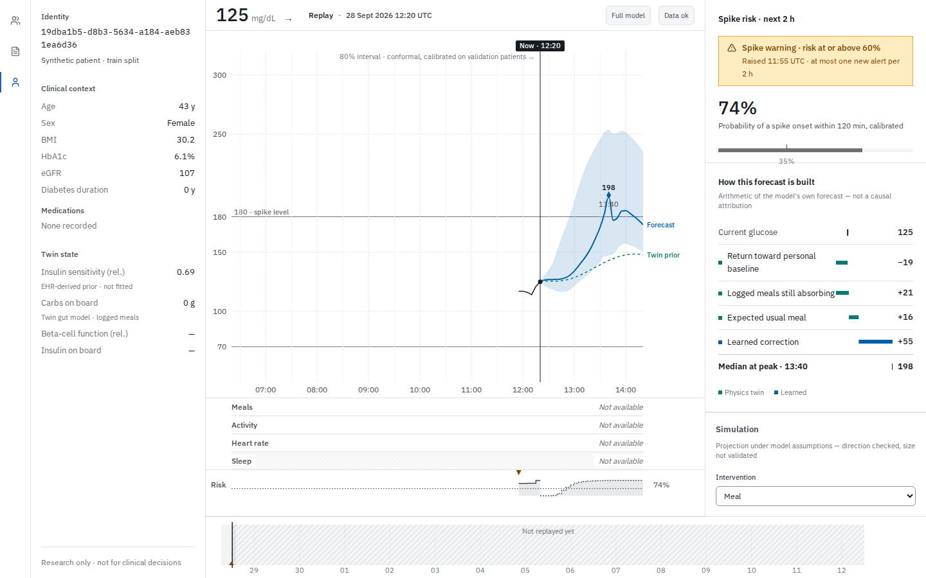
07:30–09:00 Nikhil
Reading a forecast
120-minute horizon, five-minute steps
Median and uncertainty answer different questions
Recorded synthetic replay
Repository-recorded screenshot; provenance in notes. Synthetic research only. No clinical validation claimed.
06
Notes:
TIME 07:30–09:00
PRESENTER Nikhil
SCREEN: Slide 6. Use the repository live-replay screenshot only as a labelled recorded illustration. Point at the anchor and interval, not a specific invented value. The next segment switches to the real application.
The forecast covers the next 120 minutes at five-minute steps. The median is one summary of the predicted trajectory. The surrounding quantiles describe uncertainty under the model's assumptions. The 80 percent interval uses the tenth and ninetieth percentiles, with conformal adjustment fitted on validation patients.
An interval is not a promise that a future reading must stay inside it. Its recorded coverage summarizes a collection of synthetic validation examples. It is not an individual guarantee and does not automatically transfer to a new population.
The risk panel answers a related but distinct question: what is the model's estimated probability of a spike onset within the next two hours? Alert presentation follows a served policy. We should not infer clinical urgency solely from a color or a threshold.
The contribution display is also easy to overread. It decomposes the arithmetic of the model's median forecast near its peak. It does not prove that any displayed component caused a real person's glucose to change.
The image on this slide is a repository recording artifact, labelled as such. We now switch to the connected application and read only the values that actually arrive during our recording.
SOURCE BASELINE: 1ab28f31fcc0954cf417bb10aafd4c785364e280
https://github.com/AkshayAlgoX/T2D-Glucose-Digital-Twin./blob/1ab28f31fcc0954cf417bb10aafd4c785364e280/docs/screenshots/README.md
https://github.com/AkshayAlgoX/T2D-Glucose-Digital-Twin./blob/1ab28f31fcc0954cf417bb10aafd4c785364e280/src/components/digital-twin/ForecastCanvas.tsx
Screenshots are supplied recorded evidence, not independently reproduced. EW-01 status comes from supplied project record.

Slide 7
09:00–11:30 Nikhil + Akshaya
One subject, successive updates
Connected synthetic application
Identity / timestamp / quality / forecast
Forecast updates at recorded timestamps
Synthetic training subject P0003
Synthetic research only. No clinical validation claimed.
07
Notes:
TIME 09:00–11:30
PRESENTER Nikhil + Akshaya
SCREEN: Switch from slide 7 to the real application at http://127.0.0.1:3000/cohort ONLY after a separately verified bounded recording plan. 00–25s: search P0003, confirm Type 2 and Train, open its workspace. 25–55s: Nikhil points to Replay, current glucose, UTC anchor, Full model and Data status; read actual values. 55–90s: Akshaya points to clinical context and EHR-derived prior wording. 90–120s: compare at least two actual updates, read the new anchor and risk. 120–150s: show interval and risk/contribution panels. This clip must fit inside the approved service budget, including startup. If it cannot, record a shorter genuine clip and explain it with slides. No held-out subjects, /twin calls or scenario requests in this segment. If no valid forecast arrives, stop and resolve the issue; do not replace this with fixtures.
NIKHIL: We are now in the application. This is the synthetic cohort directory. I am selecting our agreed training subject, P0003. Before reading a forecast, I am checking the identity and the synthetic-data label.
[Read the actual current glucose, UTC forecast timestamp, model mode and data-quality state. Pause while pointing to each.]
AKSHAYA: The clinical context belongs to this synthetic subject. The medication entries describe the recorded input classes. The insulin-sensitivity display explicitly identifies an EHR-derived prior. We should not call it a newly measured physiological property.
[Point to the context and prior wording. Allow the next valid update to arrive.]
NIKHIL: Now compare the timestamp with the previous one. The displayed trajectory and risk belong to that forecast anchor. We are watching a replay of synthetic observations, not a sensor attached to someone today.
[Read the second actual timestamp and risk. If no second update arrives, say: “We have only observed one forecast in this window.”]
AKSHAYA: Notice the median and the interval around it. We can inspect the model's estimate and its uncertainty together. The risk value describes the next two hours from this anchor. It does not tell us to administer a treatment.
NIKHIL: This is the behavior we wanted to make inspectable: a named synthetic subject, a timestamped response and visible uncertainty. We will now leave this connected segment and explain how the current release handles a fixed point in the replay.
SOURCE BASELINE: 1ab28f31fcc0954cf417bb10aafd4c785364e280
https://github.com/AkshayAlgoX/T2D-Glucose-Digital-Twin./blob/1ab28f31fcc0954cf417bb10aafd4c785364e280/src/components/digital-twin/PatientWorkspace.tsx
https://github.com/AkshayAlgoX/T2D-Glucose-Digital-Twin./blob/1ab28f31fcc0954cf417bb10aafd4c785364e280/src/app/cohort/page.tsx
Screenshots are supplied recorded evidence, not independently reproduced. EW-01 status comes from supplied project record.

Slide 8
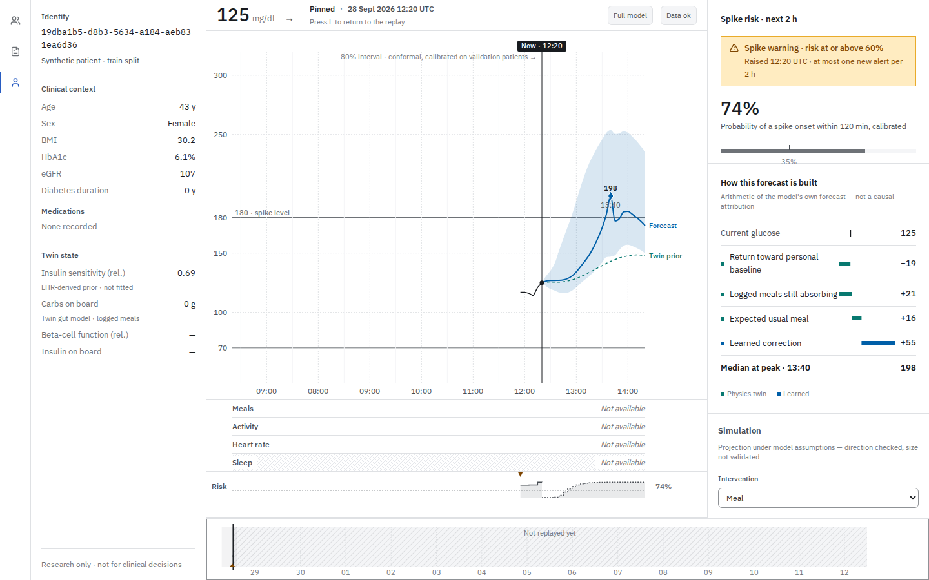
11:30–13:00 Akshaya
Holding a moment in time
A pinned view keeps the forecast anchor explicit
Timeline navigation uses received history
Recorded repository state, not a new execution
Repository-recorded screenshot; provenance in notes. Synthetic research only. No clinical validation claimed.
08
Notes:
TIME 11:30–13:00
PRESENTER Akshaya
SCREEN: Slide 8 with labelled pinned repository screenshot. Do not keep a service running behind the slides. Describe the exact rehearsal interaction: focus the timeline slider, press Space, confirm Pinned and a stable UTC anchor; ArrowLeft steps five minutes within received history; L returns to replay. Only show a newly recorded clip if separately rehearsed and bounded.
A moving replay is useful for observing updates, but it can be difficult to discuss a result while the anchor keeps changing. The current release includes a pinned view to address that interaction.
The timeline uses received history. In rehearsal, we focus the timeline and press Space to pin the current cursor. The header should identify the pinned state. Moving left steps through available time, and returning to replay restores the moving view. We must verify those actions on the recording version before showing them as a fresh demonstration.
The image here is the repository's recorded pinned state, with its provenance retained. It is useful for explaining the intended interaction, but we are not presenting it as an action just performed in this recording.
Keeping the time fixed is also important for a scenario request. A comparison should refer to the same subject and the same anchor. If the view changes, the application must avoid presenting an old comparison as though it belongs to the new time.
That gives us a natural next question in our story: what happens inside the model if we change one permitted input? The answer is an exploratory projection, with important limits.
SOURCE BASELINE: 1ab28f31fcc0954cf417bb10aafd4c785364e280
https://github.com/AkshayAlgoX/T2D-Glucose-Digital-Twin./blob/1ab28f31fcc0954cf417bb10aafd4c785364e280/src/components/digital-twin/TimeScrubber.tsx
https://github.com/AkshayAlgoX/T2D-Glucose-Digital-Twin./blob/1ab28f31fcc0954cf417bb10aafd4c785364e280/src/components/digital-twin/TimeContext.tsx
https://github.com/AkshayAlgoX/T2D-Glucose-Digital-Twin./blob/1ab28f31fcc0954cf417bb10aafd4c785364e280/docs/screenshots/README.md
Screenshots are supplied recorded evidence, not independently reproduced. EW-01 status comes from supplied project record.

Slide 9
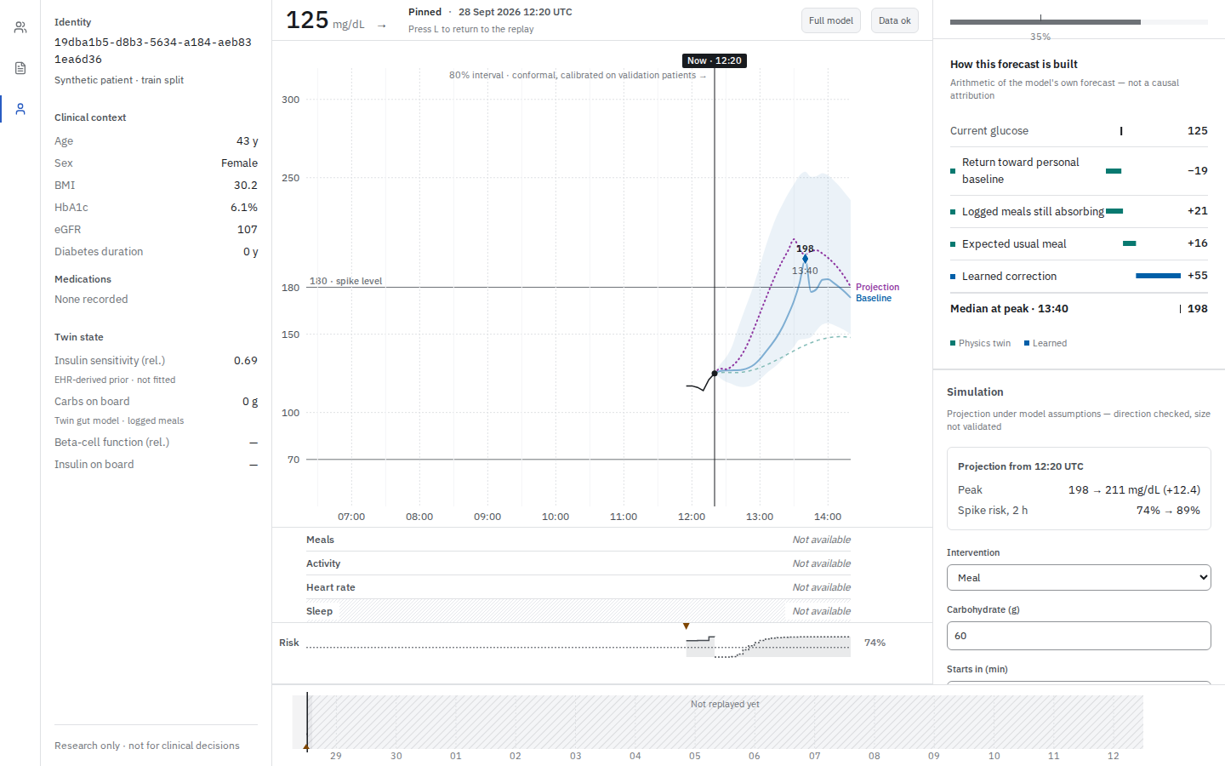
13:00–14:30 Nikhil
Scenario projections
Meal and activity projections exist in source
Medication is not modelled
Effect size is not clinically validated
Recorded 60 g example; not treatment advice
Repository-recorded screenshot; provenance in notes. Synthetic research only. No clinical validation claimed.
09
Notes:
TIME 13:00–14:30
PRESENTER Nikhil
SCREEN: Slide 9, labelled recorded what-if screenshot. Explain source-backed controls. Optional separately approved clip: pin the training subject, select Meal, enter 30 g and Starts in 0, click Run simulation once, show returned anchor, Peak and Spike risk, then Clear simulation. Never pre-script numeric results. The screenshot used here depicts the repository’s recorded 60 g example, not the planned 30 g rehearsal.
The current interface supports meal, activity and skipped-usual-meal scenario inputs. Medication is explicitly not modelled. The request is tied to the subject and the timestamp being viewed, and the web layer validates the response before presenting it.
For a separately approved rehearsal, the smallest example is a single meal input at a pinned anchor. We would enter the carbohydrate amount, run one request, and compare the returned peak and two-hour risk with the baseline shown at that same time. We would read the actual response rather than promise that it must move by a particular amount.
The recorded repository image on this slide uses a sixty-gram meal example. It is not a prescription and it is not a new execution in this preparation pass. The interface's own qualification is important: projection under model assumptions, with size not validated.
Changing a model input is not equivalent to establishing a causal treatment effect in a person. We cannot use these projections to recommend insulin, meals or exercise for an individual. For this prototype, the value is in making the model's assumptions and comparisons visible. That visibility must extend to failure, as well as to successful responses.
SOURCE BASELINE: 1ab28f31fcc0954cf417bb10aafd4c785364e280
https://github.com/AkshayAlgoX/T2D-Glucose-Digital-Twin./blob/1ab28f31fcc0954cf417bb10aafd4c785364e280/src/components/digital-twin/ScenarioEditor.tsx
https://github.com/AkshayAlgoX/T2D-Glucose-Digital-Twin./blob/1ab28f31fcc0954cf417bb10aafd4c785364e280/src/app/api/patients/[id]/scenario/route.ts
https://github.com/AkshayAlgoX/T2D-Glucose-Digital-Twin./blob/1ab28f31fcc0954cf417bb10aafd4c785364e280/docs/screenshots/README.md
Screenshots are supplied recorded evidence, not independently reproduced. EW-01 status comes from supplied project record.

Slide 10
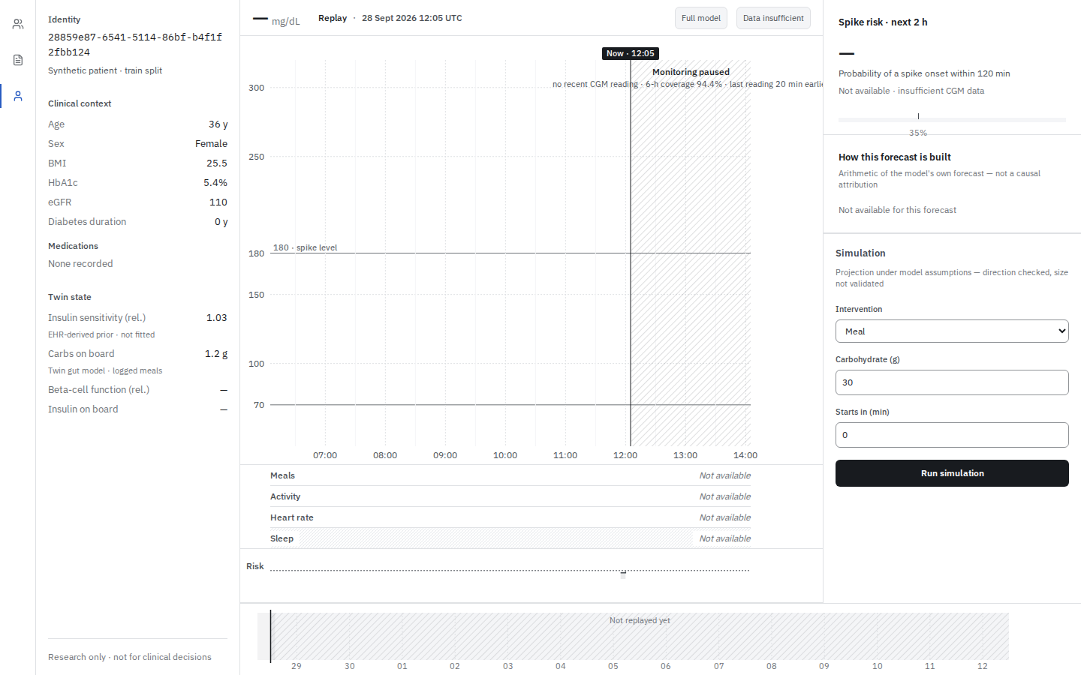
14:30–16:00 Akshaya
When the answer is unavailable
Insufficient history can mean no forecast
Stale, disconnected and invalid are distinct states
Reconnect and fallback need further verification
Repository-recorded screenshot; provenance in notes. Synthetic research only. No clinical validation claimed.
10
Notes:
TIME 14:30–16:00
PRESENTER Akshaya
SCREEN: Slide 10. Use the labelled repository insufficient-history screenshot. Do not deliberately break a service, inject data or force fallback during recording. Mention stale/disconnected as distinct states; do not claim reconnect continuity is proven.
A forecasting interface also needs to explain when it cannot provide an answer. Missing history, an unreachable service and an invalid response are different conditions. Showing a smooth curve in all of those cases would hide information the viewer needs.
The current source has explicit handling for insufficient data, disconnected or stale transport, and responses that fail contract validation. The screenshot here records an insufficient-history state from the repository. It is not a fresh fault-injection test, and we will not manufacture a failure during the live segment.
There are still engineering boundaries to be honest about. A reconnect mechanism does not by itself prove that every companion alert is delivered or that alert cooldown survives reconnection. A twin-only fallback path does not mean the browser continues inference when the network disappears. We are not claiming those properties have been fully verified in this recording version.
Our practical rule is that a failure state should remain visible and should not be narrated as a successful prediction. We would rather show an unavailable answer than disguise an invalid one. That same approach applies to our scientific evidence: an attractive dashboard cannot turn incomplete validation into established performance.
SOURCE BASELINE: 1ab28f31fcc0954cf417bb10aafd4c785364e280
https://github.com/AkshayAlgoX/T2D-Glucose-Digital-Twin./blob/1ab28f31fcc0954cf417bb10aafd4c785364e280/src/components/digital-twin/PatientWorkspace.tsx
https://github.com/AkshayAlgoX/T2D-Glucose-Digital-Twin./blob/1ab28f31fcc0954cf417bb10aafd4c785364e280/src/hooks/useRealtimeTelemetry.ts
https://github.com/AkshayAlgoX/T2D-Glucose-Digital-Twin./blob/1ab28f31fcc0954cf417bb10aafd4c785364e280/docs/screenshots/README.md
Screenshots are supplied recorded evidence, not independently reproduced. EW-01 status comes from supplied project record.

Slide 11
16:00–17:30 Nikhil
What the recorded metrics say
Recorded synthetic validation, not reproduced here
30 / 60 / 120 min RMSE: 12.36 / 19.53 / 25.03 mg/dL
80% interval coverage: 80.00%
Interval width: 37.30 mg/dL
Hazard AUROC: 0.923; Brier: 0.0703
Synthetic research only. No clinical validation claimed.
11
Notes:
TIME 16:00–17:30
PRESENTER Nikhil
SCREEN: Slide 11. Keep the synthetic-validation qualifier visible. Point to each horizon and unit. Do not open held-out split files or run evaluation. These numbers come from validation fields in the existing manifest.
The run manifest contains recorded synthetic validation results. The root mean squared error is about 12.36 milligrams per decilitre at thirty minutes, 19.53 at sixty minutes and 25.03 at one hundred and twenty minutes. The longer-horizon values help show why a two-hour forecast should not be read as an exact future measurement.
The same record reports about eighty percent coverage for the conformal interval, with an average recorded interval-width metric of 37.30 milligrams per decilitre. We label that field as interval width rather than inventing a median-width claim.
For spike-onset probability, the calibrated record reports an AUROC of approximately 0.923 and a Brier score of approximately 0.0703. These describe different aspects of prediction. Neither number is a percentage of patients treated successfully, and neither establishes a benefit in clinical practice.
We have inspected these saved values. We have not independently reproduced the experiment for this video preparation. The observations are synthetic and the validation record is separate from held-out evaluation. The next slide shows the most important reason we must keep that distinction explicit.
SOURCE BASELINE: 1ab28f31fcc0954cf417bb10aafd4c785364e280
https://github.com/AkshayAlgoX/T2D-Glucose-Digital-Twin./blob/1ab28f31fcc0954cf417bb10aafd4c785364e280/runs/pr_tft_ablation_arm_d/run_manifest.json
Screenshots are supplied recorded evidence, not independently reproduced. EW-01 status comes from supplied project record.

Slide 12
17:30–19:00 Akshaya
The realism check failed
FAIL
External EW-01 remains unexecuted
Clinical efficacy is unestablished
Gate 3 synthetic realism
Mock-real comparator
AUROC 0.932
Synthetic research only. No clinical validation claimed.
12
Notes:
TIME 17:30–19:00
PRESENTER Akshaya
SCREEN: Slide 12. Hold the FAIL text clearly. The comparator is mock-real, not clinical data. EW-01 status is carried forward from the supplied project record; do not claim a new evaluation. Use no clinical efficacy graphic.
The synthetic-data validation report records a failure of Gate 3. This check compared the generated data with an independent mock-real comparator. It did not compare our system with a real clinical deployment.
The discriminator separated the two sources much more readily than the criterion allowed. The recorded AUROC was about 0.932. That is a limitation of the data-realism evidence, not a result we can hide behind the forecast metrics on the previous slide.
The project record also leaves external EW-01 evaluation unexecuted. We have not performed that evaluation in preparing this submission. There is no basis here to claim clinical efficacy, regulatory approval, or reliable transfer to patients outside the synthetic setting.
These limitations shape the next research steps. We need to understand the realism gap, independently reproduce the existing results, and pursue appropriately governed external validation before considering clinical use. We should not rush a new scientific experiment merely to fill a presentation slide before a deadline.
Returning to our opening question, the model can offer a forecast in this synthetic workflow. The evidence does not yet tell us that acting on it would improve a real person's outcome. That is the boundary we want a reviewer to see clearly.
SOURCE BASELINE: 1ab28f31fcc0954cf417bb10aafd4c785364e280
https://github.com/AkshayAlgoX/T2D-Glucose-Digital-Twin./blob/1ab28f31fcc0954cf417bb10aafd4c785364e280/backend/synthetic_v2/validation/validation_report.json
https://github.com/AkshayAlgoX/T2D-Glucose-Digital-Twin./blob/1ab28f31fcc0954cf417bb10aafd4c785364e280/Supplied project record: EW-01 unexecuted
Screenshots are supplied recorded evidence, not independently reproduced. EW-01 status comes from supplied project record.

Slide 13
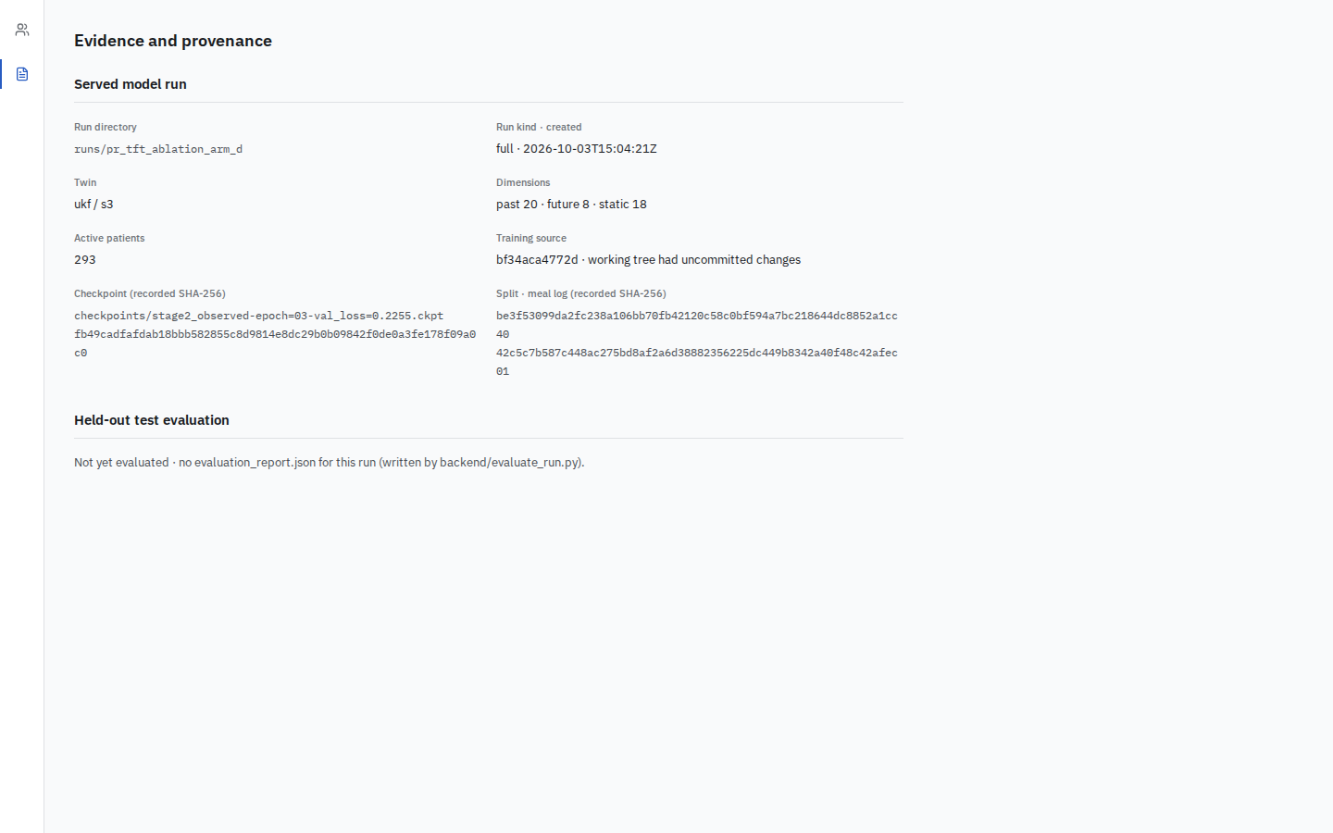
19:00–20:30 Nikhil
What a reviewer can inspect
Source, contracts and manifest are inspectable
Validation metrics and held-out evaluation differ
Provenance supports review, not clinical efficacy
Repository-recorded screenshot; provenance in notes. Synthetic research only. No clinical validation claimed.
13
Notes:
TIME 19:00–20:30
PRESENTER Nikhil
SCREEN: Slide 13 with recorded Evidence-page screenshot. Explain “Not yet evaluated” without implying the manifest contains no validation metrics. Point to source/manifest identity. No terminal commands, tokens or private browser tabs.
A reviewer should be able to connect the interface to the artifacts behind it. The repository contains the serving code, versioned contracts, model configuration and run manifest. The evidence view exposes provenance for the served run.
It also distinguishes a manifest from an evaluation report. The release does not contain the held-out evaluation report expected by that page, so the recorded page says not yet evaluated. That statement is compatible with having saved validation metrics in the training-run manifest. They are different artifacts and different claims.
The screenshot on this slide has its own recorded provenance. Our earlier connected smoke demonstration used an older commit. We do not transfer that result automatically to this release, and we do not describe a full backend suite as passing without a complete result on the exact version.
For an engineering reviewer, the remaining priority areas include fallback quantile ordering, reconnect alert continuity, missing-sample causality and null or insufficient-data responses. Those deserve focused verification. They do not justify changing scientific artifacts to make tests pass.
Our submission makes its implementation inspectable and its limitations explicit. Akshaya will close by returning to the question that started the project.
SOURCE BASELINE: 1ab28f31fcc0954cf417bb10aafd4c785364e280
https://github.com/AkshayAlgoX/T2D-Glucose-Digital-Twin./blob/1ab28f31fcc0954cf417bb10aafd4c785364e280/src/app/evidence/page.tsx
https://github.com/AkshayAlgoX/T2D-Glucose-Digital-Twin./blob/1ab28f31fcc0954cf417bb10aafd4c785364e280/docs/screenshots/README.md
https://github.com/AkshayAlgoX/T2D-Glucose-Digital-Twin./blob/1ab28f31fcc0954cf417bb10aafd4c785364e280/Supplied independent-defect review request
Screenshots are supplied recorded evidence, not independently reproduced. EW-01 status comes from supplied project record.

Slide 14
20:30–21:30 Akshaya + Nikhil
The next two hours, with evidence
An inspectable synthetic forecasting workflow
Next: engineering verification and external validation
Akshaya R and Nikhil VS
Thank you
Synthetic research only. No clinical validation claimed.
14
Notes:
TIME 20:30–21:30
PRESENTER Akshaya + Nikhil
SCREEN: Slide 14. Both presenters return on camera for the last 20 seconds. End at 21:30 or later if natural delivery needs it. Do not speed up to hit the target. Final export must remain at least 20:00.
AKSHAYA: We began with a glucose reading and a question about the next two hours. Our prototype gives that question an inspectable workflow: synthetic context enters a hybrid forecaster, and the interface presents a timestamped trajectory with uncertainty and risk.
The contribution is the working research workflow and the care taken to distinguish an estimate from evidence. The remaining work includes engineering verification, independent reproduction and external validation. We have not established a treatment benefit.
NIKHIL: We would welcome feedback on the forecasting interface, the model assumptions and the validation plan. Our immediate next step is to make the current release reproducible and reviewable, then address the remaining defects before extending the research.
AKSHAYA: Thank you for considering our T2D Glucose Digital Twin. We hope the demonstration makes both the possibilities and the boundaries clear.
SOURCE BASELINE: 1ab28f31fcc0954cf417bb10aafd4c785364e280
https://github.com/AkshayAlgoX/T2D-Glucose-Digital-Twin./blob/1ab28f31fcc0954cf417bb10aafd4c785364e280/README.md
Screenshots are supplied recorded evidence, not independently reproduced. EW-01 status comes from supplied project record.

