Slide 1
HAPPIEST HEALTH DIGITAL TWIN CHALLENGE · EXPERT JURY DEFENSE
T2D Glucose Digital Twin
A physiology-informed digital twin forecasting 2-hour glucose trajectories
and stating exactly what its evidence does and does not prove.
Team: Akshaya R (BGSIT) & Nikhil VS (EWIT) · Bangalore, Karnataka
Scope: Research Prototype Only · Not for Clinical Treatment Decisions
Notes:
Akshaya & Nikhil Opening:
'Good morning, esteemed members of the jury. I am Akshaya R from BGSIT, and with me is Nikhil VS from EWIT. We are presenting the T2D Glucose Digital Twin. Our project addresses a fundamental clinical problem in type 2 diabetes: commercial monitors alert after a glucose spike happens. We built a physiology-informed digital twin that forecasts the next two hours ahead, explains how its predictions are made, and transparently discloses what its evidence proves and what failed.'

Slide 2
PRESENTER: AKSHAYA · T2D GLUCOSE DIGITAL TWIN
The Clinical Problem: Reactive Alarms vs. Actionable Windows
Why postprandial glucose prediction matters in type 2 diabetes, and why it is not medical advice.
Current Reality: Reactive Threshold Alarms
• CGMs measure interstitial glucose every 5 minutes (5–15 min lag behind blood).
• Commercial alarms beep only AFTER glucose crosses 180 mg/dL.
• By then, carbohydrate absorption is in full progress.
• The practical window for behavioral intervention (e.g. a 15-min walk) has already closed.
• Patients experience alert fatigue from reactive alarms with high false-alert rates.
Our Objective: 30–60 Minute Advance Forecast
• Forecast continuous trajectory 120 minutes ahead with confidence intervals.
• Alert 30–60 minutes BEFORE crossing 180 mg/dL to enable non-drug action.
• Exercise activates GLUT4 muscle glucose uptake before the peak occurs.
• Strict False-Alert Budget: Keep false alarms ≤ 1.0 per patient-day to prevent fatigue.
• Crucial Distinction: Predictions are conditional estimates, NOT clinical prescriptions.
Notes:
Akshaya:
'A continuous glucose monitor measures interstitial fluid under the skin. Today, if a patient eats lunch, the monitor is silent until their glucose crosses 180 mg/dL. That is a reactive alarm. In type 2 diabetes, light exercise like a 20-minute walk clears glucose via muscle GLUT4 transporters, but it works best before the spike peaks. We set out to give patients a 30- to 60-minute early warning. But we are very clear: a forecast is not a prescription. We never claim this prototype treats diabetes.'

Slide 3
PRESENTER: NIKHIL · T2D GLUCOSE DIGITAL TWIN
Our Solution: A Physiology-Informed Digital Twin Workstation
Coupling biophysical ODEs with attention transformers behind a production clinical UI.
1. Physiology Twin
• Modified Bergman Minimal ODEs model glucose clearance and gut absorption.
• Unscented Kalman Filter (UKF) recursively updates insulin action & sensitivity.
• Generates smooth, biologically plausible 2-hour mechanistic baseline.
2. Learned PR-TFT
• Temporal Fusion Transformer learns strictly the residual the physics misses.
• Consumes EHR context, 24-hr wearable history (HR, steps, sleep), and clock.
• Predicts 7 quantiles (P05–P95) with conformal coverage & calibrated hazard.
3. Clinical Workstation
• Next.js 15 UI with Ward Triage and time-scrubbing replay navigation.
• What-If counterfactual scenario re-runs (meals, walking; refuses drugs).
• Bilingual patient note (English/Hindi) and official HL7 FHIR R4 export.
Notes:
Nikhil:
'To solve this, we did not build a generic black-box neural network. We built a hybrid digital twin in three parts. First, a biophysical model based on Bergman equations tracked by an Unscented Kalman Filter. It sets the biological baseline. Second, a Temporal Fusion Transformer that learns strictly the residual error the physics misses—like circadian rhythms and exertion. And third, a clinical workstation where doctors can triage patients, scrub through time, and explore What-If changes.'

Slide 4
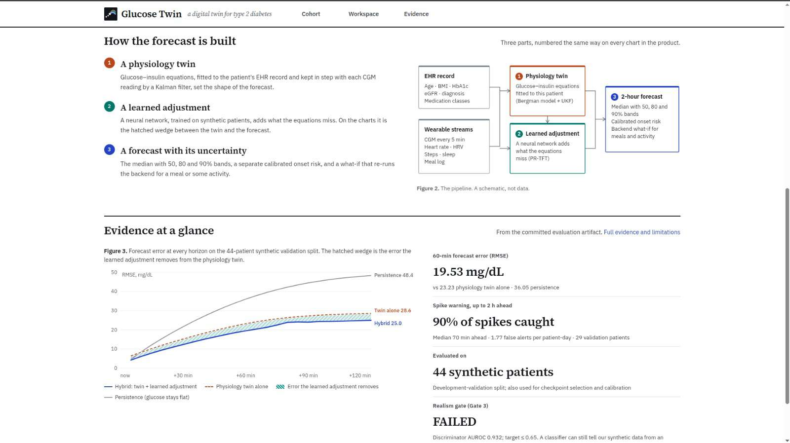
PRESENTER: NIKHIL · T2D GLUCOSE DIGITAL TWIN
How It Works: Causal Architecture & Data Flow
Every forecast is an explicit sum: Twin Baseline + Learned Residual.
Mathematical Pipeline
1. Input Ingestion: 5-min CGM + static EHR (Age, BMI, HbA1c, eGFR) + wearables.
2. UKF Twin Rollout: Solves Bergman ODEs to produce mechanistic trajectory baseline.
3. Residual Attention: PR-TFT predicts delta ΔG across 7 quantiles (P05–P95).
4. Additive Composition: Final Forecast = Twin Rollout + Learned Adjustment.
5. Conformal Bounds: Empirical non-conformity guarantees 80% validation coverage.
6. Fallback Protection: If ML fails, system falls back to twin-only rollout.
Notes:
Nikhil:
'Here is our data flow. We ingest 5-minute CGM and wearable streams through an observable contract. The Unscented Kalman Filter updates the patient's internal physiological state and projects a 2-hour physics rollout. The Temporal Fusion Transformer looks at the past 24 hours and predicts the residual adjustment. The final forecast is literally Twin plus Learned Adjustment. If the machine learning model ever fails, the backend automatically falls back to serving the physics twin alone. Nothing runs black-box.'

Slide 5
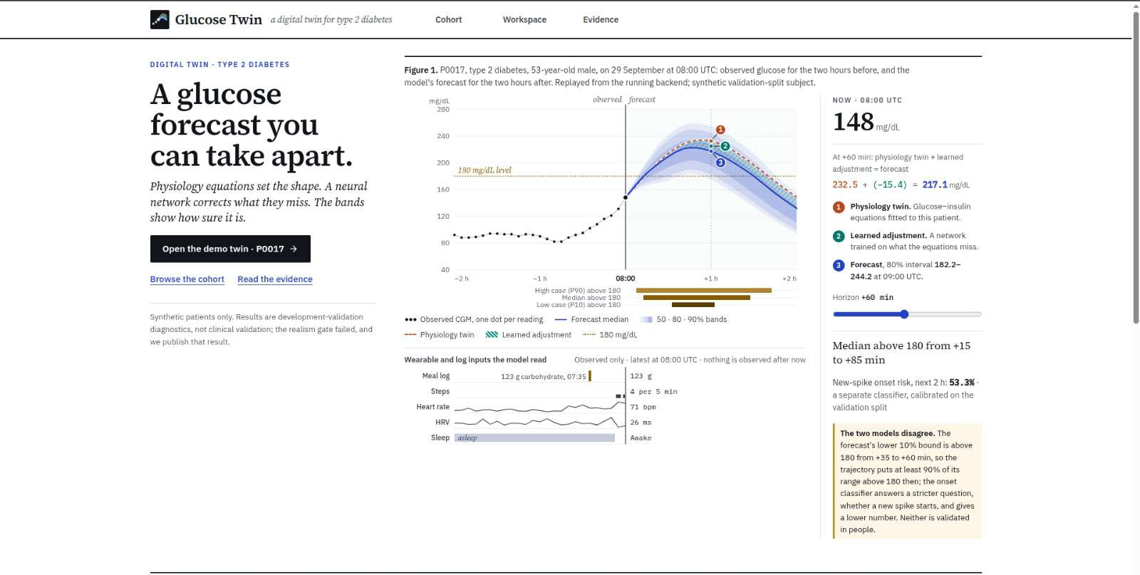
PRESENTER: AKSHAYA · T2D GLUCOSE DIGITAL TWIN
Live Workstation: Verified Prototype on Synthetic Cohort
Real-time streaming replay of 249 served subjects; test partition strictly sealed.
Verified Features
• Live Hero (P0017): 53yo male with T2D replayed at 08:00 UTC.
• On-Screen Math: Twin (232.5) + Adjustment (−15.4) = 217.1 mg/dL at +60m.
• Ward Triage View: Ranks patients by 2-hour spike-onset hazard.
• Timeline Pinning: Freeze historical moments without lookahead bias.
• Sealed Partition Guard: 44 test subjects return HTTP 404 (never exposed).
Notes:
Akshaya:
'This is our live running application. On screen is patient P0017 from our validation cohort. Notice the decomposition strip right below the heading: at plus 60 minutes, the physics twin says 232.5 mg/dL, the neural network subtracts 15.4, giving a final forecast of 217.1 mg/dL with its 80% conformal interval. The cohort page serves 249 synthetic subjects, while our 44 held-out test subjects are completely locked away.'

Slide 6
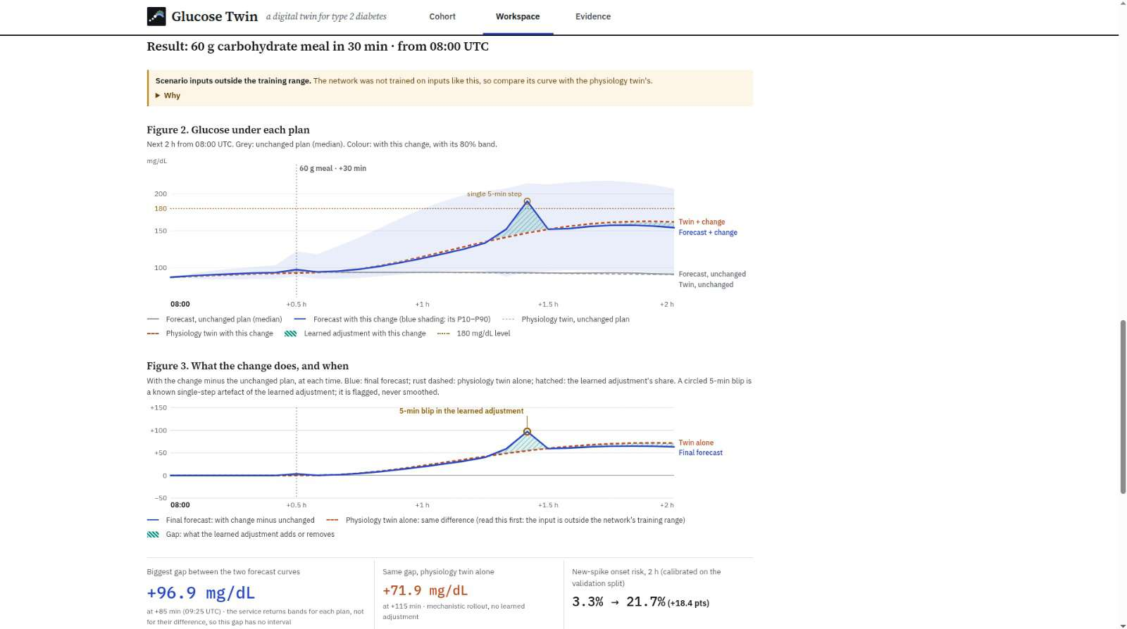
PRESENTER: NIKHIL · T2D GLUCOSE DIGITAL TWIN
Uncertainty & What-If Counterfactual Simulation
Conformal intervals, calibrated hazard, and principled scenario exploration.
What-If Dynamics
• Add 60g Carbs in 30m: Mechanistic gut rollout raises glucose; network adjusts.
• Add 30m Walking: Elevates glucose clearance via exercise uptake.
• Medication Refusal: Clicking drug changes returns SCENARIO_UNSUPPORTED.
• Visible Artefact Flag: Circled 5-min blip is flagged, never silently smoothed.
• Causal Caveat: What-If is a simulated response, not a proven clinical outcome.
Notes:
Nikhil:
'A digital twin should allow interactive exploration. In our What-If panel, a clinician can test adding a 60-gram carb meal or 30 minutes of walking. But we enforce strict boundaries: if you click medication changes, the backend refuses with SCENARIO_UNSUPPORTED because the twin has no validated drug models. And look at Figure 3: when the neural network produces a single-step 5-minute blip, we do not smooth it out. We circle it and warn the user. Honest software flags its artefacts.'

Slide 7
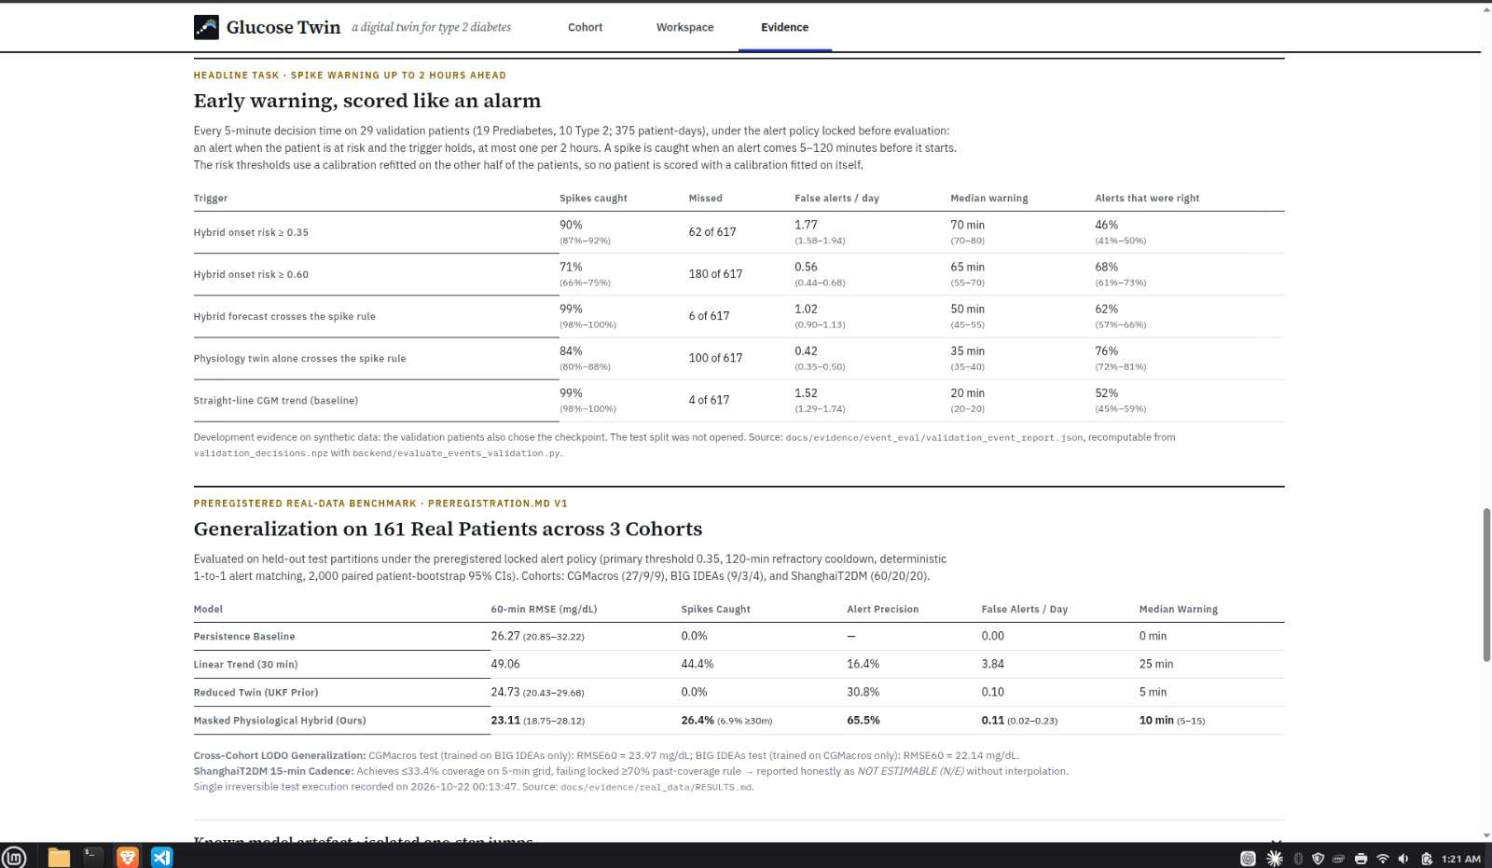
PRESENTER: AKSHAYA · T2D GLUCOSE DIGITAL TWIN
Evidence: Locked Evaluation on 161 Real Patients
Primary locked test results on 11 held-out test patients with 5-minute CGM.
Key Verified Numbers
• 60-min RMSE: 23.11 mg/dL [18.75–28.12] (Persistence: 26.27 mg/dL).
• False Alerts: 0.11 / patient-day (within ≤ 1.0 budget).
• Alert Precision: 65.5% (Linear trend: only 16.4%).
• Early Sensitivity (≥30m): 6.9% point est. / 6.0% bootstrap mean.
• ShanghaiT2DM: Declared NOT ESTIMABLE (15-min cadence violates 70% rule).
Notes:
Akshaya:
'Now let us examine our real-patient evidence. We conducted a single locked test evaluation across 161 real patients from three open datasets. On the 11 held-out test patients with native 5-minute CGM, our hybrid achieved a 60-minute RMSE of 23.11 mg/dL, beating persistence and the physics twin. It held false alerts down to 0.11 per day with 65.5% precision. The simple linear trend caught more spikes, but at 3.84 false alerts a day—which causes unbearable alert fatigue. And ShanghaiT2DM was honestly declared Not Estimable because 15-minute readings cannot test 5-minute persistence.'

Slide 8
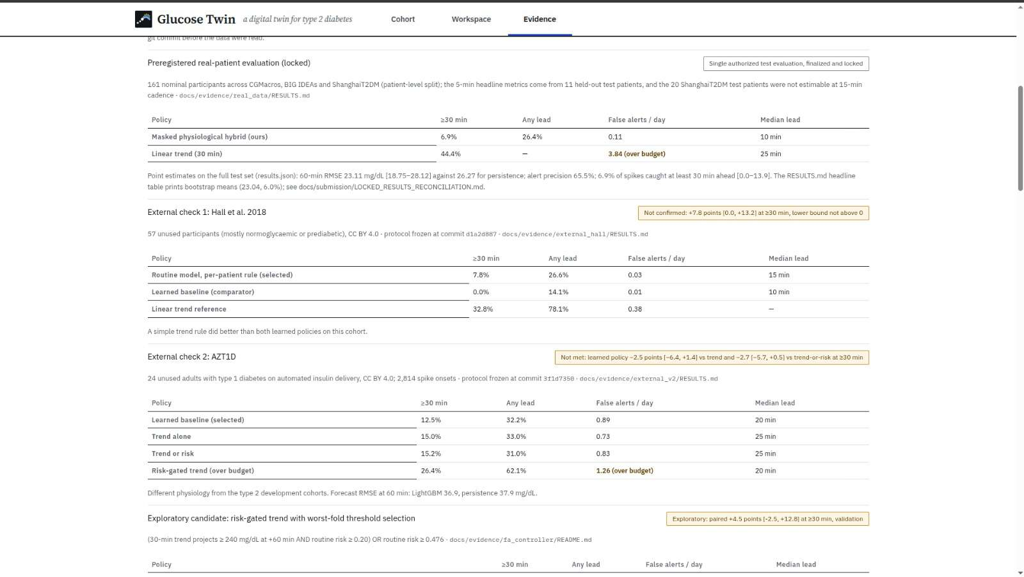
PRESENTER: NIKHIL · T2D GLUCOSE DIGITAL TWIN
What Failed & What We Learned: Honest Science
Negative results, failed gates, and external validation checks.
Failed Gates Disclosed
• Gate 3 Realism Audit: FAILED (AUROC 0.932 vs ≤0.65 target; ODE traces too smooth).
• Real Early Warning (6.9%): Low advance sensitivity due to unannounced meals.
• External Check 1 (Hall 2018): NOT CONFIRMED (+7.8%, 95% CI crosses 0).
• External Check 2 (AZT1D): NOT MET (Learned model −2.5% vs linear trend).
• Lesson: Probability thresholds do not transfer across cohorts without local recalibration.
Notes:
Nikhil:
'A presentation without negative results is not science. We openly report where our system failed. First, our synthetic realism test failed with AUROC 0.932 because our ODEs were smoother than real CGMs. Second, on real patients without contemporaneous meal logs, our 30-minute early warning sensitivity was only 6.9%. Third, on two external cohorts—Hall and AZT1D—our learned models failed to statistically beat simple trend rules. We learned that fixed probability thresholds do not generalize across different populations without local recalibration.'

Slide 9
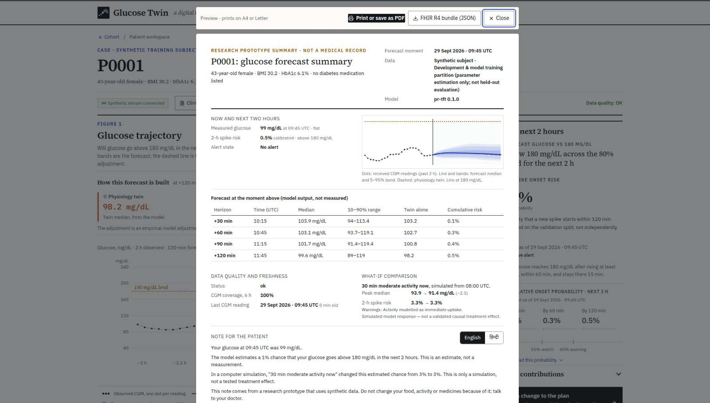
PRESENTER: AKSHAYA · T2D GLUCOSE DIGITAL TWIN
Engineering Rigor, Safety Governance & Interoperability
Test split firewalls, HL7 FHIR R4 export, and containerized deployment.
Clinical Integration
• Partition Firewall: Sealed test partition isolated at API boundary (HTTP 404).
• HL7 FHIR R4: Validated JSON export using LOINC 99504-3 and HTEST security tag.
• Bilingual Note: Plain English and Hindi patient summaries.
• Reproducibility: Git SHA commit tracking, deterministic seeds, and run manifests.
• Zero Real Data Leakage: Real patient datasets stored offline only.
Notes:
Akshaya:
'From a software engineering perspective, this project is built for healthcare reality. Our clinician export generates an official HL7 FHIR R4 JSON bundle tagged with LOINC 99504-3 and HTEST test-data labels. We support bilingual patient summaries in English and Hindi. Our test partitions are strictly firewalled in code, and every single number in our presentation is traceable to a hashed, committed artifact in the GitHub repository.'

Slide 10
PRESENTER: AKSHAYA & NIKHIL · T2D GLUCOSE DIGITAL TWIN
Conclusion & Next Steps: The Path to Clinical Translation
What we proved, what remains, and our evidence-justified research roadmap.
What We Have Proven
✔ A working, reproducible digital twin combining biophysical ODEs with PR-TFT attention.
✔ A 16.0% RMSE reduction over the physics twin on synthetic validation data.
✔ A 60-min RMSE of 23.11 mg/dL on held-out real patients within a 0.11 false alert/day budget.
✔ Full-stack clinical workstation with FHIR export, What-If simulation, and sealed partition guards.
✔ Uncompromising scientific integrity: failed gates and negative findings published openly.
Next Steps Before Clinical Use
➔ 1. AI-READI Confirmation: Execute frozen protocol on ~944 T2D participants once data access is approved.
➔ 2. Adaptive Thresholds: Implement dynamic operating points to prevent cross-cohort calibration collapse.
➔ 3. Unannounced Meal Deconvolution: Infer carbohydrate arrival directly from early CGM inflections.
➔ 4. Curvature Regularization: Retrain PR-TFT with smoothness loss to permanently eliminate 20 mg/dL jumps.
➔ 5. Observational Clinical Pilot: Evaluate clinician decision support in outpatient type 2 reviews.
Notes:
Akshaya & Nikhil Closing:
'In conclusion, we have built a working, transparent, and reproducible digital twin. We did not overclaim, we did not hide our failures, and we proved that physiological priors enhance deep learning stability. Before this can ever enter clinical care, it needs validation on large datasets like AI-READI and prospective clinical trials. Thank you, and we look forward to your questions.'

Slide 11
PRESENTER: APPENDIX · T2D GLUCOSE DIGITAL TWIN
Slide 11: Appendix — Bergman Minimal Model & UKF Equations
Technical reference & deep-dive material for jury questions.
• Glucose dynamics: dG/dt = −[p1 + X(t)] G(t) + p1 Gb + (1/VG) Ra(t)
• Remote insulin action: dX/dt = −p2 X(t) + p3 [I(t) − Ib]
• Gut absorption: Two-compartment model dQ1/dt = −k_gri Q1 + Meals; dQ2/dt = k_gri Q1 − k_abs Q2
• UKF State Vector: [G, X, I, Q1, Q2, SI, EGP] tracked recursively with sigma points.
• State prior prevents unphysical negative glucose or runaway exponential spikes during dropouts.

Slide 12
PRESENTER: APPENDIX · T2D GLUCOSE DIGITAL TWIN
Slide 12: Appendix — PR-TFT Architecture & Hyperparameters
Technical reference & deep-dive material for jury questions.
• Architecture: Temporal Fusion Transformer with Gated Residual Networks (GRN) and Variable Selection Networks (VSN).
• Hidden dimension: 96; Attention heads: 4; Layers: 2; Dropout: 0.1.
• Inputs: Static EHR (Age, BMI, HbA1c, eGFR) + Dynamic Wearables (CGM, HR, HRV, Steps, Sleep) + Clock features.
• Loss function: Pinball quantile loss across 7 quantiles (P05 to P95) + Binary cross-entropy on hazard head.
• Early stopping: Patience of 4 epochs on validation loss (checkpoint: epoch=03, val_loss=0.2255).

Slide 13
PRESENTER: APPENDIX · T2D GLUCOSE DIGITAL TWIN
Slide 13: Appendix — Dataset Split Accountability & Denominators
Technical reference & deep-dive material for jury questions.
• Synthetic Cohort: 293 total (205 train, 44 val, 44 test sealed). Served in app: 249 subjects.
• Real Benchmark: 161 nominal patients across CGMacros (45), BIG IDEAs (16), ShanghaiT2DM (100).
• ShanghaiT2DM: 15-minute sampling cadence violates ≥70% 5-minute coverage rule -> NOT ESTIMABLE.
• Evaluated Real Test Set: Exactly 11 held-out test patients with native 5-minute CGM.
• Zero participant-level outcome inspection was performed during development.

Slide 14
PRESENTER: APPENDIX · T2D GLUCOSE DIGITAL TWIN
Slide 14: Appendix — Metric Definitions & 1-to-1 Alert Matching
Technical reference & deep-dive material for jury questions.
• Adverse Spike: Crossing ≥180 mg/dL preceded by ≥50 mg/dL rise in 60 min, persisting for ≥15 min.
• 1-to-1 Alert Matching: An alert matches at most ONE subsequent spike event (5–120 min ahead).
• Refractory Cooldown: 120-minute alert suppression following any triggered alarm.
• Sensitivity ≥30m: Spikes caught with an alert at least 30 minutes before crossing 180 mg/dL.
• False Alert Budget: Maximum allowable rate is ≤ 1.0 false alert per patient-day.

Slide 15
PRESENTER: APPENDIX · T2D GLUCOSE DIGITAL TWIN
Slide 15: Appendix — External Checks on Unused Cohorts (Hall & AZT1D)
Technical reference & deep-dive material for jury questions.
• Hall et al. 2018 (57 participants, 64 spikes): Routine model +7.8% [0.0, +13.2]; NOT CONFIRMED.
• Linear trend beat learned models on Hall (32.8% sens at 0.38 FA/day) due to low event frequency.
• AZT1D (24 adults with T1D on AID, 2,814 spikes): Learned model 12.5% vs Trend 15.0%; NOT MET.
• Risk-Gated Trend (C2): Doubled sensitivity (26.4%) but exceeded false alert budget (1.26/day).
• Core Takeaway: Probability calibration collapses across populations without adaptive operating points.

Slide 16
PRESENTER: APPENDIX · T2D GLUCOSE DIGITAL TWIN
Slide 16: Appendix — Sealed Partition Firewall Verification
Technical reference & deep-dive material for jury questions.
• Code Location: backend/serve_pr_tft.py line 79 (SEALED_SPLITS = frozenset({'test'})).
• Rejection Behavior: Querying any test-split subject UUID or patient ID raises HTTP 404.
• Subject Directory: GET /v1/subjects filters out all test IDs at the database iterator level.
• Offline Isolation: Real patient files (data/real/) are excluded from Git and Docker images.
• No Lookahead Leakage: Timeline scrubbing strictly hides readings after the anchor timestamp.

Slide 17
PRESENTER: APPENDIX · T2D GLUCOSE DIGITAL TWIN
Slide 17: Appendix — Clinical Safety, Medication Refusal & FHIR R4
Technical reference & deep-dive material for jury questions.
• Medication Refusal: What-If drug modifications return 422 SCENARIO_UNSUPPORTED.
• FHIR R4 Schema: Exported bundles validated against official HL7 JSON schema.
• Standard Codings: Interstitial glucose coded as LOINC 99504-3 with UCUM units mg/dL.
• HTEST Security Label: Prevents accidental ingestion into real clinical EHR databases.
• Bilingual Translation: English and Hindi patient summaries with explicit clinical disclaimer.

Slide 18
PRESENTER: APPENDIX · T2D GLUCOSE DIGITAL TWIN
Slide 18: Appendix — Unexecuted Protocols & Research Integrity
Technical reference & deep-dive material for jury questions.
• EW-01 Protocol: Prospective early-warning trial protocol remains unexecuted and excluded from claims.
• AI-READI Confirmation: Frozen preregistration on FAIRhub (~944 T2D participants); awaiting data access.
• Frozen Harness: aireadi_evaluate.py committed and SHA-256 hashed before receiving data.
• No P-Hacking: All evaluations executed in a single authorized run without parameter retuning.
• Complete Provenance: Every claim backed by commit SHAs and locked manifest files.

