Slide 1
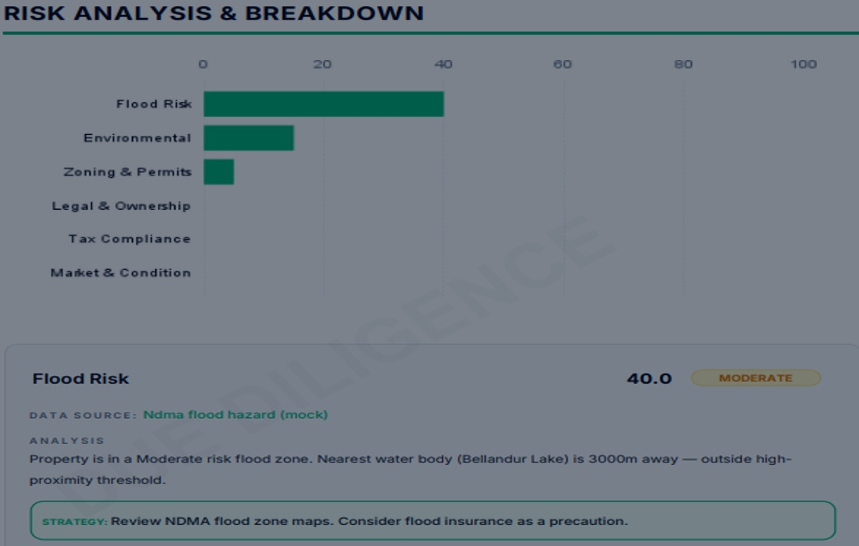
REAL ESTATE DUE DILIGENCE
AI-Powered Property Risk & Verification
From scattered checks to one evidence-driven decision.
6 risk categories
Flood • Legal • Tax • Zoning • Environmental • Market
TEAM 03
AUGUST 2026

Slide 2
01 • TECHNOLOGY STACK
The foundation behind the platform
A modern Java + React stack designed for secure, scalable property intelligence.
01
02
03
04
05
FRONTEND
BACKEND
DATABASE
INTELLIGENCE
DELIVERY
Next.js 16.2.10
Spring Boot 4.1.0
PostgreSQL 16
Groq / Llama 3.3 70B
Vercel + Render + Docker
React 19.2.4 • Tailwind v4
Java 17 • JPA • REST APIs
Hibernate • JSONB • ACID
AI summaries • SSE chat
CI/CD • health checks
Supporting layer
JWT
Bucket4j
Vitest
JUnit / Mockito
Leaflet
iText 7
Apache POI
REAL ESTATE DUE DILIGENCE AGENT • TEAM 03
02

Slide 3
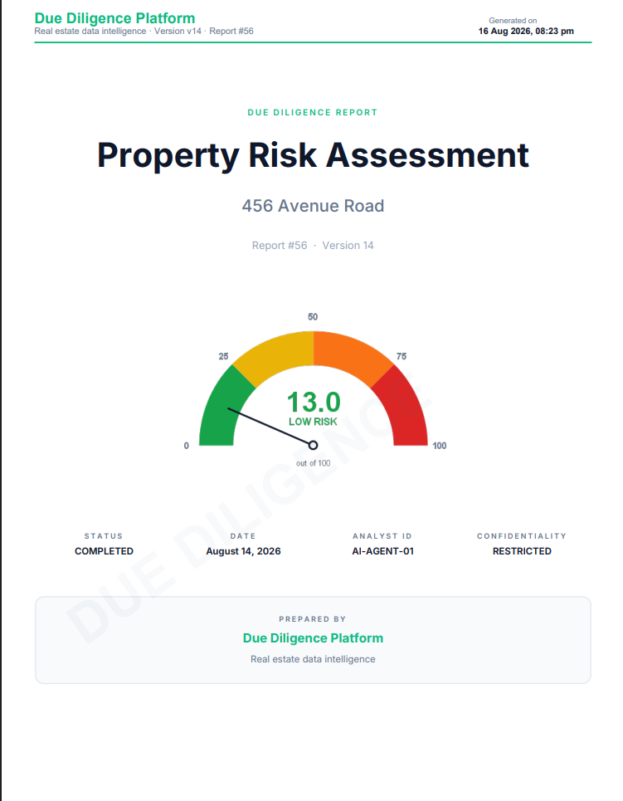
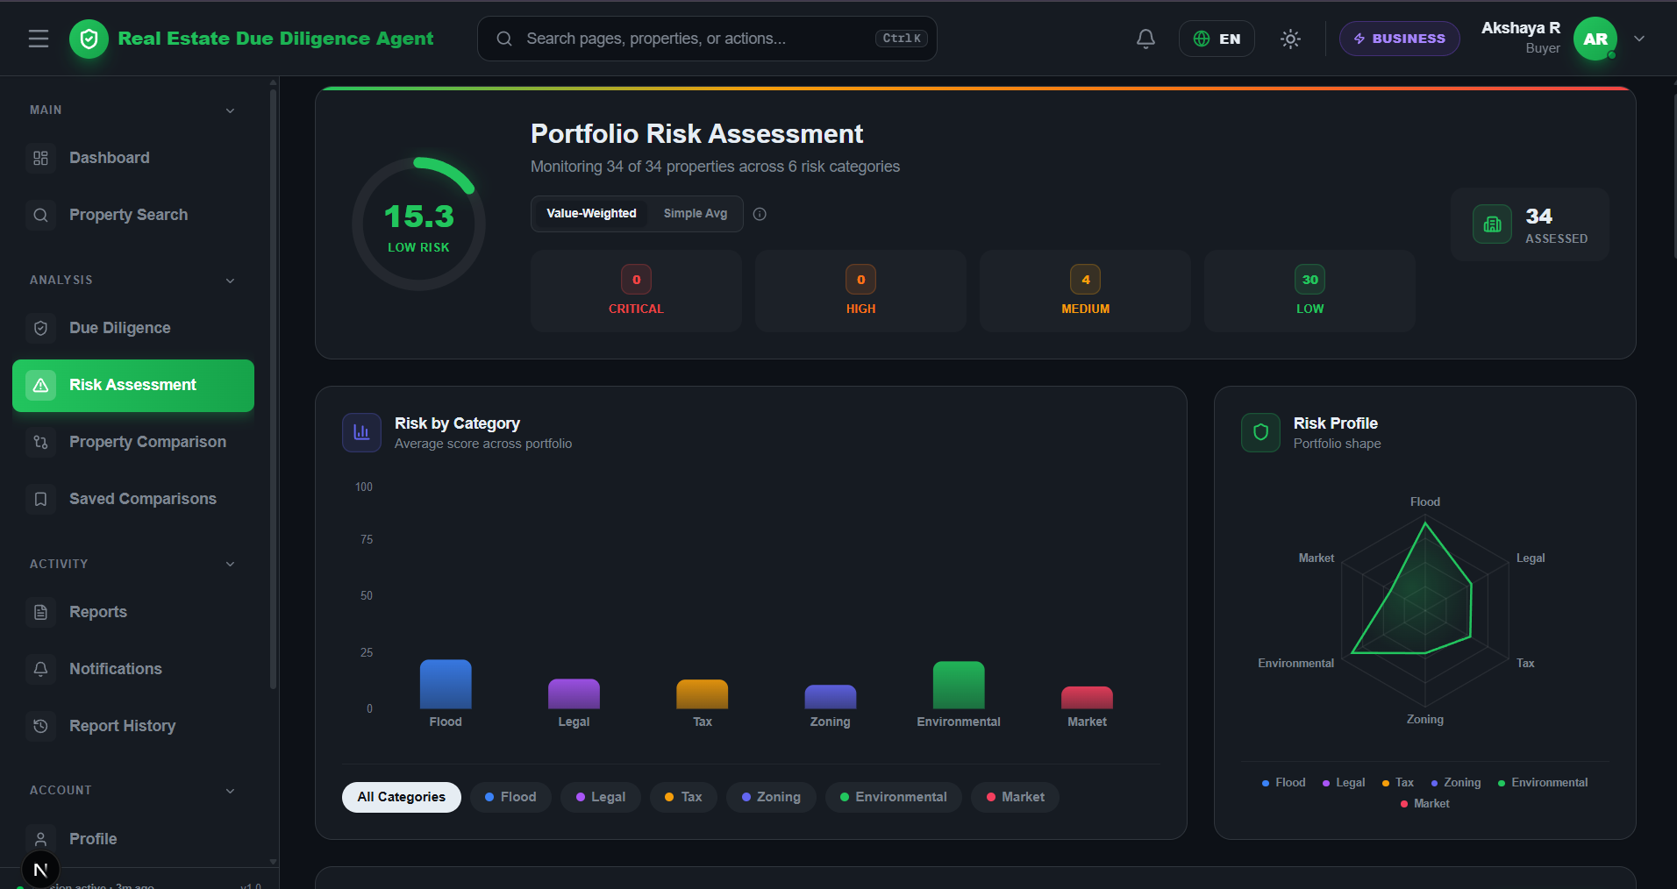
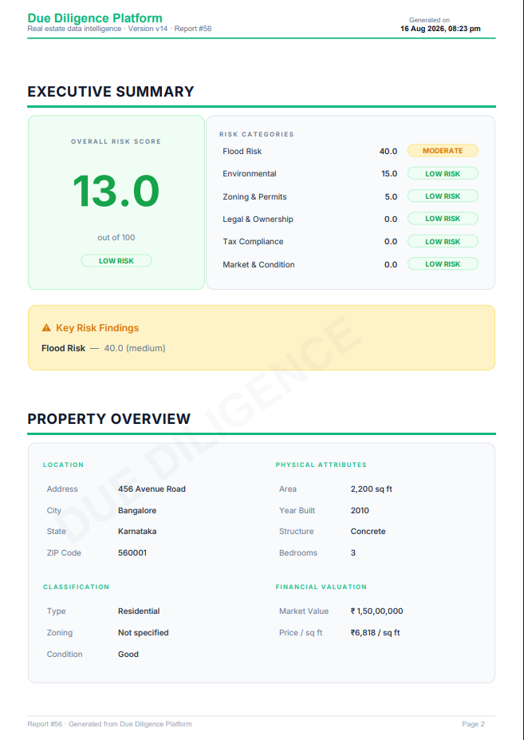
02 • CORE FEATURES
A complete property-intelligence workflow
Search → verify → assess → explain → report.
PORTFOLIO
SEARCH
RISK
Monitor
Discover
Assess
Portfolio value, verification coverage, air quality and trends.
Search properties with verification, category and risk indicators.
Six-category portfolio risk with weighted scoring and visual profiles.
REAL ESTATE DUE DILIGENCE AGENT • TEAM 03
03

Slide 4
03 • THE CHALLENGE
Property decisions are high-stakes — but evidence is fragmented
The platform is designed around the verification gaps that make due diligence slow and uncertain.
THE OLD WAY
01
02
FRAGMENTED SOURCES
FRAUD EXPOSURE
One address. Six risk questions. Many disconnected checks.
Critical evidence is spread across different systems.
Fake ownership, disputes and unauthorised work can be missed.
03
04
Ownership • tax • zoning • flood • environment • market
SLOW DECISIONS
NO SINGLE RISK VIEW
Manual research delays a buyer's ability to act.
Data exists, but the decision context is scattered.
MANUAL
REAL ESTATE DUE DILIGENCE AGENT • TEAM 03
04

Slide 5
04 • SYSTEM ARCHITECTURE
A layered platform built for secure evidence processing
Same-origin API access, layered backend services, PostgreSQL persistence and external intelligence.
FRONTEND
BACKEND
DATA
USER / BROWSER
/api/* proxy
Spring Boot
PostgreSQL 16
Next.js • React
SSR • routing • UI
Security → Controller → Service
JPA • JSONB • ACID
INTELLIGENCE + SERVICES
Groq AI
Cashfree
Google OAuth
WAQI
Nominatim
Cloudinary
SECURITY PIPELINE • rate limit → JWT filter → RBAC → validation → parameterized queries → audit logging
REAL ESTATE DUE DILIGENCE AGENT • TEAM 03
05

Slide 6
05 • HOW IT SOLVES THE PROBLEM
From an address to a decision-ready report
The platform compresses multiple verification stages into one observable workflow.
01
02
03
04
05
INPUT
EVIDENCE
RISK
AI
OUTPUT
Property address
Ownership • tax • zoning • flood • environment
Six weighted categories
Summary • key findings • verdict
PDF • Excel • history
BUY
NEGOTIATE
AVOID
← evidence-backed recommendation →
REAL ESTATE DUE DILIGENCE AGENT • TEAM 03
06

Slide 7
06 • RISK ENGINE
Six dimensions. One explainable risk profile.
The implemented portfolio view monitors all properties across six weighted categories.
WEIGHTED MODEL
Flood
25%
Legal
20%
Tax
15%
Zoning
15%
Environmental
15%
Market
10%
Risk bands
LOW ≤25 • MEDIUM ≤50 • HIGH ≤75 • CRITICAL >75
REAL ESTATE DUE DILIGENCE AGENT • TEAM 03
07

Slide 8
07 • AI INTELLIGENCE
AI is layered on top of property context — not used as a replacement for evidence.
Groq powers the property assistant and executive summaries; live responses stream through SSE.
Executive summary
PROPERTY ASSISTANT
The report closes the loop with a machine-generated headline, key findings, recommendation and verdict.
“What should I verify before buying this property?”
PROCEED
CAUTION
HIGH RISK
Checks property context, risk history and available evidence.
< 40
40–70
> 70
Streams response in real time via SSE.
Groq • Llama 3.3 70B • SSE • property context • last 10 messages
REAL ESTATE DUE DILIGENCE AGENT • TEAM 03
08

Slide 9
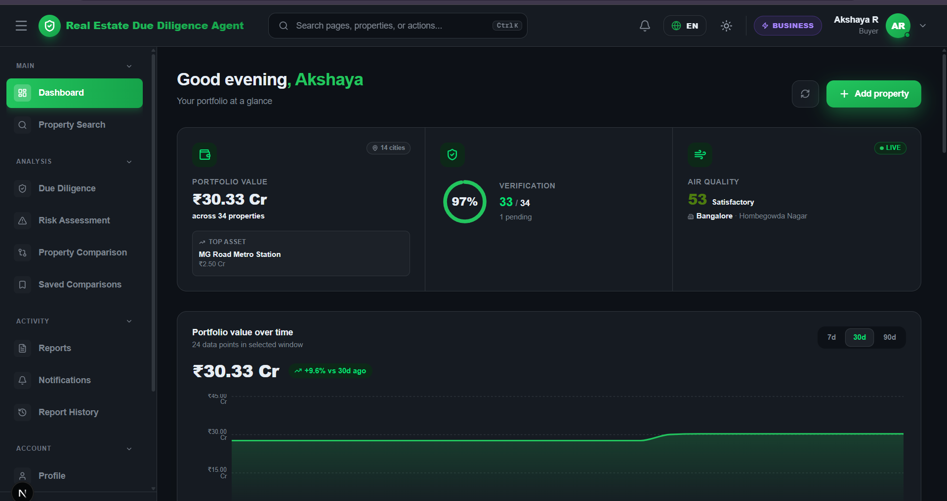
08 • THE PRODUCT
A working interface across portfolio, discovery and monitoring
Actual screens from the deployed project are used as evidence of the implementation.
AUTHENTICATION
DASHBOARD
PROPERTY SEARCH
Secure sign-in + Google OAuth
Portfolio value • verification • AQI
Search • filters • property risk
REAL ESTATE DUE DILIGENCE AGENT • TEAM 03
09

Slide 10
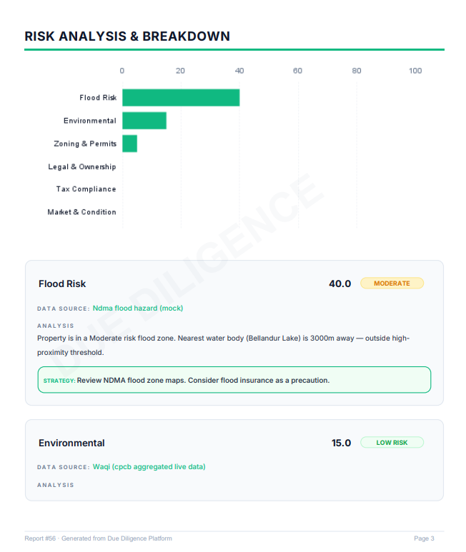
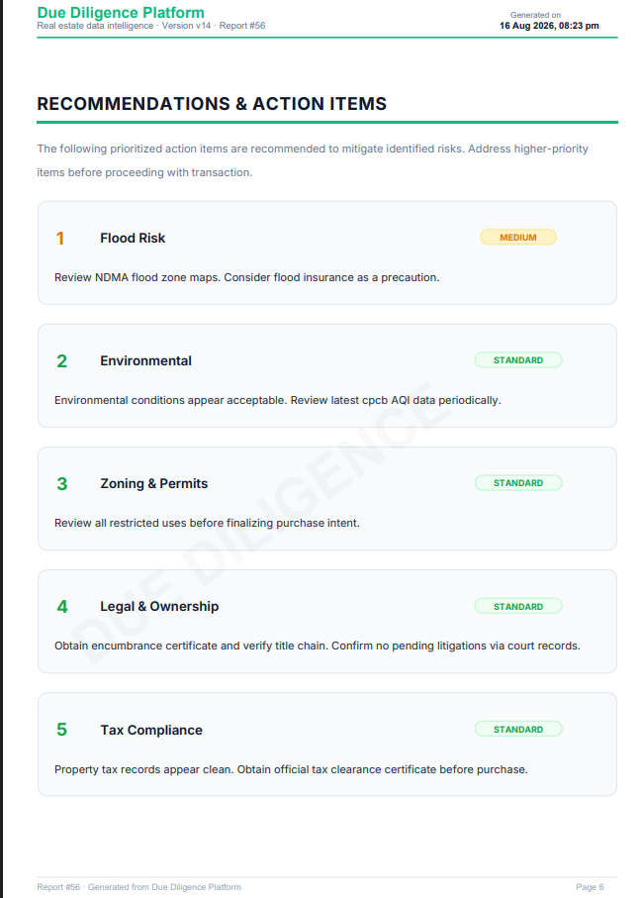
09 • DECISION REPORT
Evidence becomes a professional, exportable deliverable
The actual generated report includes risk scoring, executive summary, property overview, analysis and recommendations.
REPORT OUTPUT
PDF • Excel • version history
8 sections • AI summary • recommendations • risk breakdown
REAL ESTATE DUE DILIGENCE AGENT • TEAM 03
10

Slide 11
10 • SECURITY & ACCESS
Secure by default, role-aware by design
Five role types and layered controls protect sensitive property and user information.
BUYER
Portfolio • search • risk • reports
AGENT
Buyer capabilities + report generation
LEGAL
Report history • audit access
FINANCIAL
Risk data + exports
ADMIN
Users • analytics • audit • health
JWT • BCrypt • OTP • Bucket4j • Jakarta Validation • Parameterized JPA • Audit Logs
REAL ESTATE DUE DILIGENCE AGENT • TEAM 03
11

Slide 12
11 • ENGINEERING QUALITY
Built to be tested, deployed and maintained
The project documentation records automated tests and reproducible cloud deployment configuration.
58
33
0
0
backend tests
frontend tests
documented failures
errors
DEPLOYMENT PATH
GitHub
Vercel
Render
Postgres / Neon
CI
Next.js
Spring Boot
Data
Dockerfiles • docker-compose • render.yaml • vercel.json • JaCoCo • Vitest / Testing Library
REAL ESTATE DUE DILIGENCE AGENT • TEAM 03
12

Slide 13
12 • ROADMAP
Where the platform goes next
The strongest future gains come from deeper verification data and richer intelligence.
01
DOCUMENT OCR
02
GOVERNMENT LAND APIs
03
MOBILE APP
Sale deeds + encumbrance certificates
Real ownership + encumbrance evidence
React Native using the same API layer
04
ADVANCED ANALYTICS
05
REAL-TIME PUSH
06
BLOCKCHAIN
Price prediction + fraud clustering + heatmaps
WebSockets for richer live updates
Tamper-proof title-chain exploration
BIGGEST ACCURACY UNLOCK • Government land-record integration for real ownership and encumbrance data.
REAL ESTATE DUE DILIGENCE AGENT • TEAM 03
13

Slide 14
13 • TEAM & DEMO
The team behind the platform
Presentation video link intentionally left blank for the final submission.
01
A. Jabbar Patel
02
Akshaya R
PRESENTATION VIDEO
03
Bhavana Bhat
04
Lokesh Chowdary
https://drive.google.com/file/d/1enq3XOjdT799xZuijPH27hF6G4IMCph0/view?usp=sharing
05
Melvin Britto
06
Tanisha Alone
07
Siddu Papunka
08
Shalini Bindu
Add the final demo / presentation URL here.
THANK YOU • Turning property uncertainty into a structured decision.

