Slide 1
AIRBNB DATASET ANALYSIS
BY-AKSHAY ANAND

Slide 2
PROBLEM STATEMENT
Since 2008, guests and hosts have used Airbnb to expand on travelling possibilities and present a more unique, personalized way of experiencing the world. This dataset describes the listing activity and metrics in San Diego, California for 2019. This data file includes all the needed information to find out more about hosts, geographical availability, and necessary metrics to make predictions and draw conclusions.

Slide 3
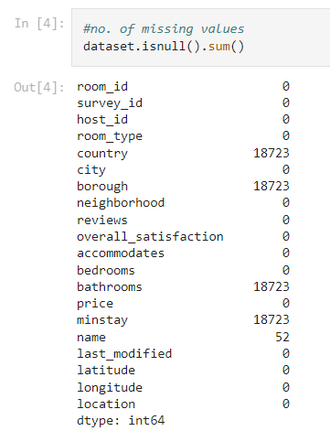
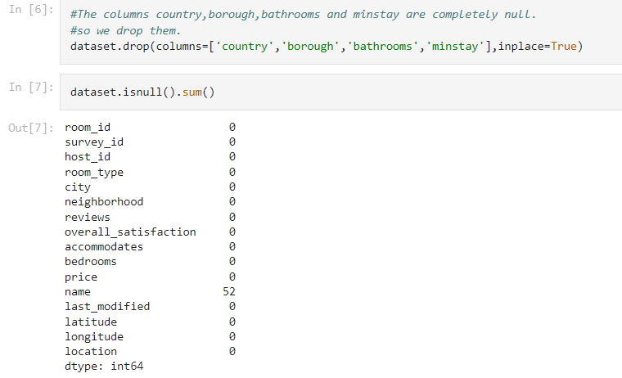
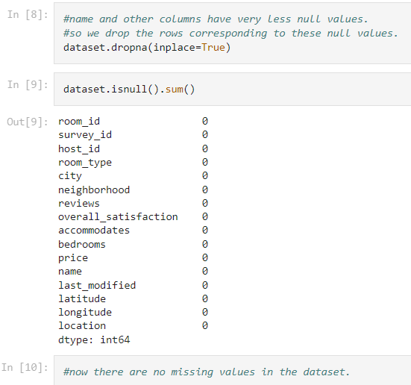
WEEK-1
PERFORMED DATA CLEANING AND INITIAL EDA TASKS.

Slide 4
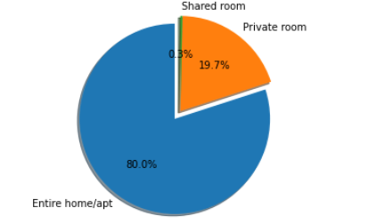
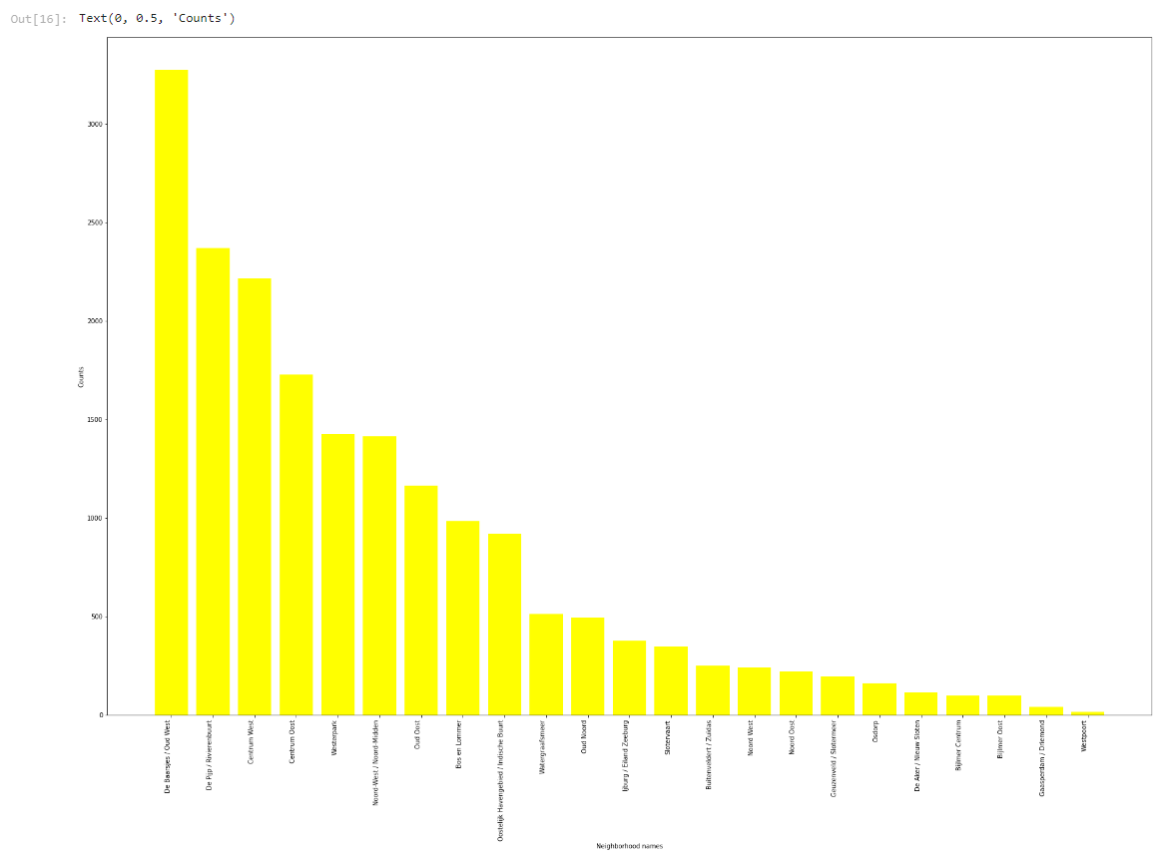
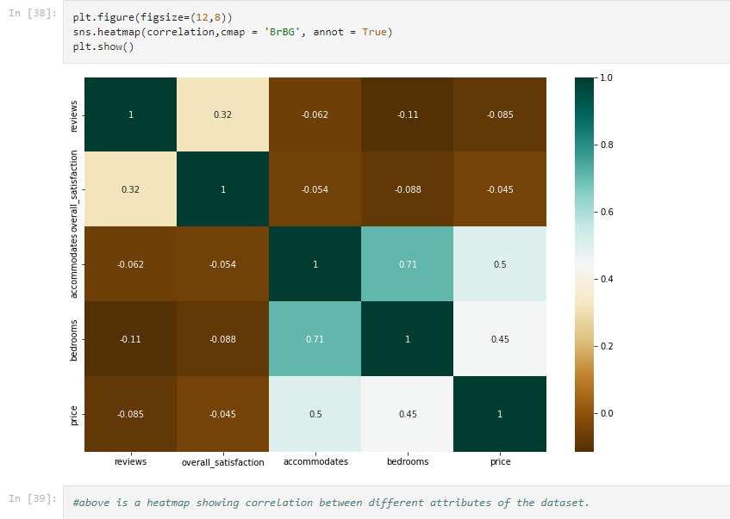
WEEK-2
PEFORMED EDA USING PYTHON AND POWER BI.

Slide 5
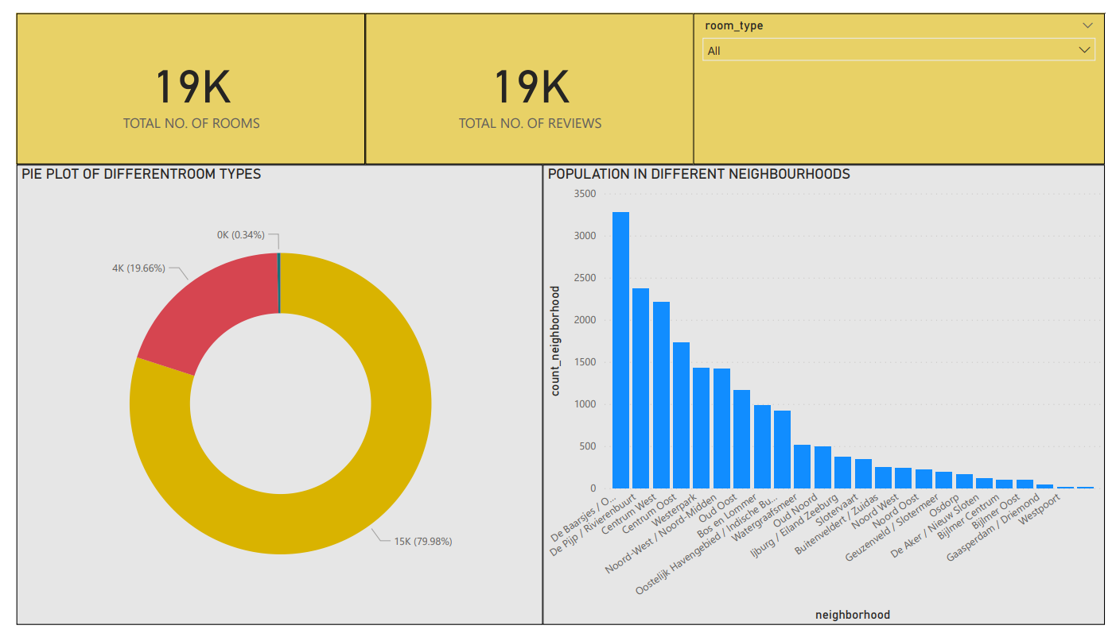
DASHBOARD

Slide 6
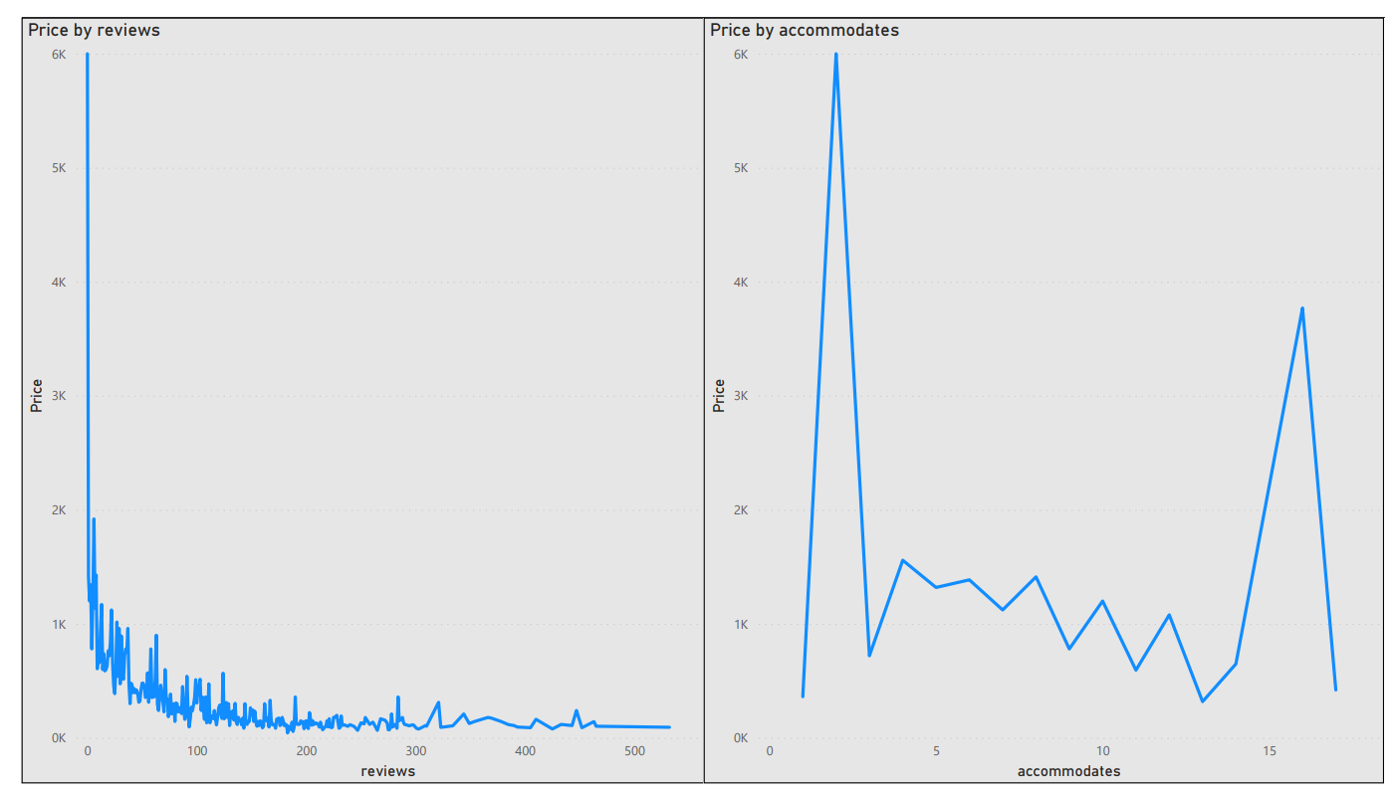

Slide 7
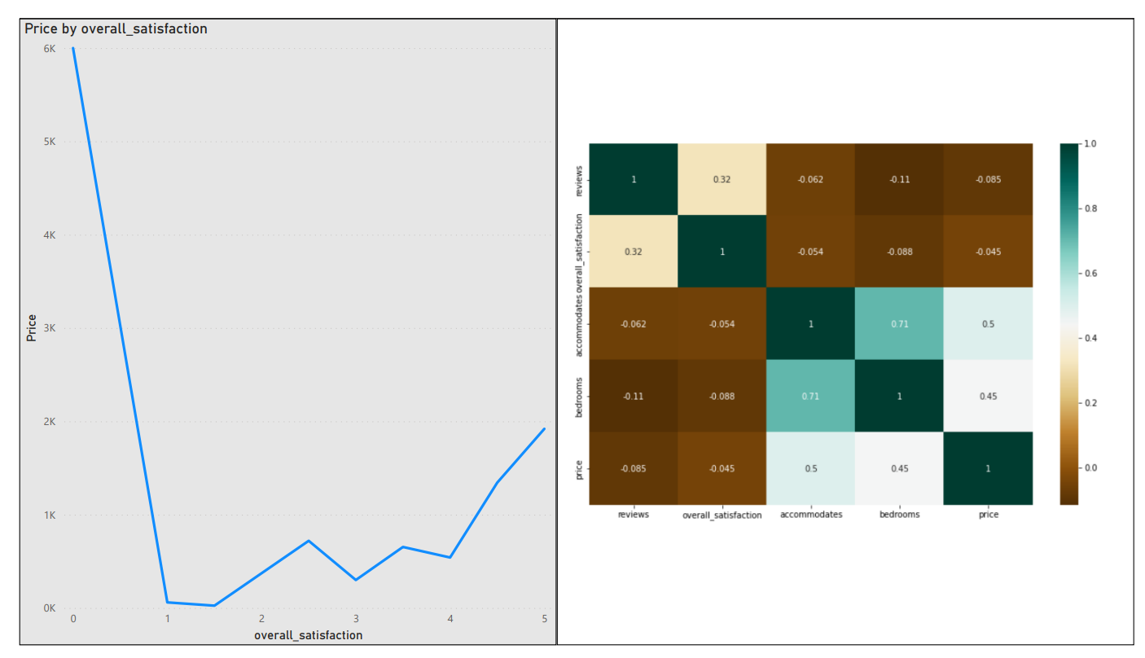

Slide 8
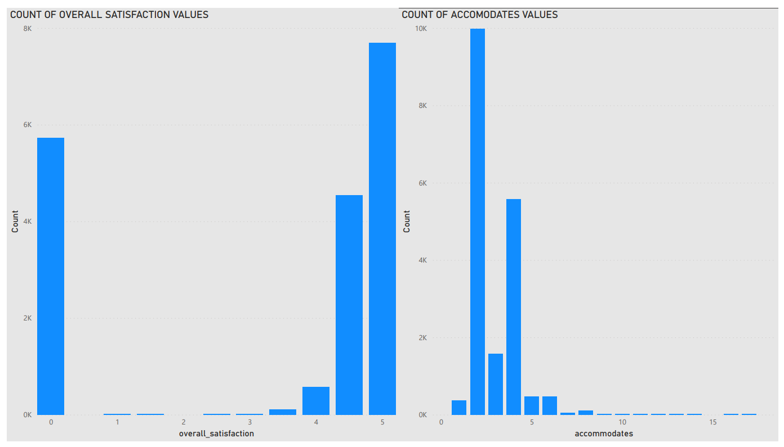

Slide 9
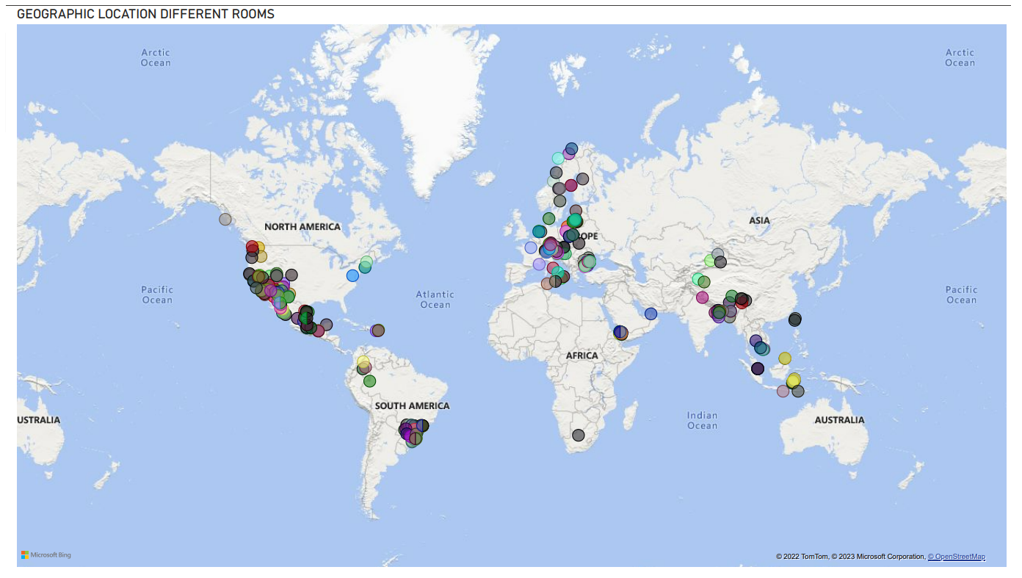

Slide 10
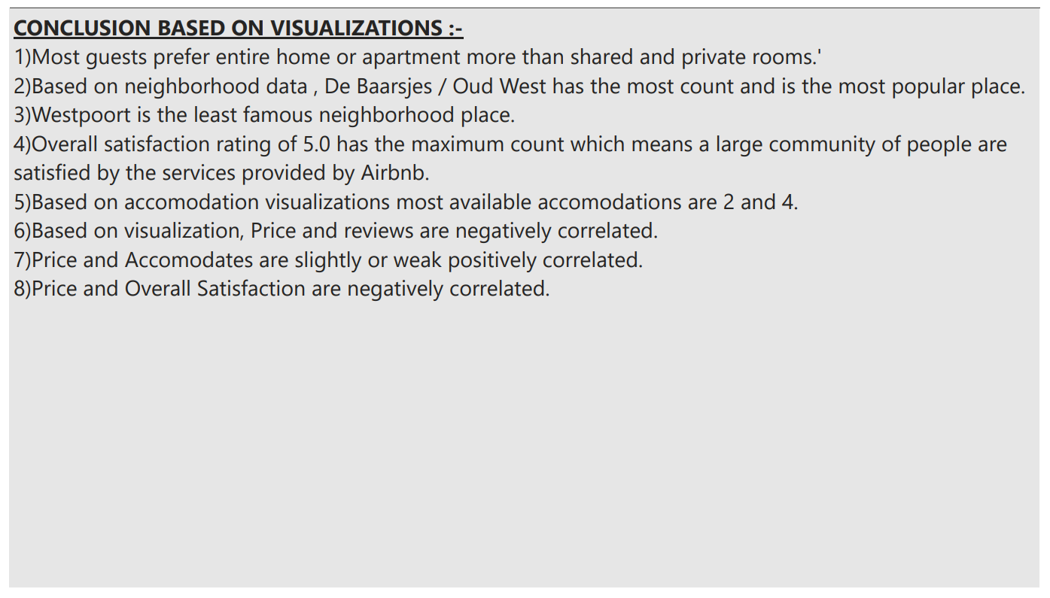

Slide 11
SWIGGY DATASET ANALYSIS BY-AKSHAY ANAND

Slide 12
PROBLEM STATEMENT
The online food ordering market includes food prepared by restaurants, prepared by independent people, and groceries ordered online and then picked up or delivered. The first online food ordering service, World Wide Waiter (now known as Waiter.com), was founded in 1995. Online food ordering is the process of ordering food from a website or other application. The product can be either ready-to-eat food or food that has not been specially prepared for direct consumption.
Find key metrics and factors and show the meaningful relationships between attributes.

Slide 13
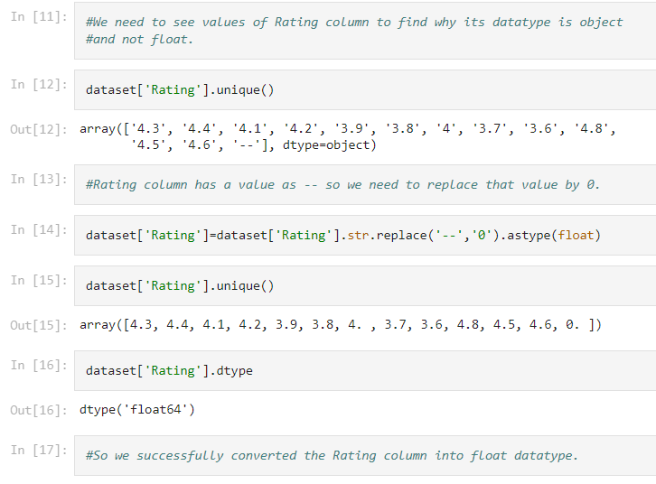
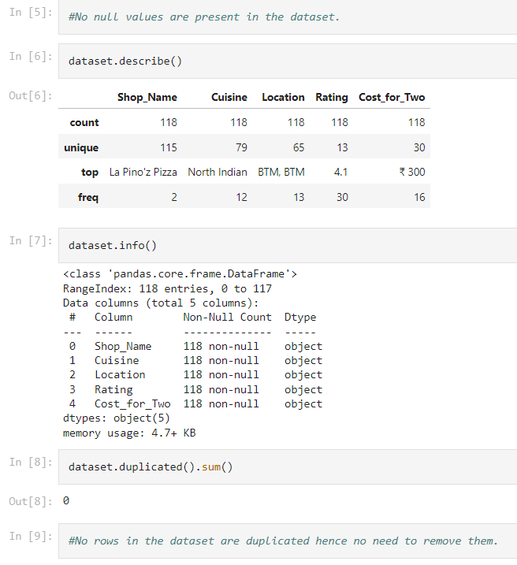
WEEK-3
PERFORMED DATA CLEANING TASKS.

Slide 14
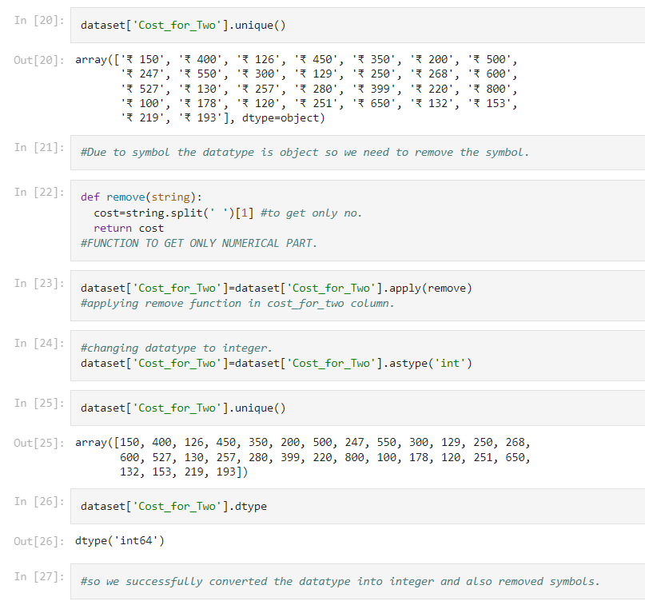
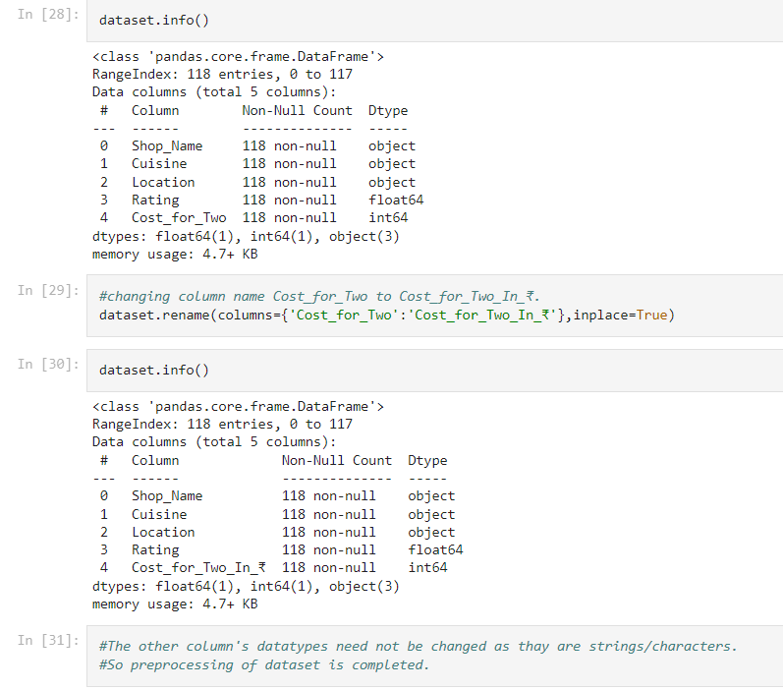

Slide 15
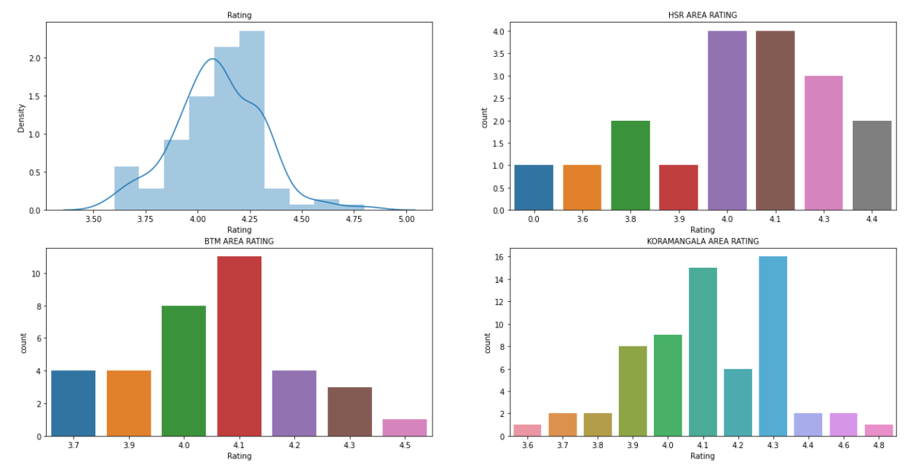
WEEK-4
PERFORMED EDA USING PYTHON AND SUBPLOTS.

Slide 16
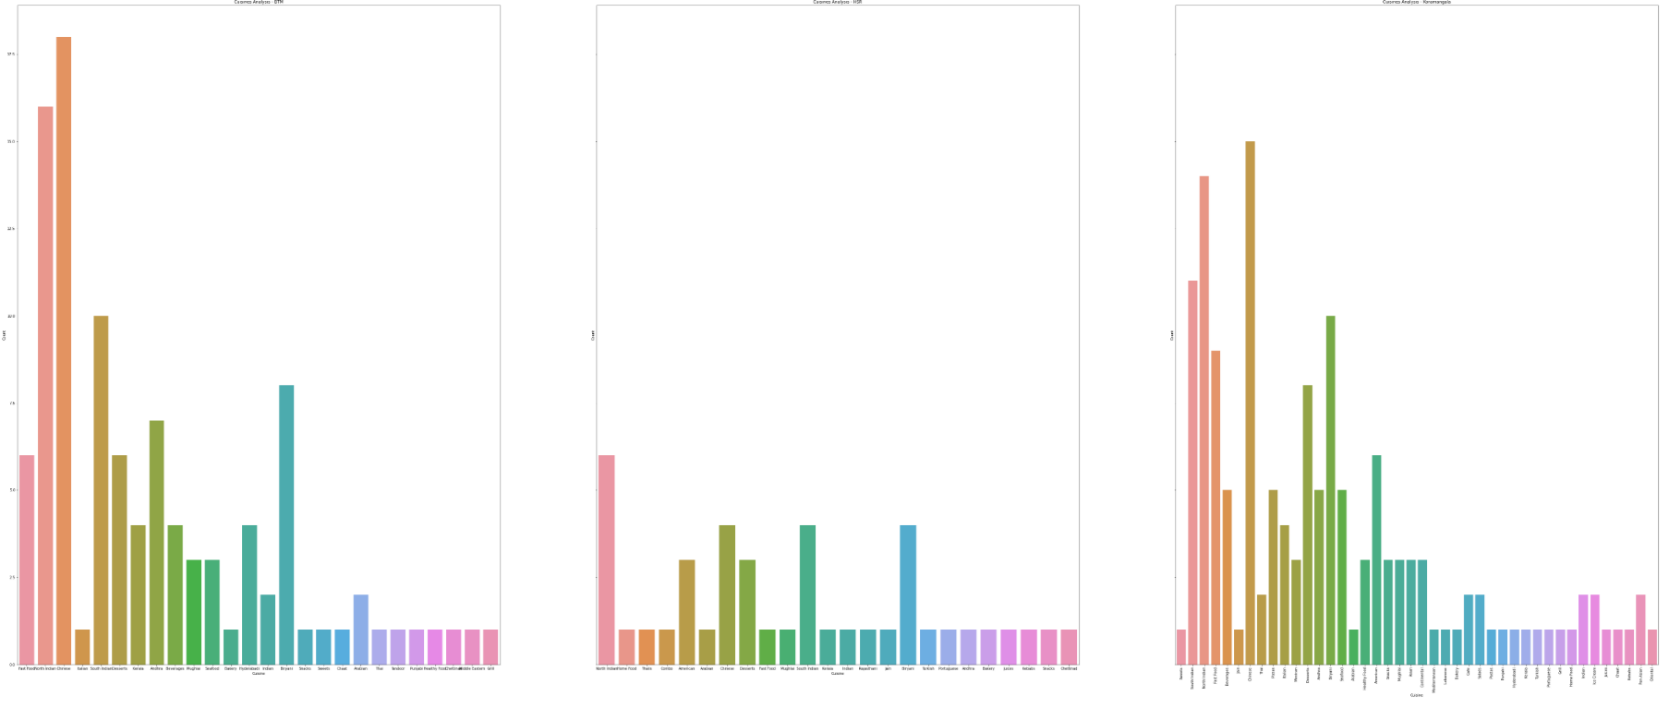

Slide 17
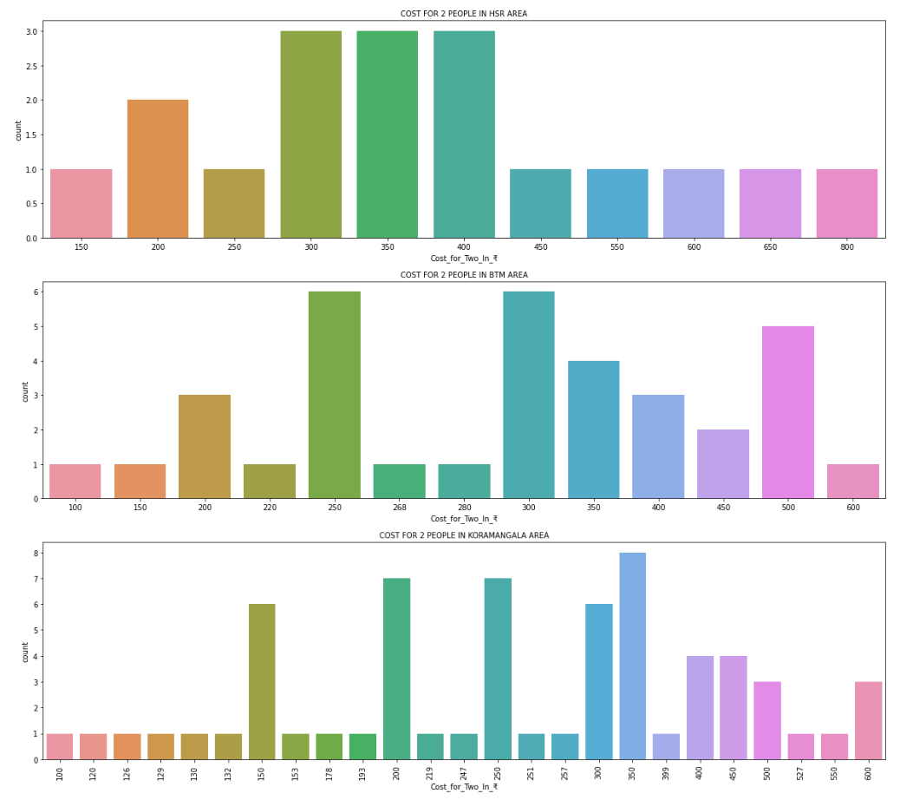

Slide 18
PROJECT-1 AND 2 LINKS
https://github.com/AkshayAnand2002/AIRBNB-DATA-ANALYSIS
https://github.com/AkshayAnand2002/SWIGGY-DATA-ANALYSIS
https://public.tableau.com/app/profile/akshay.anand8667
https://github.com/AkshayAnand2002/AIRBNB-DATA-ANALYSIS/blob/main/Airbnb_Dataset_Analysis.ipynb
https://github.com/AkshayAnand2002/SWIGGY-DATA-ANALYSIS/blob/main/SWIGGY_DATA_ANALYSIS_.ipynb

