Slide 1
SNOOZzz
A dynamic website to keep track on sleeping schedule and counting calories.
Website also provides information about importance of sleep, sleep disorders and ways to improve.
Shreya Kumari
Akshay Anil
Abhishek Kumar
Aarushi Saini

Slide 2
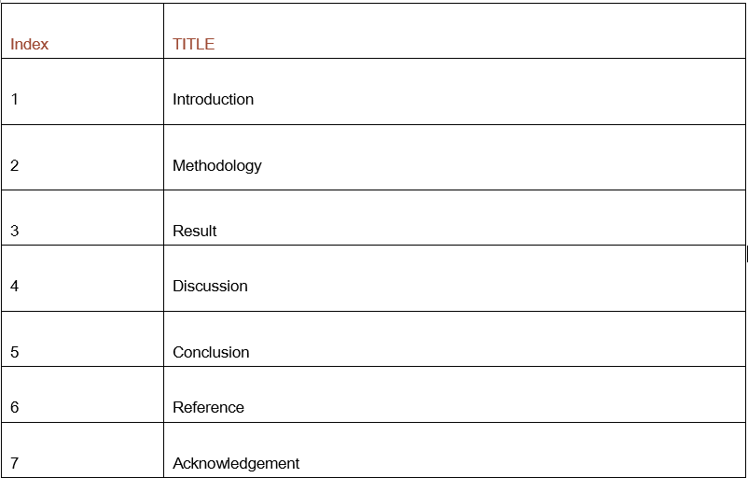

Slide 3
Introduction
Aim of this website is to provide user with adequate information on sleep, its schedules, importance, disorders and ways to improve.
OTT(Over the Top) services like Prime, Netflix and social media are main reason for disturbing sleep schedules.
After login,user can give amount of time(hr) spent on OTT and know the average sleep he/she gets for which linear regression model is used.
Data set for the model was collected through google forms for the real time scenario.
User can calculate calories required based on height, weight, age and gender.
Social media links are embedded to reach us.

Slide 4
Methodology
Research methods and data sources used for the analysis
Resources:
ML model for Linear Regression:
Sample.csv data by google form data collection
Html5, css3, bootstrap,jQuery,sql for frontend and backend
Flask: to deploy the ML model.
Created pickle file for the model to run on Flask.
Libraries and modules used
pyttsx3 : for voice automation
Numpy : For mathematical operations.
flask : deploy ML model over website.
Pickle: ML model converted into .pkl
Webbrowser: opening URL via CLI
Pandas: reading the sample.csv file
Warnings : trigger warnings while integrating the module.

Slide 5
Result
So, with the help of a machine learning model, we predicted the sleeping hours of a person. First we collected the dataset, and imported it to the ML model. Later we created a website and linked the model with it using ‘flask’.
We also used audio control and automation to directly take the user to the website which is running on the server. This is a good feature as when you run flask on your command prompt, you don’t have to rewrite the ip on your browser.

Slide 6
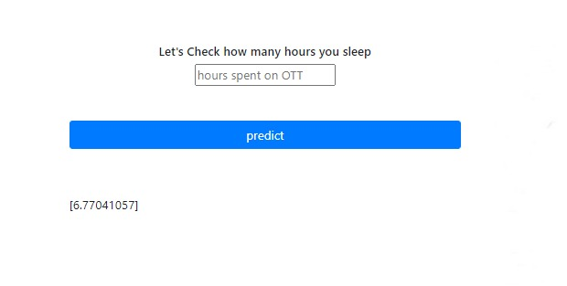
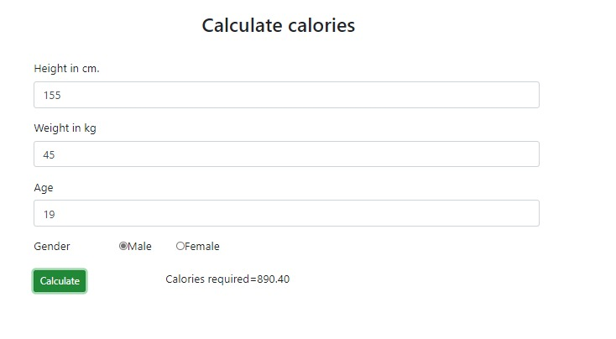
Discussion
If a person spends minimal time online, it is noticed that he/she might sleep 8 hours a day, which is a healthy habit. Our model predicts the same. So, using it, you can keep a track on your sleeping schedule. Further, you can keep a check on your calories intake by entering your height, weight, age, and gender.
So, this webapp is a one site solution for two most important issue.

Slide 7
Conclusion
On the basis of above analysis, we can conclude that it was a wonderful and learning experience for our team while working on this project. This project took us through the various phases of front end and back end of the project which give us real prediction of numbers of Hours of sleep and you can also calculate the calories needed according to your height, weight and age. The joy of working and trill involved while tackling the various problems, and challenges gave us a feeling of real “DEVELOPERS”. Our team worked very coperatively and enjoyed every bit of the project which glows in our project.

Slide 8
Reference
Sleep disorders: https://www.sleepfoundation.org/articles/how-much-sleep-do-we-really-need
bootstrap:https://getbootstrap.com/
images:https://www.shutterstock.com/search/open+source+software

Slide 9
Acknowledgement
Working with team is one of the most important aspect in today’s scenario. With each other’s support, we have managed to complete this project and deploy it successfully.
Hackerrank has once again proved to be a source of motivation for us by organising such a hackathon. Although, this is just our second hackathon, we did learn a lot.
At last, we would like to pay our deepest gratitude to Mr. Vimal Daga sir, who has made us so much capable. We thank him to understand our potential and act as a driving force in our lives.

