Slide 1



India Crime Analysis
View in Power BI

Slide 2
Introduction
This report shows the India's crime data analysis between 2020-22.
Understand crime patterns to support decision-making.
Importance of analysing historical and current crime data.
To raise community awareness and promote safer societies.

Slide 3
ABOUT DATA
Source:National Crime Records Bureau
Fact Tables: District wise number of crimes, State wise crime rates.
District data table: District Name, Cognizable IPC Crimes, Other IPC Crimes, Miscellaneous Crimes, etc.
Sate data table: State Name,Chargesheeting Rate, Crime Rate, Population, etc.
Dimension Table: Year Table, State Table, District Table
Time Period: 2020,2021,2022

Slide 4
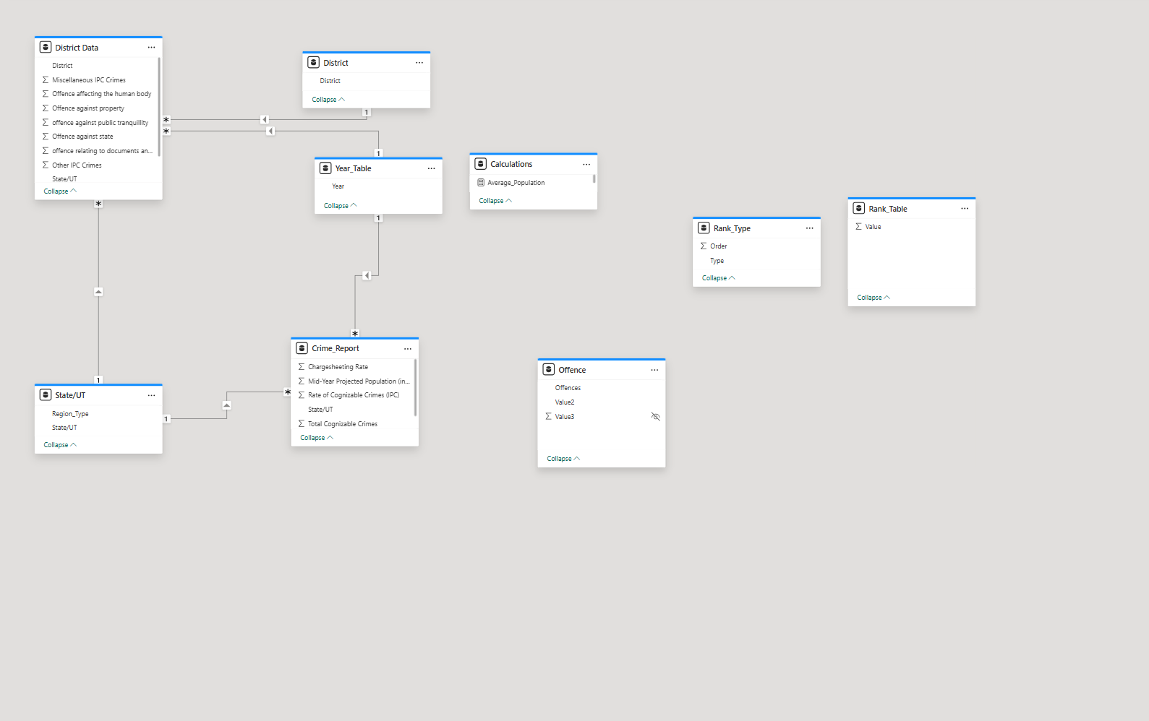
DATA MODEL

Slide 5
Historical Trends
2020: Total Cognizable IPC Crimes 4.25M.
2021: Decreased to 3.66M.
2022:Again decreased to 3.56M.
Crime was higher post-pandemic in densely populated cities.
Crimes against property and public tranquillity were rising.

Slide 6
Key Insights
Crime Volume
Total IPC (Indian Penal Code) Crimes reported: 11 Million.
Other IPC Crimes: 2 Million, Miscellaneous Crimes: 8 Million.

Slide 7
Crime Rates
IPC Crime Rate across India: 249.82 per 100,000 population.
Decreased Crime Rate by 25.01 from 2020 to 2022.
Charge Sheeting Rate (cases where charges were filed): 69.10% .
Decreased Charge Sheeting Rate by 1.93 from 2020 to 2022.

Slide 8
Geographical Hotspots
Top States for IPC Crimes: Tamil Nadu , Maharashtra, Uttar Pradesh.
Top Districts: Mumbai, Chennai, Ahmedabad show high total crimes.
The Northern Belt (U.P., Delhi, Bihar) is particularly sensitive.

Slide 9
Crime Types
Highest crimes against: Human Body (e.g., assault, murder) — Patna, Mumbai, Jabalpur districts lead.
Property-related offences — Delhi dominates this category.

Slide 10
Regional Variations
Union Territories (UTs) have a slightly higher average charge sheeting rate compared to States.
UTs have higher cognizable crime rates (57.52% vs 42.48% for States) — indicating concentration of incidents in smaller geographies.

Slide 11
FUTURE Outlook
Continued decline in total crimes expected.
Need for tech-driven crime monitoring.
Predictive policing and hotspot management essential.

Slide 12
RECOMMENDATIONS
Strengthen law enforcement in high-risk areas.
Launch community policing programs.
Promote crime awareness campaigns.
Regularly refresh and analyze crime data.

Slide 13
CONCLUSION
Crime rates are gradually declining.
Focus needed on urban and northern regions.
Data-driven strategies critical for prevention.
Future of policing lies in technology and public participation.

Slide 14
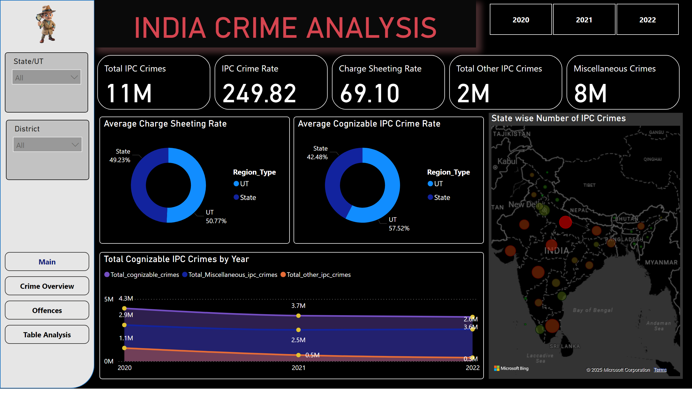
Main
Notes:
image
No alt text provided
slicer
No alt text provided
slicer
No alt text provided
pageNavigator
No alt text provided
shape
No alt text provided
card
No alt text provided
slicer
No alt text provided
cardVisual
No alt text provided
Average Charge Sheeting Rate
No alt text provided
State wise Number of IPC Crimes
No alt text provided
Total Cognizable IPC Crimes by Year
No alt text provided
Average Cognizable IPC Crime Rate
No alt text provided

Slide 15
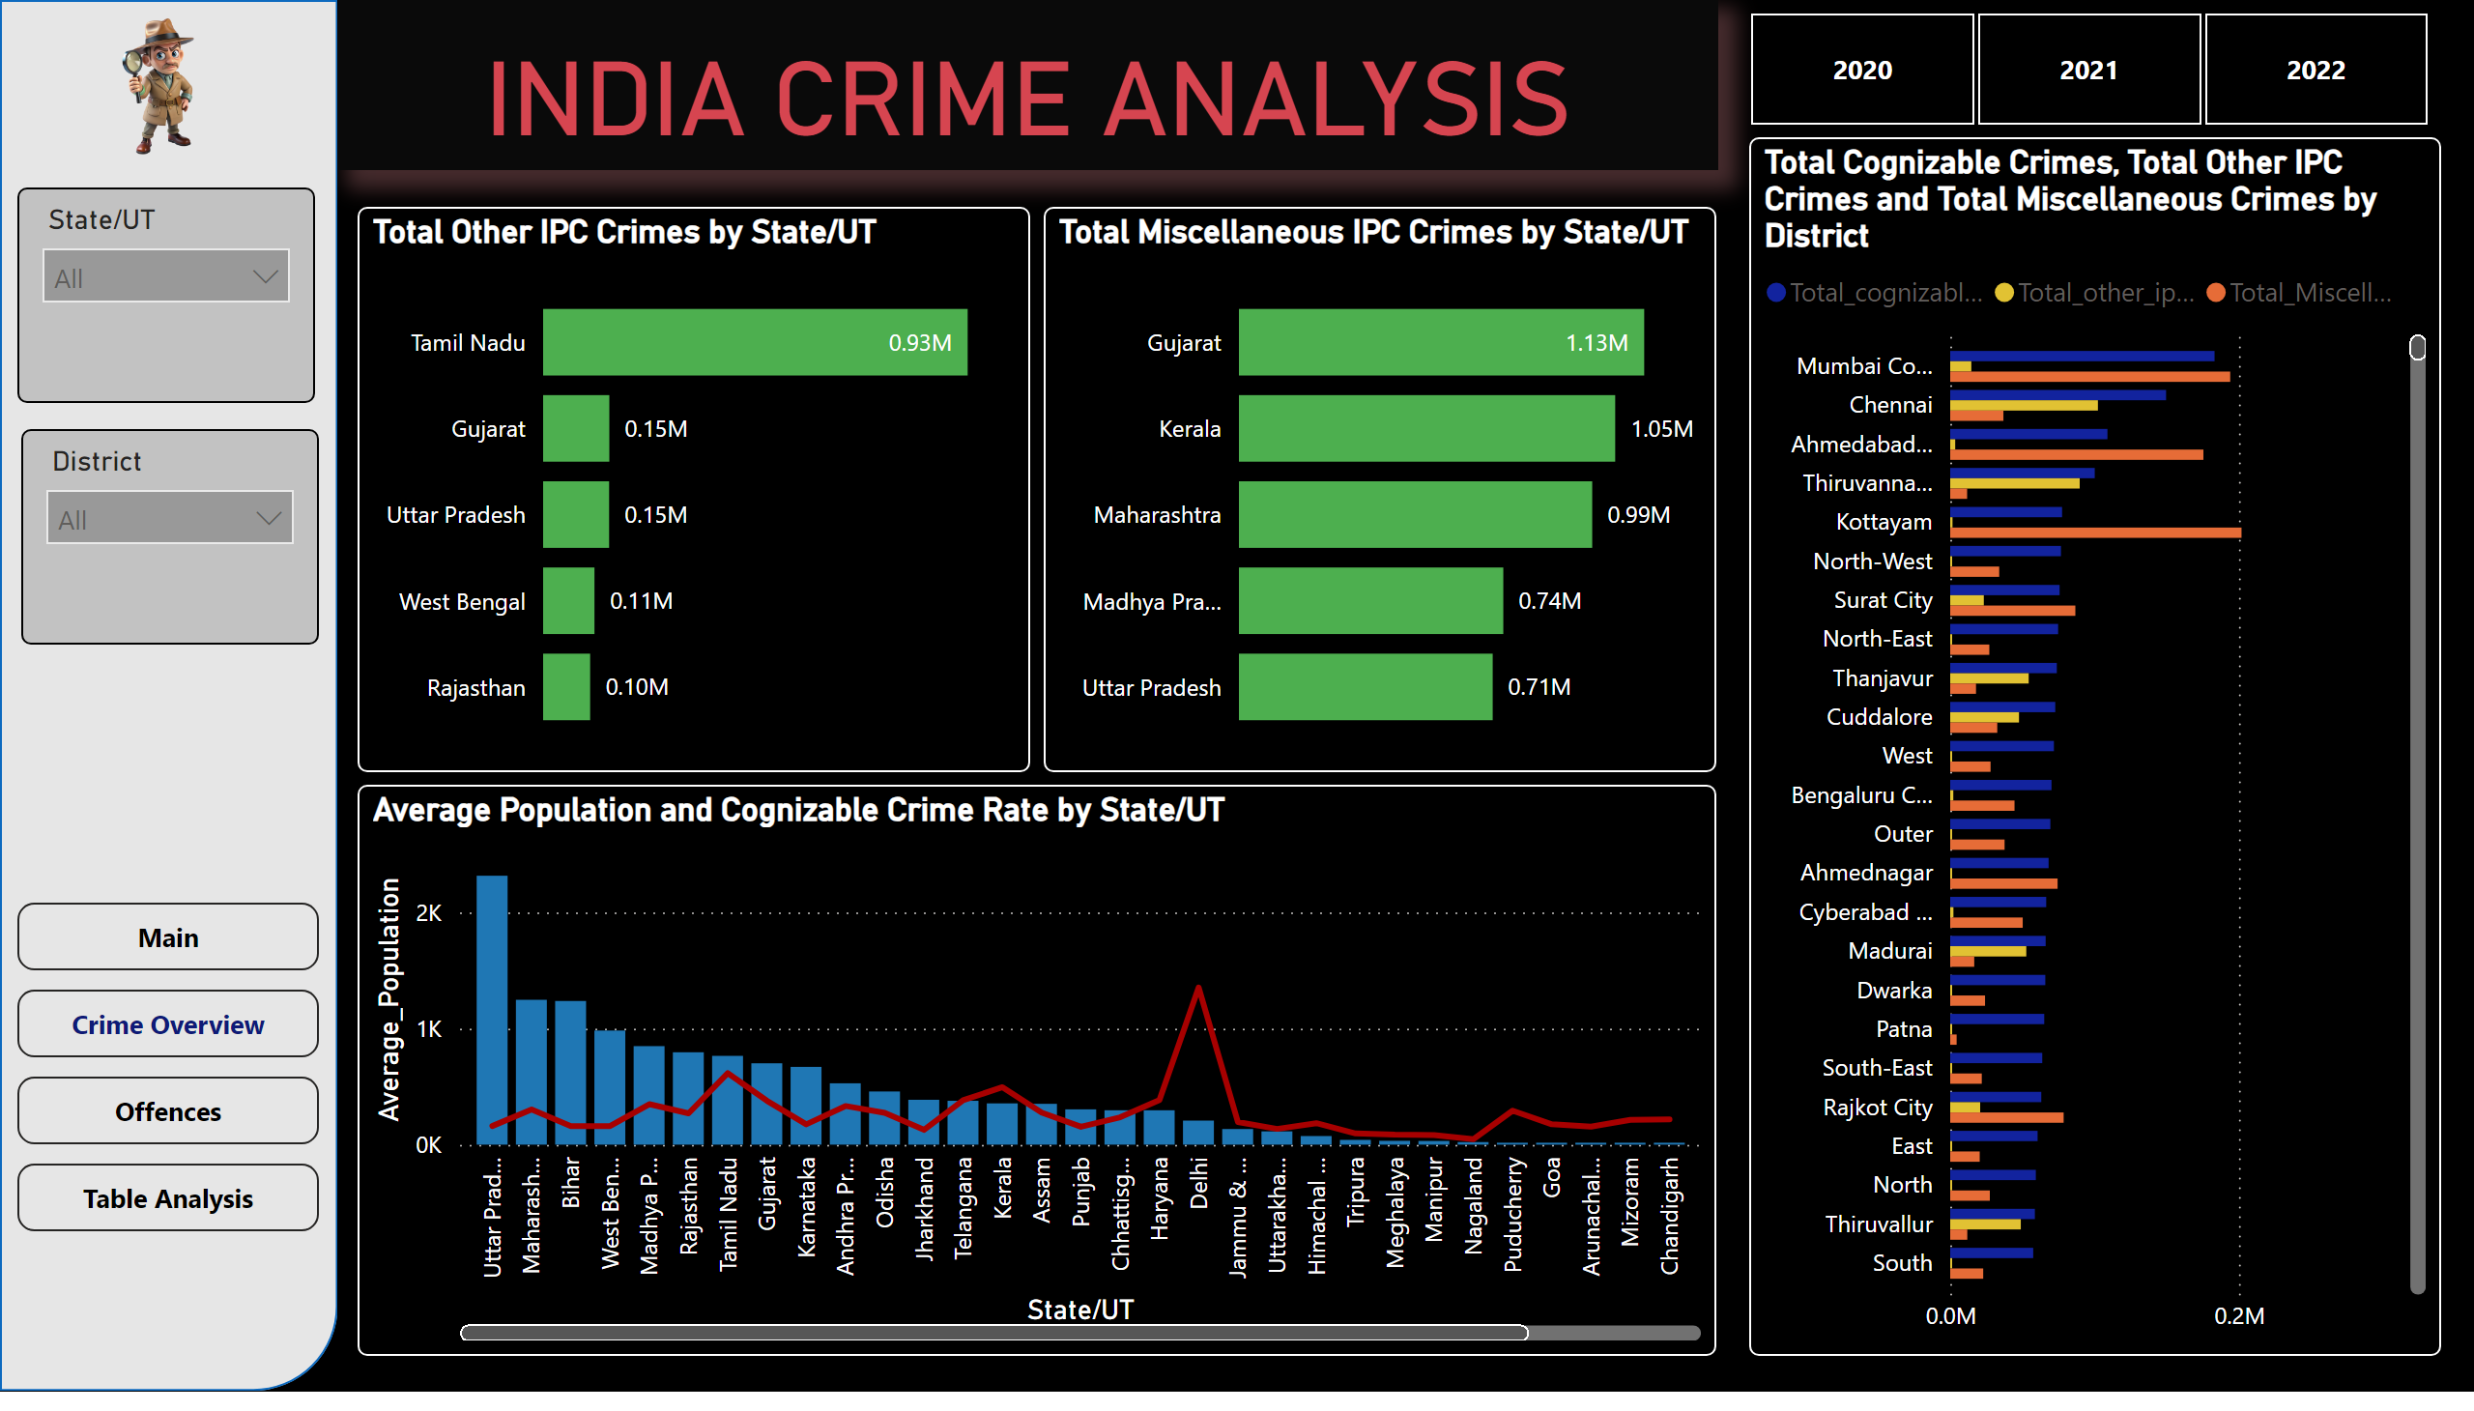
Crime Overview
Notes:
image
No alt text provided
slicer
No alt text provided
slicer
No alt text provided
shape
No alt text provided
card
No alt text provided
slicer
No alt text provided
Average Population and Cognizable Crime Rate by State/UT
No alt text provided
Total Cognizable Crimes, Total Other IPC Crimes and Total Miscellaneous Crimes by District
No alt text provided
Total Other IPC Crimes by State/UT
No alt text provided
Total Miscellaneous IPC Crimes by State/UT
No alt text provided
pageNavigator
No alt text provided

Slide 16
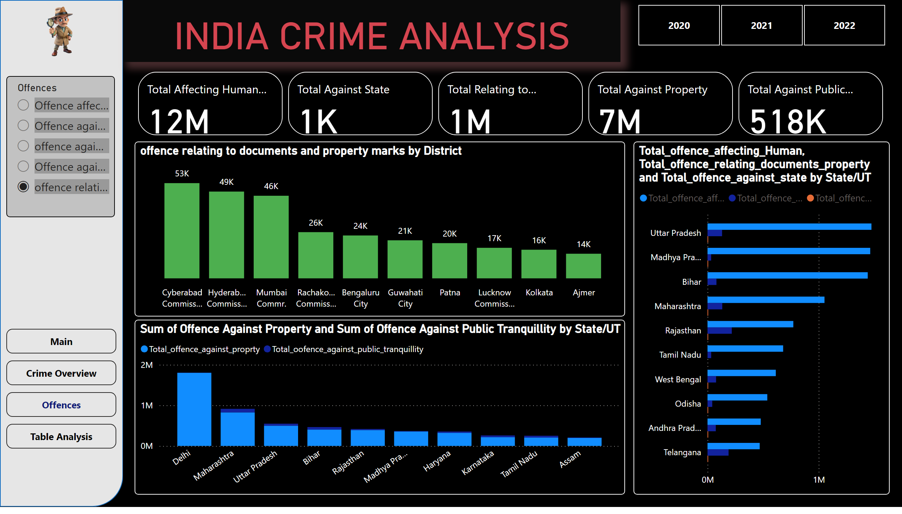
Offences
Notes:
image
No alt text provided
slicer
No alt text provided
shape
No alt text provided
card
No alt text provided
slicer
No alt text provided
Sum of Offence Against Property and Sum of Offence Against Public Tranquillity by State/UT
No alt text provided
clusteredBarChart
No alt text provided
offence relating to documents and property marks by District
No alt text provided
pageNavigator
No alt text provided
cardVisual
No alt text provided

Slide 17
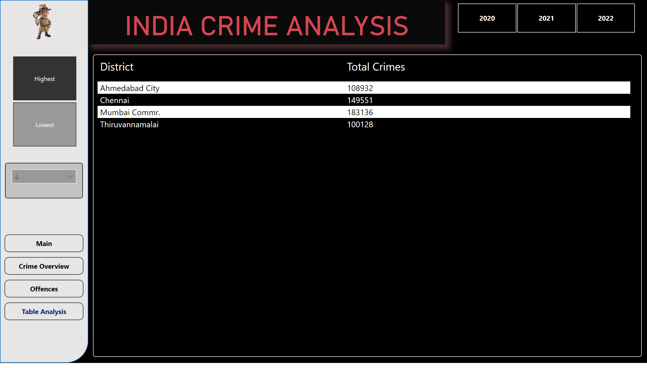
Table Analysis
Notes:
shape
No alt text provided
card
No alt text provided
slicer
No alt text provided
tableEx
No alt text provided
pageNavigator
No alt text provided
slicer
No alt text provided
slicer
No alt text provided
image
No alt text provided

Slide 18
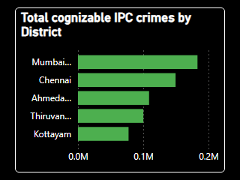
Tooltip1
Notes:
Total cognizable IPC crimes by District
No alt text provided

Slide 19
THANK YOU
Let's work together for a safer India!

