Slide 1
Plant Leaf Disease Classification
Submitted by: Akshay Bamnote (C228)
Gayatri Pardeshi (C235)
Ritesh Pawar (C233)

Slide 2
Introduction
Diseases found in agricultural crops is a major threat that cause production and economic losses as well as reduction in both quality and quantity of agricultural products.
In India 70% of population depend on agriculture and contributes 17% towards the GDP of country.
Farmers experience great difficulties in switching from one disease control policy to another. The naked eye observation of experts is the traditional approach, this method can be time consuming, expensive and inaccurate.
The crop losses can be minimized by applying pesticides or its equivalent to combat the effect of specific pathogens, if diseases are correctly diagnosed and identified early.

Slide 3
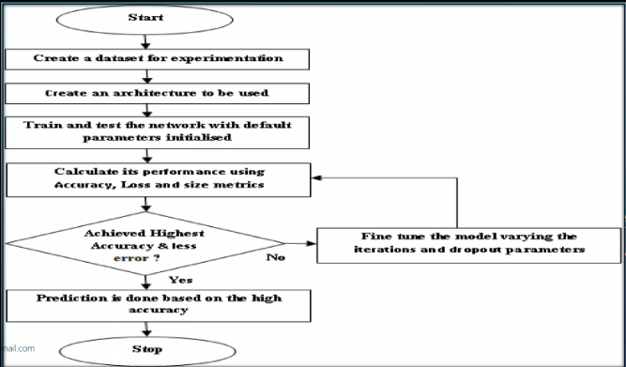
DataFlow Diagram

Slide 4
Advantages
The main advantage of automatic plant disease detection is to protect crop production from quantitative losses.
Automatic detection of plant disease is essential as it may prove benefits in monitoring large fields of crops and thus automatically detect the symptoms of diseases as soon as they appear on plant leaves.
This system can work as a universal detector, recognizing general abnormalities on the leaves such as scorching or mold etc.
It can be implemented to increase crop productivity by ensuring the quality and quantity of the food product.

Slide 5
The advantage of automatic plant disease detection and classification is to provide best Agricultural productivity. This is one of the reason that disease detection in plants plays an important role in agriculture field.
It can recognize a plant disease which provides clues to identify and treat the disease in early stages.
It provides the better advancement and enhancement in computing classifiers of a neural network approach and provide better results.
This system will be capable of distinguishing a large no of different diseases in a less time.

Slide 6
OBJECTIVES OF AUTOMATIC PLANT DISEASE DETECTION
Forecasting of plant leaf disease (Quantification) as soon it appears on plant leaves.
Automatic detection of plant leaf disease detection and classification.
Increase accuracies Using large dataset to train the Algorithm and maximize epoch values.
Make use of existing deep learning models Like VGG19 for plant leaf disease detection and will check its performance.

Slide 7
Dataset (New Plant Disease Dataset)
The Dataset collected from open source website "Kaggle".
The Dataset contains 87k image samples of 14 crops.
The dataset consists of 38 classes corresponding to 38 leaf diseases of 14 crops.

Slide 8
Transfer Learning
Transfer learning is the reuse of a pre-trained model on a new problem.
A pre-trained model is a saved network that was previously trained on a large dataset, typically on a large-scale image-classification task.
Feature Extraction: Use the representations learned by a previous network to extract meaningful features from new samples.
Fine-Tuning: Unfreeze a few of the top layers of a frozen model base and jointly train both the newly-added classifier layers and the last layers of the base model.

Slide 9
Future Scope of Project
The forecasting of disease diseases in early stage, so that appropriate measures can be taken to minimize the loss in crops.
Our project have shown pretty good accuracy, it can be implemented in real time mobile applications and web services, so that formers can identify diseases simply by taking photo of suspected leaves of plants.
Other than plant leaf disease identification, it can also be used for identification and classification of nutrients deficiency of plant leaves.
Creating and training a CNN model from scratch is a tedious process, this model can be used to detect and classification of other plant disease too, by simply training the model using respected datasets.

Slide 10

Thank You

