Slide 1



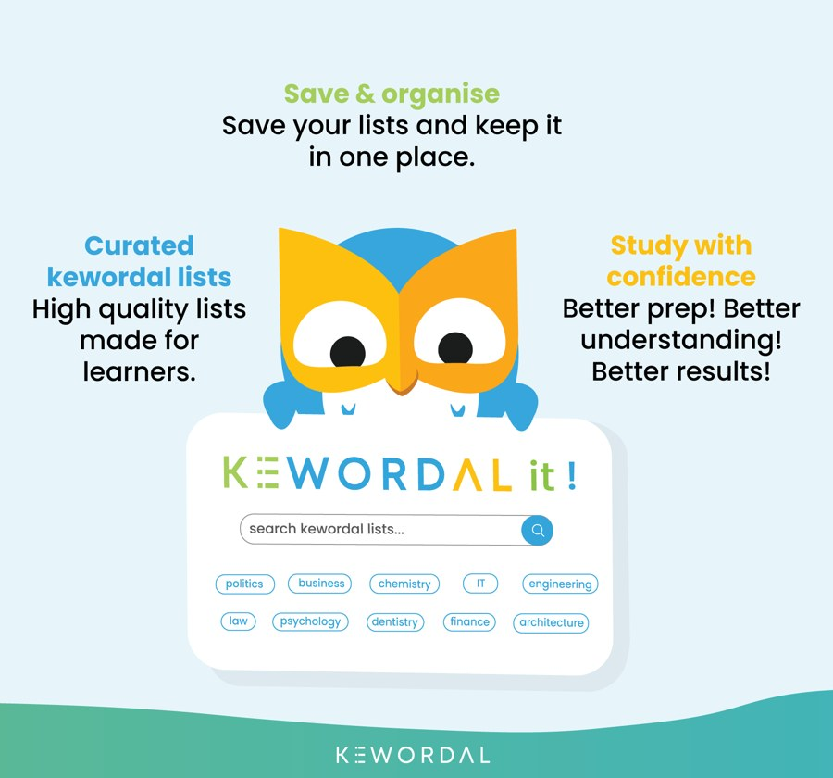








The Tech for Good, AI-powered social learning education network
SPONSOR TEASER · OCTOBER 2026 · PREPARED FOR BARCLAYS
Barclays: become a Pioneer Sponsor in Banking
Kewordal is the vehicle for businesses to engage in education and social impact, globally. Sponsor learners, put Barclays’ brand in front of them, and help lead how banking supports learning.
YOUR CHALLENGE: BANKING
We built a Kewordal list on banking. Can Barclays beat Michael’s score?
Ten keywords every banker should know. Every bank plays the same list, so you can see how Barclays compares with its peers. It takes two minutes.
Score to beat
Michael Watson
[X]/10
Play the challenge: [challenge link]
Share it with your team. Win or lose, you’ll have played Kewordal before we meet.
Three Pioneer Sponsor places in Banking. Offered while places remain.
WHAT BARCLAYS GAINS
Influence
Invested in global education and social impact, with a voice in how banking engages.
Reputation
Barclays’ brand on the profile of every learner it sponsors, from launch.
Opportunities
Your people share their expertise through Kewordal lists, then mentoring and work experience.
Networks
The Pioneers’ Circle: shape your sector’s contribution alongside your peers.
AT A GLANCE
3
99
No. 1–3
£2,995
£25k
1,000
Pioneer places in Banking
in 33 sectors and growing
numbered permanently
packages from, per year
Pioneer Sponsor from
learners: we celebrate
IN THE FULL DECK
Barclays and Kewordal at a glance
A second challenge, built around your own career
What Barclays’ sponsorship looks like on Kewordal
Pioneer Sponsor places and the Pioneers’ Circle
Packages, from 24 to 1,200 learners a year
Built on proven experience, and the team behind it
How we celebrate Barclays: Sponsored 1000 and Spotlight
What’s coming: profile page, competitions, mentoring
We would be delighted to send you the full deck, and to follow up about Barclays becoming a Pioneer Sponsor in banking.
Michael Watson, Founder & CEO | PhD (Education), MSc, BSc, Dip HRM
michael.watson@kewordal.com | kewordal.com | +44 7742 274680 | linkedin.com/in/drmichaelwatson
Prepared for Barclays; name and logo shown for illustration only. Pioneer Sponsor places are offered while places remain. Roadmap features are not yet live.

