Slide 1
LogBook / Trackspot WebApp Documentation
Prototype：https://xd.adobe.com/view/4713050e-ac56-4784-856a-f43d60c7767c-1240/?fullscreen&hints=off

Slide 2
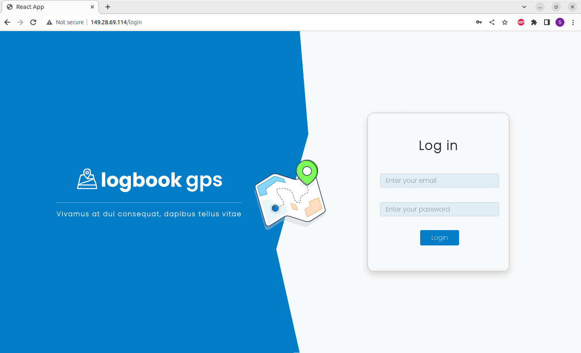
【P.01】Login ① (User and Admin single login page)
1
2
3

Slide 3
No. | Name | Content
1 | Email | Enter the admin/user registered email
2 | Password | Enter the admin/user password
3 | Login | Button to log in using above email and password

Slide 4
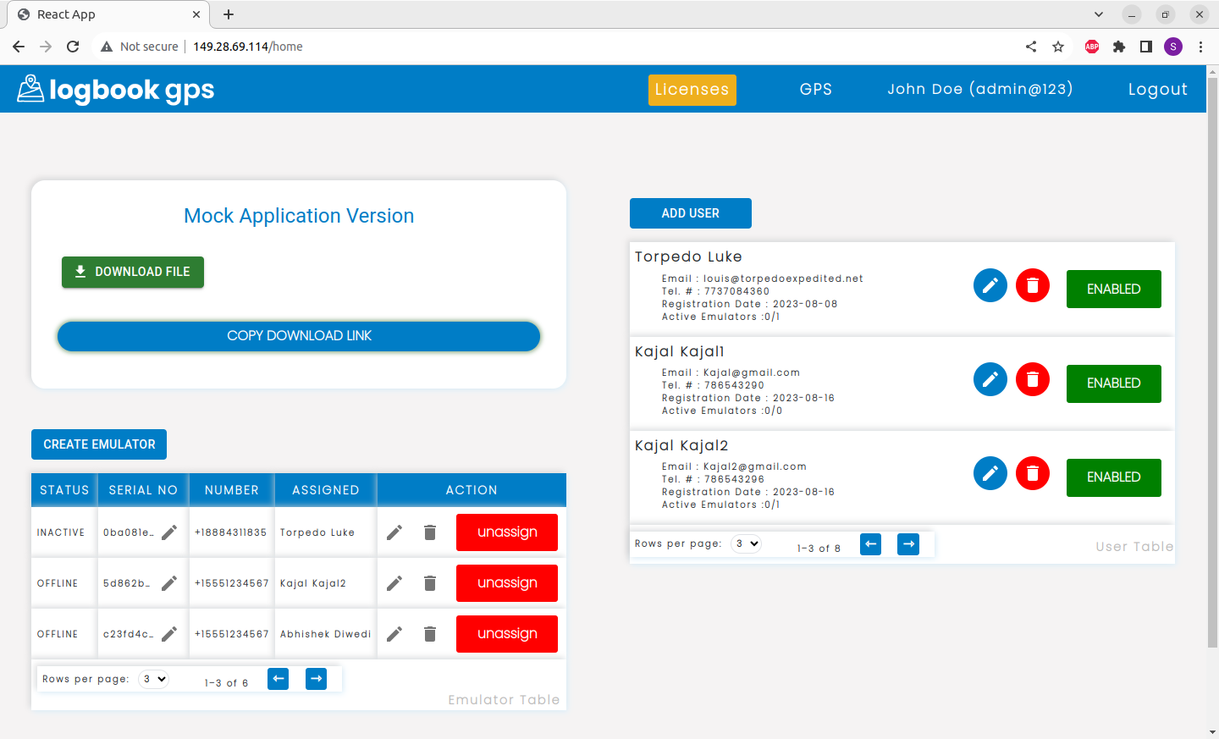
【P.02】 Licenses Page ② (Admin only)
13
14
15
16
9
10
11
12
1
2
3
4
5
6
7
8

Slide 5
No. | Name | Content
1 | Download File | Download the logbook trackspot apk with this button
2 | Copy Download Link | Copies the download URL of the APK (not working without HTTPs)
3 | Create Emulator | Create a new bare bones emulator, to be assigned a number and user later.
4 | Status | Status of the emulator (INACTIVE/OFFLINE/ACTIVE)
5 | Serial No. | Unique id of each emulator to be used on the application side for sync. You can edit the default-assigned serial no to a random new one or from another emulator.
6 | Number | The telephone number used to make calls/sms. Needs to be set manually from action (pt.8) edit icon.
7 | Assigned | The user assigned to the emulator. If none, It will show N/A
8 | Action | Consists 3 Actions. Edit phone number, delete emulator, Assign/UN-assign user

Slide 6
No. | Name | Content
9 | Add user | Opens a form to add a new user
10 | Edit User | Opens a form to edit user details
11 | Delete User | Button to delete the user
12 | User Status | Status of the User (click to toggle between active and inactive status.
13 | Licenses | Licenses page navigation top bar.
14 | Gps | Gps page navigation top bar tab.
15 | Logged in info | Currently logged in user/admin info. Name and email
16 | Logout | Log out of logbook webpage.

Slide 7
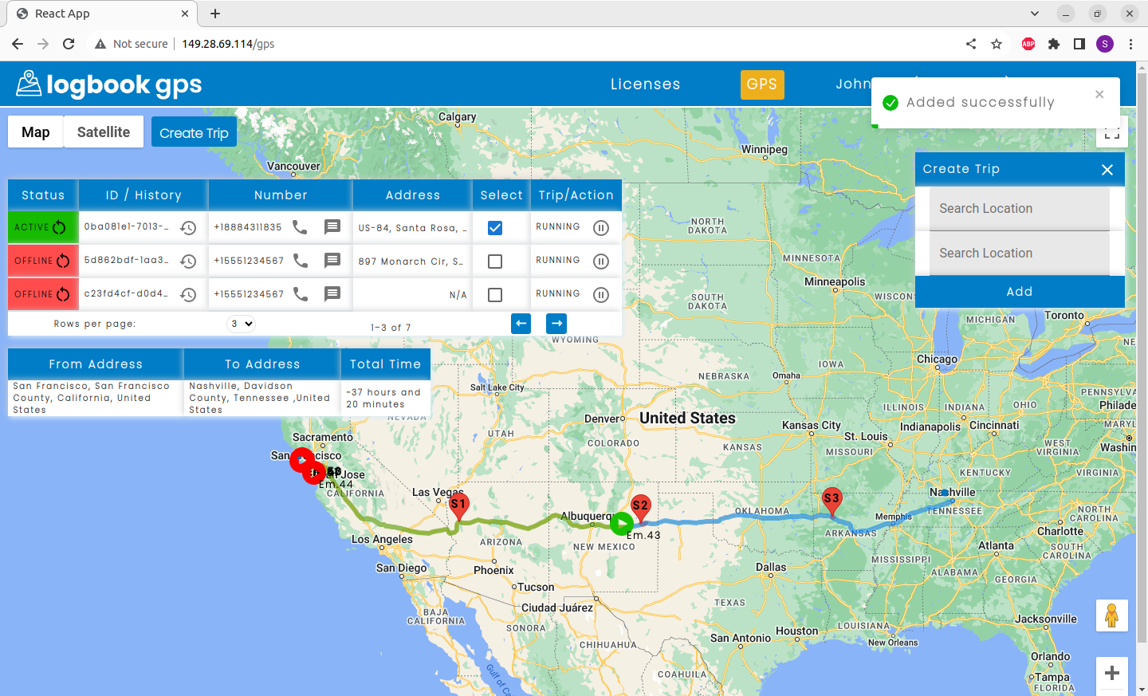
【P.03】 Gps Page ② (Admin and user accessible)
12
1
3
4
5
6
7
8
2
9
11
10

Slide 8
No. | Name | Content
1 | Create Trip | This will popup a form with ‘FROM’ and ‘TO’ to create trip for the Selected emulator(pt. 7).
2 | Create Trip Form | The input fields of ‘From’ and ‘To’ have auto suggestion for places name. Add button will send a request to create trip. This may take a couple seconds to find route etc.
3 | Emulator Status / restart | Status of the emulator (INACTIVE/OFFLINE/ACTIVE) / (icon) restart emulator/application
4 | Serial No. / Trip History | Unique id of each emulator to be used on the application side for sync. History(icon) - Previous trip details of emulator.
5 | Number / Call / Sms | The telephone number used to make calls/sms. Needs to be set manually from action (pt.8) edit icon. Call (icon) – shows a form and history of call. Can place call to a number and show previous records. Message (icon) - shows a form and history of sms. Can send sms to a number and show previous records.
6 | Address | Current / Last known address of the emulator.
7 | Select | Select an emulator to view it’s position on map and it’s trip. Also show it’s details at the Trip details table (pt.9)
8 | Trip/Action | The trip status of the emulator on a trip. Action Icons can be used to toggle between trip statuses.

Slide 9
No. | Name | Content
9 | Trip details table | This shows the trip FROM and TO as well as total time it will take to cover (without stops)
10 | Trip route path | This is the trip route path (green for covered and blue for remaining)
11 | Emulator Marker | This is the icon or Marker shown on the position of the emulator’s currently mocking location. This will change it’s image and color based on trip status and emulator online status respectively. (Red is for INACTIVE/OFFLINE emulators, Green is for ACTIVE)
12 | Alert Messages / Notifications | Any important message or alert is shown via this Toast.

