Slide 1

Development Of Smart Procurement & Purchase Order Management System Group 1
A centralized, role-based platform unifying employees, administrators, and suppliers in a single automated procurement lifecycle.

Slide 2

Introduction & Project Rationale
The Procurement System is a comprehensive web-based application designed to centralize and automate the entire procurement lifecycle within an organization. Traditional procurement processes rely heavily on manual approvals, fragmented email communications, and disconnected systems that create inefficiencies and lack transparency.
Unified Platform
Real-Time Coordination
Employees, admins, and suppliers consolidated onto one system
Track requests, budgets, and supplier updates instantly
Full Transparency
Every stakeholder sees the information they need, when they need it

Slide 3
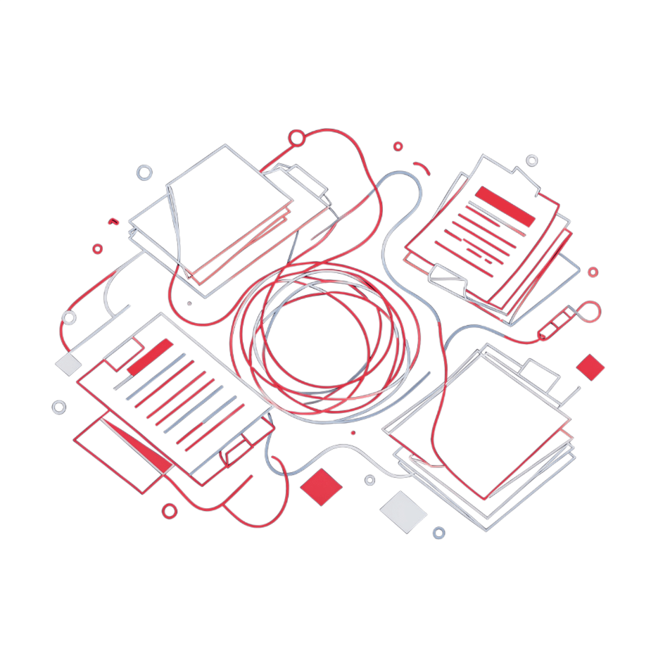
The Problem: Fragmented Procurement Processes
A Cascading Chain of Inefficiency
Organizations face significant challenges with traditional procurement methods. The process is heavily fragmented, relying on manual approvals and email chains that create multiple bottlenecks at every stage.
No Visibility for Employees
Admin Overload
Supplier Miscommunication
Financial Opacity
Manual budget verification and supplier coordination overwhelm administrators
Finance teams cannot reconcile spend against authorized purchase orders
Purchase requests disappear into email inboxes with no status tracking
Orders lost in threads cause fulfillment delays and inventory shortages

Slide 4
Technology Stack: Frontend & Backend Architecture
Frontend
Backend
React 19 + Vite
Tailwind CSS
Spring Boot + Java 21
MySQL + Spring Data JPA
Faster builds, superior developer experience, component reusability across three portals
Rapid UI development with consistent design language, no custom CSS overhead
Enterprise-grade security, dependency injection, and seamless REST API creation
Production database with in-memory testing support via Hibernate ORM
React Router DOM + Lucide React
JWT Authentication
Portal navigation management and intuitive icon library
Stateless, secure token-based auth enabling horizontal scalability across all roles

Slide 5

Role-Based Access Control (RBAC): Three Portal Architecture
Strict role-based access is enforced at both the frontend (UI elements shown/hidden by role) and backend (API endpoints validate roles before processing), ensuring security even if frontend controls are bypassed.
Employee
Admin
Supplier
Browse products, submit requests with justifications, track approval status in real-time, receive notifications, and submit delivery feedback and supplier ratings
Review requests on a comprehensive dashboard, approve or reject based on budget and justification quality, manage supplier payments, and analyze spend metrics through interactive visualizations
Receive and review incoming purchase orders, manage logistics by updating fulfillment and delivery statuses in real-time, and complete the delivery process entirely within the platform
Each role accesses only the data and functions relevant to their responsibilities — enforced by both Spring Security annotations and frontend route guards.

Slide 6
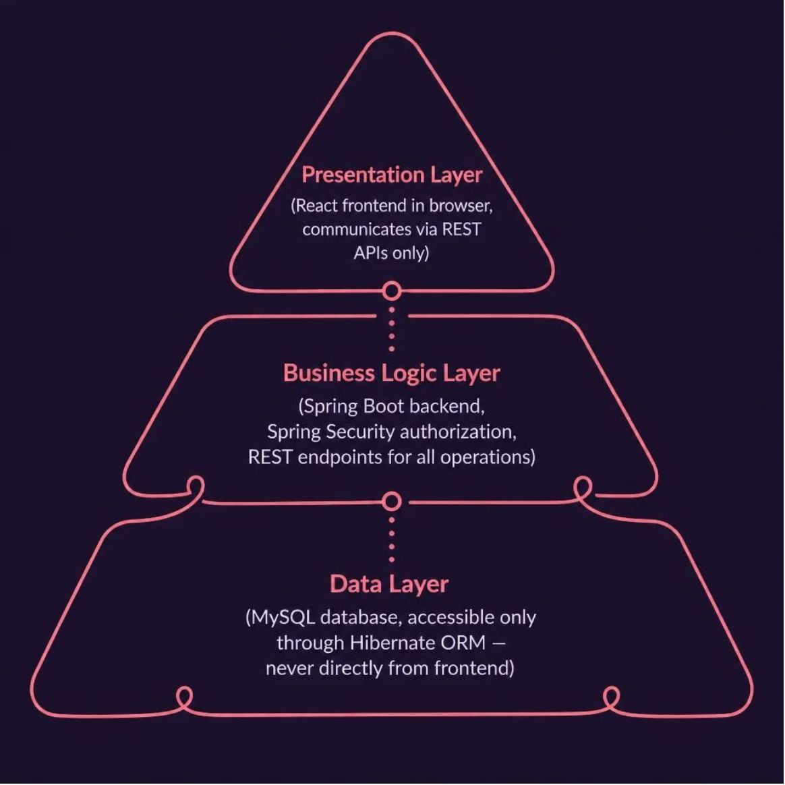
System Architecture: Client-Server Model with Separation of Concerns
A Scalable, Maintainable Foundation
The React frontend runs entirely in the browser and communicates with the backend exclusively through RESTful API endpoints — it never touches the database directly. This clean separation means frontend and backend teams can work independently, and the system can scale horizontally by adding backend servers behind a load balancer without any frontend changes.
API calls are abstracted into dedicated service modules within React, keeping components focused on rendering UI rather than managing network logic. All business rules and security checks are centralized in the backend, ensuring consistent enforcement regardless of client.
The decoupled design also enables future extensibility — a mobile application could consume the same backend APIs without any backend modifications, protecting the organization's investment as requirements evolve.
Independent Deployability
Centralized Security
Future-Ready
Frontend updates without backend changes and vice versa
All authorization enforced in one place — the backend
Mobile or third-party clients can integrate via existing APIs

Slide 7
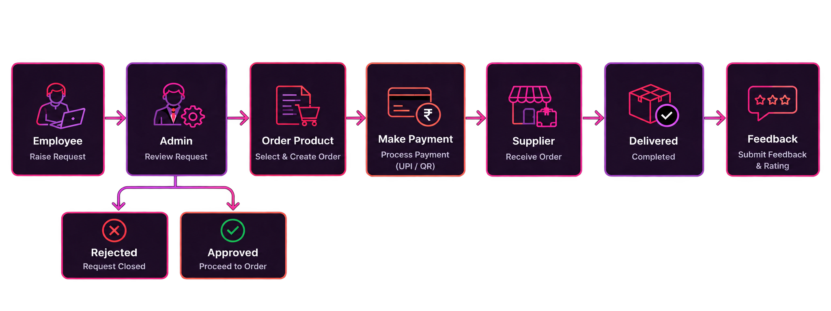
Procurement Workflow:
Complete workflow cycle: an employee submits a request, the admin reviews it, approves or rejects the order, processes payment when approved, sends the order to the supplier for fulfillment, and the employee provides feedback after delivery.

Slide 8
Admin & Supplier Workflow: Access & Operations
Admin Portal Flow
Supplier Portal Flow
Admin logs in
Supplier logs in
Dashboard (overview of all activity)
Dashboard (incoming orders)
Can navigate to: Requests: Review employee requests, approve or reject
Can navigate to: My Orders: View all assigned purchase orders with details
Payments: Process payments to suppliers for approved orders
Order Status: Update fulfillment status (In Fulfillment, In Transit, Delivered)
Departments: View department information and budgets
Payments: Track payments received for completed orders
Suppliers: Manage supplier details and performance
Performance: View delivery metrics and employee feedback ratings
Notifications: Receive real-time updates on all system activities
Both roles have restricted access—admins cannot create purchase requests, suppliers cannot modify order terms. All actions are logged and auditable.

Slide 9
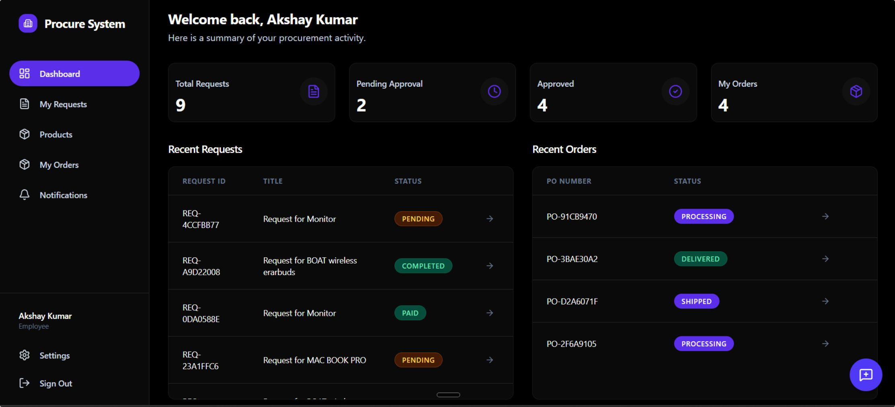
Employee Portal Workflow: Request to Feedback
Employee Portal Flow:
Key Actions:
01
02
Employee browses products and submits a request with business justification
Request appears in "My Requests" with status tracking
03
04
When admin approves and processes payment, order moves to "My Orders"
Supplier updates delivery status in real-time—employee sees progress
05
06
Upon delivery, employee provides feedback and rates the product and supplier service
Feedback is recorded and contributes to supplier performance metrics
The employee portal provides complete visibility into the procurement lifecycle, from initial request through final delivery and feedback.

Slide 10
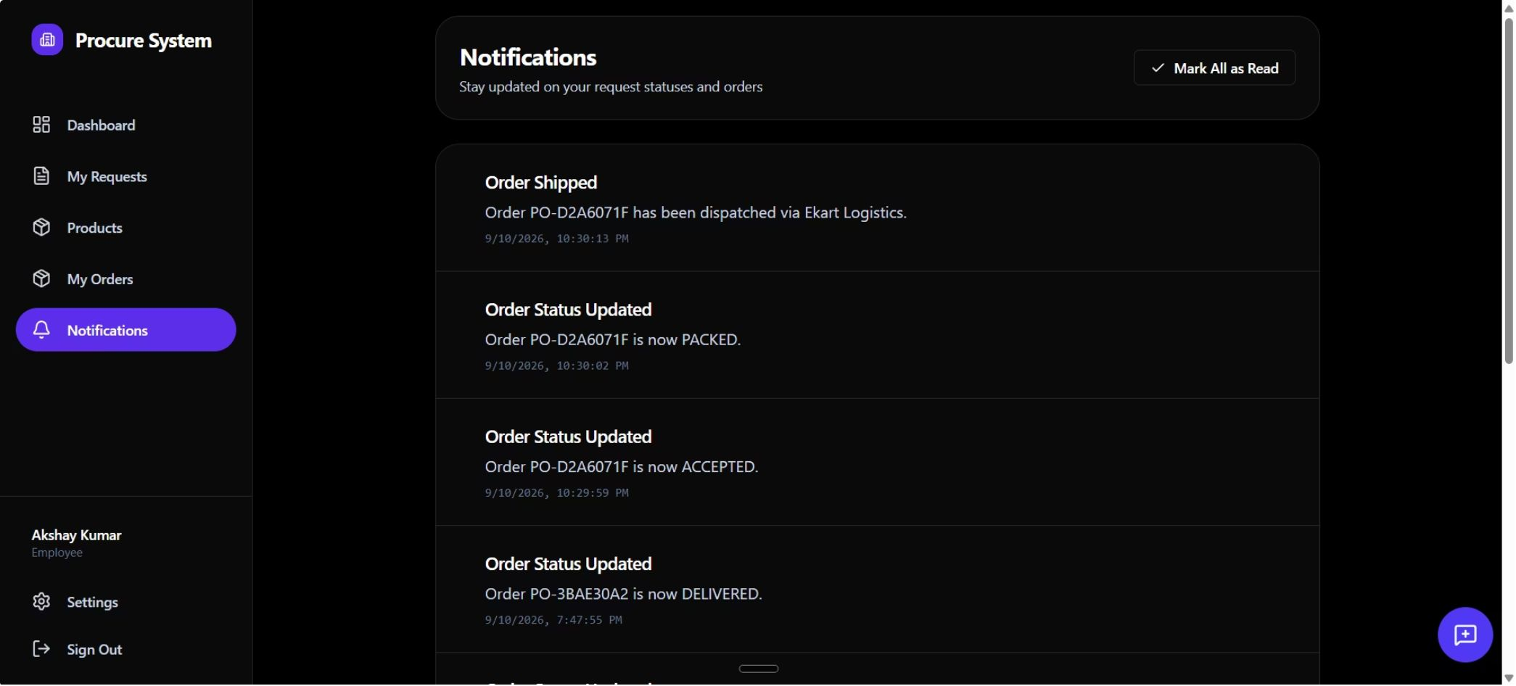
Notification System: In-App & Email Alerts
Notifications keep all stakeholders informed in real-time.
In-App Alerts
Email Alerts
When order statuses change—whether an employee's request is approved, an admin processes payment, or a supplier updates delivery status—the system sends instant notifications directly within the app. Users can view all notifications in a dedicated Notifications page, which displays a complete history of order updates, status changes, and system alerts.
Additionally, critical notifications are automatically sent to users' email addresses, ensuring they stay informed even when not actively using the platform. This dual-channel approach (in-app + email) guarantees that no important updates are missed, keeping the entire procurement workflow transparent and responsive.

Slide 11

Key Features & Business Impact
How the procurement platform improves efficiency, visibility, and control
Centralized Procurement
Budget & Approval Control
Real-Time Order Tracking
Secure Role-Based Access
One platform connects employees, administrators, and suppliers throughout the procurement lifecycle.
Requests are reviewed using budget availability and business justification before approval.
Track request approval, payment, fulfillment, and delivery status throughout the lifecycle.
Employees, admins, and suppliers access only the data and functions relevant to their roles.
Supplier Management
Notifications & Transparency
Manage purchase orders, fulfillment updates, payments, delivery information, and supplier performance.
In-app and email notifications keep stakeholders informed about important status changes.
RESULT: Reduced manual coordination • Improved visibility • Faster approvals • Better accountability • Auditable procurement lifecycle

Slide 12

Future Scope & Enhancements
Evolving the platform toward intelligent and scalable procurement
AI-Powered Procurement
Advanced Analytics
Predict future purchasing needs, identify unusual spending patterns, recommend suitable products or suppliers
Department-wise spending analysis, supplier performance dashboards, budget utilization forecasting
Mobile Application
Smart Automation
Employee request submission, admin approval from mobile, supplier delivery updates
Automated approval workflows, purchase-order generation, automated reminders for pending actions
Enterprise Integration
ERP/accounting system integration, payment gateway integration, enterprise SSO/identity integration
VISION: A scalable, intelligent procurement platform that evolves from workflow automation into data-driven procurement management.

Slide 13
Thank You

