Slide 1
CS 521 Project
Achieving Fine Grained Control Over Incidence of False-positives and False-negatives in NLP Classification Tasks using Methods Inspired by Game Theory
Akshay Channesh
achann4 at uic dot edu

Slide 2
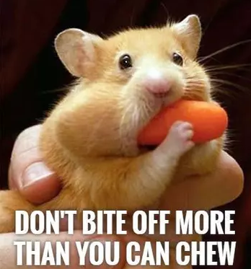
Introduction
Original Plan: Use Game Theory for work in Semantics.
Hard, and too complex. Too much time spent and nothing to show for it.
A lower hanging fruit was found!
Still interesting and still uses
Game Theory and Equilibrium methods

Slide 3
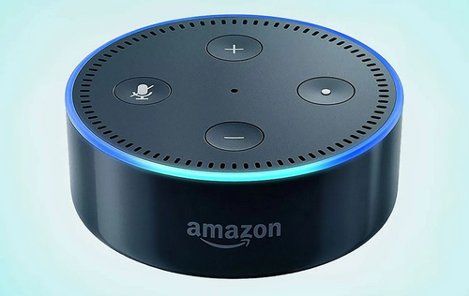
The Problem
Classifiers are somewhat rigid.
What if I want to reduce/increase the number of False Positives or False Negatives, by trading off on other parameters like accuracy?
In some cases this is very important!
  Eg. “Alexa! Don’t you listen to me unless I call you!” [False Positives are dangerous]
  Spam: I really don’t want my College Acceptance Letter to end up in spam.
  More SMS spam/ Less SMS spam. No one close to you uses SMS so might as well block all.

Slide 4
Methods
Algorithm FGC-Classify: A meta algorithm that runs a game over any existing classifier and gives you control
FGC-Classify
Input
Any Classifier

Slide 5
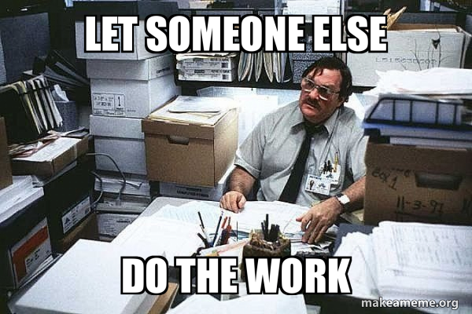
Closest existing work
Scikit Learn “class_weight” parameter.
Not classifier agnostic.
Must be handled by the classifier itself.
Very restricted context.

Slide 6
Inspiration
Communication and Content. P. Parikh. 2019
p.214 The Author remarks in passing. However does not get into the how.
… Clearly, the Nash solution involves comparing expected values of payoffs rather than pure probabilities. By adjusting the payoffs we can get different, more fine-grained results. For example, ordinarily we would want false positives (i.e. classifying some text as spam when it is not spam) to be penalized more heavily. If it is assumed that the sender in s is spamming and in s’ is not spamming sufficiently low, that is, then such a heavier penalty can be realized by making … the cost of interpreting a text that is not spam as spam high.

Slide 7
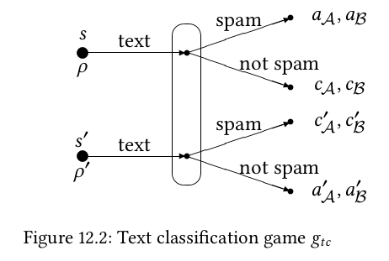
The Algorithm: Overview
FGC-Classify(Input, Utils)
  Run Classify(Input)
  Select Best_Response based on Payoffs
  Return Best_Response

Slide 8
Utilities as Hyper-parameters

Slide 9
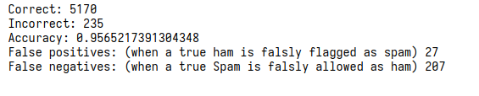
Evaluation
Naive Bayes Classifier. Follows the tutorial by KDnuggets https://www.kdnuggets.com/2020/07/spam-filter-python-naive-bayes-scratch.html
SMS Spam
Dataset: SMS Spam Collection v.1 dataset. The corpus has been collected by Tiago Agostinho de Almeida (http://www.dt.fee.unicamp.br/~tiago) and José María Gómez Hidalgo (http://www.esp.uem.es/jmgomez), and can be found here: (https://archive.ics.uci.edu/ml/datasets/sms+spam+collection#)

Slide 10
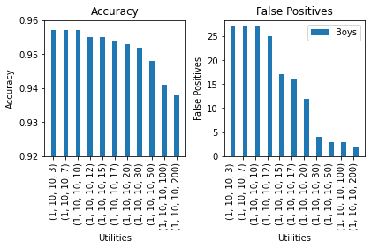
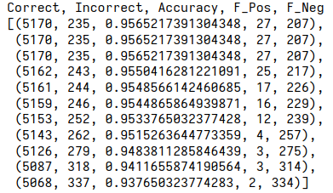
Reducing False Positives
F_Pos reduces
Accuracy drops slightly
F_Neg increases

Slide 11
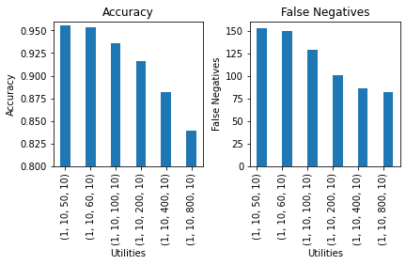
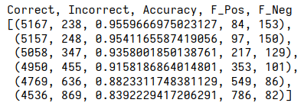
Reducing False Negatives
F_Neg reduces
Accuracy drops significantly
F_Pos shoots up dramatically

Slide 12
Discussion of Results
Utilities are Hyper-parameters
Good part is that Hyper-parameter tuning is very easy.
Utilities are linear. And robust to
Affine Transformations of the form aX + B
Utility Theory: Very well understood
https://en.wikipedia.org/wiki/Von_Neumann%E2%80%93Morgenstern_utility_theorem
Reducing incidence of any one kind of classification
is as easy as increasing the weight of other.

Slide 13
Conclusion & Future Work
Wraps around any existing classifier. [Black Box]
Selects output using Best_Response based on Utilities.
Future Work: Word Sense Disambiguation is a classification task as well.
Extends easily to Multinomial Classification

