Slide 1
Language and Equilibrium
An Introduction to Prashant Parikh’s Theory of Equilibrium Semantics
Akshay Channesh
achann4 at uic dot edu

Slide 2
Development through the years.
The Use of Language (2001)
Language and Equilibrium (2010)
Communication and Content (2019)
Main Reference: langsci-press.org/catalog/book/248
Parikh, Prashant. 2019. Communication and content.
(Topics at the Grammar-Discourse Interface 4).
Berlin: Language Science Press. DOI: 10.5281/zenodo.3243924
CC BY 4.0

Slide 3
This talk: Equilibrium Semantics
Meaning as constituted by Communication
Quick Introduction to Game Theory
Overview of Situation Theory
Formulating Communication Games
Strengths and Weaknesses

Slide 4
1. Meaning as constituted by Communication

Slide 5
Communication is central to meaning
What goes wrong when directly associating words to real objects in the world?
Gottlob Frege (1848–1925), sometimes called the father of modern semantics, held the belief that meaning comes from the interaction of language and truth. He gave this puzzle.
  “Hesperus is Phosphorus” [1]
  “Hesperus is Hesperus” [2]
They both refer to the planet Venus (as the Morning Star and Evening Star)
Since they refer to the same object (truth), they are equivalent.
Reconciled by differentiating sense from the reference.
An intermediary idea of “sense” which isn’t quite truth was required. This was Problematic.

Slide 6
Communication is central to meaning
Frege did not sufficiently articulate the distinction between a sentence and an utterance.
Many problems arise when characterizing Meaning with respect to truth.
Rather, Meaning emerges from the interactions of Agents in shared situations. It’s definition must rely more on the subjective experience of agents, than some universal notion of truth.
It was the later Wittgenstein, followed by Austin, and Grice and other ordinary language philosophers who realized the importance of seeing language as a situated activity but did not quite succeed in unraveling this elusive concept. [p.6]

Slide 7
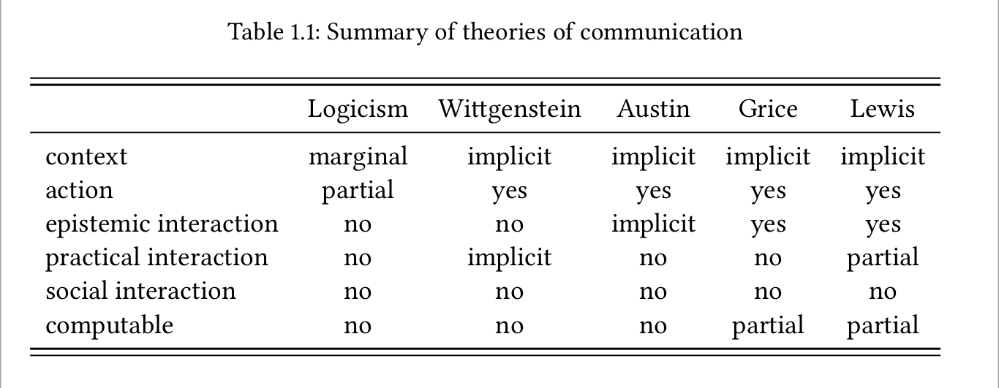
Theories of communication
Eq. Sem.
Yes
Yes
Yes
Yes
Partial
Yes

Slide 8
2. Quick Introduction to Game Theory

Slide 9
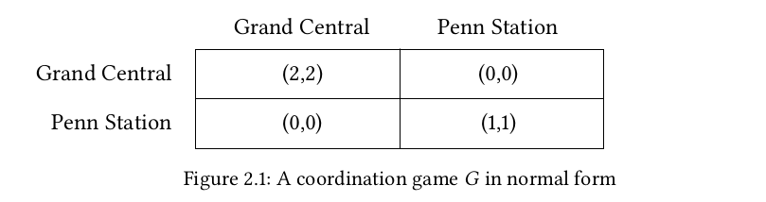
What is a game?
<I, S, U>
Agents
Actions
Payoffs (Utility)
Agents are Rational and Intelligent
Facts of the Game are Common Knowledge
Nash’s Theorem: Every finite strategic form game has an equilibrium.

Slide 10
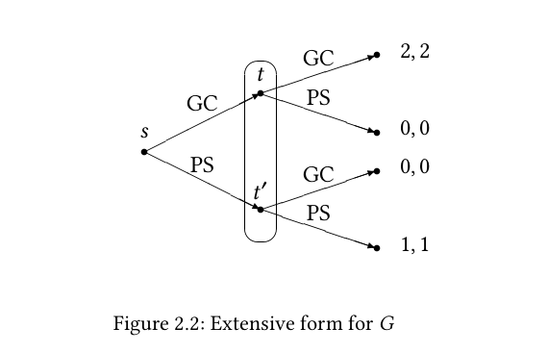
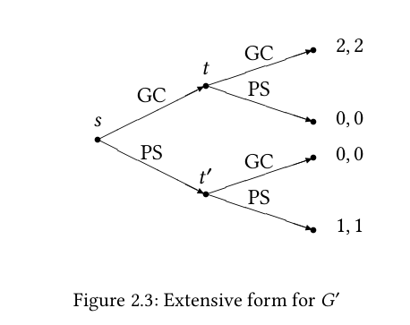
Extensive Form Game

Slide 11
3. Overview of Situation Theory

Slide 12
A Hierarchical Model
Reality: The whole of it
Ontologies (Information): Reality as viewed by agents
Environments: where Real Games happen
Situations: where Communication Games happen
Infons: smallest facts

Slide 13
Situation Theory
Jon Barwise & John Perry. 1983. Situations and attitudes. Cambridge, MA: The MIT Press.
The relation between a situation 𝑠 and an infon 𝜎 that holds in it is written 𝑠 ⊨ 𝜎 or 𝜎 ∈ 𝑠, and is described by saying 𝑠 supports 𝜎 or 𝜎 holds in 𝑠.

Slide 14
How are infons represented?
Consider an utterance of “bill smith ran” [p.16]
Basic infons are (𝑛 + 4)-tuples ⟨⟨ 𝑅; 𝑎1 ; … ; 𝑎𝑛 ; 𝑙; 𝑡; 1 ⟩⟩ made up of individuals standing in relations a certain locations 𝑙 and times 𝑡 with the last item, the number 1, being its polarity, indicating the relation holds.
Bill Smith ran can be expressed partially as ⟨⟨ ran; Bill Smith ⟩⟩ or more formally as ⟨⟨ 𝑅 ran ; 𝑏 ⟩⟩ where 𝑅 ran is a relation.
Partial infons such as ⟨⟨ 𝑅; 𝑎1 ; 𝑎3 ⟩⟩ or even ⟨⟨ 𝑎1 ⟩⟩ are legitimate infons.
A partial order ⇒ℓ on I that captures the relation “is at least as informative as” or “is at least as strong as” is assumed.
Eg. ⟨⟨ 𝑃 crimson ; 𝑎 ⟩⟩ ⇒ℓ ⟨⟨ 𝑃 red ; 𝑎 ⟩⟩,
⟨⟨ 𝑃 spinster ; 𝑎 ⟩⟩ ⇒ℓ ⟨⟨ 𝑃 female ; 𝑎 ⟩⟩

Slide 15
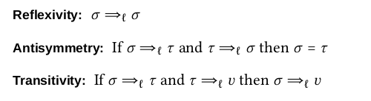
A whole set of Algebraic properties!
Let ∨ and ∧ be the induced join and meet operations. If 𝜏 = sup{𝜎, 𝜎 ′ }, then 𝜏 = 𝜎 ∨𝜎 ′ , and if 𝜏 = inf{𝜎 , 𝜎 ′ }, then 𝜏 = 𝜎 ∧𝜎 ′ .
A lattice is complete if all of its subsets, finite or infinite, have both a join and a meet. There is no reason to restrict ∨ and ∧ to finite subsets so we assume (I, ⇒ℓ ) is complete.
Metric: A valuation on I is a real-valued function 𝑣 ∶ I → ℝ such that 𝑣(𝜎 ) + 𝑣(𝜏 ) = 𝑣(𝜎 ∨𝜏 )+𝑣(𝜎 ∧𝜏 ). A positive valuation is one where 𝜎 ⇒ℓ 𝜏 implies 𝑣(𝜎) < 𝑣(𝜏 ).
A metric lattice is a lattice with a positive valuation and the corresponding metric is given by:
𝛿(𝜎, 𝜏 ) = 𝑣(𝜎 ∨ 𝜏 ) − 𝑣(𝜎 ∧ 𝜏 )

Slide 16
Language and Syntax
Three algebraic systems:
  (I, ⊙𝑢 ), (L, ○𝐺 ), (T , ⋆𝐺,𝑢 )
Semantics, Language,
and Syntax

Slide 17
4. Formulating Communication Games

Slide 18
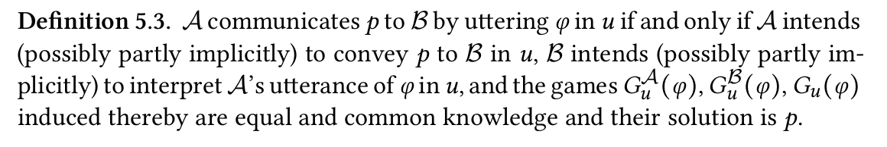
p.69

Slide 19
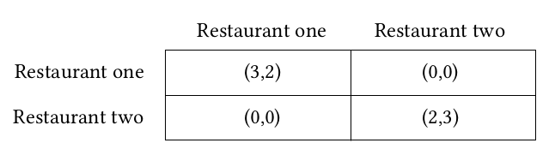
An Utterance Situation in a Communication Game
Setting Game
    A’s wish to elicit some response from B
  Content Selection Game
    A’s equilibrium content
  Generation Game
    A’s equilibrium utterance
  Interpretation Game
    B’s equilibrium content
  Content Selection Game
    B’s equilibrium response
Back to the Setting Game

Slide 20
5. Strengths and Weaknesses

Slide 21
Strengths and Weaknesses
Generalizable.
Avoids the pesky notion of truth.
Meaning as a natural phenomenon.
Claims to capture Illocutionary meaning.
Infons serve as a concrete representations for implementation.
Hard coding of semantic relationships is unnecessary.
Unsystematic as opposed to bottom up theories. [Feature not a bug. This for Wittgenstein was a merit and he stressed the diversity of linguistic acts.]
Computationally expensive. [Break down the model into many small games as opposed to few large games.]
Very little implementations. No yardstick to measure against.

