Slide 1
Project 3 - Day 4
Akshay Dube

Slide 2
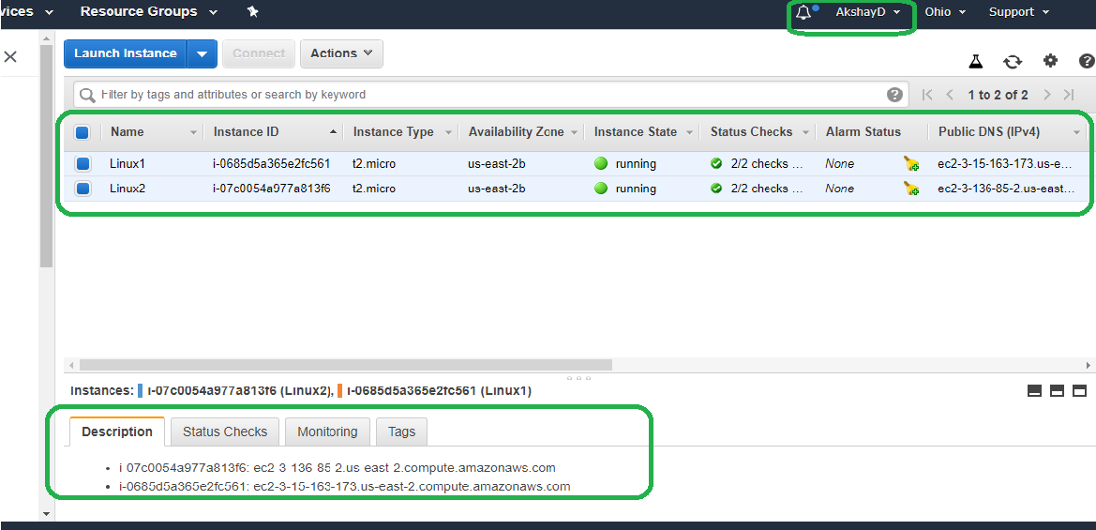
Launching Two Linux VM’s/Instances -

Slide 3
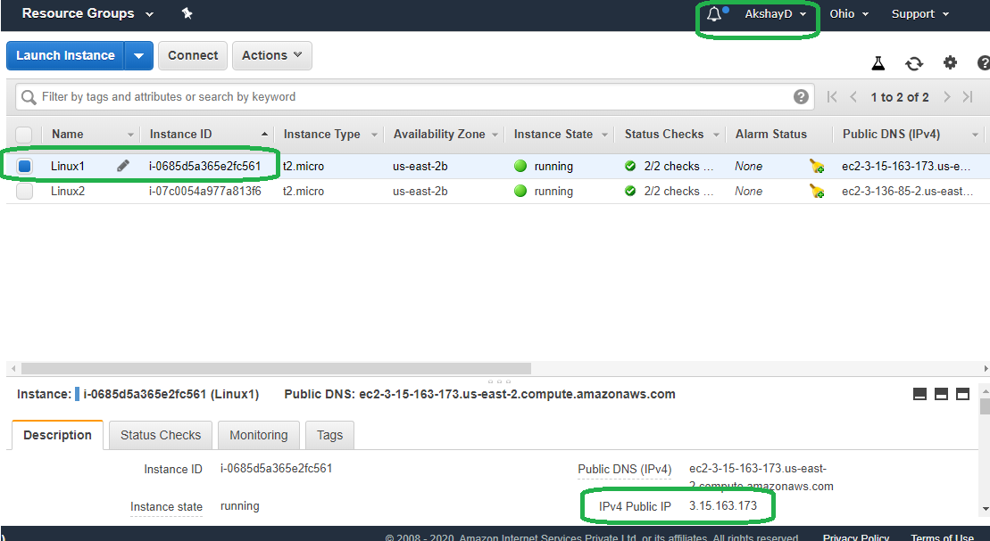
First Linux Instance(Linux1) -

Slide 4
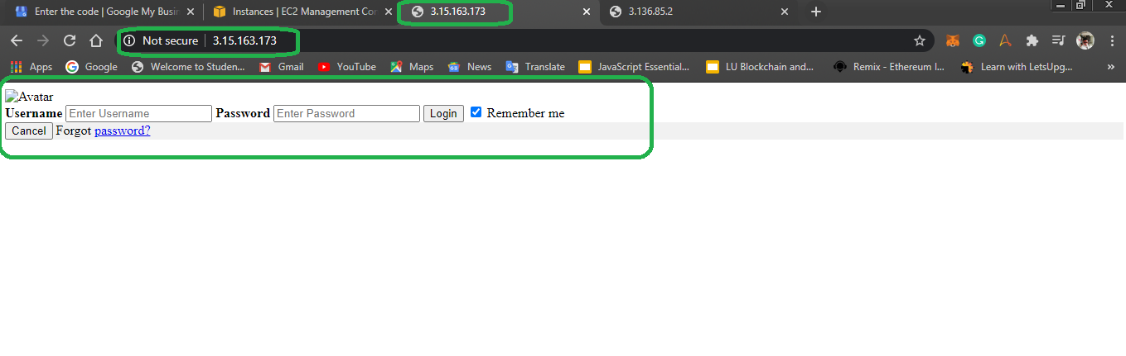
Linux1 - Output Page Post Installation.

Slide 5
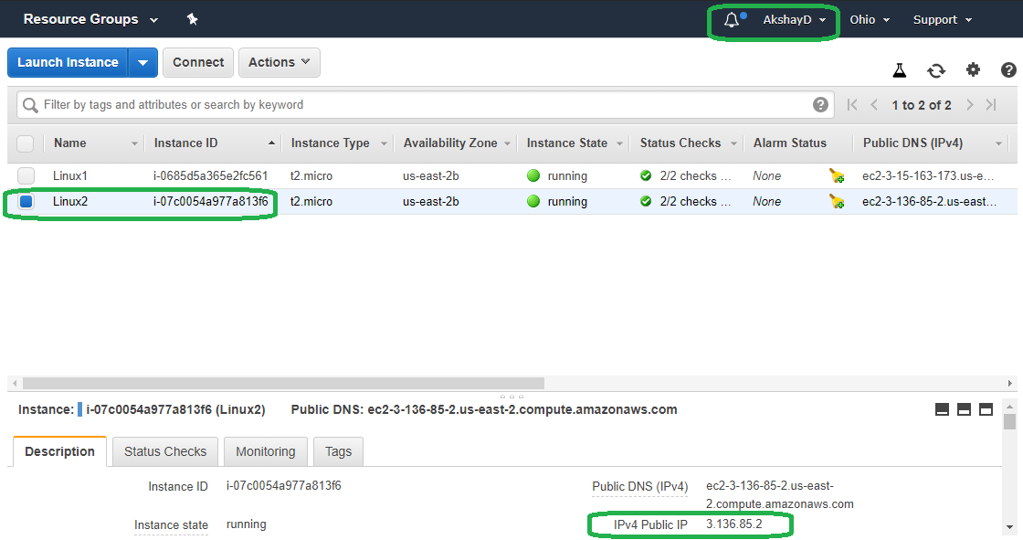
Second Linux Instance(Linux2) -

Slide 6
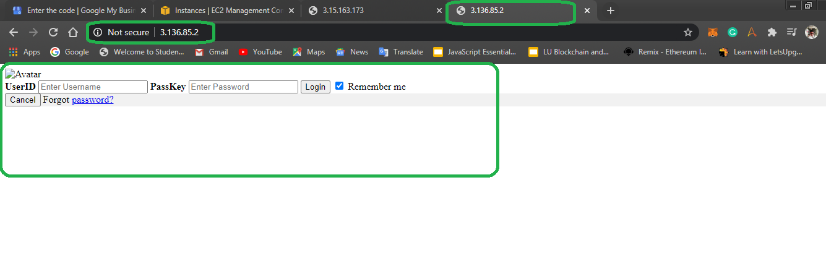
Linux2 - Output Page Post Installation.

Slide 7
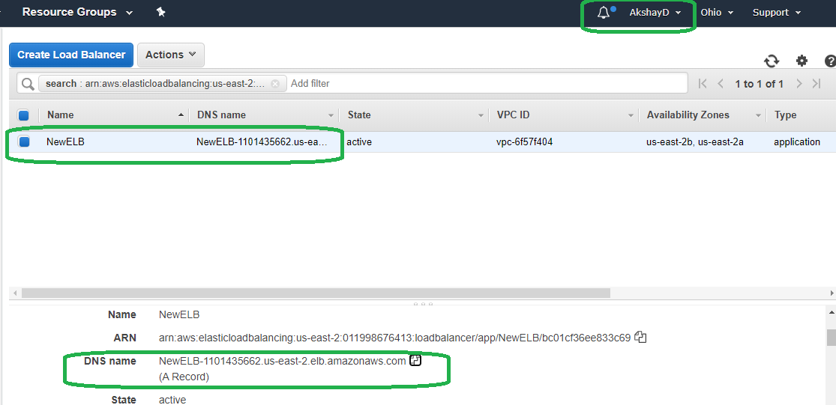
Load Balancer Creation -

Slide 8
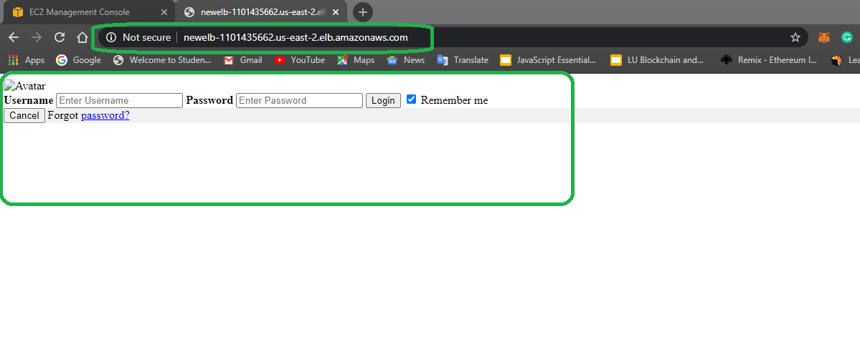
Launching Linux1 & Linux2 using One DNS Server -

Slide 9
