Slide 1
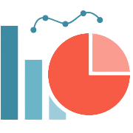

Real-time Ecommerce Analytics dashboard
Submitted By
Harshal Amrutkar (230343025005)
Vedant Bhosale (230343025010)
Akshay Funde (230343025012)
Vijay Munde (230343025034)
Guided by:-
Mr. Anay Tamhankar
Mr. Prasad Deshmukh
28/08/2023

Slide 2
Introduction
The digital realm has witnessed an explosive rise in e-commerce, driven by changing shopping patterns and technological accessibility.
Businesses face increasing pressure to stay competitive and adaptable in a rapidly evolving market.
Traditional retrospective analysis falls short in the fast-paced e-commerce arena, highlighting the need for real-time insights.
Enter the “Real-Time Ecommerce Analysis Dashboard," a tool that provides real-time monitoring, analysis, and visualization of crucial e-commerce metrics, empowering businesses with timely decision-making capabilities.

Slide 3
Objective
Enable real-time data streaming and analytics for e-commerce platforms
Use Apache Kafka for real-time data streaming
Use MongoDB for data storage
Provide a real-time analytics dashboard for data visualization

Slide 4





Project architecture
Data Collection
Transformation
Ingestion
Visualization
Data Sink

Slide 5

Data schema

Slide 6
Pyspark
Developed by Apache Spark Community for integrating Python with Spark
API provided by Apache Spark for Python.
Big data computational engine
Performs real-time
Used for large-scale data
Data processing with high computational power

Slide 7
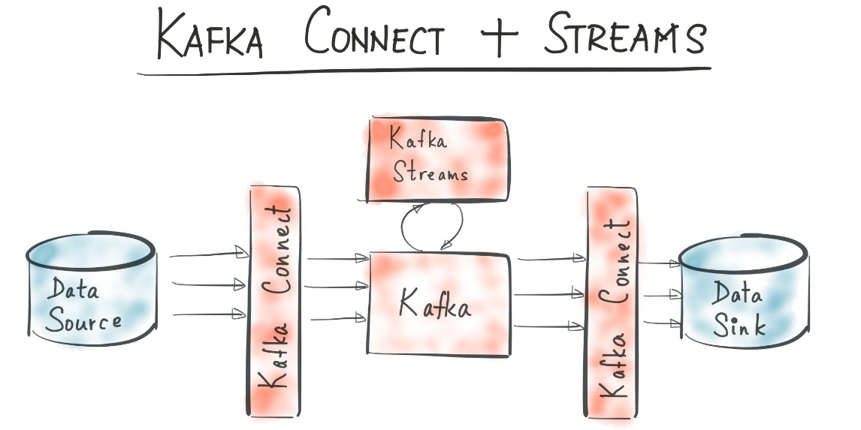
kafka
Kafka is an open-source distributed streaming platform.
It is used to collect, store, and process large amounts of data in real time.
Kafka can be used to build a variety of streaming applications, such as real-time analytics, fraud detection, and event streaming

Slide 8
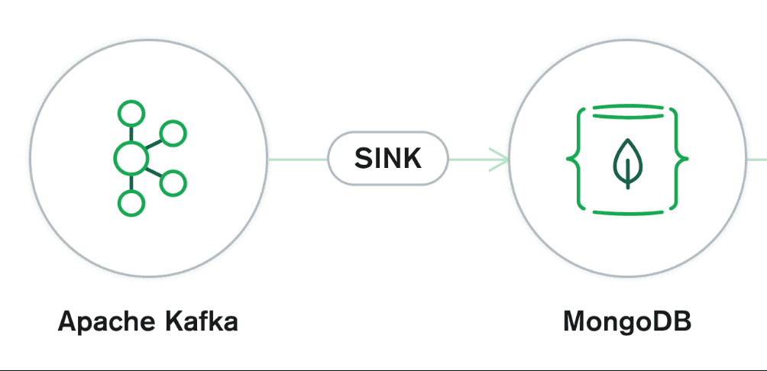
MongodB
MongoDB is a document-oriented NoSQL database.
It is open-source and free to use.
MongoDB can scale both vertically or horizontally to accommodate large data loads

Slide 9
Tableau
Used for data visualization purpose or analysis purposes.
Platform for showcasing the analytical data in a way that is easy to understand and interpret visualization so users can make informed decisions.
We have used Tableau to provide insights into key metrics such as sales, traffic, and customer behavior.
In our project, we created an Analytical Dashboard that helps users make informed decisions about the online store’s operations, product offerings, and marketing.

Slide 10
GitHub link And References
Repository link: https://github.com/AkshayFunde98/Real-time-E-commerce-Analytics-Dashboard-
Tableau Project Link : https://prod-apnortheasta.online.tableau.com/#/site/realtime
ecommercedashboard/workbooks/1126236?:origin=card_share_link
References:
https://www.kaggle.com/datasets/olistbr/brazilian-ecommerce
Exploratory Data Analysis and Visualization of Olist (Brazilian E-commerce) Public Dataset | by Rona Fauzan Noer | Medium
Exploratory Data Analysis (EDA) on Brazilian E-Commerce Olist | by Yash Bhairao | Jovian

Slide 11
Conclusion
In conclusion, our project has successfully demonstrated the potential of real-time analytics in the e-commerce sector. By leveraging Apache Kafka's streaming capabilities, we've enabled stakeholders to access and interpret up-to-the-minute insights, translating data into informed decisions.
Tableau visualization yielded an interactive and intuitive representation of e-commerce metrics. This visual interface empowers users to explore trends and draw actionable insights with ease.
Our Real-Time Analytics Dashboard project stands as a testament to the transformative potential of real-time data processing and visualization. By embracing this approach, businesses can navigate the dynamic e-commerce landscape with agility, extract actionable insights, and proactively steer their strategies towards growth and success.

Slide 12
Future Scope
Kafka's performance may limit scalability and real-time processing: Kafka is a great tool for streaming data, but it can be slow for complex processing. This could limit the scalability and real-time processing capabilities of your project.
Spark integration can improve performance: Apache Spark is a powerful processing engine that can be used to improve the performance of Kafka. Spark can handle complex processing in real time, which can help to improve the scalability and performance of your project.
Spark integration can unlock scalability, speed, and complexity handling: By integrating Spark with Kafka, you can unlock a higher level of scalability, speed, and complexity handling in your project. This can help you to make better decisions faster and to improve the overall performance of your system.
Real-Time Alerts and Notifications: Enhance the dashboard by incorporating real-time alert mechanisms that trigger notifications for critical events, anomalies, or significant changes in key performance indicators. This feature would enable stakeholders to respond promptly to emerging situations.

Slide 13
Thank You!

