Slide 1
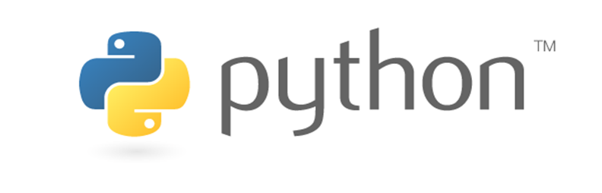
Python Introduction
ISSAC KAIST Workshop

Slide 2
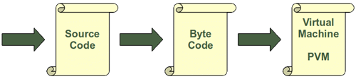
Introduction
Python is a high-level (easy to learn), interpreted, interactive and object-oriented scripting language.
It can be done with the module py_compile
python -m py_compile my_first_simple_script.py

Slide 3
Basics
Example running python on your Computer
Jupyter Notebook
Print Function
print ("Hello, Python!")
the received data is always treated as string.
Script Mode Programming
Multiline Statements
total = 2 + \ 4 + \ 6

Slide 4
Basics Cont.
Quotation in Python
('), double (") and triple (''' or """)
Comments
#
Multiple statement in Python
import sys; x = 'foo'; sys.stdout.write(x + '\n')
Suits in python
If expression: ← Header
suite ← code block

Slide 5
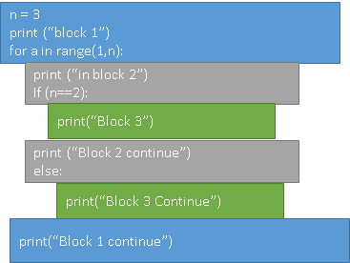
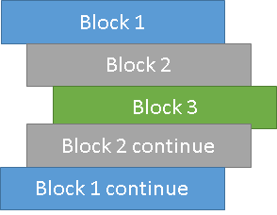
Python Sentence Structure
Python programs get structured through indentation, i.e. code blocks are defined by their indentation and colon.

Slide 6
import sys try: # open file stream file = open(file_name, "w") except IOError: print ("There was an error writing to", file_name) sys.exit() print ("Enter '", file_finish,) print "' When finished" while file_text != file_finish: file_text = raw_input("Enter text: ") if file_text == file_finish: # close the file file.close break file.write(file_text) file.write("\n") file.close()

Slide 7
Variable Types
Variable are nothing but reserve memory allocation
Explicit variable declaration
counter = 100 # An integer assignment miles = 1000.0 # A floating point name = "John" # A string
Notes:
It means that when you create a variable, you reserve some space in the memory.
Interpreter allocate memory based on data type of a variable

Slide 8
Variable Types Cont.
Multiple assignment are possible
a = b = c = 1
a, b, c = 1, 2, "john"

Slide 9
Variable Types Cont.
Standard data types
Numbers
String
List
Tuple
Dictionary
Sets

Slide 10
Variable Types -- Numbers
Three Number Types
Integer (signed numbers) e.g 10 or -10
Flat (floating point real numbers) e.g 15.20 or -15.20
Complex ( complex numbers) e.g x+yj==3.14j
a=10
a=-10 etc
Notes:
All integers in Python3 are represented as long integers. Hence, there is no separate number type as long.

Slide 11
Variable Types -- Strings
Contiguous characters in quotation marks (single or double)
str = 'Hello World!' print (str) # Prints complete string print (str[0]) # Prints first character of the string print (str[2:5]) # Prints characters starting from 3rd to 5th print (str[2:]) # Prints string starting from 3rd character print (str * 2) # Prints string two times print (str + "TEST") # Prints concatenated string

Slide 12
Variable Types -- Lists
Compound data types
list = [ 'abcd', 786 , 2.23, 'john', 70.2 ] tinylist = [123, 'john'] print (list) # Prints complete list print (list[0]) # Prints first element of the list print (list[1:3]) # Prints elements starting from 2nd till 3rd print (list[2:]) # Prints elements starting from 3rd element print (tinylist * 2) # Prints list two times print (list + tinylist) # Prints concatenated lists

Slide 13
Variable Types -- Tuples
Compound data types
tuple = ( 'abcd', 786 , 2.23, 'john', 70.2 ) tinytuple = (123, 'john') print (tuple) # Prints complete tuple print (tuple[0]) # Prints first element of the tuple print (tuple[1:3]) # Prints elements starting from 2nd till 3rd print (tuple[2:]) # Prints elements starting from 3rd element print (tinytuple * 2) # Prints tuple two times print (tuple + tinytuple) # Prints concatenated tuple
Notes:
The main difference between lists and tuples are − Lists are enclosed in brackets ( [ ] ) and their elements and size can be changed, while tuples are enclosed in parentheses ( ( ) ) and cannot be updated. Tuples can be thought of as read-only lists

Slide 14
Variable Types -- Dictionary
Key Value pair, are kind of hash table type
dict = {} dict['one'] = "This is one" dict[2] = "This is two" tinydict = {'name': 'john','code':6734, 'dept': 'sales'} print (dict['one']) # Prints value for 'one' key print (dict[2]) # Prints value for 2 key print (tinydict) # Prints complete dictionary print (tinydict.keys()) # Prints all the keys print (tinydict.values()) # Prints all the values
Notes:
Python's dictionaries are kind of hash-table type. They work like associative arrays or hashes found in Perl and consist of key-value pairs. A dictionary key can be almost any Python type, but are usually numbers or strings. Values, on the other hand, can be any arbitrary Python object.

Slide 15
Variable Types -- Data Type Conversion
Convert between types, simply type-names as a function.
e.g int(x)
x = '100' y = '-90'
print (x + y)
e.g str(x)

Slide 16
Operators
Python language supports the following types of operators
Arithmetic Operators (+, -, *, /, %,**)
Comparison (Relational) Operators (==, !=, >, <, >=, <=)
Assignment Operators (=, +=, -= and so on)
Logical Operators ( and, or , not)
Membership Operators (in, not in )
Identity Operators (is, is not)

Slide 17
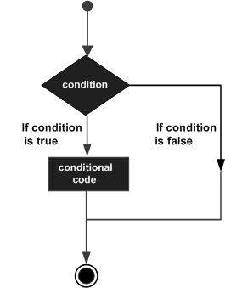
Control Flow

Slide 18
I f elif and else
amount = int(input("Enter amount: ")) if amount<1000: discount = amount*0.05 print ("Discount",discount) elif amount<5000: discount = amount*0.10 print ("Discount",discount) else: discount = amount*0.15 print ("Discount",discount) print ("Net payable:",amount-discount)

Slide 19
Loops
For loop
While loop

Slide 20
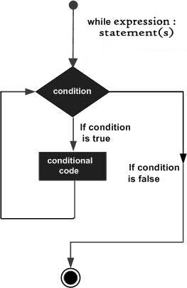
While Loop

Slide 21
While Loop
ount = 0 while (count < 9): print ('The count is:', count) count = count + 1 print ("Good bye!")
Notes:
A while loop statement in Python programming language repeatedly executes a target statement as long as a given condition is true.

Slide 22
Infinite While Loop
var = 1 while var == 1 : # This constructs an infinite loop num = int(input("Enter a number :")) print ("You entered: ", num) print ("Good bye!")
)
Notes:
A while loop statement in Python programming language repeatedly executes a target statement as long as a given condition is true.

Slide 23
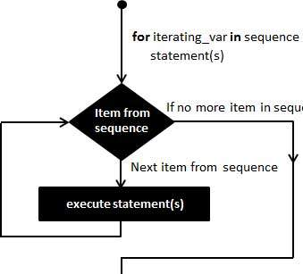
for Loop
Notes:
The for statement in Python has the ability to iterate over the items of any sequence, such as a list or a string.

Slide 24
for Loop
for letter in 'Python': # traversal of a string sequence print ('Current Letter :', letter) print() fruits = ['banana', 'apple', 'mango'] for fruit in fruits: # traversal of List sequence print ('Current fruit :', fruit) print ("Good bye!")
for var in list(range(5)): print (var)
Notes:
The for statement in Python has the ability to iterate over the items of any sequence, such as a list or a string.

Slide 25
Useful statements with Loops
Break
Terminates the loop statement and transfers execution to the statement immediately following the loop.
Continue
Causes the loop to skip the remainder of its body and immediately retest its condition prior to reiterating.
Pass
The pass statement in Python is used when a statement is required syntactically but you do not want any command or code to execute

Slide 26
Help in Python
help(module_name)
Example import sys; help(sys)
Dir (module)
Example dir(sys)

Slide 27
Jupyter Notebook (Anaconda)
Install Anaconda (one click installation but carefully select your dir)
Version | Conda --version
Update | Conda update conda
New env | Conda create --name got python=3
Remove env | Cond remove --name got --all
Activate env | Conda activate got
Jupyter install | Conda install jupyter notebook
Jupyter run | Jupyter notebook

Slide 28
Jupyter Notebook (www.issackaist.org/jupyterexamples.html)
Two modes
Edit mode
Command mode
Help
Command Line
!dir
Package installation
Conda install --name got matplotlib

