Slide 1
Stock Market Prediction
Akshay Gavandi Ajinkya Kunjir Kruti Lakhani Neelam Babel
001825055 001869353 001883036 001837464
http://www.free-powerpoint-templates-design.com

Slide 2
Agenda
Introduction
Machine Learning in stock prediction
Objective
Step by step process
Data Acquisition and Dataset
Linear Regression
K-Nearest Neighbor
Support Vector Machine (SVM)
ARIMA
When to buy, sell or hold ?
Trading Simulation Model
Conclusion
References

Slide 3
Introduction
Stock price prediction is the process of predicting the future prices of a stock or any other financial instrument traded on an exchange
Stock price prediction has been a strong topic of discussion with many trying to predict prices to yield profits
Data mining techniques have been successfully shown to generate high forecasting accuracy of stock price Movement

Slide 4
Machine learning in Stock Prediction
The field of machine learning is vast and plays a key role in a wide range of critical applications
Predicting the stock market involves predicting the closing prices of a company’s stock for any given number of days ahead
The advent of Machine Learning and eventually Deep Learning proved out to be a massive push in this field resulting in companies hiring Data Scientists for Time Series Forecast and Analysis
Machine learning has the potential to ease the whole process by analyzing large chunks of data, spotting significant patterns and generating a single output that navigates traders towards a decision based on predicted asset prices

Slide 5
Objective
To analyze and understand advantages and disadvantages of various algorithms applicable on the dataset
To answer the questions like:
Can I predict the price of a stock and if yes, to what extent?
When to buy, hold or sell a stock?
SELL
BUY
SELL
BUY

Slide 6
Step by step process
Results
Time Series Analysis
Stock Predictions
Exploratory Data Analysis
Data Acquisition and Preprocessing
Step 1
Step 2
Step 3
Step 4
Step 5

Slide 7
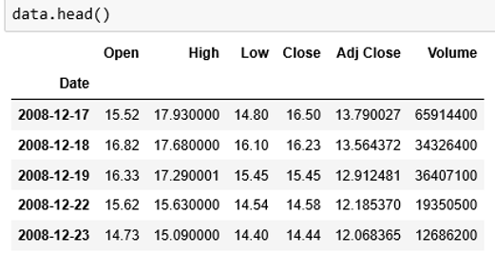
Data Acquisition and Dataset
The Historical data of the stock market is extracted for the years 2008 -2019 using web scrapping method on Yahoo finance website
Following are the columns in the scrapped data:
Open: Starting price of the stock on a specific day
Close: Final price of the stock on a specific day
High: Maximum price of the share on a specific day
Low: Minimum price of share on a specific day
Adj Close: Last closing price of share on a specific day
Volume: Number of shares bought or sold in a day

Slide 8
Linear Regression
A Linear Regression Line is a straight line that best fits the prices between a starting price point and an ending price point. A "best fit" means that a line is constructed where there is the least amount of space between the price points and the actual Linear Regression Line
The linear regression model returns an equation that determines the relationship between the independent variables and the dependent variable
The equation for linear regression can be written as: Y = 𝛽0 + 𝛽1 X
where Y is the predicted value of dependent variable
𝛽 is the y-intercept
𝛽1 is the slope
X is the value of the independent variable
For our dataset, we are considering “X” as Date and “Y” to be Closing Price

Slide 9
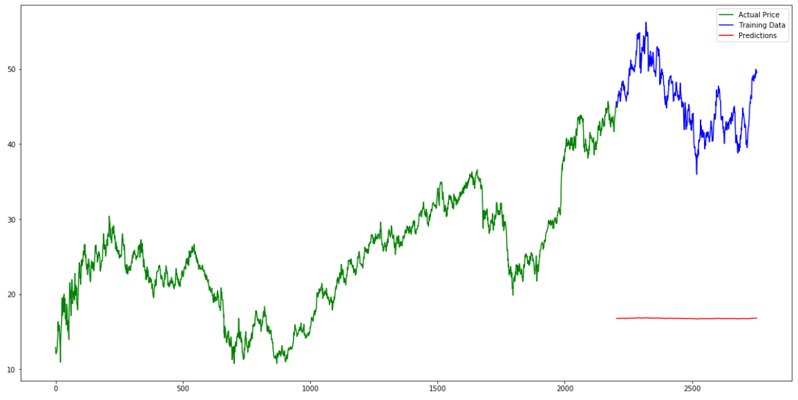
Predicted VS Actual Price Plot

Slide 10
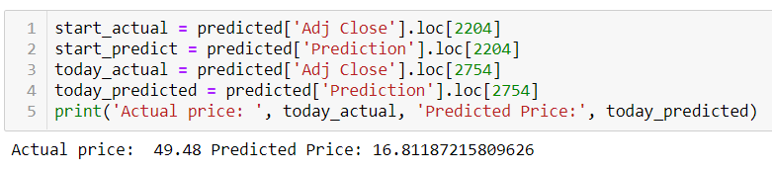
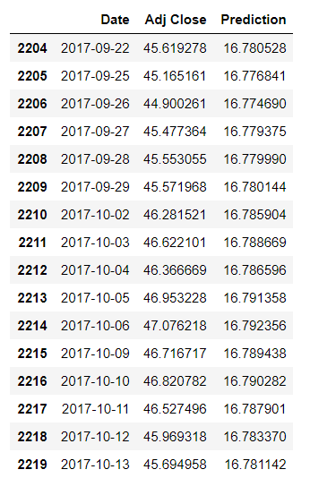
Results
The results clearly states that Linear Regression does not work efficiently for our purpose

Slide 11
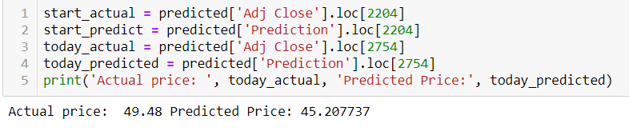
K-Nearest Neighbor
There’s a reason k-nearest neighbors is more useful for classification problems and small-scale regression.
This appears to be a classic case of overfitting. Because KNN is just calculating distances from each point to another, it was completely unable to figure out the trend of where the prices are going

Slide 12
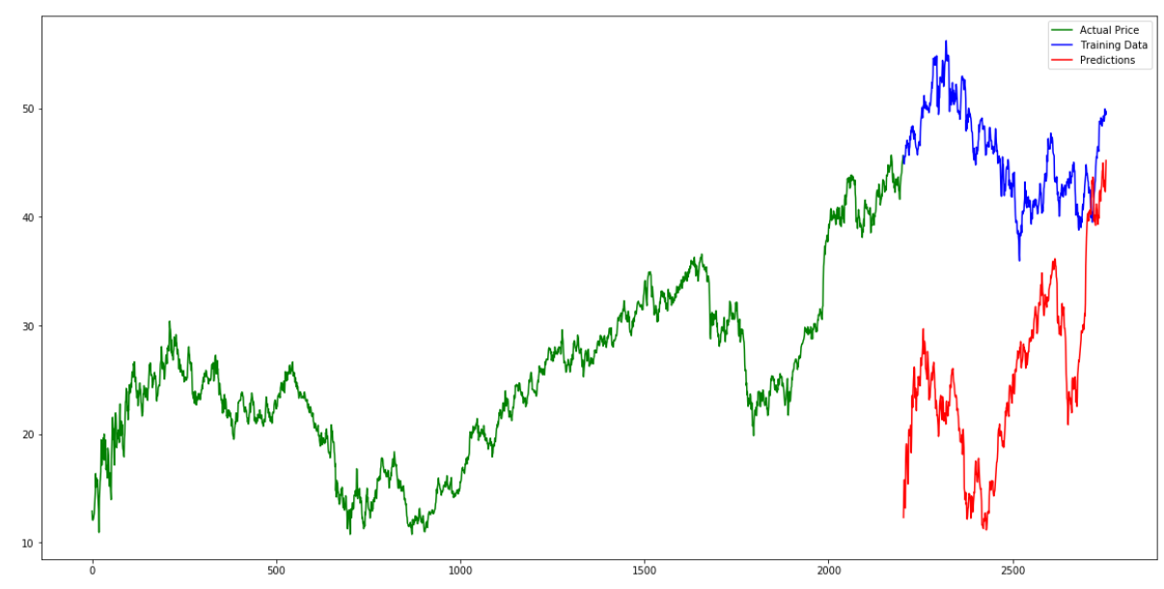
K-Nearest Neighbor
The results states that even K-Nearest Neighbor does not work efficiently for our purpose as it gives close prediction value only for some points

Slide 13
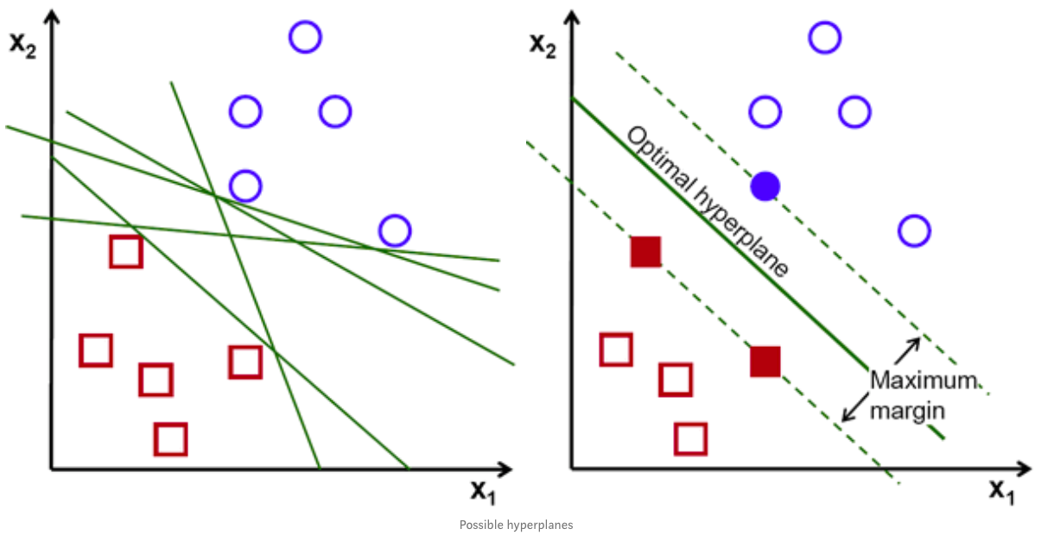
Support Vector Machine (SVM)
Support Vector Machine is used to find a Hyperplane in an N Dimensional Space (where N is the number of features) that distinctly classifies the data points.
Support vectors are data points that are closer to the hyperplane and influence the position and orientation of the hyperplane. Using these support vectors, we maximize the margin of the classifier.
Deleting the support vectors will change the position of the hyperplane. These are the points that help us build our SVM.

Slide 14
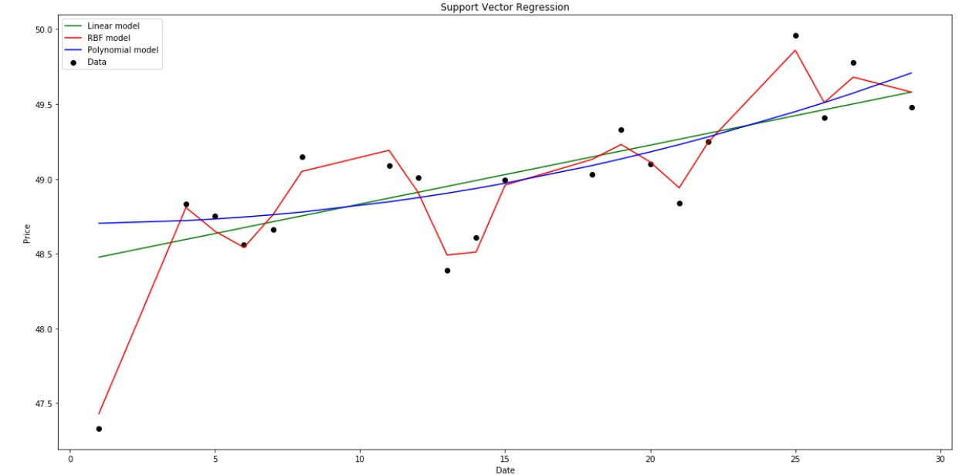
Support Vector Machine (SVM)

Slide 15
ARIMA
Arima (Auto Regressive Integrated Moving Average) models are widely used in time series forecasting which provides complementary approaches to the problem
They are of 2 types:
Seasonal model
Non-seasonal model
We have used Non-seasonal ARIMA model which consists of 3 variables namely:
P = Periods to lag for
D = Number of differencing transformations
Q = Variable denoting lag of error component

Slide 16
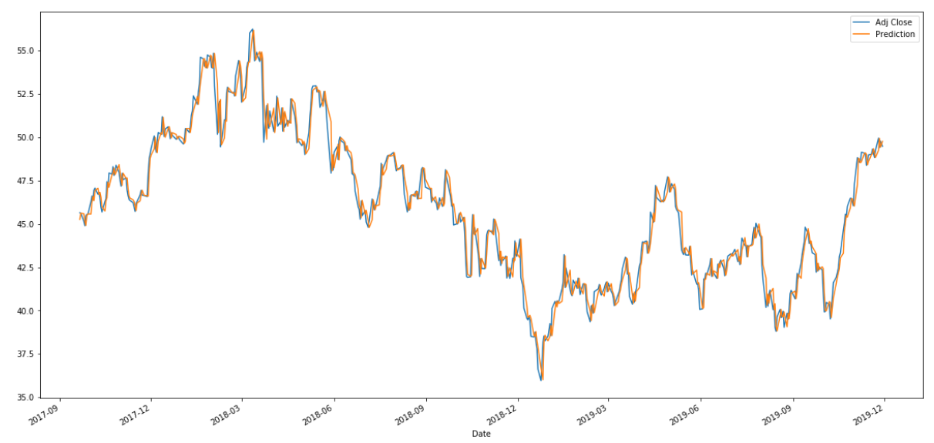
Adjacent Close Price VS Predicted Price

Slide 17
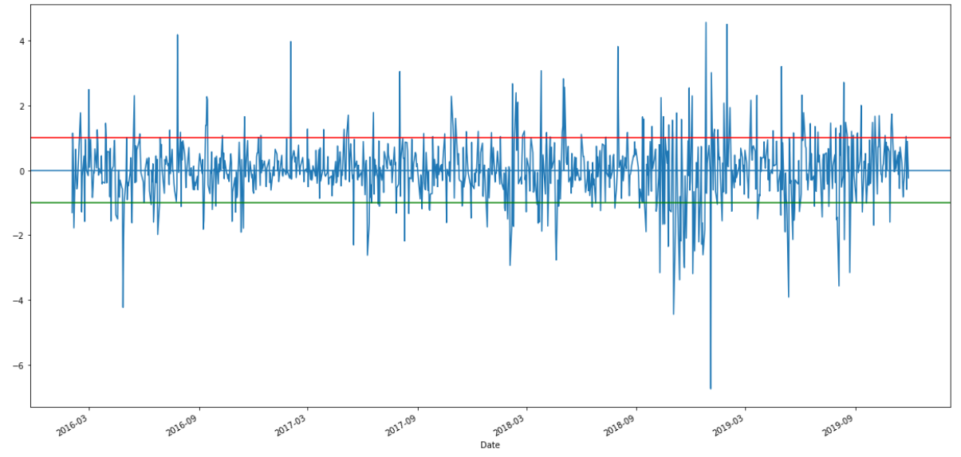
Z score graph

Slide 18
When to buy, sell or hold ?
The stock hits your buy value
When it is undervalued
When a stock goes on sale
The stock hits the target price
You achieve a specific goal
You need money for an emergency
$100.50
HOLD
BUY
SELL
$203.00

Slide 19
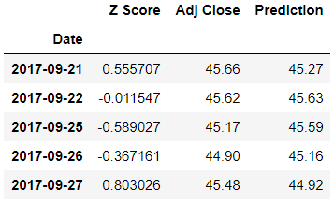
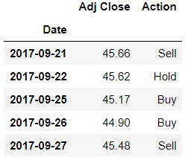
Buy when stock is underpriced testZScores['Z Score'] <=-1.00
Sell when stock is overpriced testZScores['Z Score'] >= 1.00
Hold otherwise (testZScores['Z Score'] < 1.00) & (testZScores['Z Score'] > -1.00)
BUY
SELL
SELL
BUY

Slide 20
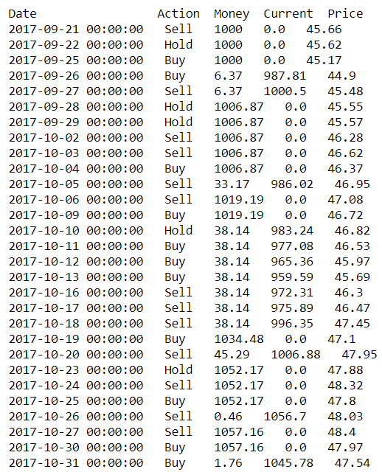
Trading Simulation Model
A trading simulation model which helps the user to make a decision based on prediction.
The model tells us about mainly 4 things:
Action: whether to buy, sell or hold stock
Money: Initial amount $1000 which changes over the time
Current: Current amount of money after every action
Price: Price of stock
BUY
SELL

Slide 21
Conclusion
Linear Regression and K-Nearest Neighbor failed to give accurate results
ARIMA being time series forecasting model gave much more accurate results than regression algorithms
Trading Simulation model gave an overview of when to buy, sell and hold share

Slide 22
References
https://towardsdatascience.com/time-series-forecasting-arima-models-7f221e9eee06
https://www.thebalance.com/know-when-to-buy-or-sell-any-stock-4023014
https://www.kaggle.com/ravishankars/nyse-stock-data-arima-model
https://www.analyticsvidhya.com/blog/2018/10/predicting-stock-price-machine-learningnd-deep-learning-techniques-python/
https://datascienceplus.com/knn-classifier-to-predict-price-of-stock/
https://medium.com/datadriveninvestor/machine-learning-for-stock-market-investing-f90ad3478b64
https://medium.com/auquan/pairs-trading-data-science-7dbedafcfe5a

Slide 23
Thank You

