Slide 1

Introduction to Software Reverse Engineering with Ghidra Session 1
Hackaday U
Matthew Alt

Slide 2
#whoami
Reverse engineer focused on embedded systems
Security researcher for Caesar Creek Software
Provide training and assessments through VoidStar
voidstarsec.com
@wrongbaud
wrongbaud.github.io

Slide 3
#Outline
What is Software Reverse Engineering (SRE)?
Software Engineering Review
SRE 101
Extracting Information from Compiled Programs
Disassembly / x86 ASM Refresher
Ghidra 101:
Installation
Basic Usage and Navigation
Exercises:
Challenge 1/2
Conclusion / Questions

Slide 4

#What is SRE?
Analyzing a software system to extract information
Source code not available
Used to recreate and understand functionality
Also used to find bugs!
Often started from the lowest layer of abstraction
Machine code
We will be focusing on x86_64 ELF binaries for Linux

Slide 5
#Software Engineering Review
Developers write code in high level languages such as C/C++
This code is then compiled into machine code – sequences of bytes that the CPU can interpret
Disassembly is the process of converting these byte sequences into assembly instructions
As reverse engineers, these byte sequences will be our starting point

Slide 6
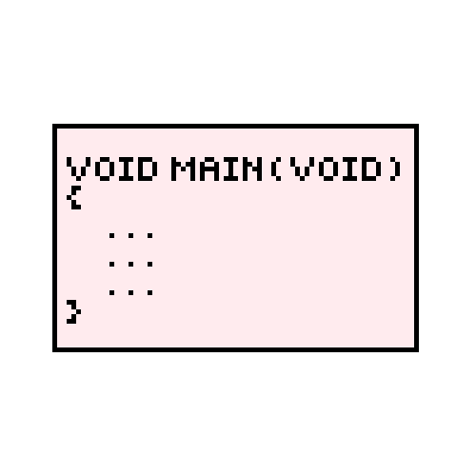

#Compilation Review
Compiling a program is a multi-stage process*
Preprocessing
Compilation
Assembly
Linking
The result is machine code that is run on the CPU
These steps are all typically performed automatically
After going through these steps, an executable is produced
* Disclaimer: These are all extremely complex fields of research, and we’re only covering a very high level view

Slide 7
#Compilers
Compiling is phase two of “compilation”
Preprocessing passes over the source code, performing:
Comment removal
Macro Expansion
Include Expansion
Conditional Compilation (IFDEF)
Compiling converts the output of preprocessor into assembly instructions

Slide 8
#Compilers – An Example
C Code
Assembly Code
#include <stdio.h>
int main(){
printf("Hello!");
return 0;
}
.LC0:
.string "Hello!"
.text
.globl main
.type main, @function
main:
.LFB0:
.cfi_startproc
pushq %rbp
.cfi_def_cfa_offset 16
.cfi_offset 6, -16
movq %rsp, %rbp
.cfi_def_cfa_register 6
movl $.LC0, %edi
movl $0, %eax
call printf
movl $0, %eax
popq %rbp
.cfi_def_cfa 7, 8
ret
.cfi_endproc

Slide 9
#Assemblers
Assemblers convert the assembly code into binary opcodes
Each instruction is represented by a binary opcode
mov rax,1 = 0x48C7C001000000
The assembler will produce an object file
Object files contain machine code
This file will contain fields to be filled by the linker

Slide 10
#Assemblers – An Example
Assembly Code
Assembled Bytecode
.LC0:
.string "Hello!"
.text
.globl main
.type main, @function
main:
.LFB0:
.cfi_startproc
pushq %rbp
.cfi_def_cfa_offset 16
.cfi_offset 6, -16
movq %rsp, %rbp
.cfi_def_cfa_register 6
movl $.LC0, %edi
movl $0, %eax
call printf
movl $0, %eax
popq %rbp
.cfi_def_cfa 7, 8
ret
.cfi_endproc
55 48 89 e5 bf 00 00 00 00 b8 00 00 00 00 e8 00
00 00 00 b8 00 00 00 00 5d c3 48 65 6c 6c 6f 21

Slide 11
#Linking
More is needed before the object code can be executed
Entry point, or starting instruction must be defined
Used to define memory regions on embedded platforms
Often done through linker scripts
The result of linking is the final executable program

Slide 12
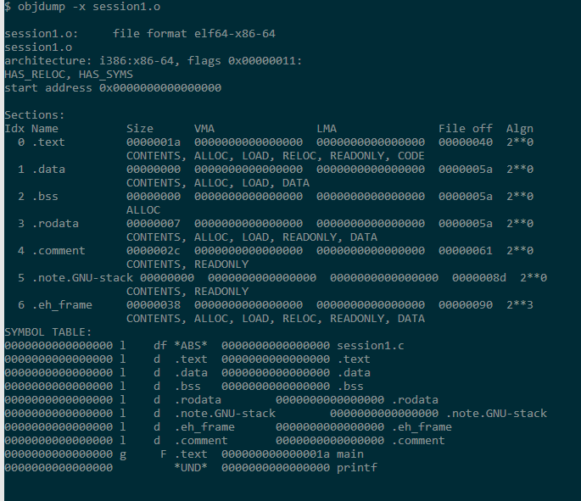
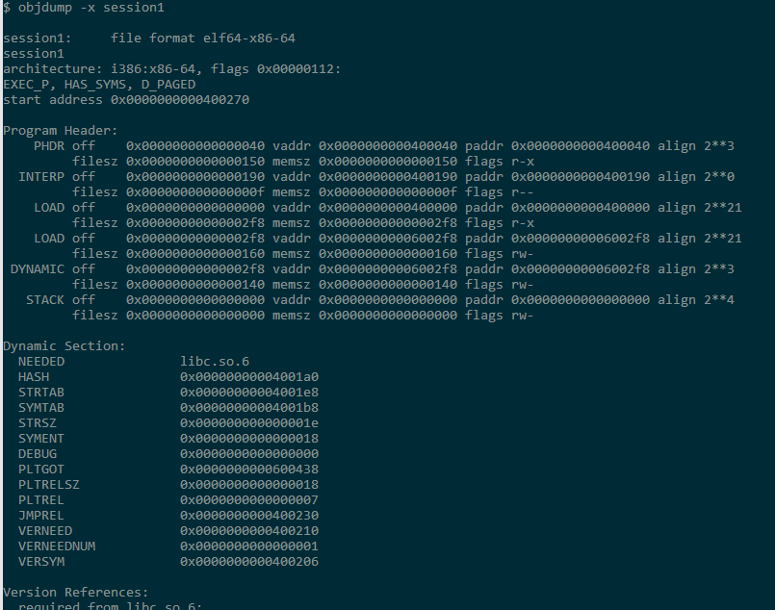
#Linking – An Example
gcc –o session1 session1.o

Slide 13
#Output Formats
The output of the compilation process can take many forms:
PE (Windows)
ELF (Linux)
Mach-O (OSX)
COFF/ECOFF
This output file is often your starting point as a reverse engineer
For this course we will focus on the ELF format

Slide 14
#ELF Files – An Overview
ELF = Executable Linking Format
Contains information identifying:
OS,endianness,etc
ELF files provide information needed for execution by the OS
ELF Files can be broken up into three components
ELF Header
Sections
Segments

Slide 15
#ELF Files: Symbols
Symbols are used to aid in debugging and provide context to the loader
The removal of these symbols makes things more difficult to reverse engineer
ELF objects contain a maximum of two symbol tables
.symtab: Symbols used for debugging / labelling (useful for RE!)
.dynsym: Contains symbols needed for dynamic linking

Slide 16
#ELF Files: A Review
ELF files define how the program is laid out in memory
Used by the OS loader to create a process
ELF files contain machine code that we will be reverse engineering
Many tools exist to analyze and read ELF files:
dumpelf
readelf
objdump
elfutils (package containing multiple utilities)

Slide 17
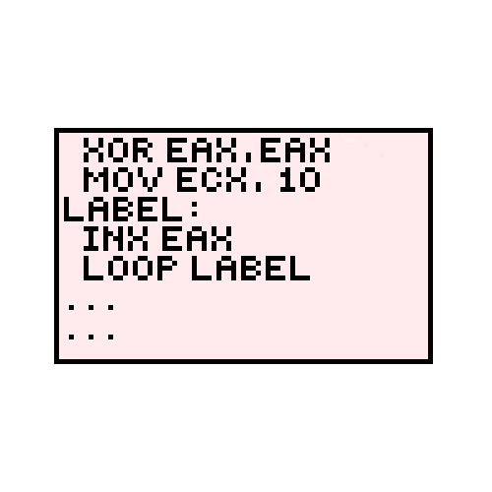
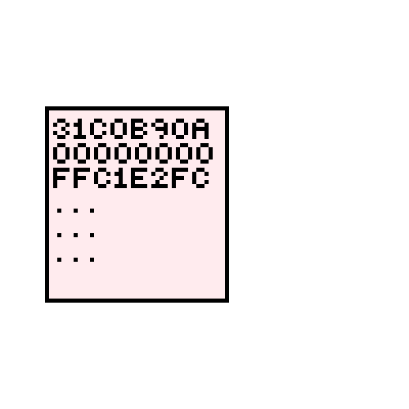
#SE Review: Pixelated Edition
Compile
Assemble

Slide 18
#SE Review: Pixelated Edition
Link

Slide 19
#Intermission: Why Review this?
Information can be limited when performing SRE
Understanding core concepts is important
File formats can be a treasure trove of information
Our goal is to work backwards from machine code
The ELF file will contain machine code
This machine code can be converted BACK into assembly language!
Machine code -> Assembly Language = Disassembly!

Slide 20
#Computer Architecture 101
When a program is running, the following must happen:
An instruction is read into memory
The instruction is process by the Arithmetic Logic Unit
The result of the operation is stored into registers or memory
For this course, we’ll deconstruct C programs info four core components
Registers
Instructions
Stack
Heap

Slide 21
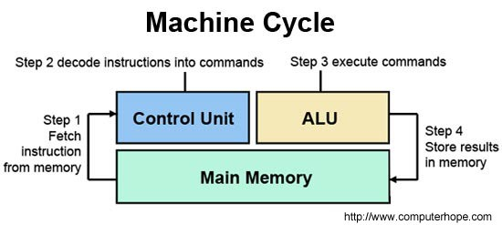
# Computer Architecture 101

Slide 22
#x86_64 Architecture
We will focus on Intel’s x86-64 instruction set
64 bit version of the x86 instruction set
Contains multiple operating modes for backwards compatibility
Original specification was created by AMD in 2000
Commonly used in desktop and laptop computers

Slide 23
#x86_64: Registers
Registers are small storage areas used by the processor
x86_64 assembly uses 16 64 bit general purpose registers (R8-15 not in table)
Register Name | 64 Bit | 32 Bit | 16 Bit | 8 Bit
R0 | RAX | EAX | AX | AH
R1 | RCX | ECX | CX | CH
R2 | RDX | EDX | DX | DH
R3 | RBX | EBX | BX | BH
R4 | RSP | ESP | SP
R5 | RBP | EBP | BP
R6 | RSI | ESI | SI
R7 | RDI | EDI | DI

Slide 24
#x86_64: Registers
RIP: Instruction pointer
Points to the next instruction to be executed
64 bits in width
RFLAGS: Stores flags used for processor flow control
FPR0-FPR7: Floating point status and control registers
RBP/RSP: Stack manipulation and usage

Slide 25
#x86_64 Instructions
These define the operations being performed by the CPU
For this course will be using the Intel syntax
instruction dest, source
Instructions can have multiple operands
These define the arguments for the specified operation
x86_64 has a large amount of available instructions
We will focus on commonly used ones to start

Slide 26
#x86_64 Instructions: mov
Moves data from one register to another
mov rax, rbx
Moves the value stored in RBX to RAX
mov rax, [rcx]
Moves the value pointed to by RCX into RAX

Slide 27
#x86_64 Instructions: add/sub
Add: Adds the two values together, storing the result in the first argument
add rax, rbx
Adds rbx to rax, the result is stored in rax
rax += rbx
Sub: Subtracts the second operand from the first one, storing the result in the first operand
sub rax, rbx
Subtracts rbx from rax, stores the result in rax
rax -= rbx

Slide 28
#x86_64 Instructions: and/xor
Performs the binary operation AND on the two operands, storing the result in the first
and rax,rax
rax = rax & rax
This syntax is used for other binary operations as well:
xor
or

Slide 29
#x86_64: The Stack
Data structure containing elements in contiguous memory
POP: Reads from stack
PUSH: Writes to stack
Elements are removed in the reverse order that they are added
Grows high to low
RSP points to top of stack
RBP contains base pointer

Slide 30
#x86_64 Instructions: push/pop
push will grow the stack by 8 and store the operand contents on the stack
push rax
Increases the value pointed to by rsp by 8, and stores rax there
pop will load the value pointed to by rsp into the operand
pop rbx
Loads the value pointed by rsp into rbx, and decreases rsp by 8

Slide 31
#x86_64: The Stack
RCX
Low Address
PUSH RAX
PUSH RBX
PUSH RCX
POP RAX
RBX
RAX
Element 1
High Address
RBP
RSP

Slide 32
#x86_64 Instructions: jmp/call
jmp is used to change what code is being executed
Modifies the value in EIP
Jmp 0x1000300
Set EIP to 0x1000300 and execute the instructions there
call is used to implement function calls
Pushes value of rbp and rip onto stack before jumping
call 0x18000000

Slide 33
#x86_64 Instructions: cmp
cmp performs a comparison operation by subtracting the operands
No storage is performed (unlike sub)
Based on the result, fields in RFLAGS are set!
cmp rax, #5
The flags in RFLAGS register are used by jmp variants
jnz: Jump if not zero
jz: Jump if zero

Slide 34
#x86_64: Addressing Modes
Instructions can access registers and memory in various modes
Immediate: The value is stored in the instruction
add rax,14; stores rax+14 into RAX
Register to Register
xor rax,rax; clears the value in RAX
Indirect Access:
add rax, [rbx]; adds the value pointed to by rbx into rax
mov rbx, 1234[8*rax+rcx]
move word at address 8*RAX+RCX+1234 into rbx

Slide 35
#x86_64 Instructions Exercise
section .text
global _start
_start:
mov rax, 0x2FFF
mov rbx, 0x3000
or rax,rbx
mov rcx, 0x10000
sub rcx, rax
add rcx, rbx
cmp rax,rbx
jg _greater
mov rax, 0x2
_greater:
mov rax, 0x1
ret
Register | Value
RAX | 0x3FFF
RBX | 0x3000
RCX | 0xF001
RIP
Register | Value
RAX | 0x3FFF
RBX | 0x3000
RCX | 0x10000
RIP
Register | Value
RAX | 0x2FFF
RBX
RCX
RIP
Register | Value
RAX | 1
RBX | 0x3000
RCX | 0xF001
RIP | _greater+5
Register | Value
RAX | 0x3FFF
RBX | 0x3000
RCX | 0xC001
RIP
Register | Value
RAX | 0x3FFF
RBX | 0x3000
RCX
RIP
Register | Value
RAX | 0x2FFF
RBX | 0x3000
RCX
RIP
Register | Value
RAX | 0x2FFF
RBX | 0x3000
RCX | 0xF001
RIP | _greater

Slide 36
#x86_64: Wrap up
x86_64 is a very complicated architecture
We’ve only covered the bare minimum
Instructions and other reference material can be found on Intel’s website
Although Ghidra has a decompiler, it is important to understand the underlying assembly

Slide 37

#Ghidra: Overview
Open source SRE tool developed by NSA
Released in March 2019
Written in Java
Free
Provides a disassembler and decompiler
Large library of supported processors / architectures
Custom processors can be added via SLEIGH modules
Active development community
146 PRs, 2,530 commits

Slide 38

#Ghidra: Installation
Download the latest release from https://ghidra-sre.org/
For this course we will use v9.1.2
Unzip the installation bundle
This contains everything you need to run Ghidra
Unzip to somewhere accessible
Install Java 11 64-bit Runtime and Development Kit (JDK)
Launch Ghidra!
./ghidraRun.sh or ./ghidraRun.bat

Slide 39
#Ghidra: Creating a Project
Ghidra groups binaries into projects
Projects can be shared across multiple users
Programs and binaries can be imported into a project
File -> New Project
Non-Shared Project
Select Directory
Name the project: “hackaday-u-ghidra”

Slide 40
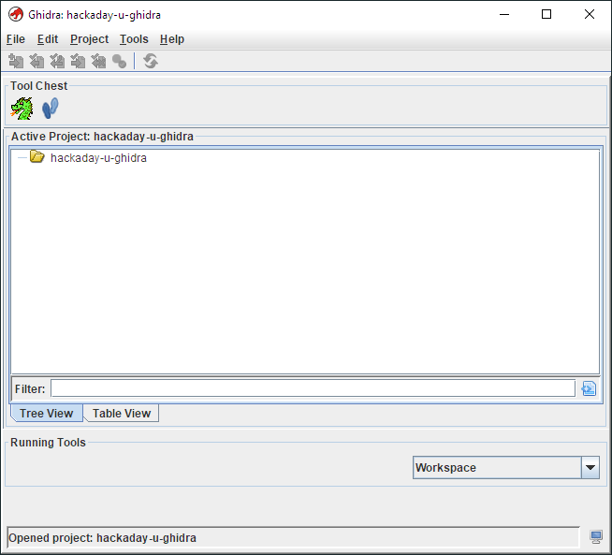
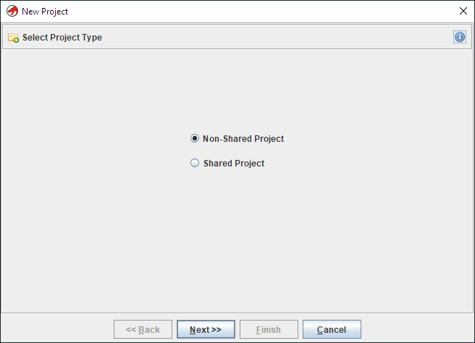
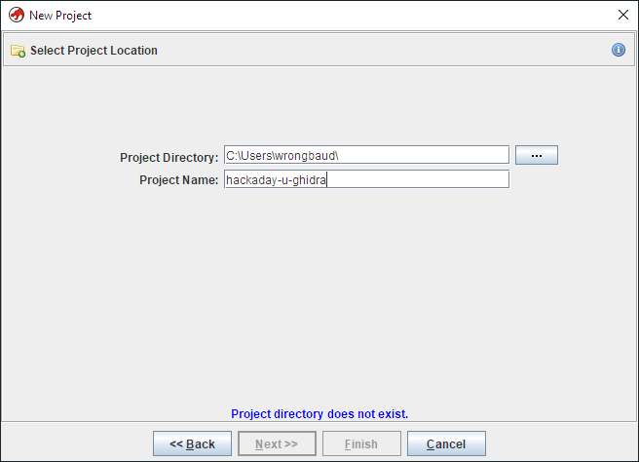
#Ghidra: Creating a Project

Slide 41
#Ghidra: Loading a Binary
Import Window
In this window you can inform Ghidra about the target binary
Architecture / Language
File format
Ghidra will attempt to autodetect features based on the file format
In our case these features are provided by the ELF header
After the file is imported, a results summary window will appear
Various file features will be listed in this window

Slide 42
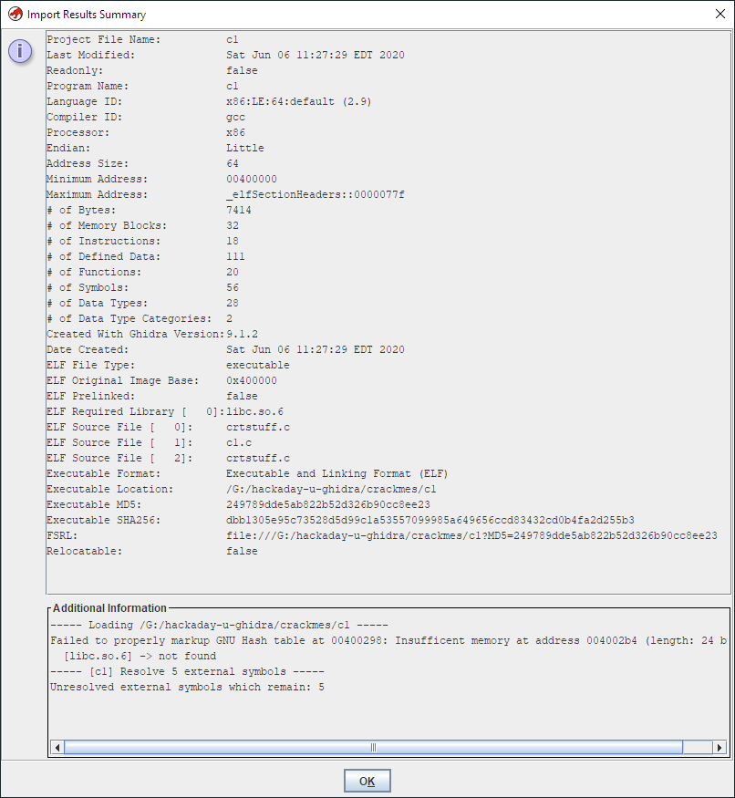
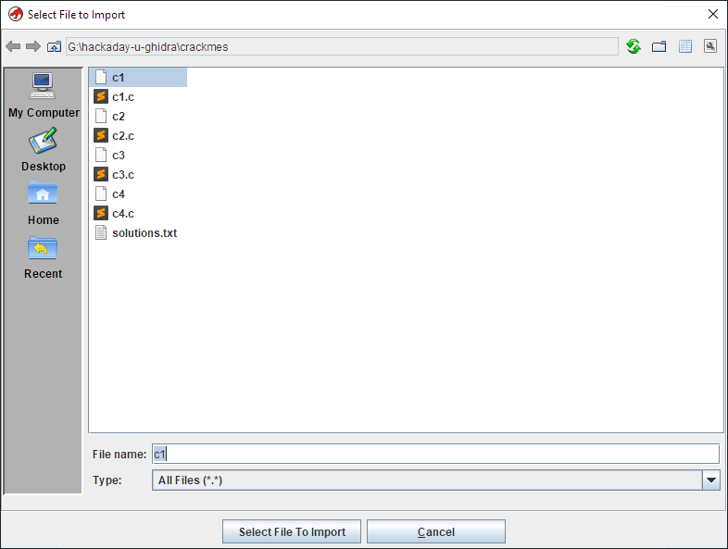
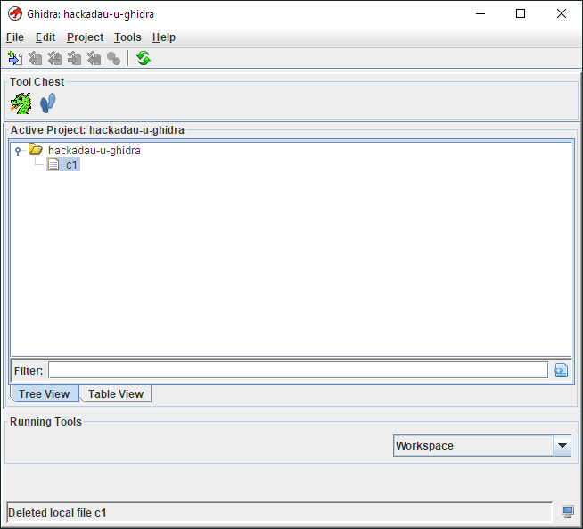
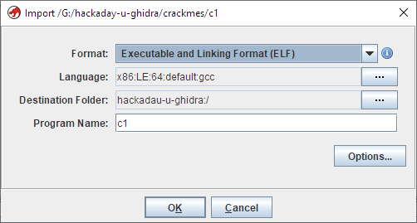
#Ghidra: Loading a Binary

Slide 43
#Ghidra: Initial Analysis
Once a program has been loaded into the active project, it can be analyzed
Double click on the program in the project view to start analysis
Ghidra will attempt to automatically analyze the binary
This is based on information inferred from the filetype
The binary entry point is determined and Ghidra begins the disassembly process
During auto-analysis Ghidra will also attempt to:
Create and label functions
Identify cross references in memory (xrefs)

Slide 44
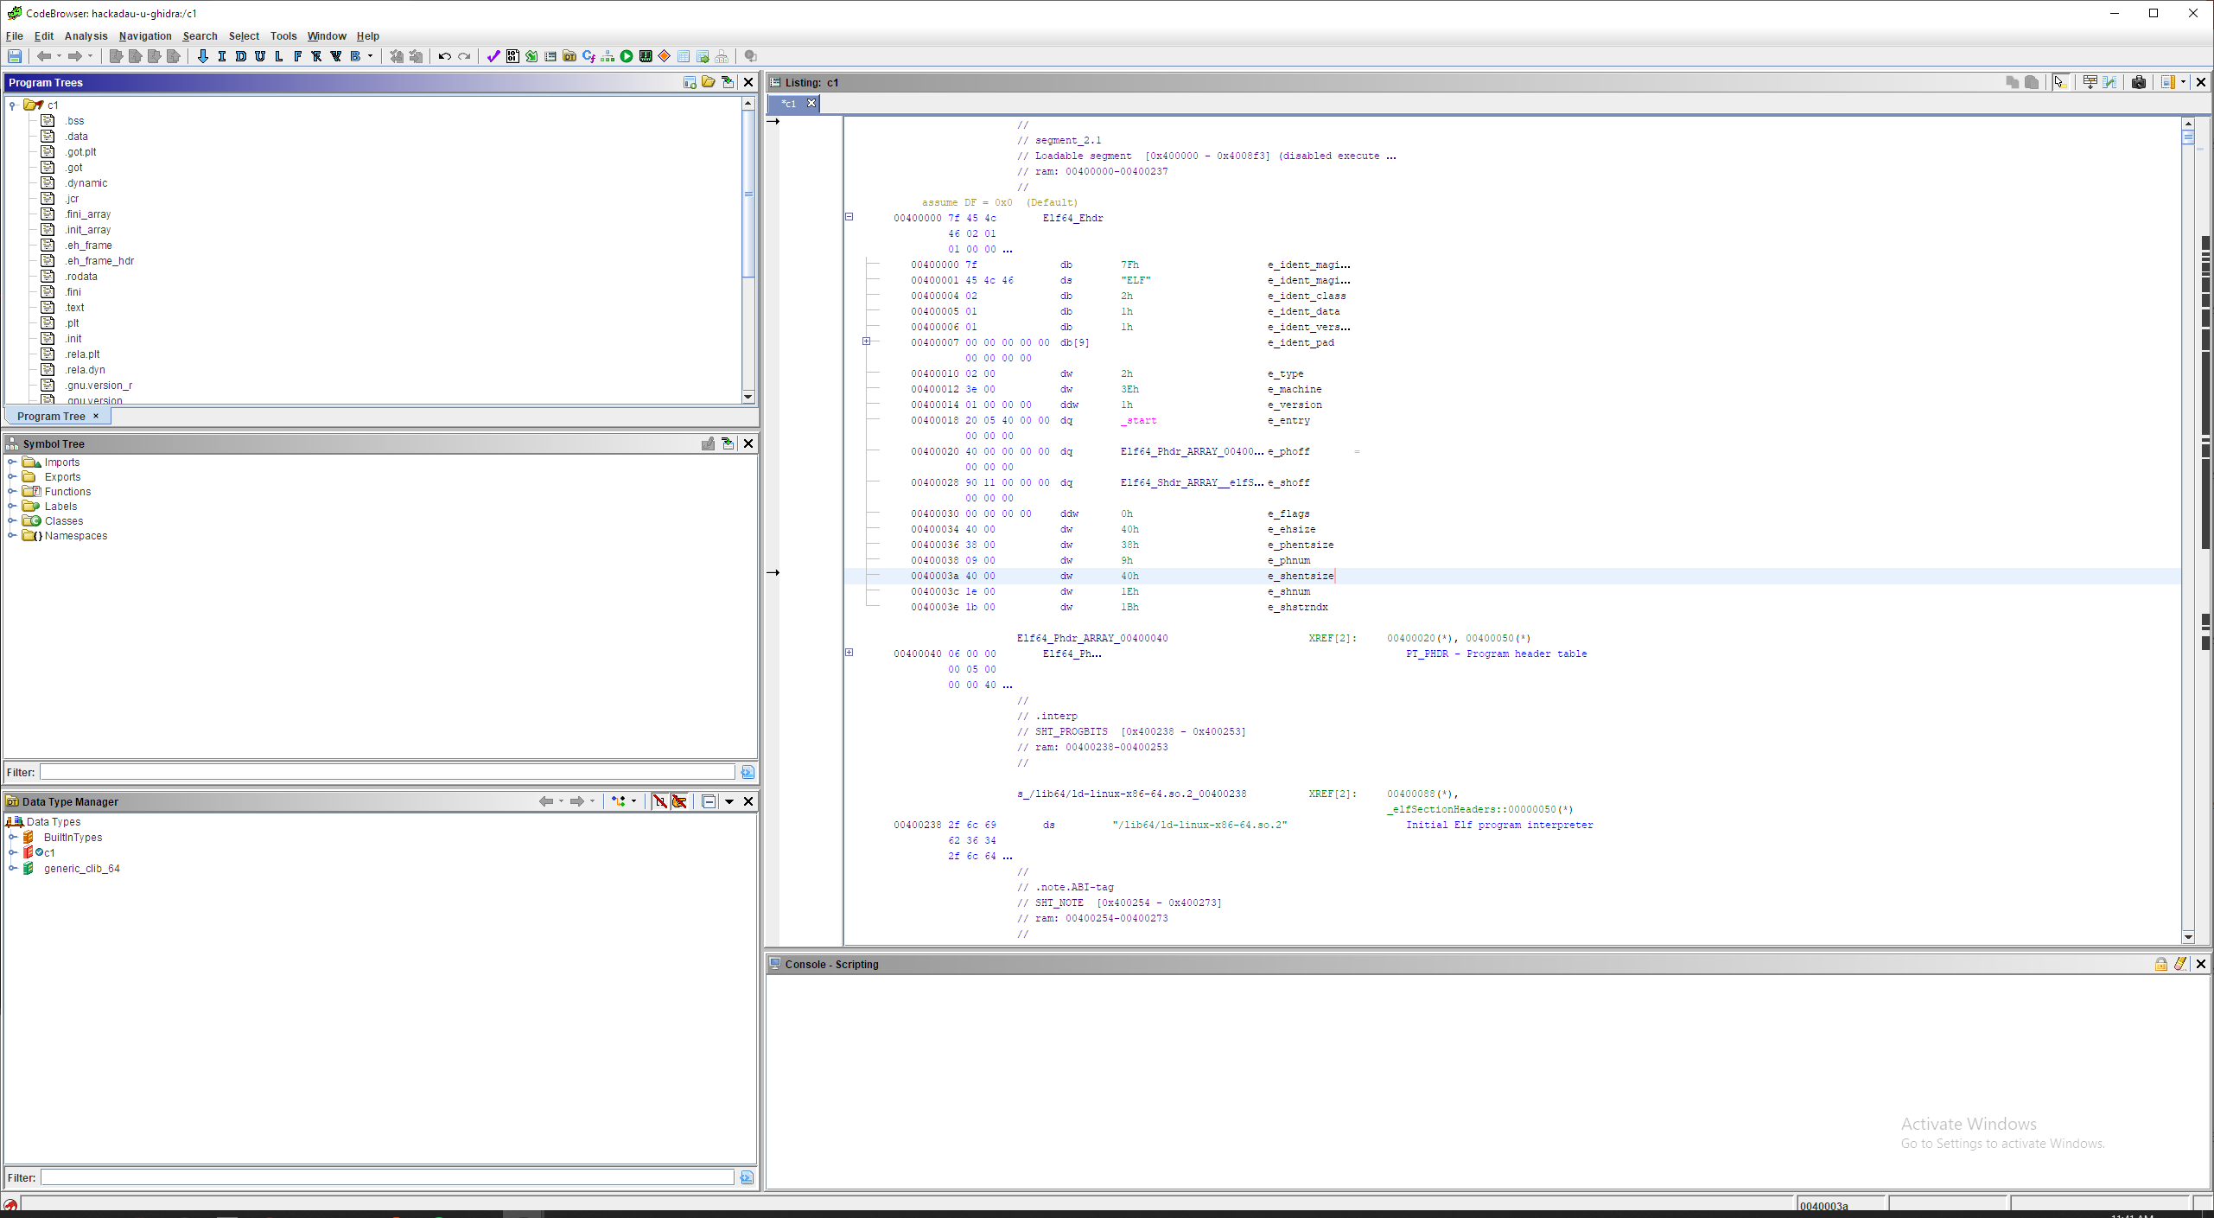
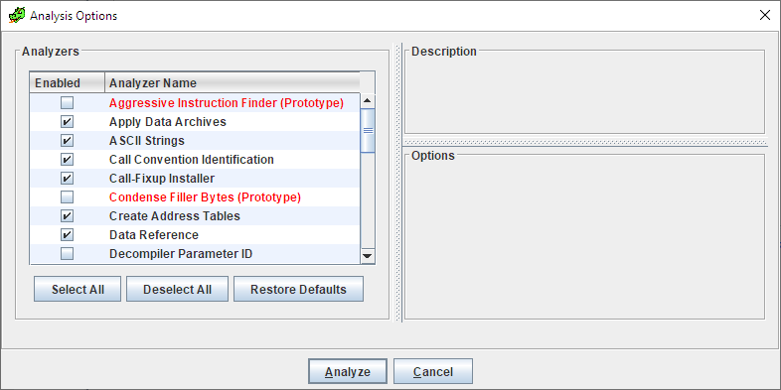
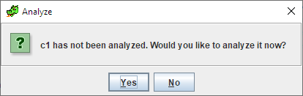
#Ghidra: Initial Analysis

Slide 45
#Ghidra: Navigation
Once the analysis window is done, the program can be explored
This is done mainly within the CodeBrowser Window
Some of the default CodeBrowser windows include:
Program Tree – this shows the segments of the ELF file
Symbol Tree – lists and displays all currently defined symbols
Data Type Manager – shows data types inferred during auto-analysis
Listing – the resulting assembly code from auto analysis
Console – tool output / debugging information

Slide 46
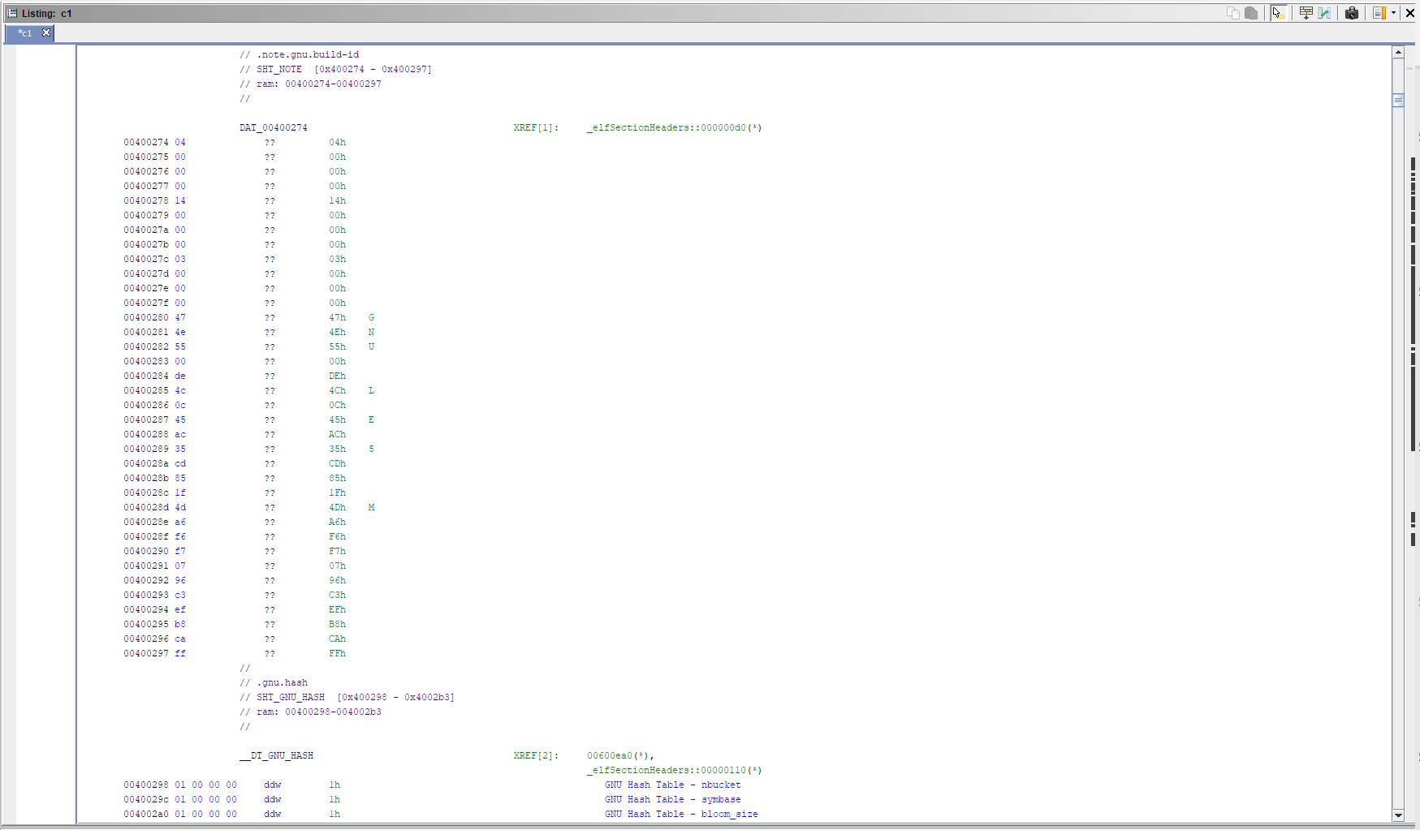
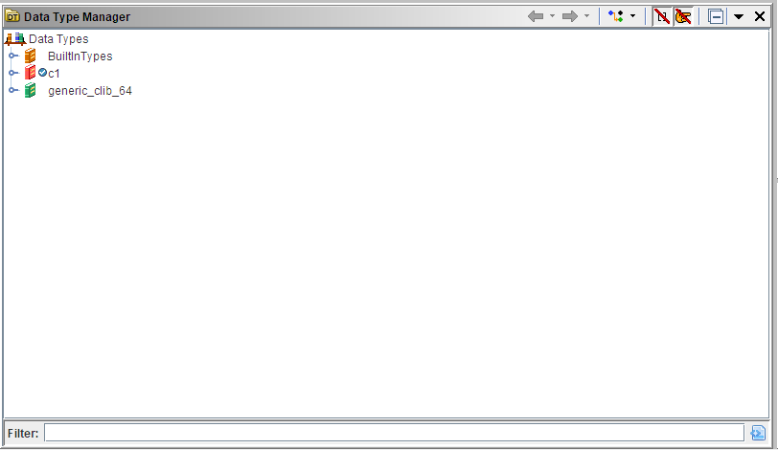
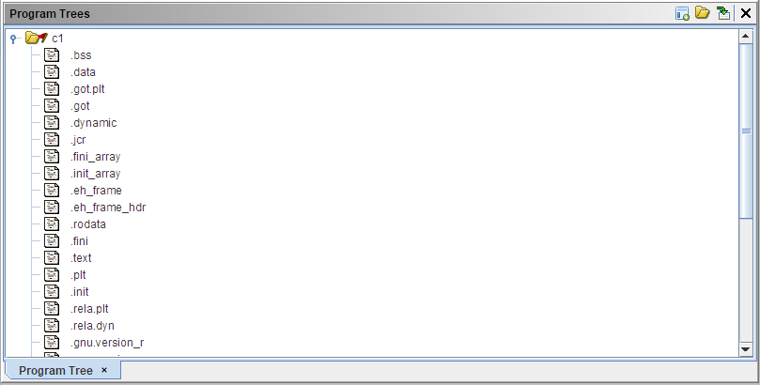
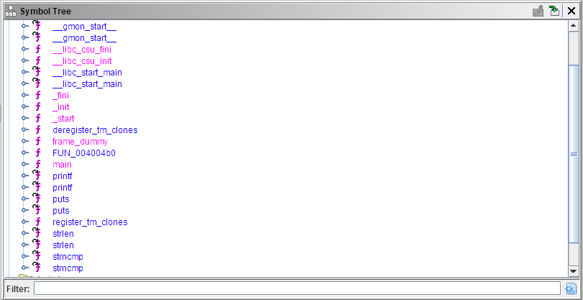
#Ghidra Navigation

Slide 47
#Ghidra Nav: Disassembly View
This is where the resulting assembly code is displayed
This listing can be edited by clicking the symbol
By default this listing contains
Address
Bytes
ASM Instructions (Mnemonics) and operands
Comments
Xrefs

Slide 48
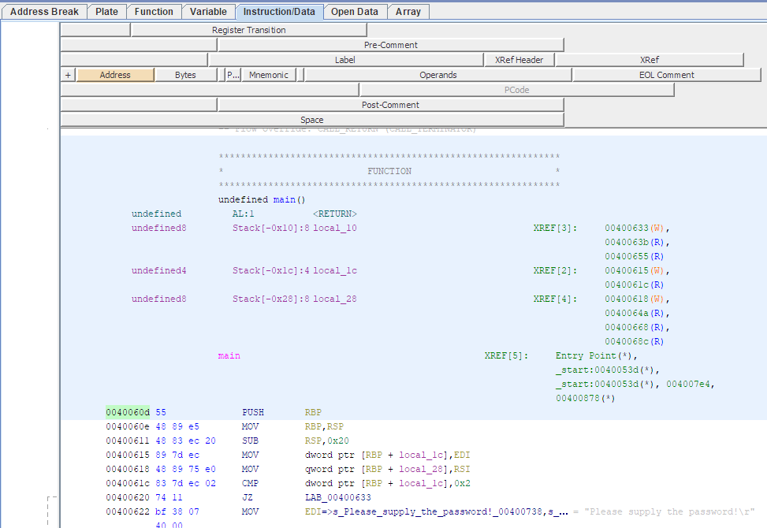
#Ghidra Nav: Disassembly View
Operands: These are the registers/memory locations used by the instruction
Address field: This represents the memory address where this data is located
XRefs: These are generated when Ghidra detects other locations or instructions that reference this address
Mnemonic: This is the instruction that has been disassembled from the opcode
Bytes: There are the opcodes that represent the instructions

Slide 49
#Ghidra: Decompiler
One of Ghidra’s most powerful features is the decompiler
Implemented utilizing Ghidra’s P-Code
P-Code abstracts assembly instructions into P-Code operations
P-Code is an intermediate language shared across all supported processors
The decompiler creates C code from the analyzed P-Code
All supported processors can utilize the decompiler
All processors are created with the SLEIGH language
SLEIGH specifies the translation from machine code to P-Code

Slide 50
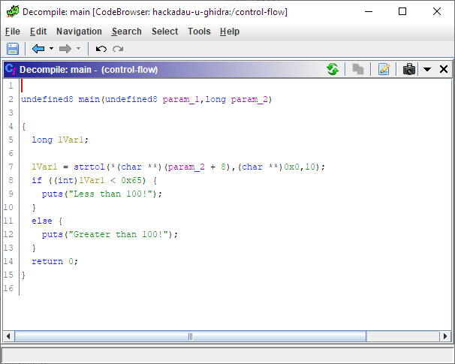
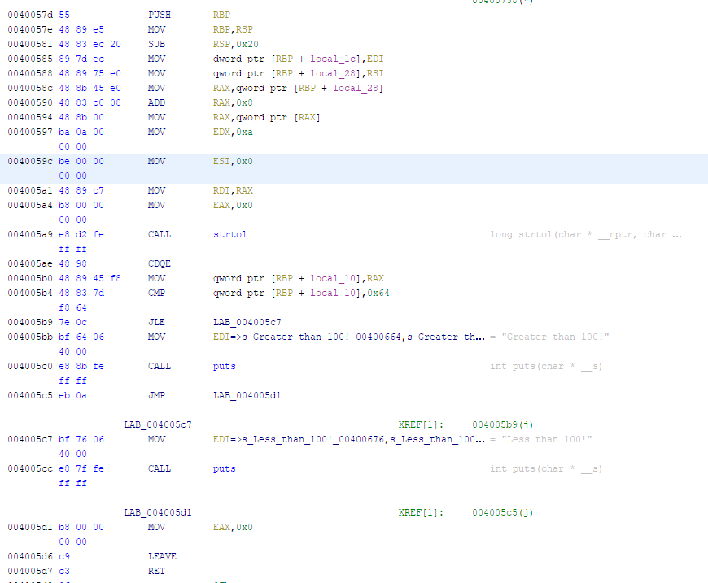
#Ghidra Nav: Decompiler View

Slide 51
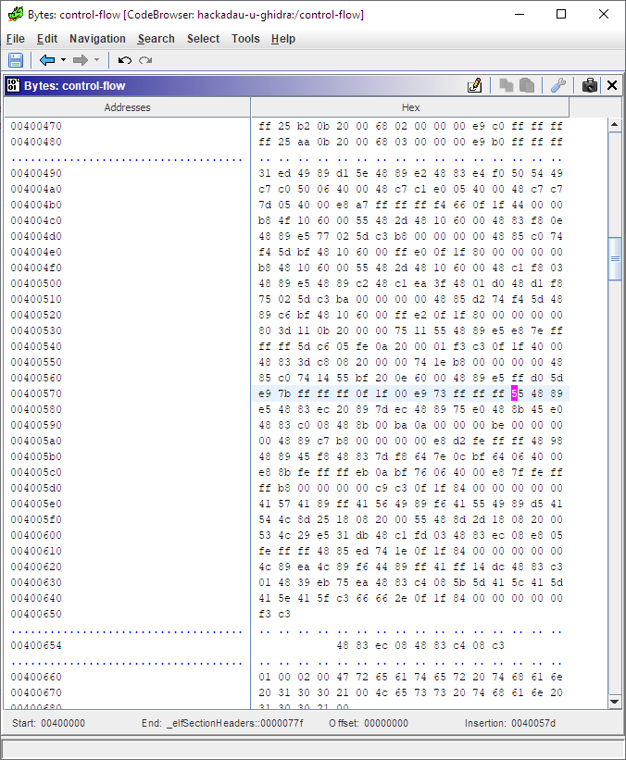
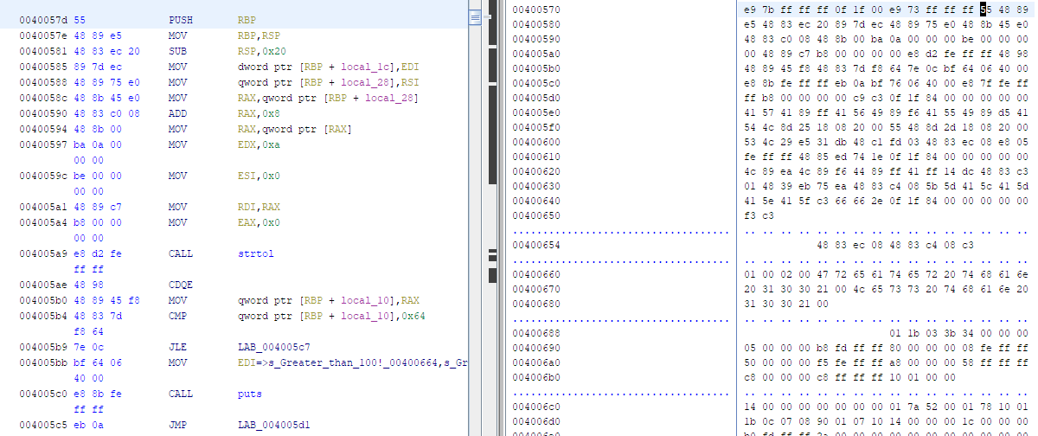
#GHIDRA: Byte View

Slide 52
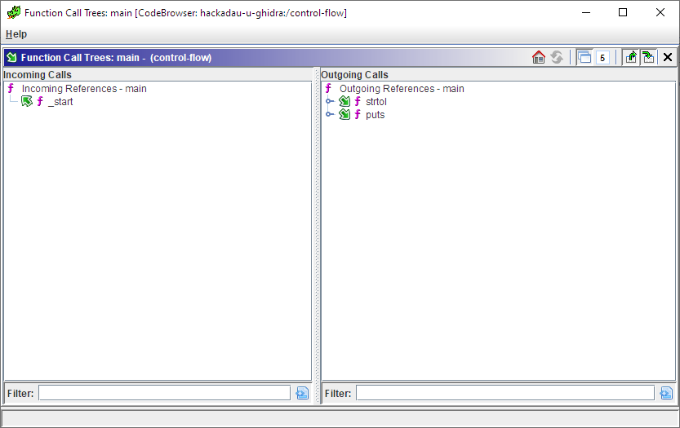
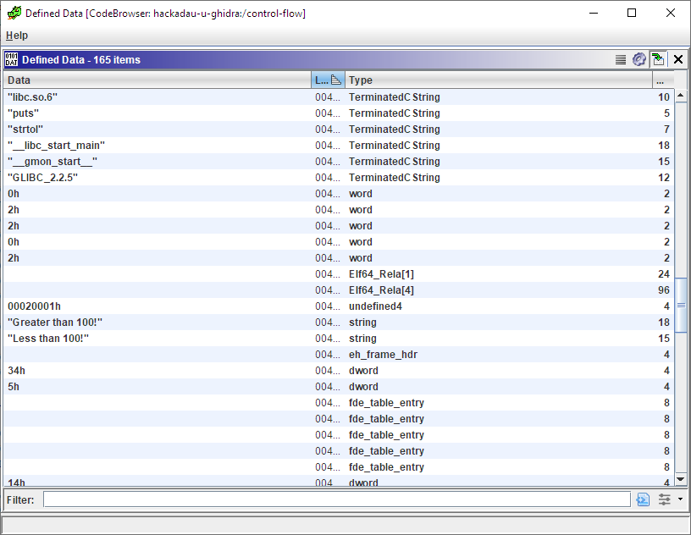
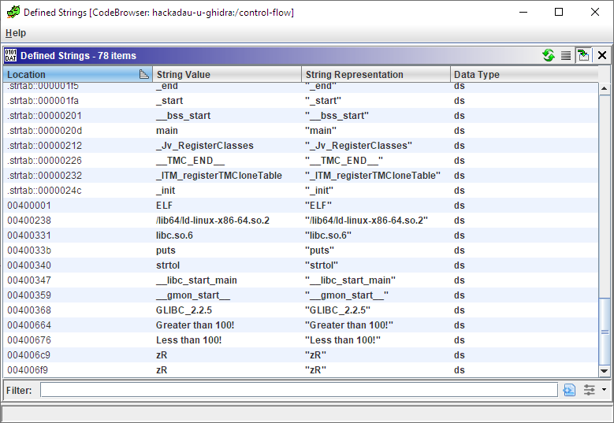
#Ghidra: Other Views

Slide 53
#GHIDRA: Navigation
The listing view can be navigated in multiple ways
Scrolling
Arrow keys
Using the side scroll bar
Double clicking on Xrefs will navigate to that location
Locations can be specified by pressing the ‘G’ key

Slide 54
#Ghidra Exercises: Overview
Multiple challenge binaries have been developed for this course
These binaries were developed to highlight Ghidra features covered in each lesson
After each lesson, two additional challenge binaries will be released
For review during office hours
On Wednesday of each session week, an advanced challenge may be released for those interested

Slide 55
#Ghidra Exercises: c1
Download the exercises from github:
https://github.com/wrongbaud/hackaday-u
This repository will hold all materials for the course
Import the C1 challenge binary into Ghidra
What is this program doing?

Slide 56
#Ghidra Exercises: c2
Load the C2 exercise into Ghidra
Run the application
How is this program different from c1?
What is it doing?

Slide 57
#Session 1: Conclusion
In this lesson we covered:
Basic x86_86 instructions and features
Ghidra features
Ghidra navigation and basic usage
For the next session, review the c3/c4 exercises in the github repository
Feel free to bring all questions to Thursday’s office hour!

Slide 58
#Questions
?

