Slide 1
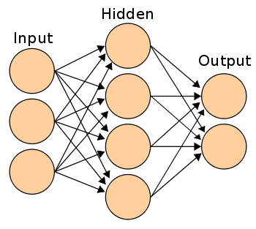
Algorithm: CNN And Techniques
1. Conventional Neural Network (CNN)
  CNN takes in processed images as input.
  Extracts different features about the images regardless of their position using a series of mathematical operations to identify the pattern.
  Every layer in CNN has API which transforms input to output with differentiable functions.

Slide 2
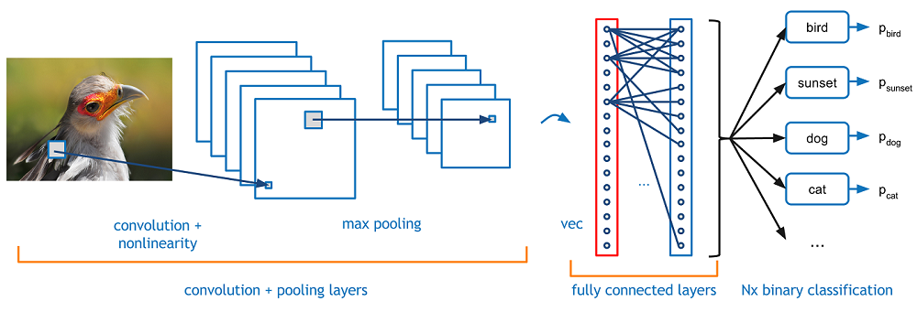
Steps In CNN
Convolutional Layer
Pooling
Flattening
Fully Connection

Slide 3
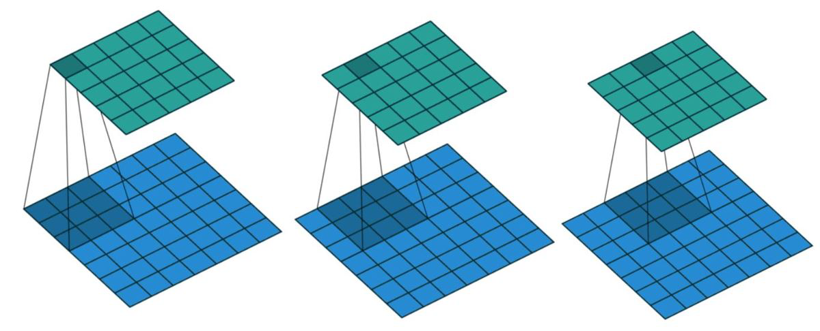
Convolutional Layer
We extract different features pixel wise by using feature detectors/kernels.
Perform numerous convolutions on input, where each operation uses a different filter. This results in different feature maps.
In the end, we take all of these feature maps and put them together as the final output of the convolution layer.

Slide 4
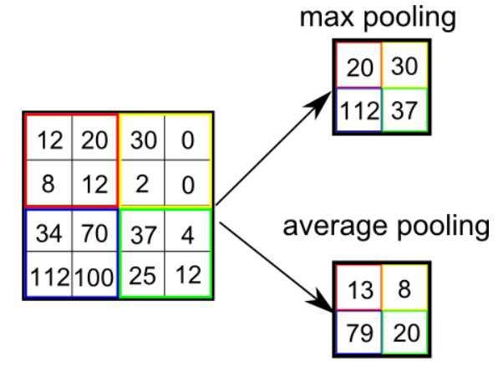
Pooling Layer
The function of pooling is to continuously reduce the dimensionality to reduce the number of parameters and computation in the network. This shortens the training time and controls over fitting
Max Pooling extracts out the highest pixel value out of a feature while average pooling calculates the average pixel value that has to be extracted.

Slide 5
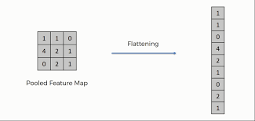
Flattening
Basically here we arrange the pooled feature into a single vector/column as a input for next layer(convert our 2D data to 1D)

Slide 6
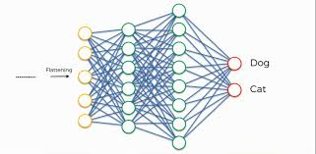
Fully Connected Layer
Neurons in a fully connected layer have full connections to all the activations in the previous layer.
Combining more neurons to predict more accurately.

