Slide 1

Strategic Analysis of Concessions
Business Technologies
Business Intelligence Team
Akshay Kanade
M.S. Business Analytics
akshay.kanade@ucdenver.edu

Slide 2
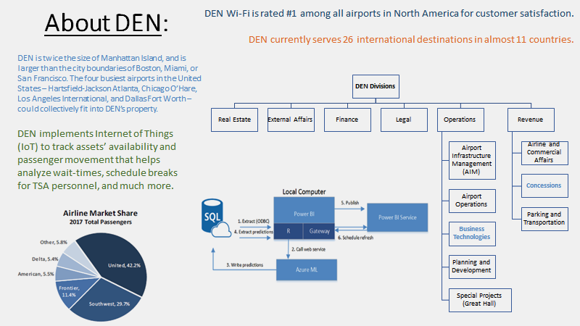

Slide 3
Summary
INPUT
ANALYSIS
What are the total sales by concourses?
Is there a relationship between the compensation and sales?
How much billable space is used for concessions?
Which category of concessions yields highest compensation per enplanement.
How many passengers are we expecting over the upcoming years?
Any overall conclusions?
Total sales in 2017 were over $1 billion.
Airport-wide concessions yield the highest percentage of compensation.
Food & Beverages compensation per enplanement is the highest.
In 2023 we would have around 70 million passengers, however we will achieve this number before 2023 due to 39 additional gates.

Slide 4
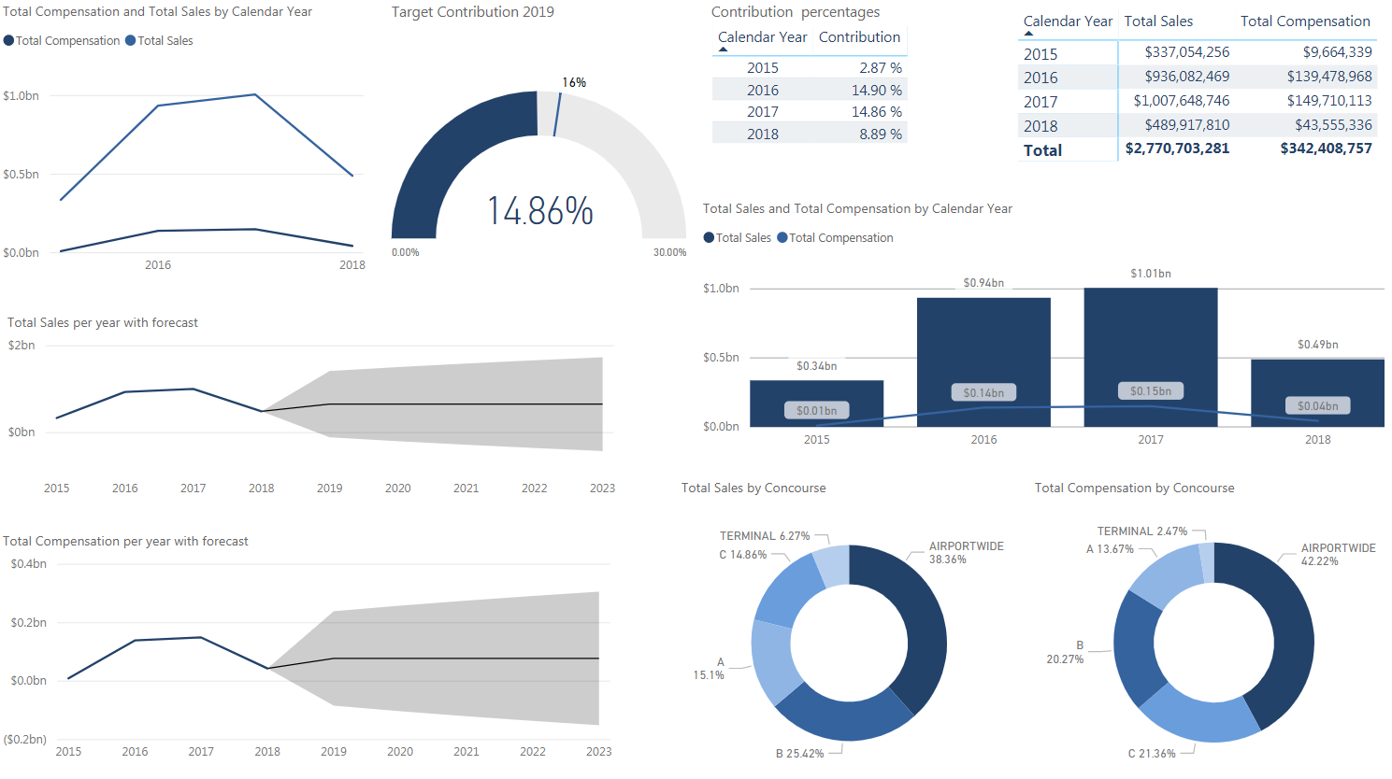
Dashboard Overview

Slide 5
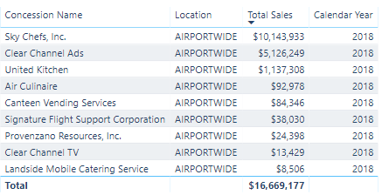
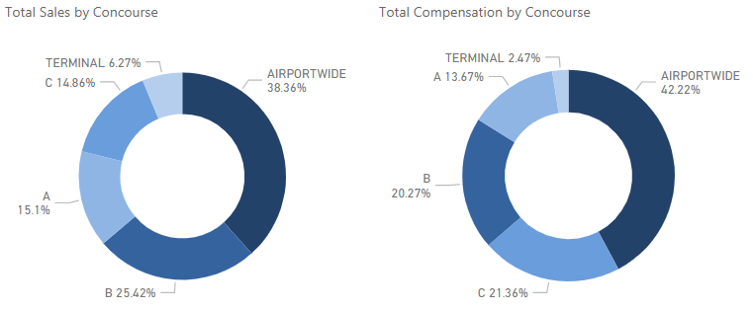
Airport-wide Concessionaires
Airport-wide & C Concourse concessionaires show a positive relationship between sales and compensation.

Slide 6
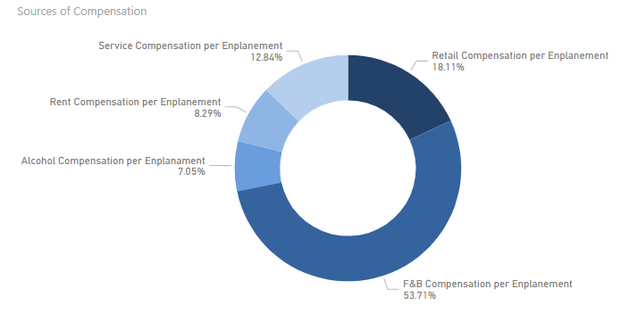
Which category yields highest compensation per enplanement?

Slide 7
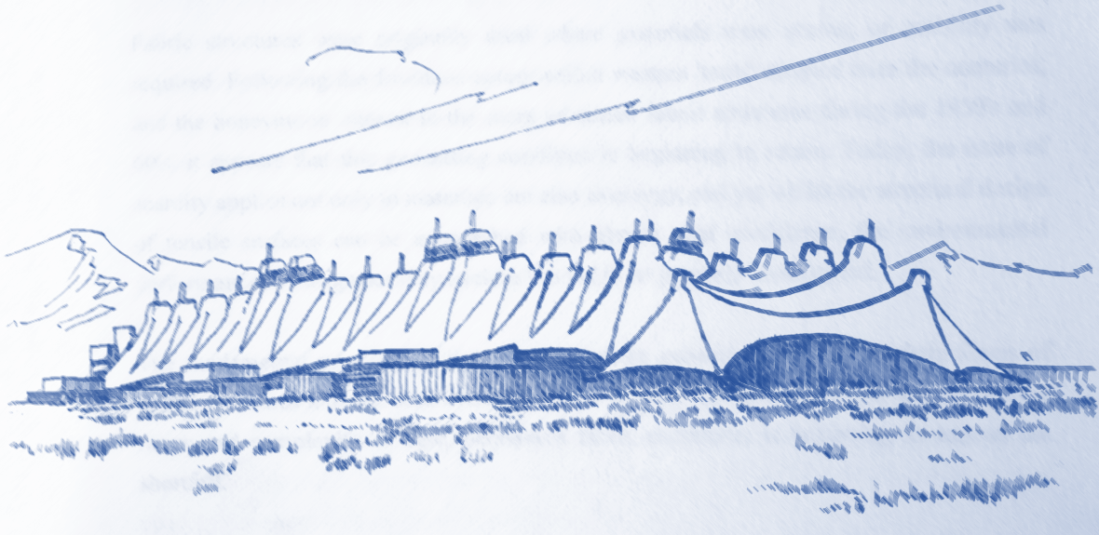
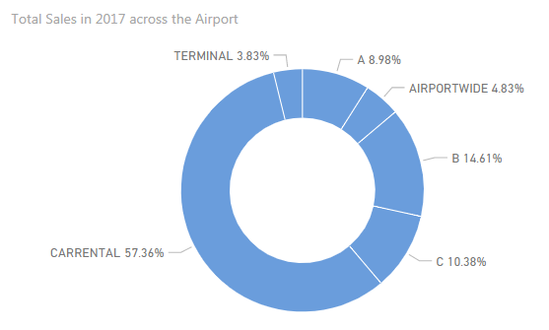
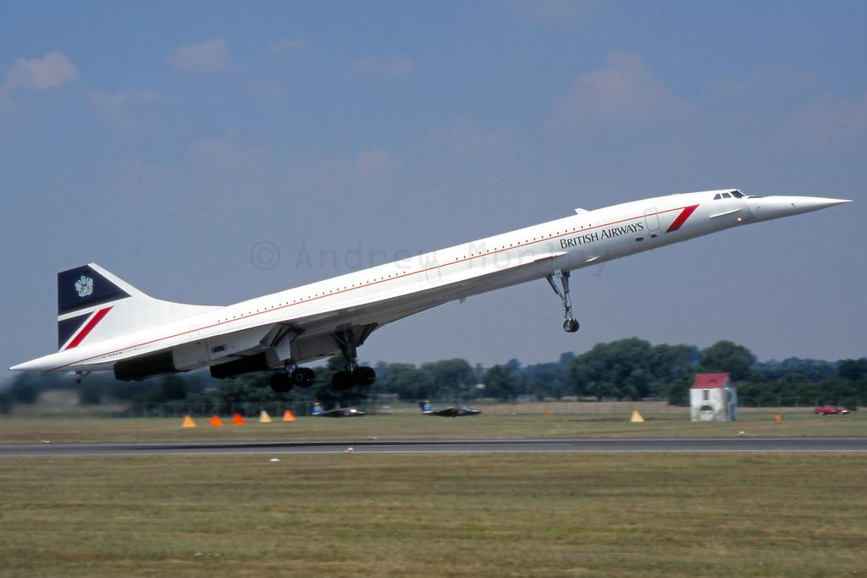
Concessions Sales Across DEN

Slide 8
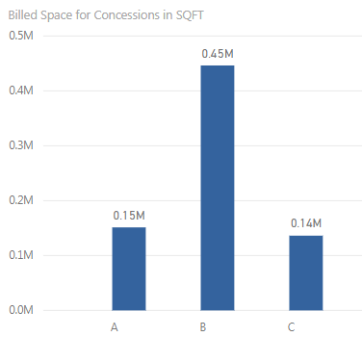
Already Billed Space for Concessions on Concourses

Slide 9
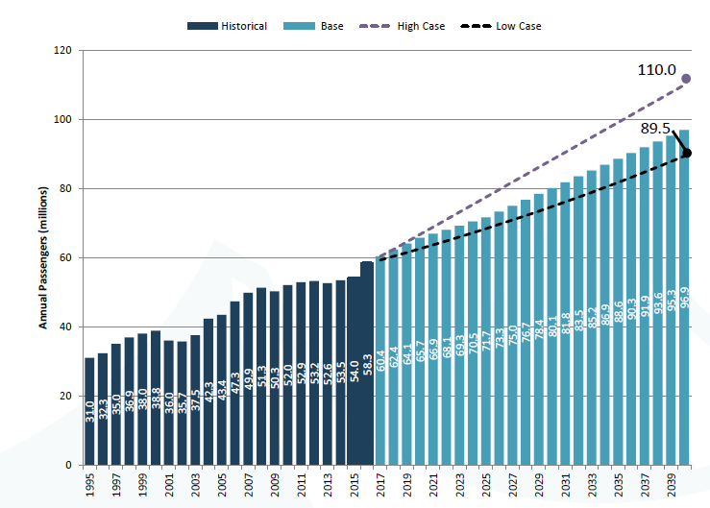
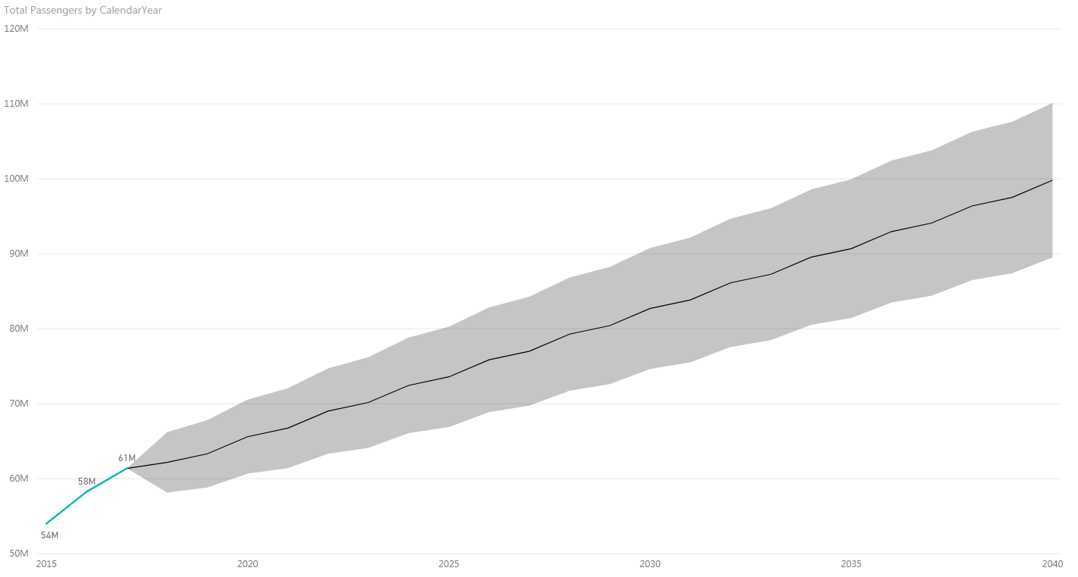
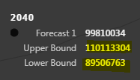
Early predictions of annual passengers
We are yet to predict the additional growth from 2021 with additional 39 gates
Where did we come from? Where are we going?
Predicted with data from 2016
Source: Gate Expansion Presentation By Patrick Heck November 17, 2017
Source: Created using 2017 data by Akshay Kanade July 30, 2018

Slide 10
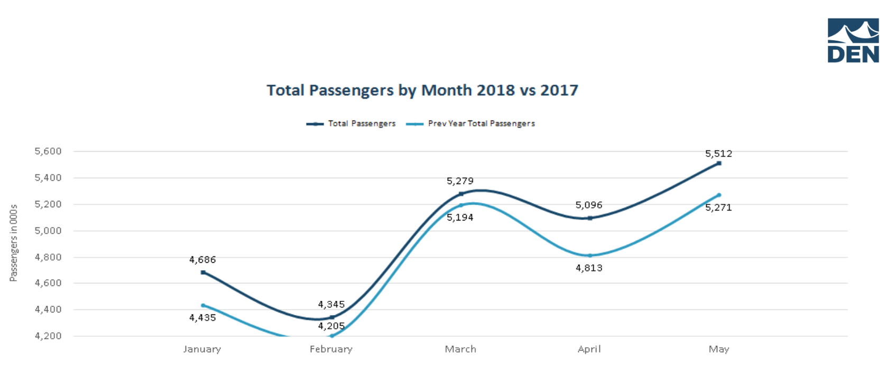
Seasonality
Seasonality among passengers is very important while we do predictions using time-series analysis.
Using this seasonality we could predict the trend in annual passengers with latest data.
Source: www.flydenver.com

Slide 11
Conclusions:
We have some limitations
Availability of data.
Forecasting capacity of tools like Power BI.
Changing trends within airlines and passengers.
Scope for further improvements
Attempt to understand international/domestic and originating/transferring passenger’s buying behavior on concourses.
Deeper penetration of IoT such as Point of Sales machines, Beacon tracking and data validation.
Learning the factors influencing concessions revenue and optimizing performance.
Predictive Analytics
‘Prevedere’ is a paid add-in that can predict using in-built datasets relevant to the data.
Machine learning techniques can predict additional growth in passengers after gate expansion in 2021.
New flight schedules, passengers and concessions can be predicted prior to the gate expansion project.
Overall. . . DEN’s FUTURE IS BRIGHT

Slide 12
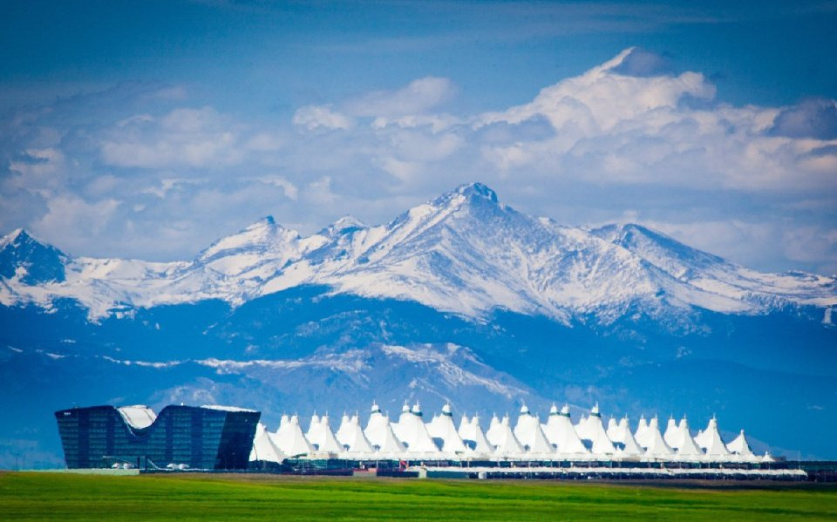

Thank You
Akshay Kanade
M.S. Business Analytics
University of Colorado Denver Business School
akshay.kanade@yahoo.co.in
303.356.4668

