Slide 1

MINI PROJECT ON
INTELLIGENT SYSTEM FOR VEHICLE SUGGESTION
DEPARTMENT OF INFORMATION TECHNOLOGY,

Slide 2
INTELLIGENT SYSTEM FOR VEHICLE SUGGESTION
PRESENTERS:
K.Akshay(2451-11-737-038)
G.Vishnu Reddy(2451-11-737-027)
G.Tharun(2451-11-737-036)
Guide’s Name:
P.Karthik.
Asst.Proff,ITD.

Slide 3
Statement Of Problem:
INTELLIGENT SYSTEM FOR VEHICLE SUGGESTION is a software that enables us to select a car or bike meeting the requirements specified by the user.
Scope Of Work :
The aim of project is to suggest a vehicle’s name which meets the users specifications.
The platform used is CLIPS ES.
Learning the concepts of CLIPS EXPERT SYSTEM.

Slide 4
Expert System
An Expert system is a computer system that emulates the decision-making ability of a human expert.
Expert systems are designed to solve complex problems by reasoning about knowledge, like an expert.
The first expert systems were created in the 1970s and then developed in the 1980s.

Slide 5
Why To Use Expert Systems?
Experts are not always available. An expert system can be used anywhere, any time.
Human experts are not 100% reliable or consistent.
Cost effective

Slide 6
Components of an Expert System
The knowledge base is the collection of facts and rules which describe all the knowledge about the problem domain
The inference engine is the part of the system that chooses which facts and rules to apply when trying to solve the user’s query
The user interface is the part of the system which takes in the user’s query in a readable form and passes it to the inference engine. It then displays the results to the user.

Slide 7
Clips - C Language Integrated Production System
Expert System Tool
Complete environment for building rule/ object based Expert Systems
Developed by Software Technology Branch, at NASA’s Johnson Space Centre (1985)
Released 1986

Slide 8
Facts and rules
CLIPS operates by maintaining a list of facts and a set of rules which operate on them.
FACTS: Facts can be Asserted using deftemplates with the assert keyword
Rules :Defrule construct, In order to accomplish useful work, an expert system must have rules as well as facts.

Slide 9
An example from our project
(defrule compare-object
=>
(printout t "What do you want to compare (car or byke)?")
(assert (object-to-compare (read))))

Slide 10
INTELLIGENT SYSTEM FOR VEHICLE SUGGESTION
It is a proposed knowledge-based system for car/bike suggestion.
All the people might not exactly know which model bike/car is too be choosen, but they have certain specifications(mileage,price,look etc).taking these specifications, our system suggests a bike/car.
It can suggest over 10 types of bikes,10 types of cars

Slide 11
How Does It Work :
The proposed system divides bike/car suggestion into two major types :
bike
car

Slide 12
Bike Suggestion
If a BIKE is chosen ,the system asks the user various questions , and reads the answers(yes/no/high/low) provided by the user and suggests a bike accordingly.
1.Do you want a bike of cc greater than 125?
2.what kind of mileage are you expecting?
3. Are you looking for a bike with ultra modern looks?
4.You are comfortable with a bike of price?

Slide 13
Car Suggestion
If CAR is choose , the system asks the user various questions , and reads the answers(yes/no/high/low) provided by the user and suggests a CAR accordingly.
Type of car?(petrol/diesel)
If your answer is “petrol” it will ask for the following questions :
1.Are you looking for a car with seating capacity greater than 4?
2. Are you looking for a car with ultra modern looks?
3.You are comfortable with a car of price?

Slide 14
Executing a CLIPS program
Open Clips editor/ Notepad
Add rules to knowledge base
Add facts to global memory
Load file
Reset file
Execute run command

Slide 15
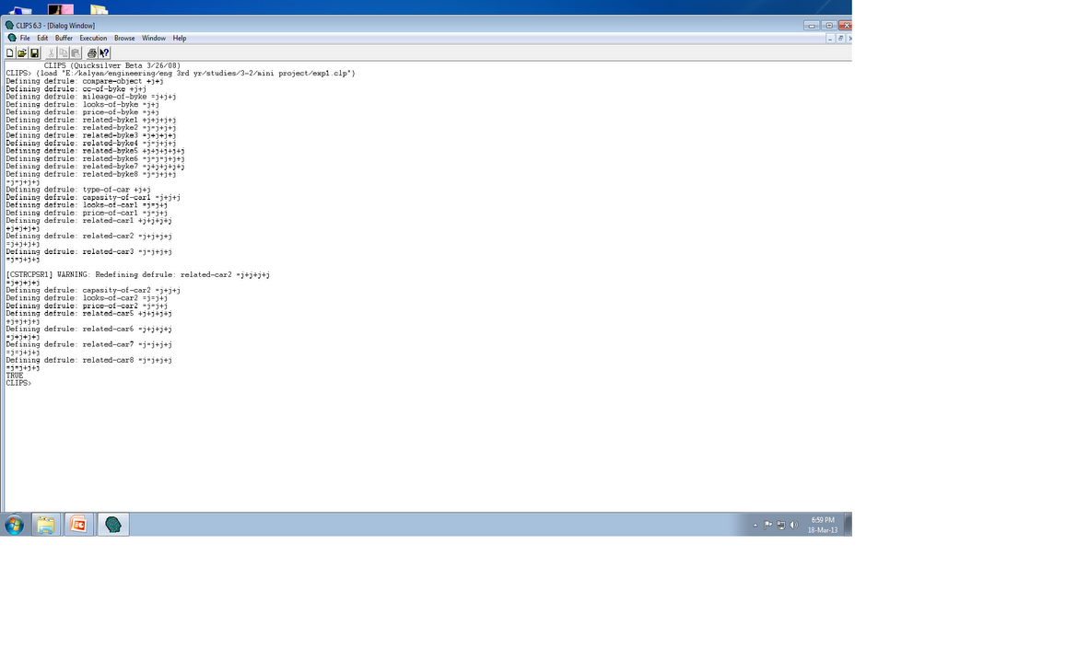
CLIPS-Loading a file

Slide 16
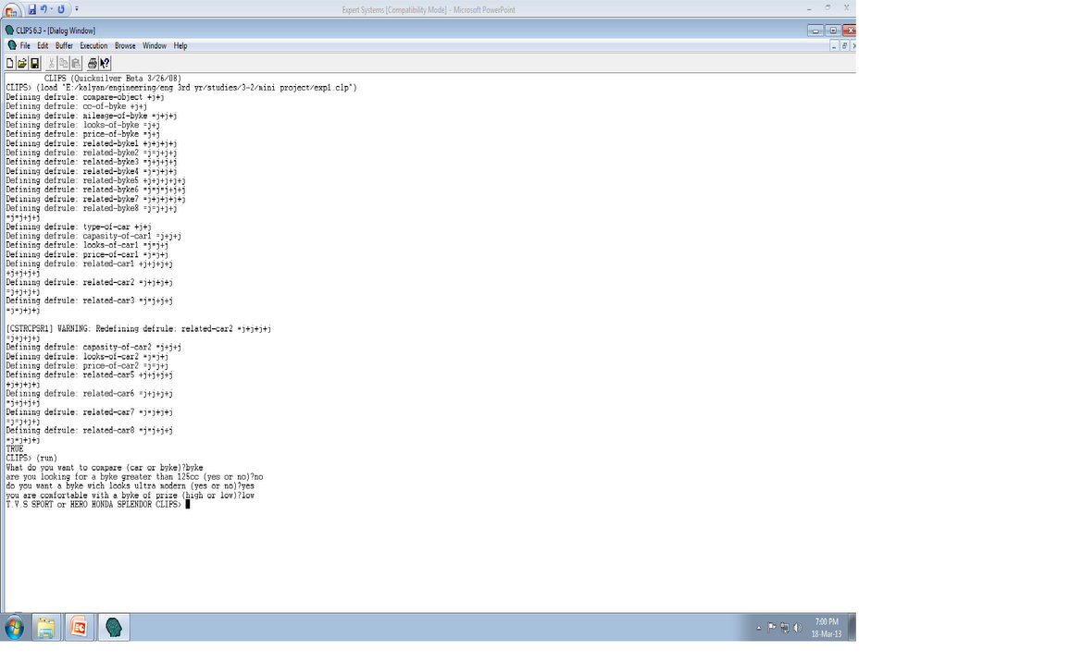
CLIPS- Bike Suggestion

Slide 17
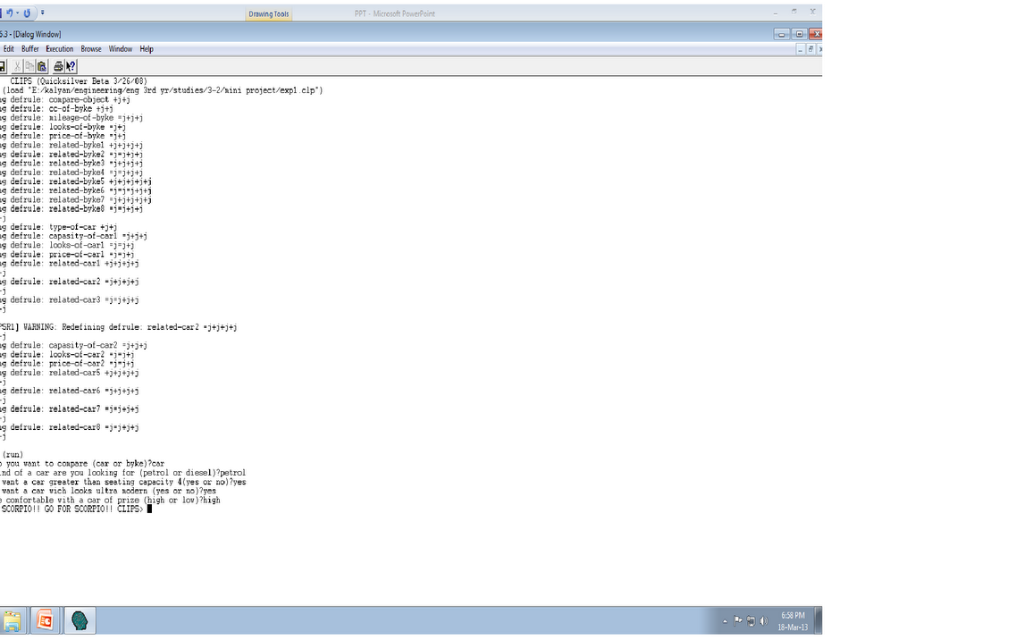
CLIPS-Car suggestion

Slide 18
QUERIES???

Slide 19
THANK YOU

