Slide 1
PROJECT
Demand Forecasting
PROJECT BY -
Mr. Akshay Kotkar

Slide 2
Project Flow :
Data Description
EDA
Visualization
Data Pre-Processing
Predictive Modeling
Model Evaluation
Deployment

Slide 3
Business Problem:
Sales Forecast
Problem Statement:
The problem statement in this project is to perform demand forecasting for a business. Specifically, the objective is to predict the quantity of goods and services that will be demanded by consumers. The project is based on historical data spanning two years, and the goal is to generate forecasts for the upcoming year.

Slide 4
Data Description
The data file contains 5 features
DATE
Store Number
Family (Product Types)
Sales
Promotion
Based on the data we have to build the best model which gives the future forecast performance.

Slide 5
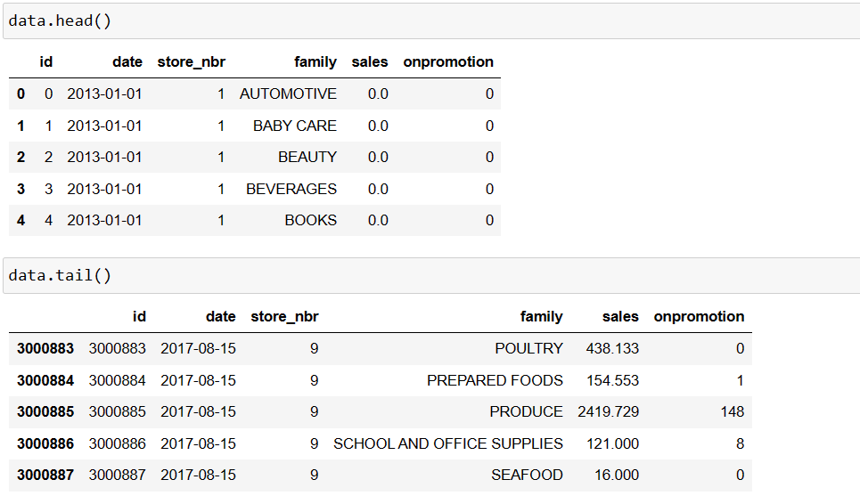
Data Observation :

Slide 6
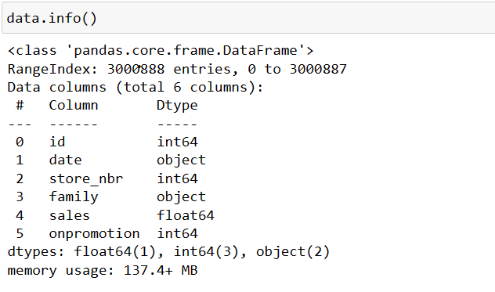
EDA :
Data.info() :

Slide 7
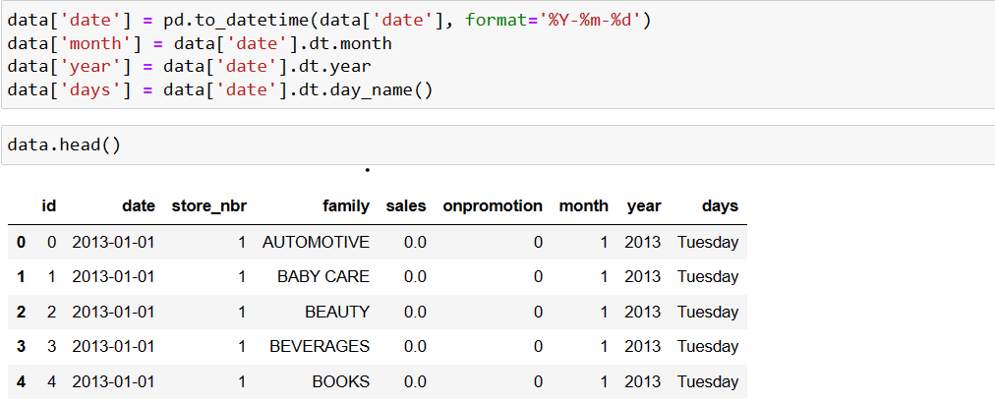
Date Attributes :
Date Attributes has been enhanced dataset including month, year, day of week. This data provide a view of sales patterns and promotional activity.

Slide 8
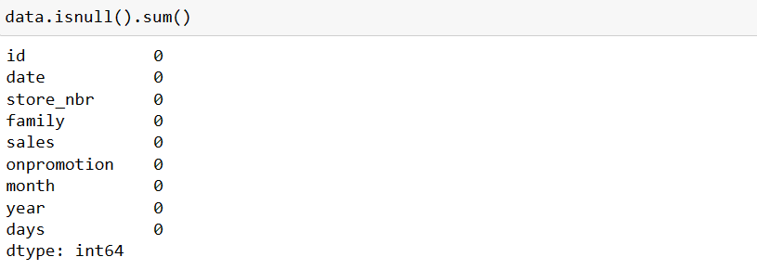
Data Cleaning :
Well, the function returned '0'.This means, there is not a single
duplicate value in our dataset and it is very good thing to know.

Slide 9
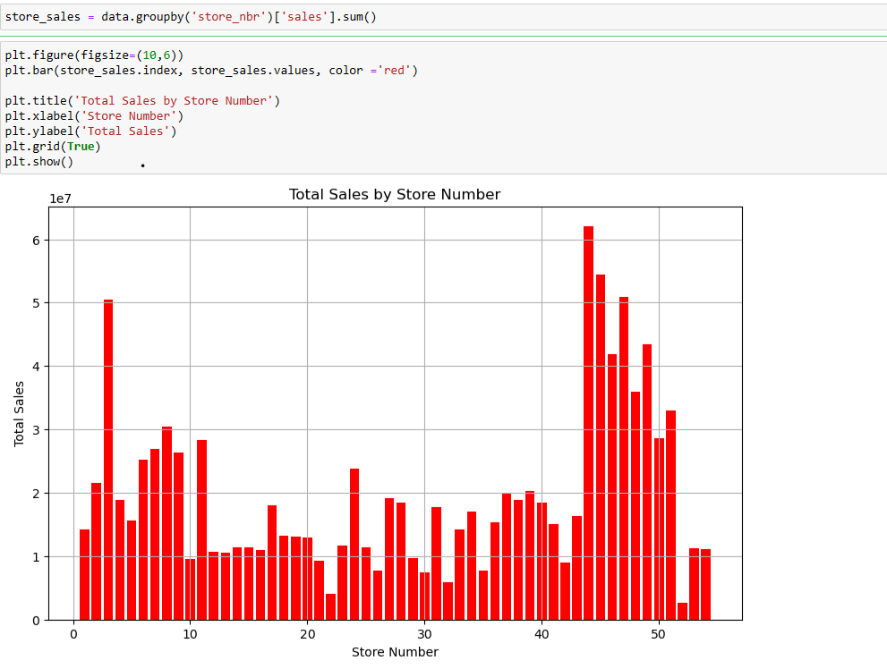
Visualization :
Total Sales in Store
In this graph we will see Store numbers 44 to 49 stand out as top performers in terms of sales.
Store Number 44, a standout performer with the highest sales among all stores.
Store Number 52 stands out with lower sales compared to other stores.

Slide 10
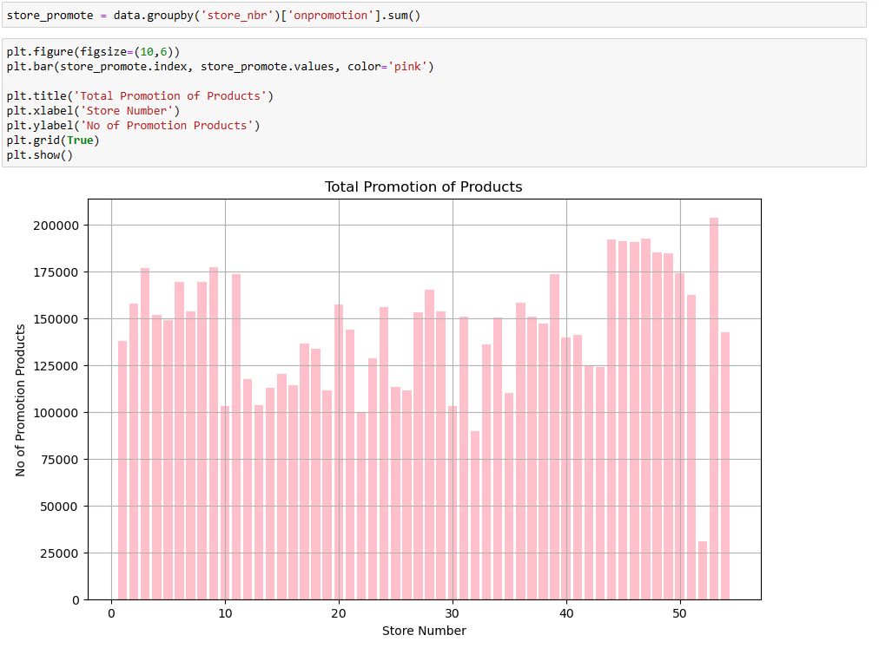
Total Promotion in Stores
In this graph we will see Store Promotions
In Store numbers 44 to 49 comparable same promotion
Store Number 53, the highest promotion among all stores.
Store Number 52 stands out with lower promotion compared to other stores.

Slide 11
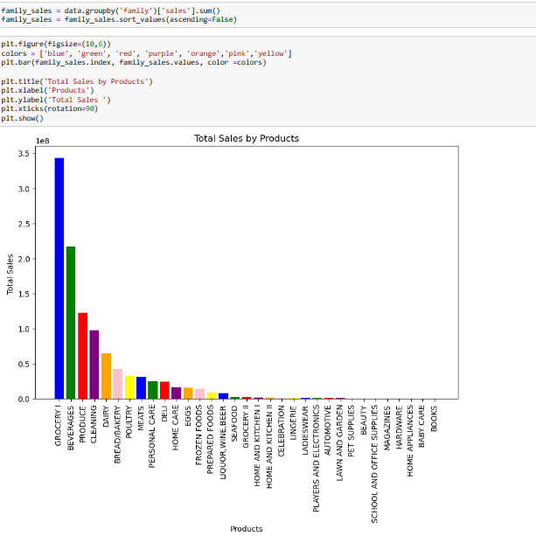
Family Wise Total Sales
In this graph we will see Grocery I, Beverages, Produce, Cleaning, Dairy Product stand out as top performers in terms of sales.
Grocery Product Sales, a standout performer with the highest sales in all Products.
Book Sales stands out with lower sales compared to other Products.

Slide 12
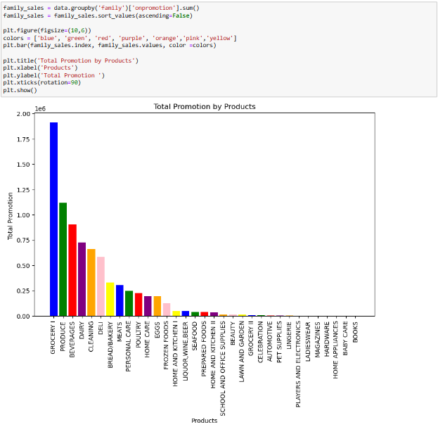
Family Wise Total Promotion
In this graph we will see Grocery I, Produce, Beverages, Dairy, Cleaning Product stand out as high promotion.
Grocery Product Promotion, the highest Promotion in all Products.
Book Sales stands out with lower Promotion compared to other Products.

Slide 13
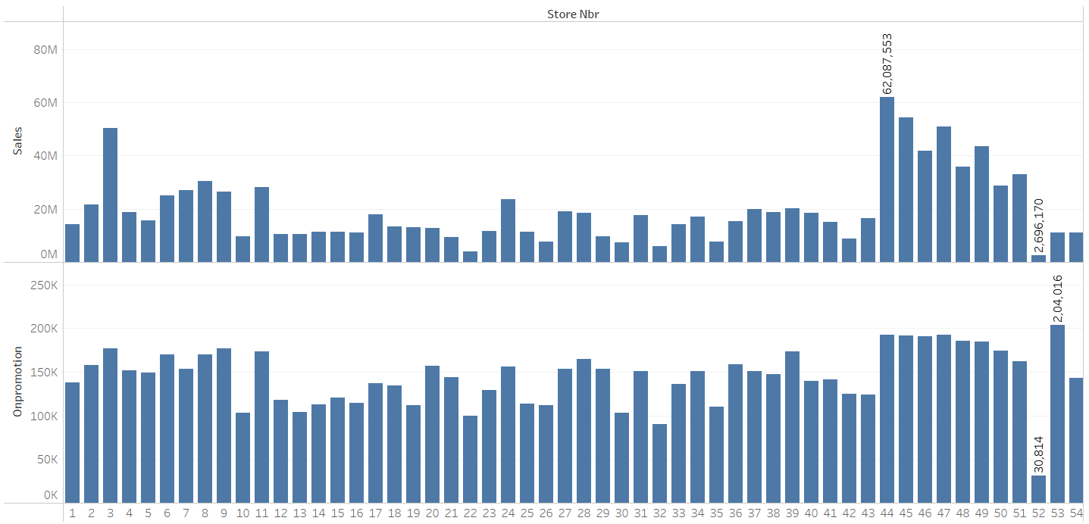
Compare Total Sales and Promotion in Stores
In this graph we will Compare Total Sales and Promotions in Stores.
Store numbers 44 to 49 comparable High sales as high promotion compared to other stores.
Store Number 53, the highest promotion but store sales is low compared to other stores.
Store Number 52 stands out with lower promotion also lower sales.

Slide 14
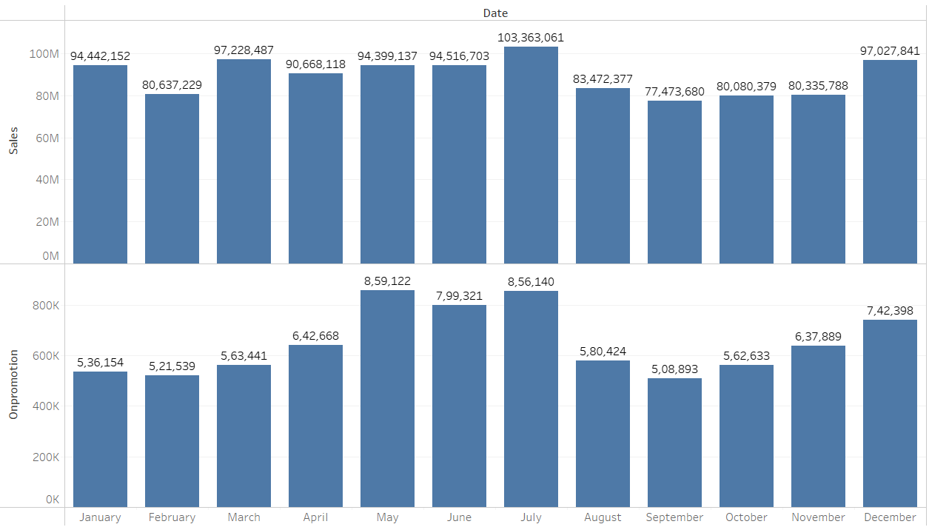
Month Wise Total Sales and Promotion
In this graph we will see Seasonal Sales and Promotions Trends in Stores.
Sales are high in March, July, December month that means this high sales period.
In this month such as holidays, festivities, or specific shopping trends.
Promotion are high in May, June, July Month because in July and December month is most of sales .

Slide 15
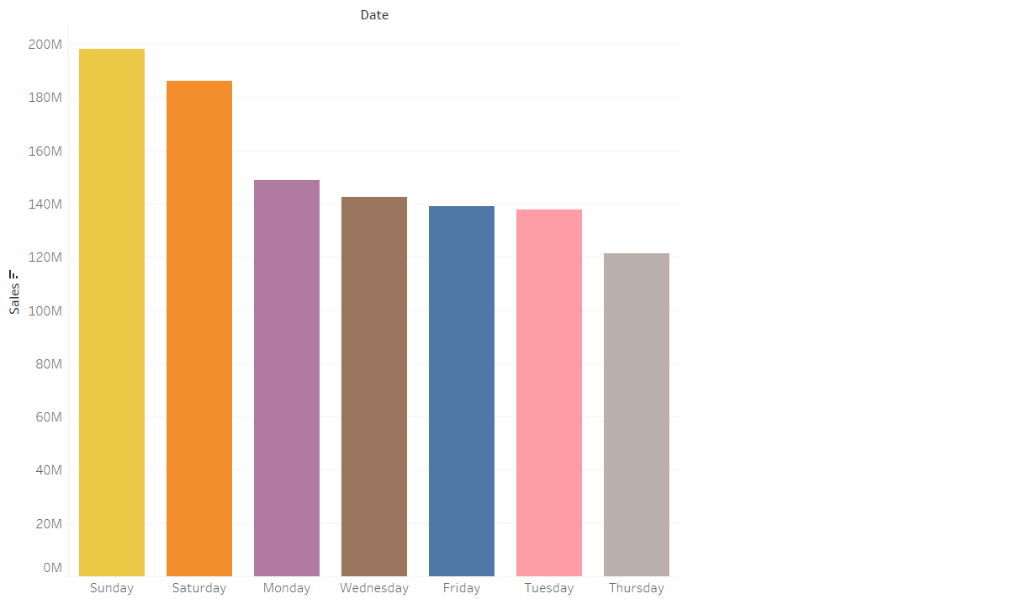
Week Days Wise Sales
In this graph we will see Week Day Wise Sale Trends in Stores.
Most of Sales in Saturday and Sunday
Because Specifically Saturday and Sunday are holiday in all location that means more consumer spending during these days.

Slide 16
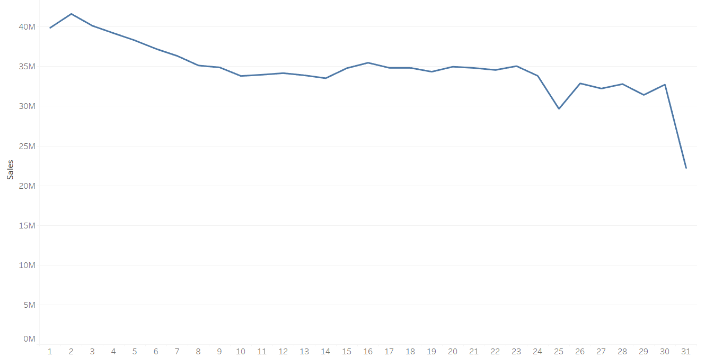
Day Wise Sales
In this graph we will see Day Wise Sale Trends in Stores.
Most of Sales are Starting of month then slowly down day by day.
In 1st day of month is high Sales in overall data
But 30th Day of month Sales was goes Down.
That means more customer purchase and shopping are starting of month.

Slide 17
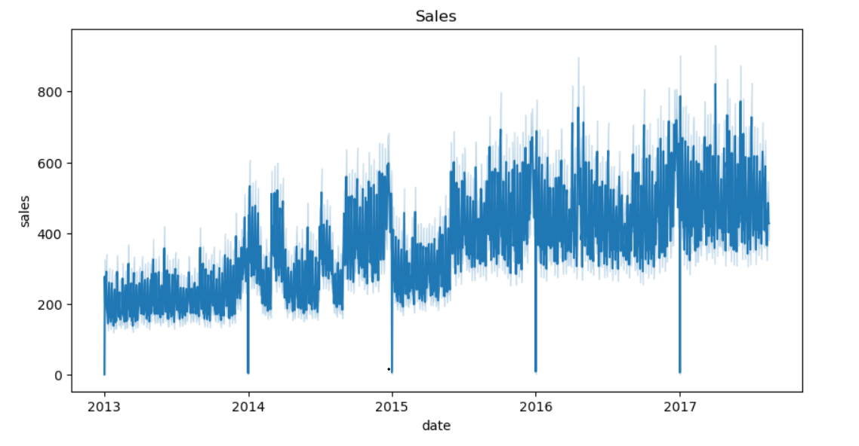
Line Plot of Sales Data

Slide 18
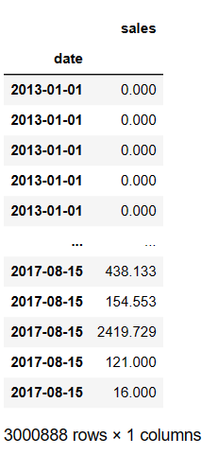
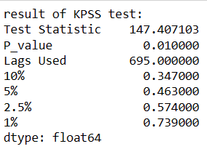
Data Preprocessing :
Check Data is Stationary or Not
Data Selection:
Removed irrelevant column for prediction
Focused on Sales Data
Check Stationary or Not
Use KPSS Test for Check stationarity or Not stationary time series data.
P-Value: Measure of evidence against H0.
Null Hypothesis (H0): P-Value > 0.05: Accept H0 (Data is stationary).
Alternative Hypothesis (H1): P-Value < 0.05: Reject H0 and Accept H1 (Data is not stationary).
Test Outcome
Our Results: P-Value= 0.01 < 0.05.
Conclusion: Data is not stationary.

Slide 19

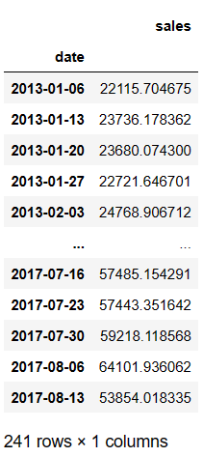
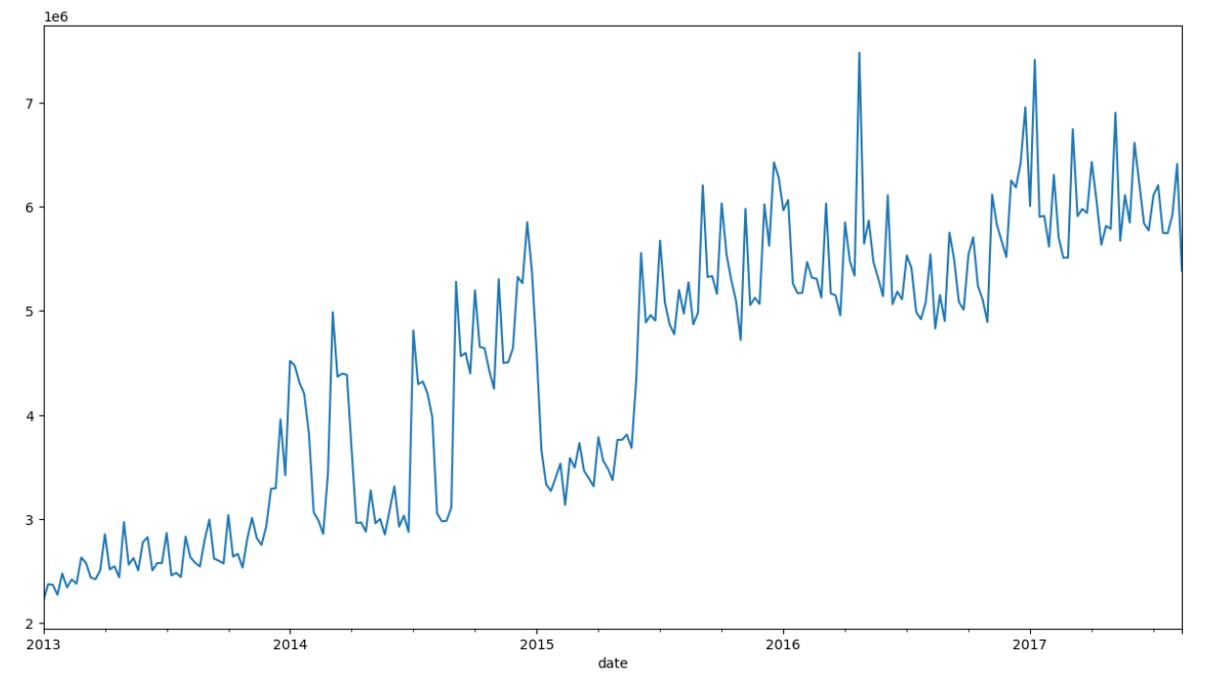
Weekly Sales Aggregation
Using 'resample' function to transform the entire sales dataset into weekly sales. It computes the sum of sales for each week.
This aggregation simplifies the data for used further prediction.

Slide 20
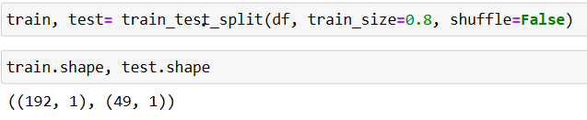
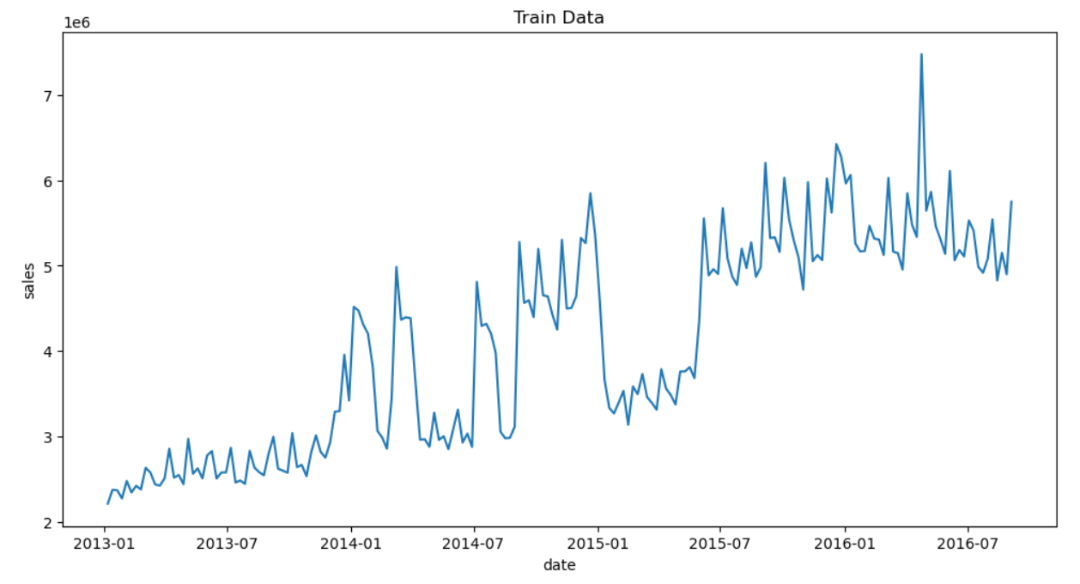
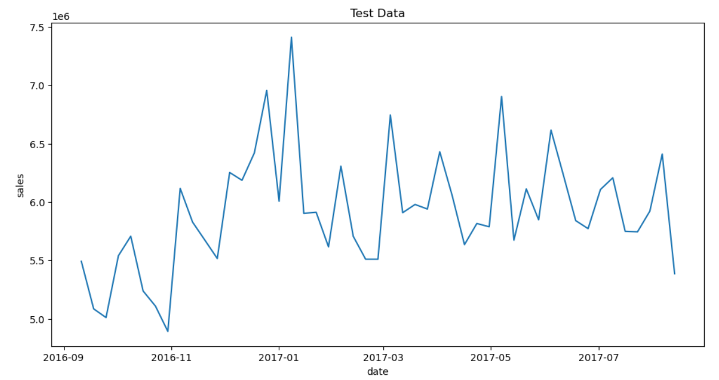
Splitting the Dataset with Model Selection Train-Test Split
Employ model selection's 'train test split' function to divide the dataset into two distinct subsets training data is 80% and testing data is 20%. Using Training data build the predictive model while testing data check models performance.
Train Data
Test Data

Slide 21
Predictive Modelling:
We’ve used a variety of prediction models to make our forecasts as accurate:
Auto ARIMA: An automated version of the ARIMA (AutoRegressive Integrated Moving Average) model, suitable for time series forecasting.
SARIMAX: Seasonal AutoRegressive Integrated Moving Average with Exogenous variables, which accommodates external factors for enhanced prediction.
Linear Regression: A classic regression model that establishes linear relationships between variables for predictive analysis.
Gradient Boosting Regressor: Leveraging gradient boosting techniques to develop a powerful ensemble model for regression tasks.
LSTM (Long Short-Term Memory): A type of recurrent neural network (RNN) optimized for sequence prediction, particularly effective for time series forecasting.

Slide 22
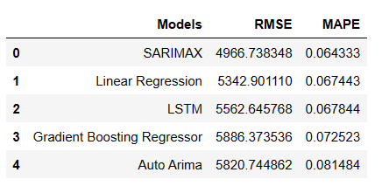
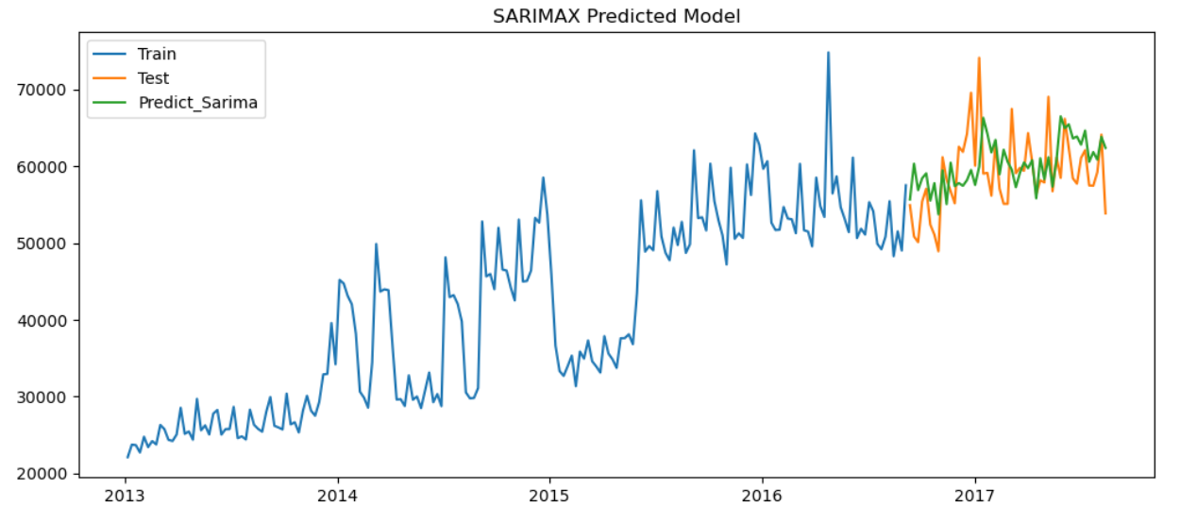
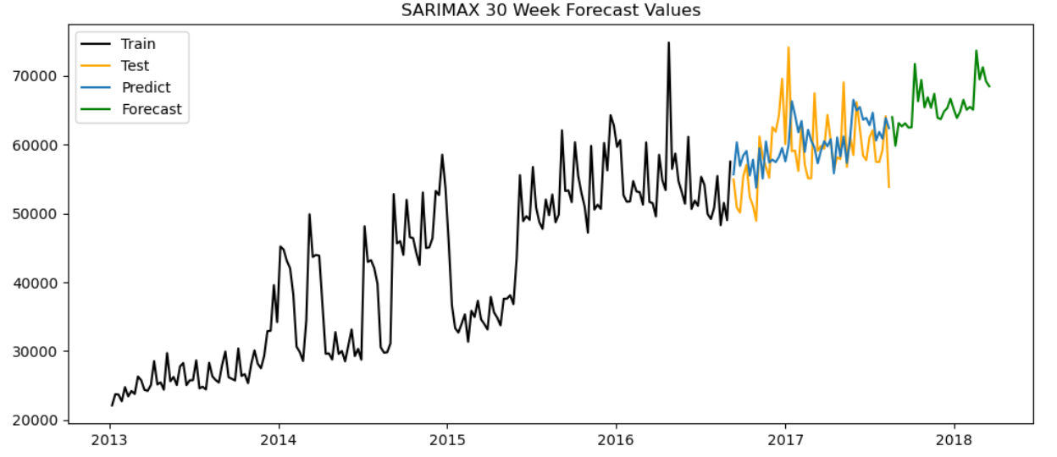
Model Evaluation:
Among the various models we used but SARIMAX model stands out as the top performer. Its Root Mean Square Error (RMSE) of 4966.74 and Mean Absolute Percentage Error (MAPE) of 0.0643 indicate a high level of accuracy in our sales predictions.
SARIMAX Prediction LineChart
SARIMAX Forecast LineChart

Slide 23

Deployment :
Deployment Using Streamlit
Streamlit is a popular open-source framework used for model deployment by machine learning and data science teams. Deployment Streamlit is the process of launching your Streamlit app on the web so that others can access it.
There are different ways to deploy your app, such as using Streamlit Community Cloud, Docker, or Kubernetes. Streamlit Community Cloud is the easiest option, as it lets you deploy your app in just one click from your GitHub repo.

Slide 24
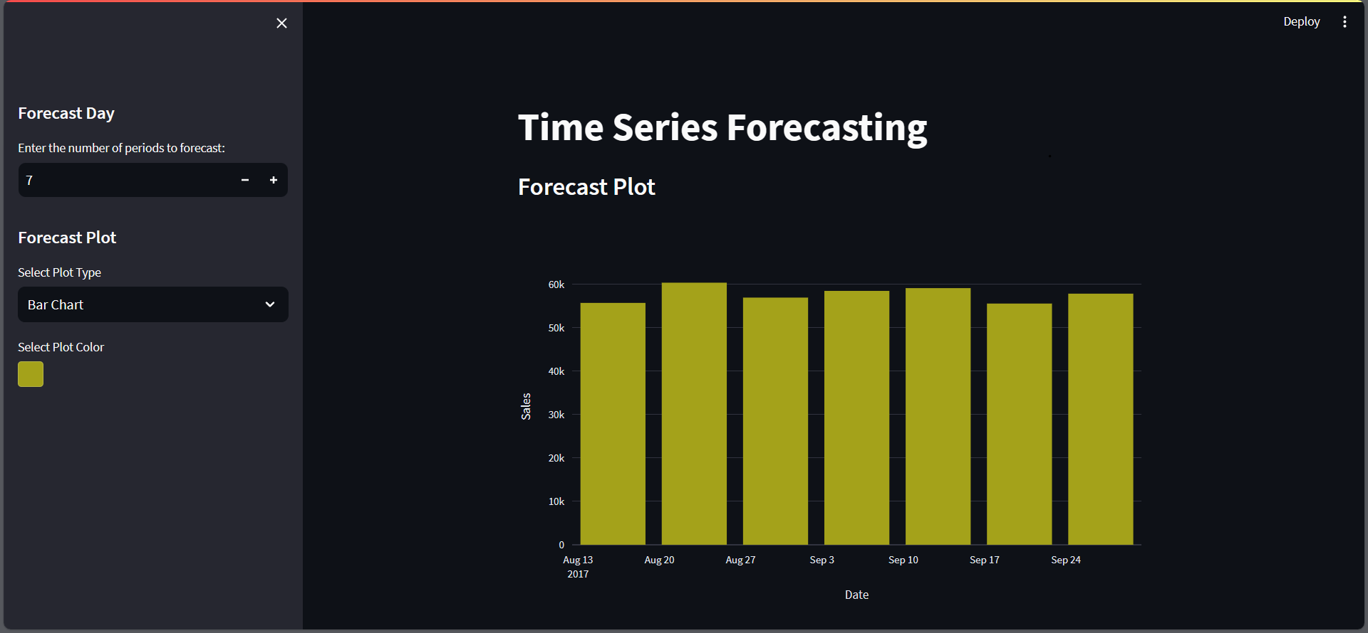
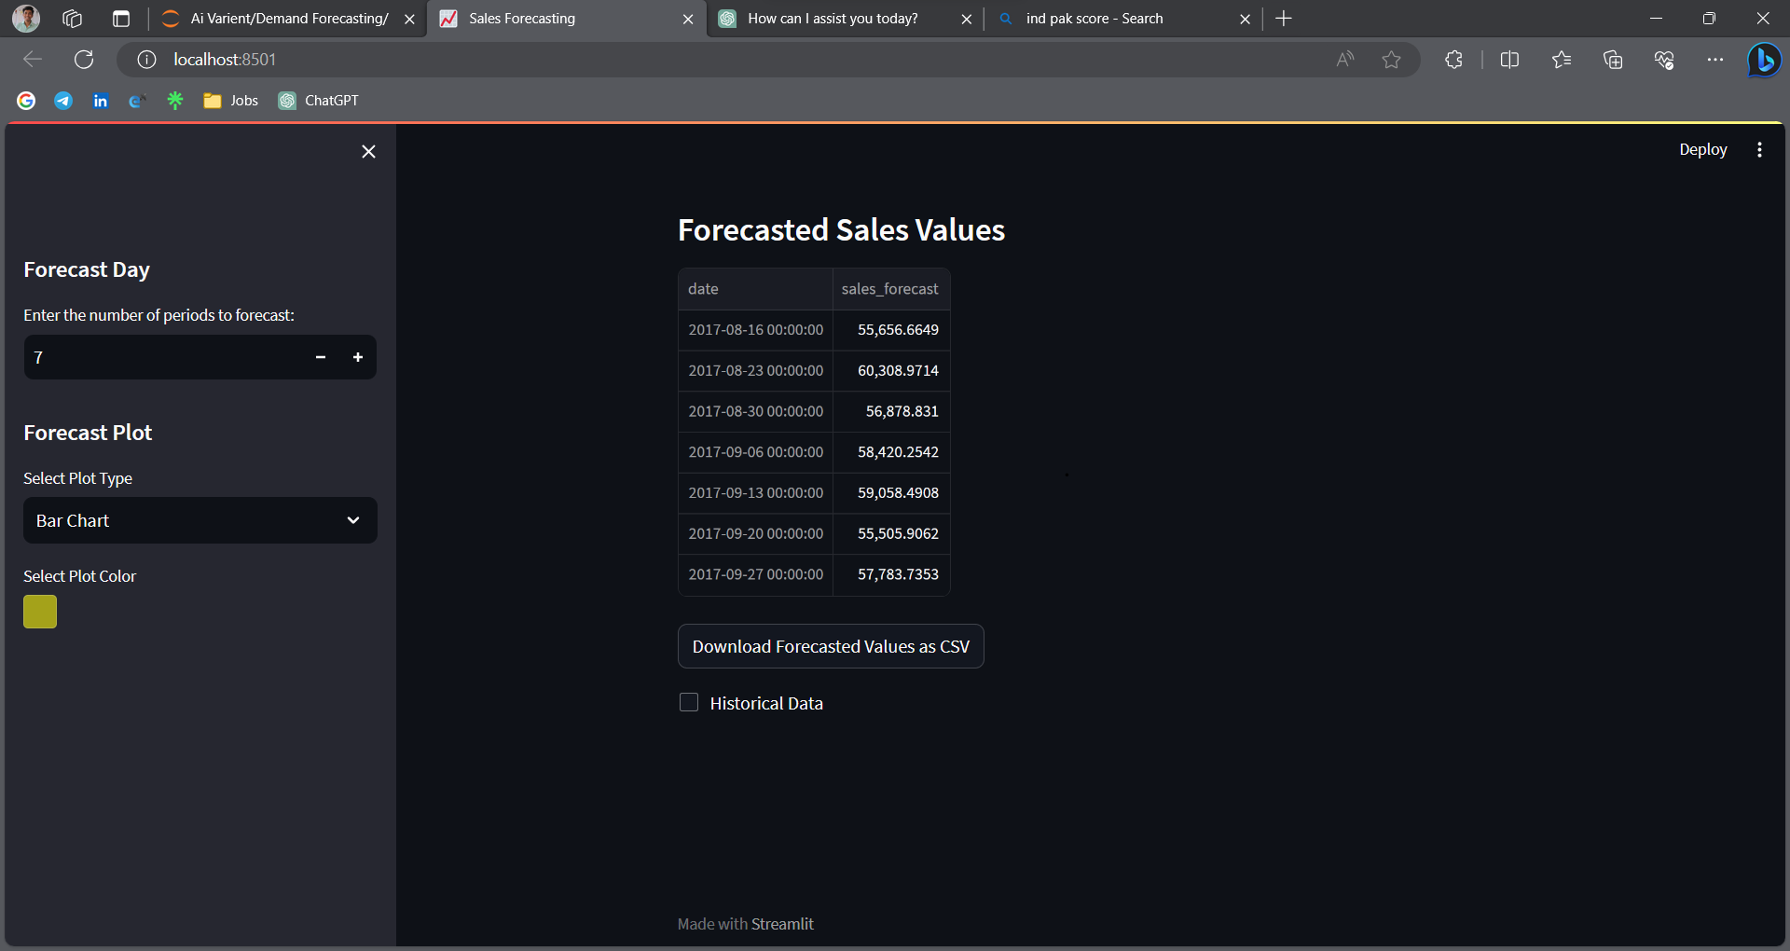
Page View
Forecasting Period Selection:
Users can specify how many weeks into the future they want to forecast sales.
Plot Customization:
Users can choose visualizations: bar charts or line plots, also choose plot color.
Forecast Plot:
Forecast plot is visualize sales predictions. Users can interpret trends and patterns.
Forecast Sales Values:
This values shows future periods sales.
Download Forecasted Values:
Users can download forecasted sales values as a CSV file.
Historical Data Display:
Historical sales data is presented in an easy-to-read table format.

Slide 25
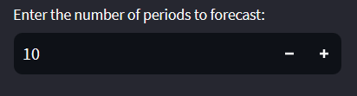
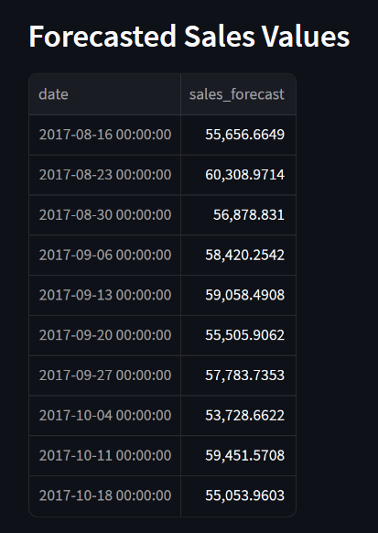
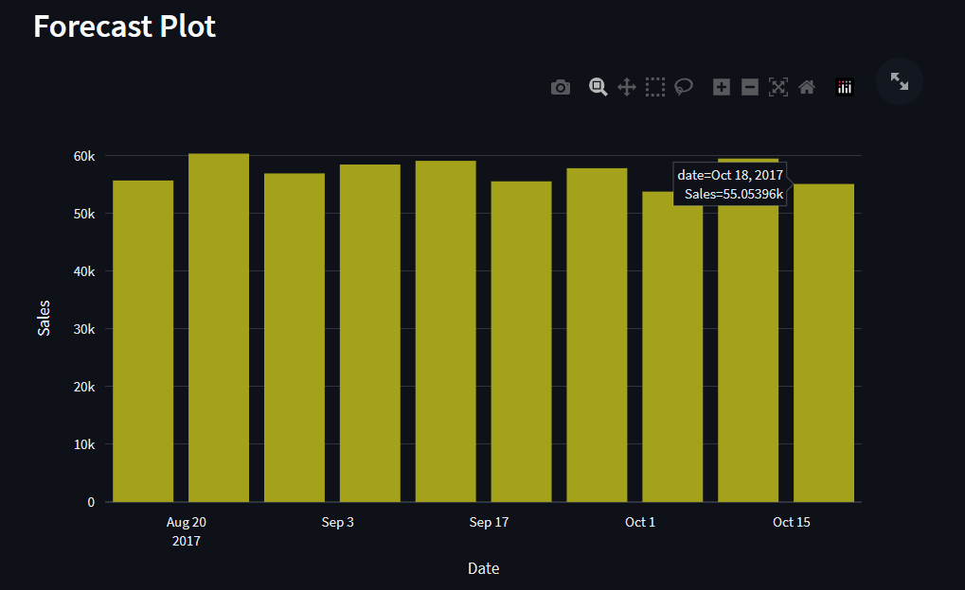

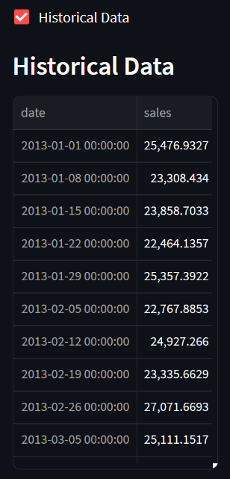
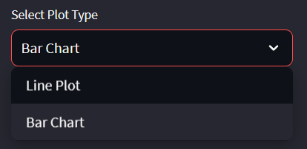
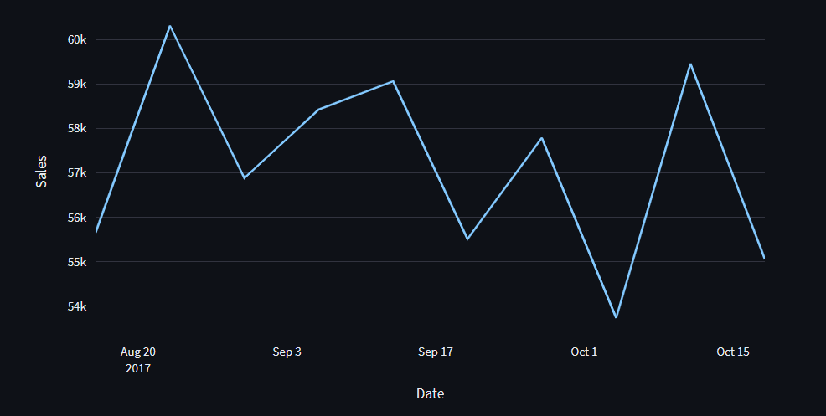
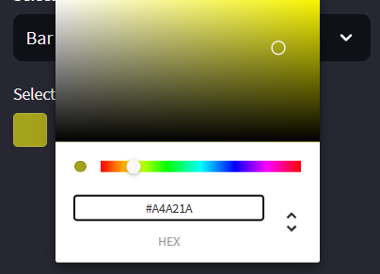

Select Week no. for Forecast
Forecasted Values
Forecast Plot (Bar Plot)
Checkbox for Historical Data
Historical Data
Select Plot Type
Forecast Plot (Line Chart)
Select Color for Bar Plot
Download Forecasted values

Slide 26
Challenge Faced:
1) Large historical data: There are 4 year Sales data its relatively large period of time, which can make it difficult to accurately forecast future prices.
2) Seasonality and Trends: We faced understanding and dealing with pattern in the sales data that repeated over time (seasonality) and long term shifts (trends). These pattern required for complex dataset when working on time based data.
3) Model selection: There are many different types of models that can be used to forecast time series data, and selecting the right one for a specific dataset can be challenging.

Slide 27
Thank You

