Slide 1
HOTEL RATING CLASSIFICATION
Project
PROJECT BY -
Mr. Akshay Kotkar

Slide 2
Architecture:
Understanding Business Objective
Exploratory Data Analysis
Visualization
Data Pre-Processing
Model Building
Model Evaluation
Feedback
Deployment

Slide 3
BUSINESS OBJECTIVE:
This is a sample dataset which consists of 20,000 reviews and ratings for different hotels and our goal is to examine how travellers are communicating their positive and negative experiences in online platforms for staying in a specific hotel and major objective is what are the attributes that travellers are considering while selecting a hotel.
With this manager can understand which elements of their hotel influence more in forming a positive review or improves hotel brand image.

Slide 4
DATA DESCRIPTION
The data file contains 3 features
Review
Rating
@
Based on the data we have to build the best sentiments which gives the best sentiment analysis.

Slide 5
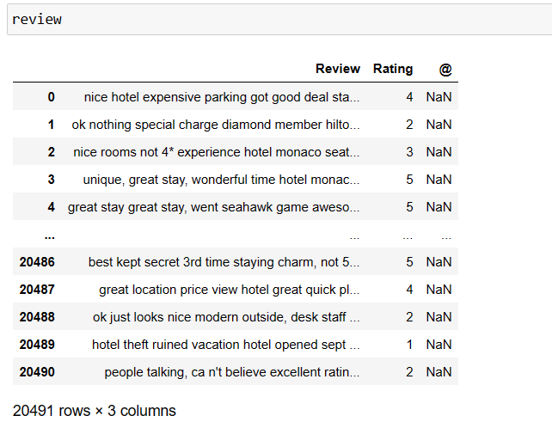
Data Observation:

Slide 6
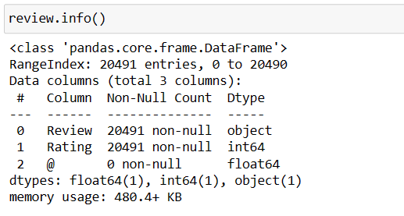
Data info()
EXPLORATORY DATA ANALYSIS (EDA):
The data types are floating point, integer, objective data types.

Slide 7
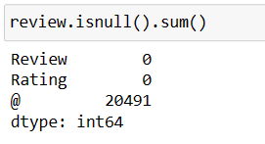

Data Cleaning
The function returned 0. but, @ column are 20491 null values then this column Drop it.
Well, The duplicated function returned 0 =. Means, There is not a single duplicated value in our dataset.

Slide 8
EXPLORATORY DATA ANALYSIS (EDA):
The data types are floating point, integer, objective data types.
The given dataset has no null values.
The given dataset has 20491rows and 3 column.
@ column is not important then Drop it.
The given dataset has remain 2 columns Review and Ratings.
There are 5 types of Ratings 1,2,3,4,5
We found 0 duplicate values on given dataset.

Slide 9
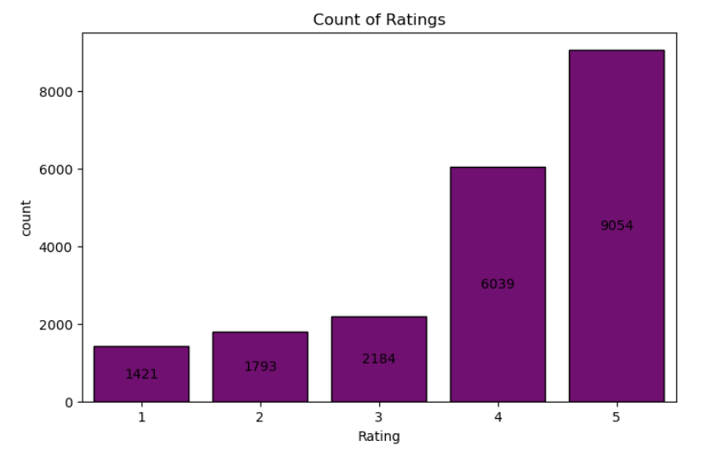
Ratings Count:
VISUalization:
In this graph we will see 5 types of Rating. 5 Star ratings stand out as top in 9054 reviews.
6039 reviews as 4 Star Ratings. 1 Star Ratings stands out with lower 1421 Reviews only.

Slide 10
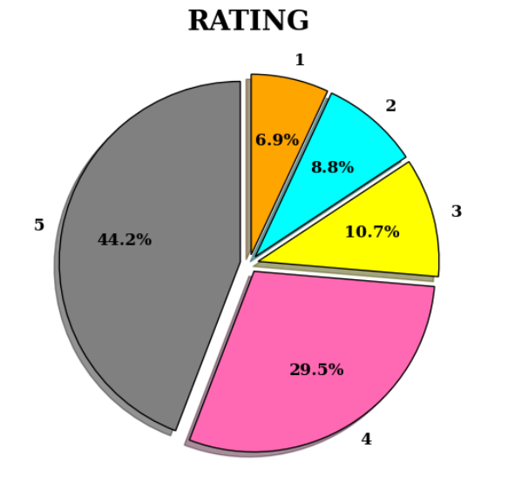
Ratings Count in percentage:
In this graph, we will see 5 types of Ratings in Percentage format. 5-star ratings can be 44.2% of reviews. That means most of the Reviews are 5-star ratings.
The 4-star rating can be 29.5%, and the 1-star rating can be 6.9% reviews.

Slide 11
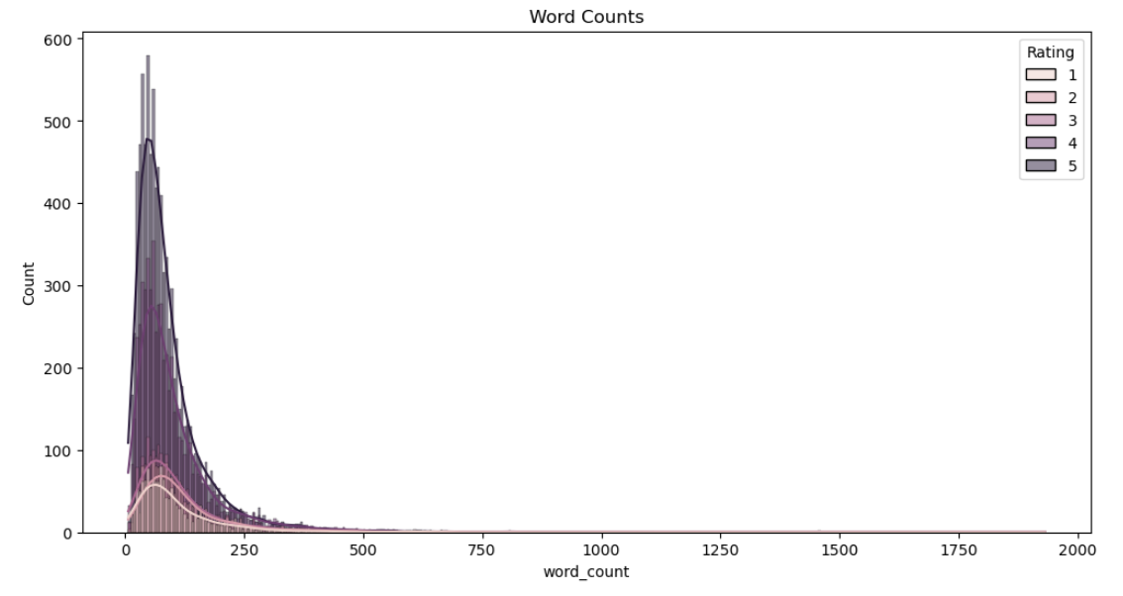

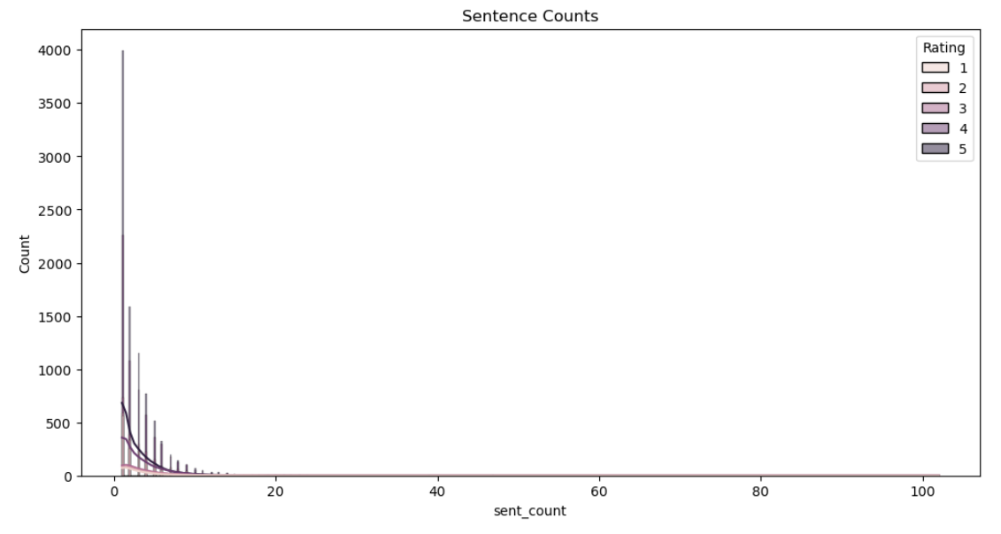
Counts of word, char, sentences:

Slide 12
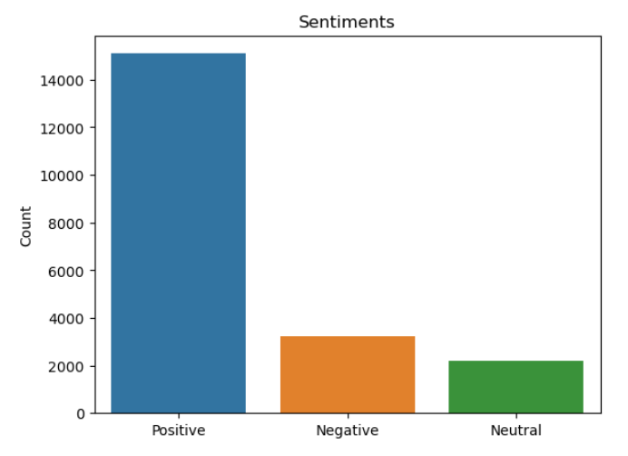
Sentiment words:
In this graph, we will see Positive, Negative, and Neutral Sentiment.
We will convert ratings into Sentiment words.
1 and 2-star Ratings Convert into Negative.
3-Star Rating Convert into Neutral Sentiment.
4 and 5-star Ratings are converted into Positive Sentiment.
There are 15000 positive reviews.

Slide 13
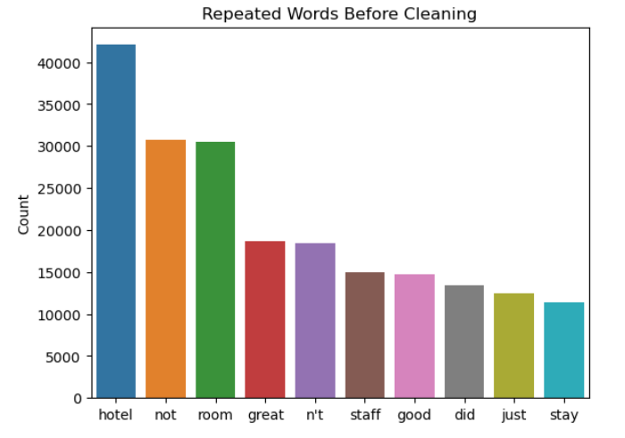
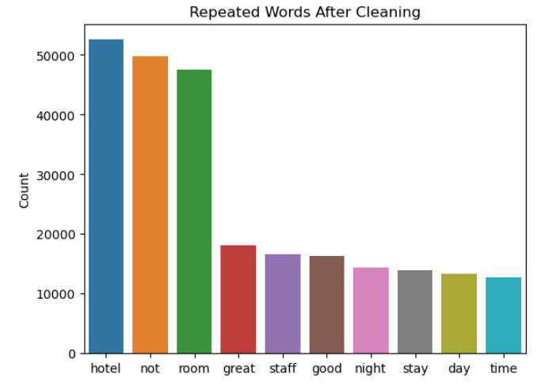
repeated words :
There are Top 10 Repeated Words in Reviews.
Before Cleaning Data We found the hotel, not, room, great, n’t words as a top.
But after cleaning the data We found the hotel, not, room, great, stuff word as a top.
That means n’t words are converted as not.

Slide 14
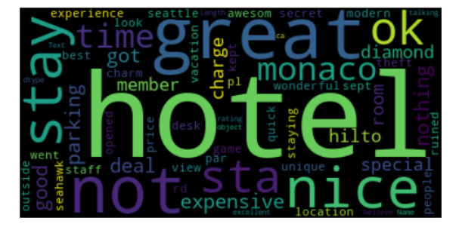
WordCloud :
A word cloud is a visual representation of text data where the size of each word in the cloud is proportional to its frequency or importance in the dataset. In the dataset the word "Hotel" is the most repeated word, then it would appear with a larger font size in the word cloud compared to other words that are less frequent.

Slide 15
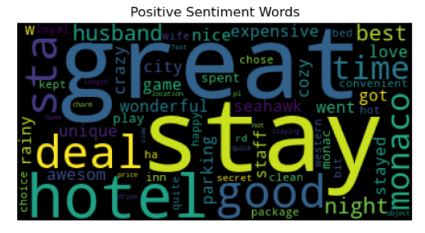
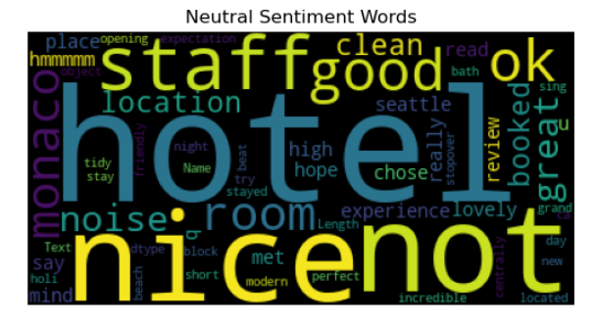
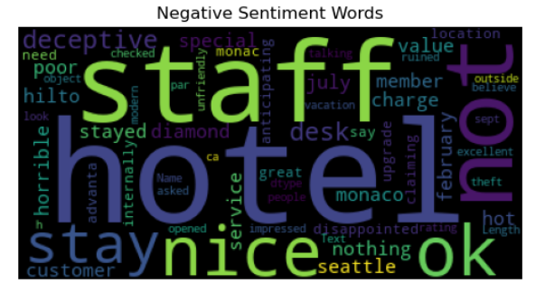
WordCloud :
Three types of Sentiments Wordcloud (Positive, Neutral, Negative)

Slide 16
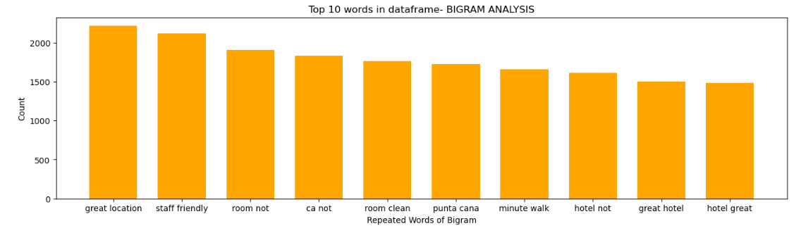
N-Grams (Bi-grams):
N-grams are continuous sequences of words, symbols, and tokens in the document. They can defined as the neighbour’s sequence of items. Here we can create Bi-grams means which generate pairs of 2 words.
We can found the Top 10 repeated 2 word pairs in dataset

Slide 17
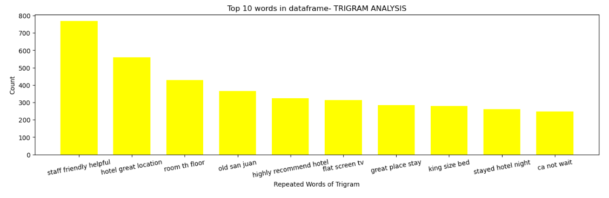
N-Grams (Tri-grams):
Here we can create Tri-grams means which generate pairs of 3 words.
We can found the Top 10 repeated 3-word pairs in dataset

Slide 18
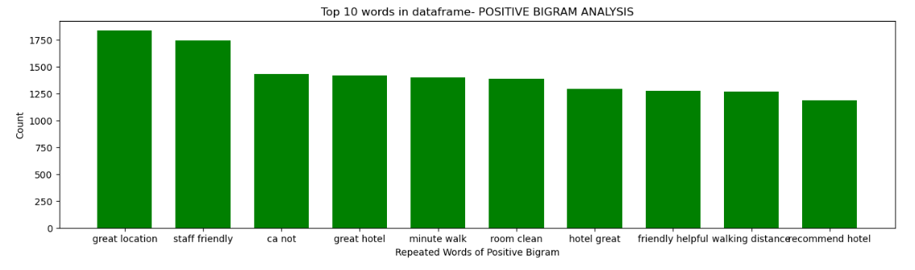
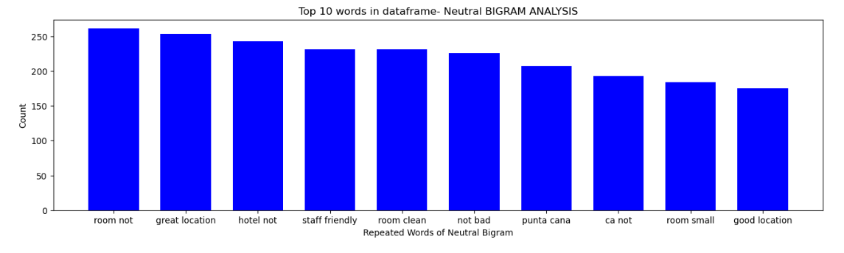
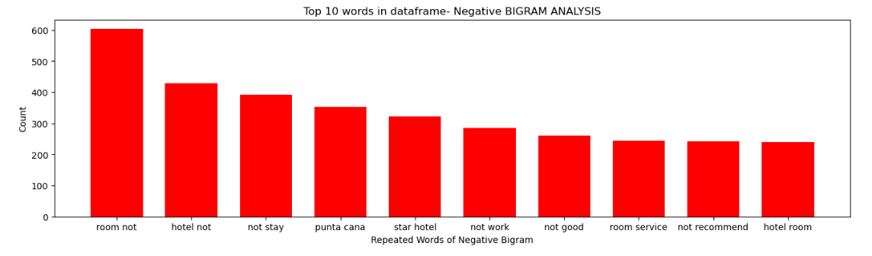
Bi-grams Word (Positive, Neutral, Negative):

Slide 19
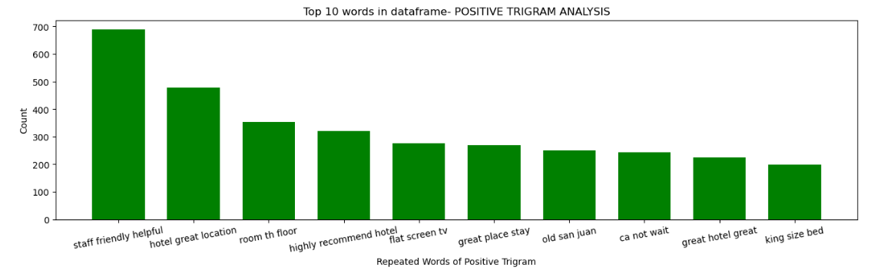
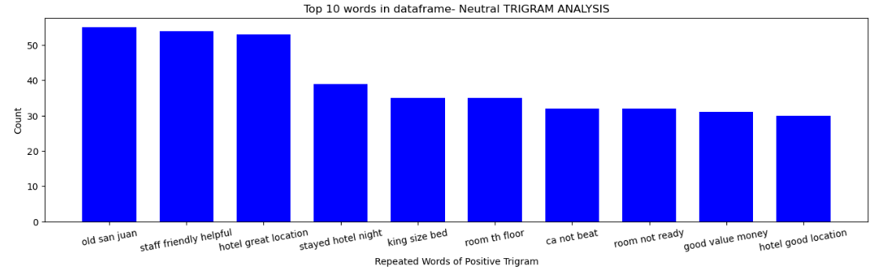
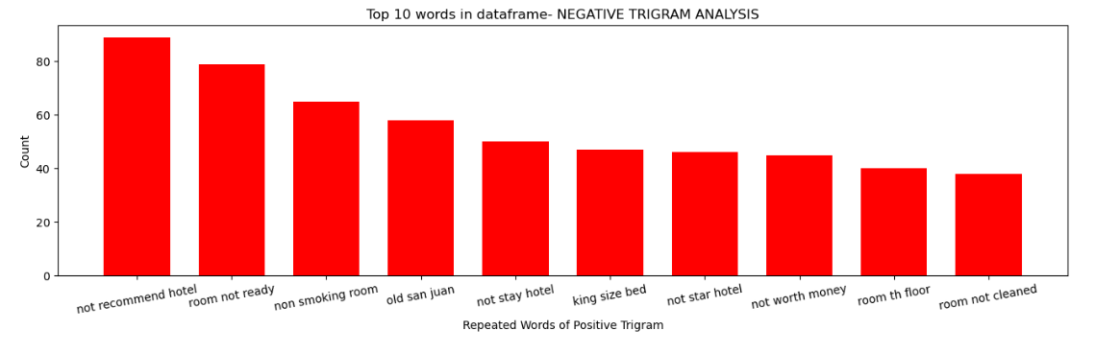
Tri-grams Word (Positive, Neutral, Negative):

Slide 20
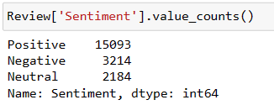
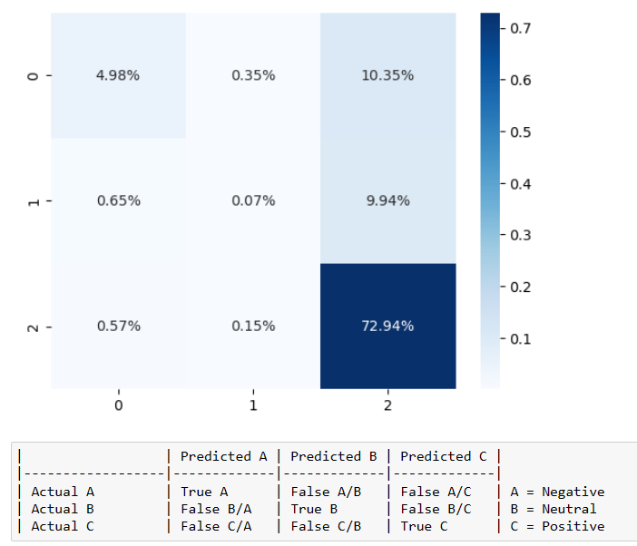
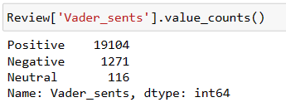
Vader Sentiment (Sentiment Intensity Analyzer)
Original Rating Value Counts
Confusion Matrix on Comparing Original and Vader Sentiments
Vader Sentiment Ratings Value Counts
The 'Vader sentiment’ method tends to classify more reviews as positive compared to the original sentiment analysis their accuracy is 0.78, which could be due to differences in the classification algorithm or criteria.

Slide 21
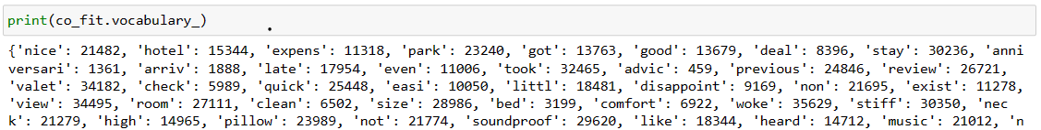
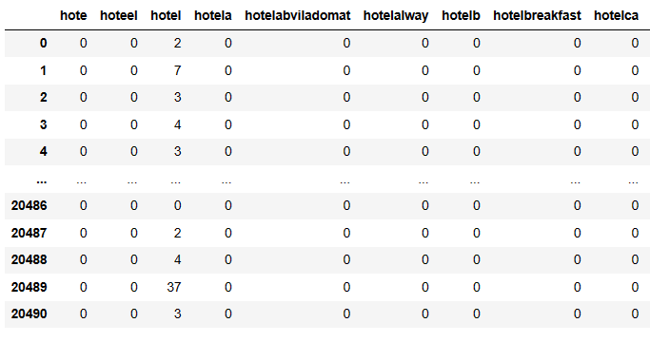
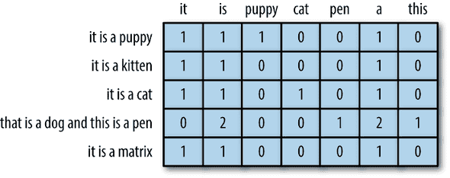
Count Vectorization
CountVectorizer is used to transform a given text into a vector on the basis of the frequency (count) of each word that occurs in the entire data frame. This is helpful for converting each word in each text into vectors (for using in further text analysis).
Vocabulary_ Attribute
The vocabulary_ attribute of CountVectorizer returns a dictionary that shows features with numbers.
Numbers represent the indices of unique words in sorting order. The sorting happens based on ASCII sort order.
toarray() funtion
Example of Count Vectorization

Slide 22
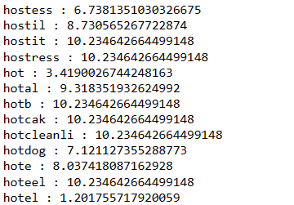
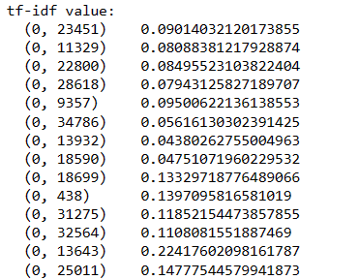
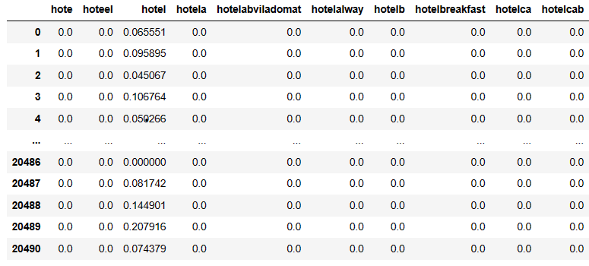
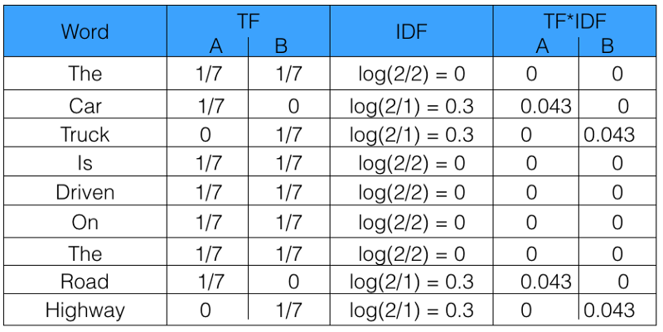
Tf-idf Vectorization
Tf-idf stands for Term freq. Inverse Document freq. is used to transform a given text into a vector.
Same as Count Vectorizer but in this TF-IDF Vectorizer takes into account not only how many times a word appears in a document but also how important that word is to the whole corpus.
IDF Values
TF-IDF Values
Normalized Term Frequency (tf)
Inverse Document Frequency (idf)
toarray() function
Example of TFIDF Vectorization

Slide 23
Model Building
We’ve used a variety of models to make our classification as accurate:
AdaBoostClassifier: Adaptive Boosting works by training the sequence of weak learners on the dataset. The final model is a weighted sum of all the weak learners, with the weights determined by their accuracy.
Gradient Boosting Classifier: It is an ensemble method that builds an additive model in the forward stage fashion. It allows for the optimization of arbitrary differentiable loss functions. The final model is a weighted sum of all the weak learners, with the weights determined by their contribution to reducing the loss function.
SVC: SVC stands for support vector classifier. It is based on finding the hyperplane that maximally separates the data points of different classes.
MultinomialNB: This model is used for text classification problems in Natural Language Processing (NLP). MultinomialNB works on the principle of Bayes theorem and assumes that the features are conditionally independent given the class variable.

Slide 24
Model evalution Metrices:
Accuracy of Count Vectorizer
Model No | Model Name | Train Accuracy | Test Accuracy
1 | Adaptive Boosting Classifier | 0.82 | 0.81
2 | Gradient Boosting Classifier | 0.85 | 0.82
3 | Support Vector Classifier | 0.92 | 0.84
4 | Multinomial Naïve Bayes | 0.88 | 0.83
5 | Bagging Classifier with Logistic Regression | 0.97 | 0.84
Accuracy of TF-IDF Vectorizer
Model No | Model Name | Train Accuracy | Test Accuracy
1 | Adaptive Boosting Classifier | 0.83 | 0.83
2 | Gradient Boosting Classifier | 0.85 | 0.82
3 | Support Vector Classifier | 0.97 | 0.86
4 | Multinomial Naïve Bayes | 0.73 | 0.74
5 | Bagging Classifier with Logistic Regression | 0.89 | 0.85

Slide 25

Deployment :
Deployment Using Streamlit
Streamlit is a popular open-source framework used for model deployment by machine learning and data science teams. Deployment Streamlit is the process of launching your Streamlit app on the web so that others can access it.
There are different ways to deploy your app, such as using Streamlit Community Cloud, Docker, or Kubernetes. Streamlit Community Cloud is the easiest option, as it lets you deploy your app in just one click from your GitHub repo.

Slide 26
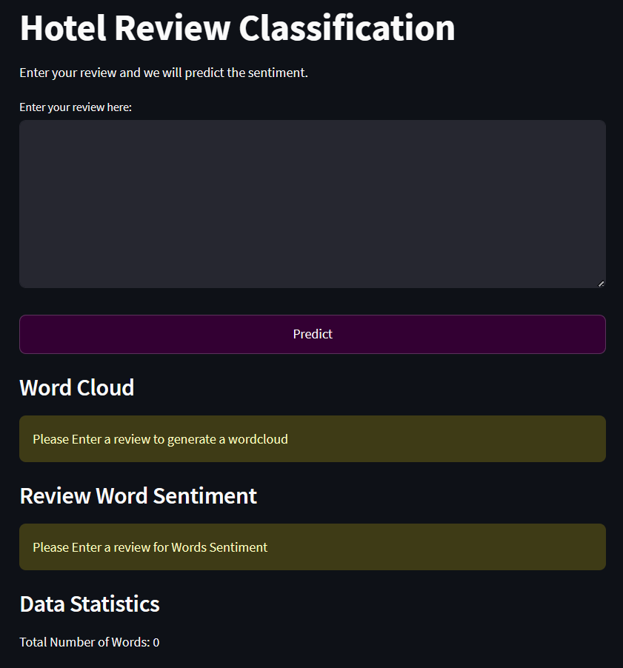
Page View
Text Cleaning: This function run in the backend for cleaning text data, and removal of HTML tags, numeric values, punctuation, and stopwords. The text is further tokenized, stemmed, and lemmatized to enhance its analysis.
Sentiment Analysis: Using the Afinn library, the code predicts sentiment (Positive/Negative) based on the Input review.
Word Cloud Generation: A word cloud is generated from the input review, presenting a visual representation of word frequency.
Data Statistics: Data statistics show the count of cleaned text including the total number of words.
User Interaction: The Streamlit application allows users to input hotel reviews for sentiment analysis. The "Predict" button triggers the analysis, displaying the sentiment prediction and associated word cloud. Users can interpret the sentiment based on the color-coded positive, negative, and neutral keywords.

Slide 27
Challenge Faced:
1) Cleaning data using NLTK: Ensuring precise sentiment analysis is tricky because not all words in a review carry equal weight The code attempts to handle this by substituting "n’t" with "not," but capturing the true importance of negative words remains a challenge
2) Review iteration challenge: Processing each review with the custom stopword removal function in a large Excel file can strain computational resources. Efficient iteration methods and optimized code are crucial to address this challenge and maintain data processing.
3) Model selection: There are many different types of models that can be used for sentiment analyst, and selecting the right one for a specific dataset can be challenging.analysis

Slide 28
THANK YOU

