Slide 1


Book Recommendation system
Group-V
Mentors-Karthik & Dhanya
08-05-2023

Slide 2
Team:
Mr. Rohith S
Mr. Akshay N R
Mr. Aniruddha Bharat Dhokate
Ms. Gayatri Gaonkar

Slide 3
Business Objective:
Generate the features from the dataset and use them to recommend the books accordingly to the users.

Slide 4
EDA & VISUALIZATION:
First we merged the datasets Books and Ratings using the common column ISBN.
We checked for null values and duplicate values then removed them.
We renamed the columns and rearranged them according to our requirement.
We treated outliers in Age column in Users dataset and filled null values with mean.
Some of the values were misplaced in some columns like “year of publications” had values like Publisher’s name & column “publisher” had values of Year of publication like 2002. We solved those problems by finding unique values of each column.

Slide 5
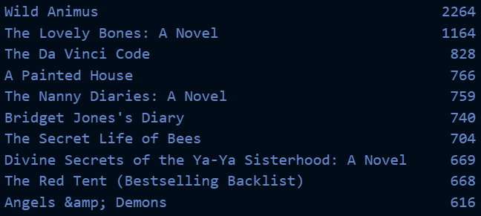
Top 10 books according to ratings:

Slide 6
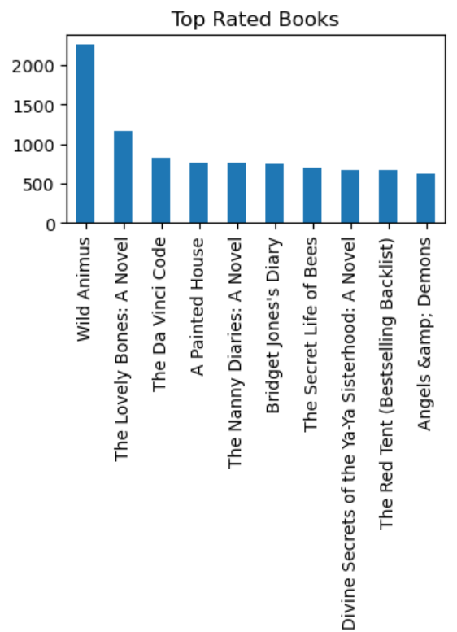
Top 10 Books
Highest rated book is “ Wild Animus”.
Below Top 2 all other books are almost have same ratings upto 10th rated book.

Slide 7
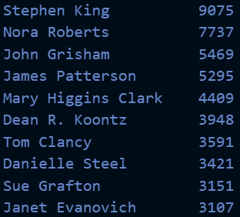
Top 10 Authors according to ratings:

Slide 8
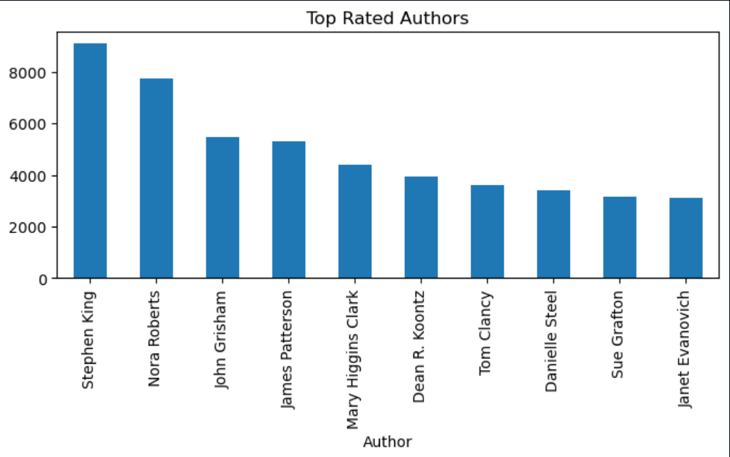
Top 10 Authors
Stephen King is highest rated author among all.

Slide 9
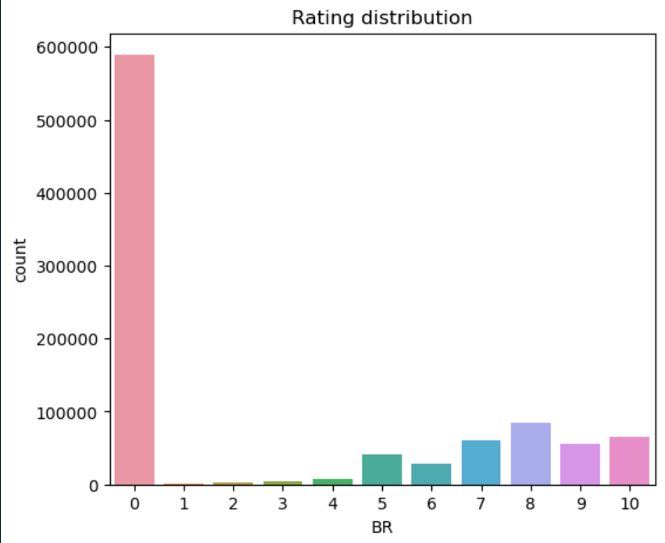
Rating Distribution-Bar plot
Zero ratings are highest as they are implicit ratings of readers.
We can observe that most of the books have good ratings .

Slide 10
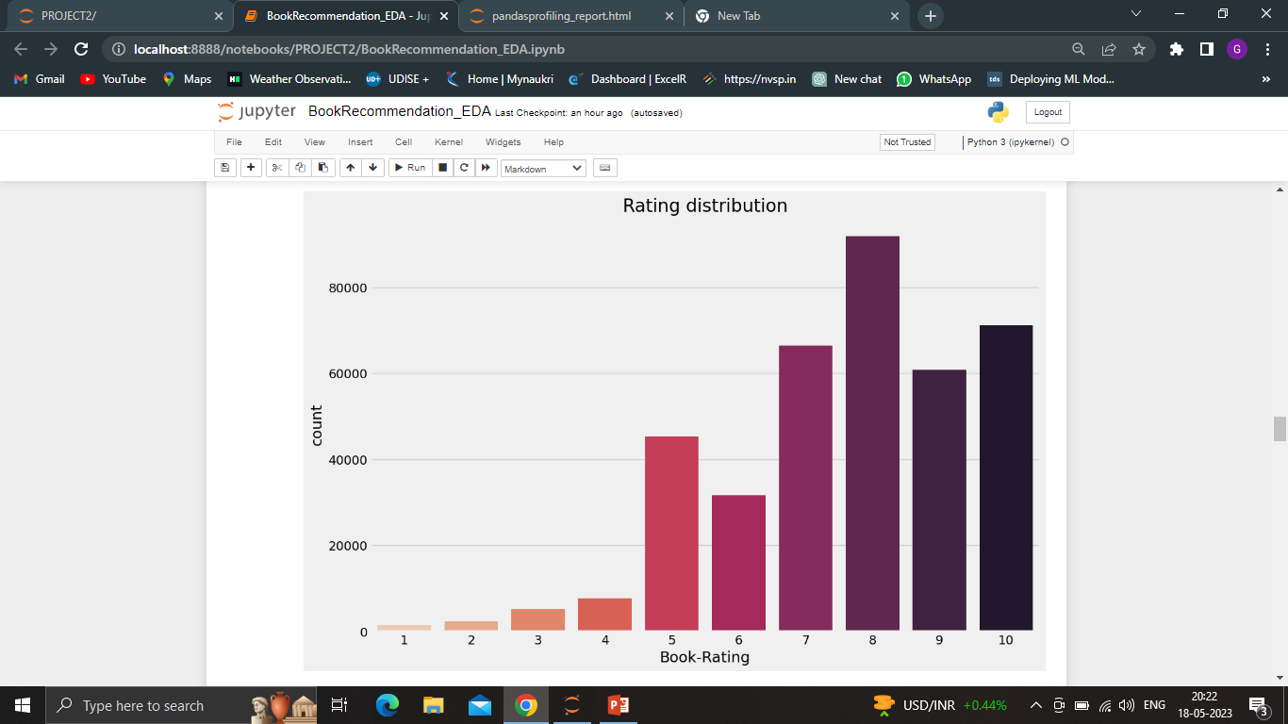
Segregating Explicit & Implicit Ratings
Rating “8” is highest.
Rating “10” is highest after “8”.
Majority of the Books got good rating between 7 & 10.
And many books got rating “5” which kind of neutral, neither good nor bad.

Slide 11
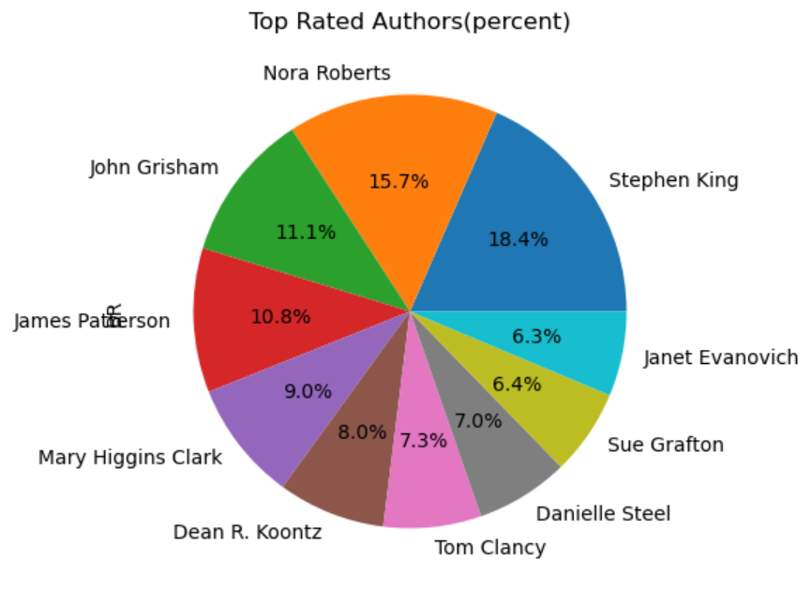
Most popular Authors according to ratings in percentage.
Stephen King got 18.4% of total ratings in Top 10.
Janet Evanovich as least 6.4% ratings in Top 10.

Slide 12
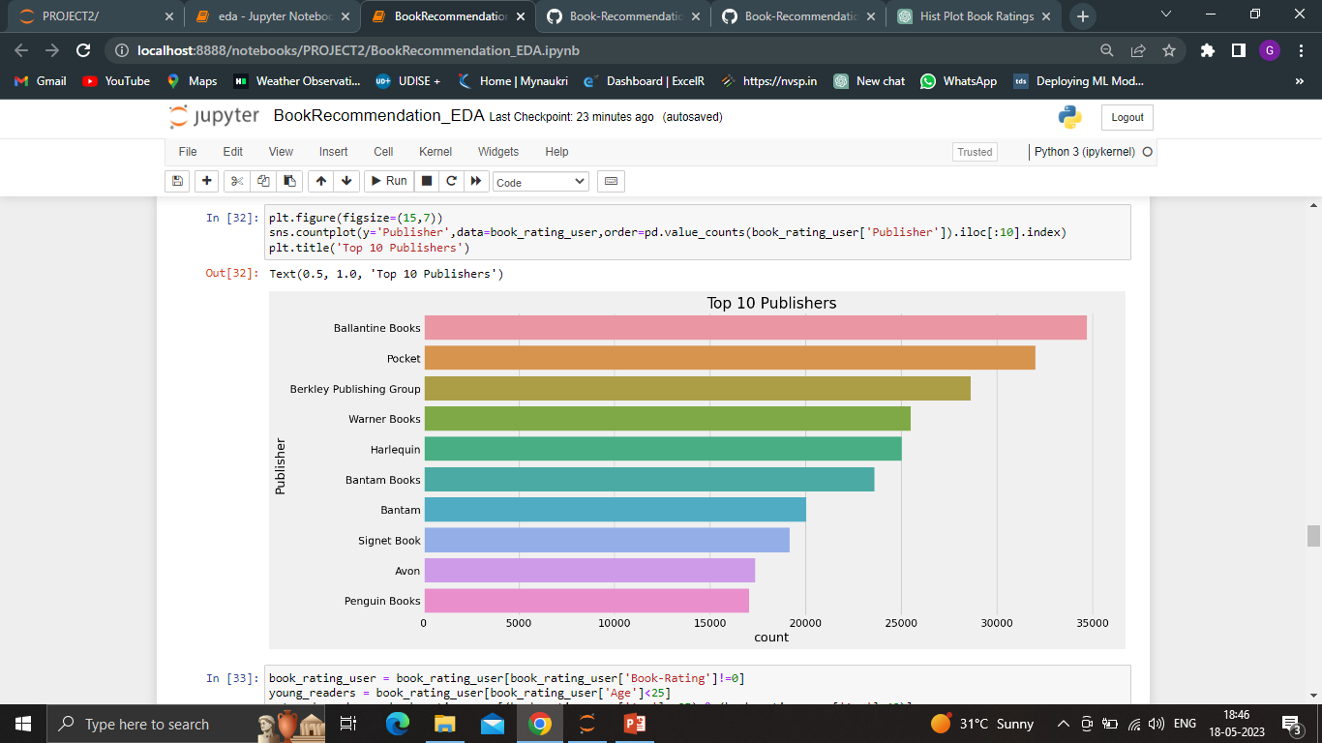
Top 10 Publisher
Ballantine Books publication is #1 publisher among all having highest books published so far.
Pocket is #2.
Berkley Publishing group is 3rd.

Slide 13
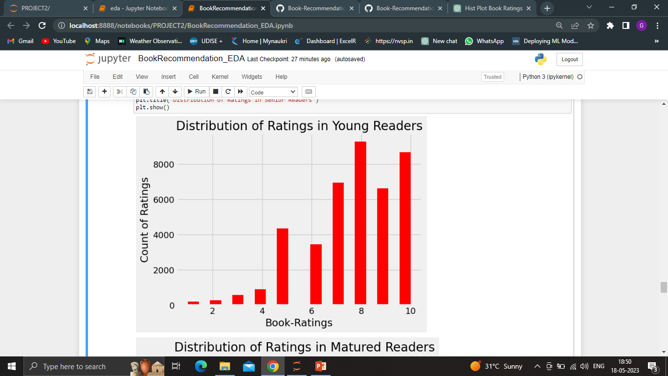
Distribution of Ratings in Young Readers
Here majority of the young readers rated 8 for the books.
And 10 after that.

Slide 14
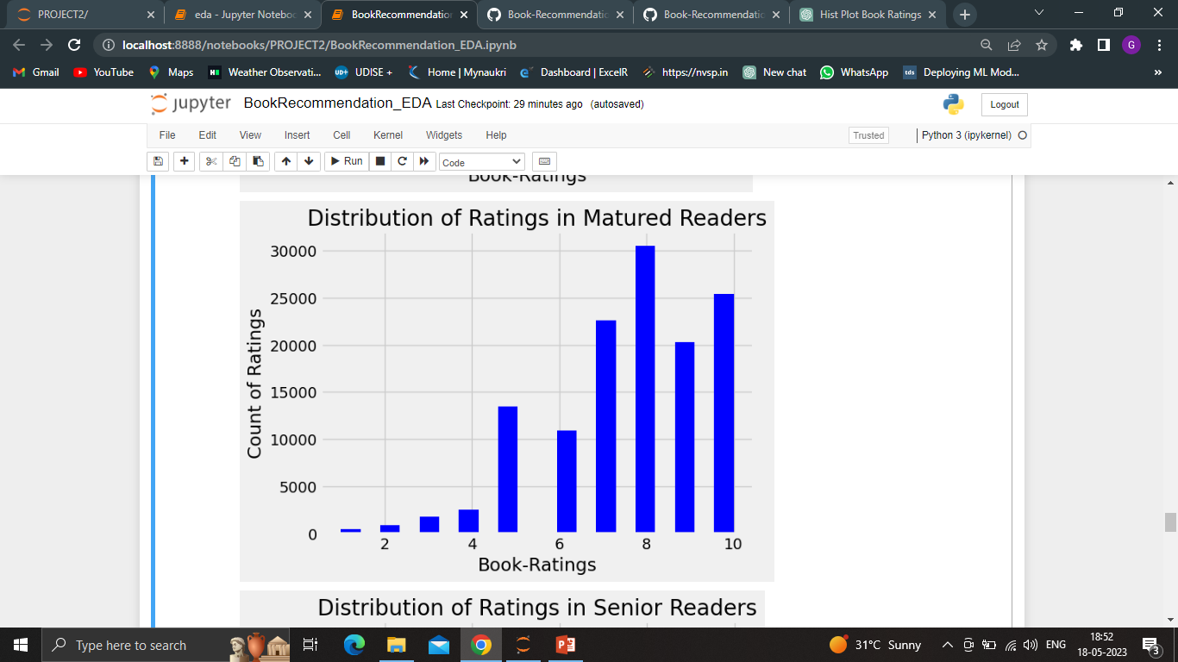
Distribution of Ratings in Matured Readers
Here also we can observe that majority of the Matured readers rated 8 for the books.
And 10 after that.

Slide 15
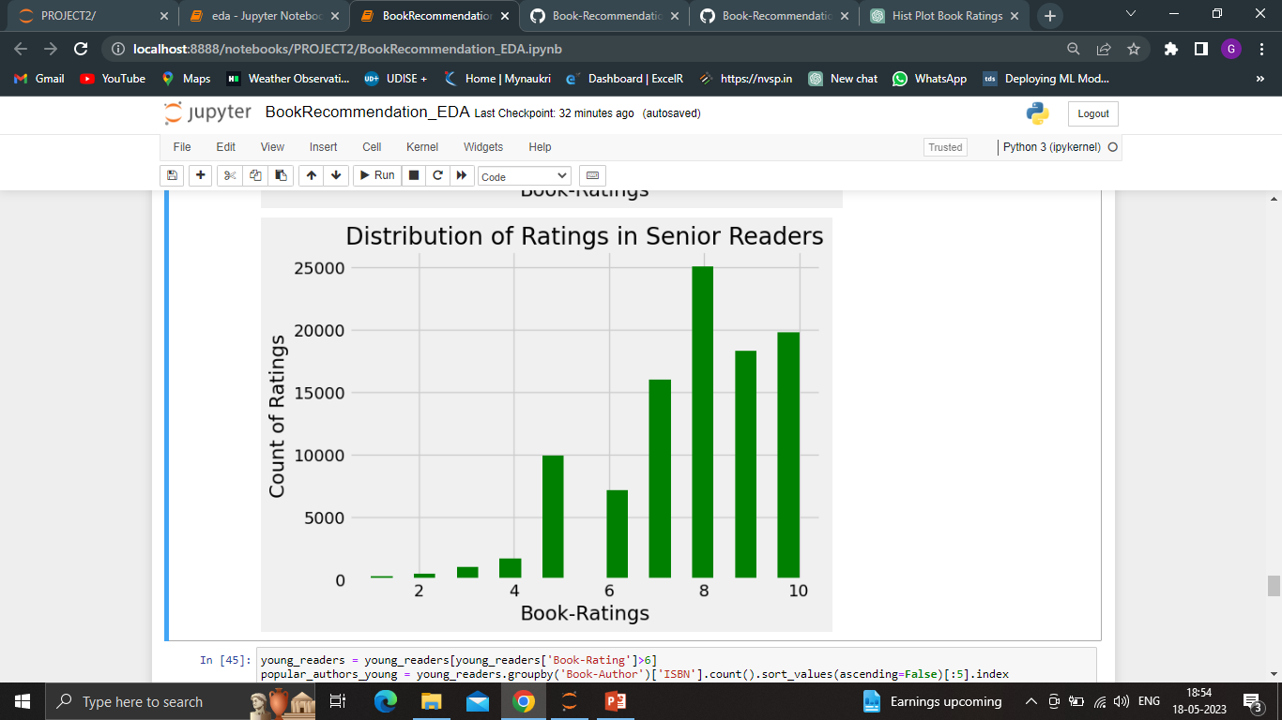
Distribution of Ratings in Senior Readers
Same as Young and Matured readers, Senior readers also gave ratings “8” more.

Slide 16
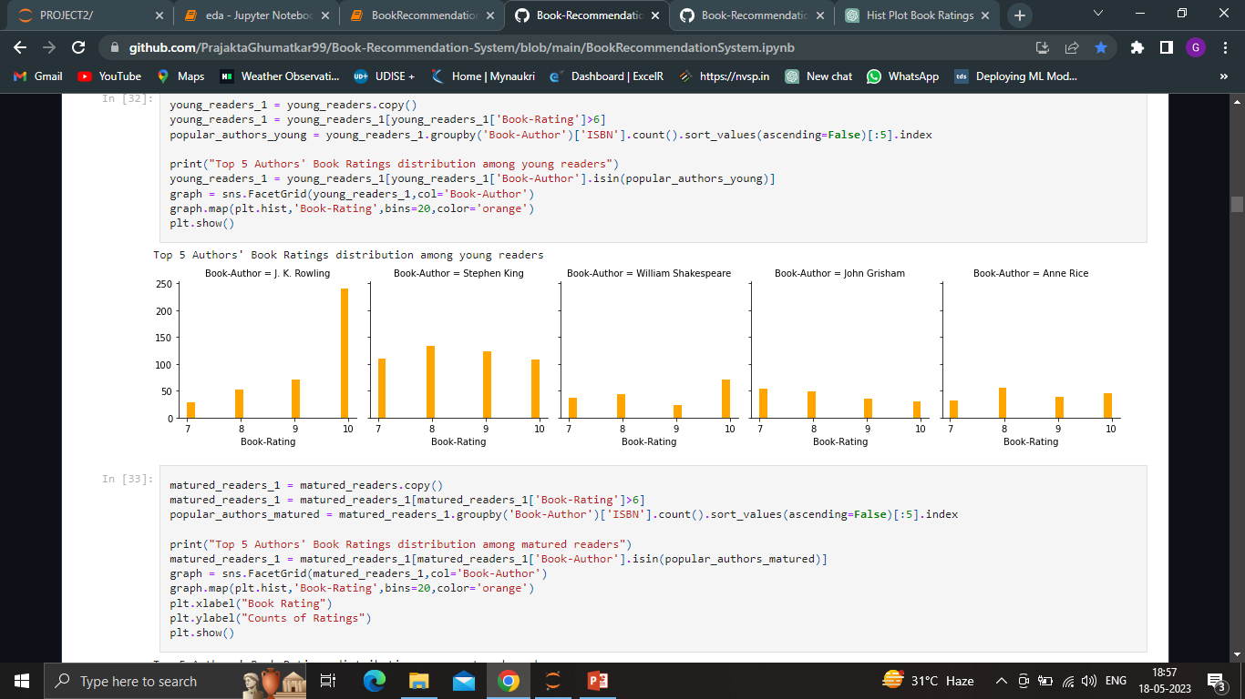
Top 5 Author’s Book Ratings distribution among Young Readers
Our fav. (Harry Potter) Author J. K. Rowling got more ratings of “10” and “7” is the least.
J. K. Rowling’s books are famous among Young Readers.
All her Harry Potter series is famous.

Slide 17
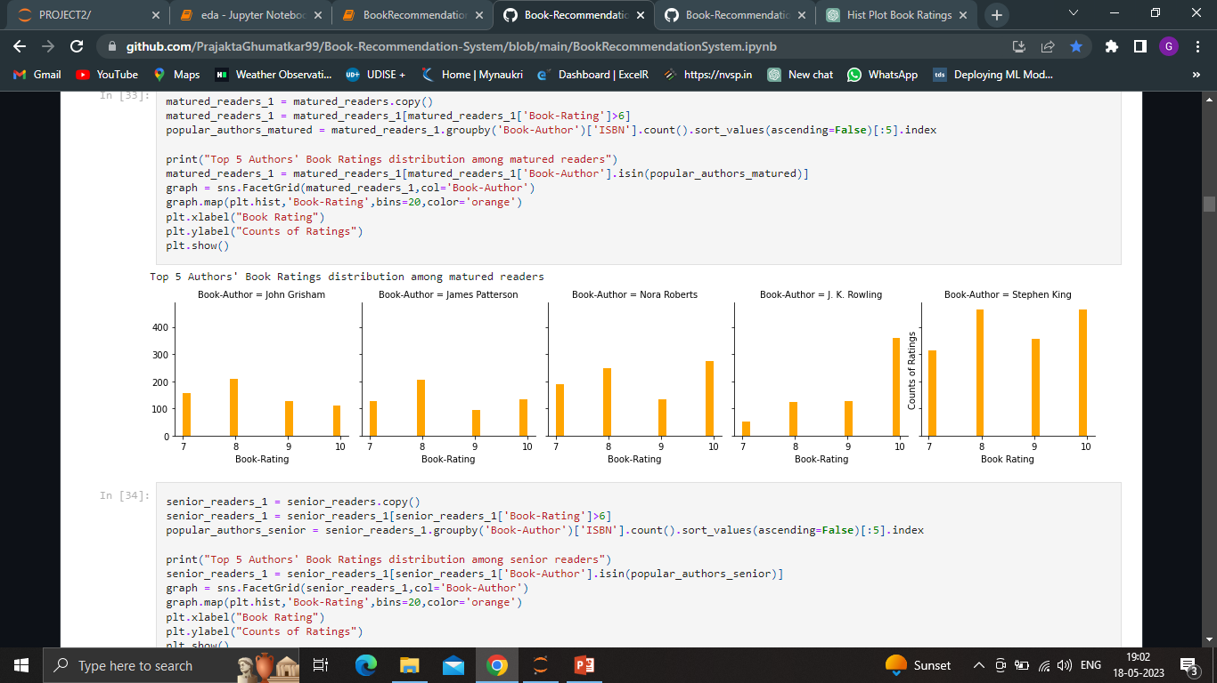
Top 5 Author’s Book Ratings distribution among Matured Readers
Stephen King got Best ratings “10” & “8” from Matured readers beating all other Authors.
Our fav. (Harry Potter) Author J. K. Rowling got more ratings of “10” and “7” is the least.

Slide 18
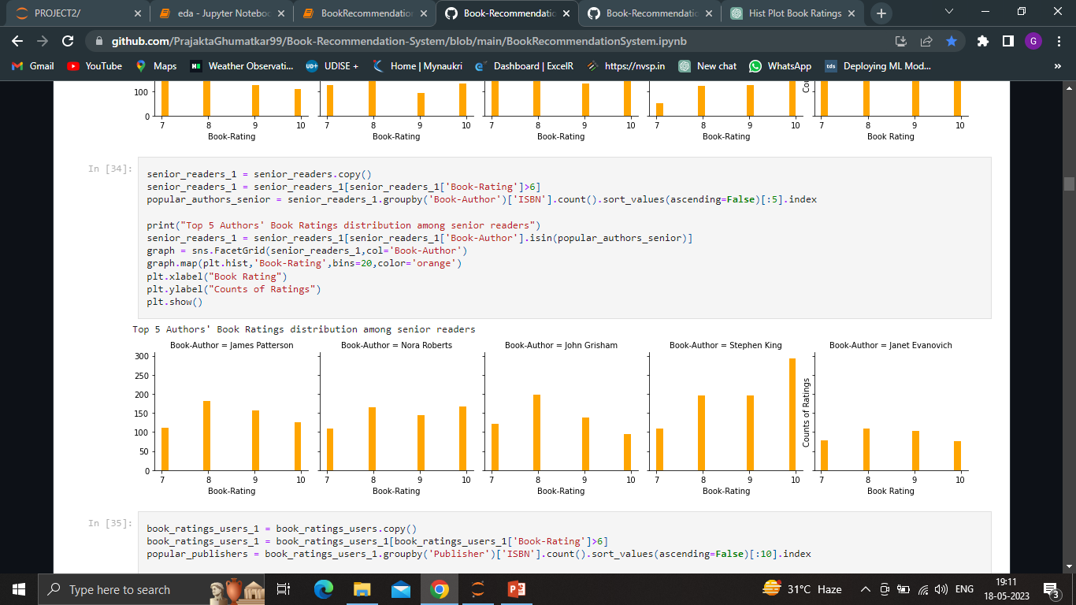
Top 5 Author’s Book Ratings distribution among Senior Readers
Stephen King got Best ratings “10” from Senior readers.
Janet Evanovich got less good ratings.
John Grisham got more rating “8”.

Slide 19
Recommender Systems
Cosine similarity.
Popularity based (Top in the whole collection).
Popularity based (Top in given place).
Books based on same author and publisher.
Content based Collaborative Filtering system.
Using NearestNeighbors.

Slide 20
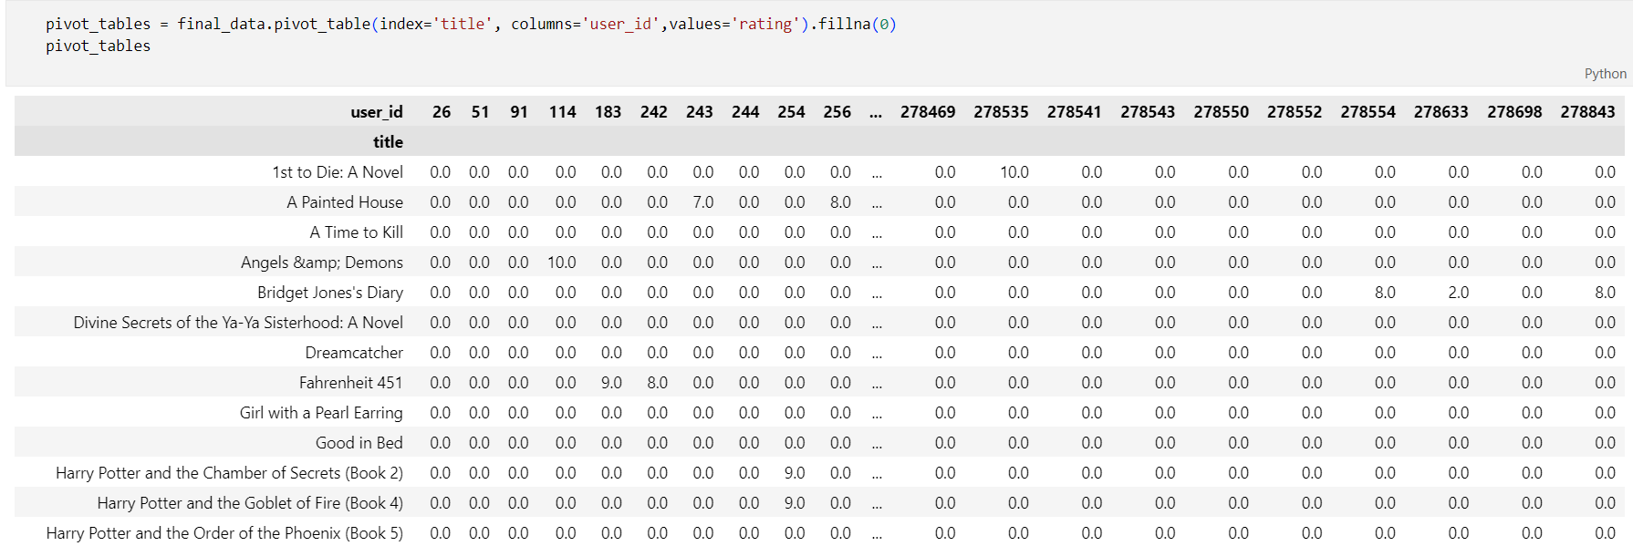
Pivot table:

Slide 21
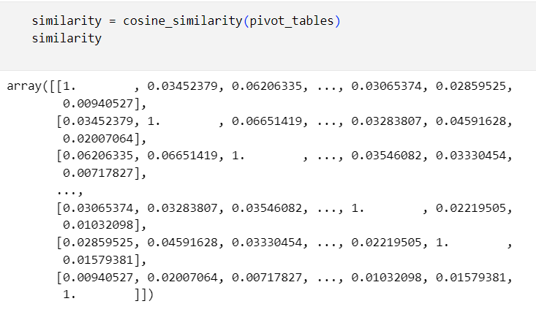
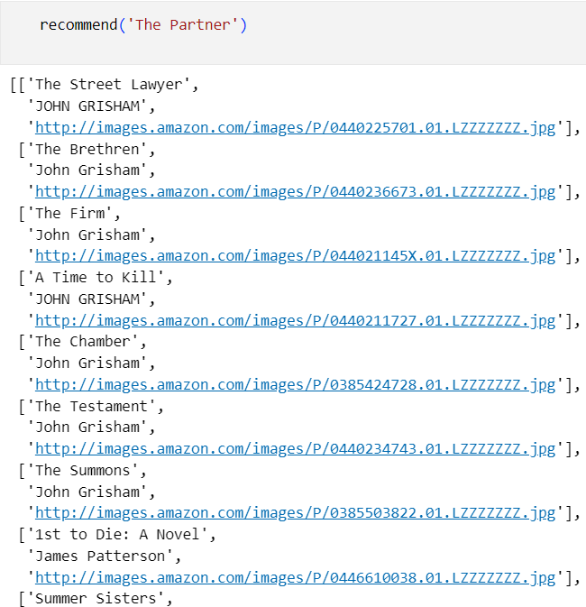
Cosine similarity:

Slide 22
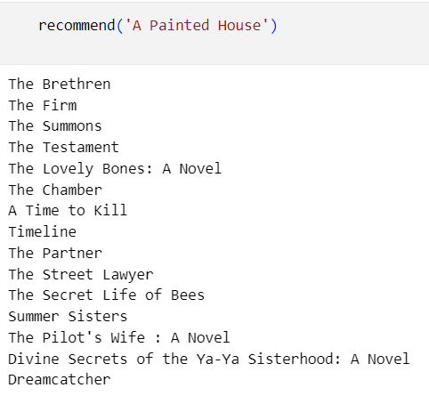
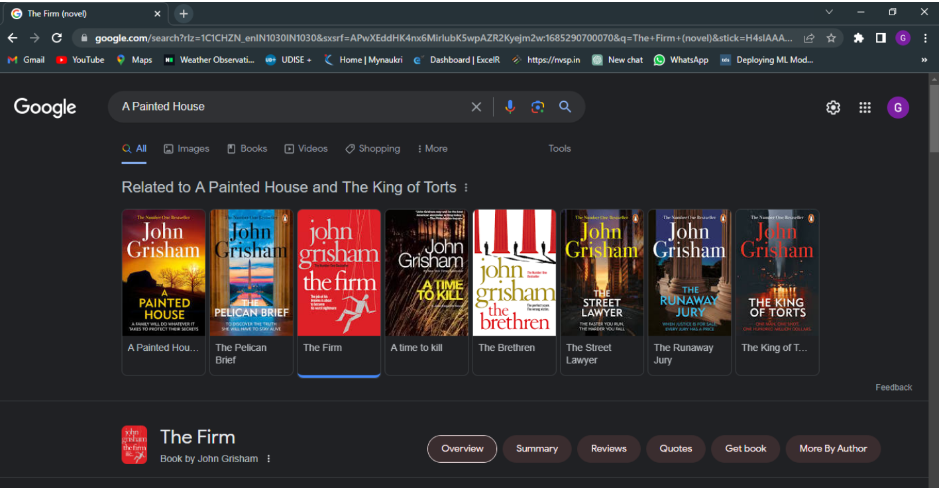
Comparing our model with google recommendations

Slide 23
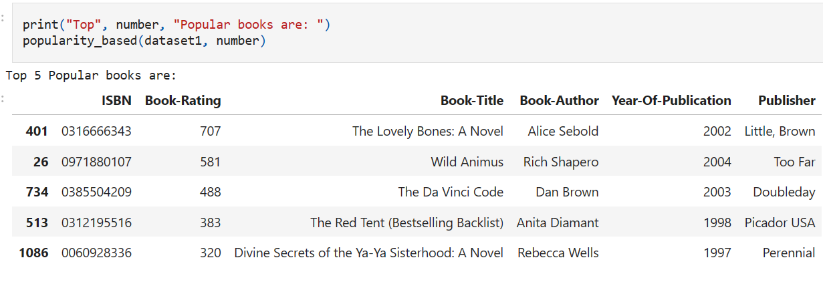
Popularity based (Top in the whole collection).

Slide 24
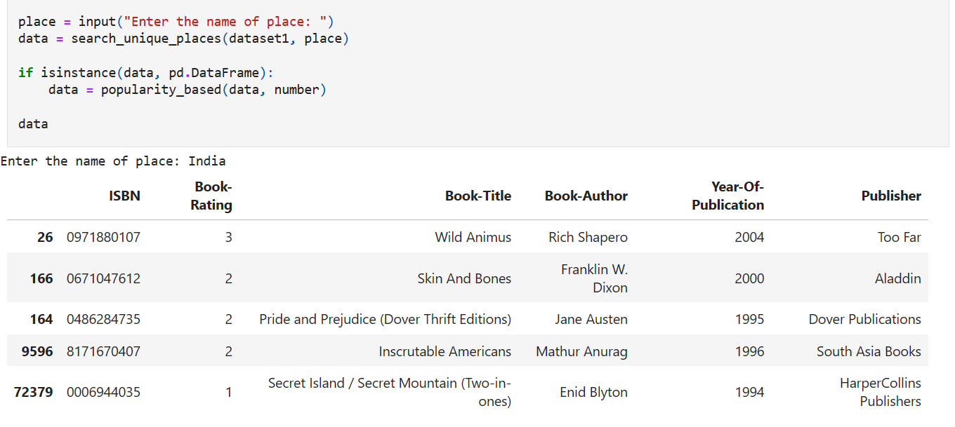
Popularity based (Top in given place)

Slide 25
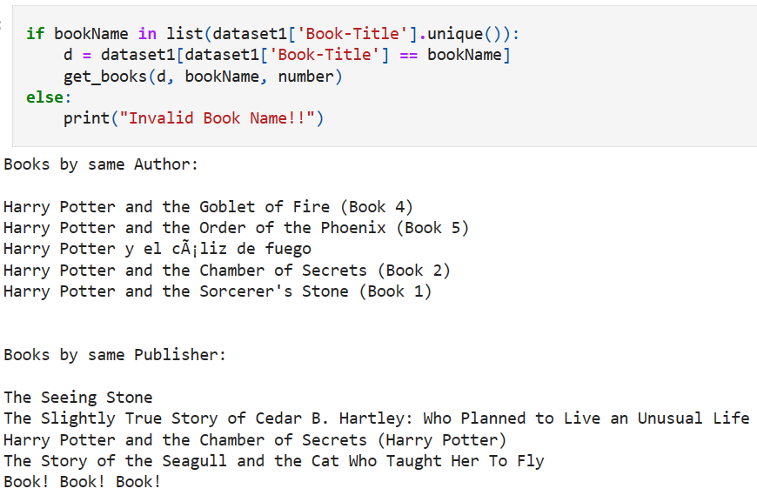
Books based on same author and publisher
BookName: Harry Potter and the Sorcerer's Stone (Harry Potter (Paperback))

Slide 26
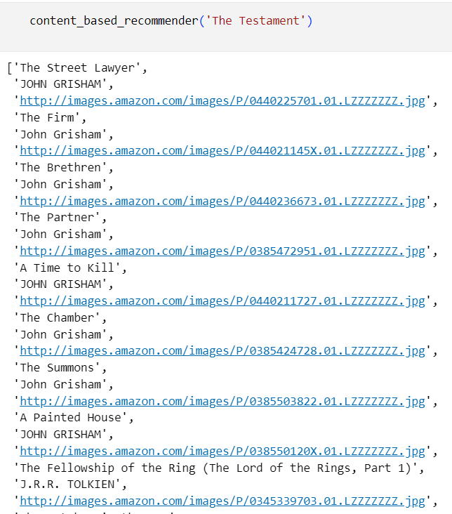
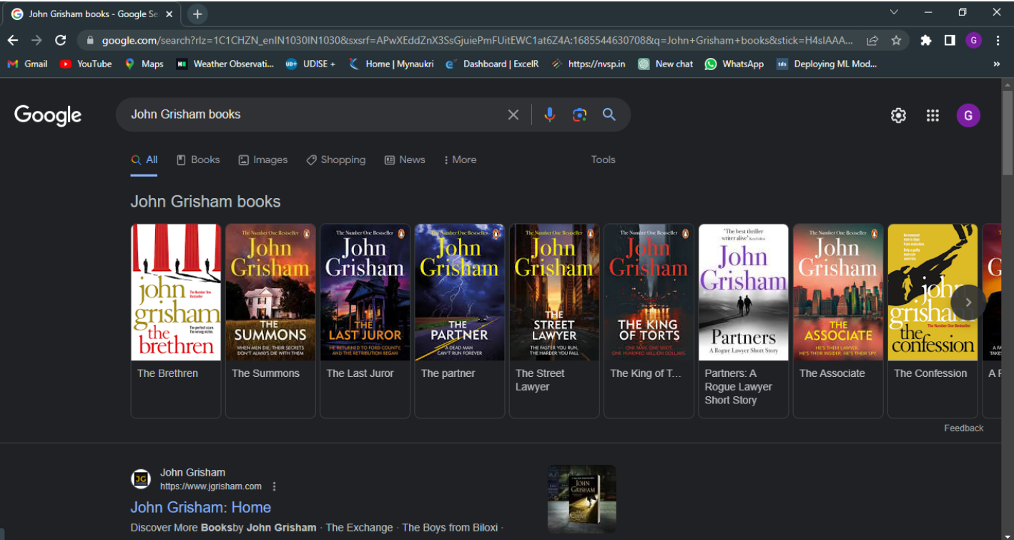
Content based Collaborative Filtering system
In this recommender system the content of the book (Title, Author, Publisher) is used to find its similarity with other books. Then the books that are most likely to be similar are recommended.

Slide 27
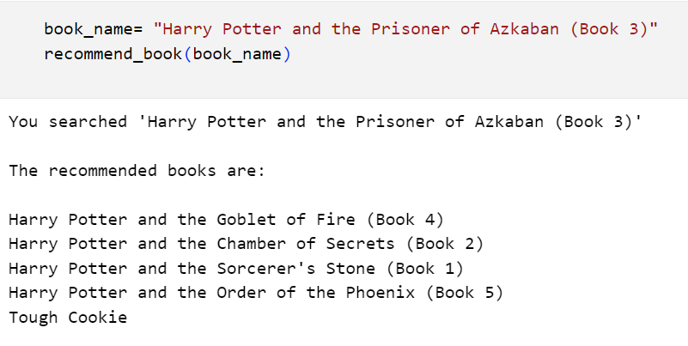
Using NearestNeighbors
Here we searched for recommendation of the book “Harry Potter and the Prisoner of Azkaban” and we got all other Harry Potter book series as suggestions to read.

Slide 28
Deployment
We are using streamlit as our deployment platform.
First we saved our model , dataset and pivot tables using pickle library.
We used content based collaborative filtering system for the deployment.

Slide 29

Deployed Interface

Slide 30
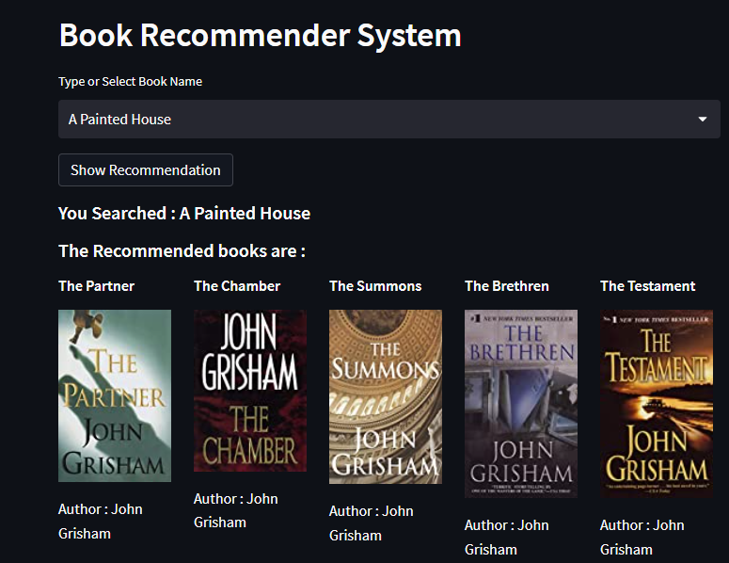
Recommended books
Here we searched for recommendation of the book “A Painted House” and we got top 5 recommendations based on the content(title, author & publisher).

Slide 31
Challenges
We had a problem in a particular column with multiple null values and inaccurate values as such we were not able to directly remove them so we overcame this problem by substituting the mean.
We faced a challenge while deploying where the recommended books were not displayed properly. We used st.column to over come this problem.

Slide 32
Thank You

