Slide 1
Netflix analysis
- Akshay Panchal

Slide 2
Why Netflix ?
As an everyday user of Netflix, I wanted to understand the content of Netflix and why has it got such popular recently.
I wanted to perform a Exploratory Data Analysis on this dataset.

Slide 3
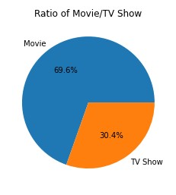
Is Netflix more focused towards Movies or TV Shows ?

Slide 4
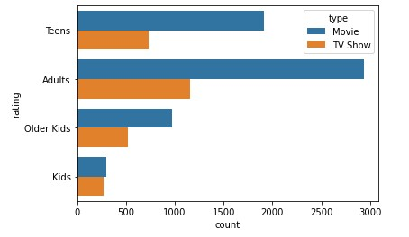
What kind of Content is available ?
Legends
'TV-PG': Older Kids
'TV-MA': Adults
'TV-Y7-FV': Older Kids
'TV-Y7': Older Kids
'TV-14': Teens
'R': Adults
'TV-Y': Kids
'NR': Adults
'PG-13': Teens
'TV-G': Kids
'PG': Older Kids
'G': Kids
'UR': Adults
'NC-17': Adults

Slide 5
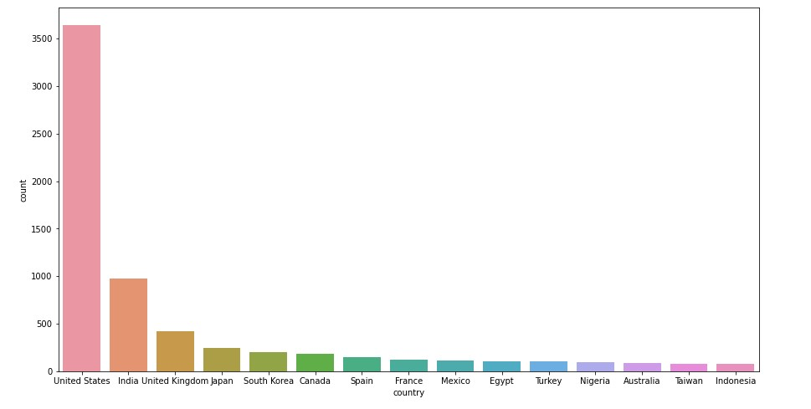
Ever wondered which countries have the most content released ?

Slide 6
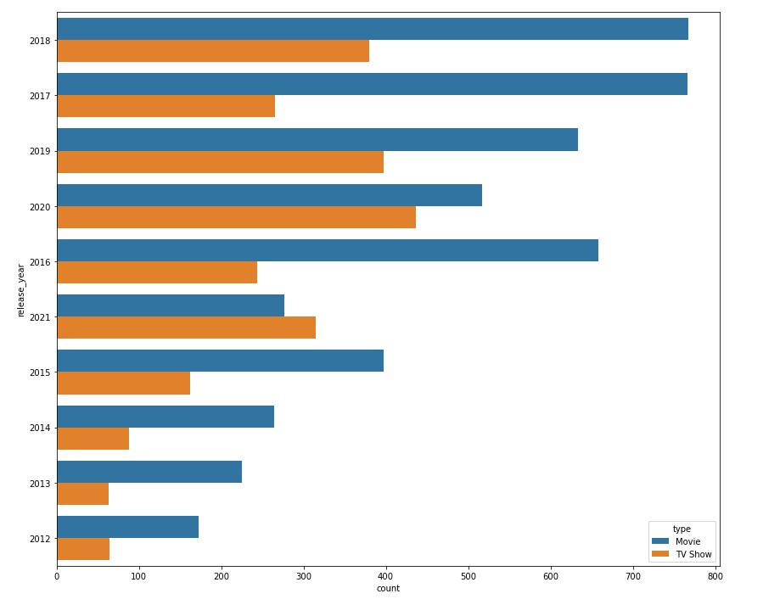
Yearly analysis of the content of Netflix

Slide 7
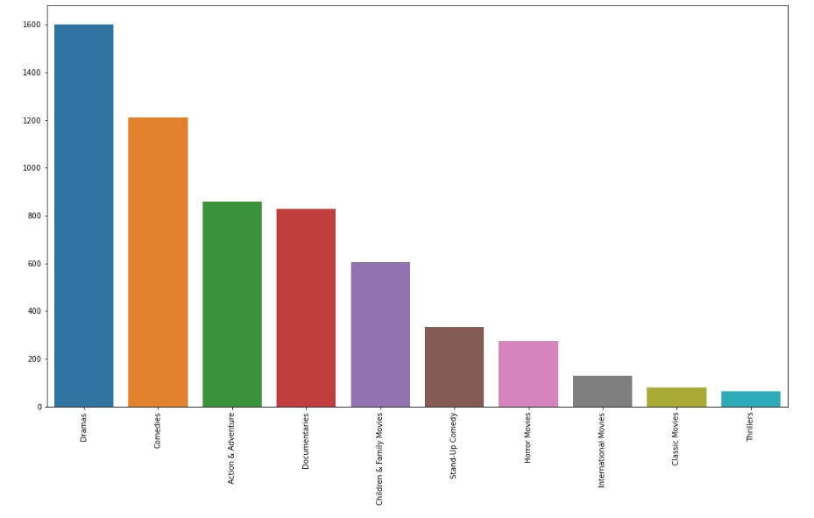
I love horror movies.. but wait lets check what movie genre is mostly available on Netflix ?

Slide 8
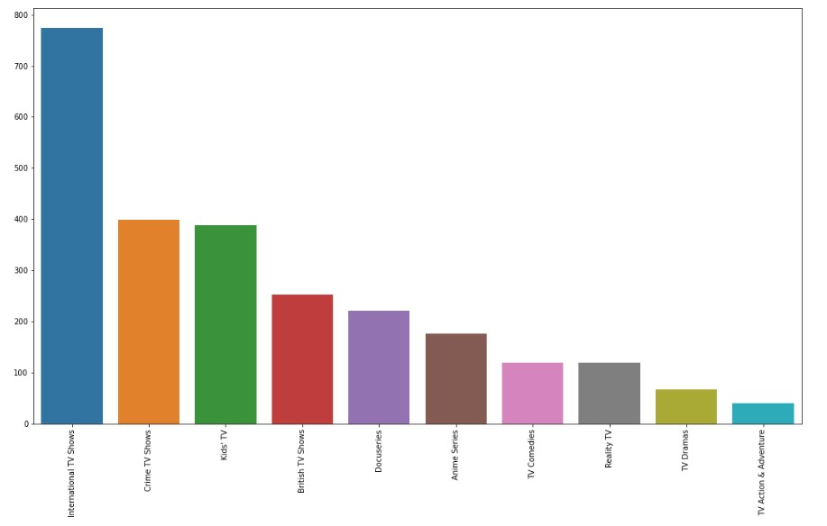
We can’t forget binge watch worthy TV series.. Lets check what Netflix offers ?

Slide 9
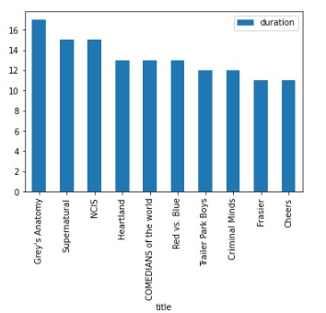
Furthermore, these are the TV Series with maximum number of seasons

Slide 10
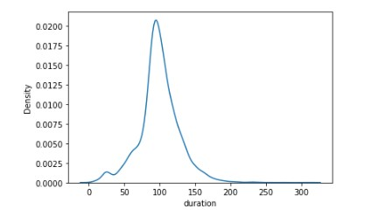
Maximum movies are in a particular duration range of 75 -120 minutes owing to today’s audience

Slide 11
Thank you !
- Akshay Panchal

