Slide 1
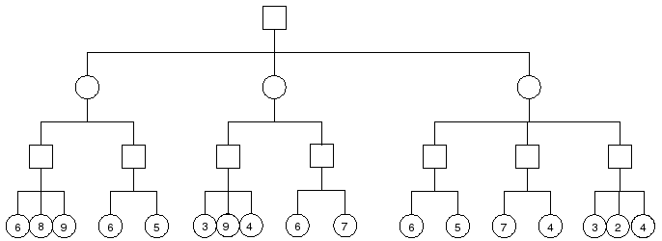
7
6
7
4
8
6
9
7
6
7
4

Slide 2
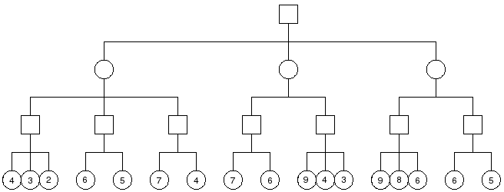
7
4
7
6
4
>=5
>=5
7
>=8
9
6
X
X
X
X

Slide 3
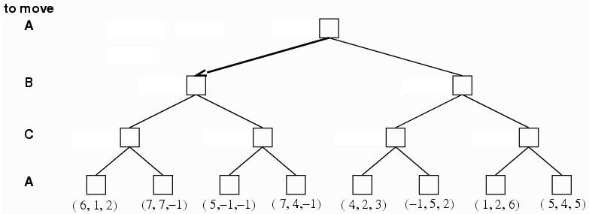
Depends on C's random decision in the left subtree. Maxbound=(7,4,-1)
Minbound=(6,1,2)
Depends on C's random decision. Maxbound=(7,4,-1)
Minbound=(6,1,2)
Random
((4,2,3),
(1,2,6))
(6,1,2)
Random
((5,-1,-1),
(7,4,-1))
(4,2,3)
(1,2,6)

