Slide 1

Nim, nim.py and games.py
Homework 4
Problem 4

Slide 2
The History of Nim Games
Believed to have been created in China; unknown date of origin
First actual recorded date- 15th century Europe
Originally known as Tsyanshidzi meaning “picking stones game”
Presently comes from German word “nimm” meaning “take”
Adapted from a presentation by Tim Larson and Danny Livarchik

Slide 3
Rules of Nim
Impartial game of mathematical strategy
Strictly two players
Alternate turns removing any number of items from any ONE heap until no pieces remain
Must remove at least one item per turn
Last player to be able to remove a wins
Variations:
  Initial number of heaps and items in each
  Misere play: last player who can move loses
  Limit on number of items that can be removed

Slide 4
Demonstration
Player 1 wins!

Slide 5
Theoretical Approach
Theorem developed by Charles Bouton in 1901
This states that in order to win, the goal is to reach a nim-sum of 0 after each turn until all turns are finished
Nim Sum: evaluated by taking the exclusive-or of the corresponding numbers when the numbers are given in binary form
Exclusive-or is used for adding two or more numbers in binary and it basically ignores all carries

Slide 6

Tree for (2,1)

Slide 7
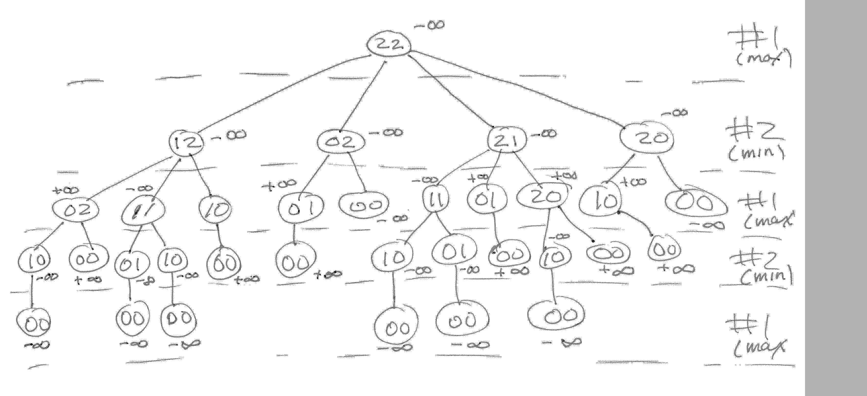
Tree for (2,2)

Slide 8
games.py
Peter Norvig’s python framework for multiple-player, turn taking games
Implements minimax and alphabeta
For a new game, subclass the Game class
  Decide how to represent the “board”
  Decide how to represent a move
  A state is (minimally) a board and whose turn to move
  Write methods to (1) initialize game instance, (2) generate legal moves from a state, (3) make a move in state, (4) recognize terminal states (win, lose or draw), (5) compute utility of a state for a player, (5) display a state

Slide 9
Assumptions about states
games.py assumes that your representation of a state is a object with at least two attributes: to_move and board
The Struct class defined in utils.py can be used to create such instances
  s = Struct(foo=‘a’, to_move = 1, board = [[1][2][3]])
  Access the attributes as s.to-move, etc.

Slide 10
Caution
Python lists are mutable objects
If you use a list to represent a board and whant to generate a new board from it, you probably want to copy it fist
  new_board = board[:]
  new_board[3] = new_board[3] - 1

Slide 11
Players
The games.py framework defines several players
random_player: choses a random move from among legal moves
alphabeta_player: uses alpha_beta to choose best move, optional args specify cutoff depth (default is 8) and some other variations
human_player: asks user to enter move

Slide 12
Variations
def make_alphabeta_player(N):
""" returns a player function that uses alpha_beta search to depth N """
return lambda game, state: alphabeta_search(state, game, d=N)
# add to the PLAYER dictionary player function named ab1,ab2,...ab20
# that use alpha_beta search with depth cutoffs between 1 and 20
for i in range(20):
PLAYER['ab'+str(i)] = make_alphabeta_player(i)

