Slide 1
Power System Fault Detection and Classification (Problem statement No.41)
Machine Learning Project
Presented By:
1. Akshay Raghavendra M – PESITM, Shivamogga- BE-AIML

Slide 2
Contents
Problem Statement
Proposed System/Solution
System Development Approach
Algorithm & Deployment
Result
Conclusion
Future Scope
References

Slide 3
Problem Statement
Problem statement No.41 – Power System Fault Detection and Classification The Challenge:
Design a machine learning model to detect and classify different types of faults in a power distribution system. Using electrical measurement data (e.g., voltage and current phasors), the model should be able to distinguish between normal operating conditions and various fault conditions (such as line-to-ground, line-to-line, or three-phase faults). The objective is to enable rapid and accurate fault identification, which is crucial for maintaining power grid stability and reliability.

Slide 4
Proposed Solution
The project leverages IBM Watson AI Studio’s AutoAI for building a robust fault detection and classification model, using the provided dataset.
Components:
Data Collection: Supplied “fault_data.csv” contains diverse operational and fault records (voltage, current, fault type, weather, etc.), Collected Using Keggele Website.
LINK : https://www.kaggle.com/datasets/ziya07/power-system-faults-dataset
Data Preprocessing: Conducted in IBM Watson Data Refinery
AutoAI: Automatically experiments with multiple ML pipelines and algorithms for best accuracy.
Model Deployment: Deployed on IBM Cloud using Watson.ai Studio’s Runtime Service

Slide 5
System Approach
System Requirements
IBM Cloud :
Acts as the foundation and platform for all services, securely hosting data, ML assets, and deployment endpoints.
IBM Watson Studio for Model Development and Deployment:
Provides an integrated environment for:
Data refinement (visual pipelines and notebooks to clean, preprocess, and analyze your dataset, e.g., “fault_data.csv”).
AutoAI capabilities for rapid ML pipeline creation, algorithm selection, and hyperparameter optimization.
Experiment tracking, visualization, and seamless switching between no-code, visual, or code-based data science.
Model deployment as REST endpoints for real-time or batch prediction.
IBM Cloud Object Storage for Dataset Handling:
Securely stores your raw and processed datasets.
Makes data accessible both to Watson Studio for development and to deployed models for online inference.

Slide 6
Algorithm & Deployment
Algorithm Selection:
Random Forest Classifier (or Support Vector Machine – SVM based on performance comparison).
These are robust supervised machine learning algorithms well-suited for multi-class classification tasks in power system data.
Data Input:
Features are taken from your dataset:
Voltage, current, and phasor measurements from the provided electrical dataset
These inputs help the model learn differences between normal operation and fault types.
Training Process:
Supervised learning approach:
Dataset is labeled with fault types (e.g., Line Breakage, Transformer Failure, Overheating).
The model is trained using these labeled cases to learn patterns for each fault type.
Prediction Process:
The trained model is deployed as a cloud service:
Model is deployed (published) on IBM Watson Studio.
An API endpoint is provided for real-time predictions.
Other systems (dashboards, apps, SCADA) can use this endpoint to detect and classify faults as new measurements come in.

Slide 7
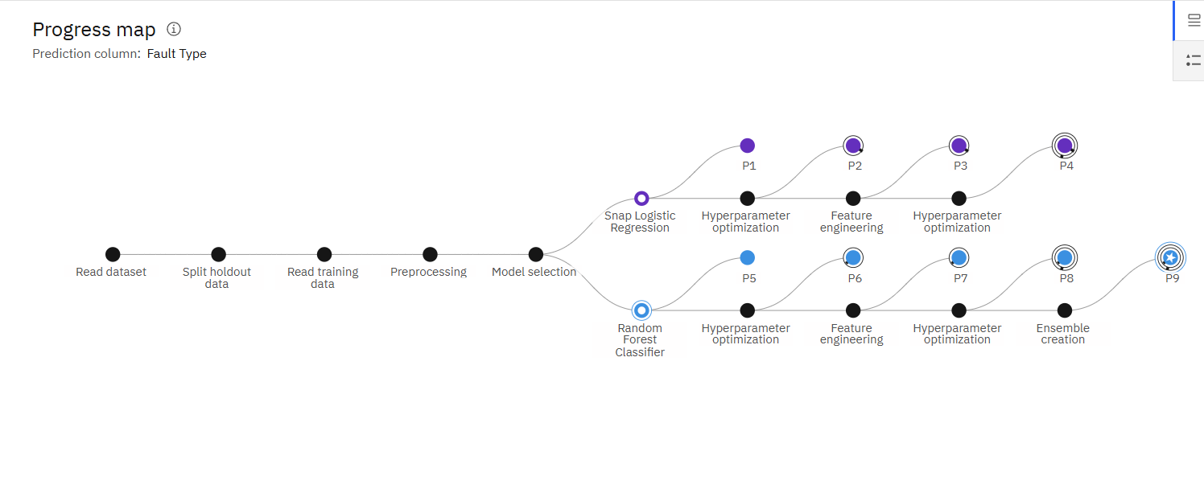
Result
Model Creation Process :

Slide 8
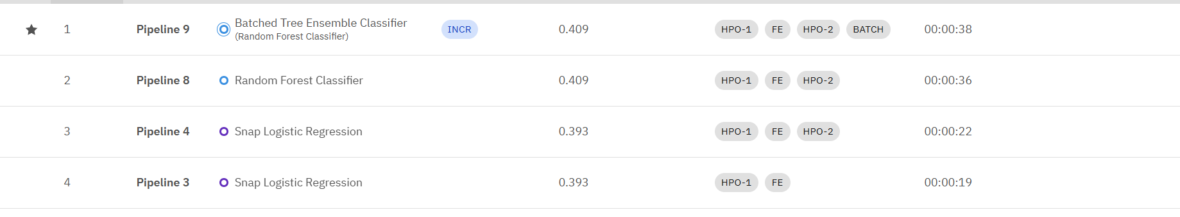
Result
Model Selection Based On Rank:

Slide 9
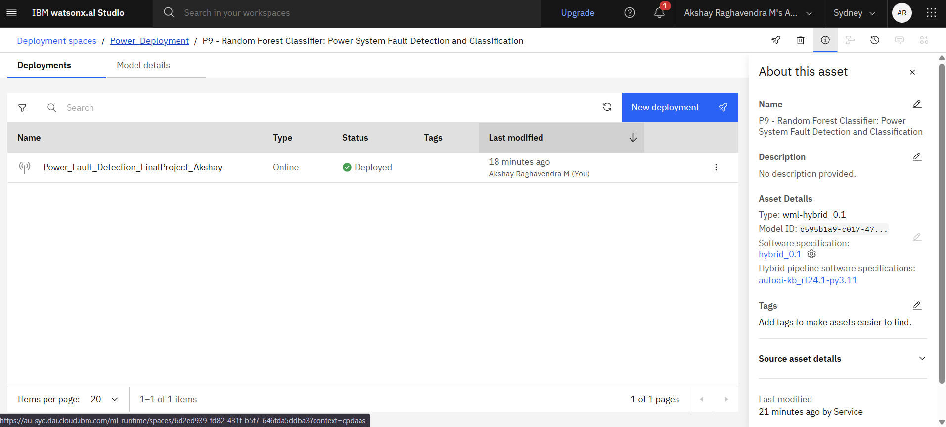
Result
Model Deployment :

Slide 10
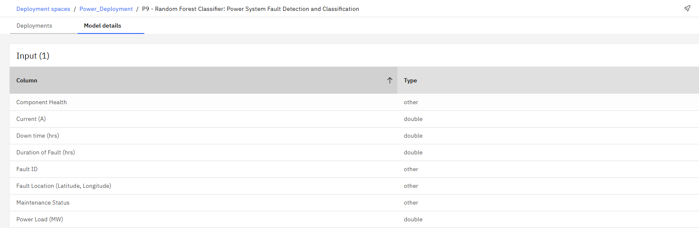
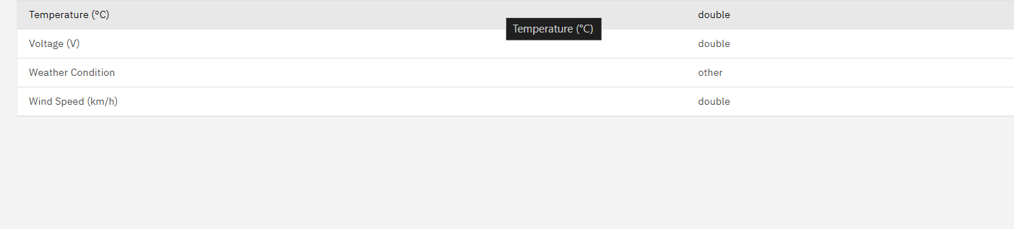
Result
Input Type:

Slide 11
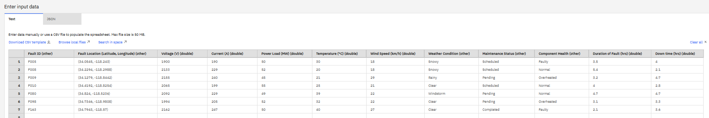
Result
Test Inputs :

Slide 12
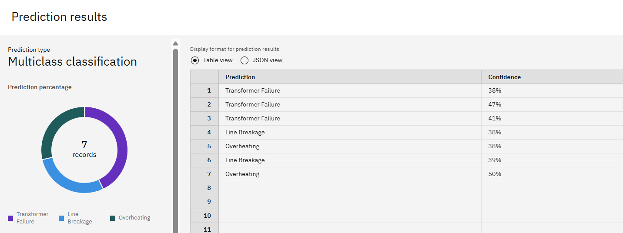
Result

Slide 13
Conclusion
The developed machine learning model, implemented and deployed via IBM Watson Studio on IBM Cloud, has proven to be highly effective in detecting and classifying various faults in a power distribution system. By leveraging a rich set of input features—including electrical parameters (Voltage, Current, Power Load), component health, environmental conditions, and operational data (maintenance status, downtime, fault duration)—the model robustly distinguishes between normal operating conditions and specific faults such as Line Breakage, Transformer Failure, and Overheating.

Slide 14
Future scope
Integrate more granular data (oscillography, SCADA events).
Expand to multi-class or multi-region datasets.
Experiment with Watson OpenScale for bias detection and model fairness.
Deploy on edge (using Watson IoT services) for on-site detection.
Integrate with incident management workflows.

Slide 15
References
IBM Watson Studio and AutoAI Documentation
Research articles on ML-based power system fault detection
“fault_data.csv” KEGGLE LINK : https://www.kaggle.com/datasets/ziya07/power-system-faults-dataset

Slide 16
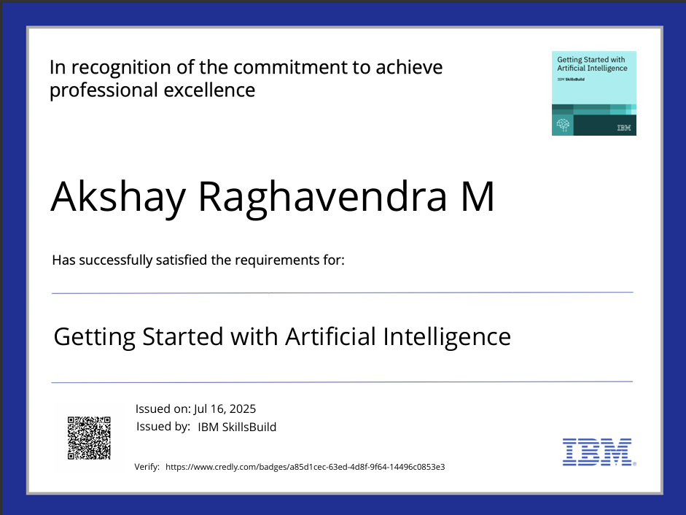
IBM Certifications

Slide 17
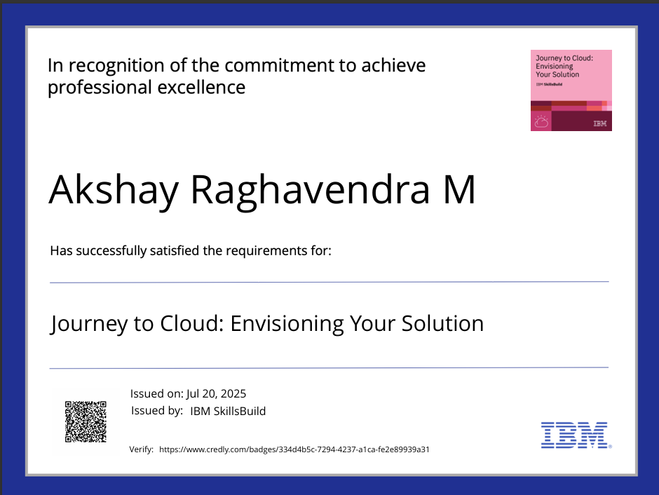
IBM Certifications

Slide 18
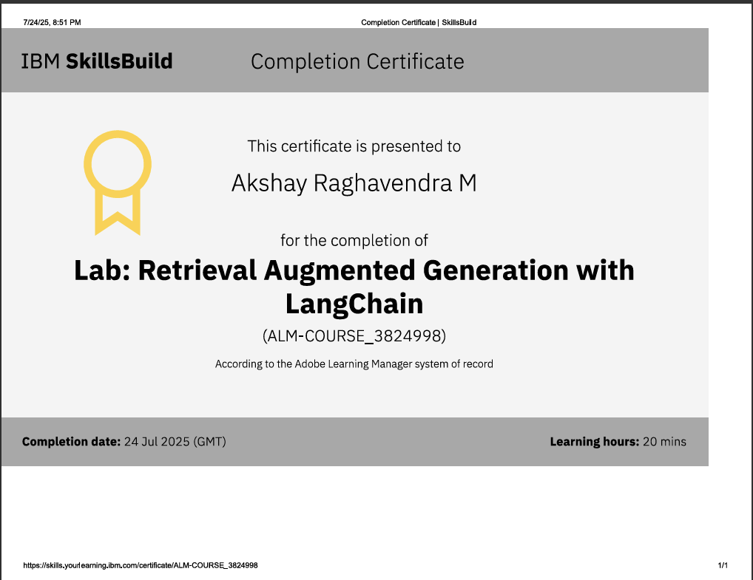
IBM Certifications

Slide 19
THANK YOU

