Slide 1
Project Based Learning -II
Team Details:
Member 1: Sanyam Gupta
Roll no: 2210993842
Member 2: Pratham Gupta
Roll no: 2210993827
Faculty Coordinator: Dr. Amanpreet Singh and Dr. N. Bhartiraja
:
Chitkara University Institute of Engineering and Technology,
Chitkara University, Punjab

Slide 2
Table of Contents
Introduction
Project Plan
Project Distribution
Architecture of a Crypto exchange website
Problem Statement
Technical Details
Key Features
Project Highlights
Project Result
Conclusion
Future Scope
References/Links used

Slide 3

— Satoshi Nakamoto
Founder of the first cryptocurrency - BITCOIN

Slide 4
Introduction
What’s Cryptocurrency and how Cryptocurrency works?..
Cryptocurrency is a revolutionary digital currency that operates independently of any government or financial institution. It is designed to be a decentralized and secure form of currency, using advanced cryptography to keep transactions safe and transparent.
The creation of cryptocurrency involves a complex process known as mining, which involves solving mathematical equations and verifying transactions on the blockchain network. The blockchain is a public ledger that records all transactions and ensures their validity, making it a highly secure and transparent system.
Cryptocurrencies offer a range of benefits over traditional fiat currencies, such as low transaction fees, fast processing times, and a high level of privacy and security. They can be bought and sold on cryptocurrency exchanges, and can also be used to purchase goods and services online.
However, the world of cryptocurrency is also highly volatile and constantly evolving. The value of cryptocurrencies can fluctuate widely in a short period of time, making it a risky investment. Additionally, regulation and adoption of cryptocurrencies vary widely across different countries and jurisdictions, adding to the complexity of this exciting and rapidly changing field.

Slide 5
Cryptocurrency exchanges and trading platforms are digital marketplaces where users can buy, sell, and trade various cryptocurrencies. These platforms offer a convenient and efficient way to exchange digital assets, and are designed to be user-friendly for both novice and experienced traders.
To use a cryptocurrency exchanger, users typically need to create an account and go through a verification process. Once verified, they can deposit funds into their account using a variety of payment methods. These funds can then be used to buy or sell cryptocurrencies at market-driven prices.
Each exchange offers different features, such as trading pairs, order types, and charting tools, to help traders analyze and execute their trades. Some exchanges even offer margin trading and futures trading for advanced users.
However, trading cryptocurrencies can be risky due to the high volatility of the market. Therefore, it's important for traders to conduct their own research and make informed decisions when investing. They should also take necessary security measures, such as using two-factor authentication and keeping their private keys secure, to protect their assets from potential hacks or theft.

Slide 6
Project Plan
Ⅰ
ⅠII
Stage 1
Stage 2
Stage 3
Stage 4
Making a base webpage using HTML
Transforming HTML document using CSS
Using JS to dynamically update the content
Involving API to get real-time crypto prices
ⅠI
Ⅳ

Slide 7
Project Distribution
36%
CSS
59%
HTML
5%
JAVASCRIPT

Slide 8
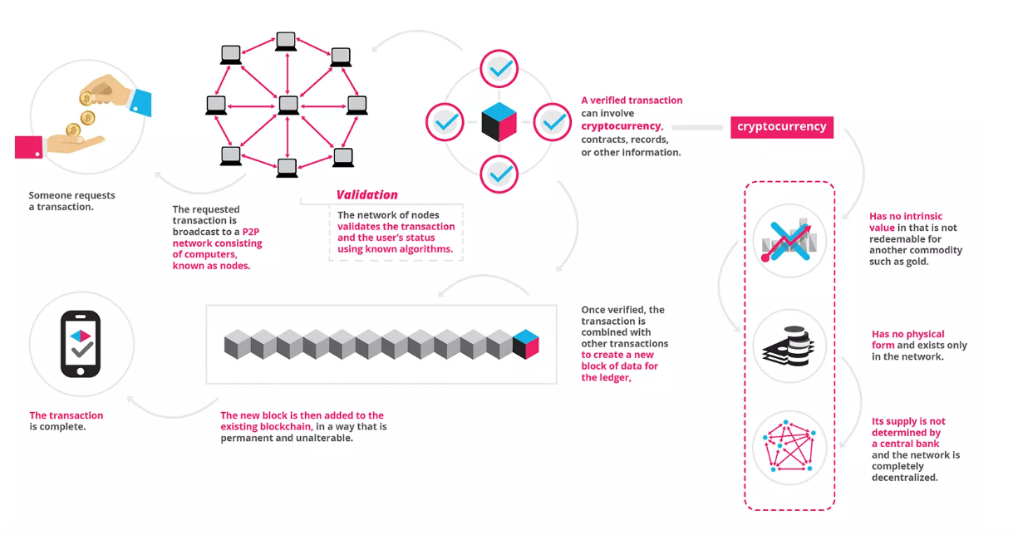
Architecture of a Crypto exchange website

Slide 9
Problem Statement
The project aims to design and develop a user-friendly cryptocurrency platform that simplifies the process of buying, selling, and trading cryptocurrencies while ensuring compliance with regulatory requirements. The project will address the challenges and limitations of existing platforms, implement necessary security measures, and evaluate potential benefits and drawbacks of integrating cryptocurrencies into traditional financial systems. The project involves a literature review, platform design and development, and user testing to create a secure, efficient, and user-friendly experience for investors.

Slide 10
Technical Details
HTML: HTML is used for creating and structuring content on the web.
CSS: Used for styling and formatting HTML content on the web.
JAVASCRIPT: Used for creating interactive and dynamic behavior on web pages.
API Network: Allows different software applications to communicate and exchange data with each other over the internet.

Slide 11
Key Features
User-friendly interface: A platform that is easy to use, navigate and understand for users of different technical backgrounds.
2.Secure payment gateway: A secure payment gateway that enables users to buy, sell and trade cryptocurrencies without the fear of fraud or hacking.
3.Support for multiple cryptocurrencies: The platform should support a wide range of cryptocurrencies to provide users with more options for trading.
4.Real-time market data: The platform should provide real-time market data and insights to help users make informed decisions while trading.
5.Mobile compatibility: The platform should be mobile-friendly and accessible on different devices to provide users with more flexibility and convenience.

Slide 12
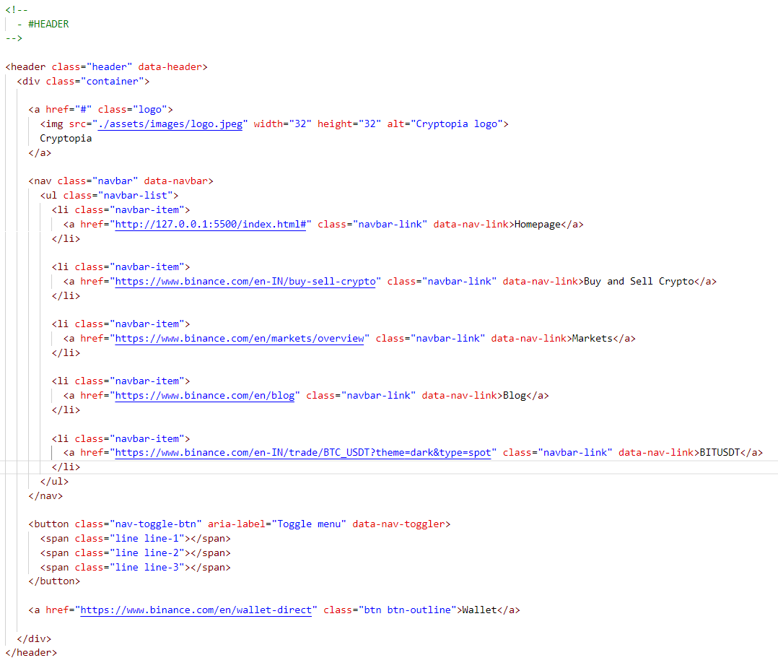
Project Highlights

Slide 13
Inside the header, there is a container div that holds the website logo and navigation menu. The logo is an anchor tag with a class of "logo" and an image tag inside it. The navigation menu is a nav tag with a class of "navbar" and a custom data attribute of "data-navbar".
The navigation menu contains an unordered list with class "navbar-list" and several list items with class "navbar-item". Each list item has an anchor tag with class "navbar-link" and a custom data attribute of "data-nav-link". These links lead to different pages on the website or to external sites.
At the end of the container div, there is a button with a class of "nav-toggle-btn" and a custom data attribute of "data-nav-toggler" that toggles the navigation menu when clicked. There is also a link to a wallet page with a class of "btn btn-outline".

Slide 14
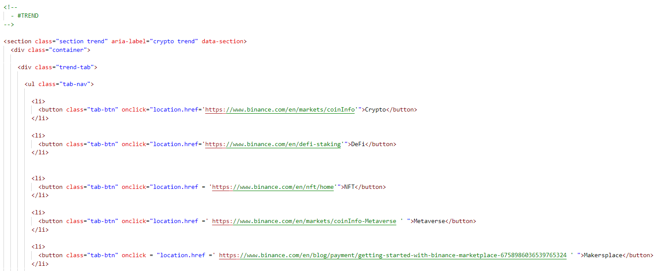

Slide 15
Inside the section, there is a container div that holds a "trend-tab" div. The "trend-tab" div contains an unordered list with class "tab-nav" and several list items with buttons.
Each button has a class of "tab-btn" and an onclick attribute that leads to a different page on the website or an external site. The first button leads to the Binance markets coin info page, the second button leads to the DeFi staking page, the third button leads to the Binance NFT page, the fourth button leads to the Binance markets coin info Metaverse page, and the fifth button leads to the Makerspace getting started with Binance marketplace blog post.

Slide 16
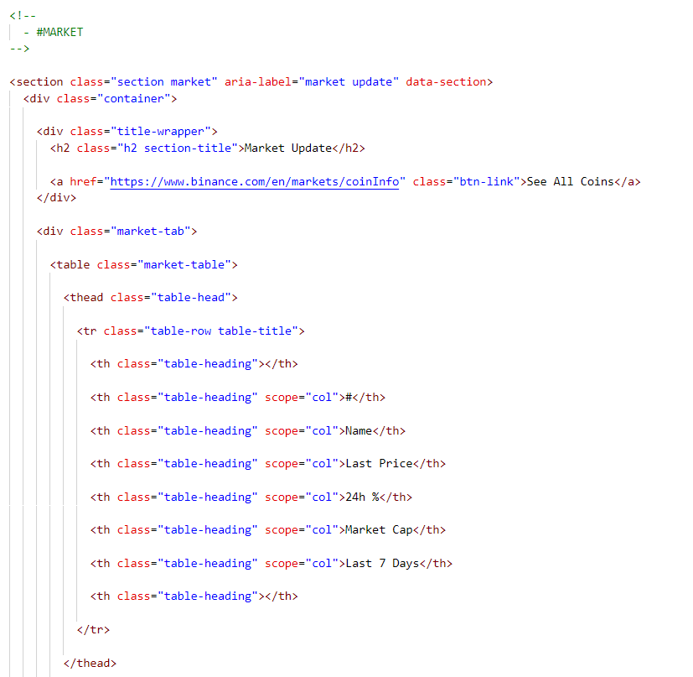

Slide 17
Inside the section, there is a container div that holds a "title-wrapper" div and a "market-tab" div.
The "title-wrapper" div contains an h2 heading with class "h2 section-title" and text "Market Update", and an anchor tag with class "btn-link" that leads to the Binance markets coin info page.
The "market-tab" div contains a table with class "market-table". The table has a thead element with class "table-head" and a single row with class "table-row table-title". The row contains eight cells, each with a class of "table-heading".
The first cell is empty, while the second, third, fourth, fifth, and sixth cells have a scope attribute with the value of "col". The last cell is also empty.
The second cell contains the text "#", the third cell contains the text "Name", the fourth cell contains the text "Last Price", the fifth cell contains the text "24h %", and the sixth cell contains the text "Market Cap".

Slide 18
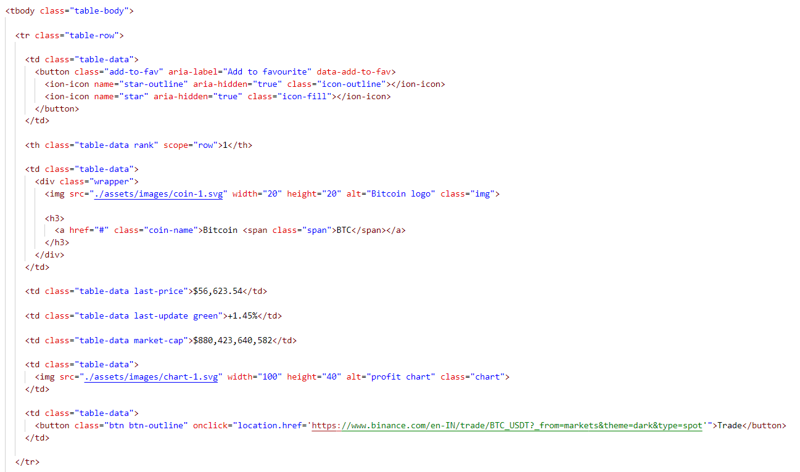

Slide 19
The row contains data such as the cryptocurrency's rank, name, logo, last price, 24h percentage change, market cap, and a profit chart for the last 7 days. The row also includes a button to add the cryptocurrency to the user's favorites list and a "Trade" button to buy or sell the cryptocurrency on the Binance exchange.

Slide 20
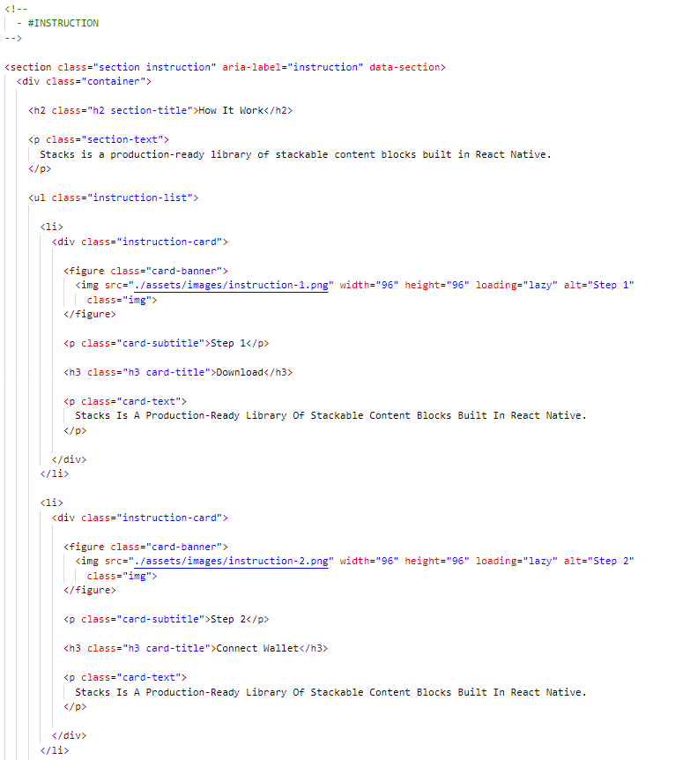

Slide 21
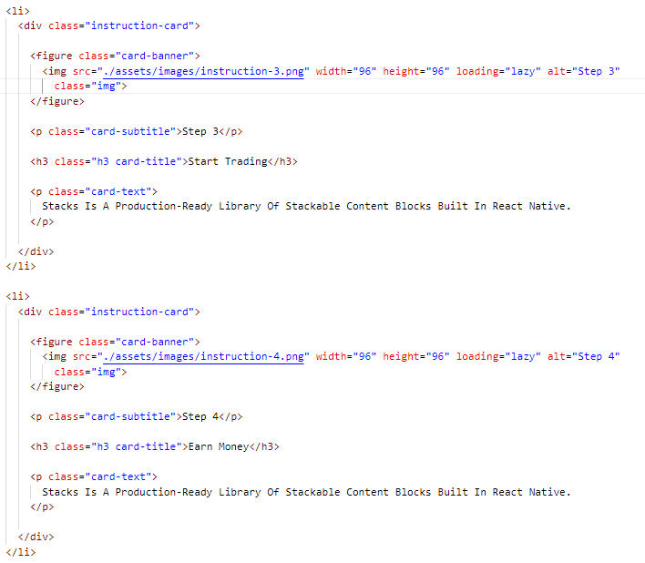

Slide 22
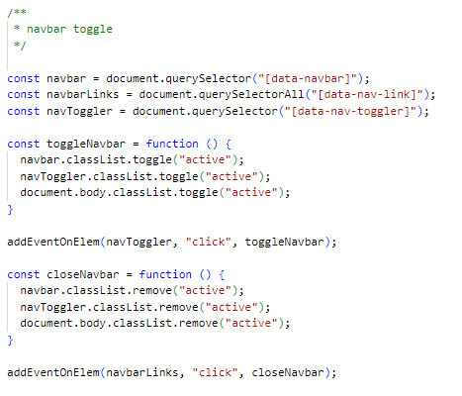

Slide 23
It first selects the navbar, the navbar links, and the navbar toggler button using their respective data attributes. It then defines a function named toggleNavbar that toggles the active class on the navbar, navbar toggler, and the body element. This function is called when the navbar toggler button is clicked.
Another function named closeNavbar is defined, which removes the active class from the navbar, navbar toggler, and the body element. This function is called when any navbar link is clicked.
Finally, the addEventOnElem function is used to add event listeners to the navbar toggler and navbar links. The addEventOnElem function is likely a custom function that abstracts away the complexity of adding event listeners to multiple elements at once.

Slide 24
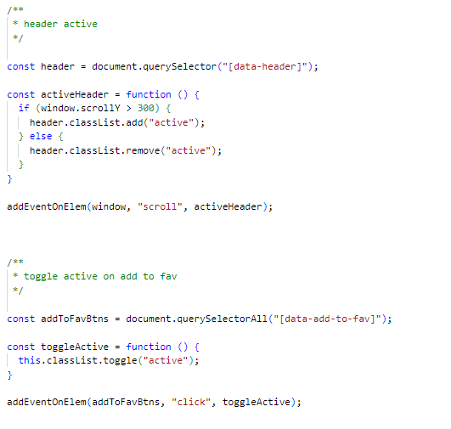

Slide 25
The first block of code is used to create a navigation bar with a toggle button that shows and hides the links when clicked. The code selects the necessary elements using the querySelector method and adds an event listener to the toggle button to show or hide the navigation bar when clicked. It also adds an event listener to the navigation links to hide the navigation bar when a link is clicked.
The second block of code uses the scroll Y property to determine the page's current scroll position and adds or removes the active class from the header element accordingly.
The third block of code is used to add or remove the active class from an element when it is clicked. The code selects all elements with the data-add-to-fav attribute and adds an event listener to each of them. When an element is clicked, the code toggles the active class on that element.

Slide 26
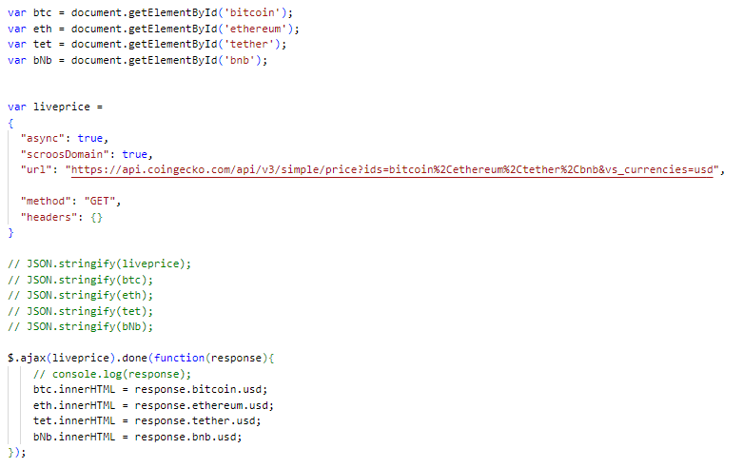

Slide 27
This code block is fetching the live price data for four cryptocurrencies (Bitcoin, Ethereum, Tether, and Binance Coin) using the CoinGecko API. It then updates the HTML content of four elements (identified by their respective IDs) with the current USD price of each cryptocurrency.
The liveprice object is a configuration object for the AJAX request. It specifies the URL of the API endpoint and the HTTP method (GET). The $.ajax() method sends the AJAX request and waits for the response. Once the response is received, the done() method is called, which takes a callback function. The callback function extracts the price data from the response object and updates the HTML content of the corresponding elements.

Slide 28
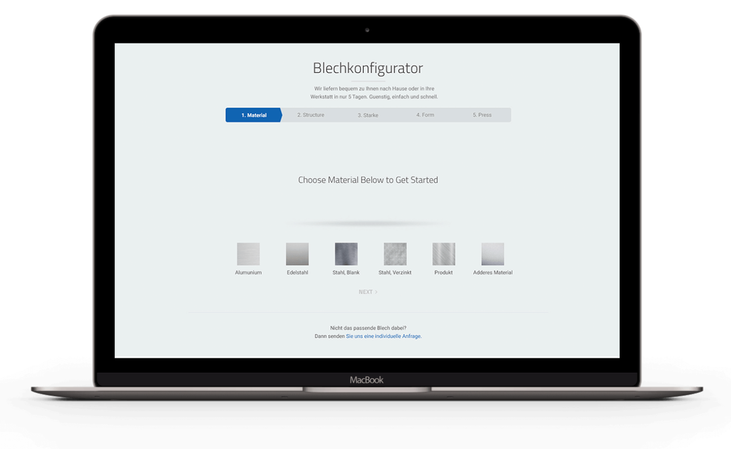
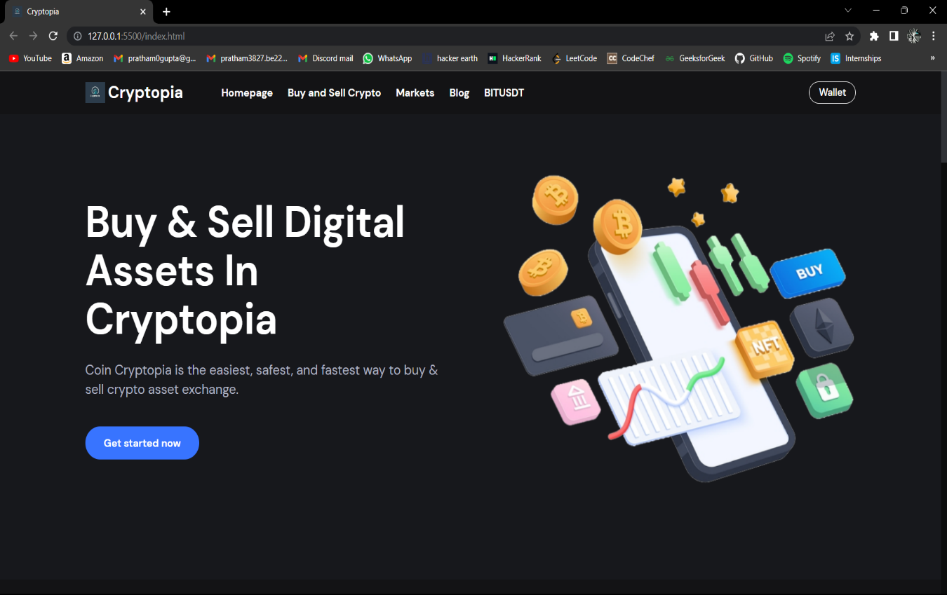
Project Result

Slide 29
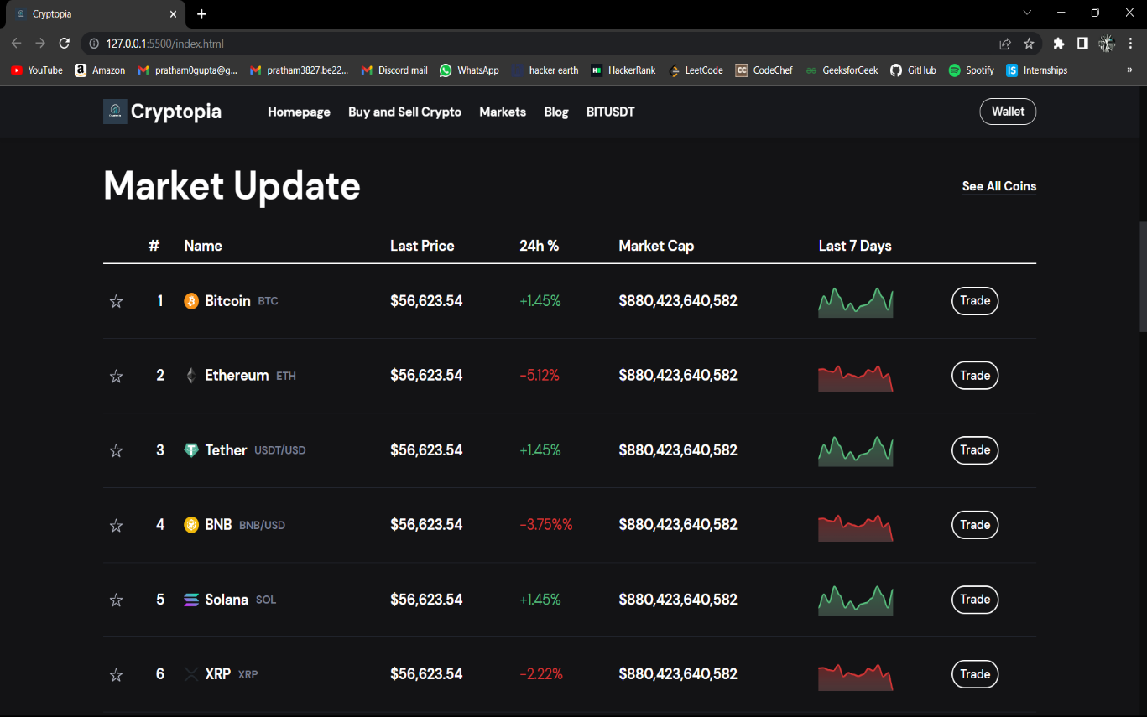

Slide 30
Conclusion
In conclusion, the adoption of cryptocurrency has increased significantly in recent years, and it has become essential to have a secure and user-friendly platform for buying, selling, and trading digital assets. The college project aimed to design and develop such a platform by addressing the challenges and limitations of existing platforms and complying with regulatory requirements. The project focused on key features such as user-friendly interface, secure payment gateway, support for multiple cryptocurrencies, real-time market data, transparency, integration with external wallets and mobile compatibility. The project aimed to provide a secure, efficient, and user-friendly experience for investors and contribute to the adoption of cryptocurrencies into traditional financial systems.

Slide 31
Future Scope
Expand the platform's functionality to support more cryptocurrencies and integrate with more external wallets, thus providing users with more flexibility and options for trading.
Enhance the platform's security features by incorporating advanced security measures such as biometric authentication, hardware wallets, and multi-signature authentication.
Incorporating machine learning and artificial intelligence algorithms to provide users with personalized investment recommendations and insights.
Incorporating features such as real-time market data, price alerts, and trading notifications, thus enhancing the user experience.

Slide 32
References/Links used
www.youtube.com
GeeksForGeeks
Github.io
CoinGecko API

Slide 33
Project Domain
cryptopia-eight.vercel.app

Slide 34


