Slide 1
Group 2 Presentation
Chapter 2 - The Power of Positive Thinking

Slide 2

Summary
This scenario initially highlights lack of company knowledge by Stanley with the use of wrong material for insulation.
Later during CEO’s tour, Stanley's explanation to using Expandrium showcases the dual benefits of cost efficiency and employee loyalty.
Stanley's ability to adapt to the situation and positively present his choice of insulation material reflects the value of a positive and adaptable mindset, as emphasized by Peter Senge (Mike Clayton, 2021).
Mike Clayton. (2021, April 8). What is Peter Senge’s learning organization? YouTube. https://www.youtube.com/watch?v=k1k2h1l2VO0&t=246s

Slide 3

Stanley’s Transformation
A Lesson in Workplace Adaptability
(3.Q)“Why does Stanley say, ‘I am an engineer, not a salesperson, I am not supposed to worry about that sort of thing anyway’?”
Adaptability
Corporate Culture
key
Impression Management
Teamwork
Redirect Notice. (2023). Google.com. https://www.google.com/url?sa=i&url=https%3A%2F%2Fedexec.co.uk%2Fhow-could-flexible-working-look-in-your-school%2F&psig=AOvVaw02P9JezhGNsDGqWdCbpHNJ&ust=1697418889686000&source=images&cd=vfe&opi=89978449&ved=0CBAQjRxqFwoTCNDfpaHw9oEDFQAAAAAdAAAAABBE
‌

Slide 4
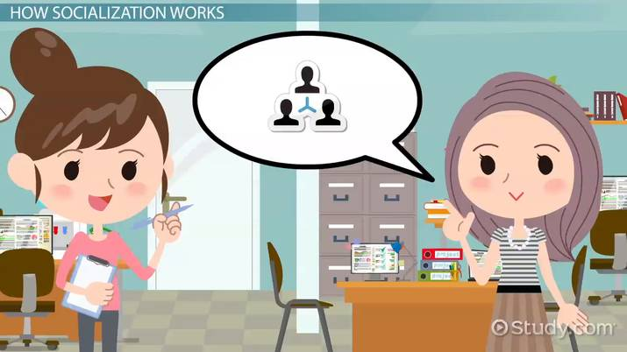
Socialization
Learning the Ropes in a New Organization
Conforming to Organizational Norms
Company Values and Attitudes
Socialization
Mentoring and Guidance
Onboarding and Training
Informal Socialization

Slide 5

Are All Employees Salespeople for the Company?
Argument For: Employees represent the company and can influence its image and success.
Argument Against: Employees have diverse roles and may not directly engage with customers or clients.
Employees should promote the company's values, but not all can be considered traditional "salespeople."
Lewinter, H. (2019, January 29). Every employee at your business is a salesperson. Talk Business with Howard. https://www.talkbusinesswithhoward.com/every-employee-at-your-business-is-a-salesperson/#:~:text=In%20fact%2C%20every%20employee%20at%20your%20business%20is,of%20customers.%20All%20part%20of%20the%20sales%20process.

Slide 6
Lessons Learned
Ben
Use Expandium because a company should solve its problems with its own solutions.
Understand the bigger picture
Learning Organization Perspective
Stanley
Use Insuban because it meets the specs for the job.
Engineering Perspective

Slide 7
Thank You

