Slide 1
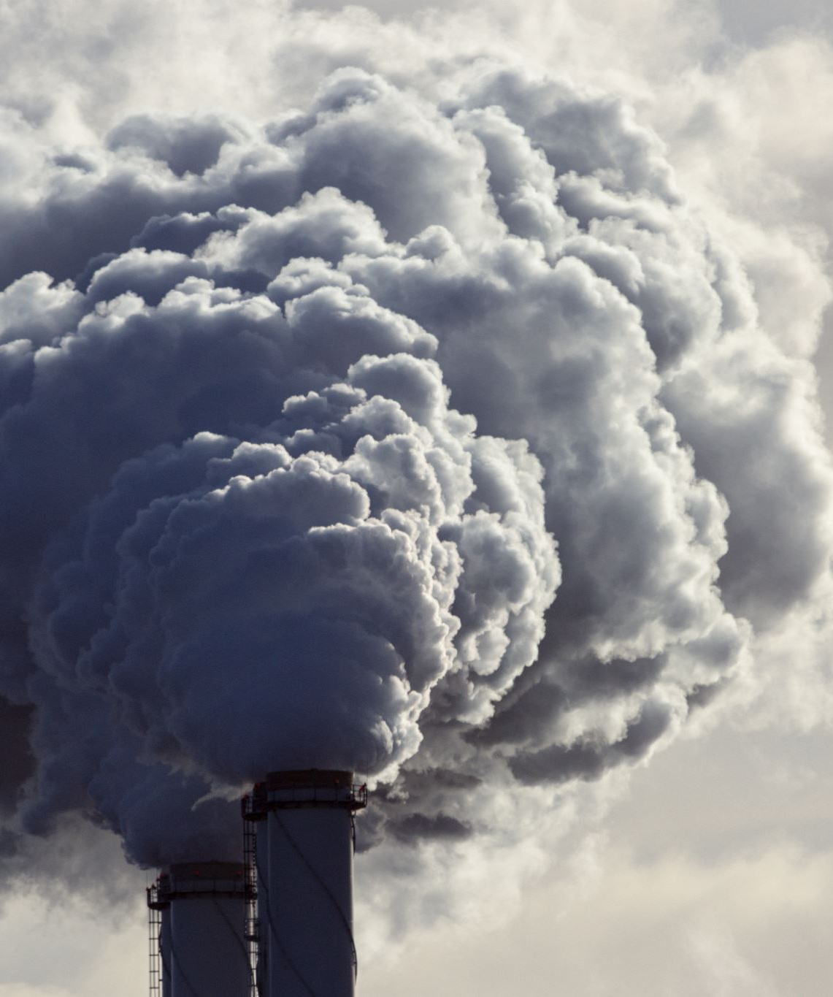
Predicting Air Quality and Pollution Levels Using Machine Learning and Deep Learning Techniques.
Presented by:
Vishal Balaji Kotrike (EE36010)
Akshay Reddy Gone (AM60898)

Slide 2
Problem Explanation
Air pollution has a significant impact on human health and the environment. Predicting air quality levels and pollution spikes can help local governments, businesses, and citizens make informed decisions about outdoor activities, transportation, and industrial production. The challenge is to predict air quality index (AQI) values and pollutant concentrations (like CO2, NO2, PM2.5, etc.) using historical air quality data and external factors such as weather conditions.

Slide 3
Approach
Data Collection
Data Pre-processing
Data Analysis and Visualization
Model Development and Simulations
Results Interpretation

Slide 4
Advantages
- Help authorities in large cities forecast air quality and make decisions that reduce pollution.
- Could be applied to design smart city infrastructure that minimizes traffic-related pollution.
- Useful for businesses to optimize operations and comply with environmental regulations.
Importance:
With increasing urbanization, predicting and controlling air pollution is crucial for public health and environmental sustainability. Accurate predictions can help authorities implement preventive measures and reduce exposure to harmful pollutants.

Slide 5

Thank You

