Slide 1


Crop Production Analysis
in India
Akshay R. Salve
iNeuron

Slide 2
OBJECTIVES -
To get the insights of the crop production of various states and districts in the India. Insights include their production to area ratio , percentage area captured by each crop season and each crop category.
To get the insights about the top states according to crop season , top crops with higher average of area and production. These insights will help the stakeholders to decide which crop have more yield in which state or district and will help them to take decisions accordingly to get economical benefits.

Slide 3
DATA SHARING AGREEMENT -
Sample File Name (ex. crop_production.csv)
Length of Data Stamp (8 digits)
Length of Time Stamp (6 digits)
Number of columns
Column Name
Column Data Type

Slide 4
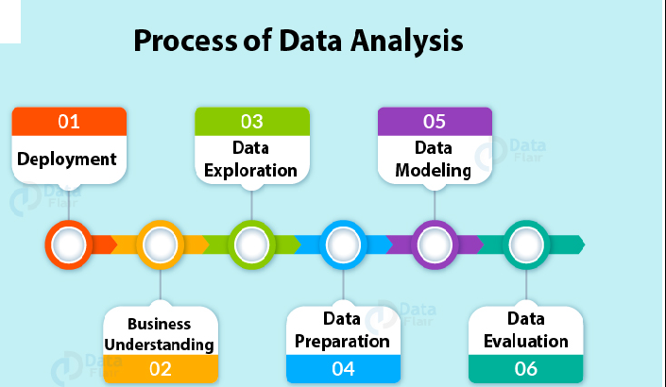
ARCHITECTURE -

Slide 5
DATA OVERVIEW -
The Data includes single .csv file with all examples, ordered by date( Year 1997 to Year 2015).
The Number of Instance - 246091 for crop_production.csv
Number of attributes – 7 attributes

Slide 6
KEY PERFORMANCE INDICATORS-
Key indicators displaying a summary of the Crop Production area and production information based on various parameters –
Crops Producing States of India.
Crop Producing districts of India.
The year of crop production.
Season under which crops fall.
Names of the crop produced in India.
Area cultivated under each crop (in Hectares).
Total production quantity of a crop (in Tons).

Slide 7
INSIGHT SUMMARY -
There are total 33 Crop Producing states and union territories in India.
In the 33 Crop Producing states and union territories there are total 646 crop producing districts in India.
There are total 124 crops which are produced in India.
There are total 6 seasons under which crops are produced in India viz. Summer, Winter, Whole Year, Kharif , Rabi and Autumn.

Slide 8
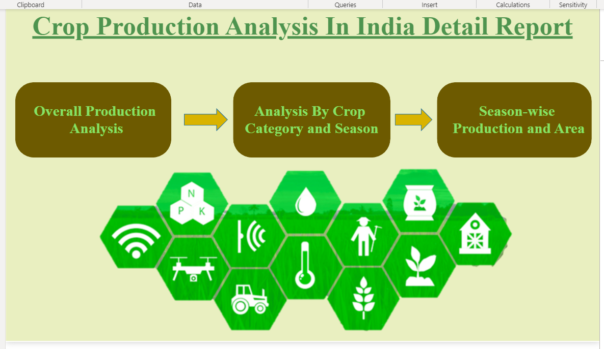
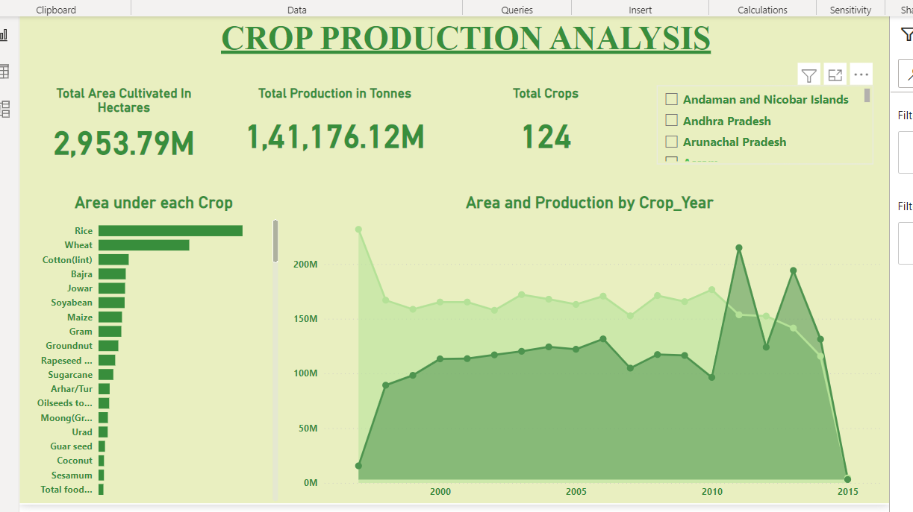
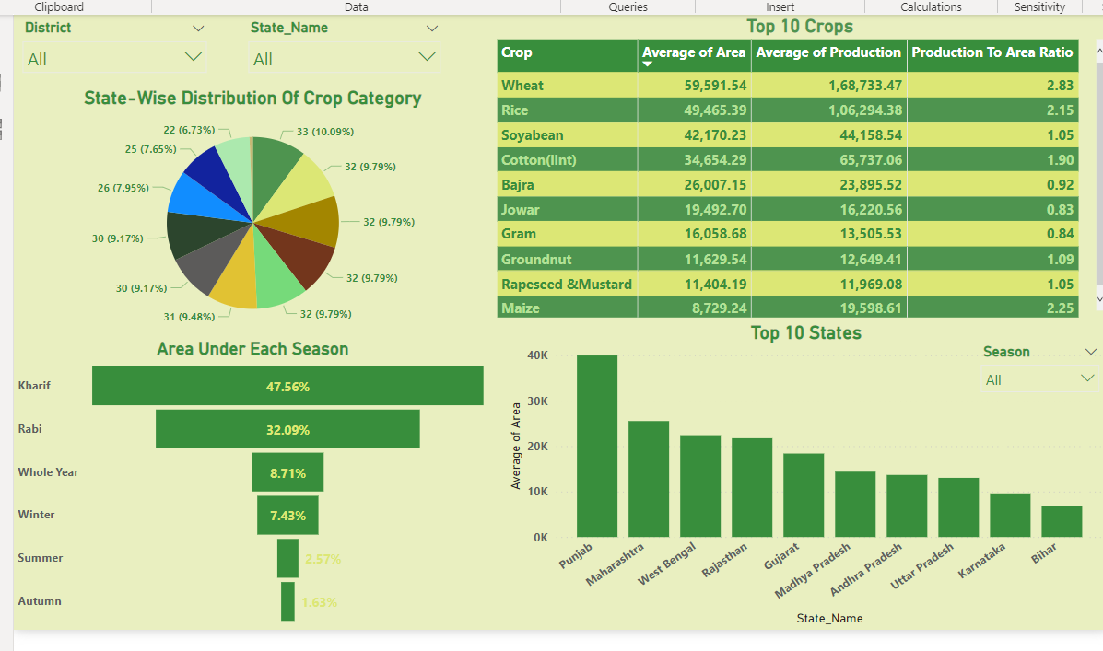
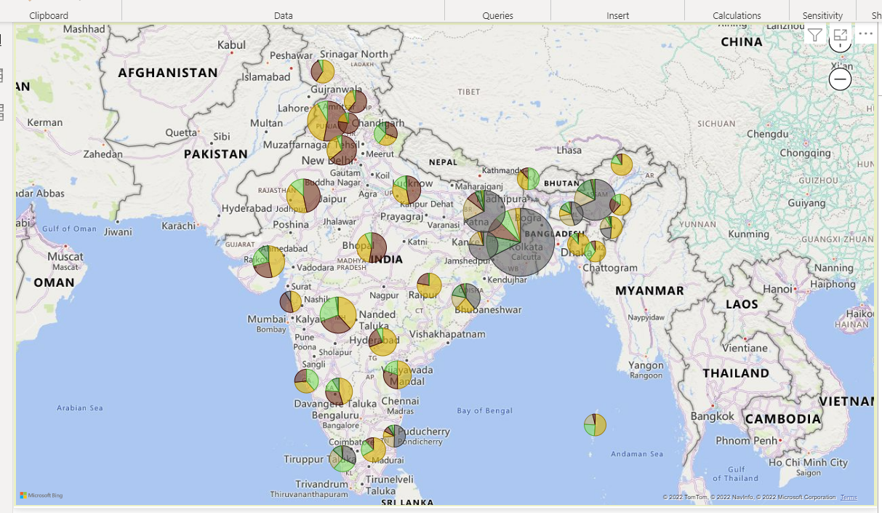
DASHBOARD

Slide 9
INSIGHTS SUMMARY -
Total of 2953.79 Millions Hectares area is cultivated till date in India.
The total food grain production in the country was recorded at 141176.12 million Tons.
51.19 % of Total area of India is under five crops viz. Rice, Wheat , Cotton , Bajra and Jowar.
Among the Top 5 crops above mentioned Rice has the highest percentage of 25.29%.
From year 1997 to 2015, Year 2011 records the highest crop production which is 14,308.9 Millions Tons.
Whereas Year 2013 records the second highest crop production after Year 2011 which is 12903.59 Millions Tons.
All states and union territories in India produce Cereals which makes them the most produced crop category in India.
Oil seeds, Pulses and Beans are the second most produced crop category in India(32 States).

Slide 10
INSIGHTS SUMMARY -
47.56% of Total area cultivated in India is under Kharif Season which shows that the Indian Environment is more suitable for the Kharif crops.
32.09% of Total area cultivated in India is under Rabi Season which makes it the second highest after the Kharif season.
The Indian environment is least suitable for the growth of crops which falls under Summer and Autumn Season.
Top 10 cultivated states in India are as follows –
1. Punjab 2. Maharashtra 3. West Bengal 4. Rajasthan 5. Gujrat 6. Madhya Pradesh
7. Andhra Pradesh 8. Uttar Pradesh 9. Karnataka 10. Bihar.

Slide 11
INSIGHTS SUMMARY -
Top 3 States For Each Season –
Kharif => 1. Punjab 2. Maharashtra 3. Rajasthan
Rabi => 1. Punjab 2. Rajasthan 3. Haryana
Whole Year => 1. Punjab 2. Maharashtra 3. Rajasthan
Winter => 1. West Bengal 2. Bihar 3. Assam
Summer => 1. West Bengal 2. Assam 3. Gujrat
Autumn => 1. Bihar 2. West Bengal 3. Assam
Top 10 Crops according to average cultivated area are –
1. Wheat 2. Rice 3. Soyabean 4. Cotton 5. Bajra 6. Jowar 7. Gram 8. Groundnut
9. Rapeseed and Mustard 10. Maize.

Slide 12
Q & A-
Q.1). What’s the Source of Dataset ?
ANS – This Dataset is publicly available for research, Available at https://data.world/thatzprem/agriculture-india named as crop_production.csv.
Q.2). What was the Type of Dataset ?
ANS – The Data was available in csv format.
Q.3). What’s the complete flow you followed in this Project?
ANS – Refer all slides in sequence for better Understanding.
Q 4) What steps should I follow to get insights from the data?
Step1 – Download the data and store it in a location in your PC.
Step2 – Open Crop_Prod_Report.pbix file in your pc and then you can see all the insights.

