Slide 1
Capstone Presentation
Supply Chain Optimization in FMCG Sector

Slide 2
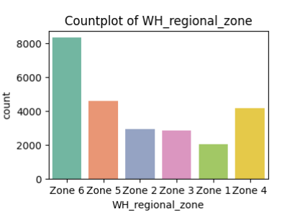
Business Problem Understanding
FMCG company faces shipment imbalances across warehouses.
Some warehouses are oversupplied, others undersupplied.
Need a model to optimize product weight distribution.
Analysis must also identify high-demand areas and risk factors.

Slide 3
Data Exploration & Key Observations
Location_type: Mostly rural warehouses.
WH_capacity_size: Mostly Large & Mid.
North & West zones have the most warehouses.
Zone 6 highest concentration, then Zone 5 and Zone 4.
Company-owned warehouses slightly more than rented.

Slide 4
Modeling Approach Used & Why
Best Model: Random Forest Regressor.
Selected because it gives high accuracy, works well with complex data, and shows which factors are most important.
Model | R2 Score
Random Forest | 0.993
SVR | 0.989
Ridge | 0.977
Lasso | 0.966

Slide 5
Model Tuning & Final Performance
Random Forest selected and hyperparameter tuned to get the best model.
Fitting 10 folds for each of 160 candidates so total 1600 fits.
Best Score: 0.9519
Best Parameters: max_depth=20, max_features='sqrt', min_samples_leaf=5, n_estimators=200.
Final Test R² Score: 0.9548

Slide 6
Insights from Analysis
Some high-shipment warehouses lack electricity or temperature control, creating a risk of spoilage.
Flood-affected zones get less supply.
Government checks have little effect on supply.
More distributors = better supply management despite competition

Slide 7
Demand & Supply Patterns
Zone 6 has highest supply & warehouse count.
Zone 1 has lowest supply.
High-supply zones often overlap with high distributor presence
Supply is shaped by infrastructure, risks, and competition.

Slide 8
Recommendations
Upgrade infrastructure in high-shipment warehouses
Factor flood risks into supply planning
Maintain a strong distributor network for wider coverage.
Track competition impact regularly to adapt strategy.
Implement real-time monitoring of warehouse conditions (temperature, electricity).
Use predictive analytics to forecast demand and adjust shipments in advance.
Develop contingency supply routes for high-risk zones.

Slide 9
Conclusion
Implementing the recommendations will improve supply reliability and reduce losses.
Tuned Random Forest model ensures accurate prediction of warehouse needs.
Balanced supply planning will optimize resources and minimize risks.
Integration into the supply chain system enables faster, data-driven decisions.

