Slide 1




Minor Specialization Project Presentation
On
Data Analysis and Visualization of Global Store Sales Using Power Bi
By:-
AKSHAY SARKAR (201900183)

Slide 2
List Of Contents
Sl. No. | Content | Page No.
1 | Abstract | 3
2 | Introduction | 4
3 | Literature Survey | 5-6
4 | Problem Definition | 7
5 | Solution Strategy | 8
6 | Block Diagram | 9
7 | Flow Chart | 10
8 | Implementation Details | 11-12
8 | Results | 13
9 | Limitation and Future Scope | 14
10 | Gantt Chart | 15
11 | References | 16-17

Slide 3
Abstract
Data analytics is one of the most important subfield of the Data Science domain which focuses on processing and performing analysis of existing datasets and find actionable insights from it.
The field of analytics is directed towards solving problems for questions we don’t know the answers to.
Data visualization aims to present complex data in a visual format that is easy to understand, interpret, and gain insights from.
This project is based on extracting meaningful insights from The Global Store Sales data which will help in taking desirable actions

Slide 4
Introduction
The project aims to analyze and visualize global store sales data to gain valuable insights and support decision-making processes.
It ensures an intuitive and user-friendly interface, enabling users to navigate the analysis tool, perform analysis tasks, and create visualizations without extensive technical expertise.
It will facilitate collaboration among users by providing features for sharing analysis workflows, visualizations, and insights, promoting teamwork and knowledge sharing.
Advanced data analysis technique like descriptive analysis is applied to uncover patterns, trends, and relationships within the sales data.

Slide 5
Literature Survey
SI.No. | Author | Paper And Publication Details | Findings | Relevance to the project
1 | Kiran Singh and Rakhi Wajgi | “Data analysis of sales data,” 2016 World Conference on Futuristic Trends in Research and Innovation for Social Welfare (Startup Conclave)., INSPEC Accession Number: 16358540 ,DOI: 10.1109/STARTUP.2016.7583967 | Identifying different customer segments based on purchasing behavior, demographics, and preferences. The analysis also revealed the most profitable, | Helped in understanding the basic workflow of handling sales data.
2 | Mandava Geetha Bhargava, K. Surya Kiran and Duvvada Rajeswara Rao | “, Analysis and Design for Visualization of Educational Institution Database using Power BI Tool”, Global Journal of Computer Science and Technology Software & Data Engineering, Volume 1 Issue 4 Version 1.0 Year 2018 | The research emphasized the significance of data visualization in effectively communicating sales insights. By utilizing interactive dashboards, charts, graphs. | Helped in understanding the capabilities of PowerBi on Data Analysis.

Slide 6
3 | Amrapali Bansal, A. K. Upadhyay | “Microsoft Power BI”, International Journal of Soft Computing and Engineering (IJSCE), ISSN: 2231-2307, Volume-7 Issue-3, July 2017 | Power BI's capacity to conduct sophisticated calculations, implement data transformations, and derive meaningful insights from intricate datasets. These capabilities have facilitated the extraction of valuable information and fostered a more profound comprehension of the data at hand. | Helped in working with Power BI to analyze Global Store Sales. It also helped to know the capabilities of PowerBi in the field of Data Science.
4 | Matthew N. O. Sadiku, Adebowale E. Shadare, and Cajetan M. Akujuobi | “Data Visualiztion”, International Journal of Engineering Research and Advanced Technology(IJERAT),2016 Volume.2 Issue.12, December | Showing the use of visualizations significantly improved comprehension and facilitated effective decision-making by providing a clear and intuitive representation of complex data. | This paper showed the detailed use cases of data visualization and further showing multiple visualizing techniques.
Literature Survey

Slide 7
Problem Definition
Volume and Complexity of Data- Challenge of effectively managing and
analyzing large volumes of data.
Lack of Actionable Insights- Traditional methods and manual approaches are time-consuming, prone to errors.
Geographical Variations- Difficulty in understanding and analyzing these variations for developing targeted marketing strategies and optimizing sales performance.
Lack of interactive visualization- Challenge of visualizing multiple year-based data in a single dashboard.

Slide 8
Solution Strategy
Data processing will be done to reduce the volume of data and make the data ready to be used for analysis.
DAX(Data Analysis Expressions) is a formula language that will be used to define custom calculations and measures for the purpose of performing in-depth analysis.
Performing geographic analysis to comprehend regional variations in-store sales.
Power Bi, which is an interactive data visualization and data manipulation software will be used with a primary focus on business intelligence.

Slide 9
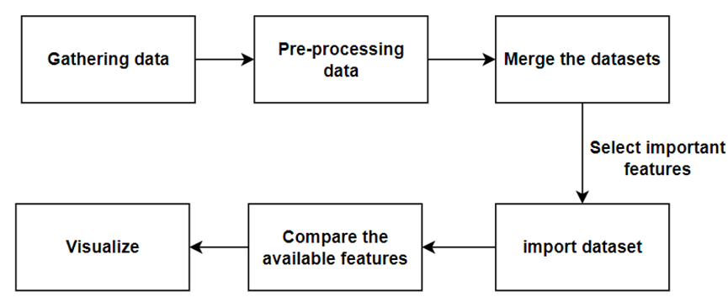
Block Diagram
Block Diagram for Data Analysis

Slide 10
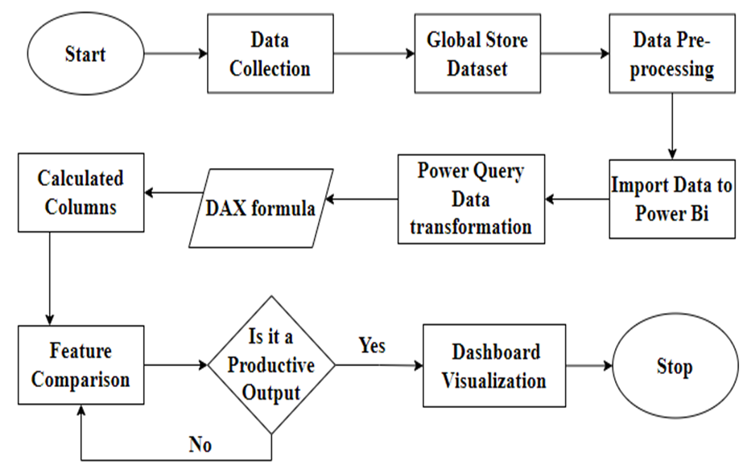
Flow Chart
Flow Chart for Data analysis and visualization of Global Store Sales

Slide 11
Implementation Details
Algorithm
Step 0- Start
Step 1- Identify and gather relevant data from various sources, such as sales databases, customer databases, and product databases.
Step 2- Apply data cleaning techniques to handle missing values, remove duplicates, and address inconsistencies.
Step 3-Implement features such as filtering, drill-down, and interactive elements to enhance the user experience.
Step 4- Define calculated columns using Dax
Step 5- Deploy the data analysis and visualization solution in a suitable environment, ensuring accessibility for authorized users.

Slide 12
Step 6- Perform user acceptance testing to gather feedback and make necessary improvements.
Step 7- Continuous Monitoring and Maintenance
Step 8- Stop

Slide 13
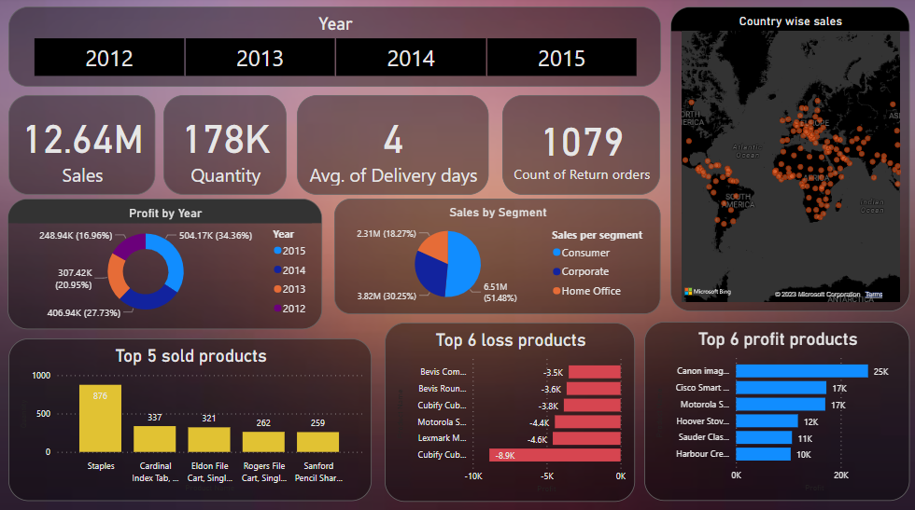
Results
Interactive Dashboard Visualization of Global Store Sales

Slide 14
Limitations and Future Scope
Limitations:
Scalability
Technical Expertise
High Processing Time
Future Scope:
Advanced Analytics
Real-time Data Analysis
Customer Behavior Analysis

Slide 15
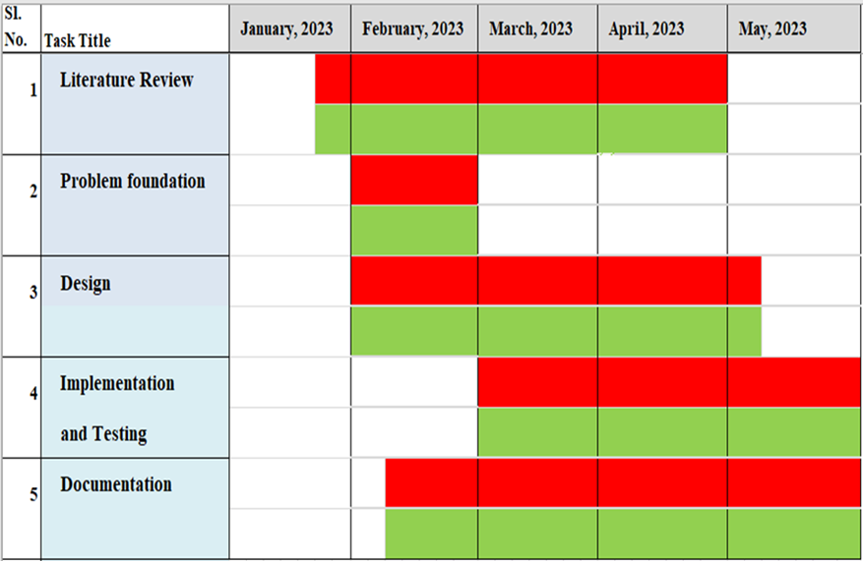
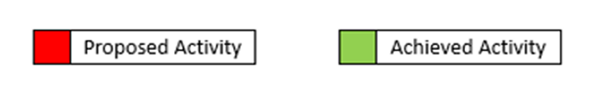
Gantt Chart
Gantt Chart of the Project

Slide 16
References
  [1] Kiran Singh and Rakhi Wajgi, “Data analysis and visualization of sales data,”
  2016 World Conference on Futuristic Trends in Research and Innovation for
  Social Welfare (Startup Conclave)., IN-SPEC Accession Number: 16358540,
  DOI: 10.1109/STARTUP.2016.7583967
  [2] By Mandava Geetha Bhargava, K. Tara Phani Surya Kiran, and Duvvada Rajeswara
  Rao, Analysis and Design of Visualization of Educational Institution Database
  using Power BI Tool, Global Journal of Computer Science and Technology
  Software & Data Engineering, Volume 1 Issue 4 Version 1.0 Year 2018, Online
  ISSN: 0975-4172 & Print ISSN: 0975-4350
  [3] Amrapali Bansal, A. K. Upadhyay, “Microsoft Power BI”, International Journal of
  Soft Computing and Engineering (IJSCE), ISSN: 2231-2307, Volume-7 Issue-3,
  July 2017

Slide 17
  [4] Matthew N. O. Sadiku, Adebowale E. Shadare, Sarhan M. Musa and Cajetan M.
  Akujuobi, “DATA VISUALIZATION”, International Journal of Engineering Re-
  search and Advanced Technology(IJERAT), Volume.2 Issue.12, December 2016
  [5] Michael Diamond and Angela Mattia, “Data visualization: an exploratory study
  into the software tools used by businesses”, Journal of Instructional Pedagogies,
  Volume 18
  [6] Vinh T Nguyen, Kwanghee Jung & Vibhuti Gupta, “Examining data visualization
  pitfalls in scientific publications”, Visual Computing for Industry, Biomedicine,
  and Art, Volume 4 Article number: 27 (2021), 29 October 2021
  [7] Sun Binli, ”Research on data-preprocessing for construction of university
  information systems”, IEEE Conference. Computer Application and System
  Modeling (ICCASM), 2010 International Conference Volume:1. 22-24 Oct. 2010

