Slide 1
Power
Coal
Gas
Non-Renewable
Renewable
Solar
Wind
Diesel
Hydro
Nuclear

Slide 2

Map Points Info.
Name of Plant
Yield
Sector i.e. private or public

Slide 3
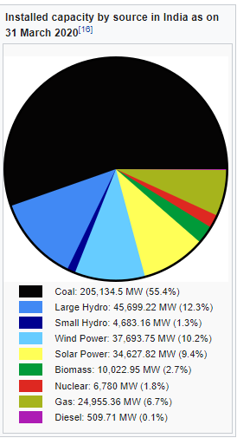
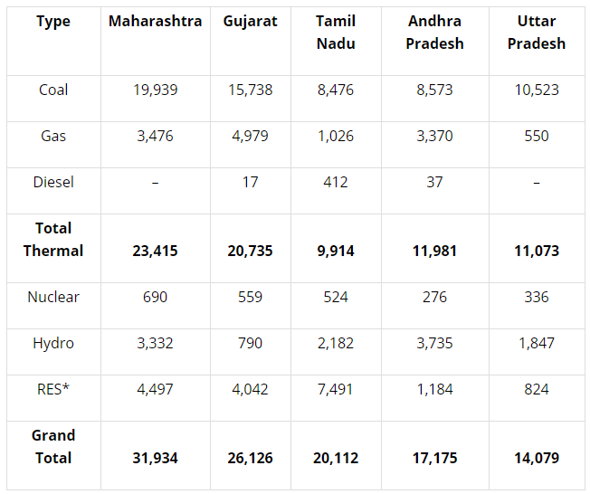
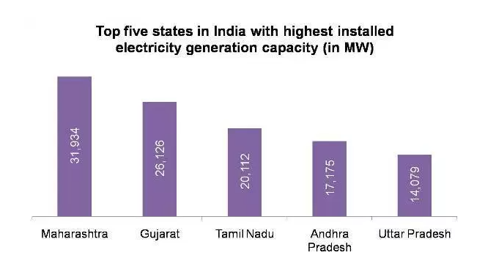
Stats
India is the world’s fifth largest electricity generator with total installed capacity of 2,28,722 MW. Out of this, 90,062 MW is from state owned utilities, 72,927 MW is from privately owned utilities and 65,733 MW is from central owned utilities. The pace of investment from private players is considerable which shows an encouraging environment for the electricity sector.

Slide 4
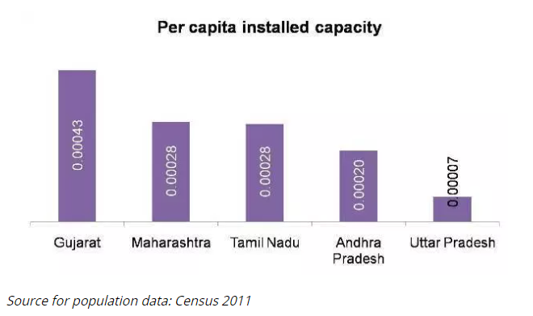
Power Per Capita
The state of Maharashtra, Gujarat and Tamil Nadu are highly industrialized. Therefore, their electricity demand is also higher than other states. If we compare total installed electricity generation capacity with the population of respective states, then following results are arrived at:

Slide 5
Tools and libraries used
Rvest [Scrape tables from web using xpath]
Manually extracting datasets from web and editing
Excel functions:
-> [=LEFT(J2,19):- for eliminating extra characters in coordinates scraped]
-> [=E2&" "&F2] :- combining two columns
-> Text to Columns :- Extracting Lat. and long. From degrees format

Slide 6
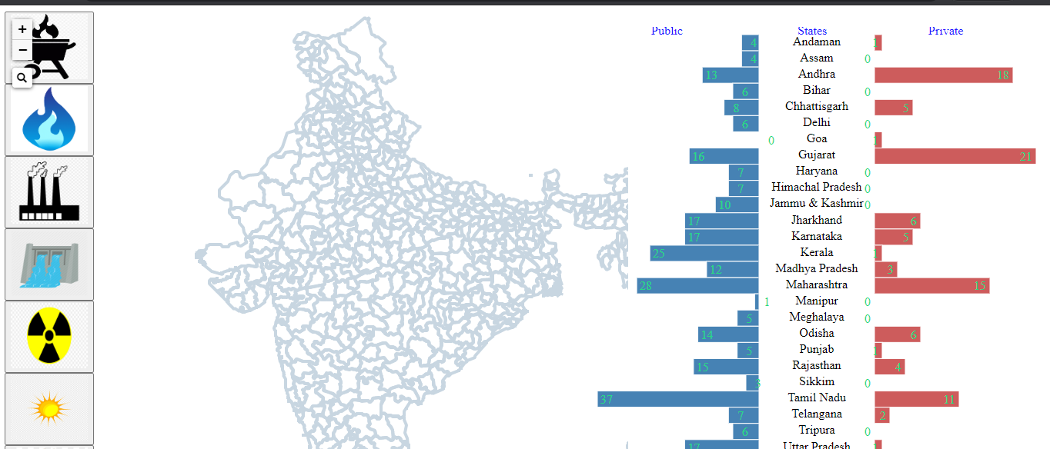
Output

