Slide 1


FRONTEND TECHNOLOGIES AND BACKEND TECHNOLOGIES
Presentation By – Akshay J Sharma
BPEM0569

Slide 2



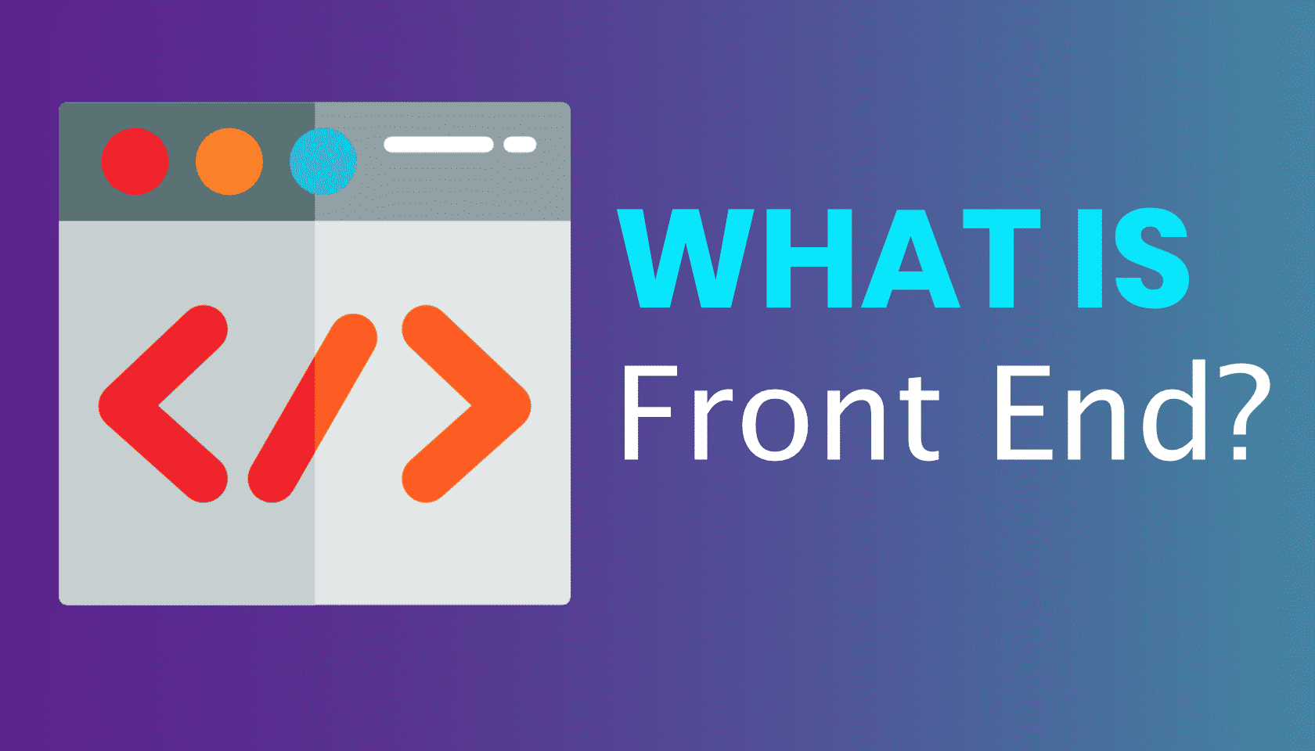
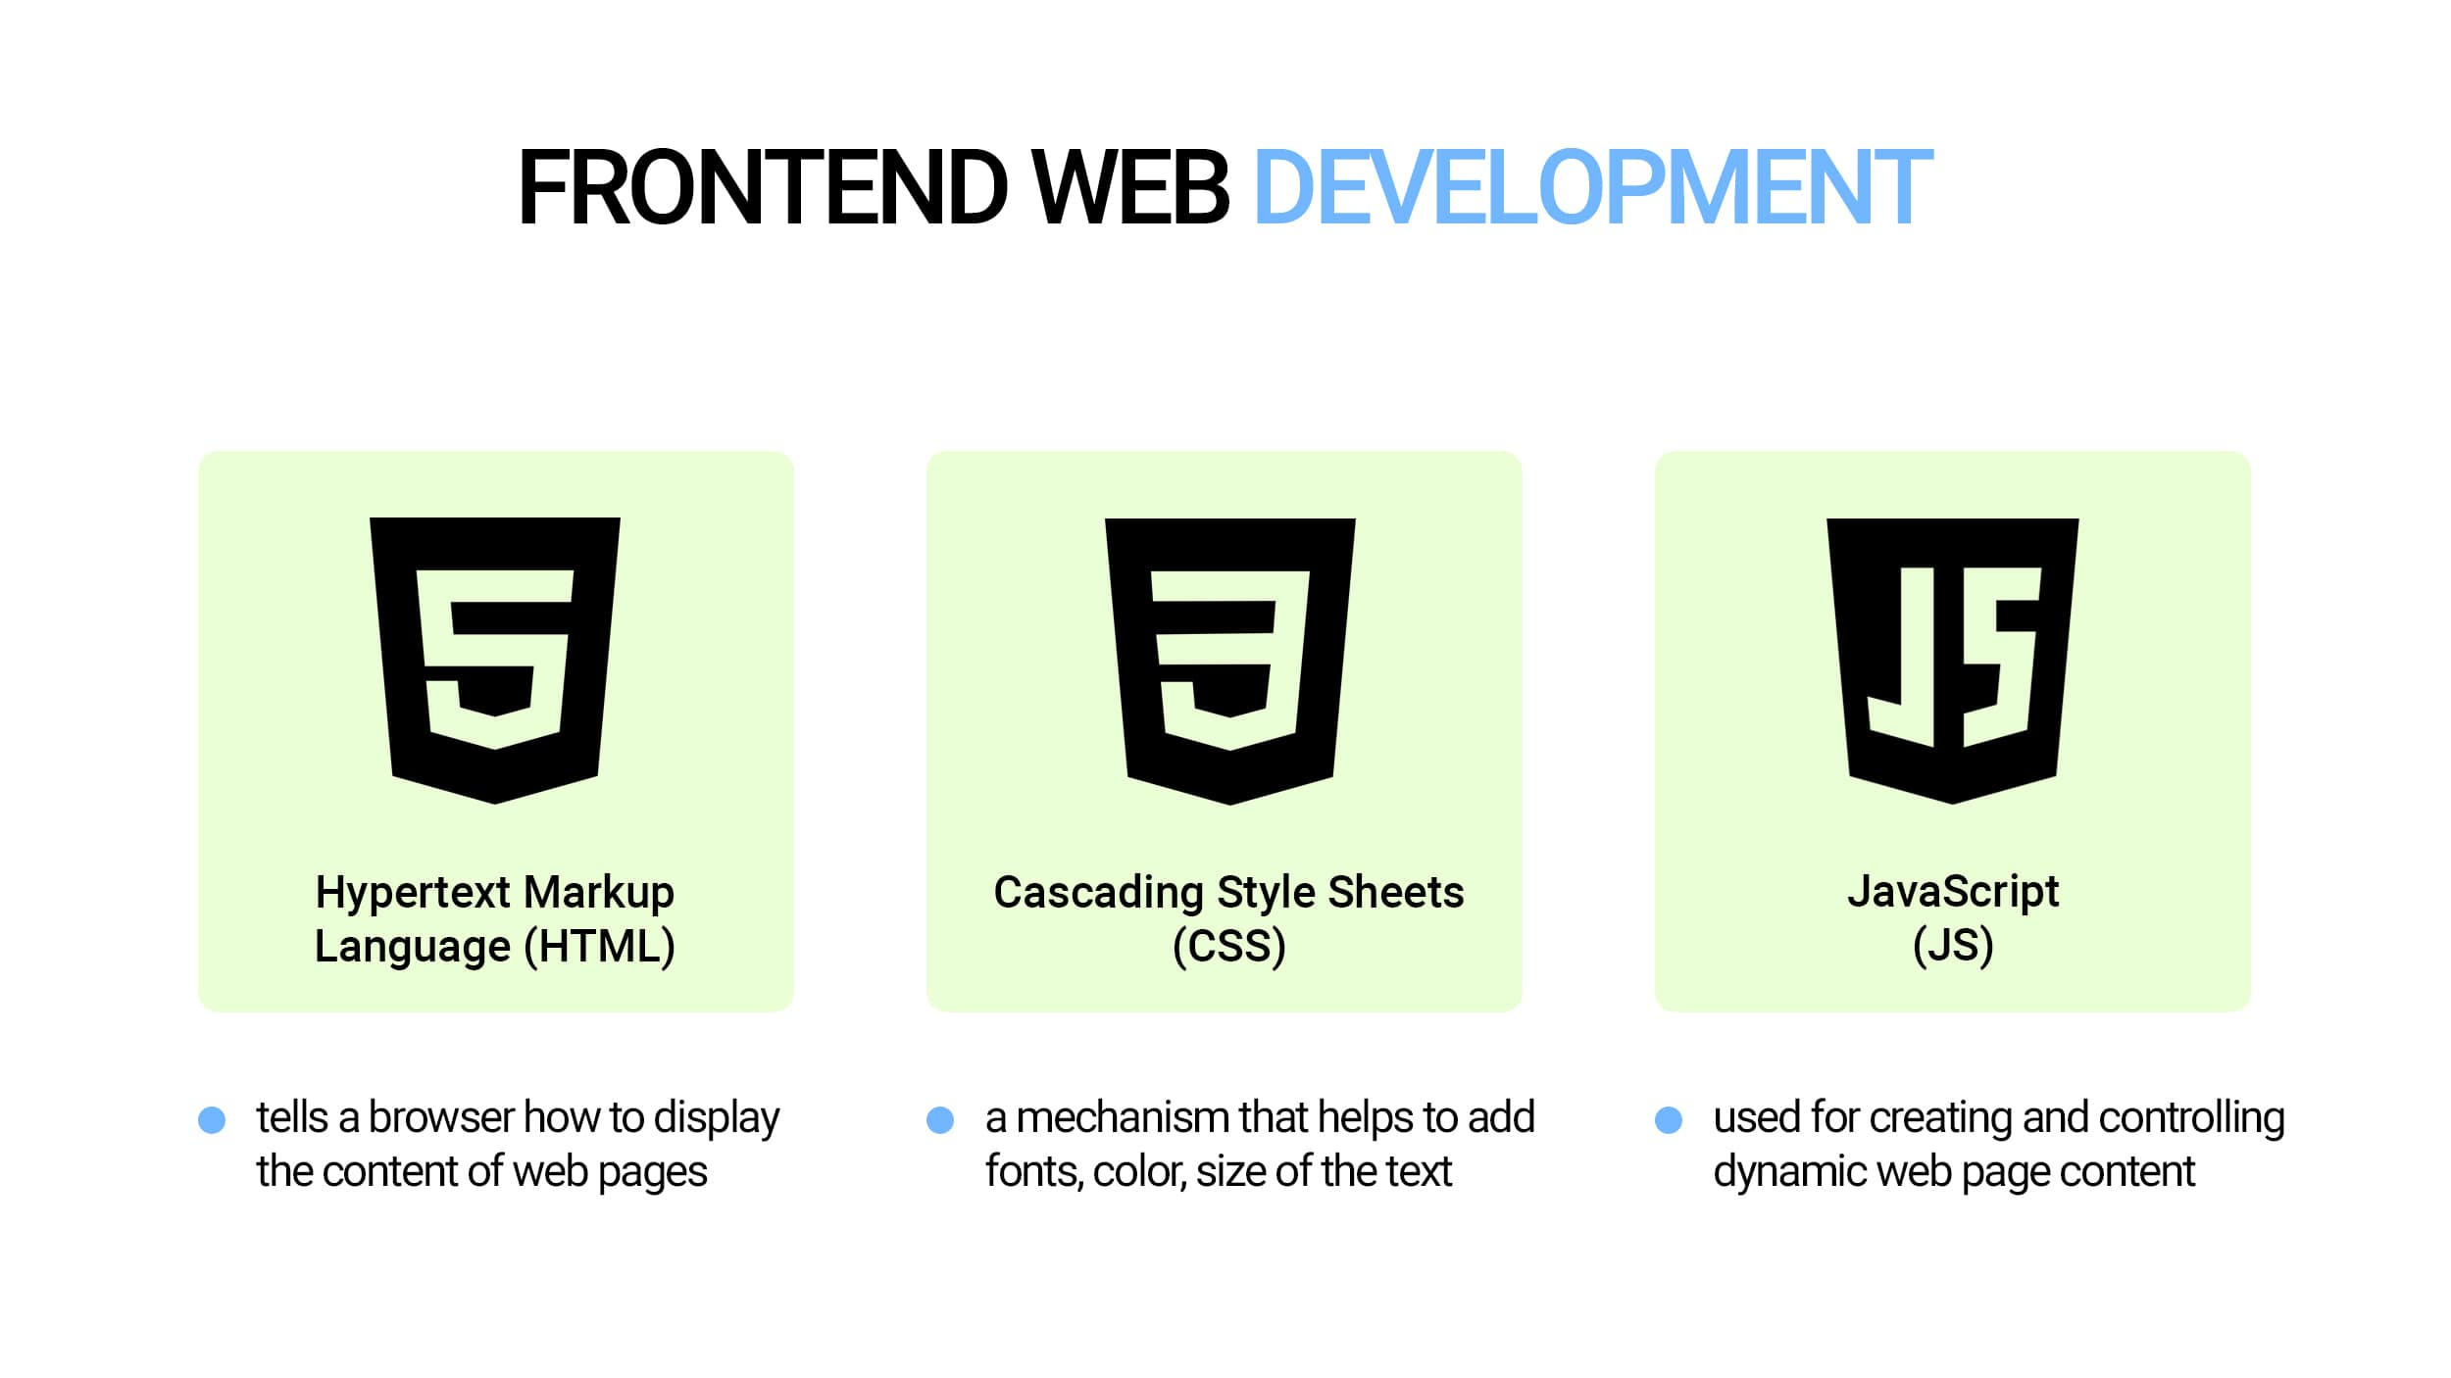
FRONTEND TECHNOLOGY
User Interface (UI) Development: It involves creating the visual components of a website or web application that users interact with directly, such as layout, design, and user experience elements.
Client-Side Technologies: Frontend technologies encompass languages and frameworks like HTML, CSS, and JavaScript used to structure, style, and add interactivity to web pages, ensuring a compelling and responsive user interface.

Slide 3
TECHNOLOGIES USED IN FRONTEND
Text Editors and Integrated Development Environments (IDEs):
Visual Studio Code
Sublime Text
Atom
WebStorm
Brackets
Version Control:
Git
GitHub
Bitbucket
Browser Developer Tools:
Chrome DevTools
Firefox Developer Tools
Edge DevTools
JavaScript Frameworks and Libraries:
React.js
Angular
Vue.js
jQuery
Ember.js
Graphics and Design Tools:
Adobe Photoshop
Adobe Illustrator
Sketch
Figma
UI/UX Design and Prototyping:
Adobe XD
Sketch
Figma
InVision
JavaScript Frameworks and Libraries:
React.js
Angular
Vue.js
jQuery
Ember.js
Responsive Design Tools:
Bootstrap
Foundation
Material-UI
Bulma
API Development and Testing:
Postman
Insomnia

Slide 4
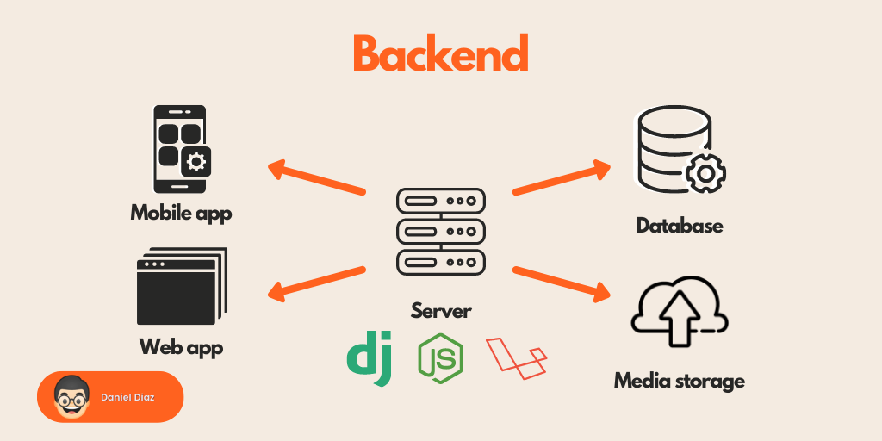
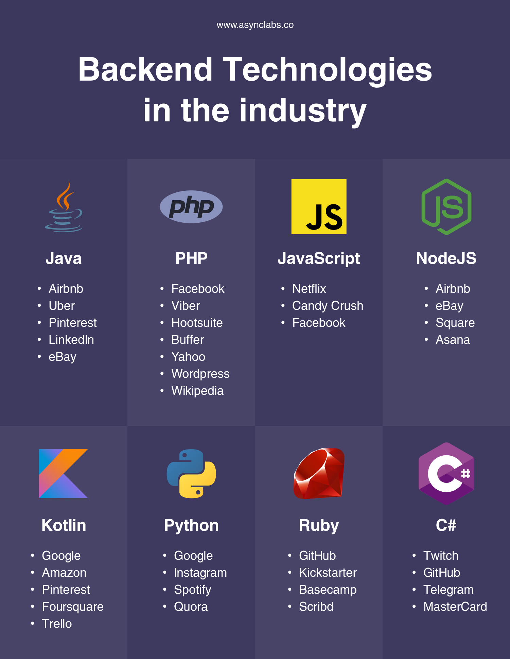
Backend technology
Backend technology is the part of web development responsible for server-side logic, databases, and other behind-the-scenes processes that power a website or web application.
Server-Side Logic: Backend technology focuses on the server-side of web applications. It involves handling data storage, processing, and managing the business logic of the application. This includes tasks such as database management, user authentication, server configurations, and responding to client requests.
Data Management and Security: Backend technology is responsible for securely storing and managing data, ensuring data integrity, and protecting sensitive information. It often involves working with databases, server-side scripting languages (e.g., Node.js, Python, Ruby), and frameworks to handle data transactions and provide a secure foundation for the frontend to interact with.

Slide 5
Differences between Backend technology Differences based on Programming Languages Used
Node.js:
Programming Language: JavaScript (runtime environment).
Notable Features: Non-blocking I/O, event-driven architecture.
Ruby on Rails:
Programming Language: Ruby.
Notable Features: Convention over configuration, rapid development.
Python (Django and Flask):
Programming Language: Python.
Notable Features: Django offers a comprehensive framework with many built-in features, while Flask is a microframework for more minimalistic needs.
PHP (Laravel):
Programming Language: PHP.
Notable Features: Laravel provides a clean and expressive syntax.
Java (Spring):
Programming Language: Java.
Notable Features: Robust and enterprise-grade, strong typing.
.NET (ASP.NET):
Programming Language: C# (mostly).
Notable Features: Versatile, well-suited for Windows-based applications.

Slide 6
Differences based on Frameworks and Libraries
Node.js:
Frameworks: Express.js is the most commonly used framework for Node.js.
Libraries: Node.js has a vast ecosystem of libraries available through npm (Node Package Manager).
Characteristics: It's known for its flexibility in choosing libraries for various purposes, which allows developers to build custom solutions.
Ruby on Rails:
Frameworks: Ruby on Rails is a full-stack framework that provides many built-in features.
Libraries: It comes with a set of libraries for common tasks, such as database interactions.
Characteristics: Rails follows the "convention over configuration" principle, making it easy to get started quickly without needing to choose many libraries.
Python (Django and Flask):
Frameworks: Django and Flask are popular Python backend frameworks.
Libraries: Django comes with a wide range of built-in libraries, while Flask is more minimalistic and allows developers to choose libraries as needed.
Characteristics: Django provides an all-in-one solution with many prebuilt features, whereas Flask offers more flexibility in choosing libraries for specific functionalities.
PHP (Laravel):
Frameworks: Laravel is the primary PHP framework.
Libraries: Laravel includes libraries for tasks like authentication, database management, and routing.
Characteristics: It offers an expressive syntax and a set of tools and libraries to streamline common web development tasks.
Java (Spring):
Frameworks: Spring is the dominant Java backend framework.
Libraries: Spring offers a comprehensive set of libraries for various aspects of web development, such as security, data access, and transaction management.
Characteristics: Spring is known for its extensive library support and flexibility, making it suitable for large-scale enterprise applications.
.NET (ASP.NET):
Frameworks: ASP.NET is the primary framework for .NET backend development.
Libraries: The .NET ecosystem includes libraries for web development, such as Entity Framework for data access.
Characteristics: .NET provides a versatile environment for building Windows-based applications and enterprise-level systems.

Slide 7
Differences based on Scalability and Performance
Node.js:
Scalability: Node.js is well-known for its ability to handle a large number of concurrent connections and is particularly suitable for applications requiring real-time features, such as chat applications and online gaming.
Performance: It has good performance due to its non-blocking, event-driven architecture, making it efficient for handling I/O-bound tasks. However, CPU-bound tasks may require additional workarounds for optimal performance.
Ruby on Rails:
Scalability: Ruby on Rails is less inherently scalable than some other technologies. While it can handle moderate traffic, it may require more resources or advanced scaling techniques for high-concurrency scenarios.
Performance: Rails prioritizes developer productivity over raw performance. It may not be the best choice for high-performance applications but is suitable for rapid development.
Python (Django and Flask):
Scalability: Django can handle scalable applications, especially when optimized and deployed in a distributed environment. Flask, being more minimalistic, requires developers to make explicit scalability choices.
Performance: Django offers good performance, but performance optimization may be required for extremely high-traffic applications. Flask's performance depends largely on how it's configured and the libraries used.
PHP (Laravel):
Scalability: Laravel can handle medium to large-scale applications, and it provides features like database sharding and load balancing for scaling. However, extreme scalability may require additional considerations.
Performance: Laravel offers good performance, and its built-in caching and optimization features help improve response times.
Java (Spring):
Scalability: Java, especially when using Spring, is well-suited for enterprise-level applications with high scalability requirements. It can efficiently handle large and complex systems.
Performance: Java's performance is generally excellent, thanks to its compiled nature and Just-In-Time (JIT) compilation. Spring's comprehensive ecosystem provides tools for optimizing performance.
.NET (ASP.NET):
Scalability: .NET, with ASP.NET, is designed for scalable and enterprise-grade applications. It supports various scalability techniques, such as load balancing and microservices architecture.
Performance: .NET offers strong performance, particularly for Windows-based applications. It benefits from features like Just-In-Time compilation and native integration with the Windows ecosystem.

Slide 8
FRONTEND BACKEND INTERACTION
Client-Server Architecture: Web applications follow a client-server architecture. The frontend (client) is responsible for the user interface and runs in the user's web browser, while the backend (server) handles data processing, storage, and business logic on the server-side.
HTTP Requests and Responses: Interaction between frontend and backend primarily occurs through HTTP (Hypertext Transfer Protocol). The frontend sends HTTP requests to the backend, requesting data or specific actions, while the backend processes these requests and sends back HTTP responses with the requested information or results of actions.
RESTful APIs: Representational State Transfer (REST) is a common architectural style used for frontend-backend communication. RESTful APIs define a set of conventions for creating, reading, updating, and deleting resources (e.g., data records) on the server. Frontend applications make HTTP requests to these APIs to perform CRUD operations.
Data Exchange Formats: Data is typically exchanged between frontend and backend in standardized formats like JSON (JavaScript Object Notation) or XML (eXtensible Markup Language). JSON is more commonly used due to its simplicity and compatibility with JavaScript.
Authentication and Authorization: Backend systems implement authentication and authorization mechanisms to ensure that only authorized users can access certain resources or perform specific actions. The frontend handles user authentication, such as login forms, and sends authentication tokens or credentials to the backend for verification.
Real-Time Communication: In some cases, web applications require real-time updates or messaging between the frontend and backend. WebSockets and technologies like Server-Sent Events (SSE) are used to establish bidirectional communication channels, allowing the server to push updates to the client in real-time.

Slide 9
FRONTEND BACKEND INTERACTION
Project Requirements:
The choice of backend technology should align with the specific requirements of your project. Consider factors like the type of application you're building (e.g., e-commerce, social media, enterprise software), the complexity of the functionality, and any unique features needed.
For instance, if you're creating a real-time chat application, you might lean towards technologies like Node.js due to their ability to handle concurrent connections efficiently.
Scalability Needs:
Consider the scalability requirements of your project. Will your application need to handle a growing user base and increasing data volume? Different backend technologies have varying scalability characteristics.
For instance, if you anticipate rapid growth, you might opt for a technology like Java or .NET, known for their ability to handle large-scale enterprise systems.
Community and Support:
Evaluate the strength of the community around a particular backend technology. A strong and active community often results in better documentation, a wider range of third-party libraries, and more robust support.
Technologies with large communities, like JavaScript (Node.js) and PHP (Laravel), tend to offer ample resources for troubleshooting and development.

Slide 10


