Slide 1
WELCOME

Slide 2
LIBRARY MANAGEMENT SYSTEM IN C++
GANPAT UNIVERSITY
CSE BDA
PPT BY AKSHAY THAKUR
21162121001
ESFP-II

Slide 3
CONCEPTS USED IN PROGRAM
File Handling -File handling is used for store a data permanently in computer. Using file handling we can store our data in secondary memory (Hard disk).
Class and Object-A class in C++ is the building block that leads to Object-Oriented programming. It is a user-defined data type, which holds its own data members and member functions, which can be accessed and used by creating an instance of that class. A C++ class is like a blueprint for an object.
An Object is an instance of a Class. When a class is defined, no memory is allocated but when it is instantiated (i.e. an object is created) memory is allocated.
Loops-In programming, sometimes there is a need to perform some operation more than once or (say) n number of times. Loops come into use when we need to repeatedly execute a block of statements.

Slide 4
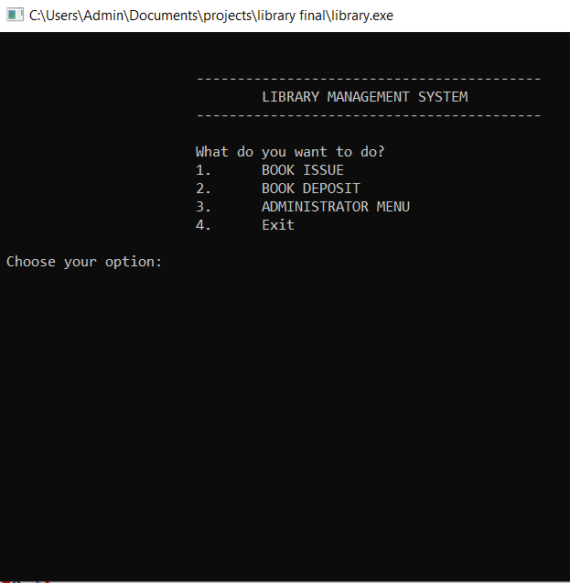
MAIN MENU

Slide 5
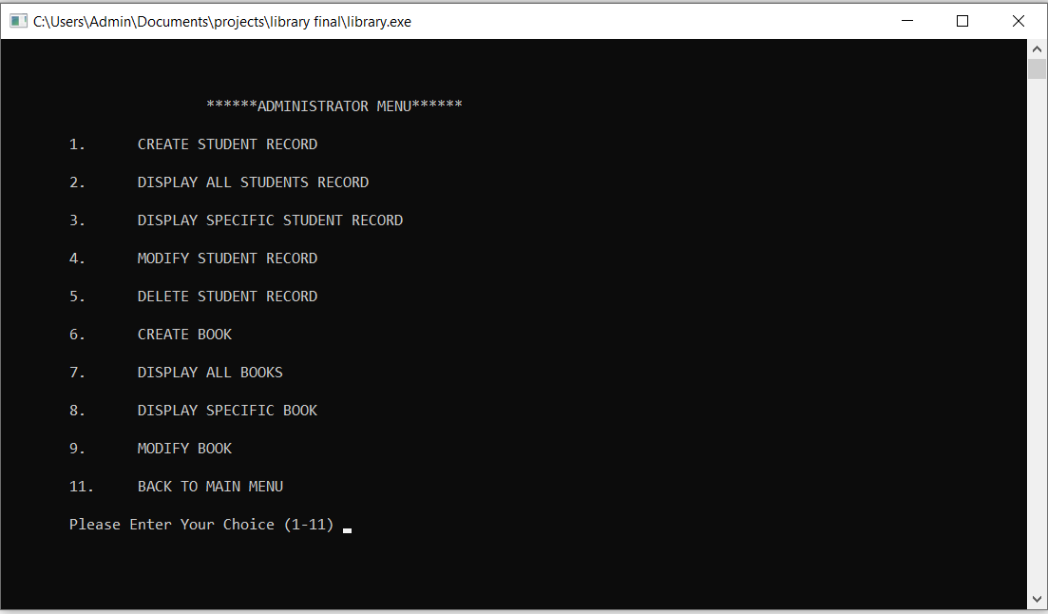
ADMINISTRATOR MENU

Slide 6
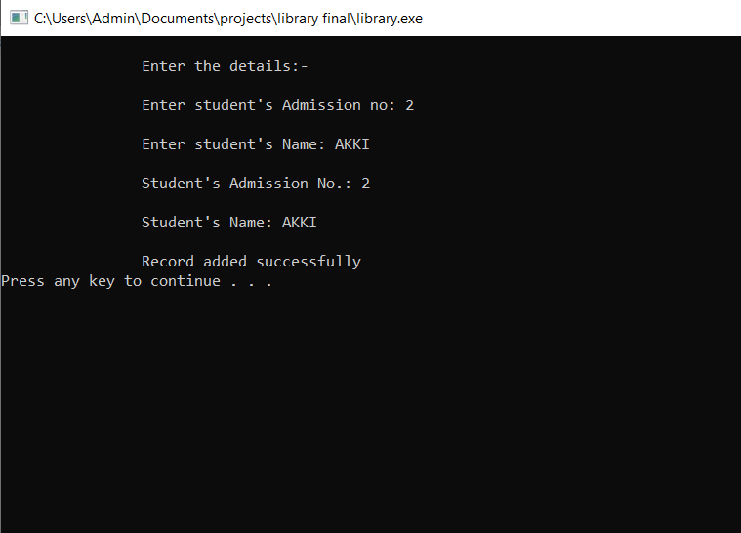
Adding student record

Slide 7
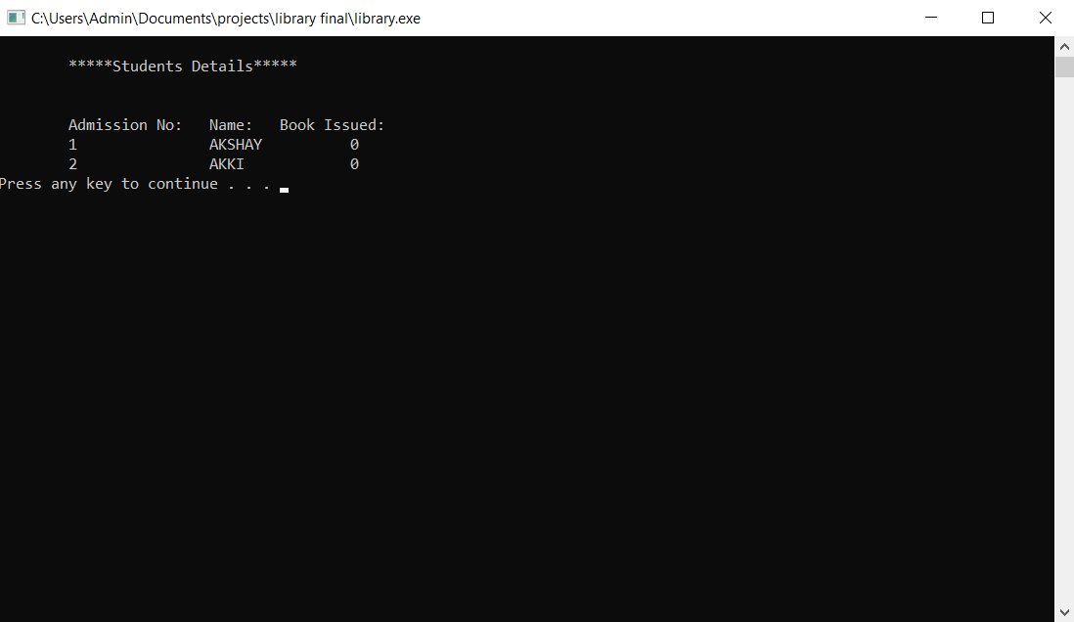
Displaying student record

Slide 8
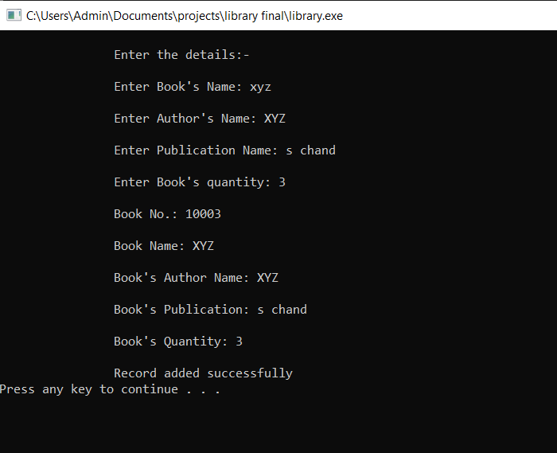
Adding book record

Slide 9
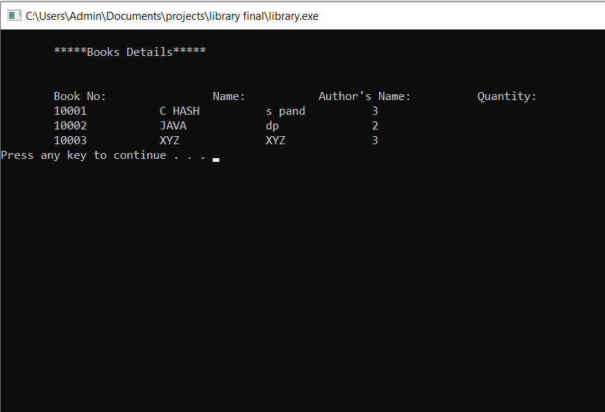
Displaying book records

Slide 10
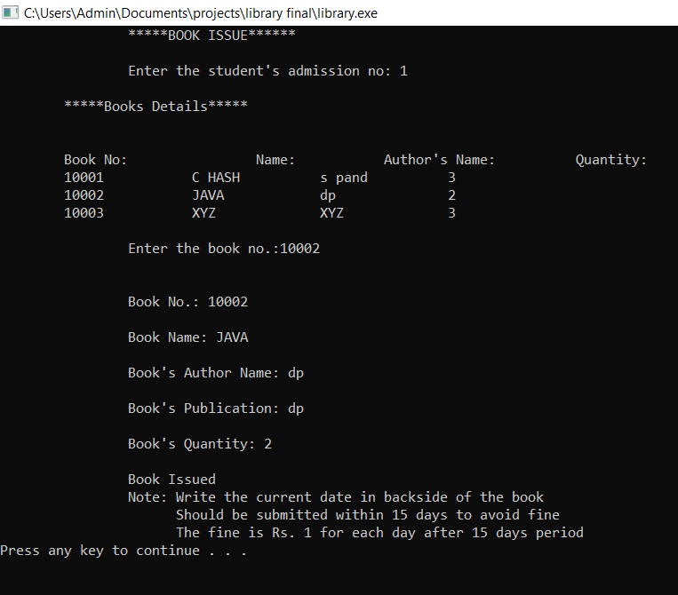
BOOK ISSUE

Slide 11
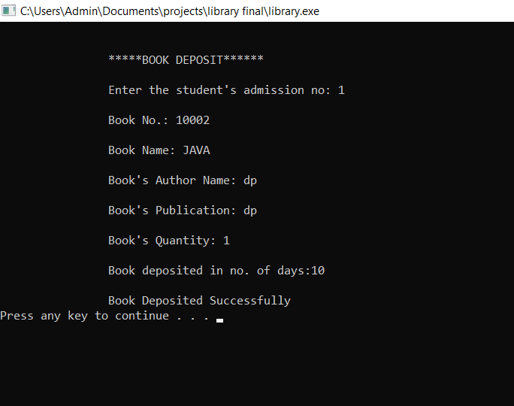
BOOK DEPOSIT

Slide 12
THANKYOU

