Slide 1
PS Admin Design Guide

Slide 2
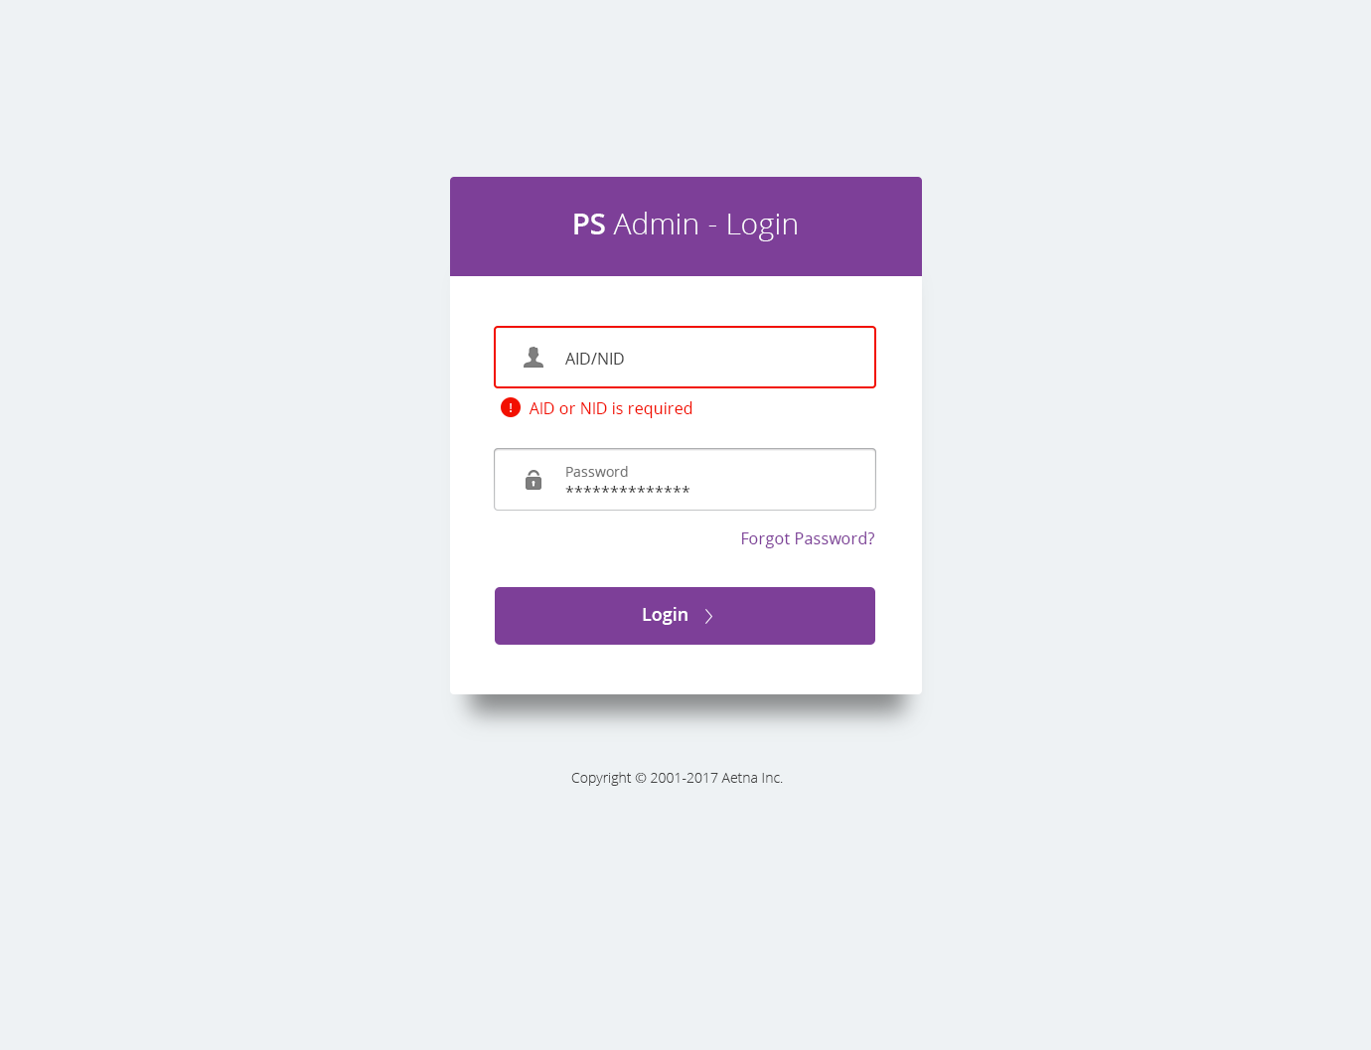
#7D3F98
Open Sans Semibold, 30 pt,
#FFFFFF
Open Sans Light, 30 pt,
#FFFFFF
#F21000
Open Sans Regular, 16 pt,
#F21000
Open Sans Regular, 16 pt,
#414141
Open Sans Regular, 16 pt,
#7D3F98
Open Sans Semibold, 18 pt,
#FFFFFF
#7D3F98
Background, #eef2f4

Slide 3
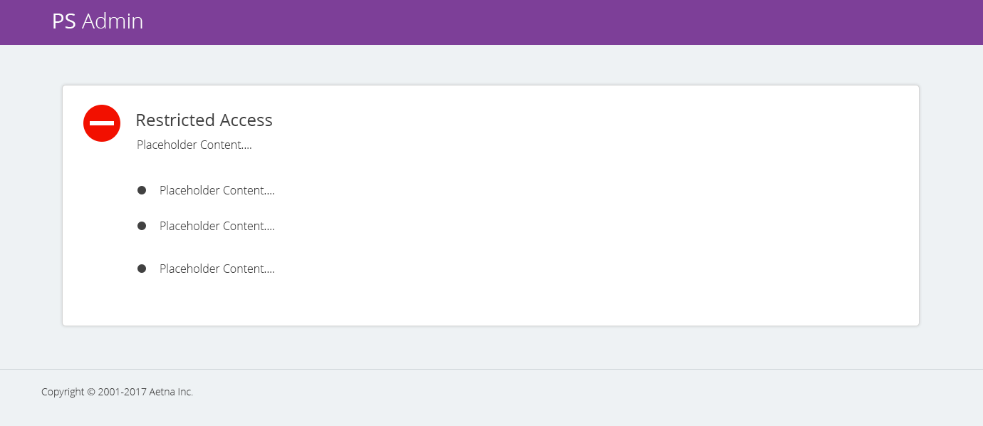
Open Sans Regular, 24 pt,
#414141
Open Sans Light, 16 pt,
#414141
Container: #FFFFFF with shadow
Background, #EEF2F4

Slide 4
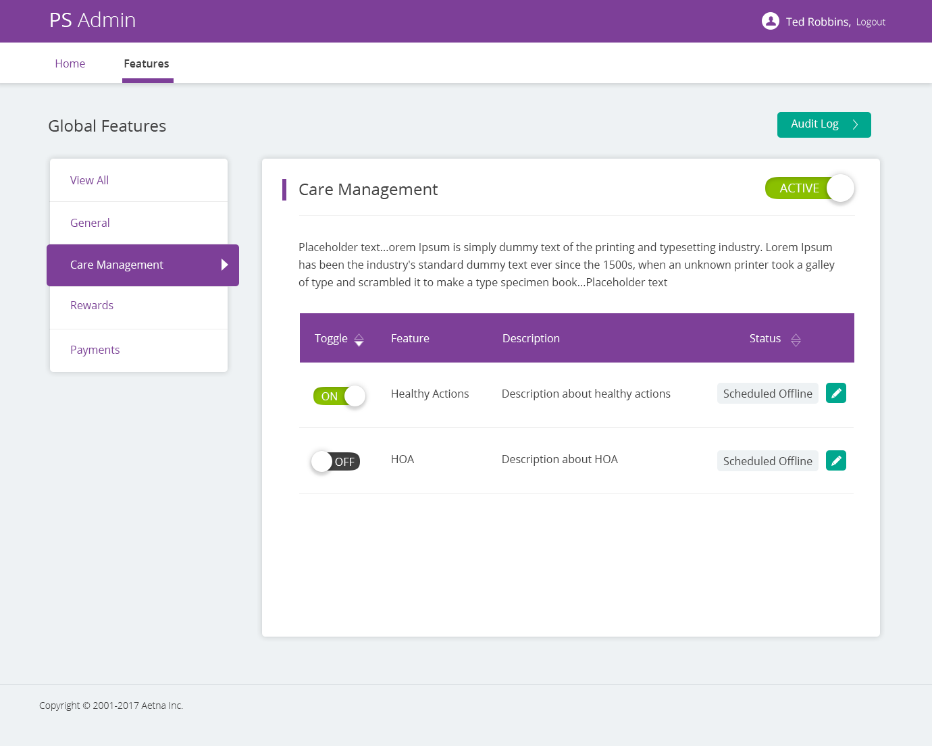

Open Sans Semibold, 16 pt, #414141
#7D3F98
Open Sans Regular, 16 pt,
#FFFFF
Open Sans Light, 14 pt,
#FFFFF
Open Sans Regular, 16 pt, #7D3F98
Open Sans Regular, 24pt, #414141
#00A78E
Open Sans Regular, 16pt, #414141
Open Sans Regular, 16 pt,
#FFFFF
1 px line, #EEF2F4
Open Sans Regular, 16 pt,
#FFFFFF
#7D3F98
Open Sans Regular, 16 pt, #FFFFFF
Open Sans Regular, 16 pt, #7D3F98
Open Sans Regular, 16 pt,
#414141
#EEF2F4
Background, #EEF2F4

Slide 5
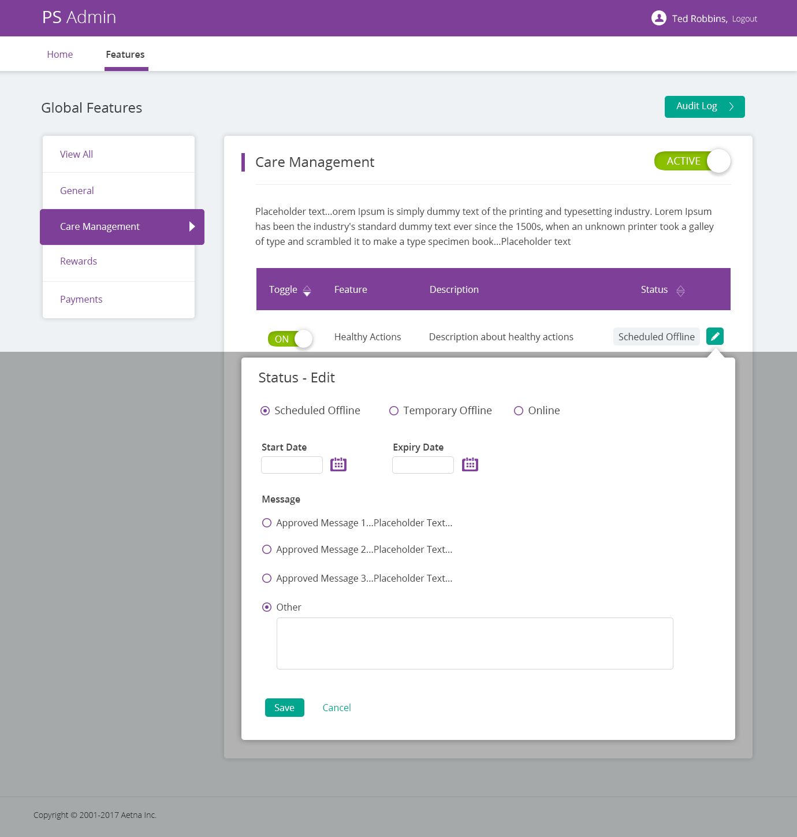
Open Sans Regular, 18pt, #414141
Open Sans Semibold, 16pt, #414141
Open Sans Regular, 16pt, #414141
Open Sans Regular, 16pt, #FFFFFF
#00A78E
Open Sans Regular, 16pt, #00A78E

Slide 6
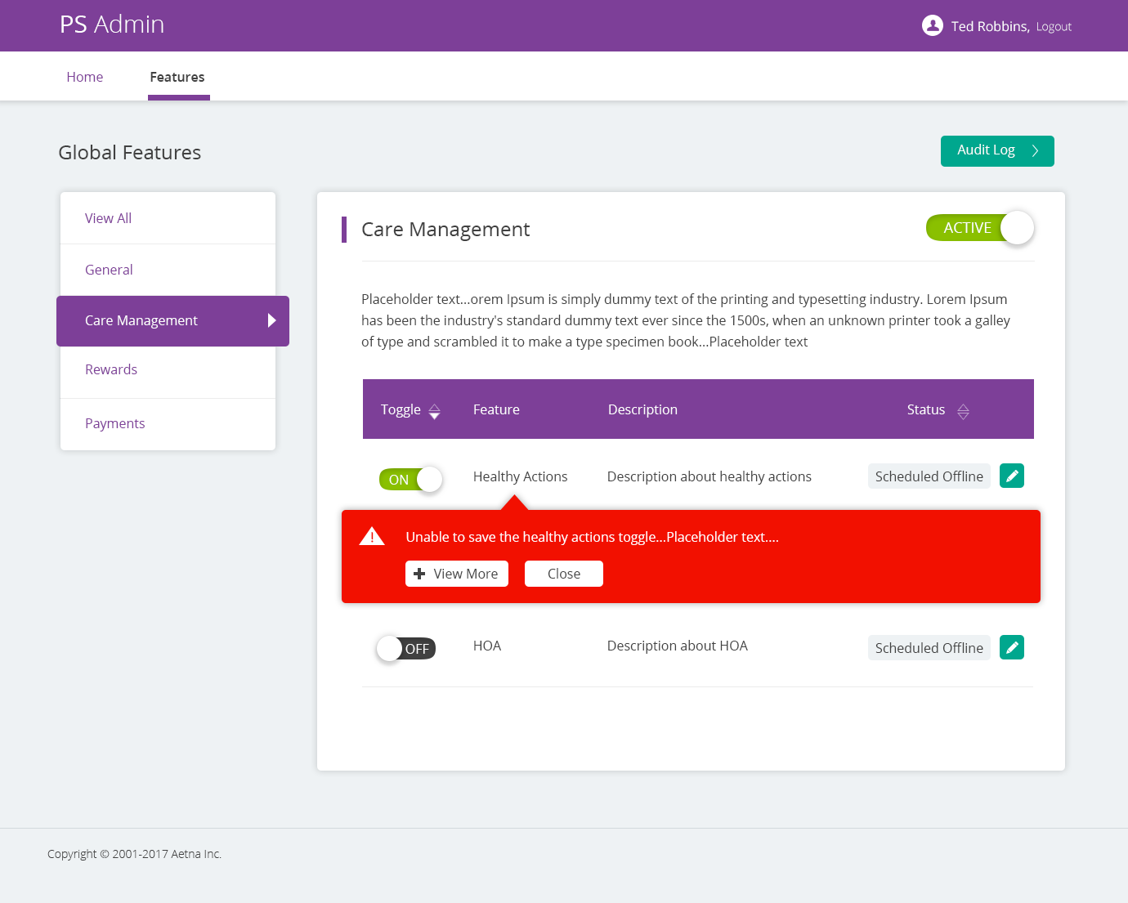
Open Sans Regular, 16pt, #FFFFFF
#F21000
Open Sans Regular, 16pt, #414141

Slide 7
Thank You

