Slide 1
Problem Statement : SUSTAINABLE CITIES AND COMMUNITIES
Team Name : ZenNex
Members Name: Mentor NAME:
Akshay V - ECE 2nd Year Dr . N. Vikram (Assistant Professor ECE )
Elaiyachandru - ECE 2nd Year
Vishaal S- ECE 2nd Year
Isaac C K - ECE 2nd Year
Project Title : Smart Trash Management System

Slide 2
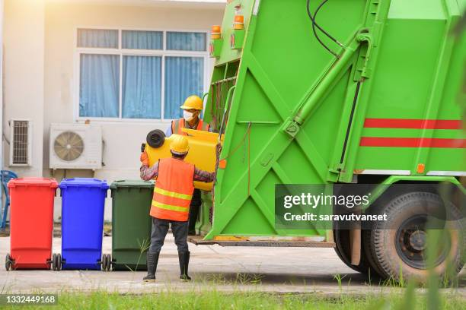
Solution Overview
🚮The smart waste management system warns municipal waste collectors when garbage is full, ensuring prompt collection.
🚮 Utilizes GPS and sensors to detect bin status and applies Dijkstra’s algorithm to compute the shortest route, optimizing waste collection by including nearby partially filled bins.
🚮 A web platform allows enabling users to report civic issues via voice/text input and view real-time smart bin status using IOT integration and geolocation services

Slide 3
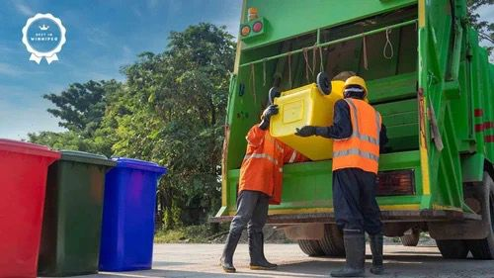
Target Beneficiaries& Social/Economic/Technological Impact
🚮 “By cleaning the garbage regularly , we can reduce mosquito breading and prevent diseases like dengue and malaria”.
🚮 It also helps reduce foul smells and improves the overall air quality in the area .
🚮 “it helps the municipal collector save time by showing which bins are full so they don’t have to check every bin manually”.

Slide 4
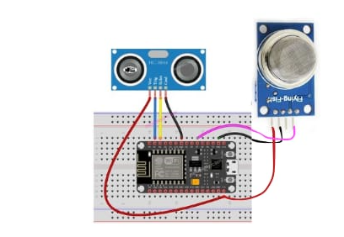
AN INTELLIGENT E-WASTE DETECTION SYSTEM AND COLLECTION USING HYBRID ROUTING TECHNIQUES
In this project, an ultrasonic sensor and a gas sensor are connected to an ESP8266 microcontroller. The connections are configured as follows:
Ultrasonic Sensor: Used to measure the level of garbage in the bin by calculating the distance between the sensor and the garbage. This helps in determining the percentage of the bin filled.
Gas Sensor: Detects the presence of harmful gases or bad odor from the garbage, indicating the level of decomposition or presence of hazardous materials.
The ESP8266 collects data from both sensors and sends it to an IoT platform (such as Blynk). Users can view the real-time garbage fill level and gas concentration data from the IoT dashboard.
This setup enables remote monitoring of waste levels, making garbage collection more efficient and environmentally friendly.

Slide 5
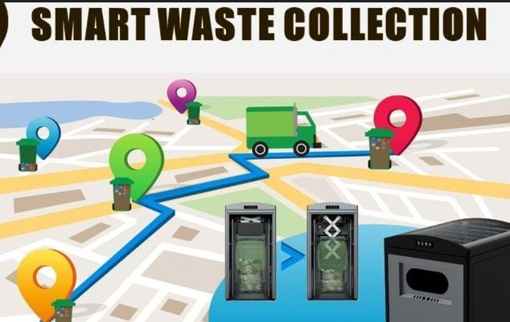
🚮 Communication Flow to Government (Municipality):
The system automatically sends notifications to the municipal authorities (manager/administration) when:
  A bin’s fill level exceeds 80%.
  A user lodges a complaint through the web platform (via voice or text input).
These messages are sent via:
  Email notifications, SMS alerts, or dashboard updates integrated into the admin panel of the web platform.
  Real-time status updates are logged and visible to officials using IoT dashboards with geolocation.
🚮 Communication to Garbage Collectors:
After applying Dijkstra’s algorithm, the system determines the shortest and most efficient route to the bins that are over 80% filled.
This optimized route, along with the bin locations, is:
  Displayed on the collector's dashboard or mobile app using a map interface.
  Sent as a notification with GPS directions, ensuring timely and efficient collection.
Collectors can also update status (e.g., bin emptied) through their interface, syncing in real time.

Slide 6
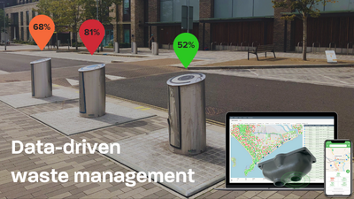
🚮 User Access to the Web Platform:
Users can access the platform through a web browser on their phone or computer.
Features include:
  Real-time view of nearby smart bins and their status.
  Option to report civic issues or garbage overflow using voice or text input.
  Geolocation services help identify their current area for better accuracy in complaints.
🚮 Data Collection for Future Research and Analysis:
All sensor data (bin fill levels, gas presence, timestamps, collection routes, and user complaints) are stored in a central database.
This data helps in:
  Predictive analysis of garbage generation patterns over time.
  Planning better waste management strategies based on real usage.
  Supporting research and development in smart city planning, environmental monitoring, and sustainable urban management.
  Providing insights to policy makers and researchers for data-driven decisions.

Slide 7
Implementation Plan
Plan the system
Set up hardware
Build software
Test the system
Maintain & Monitor

Slide 8
Get level of bin
Ultrasonic sensor
Check for gas emission
Check for abnormality
Get data from sensors
Continuous monitoring
Gas sensors
Find the nearest bin collecting vechicle sing(vrp algorithm)
Garbage vechicle reaches the destiny using vrp algorithm
Sms to garbage vechicle

Slide 9
Business Model & Monetization
Revenue System | Description | Estimated % of Total Revenue
Hardware Sales/Leasing | Smart bin units with sensors, GPS, solar modules | 35%
SaaS Subscriptions | Access to the management platform (tiered by features/users) | 25%
Maintenance Contracts | Ongoing service, firmware updates, support | 15%
Route Optimization Licensing | Licensing digital algorithms to 3rd parties | 10%
Data Insights & Reports | Selling aggregated data to environmental and policy groups | 15%
Sponsorship/Advertising | Optional local advertising/sponsorship revenue | 5%

Slide 10

Scalability
Solar-Powered, Self-Sustained Units:
Solar panel integration allows deployment in remote or off-grid areas without power concerns.
Cloud-Based Data Handling:
Easily scale the system across cities using cloud platforms like AWS, Azure, or Firebase.
Modular System Architecture:
New bins, sensors, and users can be added without impacting existing functionality.
Multi-Role Access:
Expandable platform with roles for users, garbage collectors, municipal officers, and researchers.
Nationwide Deployment Potential:
Can be implemented across districts and scaled to a national smart waste management network.
Multi-Language & Regional Support:
Voice/text features can be adapted to local languages to improve accessibility across regions.

Slide 11
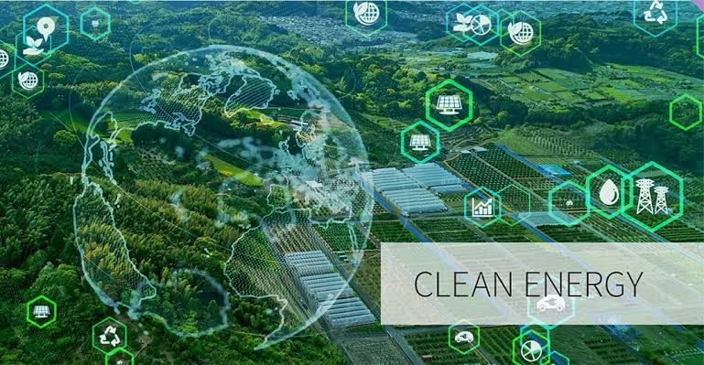
Future Scope
Integration with AI & Machine Learning:
  Predict future waste trends and optimize collection schedules using historical data.
  Anomaly detection for unusual garbage patterns or illegal dumping.
Advanced Waste Categorization:
  Incorporate smart camera modules to identify and classify types of waste (plastic, organic, etc.).
Citizen Engagement Tools:
  Launch mobile app for improved user interaction, bin location tracking, and real-time complaint status.
  Implement a reward system for users reporting issues or promoting cleanliness.
Environmental Monitoring:
  Extend system to monitor air quality, temperature, and humidity around garbage bins using additional sensors.
Blockchain for Transparency:
  Record waste data and complaint resolutions securely using blockchain for enhanced trust and accountability.

Slide 12

Conclusion & Call to Action
🚮 This idea supports the Swachh Bharat mission – Clean India, Green India.
🚮 By using a smart system to detect full dustbins and send alerts to the garbage collectors, through we can keep our surroundings clean and make sure waste is collected on time.
🚮 It helps in better waste management
and a cleaner environment."

Slide 13
Thank you

