Slide 1
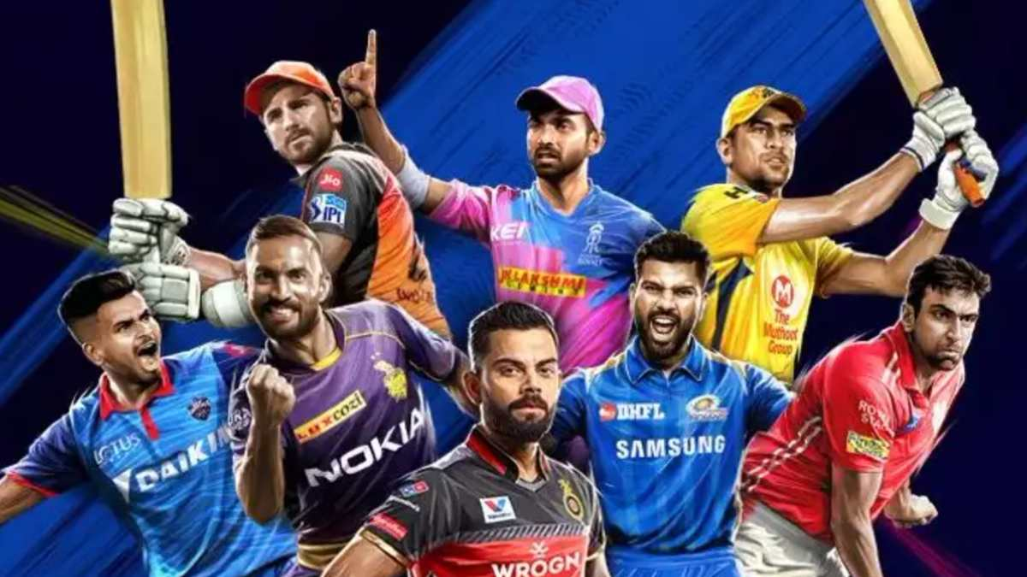
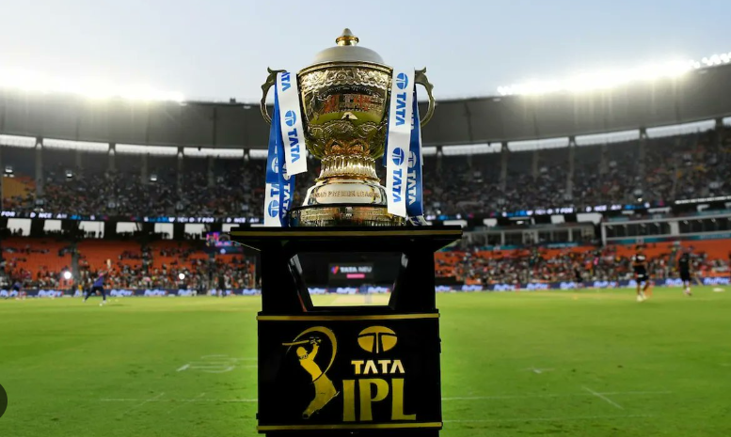
ADVANCED DATA ANALYSIS – ipl SUPER 11
Group 06
Akshaykumar Mistry (MBAA21003)||Chandni Kaundilya (MBAA21021)||Anchal Gupta (MBAA21005)||
Rishu Verma (MBAA21041)||Yukti Dewan (MBAA21059)

Slide 2

IPL Rules for team formation
Our assumptions
The number of matches played for a player in IPL as given in the data set are less compared to what they have actually played in IPL when checked on internet, So we choose our Super 11 based on the dataset given.
We have excluded the retired IPL players based on current news.
A team is supposed to have 12 players available - 11 on the field, of which at least seven must be Indian, and one substitute - for selection on a matchday.
Only 4 players in a team can be foreigners.

Slide 3
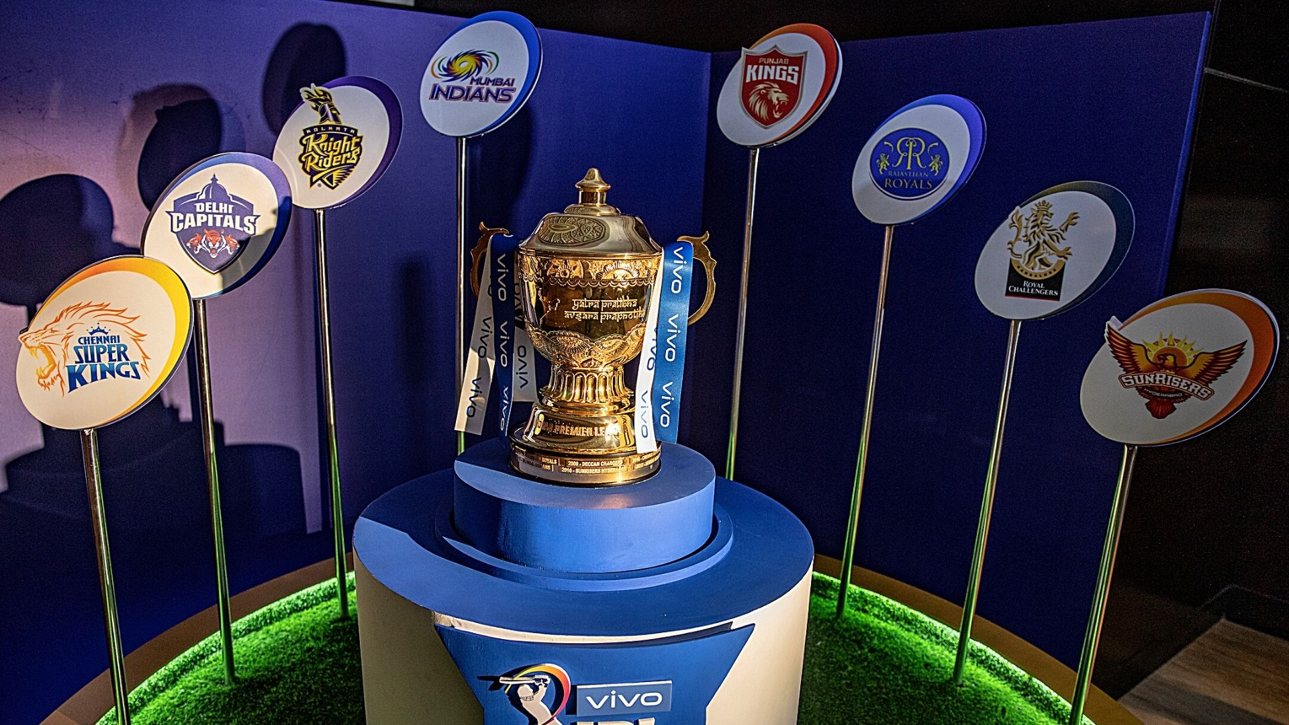
AUCTION PROCESS
In this Auction process, we are selecting an super team for IPL based on a datasets from 2008-2020 containing all ball-by-ball and match-by-match order.
We have selected players who have played or bowled more than 300 balls only.
Our team combination will be consisting of strong openers, middle-order hitters, all-rounders, a wicketkeeper, and quick and spin bowlers.
For this, each player’s past IPL performance will be analysed including number of balls played/bowled, runs scored/given, strike rate/economy, 4’s and 6’s , stumps/catches, etc and finally we will be selecting our Super 11.

Slide 4



Team combination
batsmen
bowler
All-rounder
4 Bowlers
1 Spinner
2 Fast Bowler
1 Medium Pacer
5 Batsmen
2 Opener Batsmen
3 Middle Order Batsmen
2 All-Rounders
1 Spinner + Middle-order batsman
1 Fast Bowler + Middle-Order batsman

Slide 5
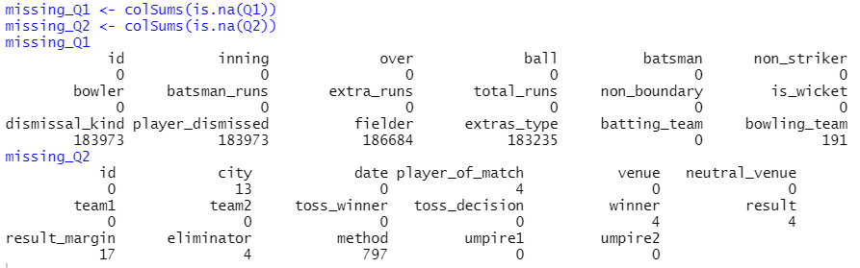
Missing Value Analysis
We have not removed the missing values as there be significant loss in data.
It is also difficult to Impute.

Slide 6
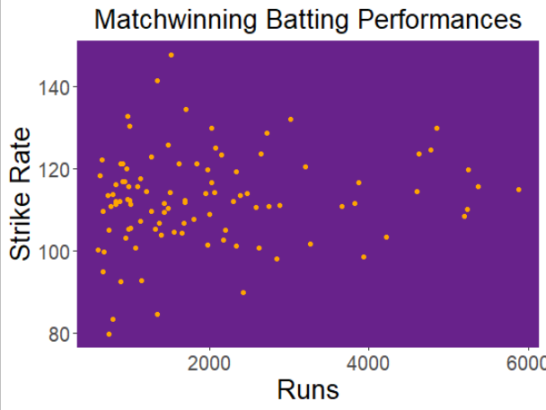
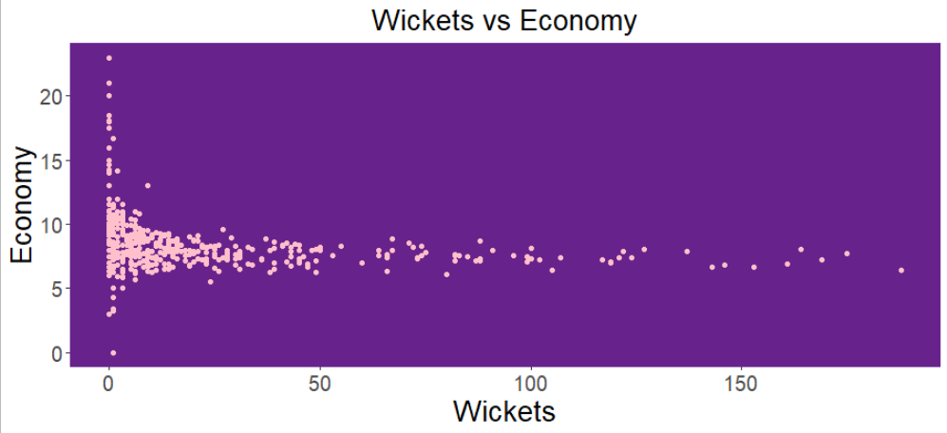
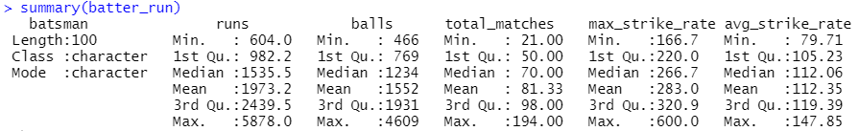
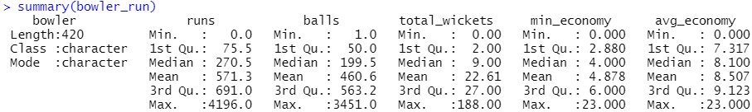
BATSMAN – Scatter Plot
Bowler – Scatter Plot
Average strike rate should be 112.35
Average economy should be 8.507

Slide 7
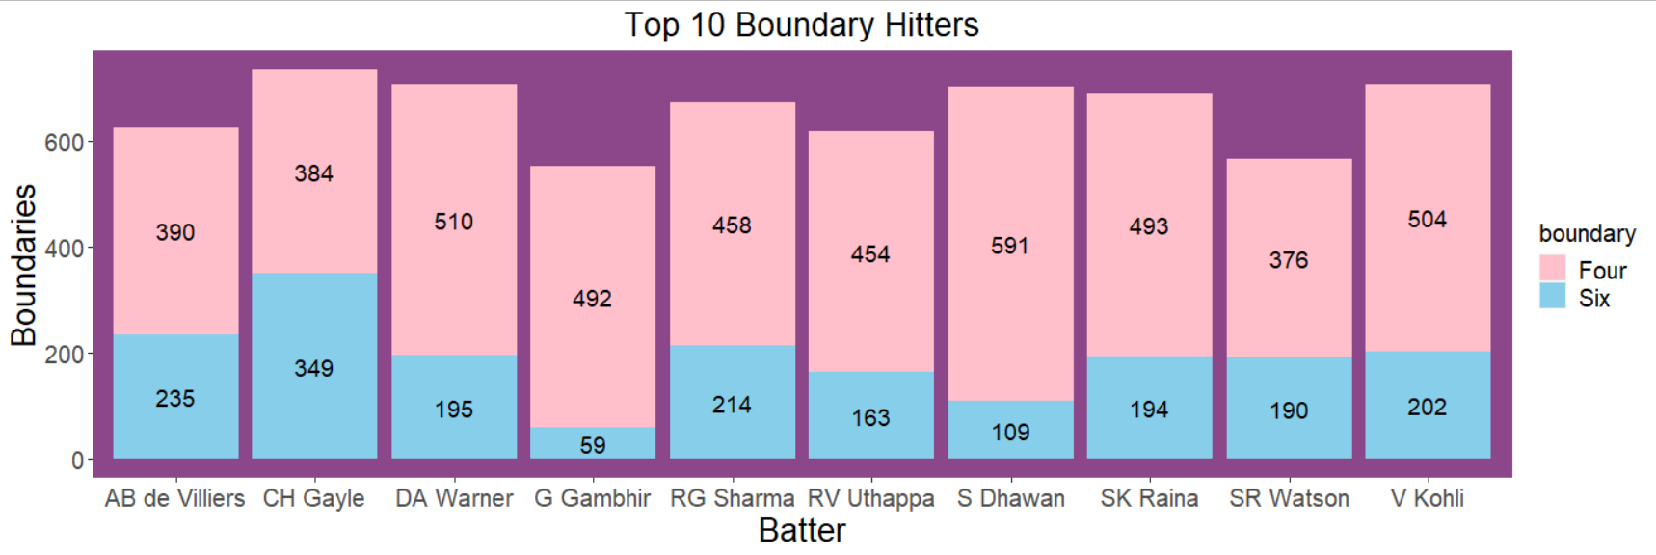
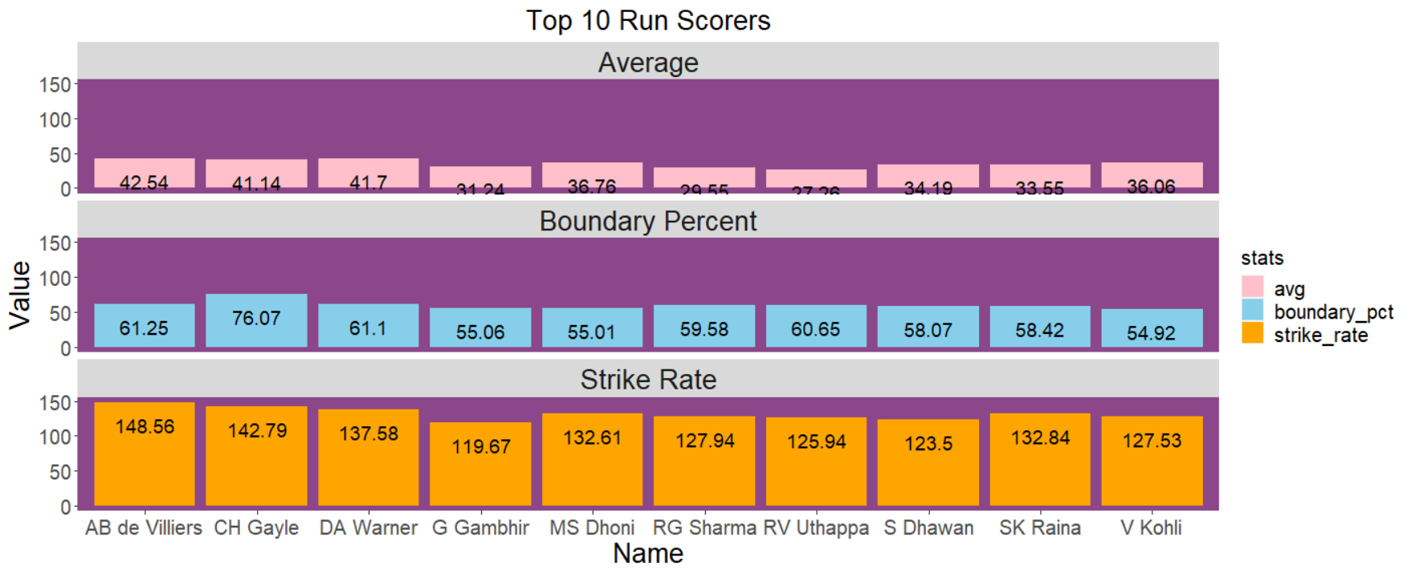
Top 10 Hitters
Top 10 run scorers
Most Players hit way more fours than sixes
Top 10 scorers with Average run, boundary percentage and Strike rate

Slide 8
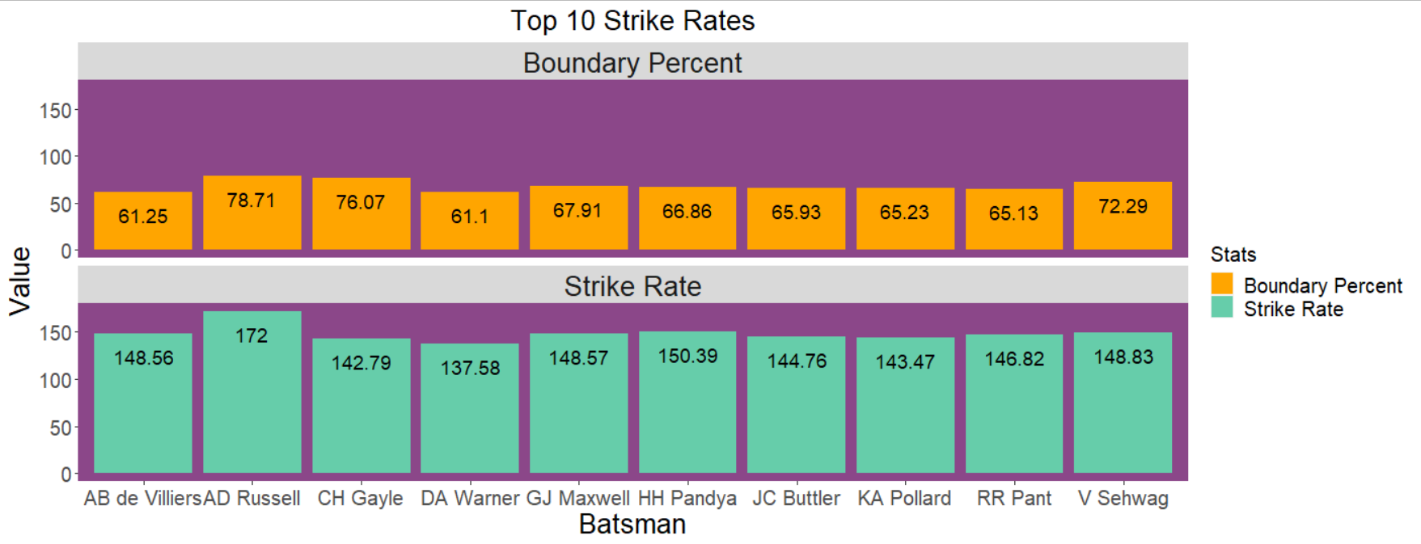
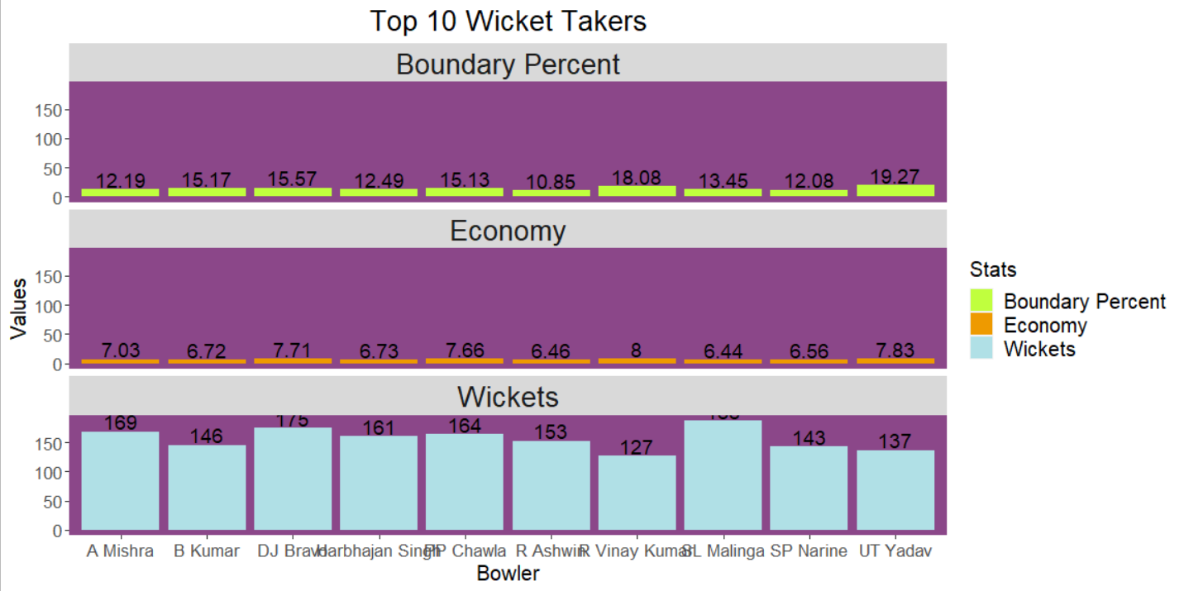
Top 10 Batsman by Strike Rate
Top 10 bowlers by wickets taken
Top 10 batsman with boundary percentage and strike rate
Top 10 bowlers with boundary percentage, economy and wickets

Slide 9
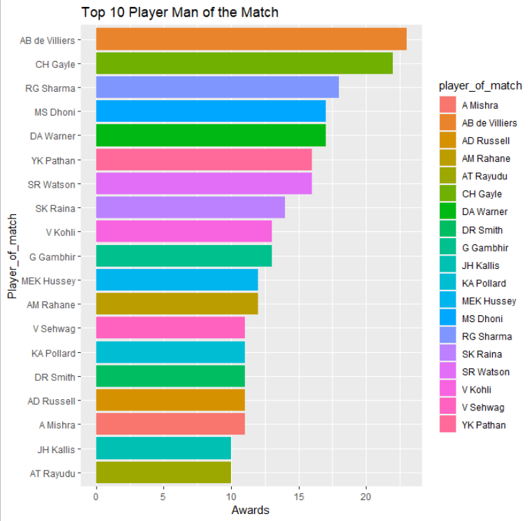
Top "MAn of the match" players
AB de Villiers being the player in IPL to have maximum "Man of the Match" award

Slide 10
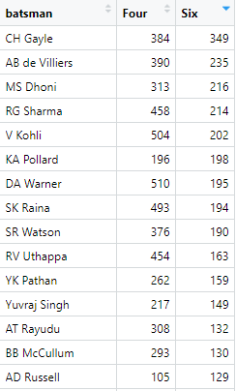
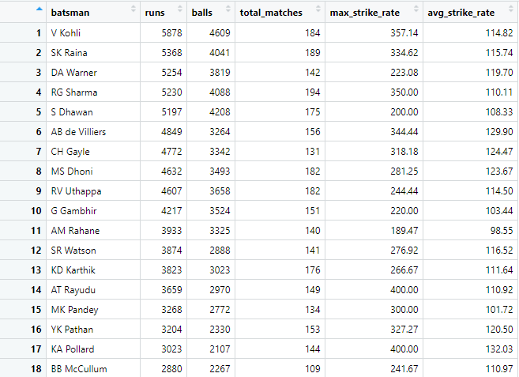
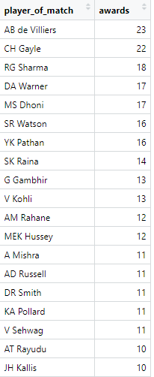
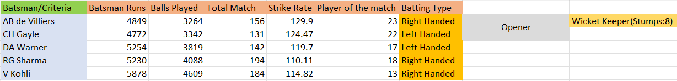
Batsmen selection criteria
Firstly we saw no. of runs scored.
Next we saw strike rate.
Last criteria was player of match.
Wicketkeeper is based on no. of stumps max out of batsmen.

Slide 11
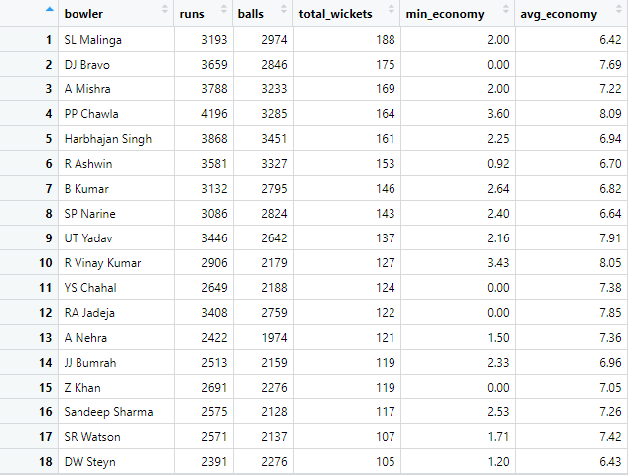
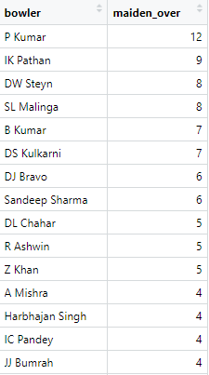
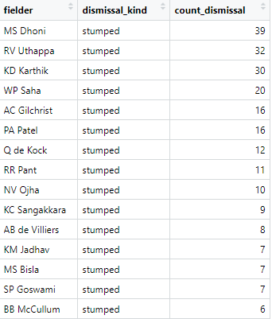
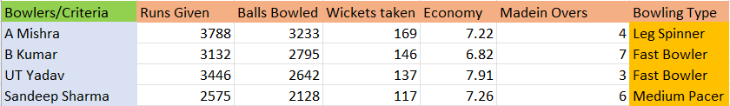
Bowlers' selection criteria
Firstly we saw no. of wickets taken(max).
Economy (runs/no. of balls(6)) was the next criteria.

Slide 12
All-rounder selection criteria
The criteria was to choose an above average bowler and batsmen both.
Top bowlers were searched in the top 50 batsmen list.

Slide 13
Extra player selection criteria
Extra player was selected on the criteria of all-rounder only.

Slide 14
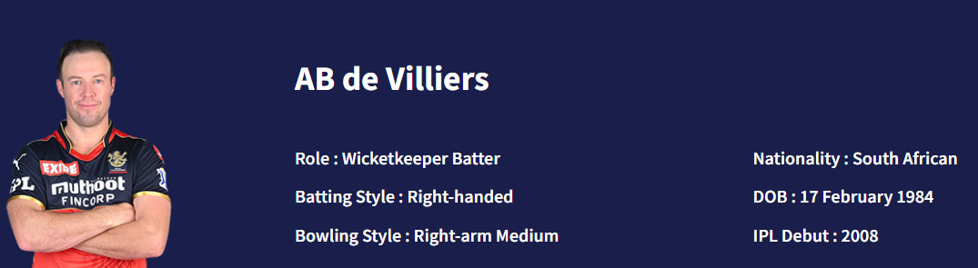
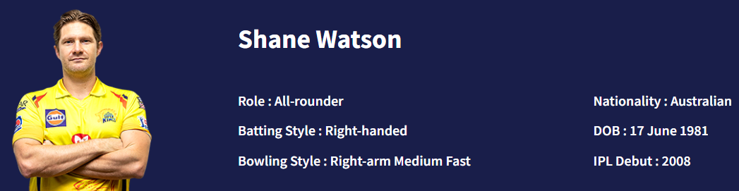
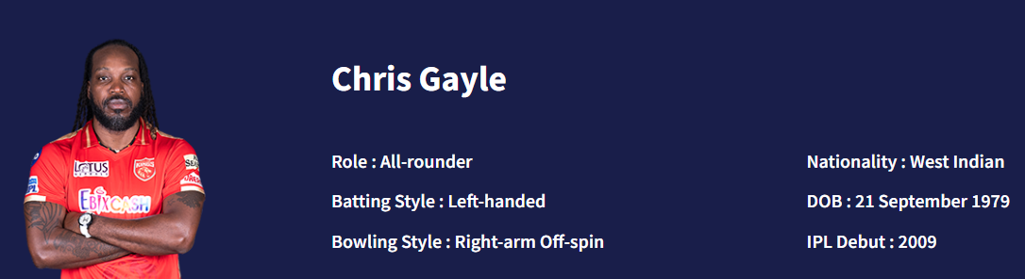
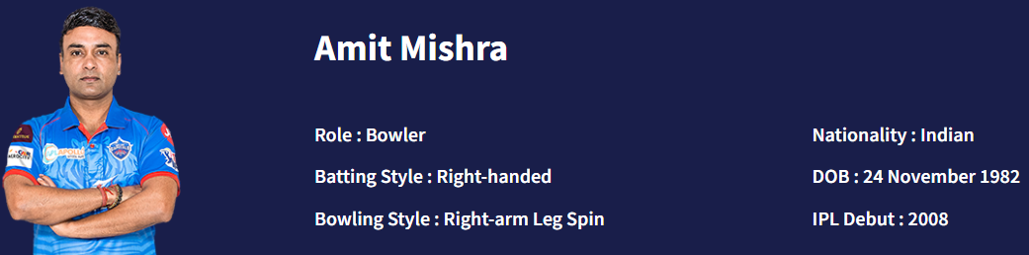
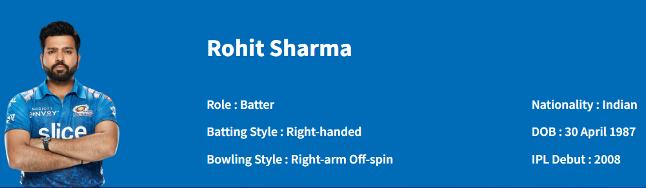
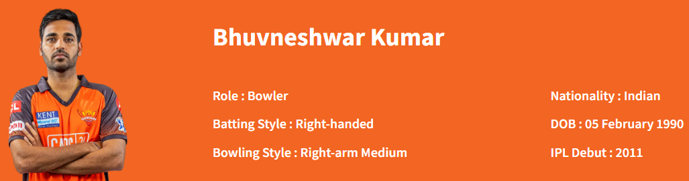
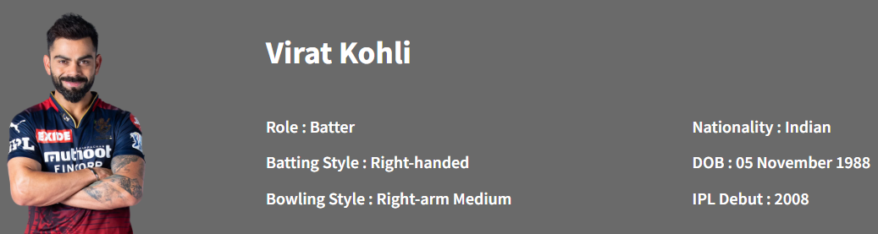
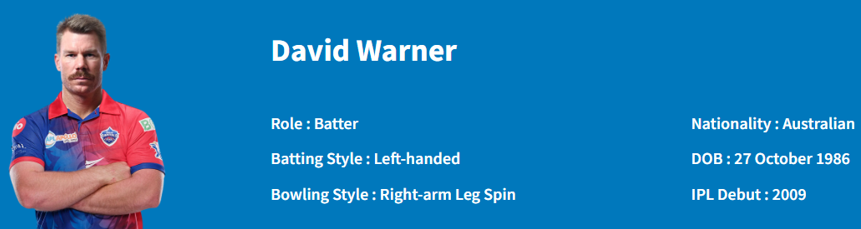
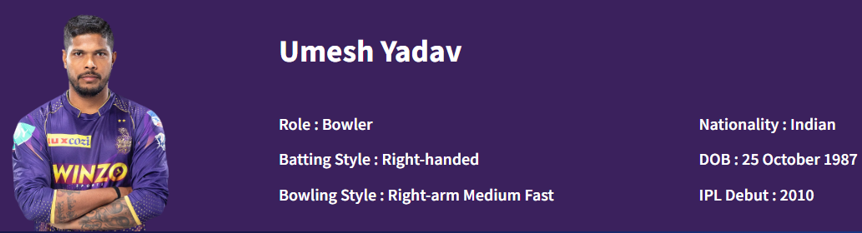
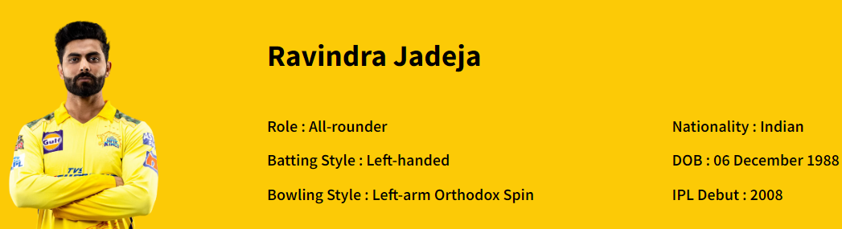
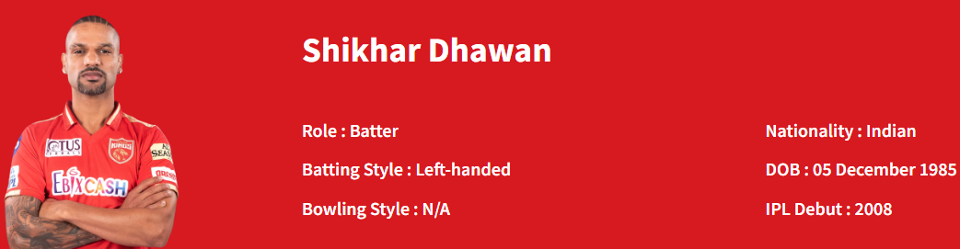
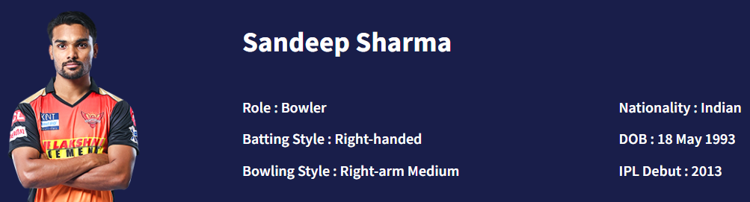
01
AB de Villiers
Uttrakhand UNICORNS
(WC)
07
Shane WatSon
02
Chris Gayle
08
Amit mishra
03
ROHIT SHARMA
09
Bhuvneshwar kumar
04
Virat kohli
©
05
David Warner
10
Umesh yadav
06
Ravindra JAdeja
12
Shikhar Dhawan
ExtRA
11
Sandeep sharma

Slide 15
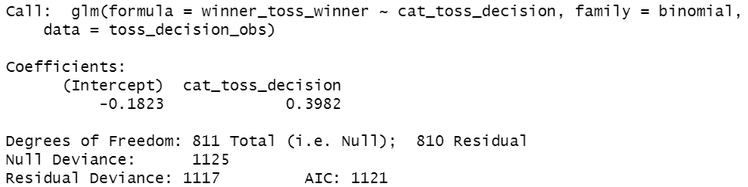
Logistics Regression
When the team wins the toss, then compared to choosing to ‘Bat’ if the team chooses to ‘Field’ then the probability of winning the match increases by 0.39 i.e. 39.82%

Slide 16
