Slide 1

Department of Computer Science and Engineering
(Cyber Security)
CS23533– Foundations of Artificial Intelligence
2026-2027
ADAPTIVE DECISION INTELLIGENCE FOR CRISIS MANAGEMENT
END SEMESTER REVIEW
Angelin Praisee K
(241901004)
Akshaya D
(241901002)
Dr. BHUVANA PhD.,
Assistant Professor (SG)

Slide 2
Problem Statement and Motivation
Emergency response involves multiple incidents, limited resources, and rapidly changing conditions.
Manual decision-making can make it difficult to prioritize emergencies and allocate suitable resources efficiently.
Road blockages, weather changes, and resource unavailability can affect response plans.
Existing approaches may lack integrated resource allocation, route analysis, and adaptive re-planning.

Slide 3
Objectives
Incident Prioritization: Assess emergencies based on severity, population impact, and surrounding conditions.
Intelligent Resource Allocation: Identify and allocate suitable resources according to availability and operational constraints.
Optimal Route Planning: Apply A* search to identify suitable routes and estimate travel time.
Constraint-Based Decision Making: Use Constraint Satisfaction Problem (CSP) principles to filter infeasible resource assignments.

Slide 4
Abstract
Emergency response planning is challenging due to limited resources, multiple incidents, and rapidly changing environmental conditions. The proposed Adaptive Decision Intelligence for Crisis Management system aims to support emergency coordinators through intelligent decision-making and adaptive planning. It assesses incident severity, prioritizes emergencies, and identifies suitable resources based on availability and operational constraints.The system integrates A* search for route planning and Constraint Satisfaction Problem (CSP) principles for filtering infeasible resource assignments.

Slide 5
Literature Survey
S. No. | Author(s) & Year | Paper Title | Methodology / Algorithm | Limitations
1 | N. Altay and W. G. Green III (2006) | OR/MS Research in Disaster Operations Management | Review of Operations Research and Management Science techniques. | Covers a broad range of disaster management problems; integrating different methods.
2 | E. Galindo and R. Batta (2013) | Review of Recent Developments in OR/MS Research in Disaster Operations Management | Literature review of optimization, logistics, and resource allocation techniques. | Many approaches address specific planning problems and may not fully account for rapidly changing incident.
3 | M. Turoff et al. (2004) | The Design of a Dynamic Emergency Response Management Information System (DERMIS) | Dynamic emergency response information system for managing information and supporting decisions. | Effectiveness depends on timely information, system integration, and the availability of accurate incident data.

Slide 6
Literature Survey
S. No. | Author(s) & Year | Paper Title | Methodology / Algorithm | Limitations
4 | P. E. Hart, N. J. Nilsson, and B. Raphael (1968) | A Formal Basis for the Heuristic Determination of Minimum Cost Paths | A* heuristic search algorithm for finding minimum-cost paths in a graph. | Route quality depends on graph accuracy, cost information, and heuristic suitability; basic A* does not automatically account for live road conditions.
5 | A. K. Mackworth (1977) | Consistency in Networks of Relations | Constraint consistency techniques for identifying incompatible values in constraint-based problems. | Constraint consistency alone does not determine the best overall resource allocation or automatically adapt to changing crisis conditions.

Slide 7
Research Gap/Existing System
Existing studies
Apply optimization techniques for disaster response and resource allocation.
Use decision-support systems to manage emergency information.
Apply A* search for route planning and constraint-based methods for feasible assignments.
Limitations observed
Many approaches focus on individual problems rather than an integrated workflow.
Resource allocation may not fully account for changing incident conditions.
Decision explanations and plan comparisons may be limited.
Research gap
Need for an integrated system combining incident prioritization, resource allocation, route planning, and constraint filtering.
Limited coordination between resource selection and dynamic re-planning when conditions change.
Our project responds
Calculates incident priority using severity and impact factors.
Uses CSP principles to filter infeasible resource assignments.
Applies A* search for route planning when road-network data are available.
Re-evaluates resource allocation after changes and compares updated plans.
Displays recommendations and explanations through a unified dashboard.

Slide 8
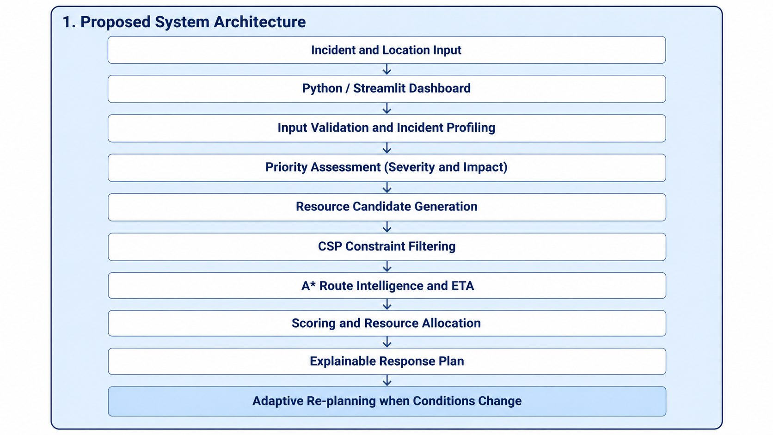
Proposed System

Slide 9
Proposed System
Collects incident details, location, severity, population impact, and environmental conditions.
Uses priority scoring to rank incidents and identify suitable resources based on availability and requirements.
Applies CSP principles to filter infeasible assignments based on resource capability, workload, and availability.
Uses A* search for route planning when road-network data are available, generates an explainable response plan.

Slide 10
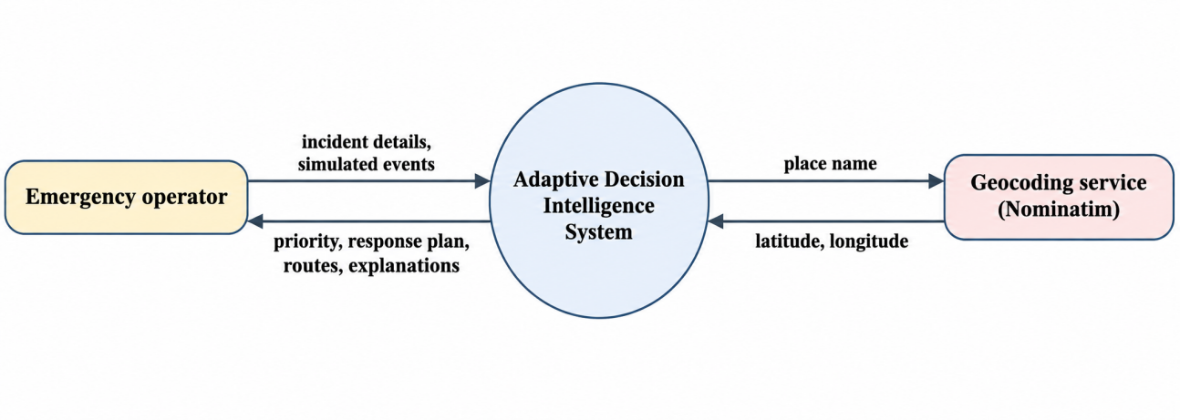
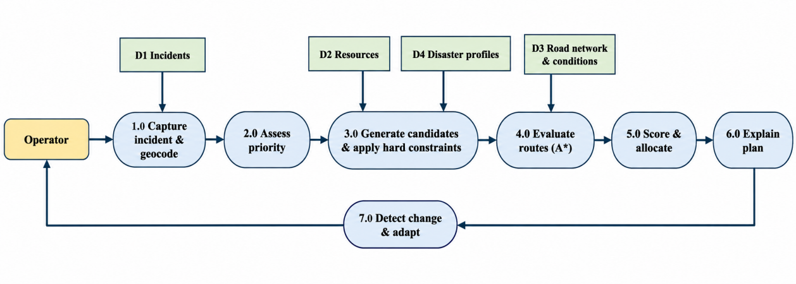
DFD Diagram
Data Flow Diagram (DFD – Level 0)
At the highest level the operator supplies incident details and simulated events, and the system returns the priority, response plan, routes and explanations. The only external entity besides the operator is the geocoding service.
Data Flow Diagram (DFD – Level 1)
Level 1 expands the system into seven processes and four data stores. Process 7.0 modifies the stores and triggers the earlier processes again, which is the adaptive loop.

Slide 11
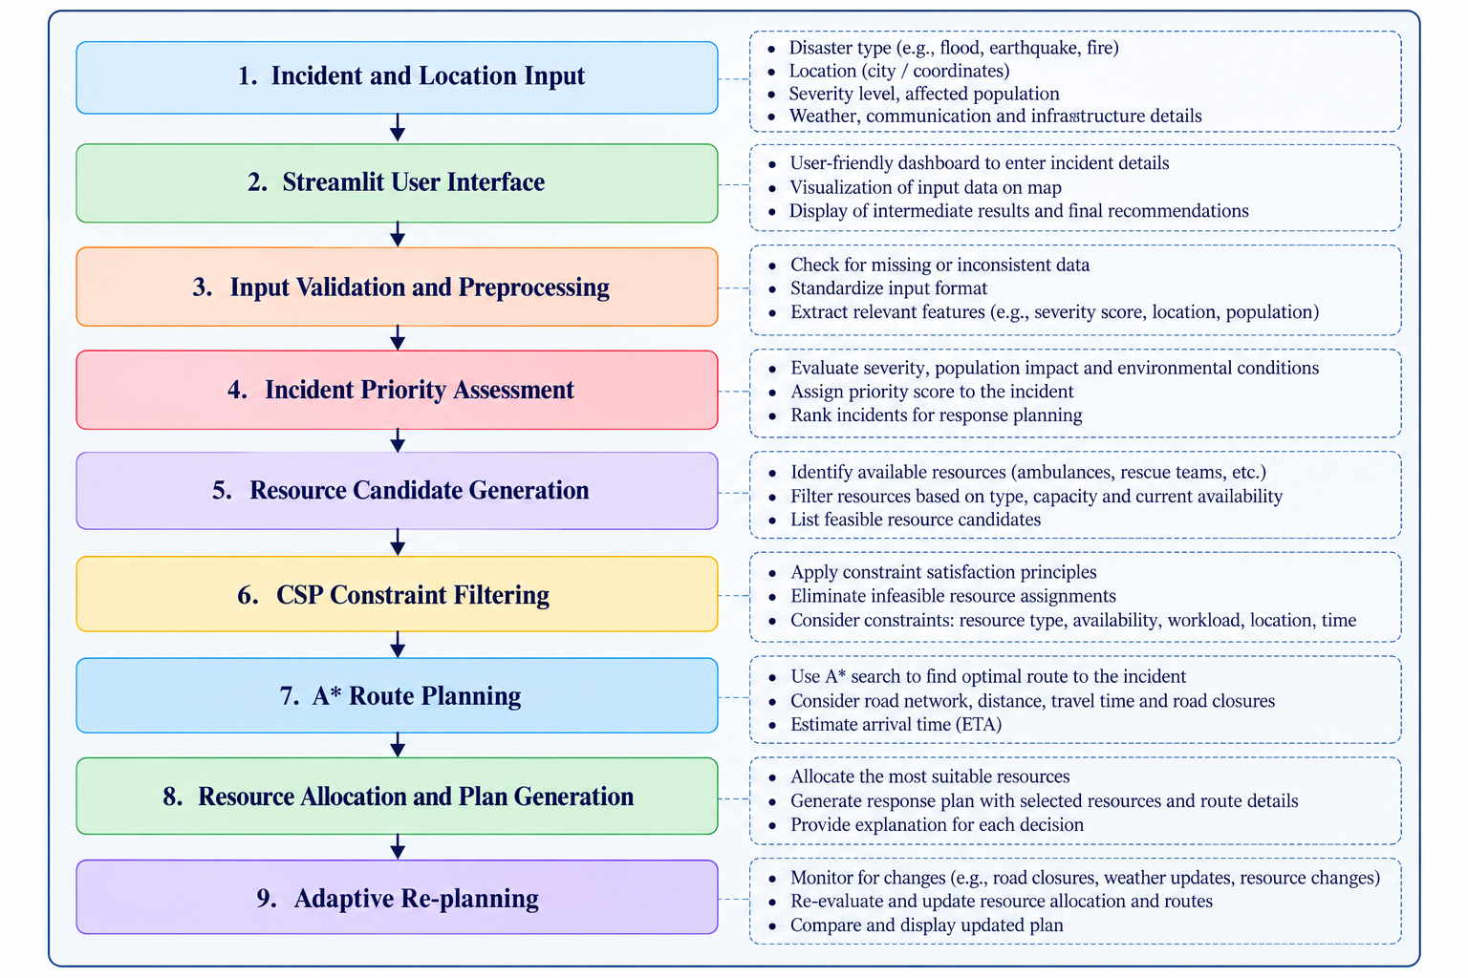
Methodology/Work Flow Diagram

Slide 12
Tools and Technologies
Programming Languages
  Python: Core decision-making logic, priority assessment, and resource allocation.
Frameworks and Libraries
  Streamlit: Interactive dashboard and user interface.
  NetworkX: Road-network graph representation and graph algorithms.
  Pandas: Data processing and tabular representation, if used.
Software and Tools
  Visual Studio Code: Code development and debugging.
  Git and GitHub: Version control and project management.
  OpenStreetMap / Geocoding Services: Location visualization and coordinate lookup, where integrated.

Slide 13
Tools and Technologies
Algorithms and Techniques
  A Search:* Route finding using a road-network graph.
  Constraint Satisfaction Problem (CSP): Filtering infeasible resource assignments.
  Weighted Scoring: Incident prioritization and candidate ranking.
  Adaptive Re-planning: Updating response plans when conditions change.
Hardware Requirements
  Computer/Laptop: Development and execution of the application.
  Internet Connection: Required for online maps or external services.
  Minimum practical setup: 4 GB RAM; 8 GB or more recommended for smoother development.

Slide 14
Tools and Technologies
Datasets
  Incident Data: Disaster type, severity, location, and affected population.
  Resource Data: Resource type, capability, availability, capacity, and location.
  Road-Network Data: Roads and connections for route planning.
  Environmental Data: Weather and infrastructure conditions, if available.
  Scenario Data: Simulated road closures, resource shortages, and changing incident conditions for testing.

Slide 15
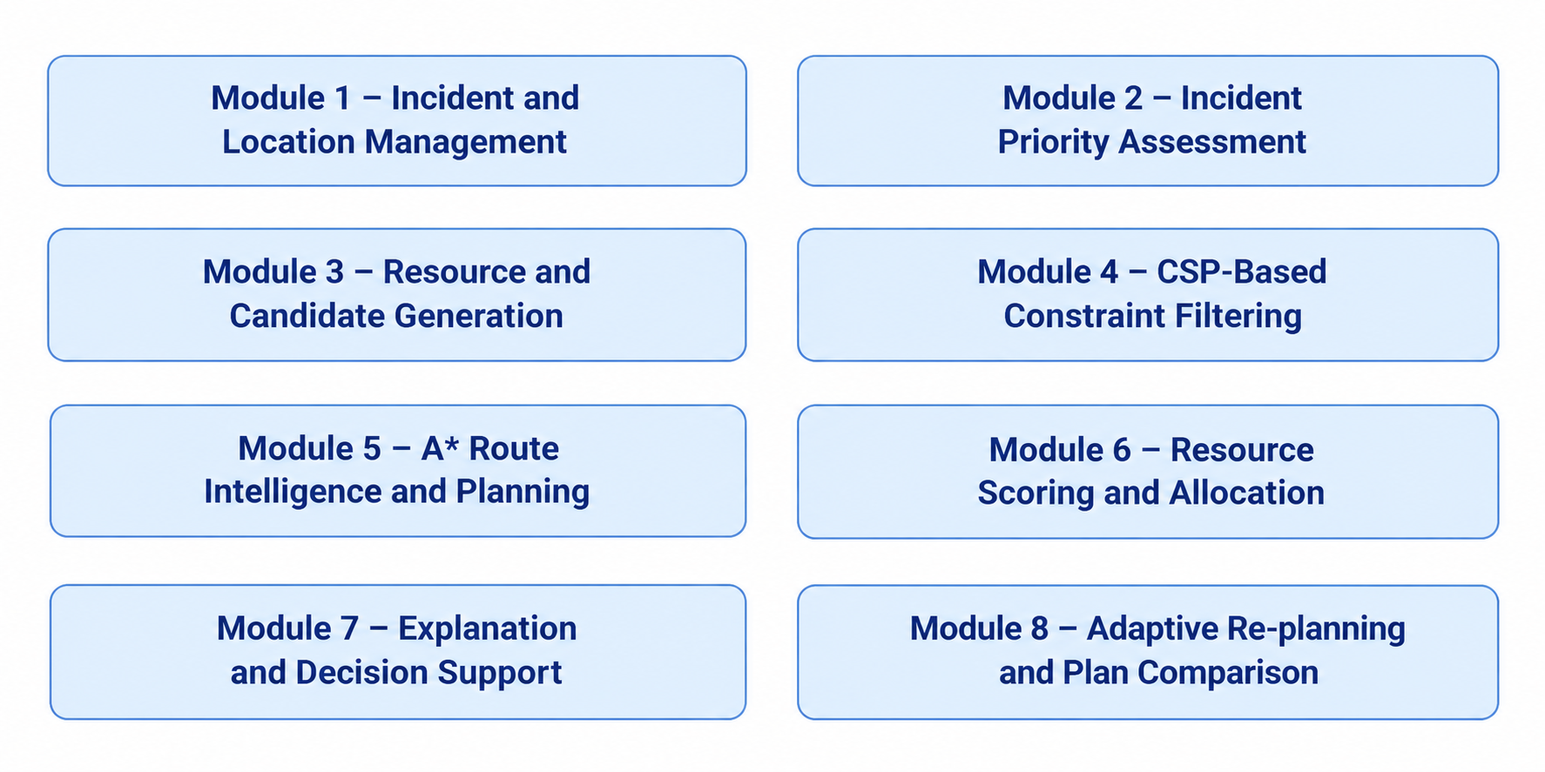
List of Modules

Slide 16
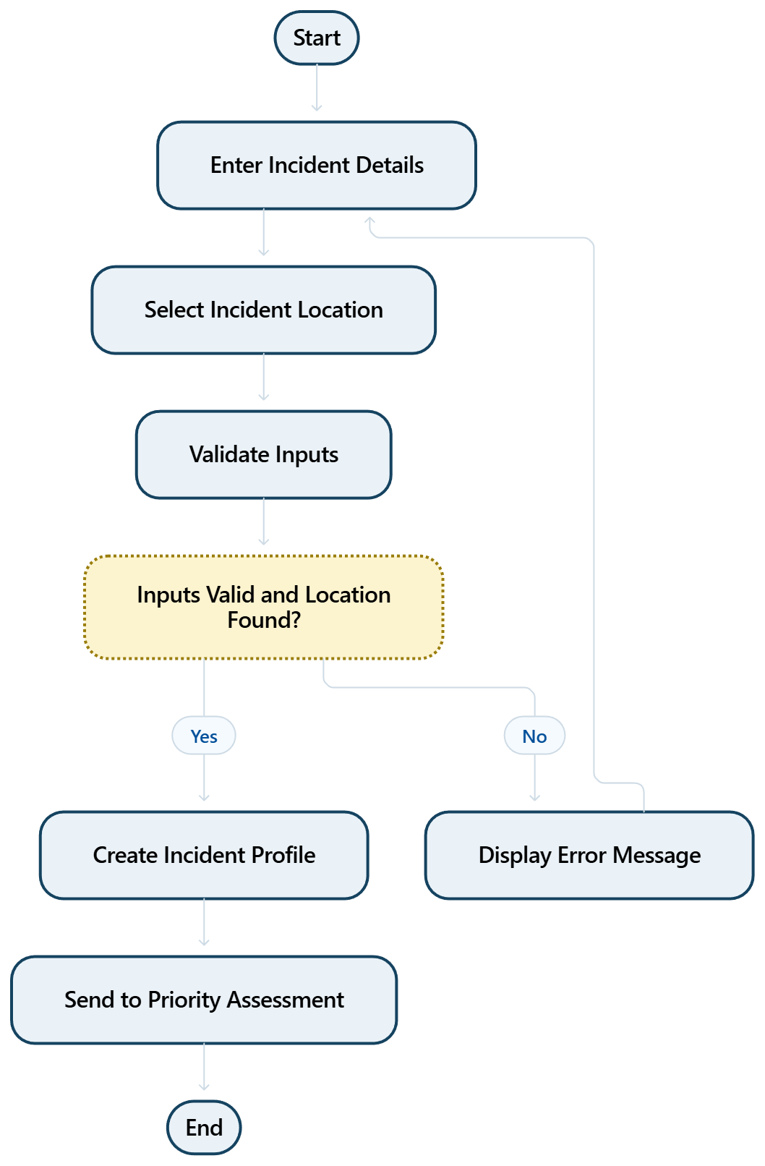
MODULE DESCRIPTION
1. INCIDENT AND LOCATION MANAGEMENT
INCIDENT AND LOCATION MANAGEMENT
Purpose: Collects crisis details and identifies the incident location for decision-making.
Implemented features:
1.Enter incident type, severity, affected population, and time.
2.Select or enter the incident location.
3.Validate inputs and obtain location coordinates when available.
4.Store incident details for the decision pipeline.

Slide 17
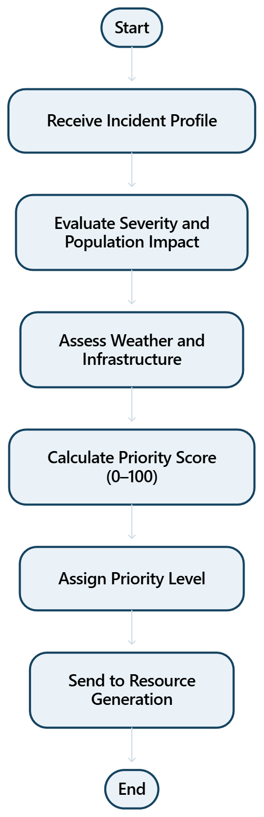
2.PRIORITY ASSESSMENT
PRIORITY ASSESSMENT
Purpose: Calculates an incident priority score to help determine which crisis needs attention first.
Implemented features
1.Evaluate severity and population affected.
2.Consider weather, infrastructure, and communication conditions.
3.Calculate a weighted priority score from 0 to 100.
4.Assign a priority level for decision support.

Slide 18
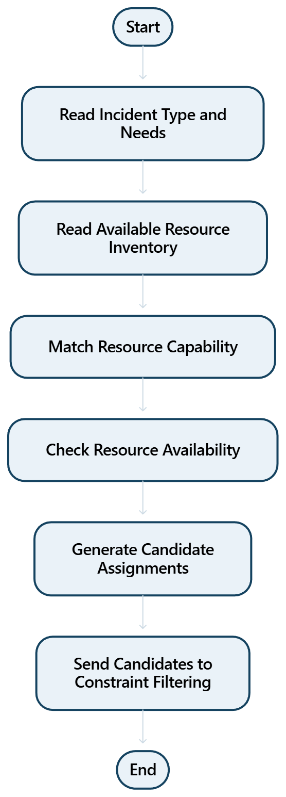
3.RESOURCE AND CANDIDATE GENERATION
RESOURCE AND CANDIDATE GENERATION
Purpose: Identifies suitable response resources and creates possible assignments for the incident.
Implemented features
1.Read available resources and their capabilities.
2.Match resource types to incident needs.
3.Generate candidate resource groups for each need.
4.Exclude resources that are unavailable before detailed filtering.

Slide 19
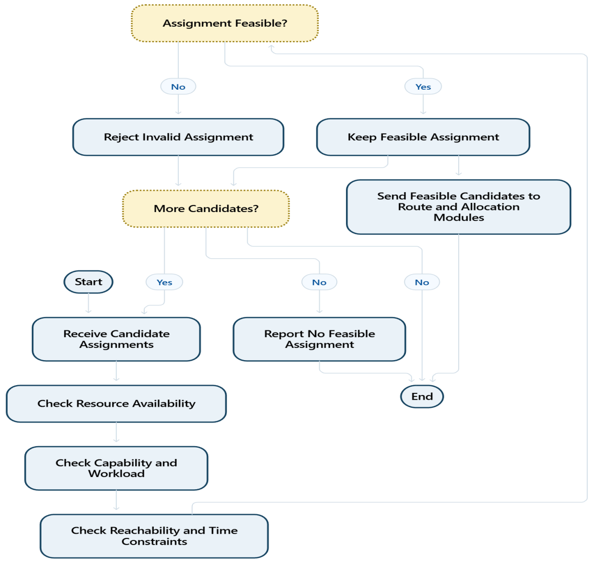
4. CONSTRAINT FILTERING(CSP)
CONSTRAINT FILTERING (CSP)
Purpose: Removes resource assignments that violate essential operational constraints.
Implemented features
1.Check resource availability and capability.
2.Check workload, reachability, and time-window constraints.
3.Reject infeasible combinations.
4.Pass only feasible candidates to allocation.

Slide 20
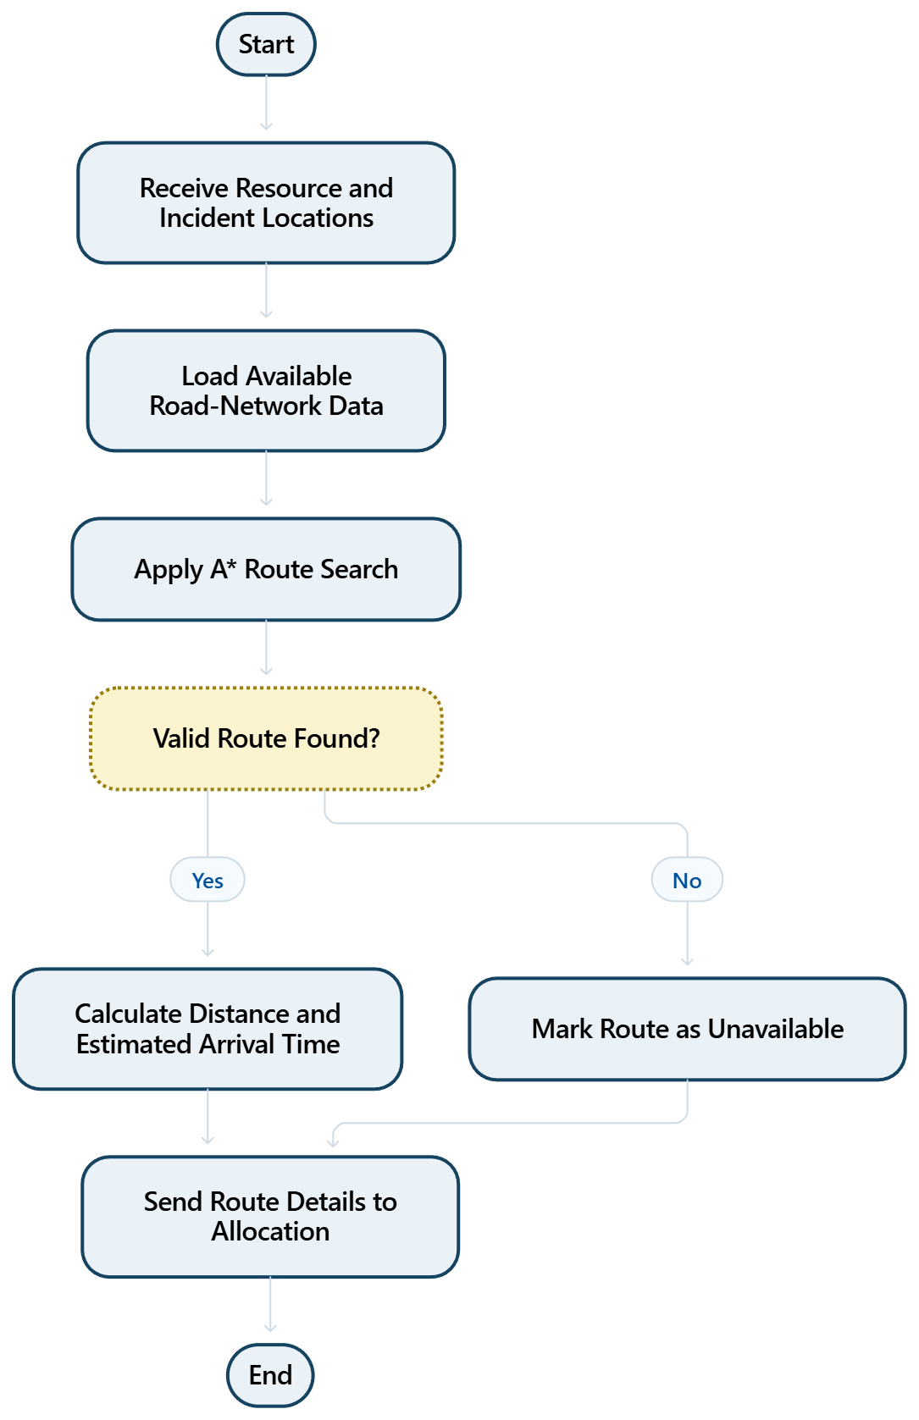
5. ROUTE INTELLIGENCE (A*)
ROUTE INTELLIGENCE (A*)
Purpose: Estimates routes and travel times to support safer and more practical resource deployment.
Implemented features
1.Use available location and road-network data.
2.Apply A* search to find a suitable route when graph data is available.
3.Estimate travel distance and time.
4.Mark routes as unavailable when a valid path cannot be found.

Slide 21
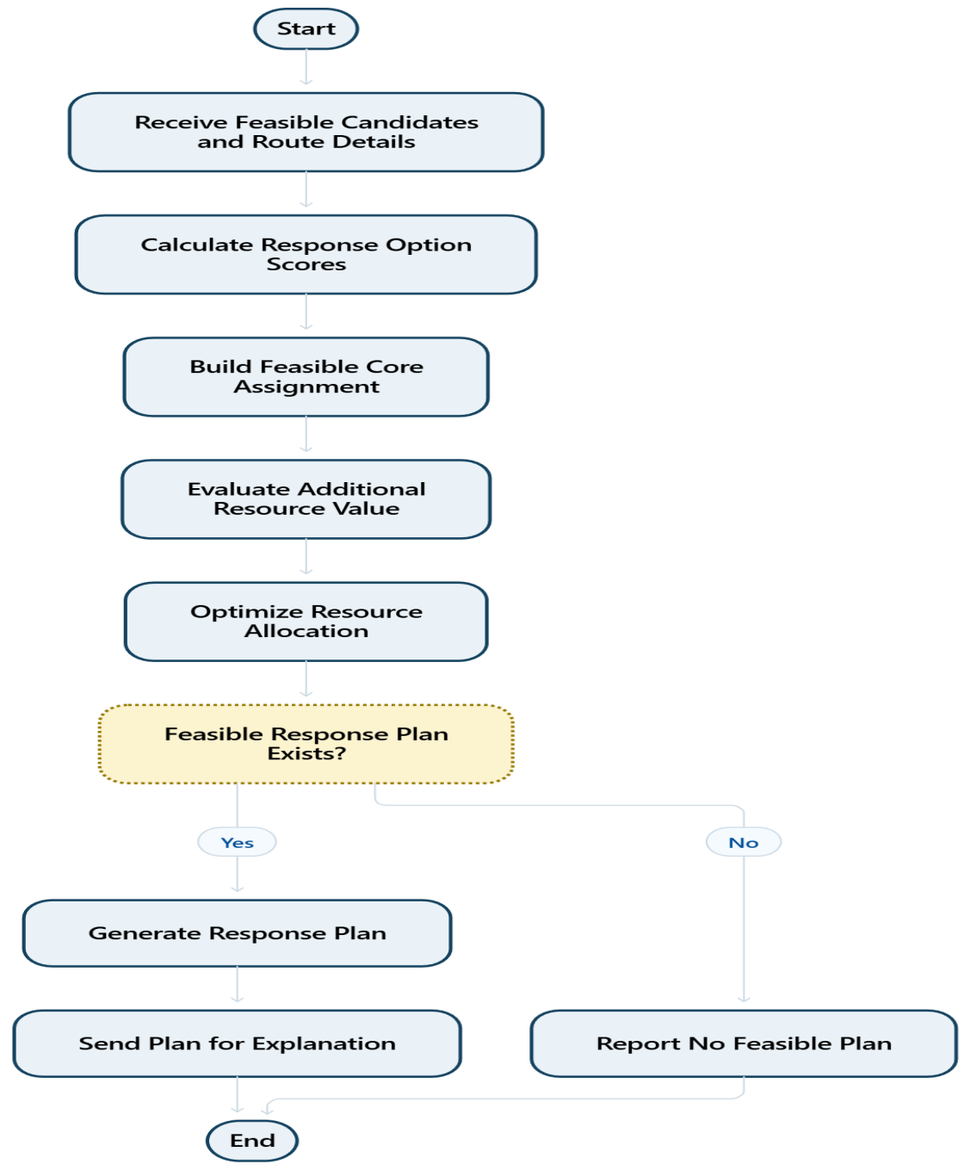
6. SCORING AND RESOURCE ALLOCATION
SCORING AND RESOURCE ALLOCATION
Purpose: Ranks feasible response options and assigns resources according to incident needs and constraints.
Implemented features
1.Combine priority, suitability, travel time, and resource limits.
2.Create a feasible core assignment using constraints.
3.Use marginal-value scoring to improve additional assignments.
4.Produce a response plan with selected resources.

Slide 22
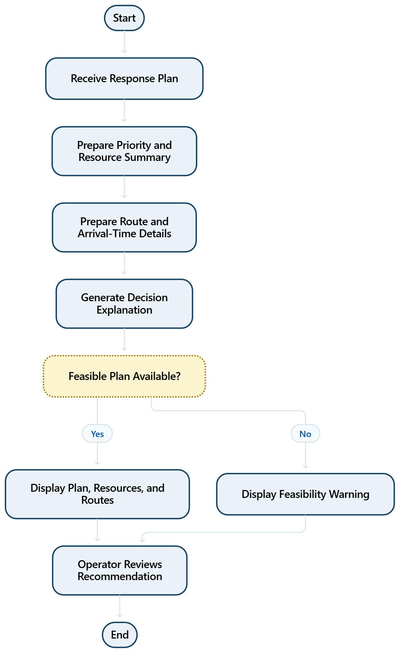
7. EXPLANATION AND DECISION DISPLAY
EXPLANATION AND DECISION DISPLAY
Purpose: Shows the recommended response plan and explains the main reasons behind each decision.
Implemented features
1.Display priority score and incident summary.
2.Show selected resources, routes, and estimated arrival times.
3.Explain important constraints and selection reasons.
4.Clearly indicate when no feasible plan is found.

Slide 23
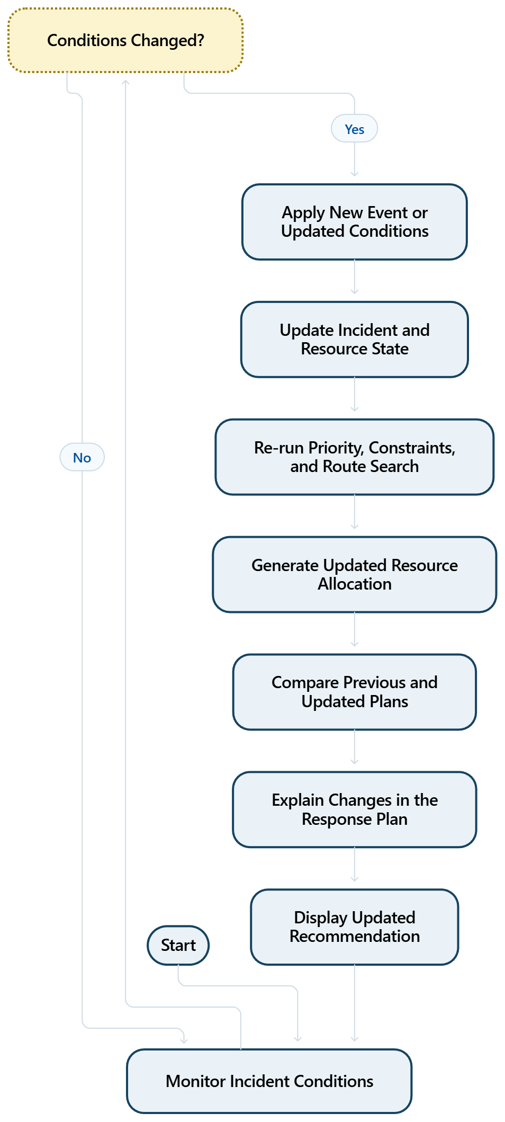
8. ADAPTATION AND RE-PLANNING
ADAPTATION AND RE-PLANNING
Purpose: Updates the response plan when crisis conditions or resource availability change.
Implemented features
1.Accept events such as road closures, weather changes, or resource loss.
2.Update the current incident and resource state.
3.Re-run priority, route, constraint, and allocation steps.
4.Compare the new plan with the previous plan and explain changes.

Slide 24
Results & Discussion
Incident Prioritization: Evaluates incidents based on severity and impact factors.
Resource Allocation: Identifies suitable resources based on availability and operational constraints.
Route Planning: Uses A* search to determine suitable routes when road-network data are available.
Constraint Validation: Filters infeasible resource assignments using CSP principles.
Adaptive Re-planning: Updates and compares response plans when incident conditions or resource availability change.

Slide 25
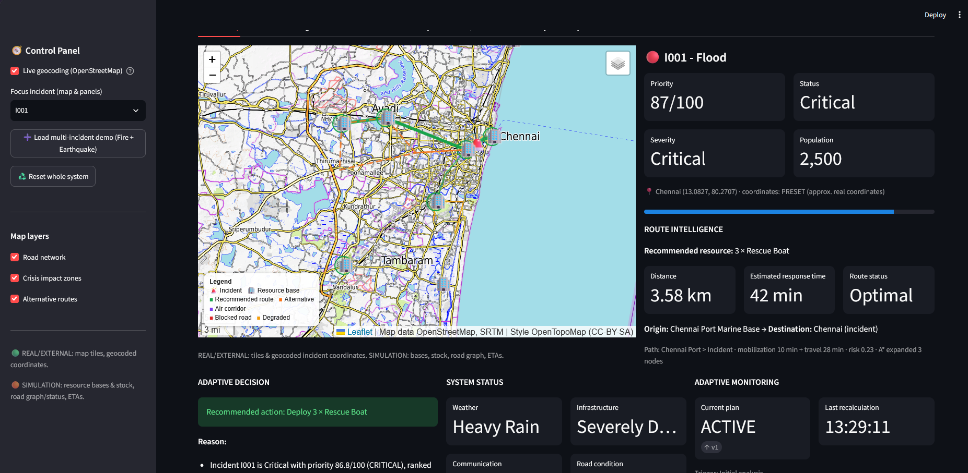
User Interface/ Screenshots

Slide 26
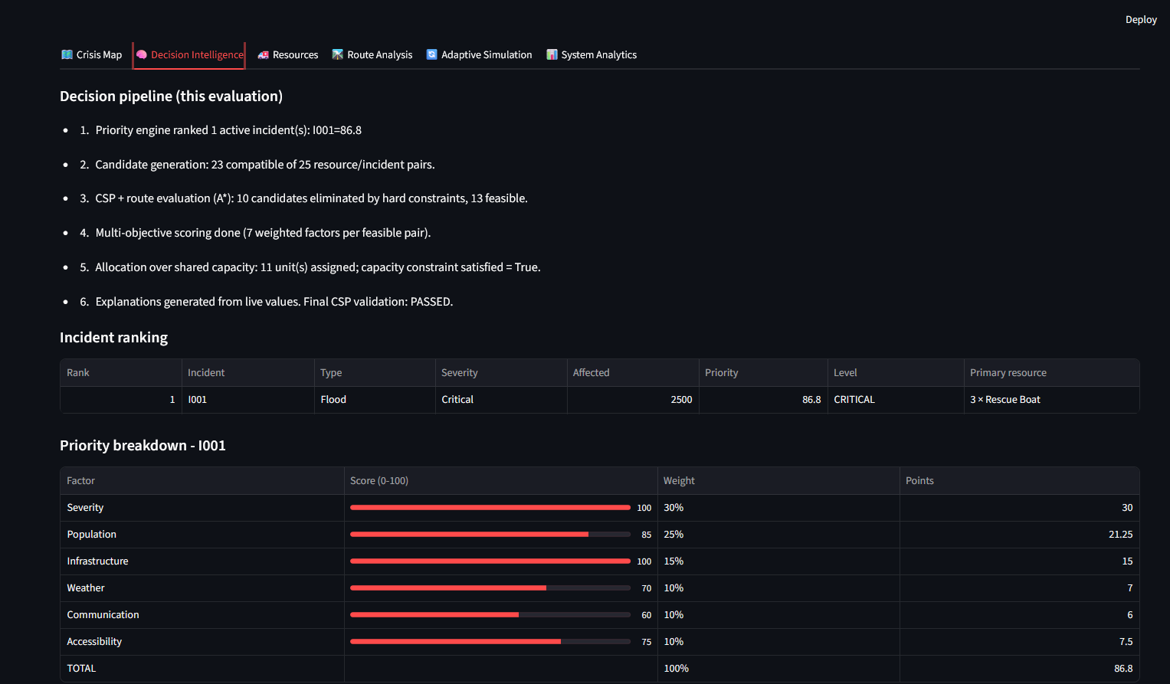
User Interface/ Screenshots

Slide 27
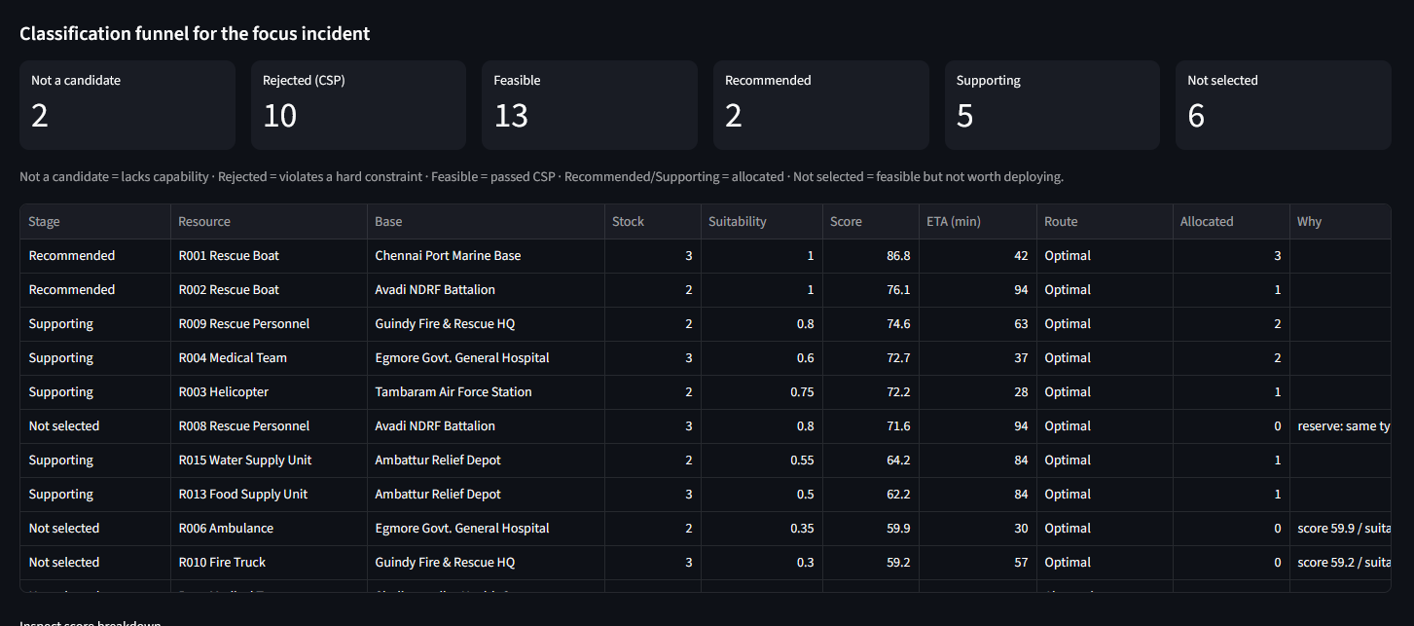
User Interface/ Screenshots

Slide 28
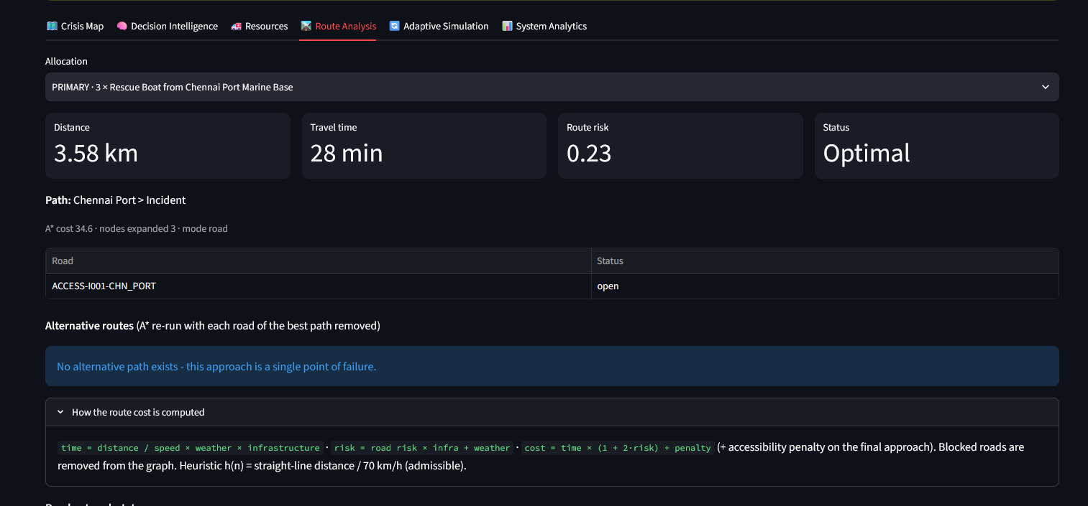
User Interface/ Screenshots

Slide 29
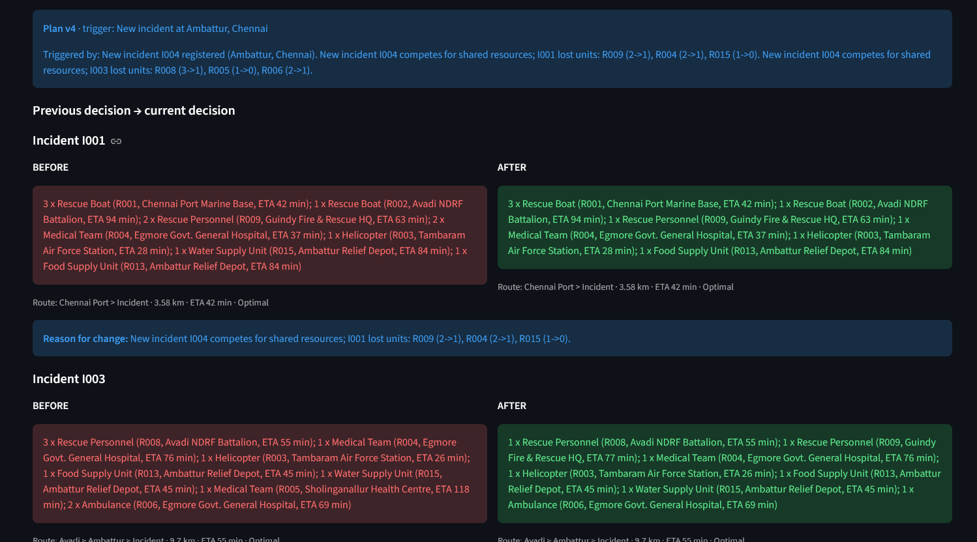
User Interface/ Screenshots

Slide 30
Conclusion
The proposed system integrates incident prioritization, intelligent resource allocation, and route planning into a unified decision-support framework.
CSP-based constraint filtering helps identify feasible resource assignments, while A* search supports route planning.
Adaptive re-planning updates response recommendations when incident conditions or resource availability change.
The dashboard provides transparent recommendations to support emergency coordinators in making informed decisions.

Slide 31
Future Work
Real-Time Data Integration: Incorporate live weather updates, incident reports, and road conditions.
Advanced Resource Optimization: Improve resource allocation for multiple incidents competing for limited resources.
Dynamic Route Planning: Update routes based on road closures, traffic, and changing environmental conditions.
Enhanced Decision Intelligence: Incorporate uncertainty-aware scoring and improved prioritization techniques.
Performance Evaluation: Test the system using realistic disaster scenarios and compare its results with baseline methods.

Slide 32
References
[1] N. Altay and W. G. Green III, “OR/MS Research in Disaster Operations Management,” European Journal of Operational Research, vol. 175, no. 1, pp. 475–493, 2006.
[2] E. Galindo and R. Batta, “Review of Recent Developments in OR/MS Research in Disaster Operations Management,” European Journal of Operational Research, vol. 230, no. 2, pp. 201–211, 2013.
[3] A. K. Mackworth, “Consistency in Networks of Relations,” Artificial Intelligence, vol. 8, no. 1, pp. 99–118, 1977.

Slide 33
Thank You

