Slide 1

Department of Cyber Security
2026-2027- Odd Semester
III Year /V Sem
CS23533-FOUNDATIONS OF ARTIFICIAL INTELLIGENCE
Review 1– 11.08.2026

Slide 2
Introduction
2
Adaptive Decision Intelligence for Crisis Management is an AI-based decision support system designed to assist decision-makers during emergencies and critical situations.
The project combines Artificial Intelligence, Decision Intelligence, Real-Time Data Analysis, and Crisis Management to support effective crisis response.
It evaluates available crisis information to understand severity, priorities, affected areas, and resource requirements, helping decision-makers respond appropriately.
The system provides adaptive recommendations as the situation changes, helping reduce response time, improve prioritization, optimize resource utilization, and support informed decision-making.
Cyber Security | Project Review – 1 | 2026-27

Slide 3
Problem Statement
3
Crisis situations involve rapidly changing conditions, making it difficult to assess severity, identify priorities, and make timely decisions.
Existing approaches often rely on predefined plans or manual assessment and may not adapt effectively to changes in the crisis situation and available resources.
Delayed or inappropriate decisions can lead to poor prioritization, inefficient resource utilization, and increased impact during emergencies.
Therefore, an Adaptive Decision Intelligence system is needed to analyze available crisis information, dynamically prioritize situations, and provide context-aware recommendations for effective response.
[Department] | Project Review – 1 | [Academic Year]

Slide 4
Motivation
4
Project Selection: Selected to address the need for faster and more adaptive decision-making during crisis situations where conditions change rapidly.
Research / Industry Motivation: Growing use of AI and decision intelligence in emergency management creates opportunities to improve how crisis information is analyzed and acted upon.
Expected Benefits: Enables better prioritization, faster response, efficient resource allocation, and context-aware decision support.
Practical Significance: Can assist emergency response teams and decision-makers in evaluating crisis situations and selecting appropriate actions based on current conditions.
[Department] | Project Review – 1 | [Academic Year]

Slide 5
Objectives
5
To analyze crisis-related information and assess the severity and impact of emergency situations.
To identify critical situations and prioritize response actions based on current conditions.
To support decision-making by generating appropriate and context-aware response recommendations.
To adapt recommendations dynamically as the crisis situation, priorities, and available resources change.
To improve crisis response efficiency through faster decision-making and effective resource utilization.
[Department] | Project Review – 1 | [Academic Year]

Slide 6
Literature Survey
6
S.No. | Author & Year | Method / Technique | Key Findings | Limitations
1 | Ruhizal Roosli, 2025 | Qualitative Thematic Analysis, Comparitive Analysis | Faster Crisis response, Improved situational awareness,better resource prioritization | Data reliability,misinformation and verification,privacy and ethical concerns
2 | Lazima Faiah Bari, 2023 | AI, Machine Learning,Predictive Analytics,Risk Assessment | Improved emergency response,emergency healthcare,Trust and adoption | Prediction accuracy,data dependency
3 | Emmanuel Adjei Domfeh, 2025 | Natural Language Processing,Conventional Neural Networks | Human-AI Decision Support,Simulation and Training | Scalability,Interpretability,need for adaptability
[Department] | Project Review – 1 | [Academic Year]

Slide 7
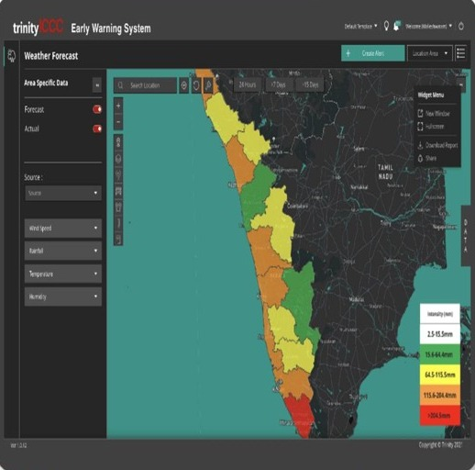
Existing System
7
Existing Approach
Manual monitoring and predefined emergency response plans.
GIS-based disaster mapping and risk assessment.
Existing Technologies
GIS & GPS
Remote sensing / satellite data
IoT sensors
Statistical risk assessment
Rule-based alert systems
Advantages
Provides real-time disaster monitoring.
Helps visualize affected and high-risk areas.
Supports basic emergency planning.
Limitations
Mostly monitoring-focused rather than decision-focused.
Limited adaptability to rapidly changing situations.
Requires human intervention for complex decisions.
[Department] | Project Review – 1 | [Academic Year]

Slide 8
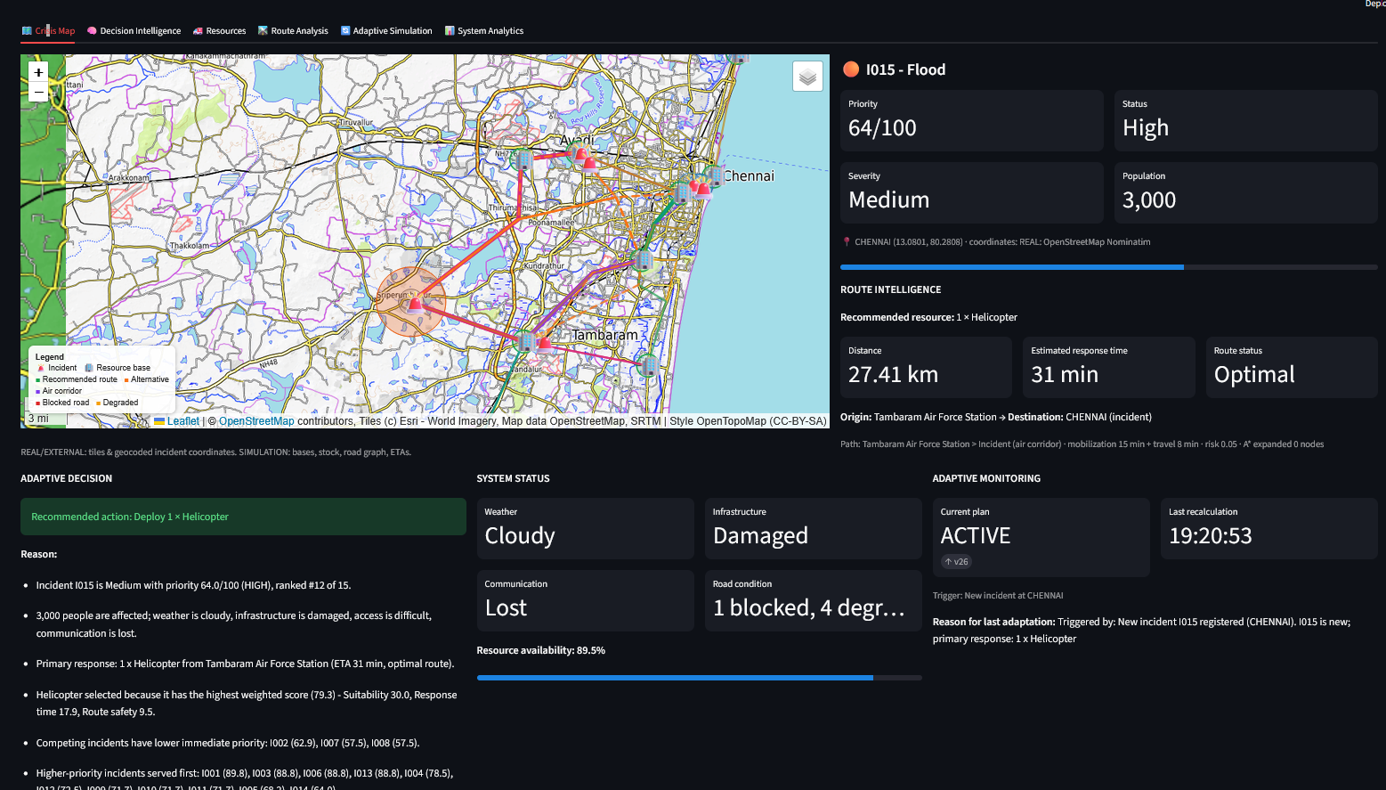
Proposed System
8
Proposed Approach
Develop an AI-based adaptive decision support system that analyzes real-time crisis information and suggests suitable response actions.
Key Features / Innovations
Real-time crisis assessment and prioritization.
Dynamic resource allocation and adaptive recommendations.
How It Improves the Existing System
Replaces fixed responses with data-driven, adaptive decisions, enables faster prioritization of critical situations.
Expected Outcome
Faster response, efficient resource use.
[Department] | Project Review – 1 | [Academic Year]

Slide 9
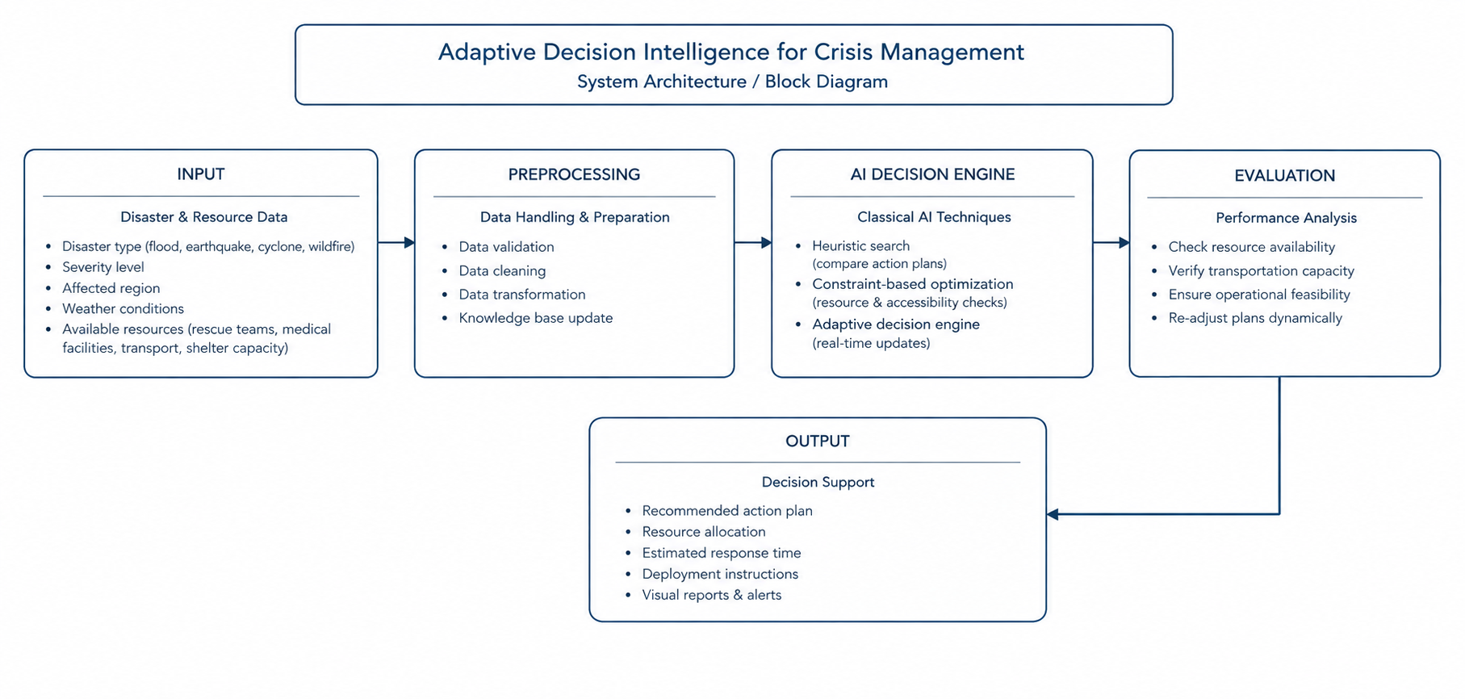
System Architecture / Block Diagram
9
INPUT
PREPROCESSING
PROPOSED METHOD / MODEL
EVALUATION
OUTPUT
Replace the placeholders with your project-specific architecture and arrows.
[Department] | Project Review – 1 | [Academic Year]

Slide 10
Methodology
10
1. [Data Collection / Input]
2. [Preprocessing]
3. [Feature Selection / Processing]
4. [Algorithm / Model]
5. [Evaluation]
6. [Output / Deployment]
[Department] | Project Review – 1 | [Academic Year]

Slide 11
Technologies Used
11
Programming Language: Python
Framework / Library: Streamlit
Database: MySQL
Tools / IDE: Visual Studio Code
Hardware: Intel Core i5/Ryzen 5, 8 GB RAM, 256 GB SSD, Internet Connection.
[Department] | Project Review – 1 | [Academic Year]

Slide 12
Module Description
12
Module 1 – Crisis Data Input
Module 2 – Data Preprocessing
Module 3 – Crisis Severity Assessment
Module 4 – Risk & Priority Assessment
Module 5 – Resource Allocation
[Department] | Project Review – 1 | [Academic Year]

Slide 13
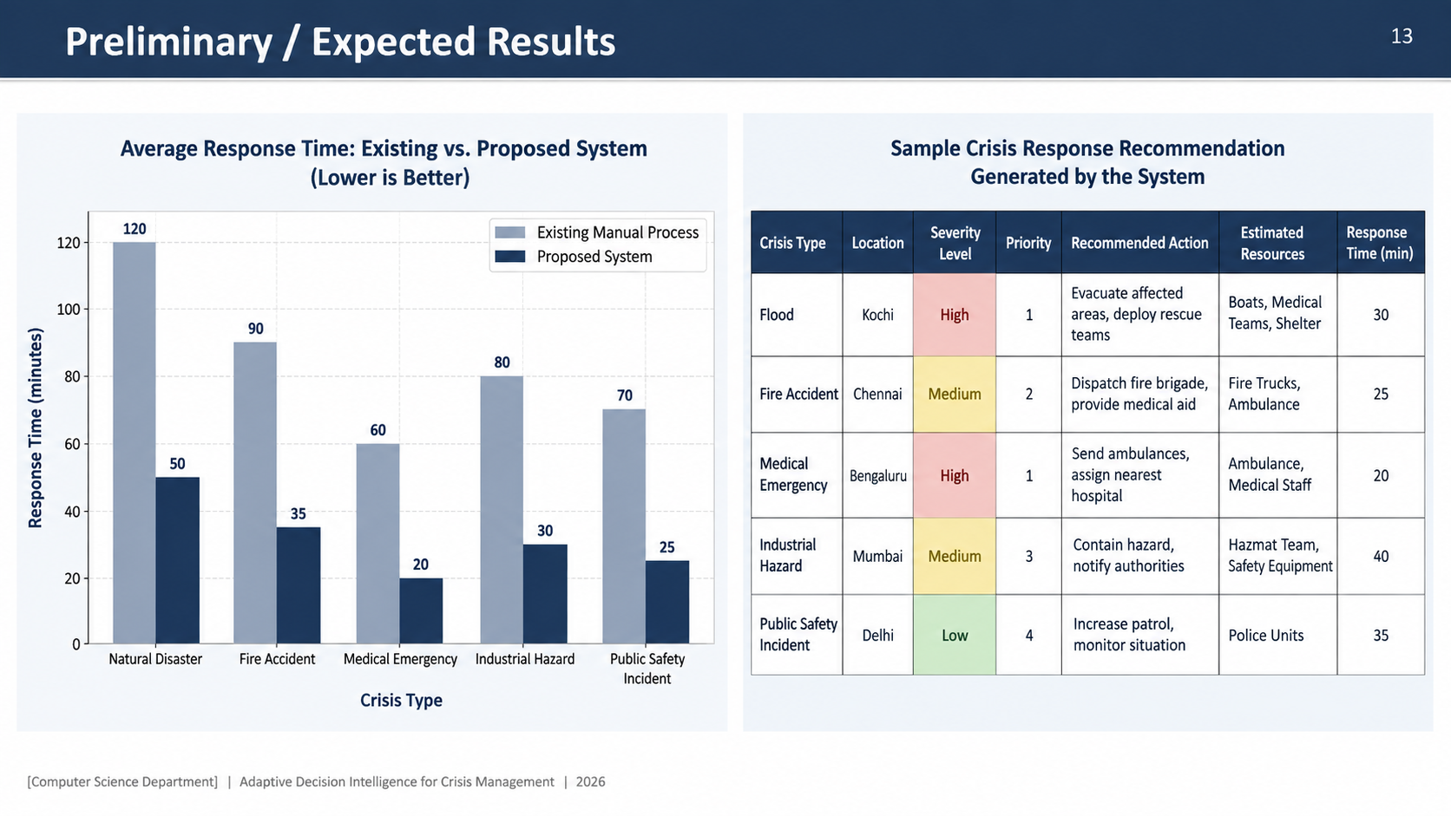

Preliminary / Expected Results
13
[Insert Screenshot / Table]
[Department] | Project Review – 1 | [Academic Year]

Slide 14
Project Schedule
14
Activity | Month 1 | Month 2 | Month 3 | Month 4
Literature Survey | ✓
Problem Identification | ✓
System Design |  | ✓
Implementation |  | ✓
Testing & Evaluation |  |  | ✓ | ✓
[Department] | Project Review – 1 | [Academic Year]

Slide 15
Current Progress
15
✓ Literature survey completed
✓ Problem identification completed
✓ Requirement analysis and methodology finalized
✓ System architecture and module design completed
☐ Implementation and integration of modules
☐ Testing and validation of the system
☐ Performance evaluation and final documentation
[Department] | Project Review – 1 | [Academic Year]

Slide 16
Future Work
16
Complete implementation of the decision intelligence system.
Integrate real-time incident and weather data.
Develop adaptive resource allocation and emergency response planning.
Evaluate system performance under different crisis scenarios.
Prepare the final system, project report, and documentation.
[Department] | Project Review – 1 | [Academic Year]

Slide 17
Conclusion
17
Project Summary:
The Adaptive Decision Intelligence for Crisis Management project aims to improve emergency response planning through an intelligent, data-driven decision support system.
Key Contribution / Novelty:
The key contribution of the proposed system is its adaptive decision-making approach, which considers incident severity, resource availability, operational constraints, and route conditions when selecting response strategies.
Expected Outcome and Significance:
The system is expected to support faster and more organized emergency response planning, improve the utilization of limited resources, and provide transparent explanations for recommended decisions.
[Department] | Project Review – 1 | [Academic Year]

Slide 18
References
18
[1]S. Russell and P. Norvig, Artificial Intelligence: A Modern Approach, 4th ed. Hoboken, NJ, USA: Pearson, 2021.
[2]P. E. Hart, N. J. Nilsson, and B. Raphael, “A formal basis for the heuristic determination of minimum cost paths,” IEEE Trans. Syst. Sci. Cybern., vol. 4, no. 2, pp. 100–107, 1968.
[3]E. W. Dijkstra, “A note on two problems in connexion with graphs,” Numerische Mathematik, vol. 1, no. 1, pp. 269–271, 1959.
[Department] | Project Review – 1 | [Academic Year]

Slide 19
THANK YOU
Questions & Suggestions

