Slide 1

Department of Computer Science and Engineering
(Cyber Security)
CS23533– Foundations of Artificial Intelligence
2026-2027
ADAPTIVE DECISION INTELLIGENCE FOR CRISIS MANAGEMENT — REVIEW 2
Dr. S. Bhuvana PhD.,
Assistant Professor
Akshaya D. 241901002
Angelin Praisee K. 241901004

Slide 2
Problem Statement and Motivation
Emergency response involves multiple incidents, limited resources, and rapidly changing conditions.
Manual decision-making can make it difficult to prioritize emergencies and allocate suitable resources efficiently.
Road blockages, weather changes, and resource unavailability can affect response plans.
Existing approaches may lack integrated resource allocation, route analysis, and adaptive re-planning.

Slide 3
Objectives
Incident Prioritization: Assess emergencies based on severity, population impact, and surrounding conditions.
Intelligent Resource Allocation: Identify and allocate suitable resources according to availability and operational constraints.
Optimal Route Planning: Apply A* search to identify suitable routes and estimate travel time.
Constraint-Based Decision Making: Use Constraint Satisfaction Problem (CSP) principles to filter infeasible resource assignments.

Slide 4
Project Progress Since Review 1
Designed the system architecture and user interface using Python and Streamlit.
Developed the initial dashboard for crisis information and emergency response planning.
Implemented input fields for disaster type, severity, affected population, weather conditions, communication, and infrastructure status.
Designed the decision-making workflow considering crisis severity, resource availability, and operational constraints.
Explored AI search algorithms, including A*, BFS, DFS, and heuristic-based approaches, for emergency response planning.

Slide 5
Literature Survey
S. No. | Author(s) & Year | Paper Title | Methodology / Algorithm | Limitations
1 | N. Altay and W. G. Green III (2006) | OR/MS Research in Disaster Operations Management | Review of Operations Research and Management Science techniques. | Covers a broad range of disaster management problems; integrating different methods.
2 | E. Galindo and R. Batta (2013) | Review of Recent Developments in OR/MS Research in Disaster Operations Management | Literature review of optimization, logistics, and resource allocation techniques. | Many approaches address specific planning problems and may not fully account for rapidly changing incident.
3 | M. Turoff et al. (2004) | The Design of a Dynamic Emergency Response Management Information System (DERMIS) | Dynamic emergency response information system for managing information and supporting decisions. | Effectiveness depends on timely information, system integration, and the availability of accurate incident data.

Slide 6
Literature Survey
S. No. | Author(s) & Year | Paper Title | Methodology / Algorithm | Limitations
4 | Author D et al. (Year) | Enter the research paper title | Proposed approach | Gap that motivates your project
5 | Author D et al. (Year) | Enter the research paper title | Proposed approach | Gap that motivates your project

Slide 7
Research Gap/Existing System
What existing studies do?
Apply optimization techniques for disaster response and resource allocation.
Use decision-support systems to manage emergency information.
Apply A* search for route planning and constraint-based methods for feasible assignments.
Limitations observed
Many approaches focus on individual problems rather than an integrated workflow.
Resource allocation may not fully account for changing incident conditions.
Decision explanations and plan comparisons may be limited.
Research gap
Need for an integrated system combining incident prioritization, resource allocation, route planning, and constraint filtering.
Limited coordination between resource selection and dynamic re-planning when conditions change.
How our project responds?
Calculates incident priority using severity and impact factors.
Uses CSP principles to filter infeasible resource assignments.
Applies A* search for route planning when road-network data are available.
Re-evaluates resource allocation after changes and compares updated plans.
Displays recommendations and explanations through a unified dashboard.

Slide 8
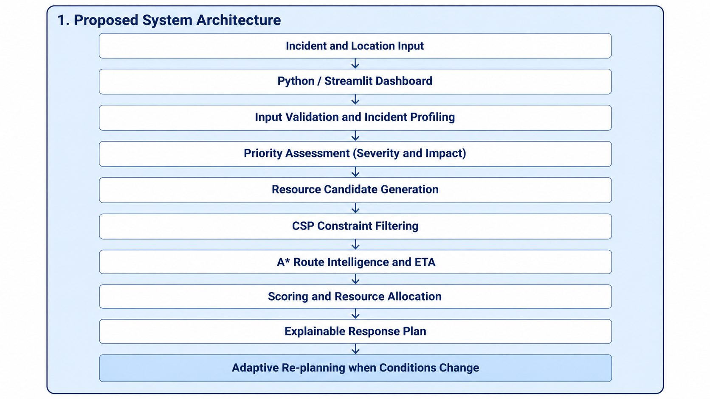
System Architecture / Proposed System

Slide 9
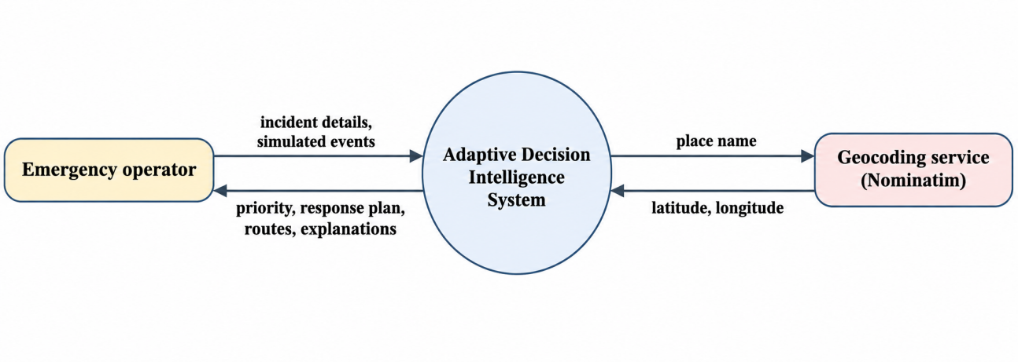
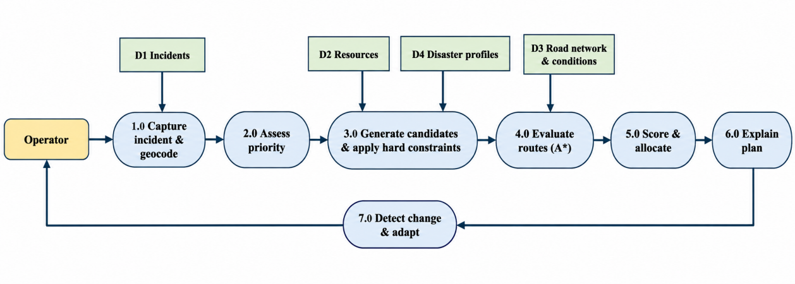
DFD Diagram
Data Flow Diagram (DFD – Level 0)
At the highest level the operator supplies incident details and simulated events, and the system returns the priority, response plan, routes and explanations. The only external entity besides the operator is the geocoding service.
Data Flow Diagram (DFD – Level 1)
Level 1 expands the system into seven processes and four data stores. Process 7.0 modifies the stores and triggers the earlier processes again, which is the adaptive loop.

Slide 10
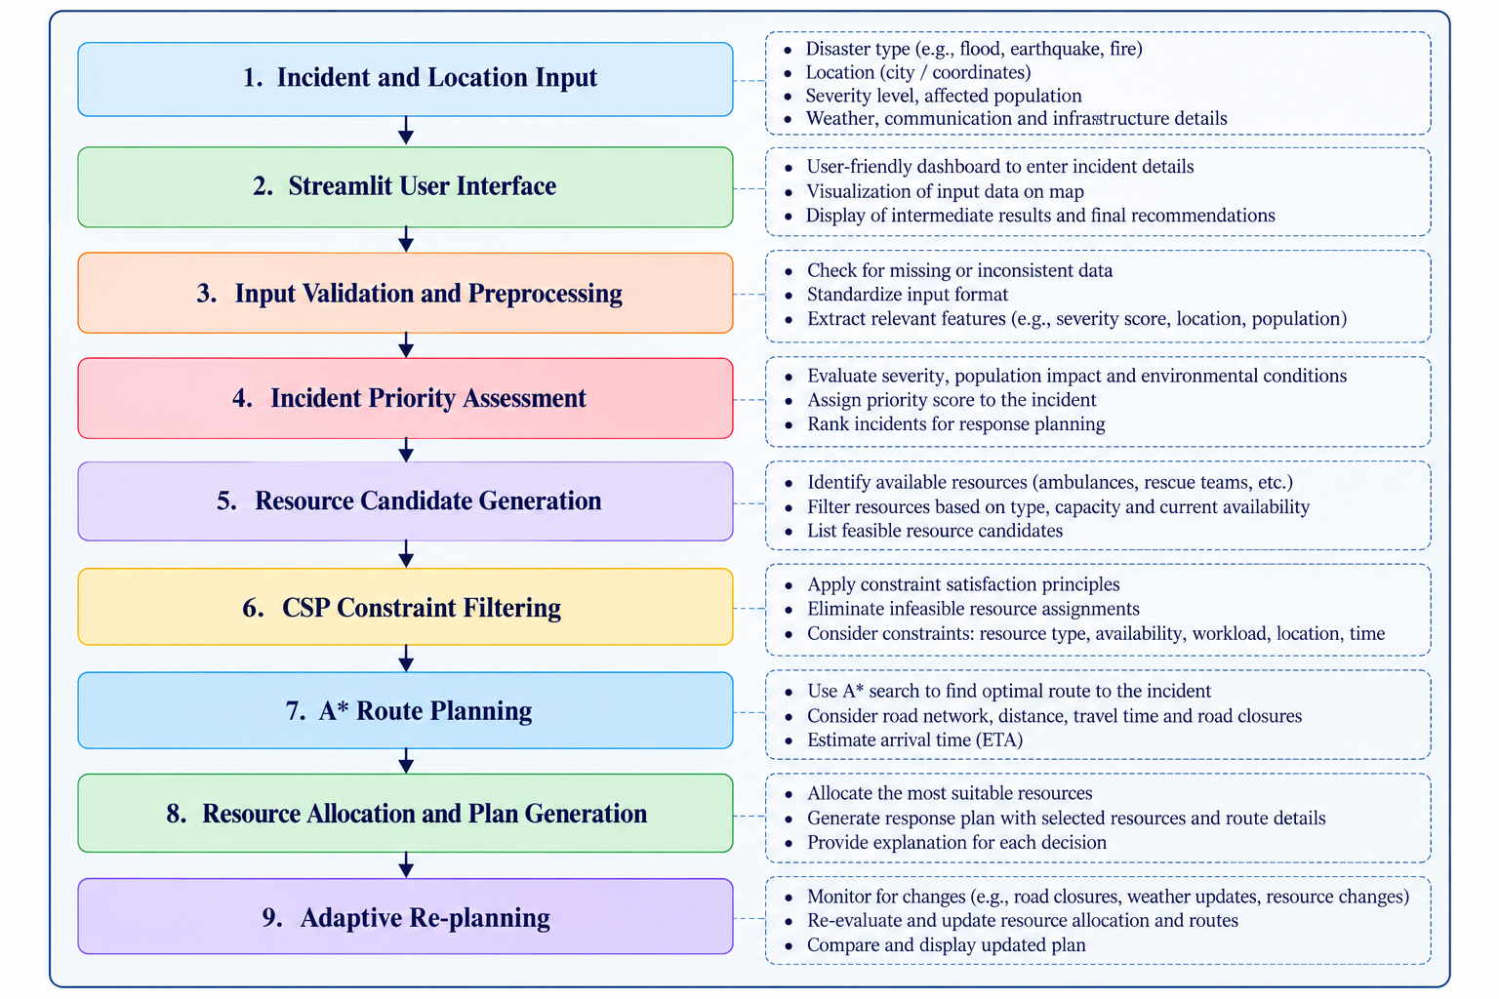
Methodology / Workflow Diagram

Slide 11
Tools and Technologies
Programming Languages
  Python: Core decision-making logic, priority assessment, and resource allocation.
Frameworks and Libraries
  Streamlit: Interactive dashboard and user interface.
  NetworkX: Road-network graph representation and graph algorithms.
  Pandas: Data processing and tabular representation, if used.
Software and Tools
  Visual Studio Code: Code development and debugging.
  Git and GitHub: Version control and project management.
  OpenStreetMap / Geocoding Services: Location visualization and coordinate lookup, where integrated.

Slide 12
Tools and Technologies
Algorithms and Techniques
  A Search:* Route finding using a road-network graph.
  Constraint Satisfaction Problem (CSP): Filtering infeasible resource assignments.
  Weighted Scoring: Incident prioritization and candidate ranking.
  Adaptive Re-planning: Updating response plans when conditions change.
Hardware Requirements
  Computer/Laptop: Development and execution of the application.
  Internet Connection: Required for online maps or external services.
  Minimum practical setup: 4 GB RAM; 8 GB or more recommended for smoother development.

Slide 13
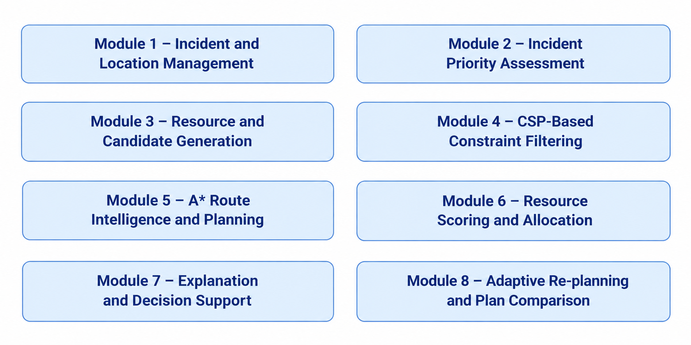
List of Modules

Slide 14
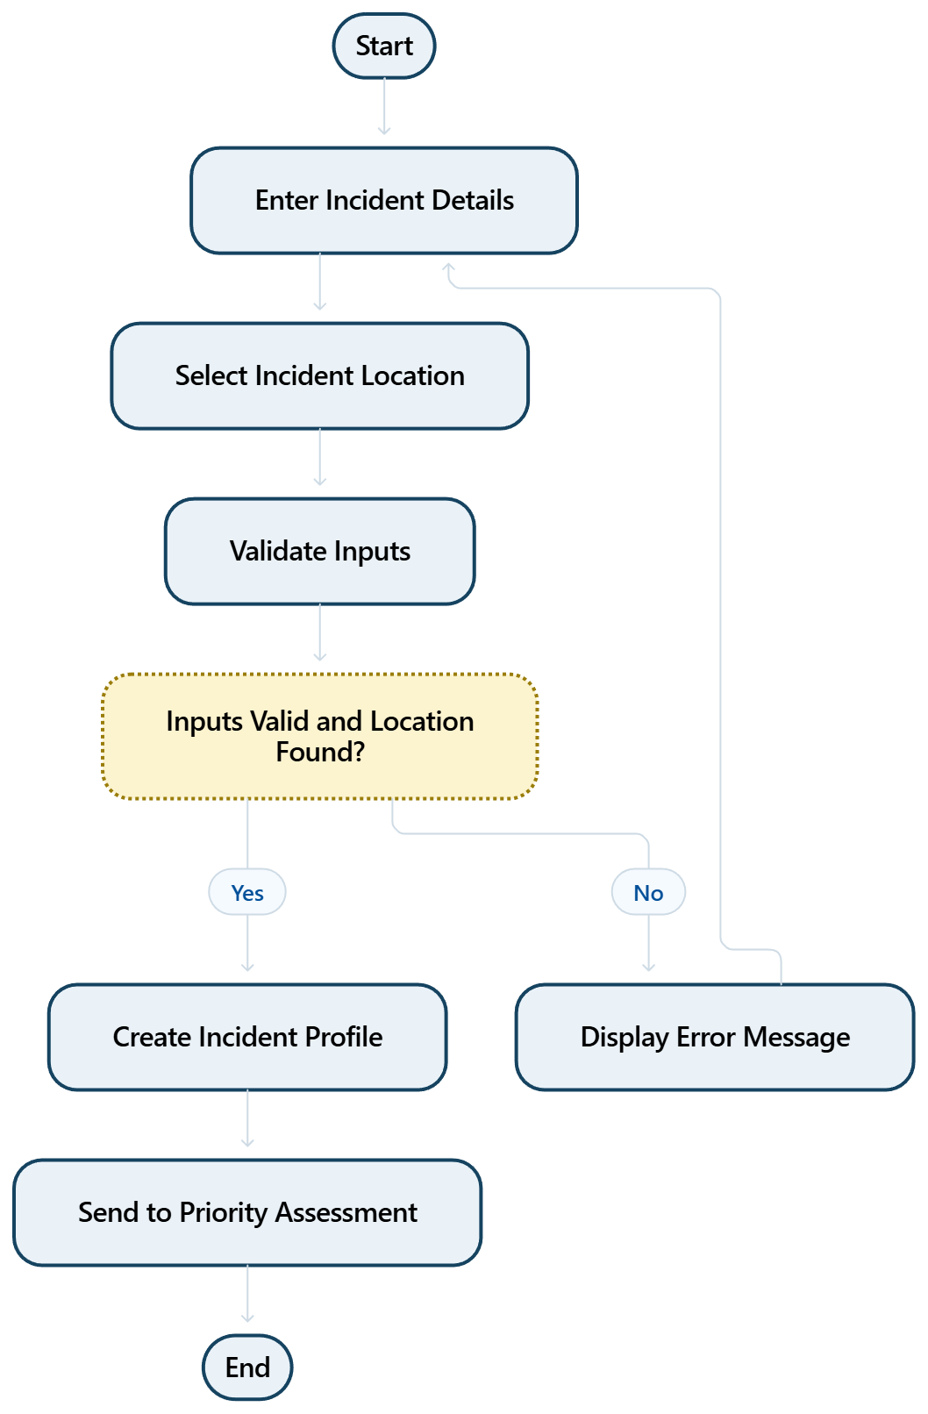
Module Description
Module - 01
INCIDENT AND LOCATION MANAGEMENT
Purpose: Collects crisis details and identifies the incident location for decision-making.
Implemented features:
1.Enter incident type, severity, affected population, and time.
2.Select or enter the incident location.
3.Validate inputs and obtain location coordinates when available.
4.Store incident details for the decision pipeline.

Slide 15
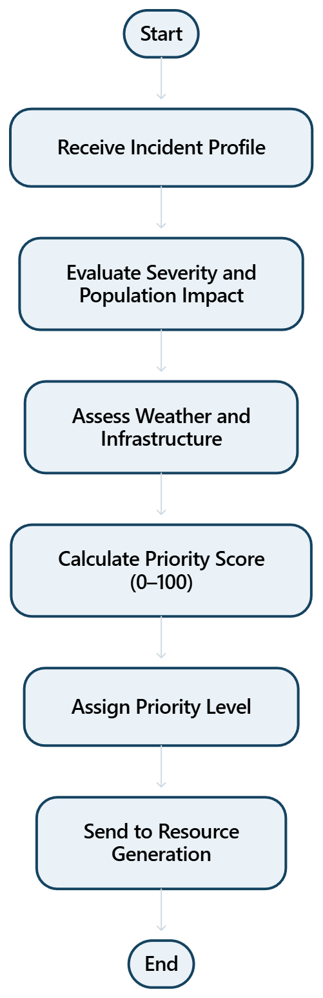
Module Description
Module - 02
PRIORITY ASSESSMENT
Purpose: Calculates an incident priority score to help determine which crisis needs attention first.
Implemented features
1.Evaluate severity and population affected.
2.Consider weather, infrastructure, and communication conditions.
3.Calculate a weighted priority score from 0 to 100.
4.Assign a priority level for decision support.

Slide 16
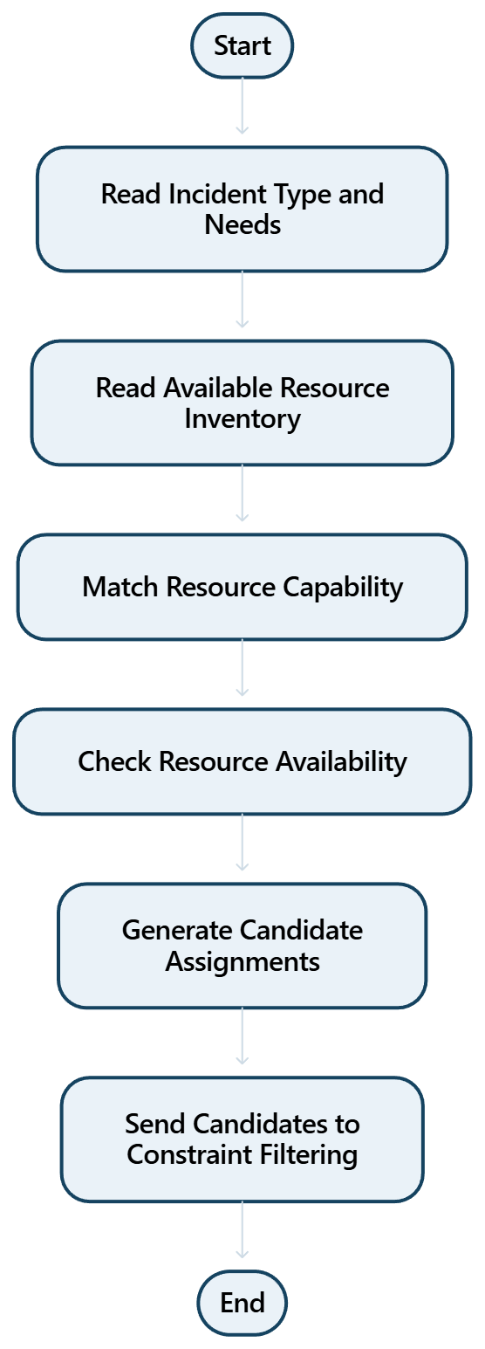
Module Description
Module - 03
RESOURCE AND CANDIDATE GENERATION
Purpose: Identifies suitable response resources and creates possible assignments for the incident.
Implemented features
1.Read available resources and their capabilities.
2.Match resource types to incident needs.
3.Generate candidate resource groups for each need.
4.Exclude resources that are unavailable before detailed filtering.

Slide 17
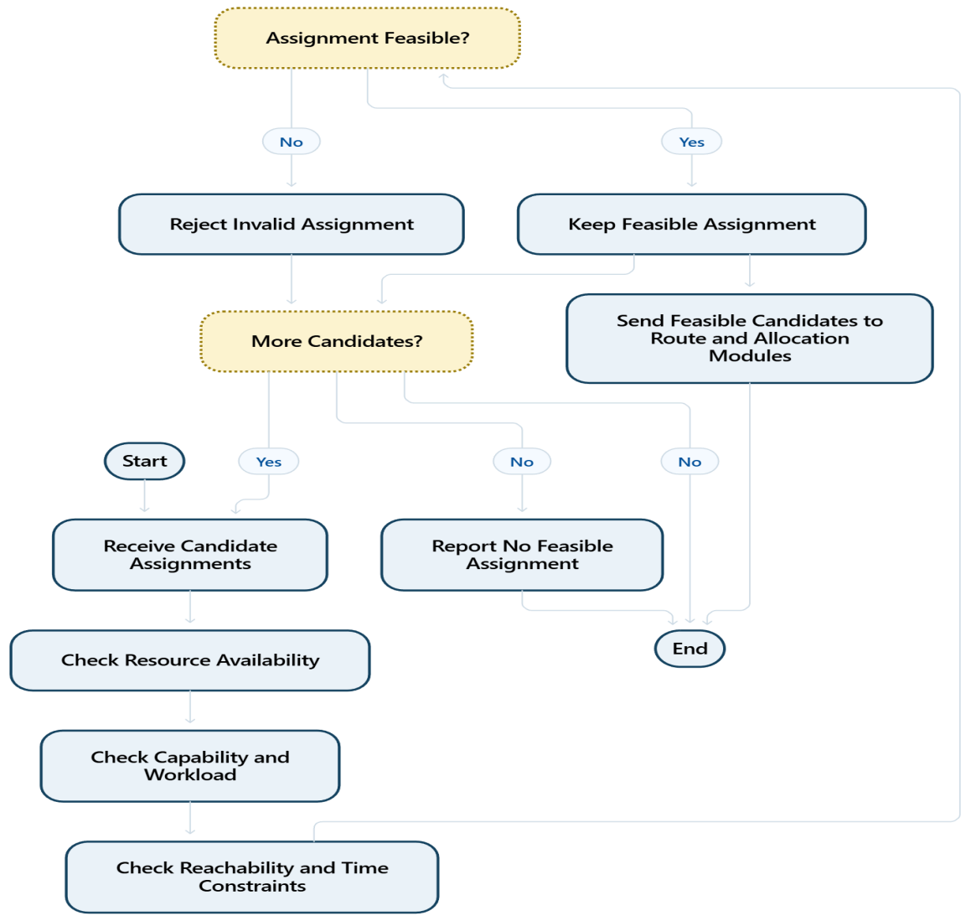
Module Description
Module - 04
CONSTRAINT FILTERING (CSP)
Purpose: Removes resource assignments that violate essential operational constraints.
Implemented features
1.Check resource availability and capability.
2.Check workload, reachability, and time-window constraints.
3.Reject infeasible combinations.
4.Pass only feasible candidates to allocation.

Slide 18
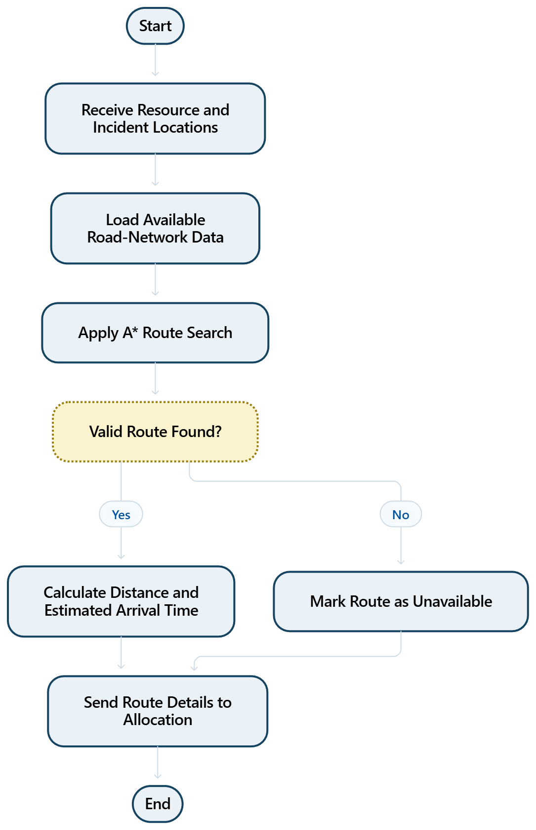
Module Description
Module - 05
ROUTE INTELLIGENCE (A*)
Purpose: Estimates routes and travel times to support safer and more practical resource deployment.
Implemented features
1.Use available location and road-network data.
2.Apply A* search to find a suitable route when graph data is available.
3.Estimate travel distance and time.
4.Mark routes as unavailable when a valid path cannot be found.

Slide 19
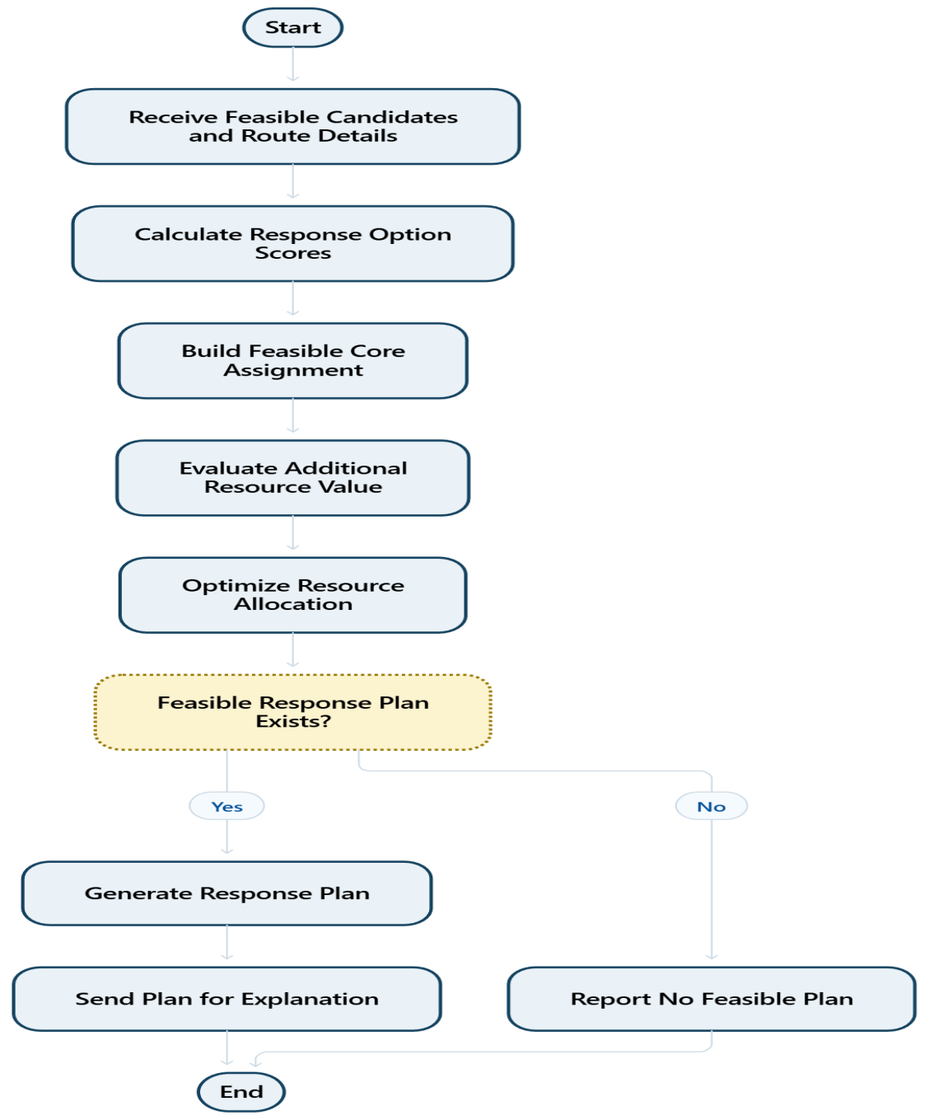
Module Description
Module - 06
SCORING AND RESOURCE ALLOCATION
Purpose: Ranks feasible response options and assigns resources according to incident needs and constraints.
Implemented features
1.Combine priority, suitability, travel time, and resource limits.
2.Create a feasible core assignment using constraints.
3.Use marginal-value scoring to improve additional assignments.
4.Produce a response plan with selected resources.

Slide 20
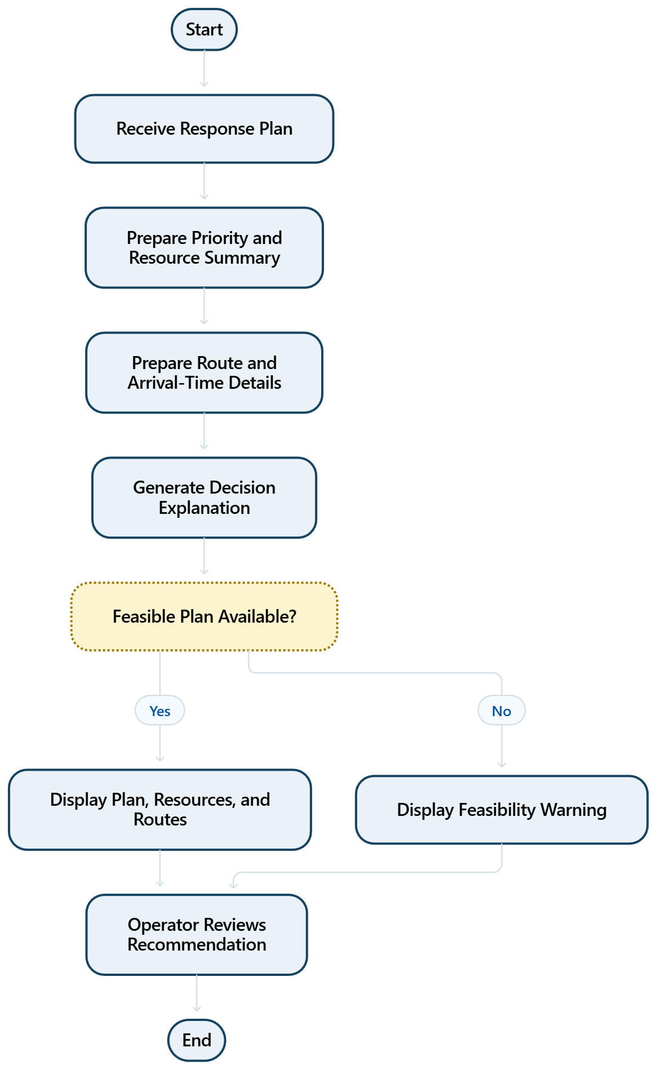
Module Description
Module - 07
EXPLANATION AND DECISION DISPLAY
Purpose: Shows the recommended response plan and explains the main reasons behind each decision.
Implemented features
1.Display priority score and incident summary.
2.Show selected resources, routes, and estimated arrival times.
3.Explain important constraints and selection reasons.
4.Clearly indicate when no feasible plan is found.

Slide 21
Results & Discussion
Incident Prioritization: Evaluates incidents based on severity and impact factors.
Resource Allocation: Identifies suitable resources based on availability and operational constraints.
Route Planning: Uses A* search to determine suitable routes when road-network data are available.
Constraint Validation: Filters infeasible resource assignments using CSP principles.
Adaptive Re-planning: Updates and compares response plans when incident conditions or resource availability change.

Slide 22
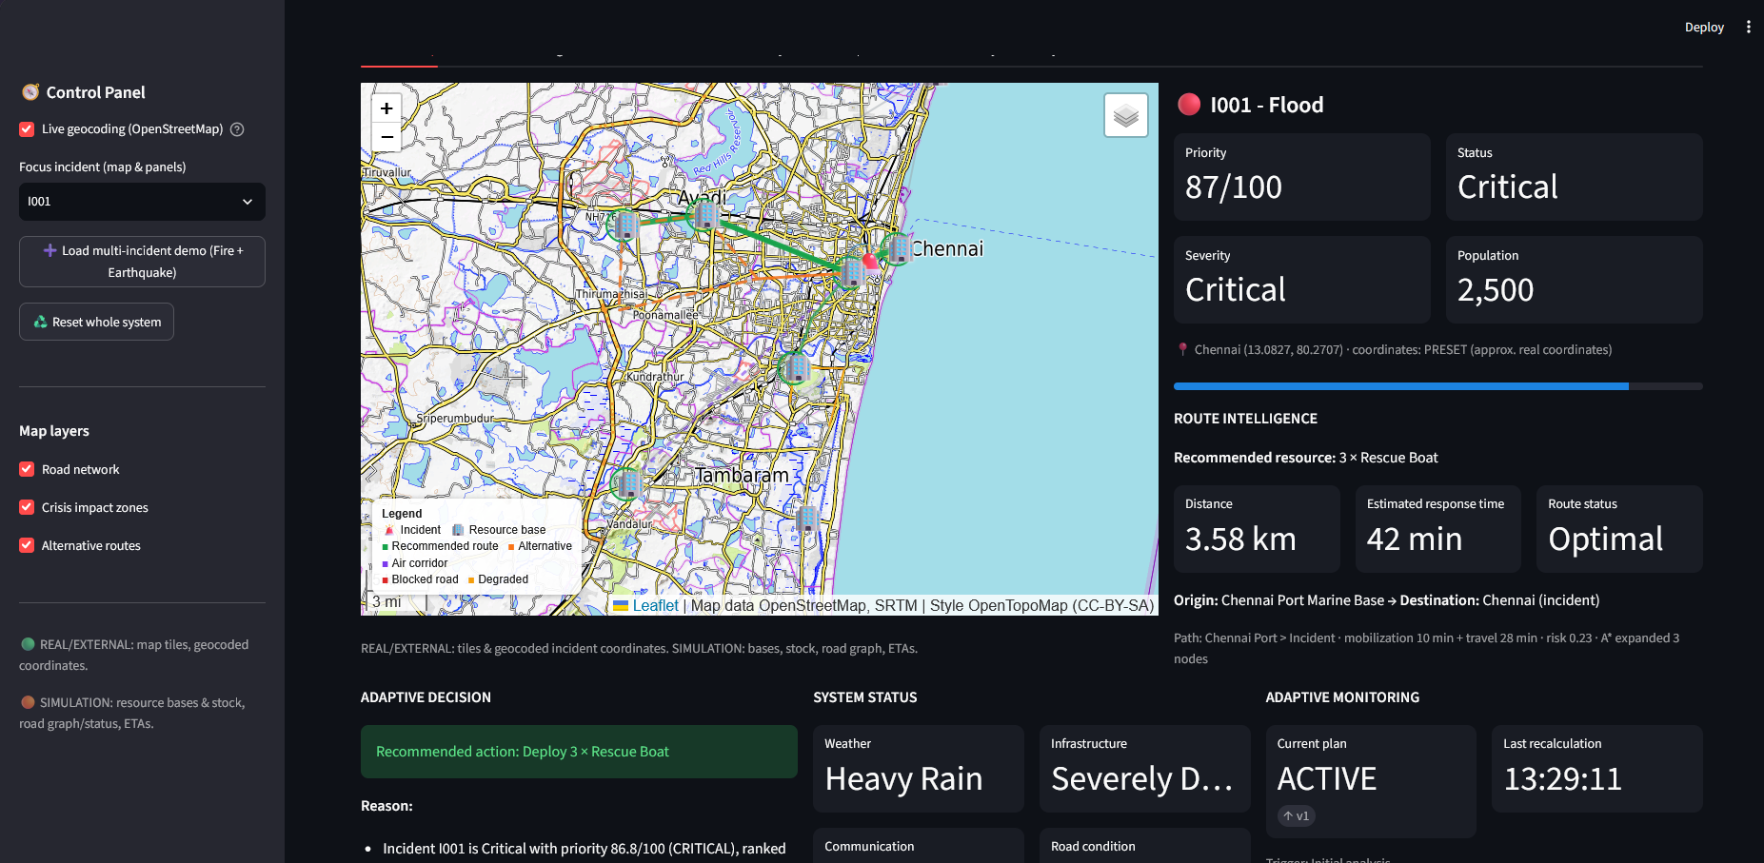
User Interface/ Screenshots

Slide 23
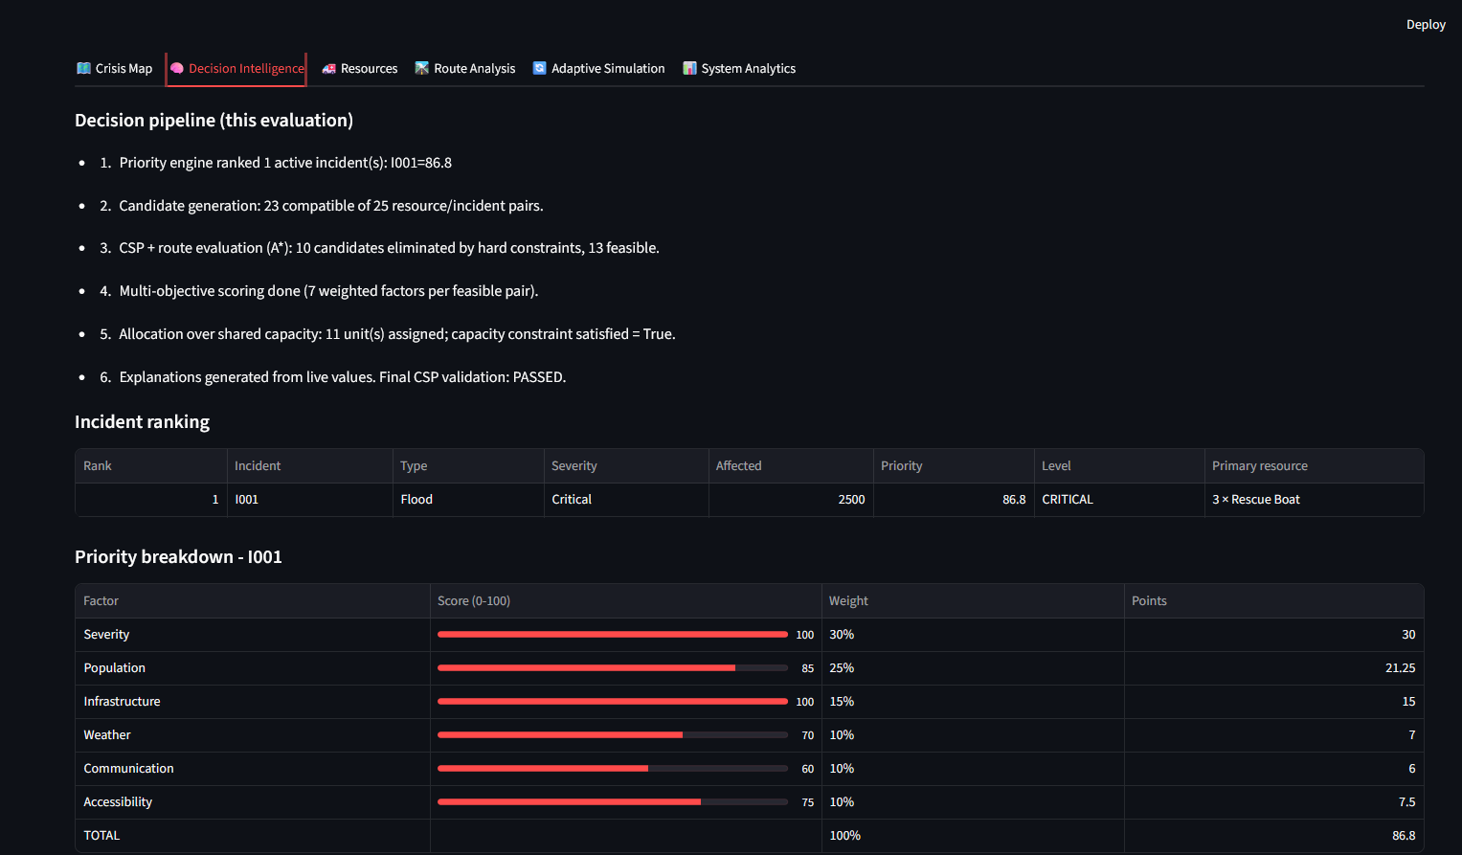
User Interface/ Screenshots

Slide 24
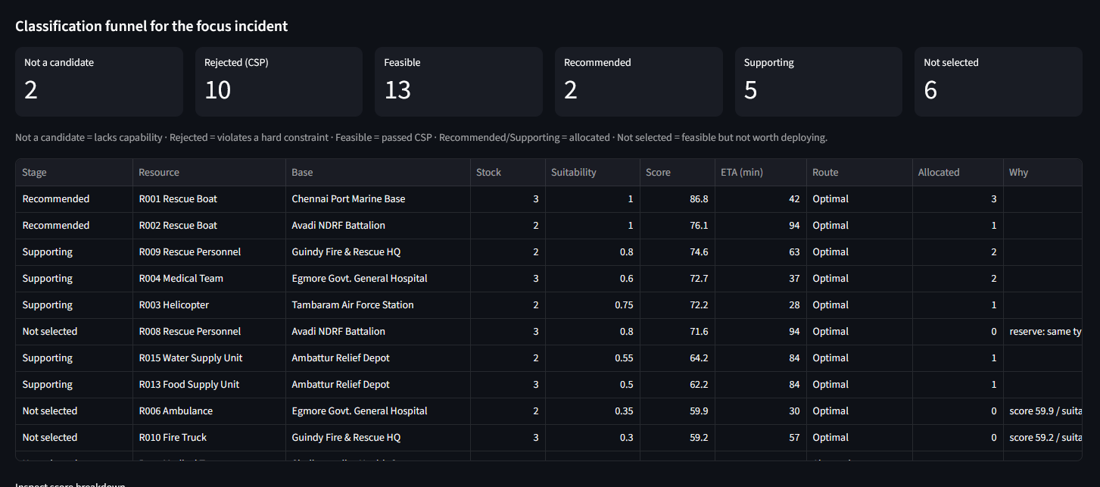
User Interface/ Screenshots

Slide 25
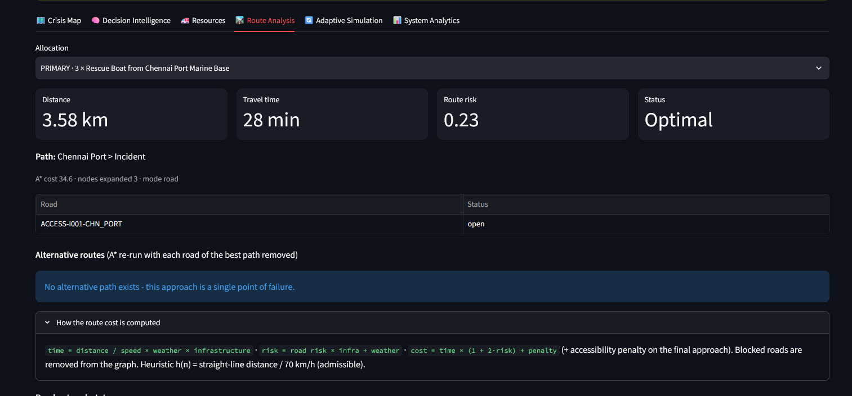
User Interface/ Screenshots

Slide 26
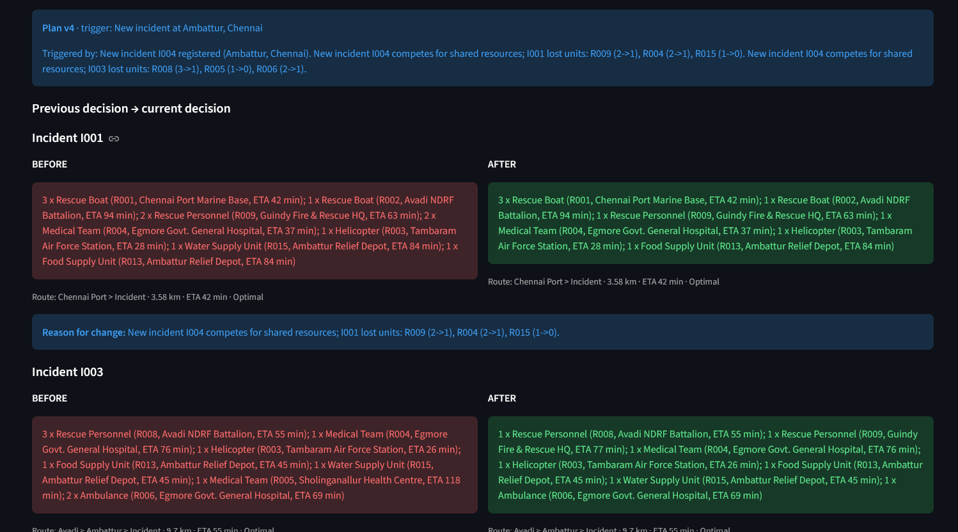
User Interface/ Screenshots

Slide 27
Challenges Faced and Solutions
Challenges Encountered
Integrating decision-making algorithms into the Streamlit application.
Designing adaptive decisions based on crisis severity and resource availability.
Handling multiple disaster scenarios with different response requirements.
Identifying reliable sources for real-time incident and weather data.

Slide 28
Challenges Faced and Solutions
Solutions and Workarounds
Structured the application into modular components for easier development and debugging.
Designed a decision-making workflow considering severity, available resources, and operational constraints.
Explored search algorithms such as A* and BFS for emergency response planning.
Identified suitable APIs and data sources for future real-time integration.

Slide 29
Challenges Faced and Solutions
Remaining Issues
Complete implementation and integration of decision-making modules.
Integrate and validate real-time incident and weather data.
Test recommendations across different crisis scenarios.
Evaluate system accuracy, response efficiency, and resource allocation performance.

Slide 30
Work Plan Until Final Review
1. Implementation and Integration
Complete the decision-making algorithm and adaptive resource allocation modules.
Integrate real-time incident and weather data.
Finalize the emergency response recommendation dashboard.
2. Testing and Evaluation
Test the system using different crisis scenarios.
Validate decision recommendations and resource allocation.
Evaluate response efficiency and system performance.

Slide 31
Work Plan Until Final Review
3. Documentation
Prepare the final project report and technical documentation.
Document system architecture, algorithms, and implementation results.
Include test cases, outputs, and evaluation results.
4. Final Review Preparation
Prepare the final PowerPoint presentation and demonstration.
Organize screenshots, results, and system outputs.
Complete final verification and incorporate review feedback.

Slide 32
References
[1] N. Altay and W. G. Green III, “OR/MS Research in Disaster Operations Management,” European Journal of Operational Research, vol. 175, no. 1, pp. 475–493, 2006.
[2] E. Galindo and R. Batta, “Review of Recent Developments in OR/MS Research in Disaster Operations Management,” European Journal of Operational Research, vol. 230, no. 2, pp. 201–211, 2013.
[3] A. K. Mackworth, “Consistency in Networks of Relations,” Artificial Intelligence, vol. 8, no. 1, pp. 99–118, 1977.

Slide 33
Thank You

