Slide 1

Department of Cyber Security 2026-2027- Odd Semester
III Year /V Sem
CS23533 - FOUNDATIONS OF ARTIFICIAL INTELLIGENCE
Zeroth Review – 31.07.2026

Slide 2
ADAPTIVE DECISION INTELLIGENCE
FOR CRISIS MANAGEMENT
Batch Members :
Akshaya: 241901002
Angelin Praisee: 241901004
Supervisor: Dr. S.Bhuvana
Assistant Professor[SG]

Slide 3
OUTLINE
Abstract
Objective
Literature Survey
Summary of Literature
Proposed System & Novelty
Block Diagram
Hardware/Software requirements
References

Slide 4
ABSTRACT
As disasters and emergency situations become increasingly complex, the need for intelligent decision-support systems in crisis management has grown significantly. This project presents an AI-based Adaptive Decision Intelligence framework designed to enhance emergency response planning and resource coordination during crisis events. The system analyzes multiple contextual factors, including disaster type, severity level, affected region, resource availability, and environmental conditions, to generate optimized response recommendations. By integrating heuristic search techniques, rule-based reasoning, and constraint-based optimization, the framework evaluates alternative action plans and prioritizes resource allocation based on predefined objectives. The adaptive decision engine continuously updates its recommendations as new information becomes available, enabling dynamic and informed decision-making. The proposed approach aims to improve response efficiency, reduce decision delays, and support emergency management authorities in handling rapidly evolving situations. The study demonstrates how Artificial Intelligence can contribute to building more resilient, adaptive, and effective crisis management systems.

Slide 5
OBJECTIVE
To develop an AI-based decision support system that assists emergency management authorities in making timely and effective decisions during crisis situations.
To analyze multiple disaster-related factors such as disaster type, severity, affected region, resource availability, and environmental conditions to generate optimized response recommendations.
To implement heuristic search, rule-based reasoning, and constraint-based optimization techniques for evaluating alternative action plans and prioritizing resource allocation.
To enable adaptive decision-making by continuously updating response strategies as new information becomes available during an ongoing crisis.
To improve emergency response efficiency, reduce decision-making delays, and enhance coordination among stakeholders involved in disaster management.

Slide 6
Literature Survey
TITLE | YEAR | AUTHOR | TECHNIQUE
AI-enhanced crowdsourcing for disaster management | 2025 | Ruhizal Roosli, Umber Nazir, Sheikh Kamran Abid. | Qualitative Thematic Analysis, Comparative Analysis
Potential Use of Artificial Intelligence (AI) in Disaster Risk and Emergency Health Management | 2023 | Lazima Faiah Bari, Iftekhar Ahmed, Rayhan Ahamed, et al. | AI, Machine Learning, Predictive Analytics, Risk Assessment, Resource Allocation, Decision Support Systems.
Human-AI Use Patterns for Decision-Making in Disaster Scenarios | 2025 | Emmanuel Adjei Domfeh,Christopher L. Dancy | Natural Language Processing,Convolutional Neural NetworksLong Short-Term Memory

Slide 7
EXISTING SYSTEM
Conventional
Rule - based
Manual monitoring
Rely on traditional forecasting techniques
Lack robust data validation
Continuous monitoring
Resource allocation is semi - automated

Slide 8
PROPOSED SYSTEM
Multi - Source Data Fusion improves accuracy
Intelligent Decision Support
Faster Response Time
Optimized Resource Allocation
Adaptive and Dynamic planning
Evaluation of Multiple response strategy
Reduced Human Workload
Operational Reliability

Slide 9
Novelty in Proposed System
Banna et al. [5], Bhargava et al. [12], and Manral et al. [45] focused on earthquake prediction using AI models.
Zhu et al. [82] and Collini et al. [18] addressed landslide forecasting.
Lohumi et al. [40], Chang et al. [15], and Ding et al. [20] developed AI-based flood prediction systems.
Zhao et al. [80] and Zhang et al. [79] proposed wildfire detection frameworks.
Research Gap: Existing approaches emphasize prediction, detection, and damage assessment but provide limited support for adaptive response planning.
Proposed Novelty: A unified AI-driven decision intelligence framework that employs heuristic search, rule-based reasoning, and constraint optimization to generate dynamic response strategies, prioritize resources, and continuously adapt emergency actions during evolving crisis situations.

Slide 10
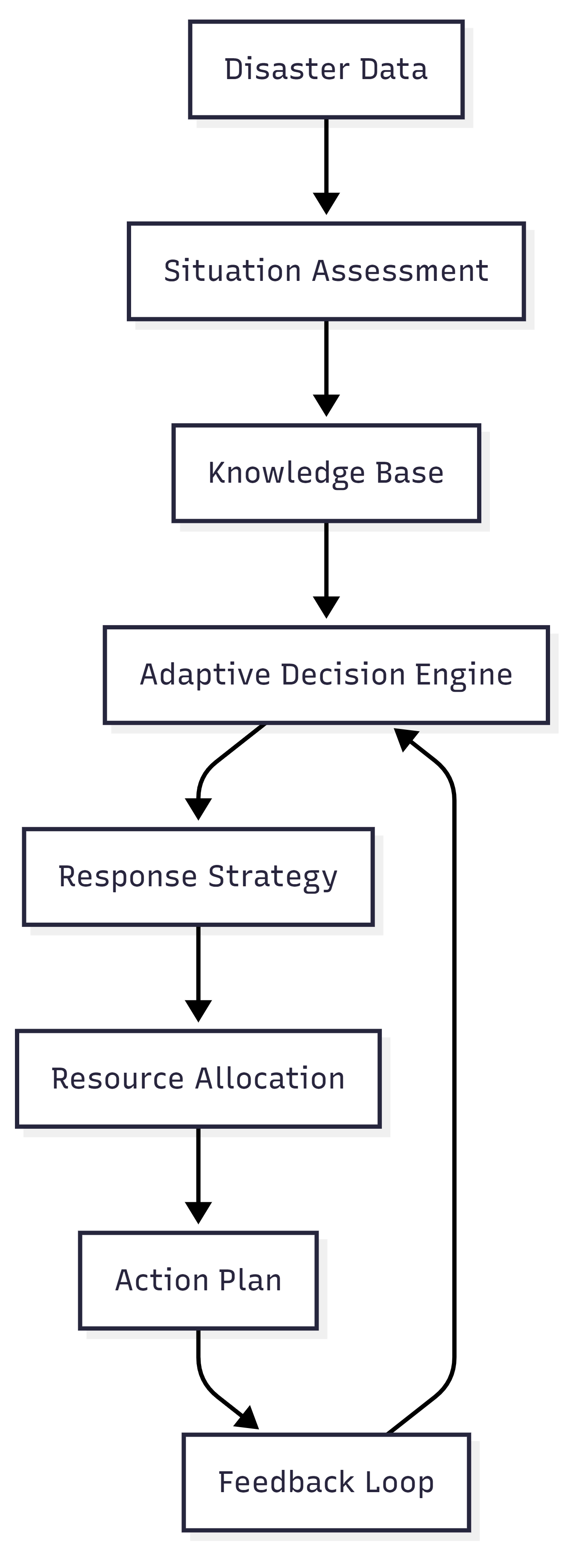
BLOCK DIAGRAM(PROPOSED SYSTEM)

Slide 11
Hardware/Software Requirements
Hardware Requirement:
Processor: Intel Core i5 / AMD Ryzen 5
RAM: 16 GB
SSD Storage
Stable Internet Connection
Software Requirement:
Python 3.11+
Visual Studio Code
Streamlit Framework
SQLite Database
Pandas, NumPy, NetworkX, Python-Constraint
Google Chrome / Microsoft Edge

Slide 12
References
[1] Tanu Gupta and Sudip Roy. (2024). Applications of Artificial Intelligence in Disaster Management. 10th International Conference on Computing and Artificial Intelligence (ICCAI 2024), 313–318. https://doi.org/10.1145/3669754.3669802
[2] Dcruz, J.G., Zolotas, A., Greenwood, N.R. et al. (2025). Structured AI decision-making in disaster management. Sci Rep 15(32093). https://doi.org/10.1038/s41598-025-15317-w
[3] Linardos, V., Drakaki, M., Tzionas, P. & Karnavas, Y. L. (2022). Machine learning in disaster management: Recent developments in methods and applications. Mach. Learn. Knowl. Extract. 4(2), 446–473. https://doi.org/10.3390/make4020020
[4] Amiran, A., Behnam, B. & Seyedin, S. (2024). Ai-based model for site-selecting earthquake emergency shelters. Sci. Rep. 14(1), 29033. https://doi.org/10.1038/s41598-024-80586-w

