Slide 1
REAL TIME FACE RECOGNITION
BASED
ATTENDANCE SYSTEM
Advisor Name
Ashutosh Parida
Notes:
BY KHUSHBU KHAN & ISAN SAHOO
B-TECH PROJECT MID-SEM PRESENTATION 2011
BY KHUSHBU KHAN & ISAN SAHOO
1

Slide 2
GROUP MEMBERS AND THEIR ROLES :
AISWARYA : Team Lead
IMRAN : Developer
SARBAJIT : Developer
KAJAL : Database
ANKIT : Tester

Slide 3
Abstract :
In this project, we would be building an automated face
recognition based attendance system that aims to create an
efficient class attendance system using techniques for facial
Recognition and storing the same in MongoDB database.
We would be using a web UI to display the attendance stored in
the database.

Slide 4
Languages and Tools used :
Python Language
OpenCV library
Haar-Cascade XML
Face-recognition library
MongoDB database
FastAPI
React.js, Node.js, axios, Chakra-UI, react-hooks
Notes:
BY KHUSHBU KHAN & ISAN SAHOO
B-TECH PROJECT MID-SEM PRESENTATION 2011
BY KHUSHBU KHAN & ISAN SAHOO
4
4

Slide 5
Steps to be performed :
Typically this project can be divided into 4 stages :
Dataset Creation
Face Detection
Face Recognition
Attendance Updation
Notes:
BY KHUSHBU KHAN & ISAN SAHOO
B-TECH PROJECT MID-SEM PRESENTATION 2011
BY KHUSHBU KHAN & ISAN SAHOO
5
5

Slide 6
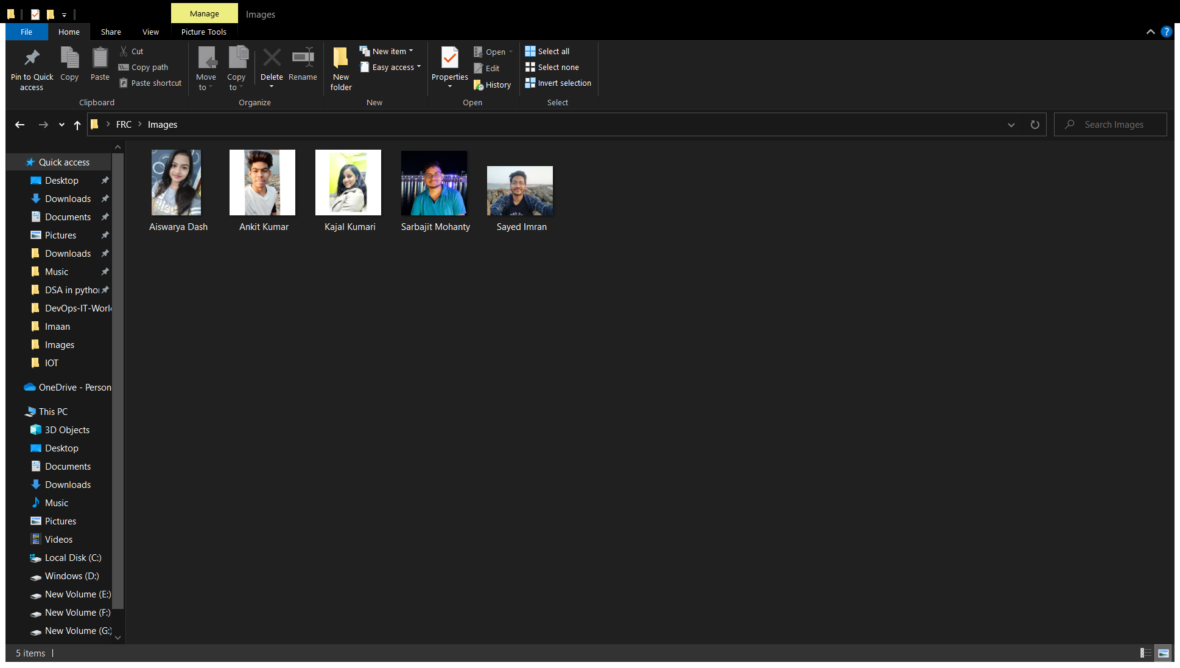
Creating Dataset :
Image Data Collected using OpenCV

Slide 7
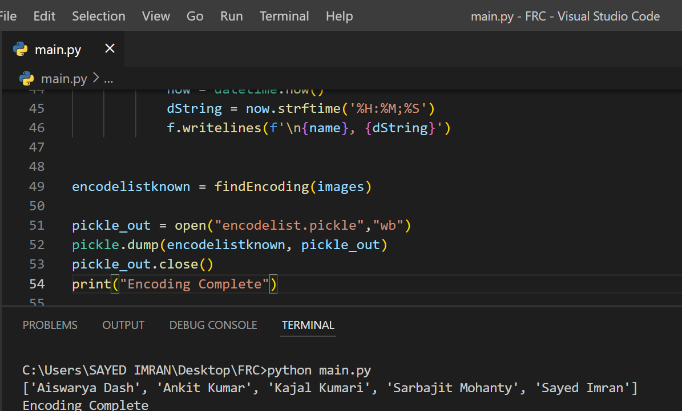
Encoding the Images of the Faces :

Slide 8
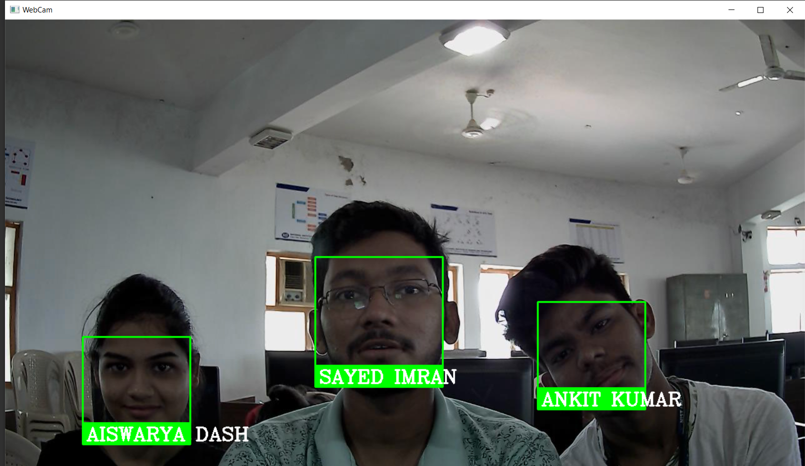
Multi-face Recognition using the Model :

Slide 9
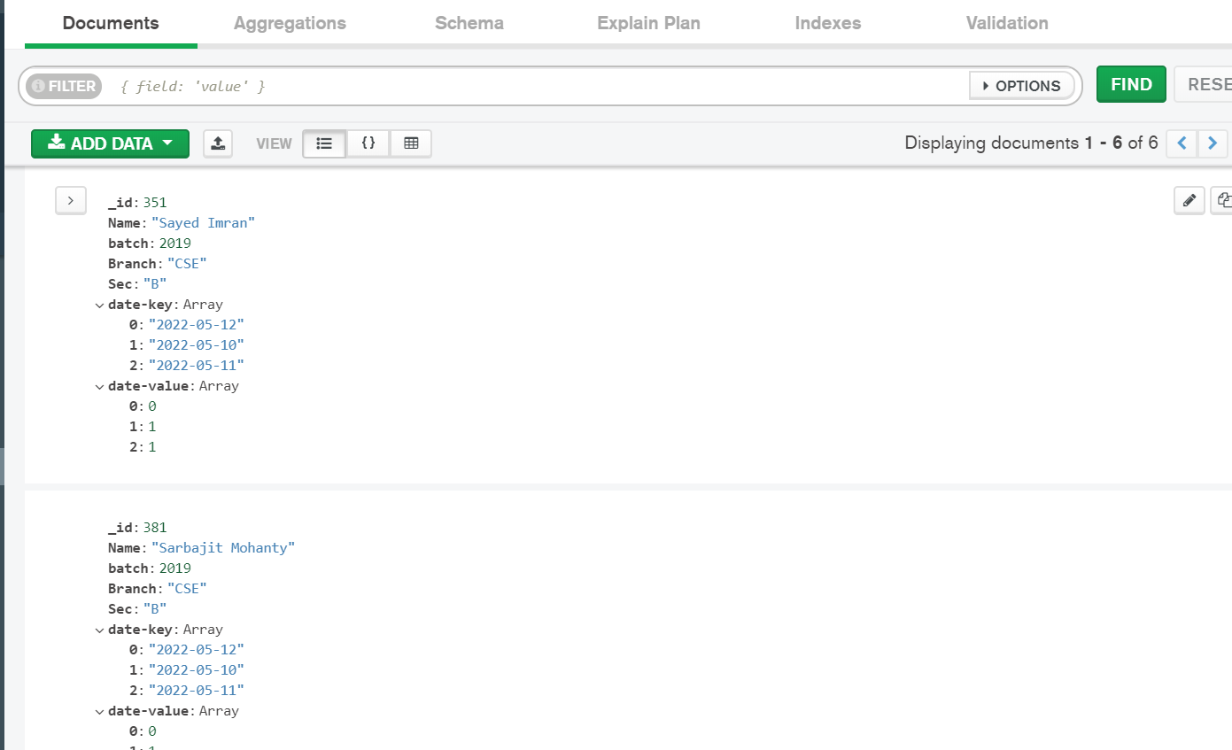
Data Stored in MongoDB Container in AWS Instance :

Slide 10
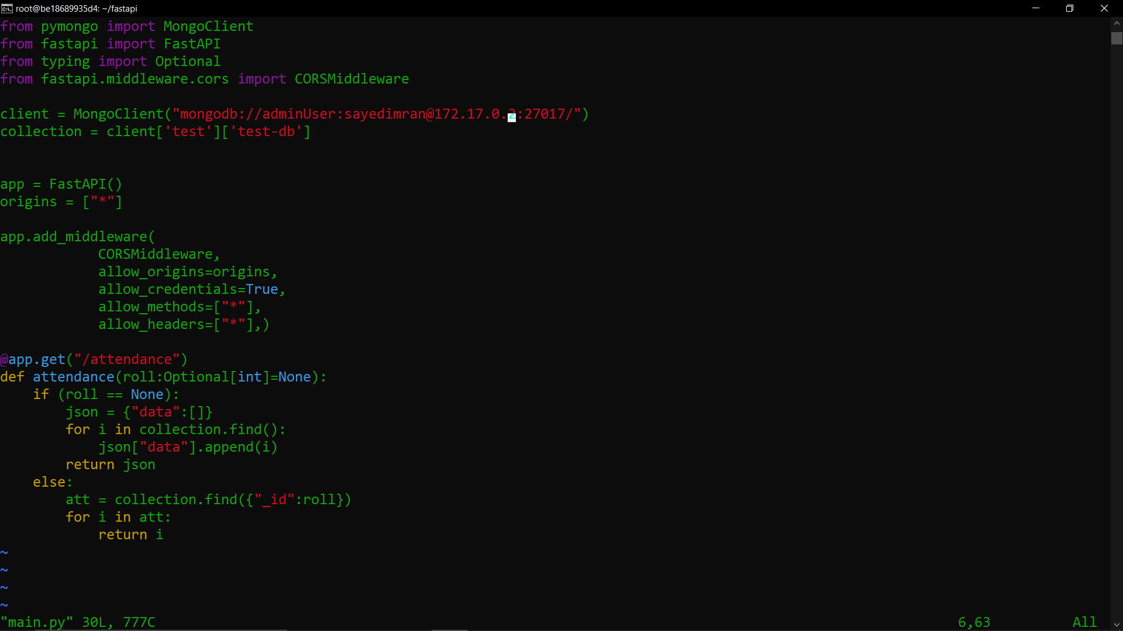
Fast-API backend that handles all operations :

Slide 11
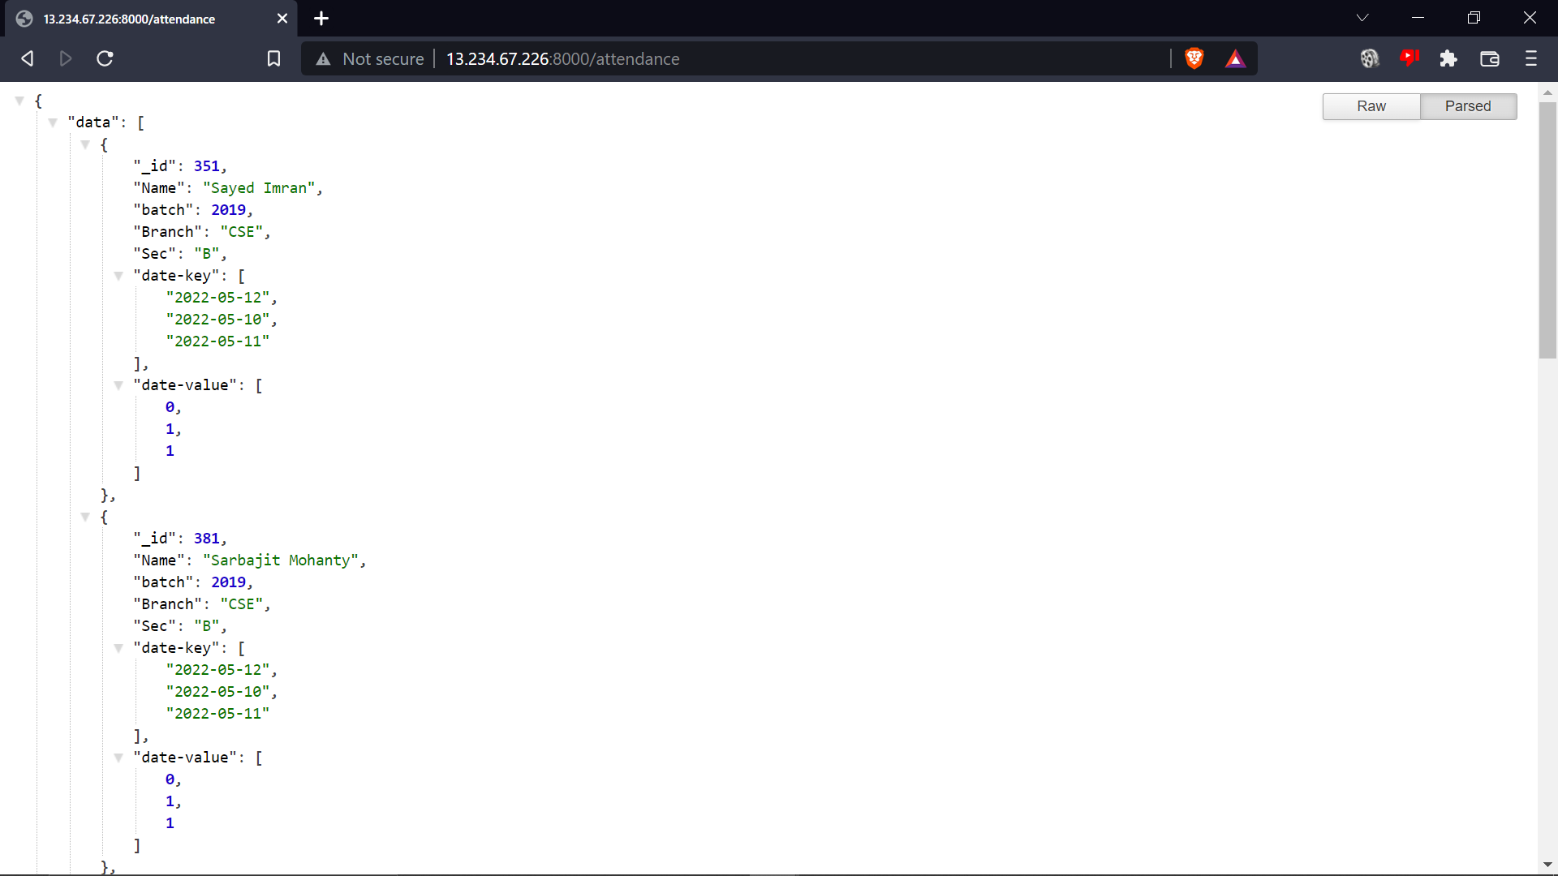
Data fetched from server is hosted in docker container in an AWS instance :

Slide 12
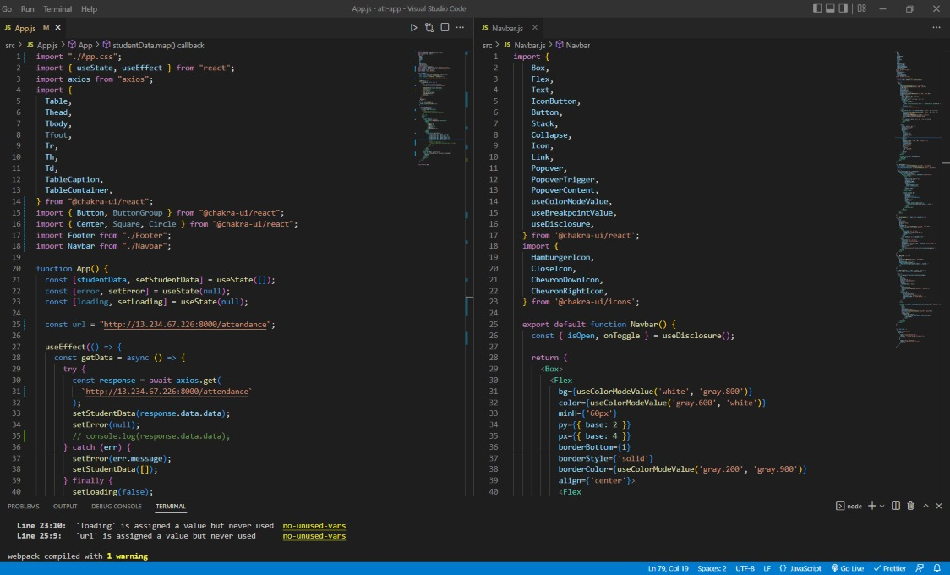
Front-end built using React and Component library: Chakra-UI

Slide 13
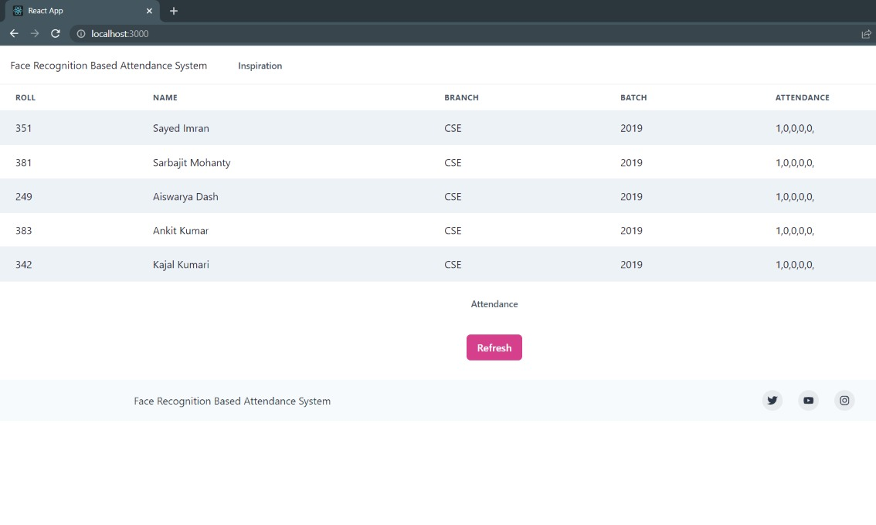
Dashboard for the same user interface :

Slide 14
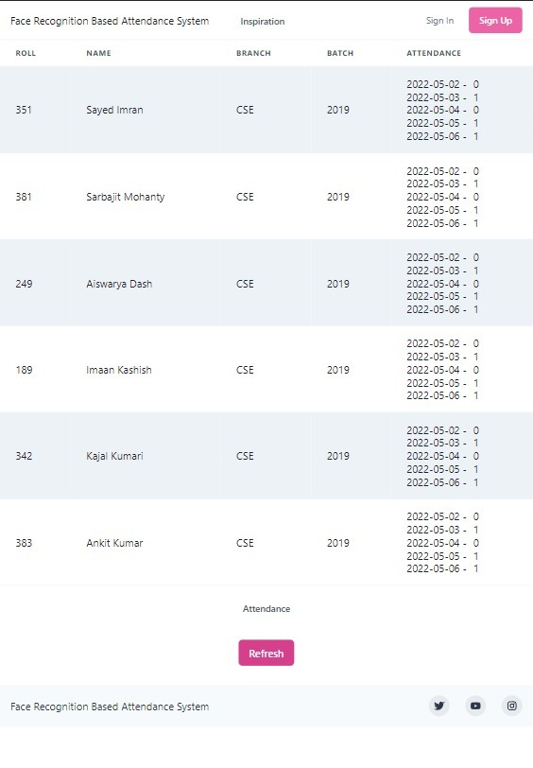
Final Output :- Attendance Dashboard

Slide 15
Weekly work report of all team members :
Name - Sarbajit Mohanty Roll – 201910381
Week 1 -> Installed Node.js and React.
Week 2 -> Implemented Hooks in React.
Week 3 -> Learnt about REST-full APIs.
Week 4 -> Built a basic User Interface of the Application.
Week 5 -> Implemented the User Interface using a Component
Library called Chakra-UI.
Week 6 -> Had discussion over model refactoring and multi-face
detection of the model.
Week 7 -> Implemented 'axios' a npm package to seamlessly fetch
data from server.
Week 8 -> Final Testing and finishing the Student Attendance
Dashboard

Slide 16
Weekly work report of all team members :
Name – Kajal Kumari Roll – 201911342
Week 1 -> Discussed about the database requirements.
Week 2 -> Installed MongoDB.
Week 3 -> Learnt about its implementation from ground level.
Week 4 -> Learnt more about its implementation
Week 5 -> Implemented the database.
Week 6 -> Had discussion over the model and the modifications
required.
Week 7 -> Implemented the changes required.
Week 8 -> Final Testing of the project.

Slide 17
Weekly work report of all team members :
Name – Aiswarya Dash Roll – 201943249
Week 1 -> Discussed about the topic and requirements of project.
Week 2 -> Checked whether all necessary installations are done.
Week 3 -> Studied about each member’s work.
Week 4 -> Learnt more about the implementations and working.
Week 5 -> Testing individual member’s work.
Week 6 -> Integration of all member’s work and testing. Finding
errors and future possible requirements.
Week 7 -> Implemented the required changes in the project.
Week 8 -> Final Testing of the project.

Slide 18
Weekly work report of all team members :
Name – Sayed Imran Roll – 201910351
Week 1 -> Designed the database schema in MongoDB.
Week 2 -> Manually tested the database operations.
Week 3 -> Learnt about the FastAPI framework.
Week 4 -> Designed the required API.
Week 5 -> Integrated the API with the database.
Week 6 -> Developed the code for the face recognition model.
Week 7 -> Integrated the database with the output of the model to
record attendance.
Week 8 -> Tested the project end to end.

Slide 19
Weekly work report of all team members :
Name – Ankit Kumar Roll – 201910383
Week 1 -> Created a test plan according to the application requirements.
Week 2 -> Developed manual test case scenarios from the end-users perspective.
Week 3 -> Detected software failures so that defects may be discovered and
corrected.
Week 4 -> Analyzed the changes.
Week 5 -> Checked the final prototype in order to determine how far the needs
and requirements are met.
Week 6 -> Evaluated the functionality of the application with an intent to find
whether the developed software is defect-free.
Week 7 -> Identified and fixed the bugs which occurred during the initial
testing phase.
Week 8 -> Improved the reliability , quality and performance of the software.

Slide 20
Thank You

