Slide 1



SKILL Tracker
Team Members:
Akshaya R
Arun Kumar K
Geethanjali Peruru
Keerthana K
Priya R
Ram Murti
Sobhesh Barun Tripathy

Slide 2

INTRODUCTION
  The main objective of the project is to provide an efficient way of searching and managing an employee’s information..

Slide 3
Problem Statement
We need to develop a skill management single page application which is used to keep track of skills of the associates.
We need to provide a customized searching feature based on the attribute of associate.
We need to provide an easy way of managing the associate details.

Slide 4




Solution
An application to keep track of associate’s skills.
Search
Manage
Statistics
Search for associate information
Add, Remove and View an associate
Statistical representation of skiils

Slide 5

Demonstration

Slide 6
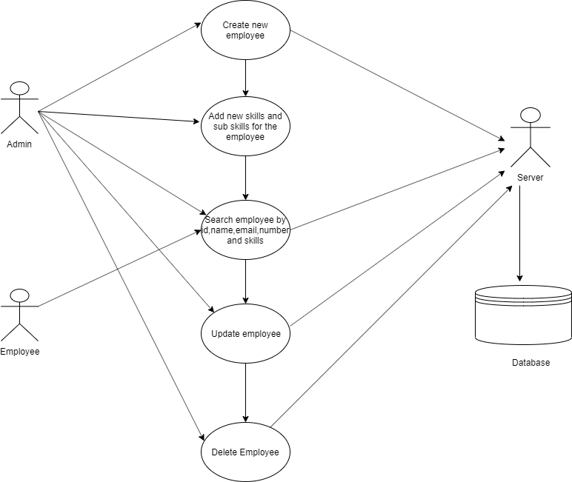
Log In
WORK FLOW
Admin
Is Admin / Associate
Associate
Search Associate
Search Associates
Add Associate
Remove Associate
Add Skills
Edit Associate’s Profile
Log out

Slide 7
TECHNOLOGIES USED
FRONT-END
MIDDLEWARE
BACK-END
Angular 8
Bootstrap 4
Type Script
Java Script
CSS 3
HTML 5
Java 8.x
Spring Boot 2.1.8
Eureka Server 1.4.2
Eureka Client 1.9.13
Feign Client 1.2.6
Hibernate
MySQL 8.0

Slide 8



IDE Used
Visual Studio Code
MySQL Workbench
Spring Tool Suite

Slide 9
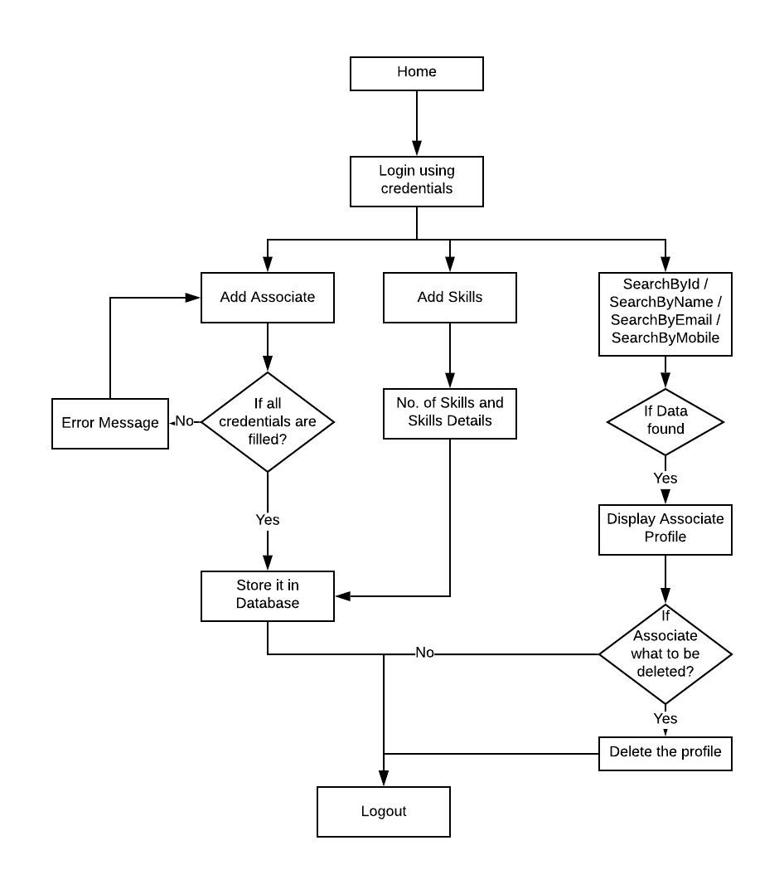
ADMIN LOGIN FLOW ARCHITECTURE

Slide 10
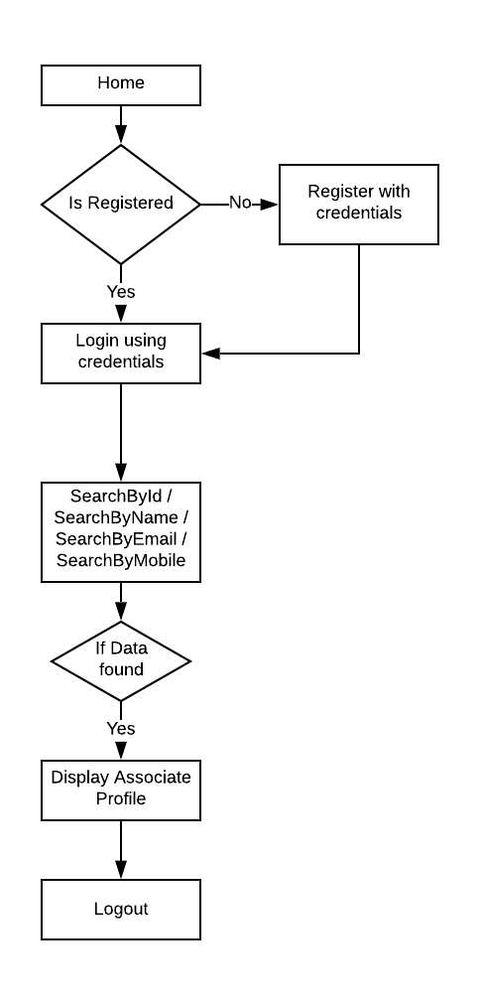
ASSOCIATE LOGIN-FLOW

Slide 11
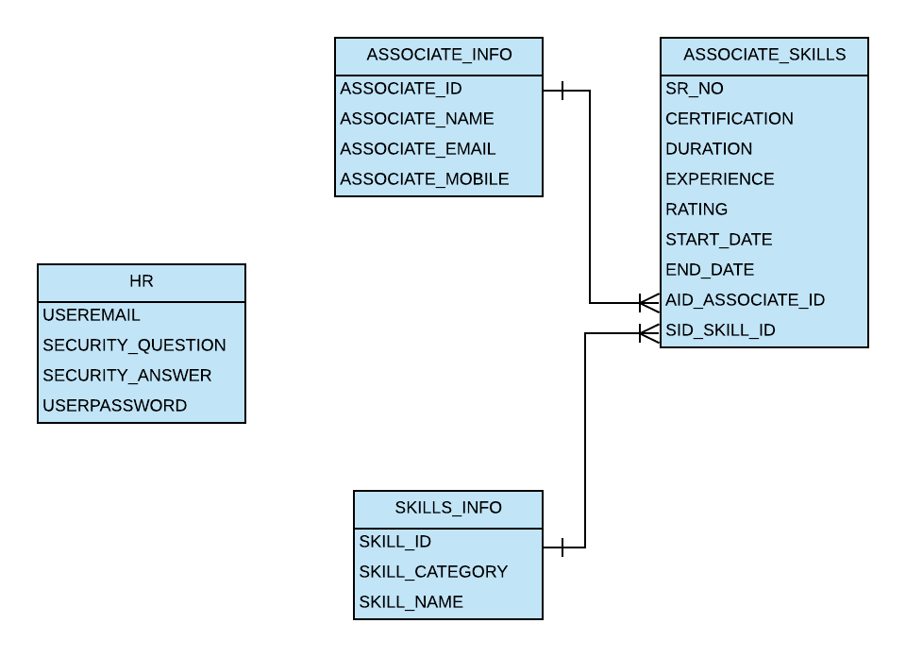
BACK-END ARCHITECTURE

Slide 12
COMPONENTS
Home
Login
Dropdown-split
Dropdown-emp
Star-rating
Search-emp
Password
Add-skills

Slide 13
ANGULAR
  Jasmine
  Karma
TESTING

Slide 14
FUTURE SCOPE
Will create the profile page.
Associate can add new skills and upload the certification and a mail notification will be sent to admin.
Notification in the profiles.

Slide 15

Thank you

