Slide 1
TEAM MEMBERS
ACE
Engineering College
An AUTONOMOUS Institution
Department Of Computer Science and Engineering
I Year B .Tech Semester – II Section - A
Project Abstract
for
Real-Time Research Project / Societal Related Project
On
“HOSPITAL MANAGEMENT RECORD ”
By
*co Ordinator M.SIVA KUMAR sir
Asst.Professor
G.AKSHAYA 24AG1A1221
CH.SOWJANYA 24AG1A1209
G.UTTEJ KUMAR 24AG1A1244

Slide 2
ABSTRACT: TITLE:HOSPITAL MANAGEMENT RECORD This project presents a simple yet effective Hospital Management System built using Python's Tkinter library for the graphical user interface. The application is designed to manage patient data in small clinics or healthcare setups by allowing users to add, view, search, update, and delete patient records easily. Each patient record includes key information such as name, age, phone number, gender, illness, a fixed consultant fee, and the bill payment status. The GUI is user-friendly, designed with a clean layout, and features a light blue background to enhance visual appeal and usability. Input fields are provided for user entry, along with radio buttons to select gender and bill status. The system uses a patients.txt file to store records persistently without requiring a database, making it lightweight and portable . Functionality is divided into modules, with clear separation between data handling (file I/O) and interface controls. Patients are displayed in a listbox , and their details can be viewed in pop-up dialogs. Users can search for a patient by name using a keyword search, or update and delete existing records with confirmation prompts to avoid accidental changes. On launching the program, all stored patient records are loaded automatically into the interface. This project is a practical implementation of Python’s core features, combining GUI programming, file handling, and basic data management. It provides an excellent foundation for understanding how desktop-based record systems work and can be further extended with database integration or more advanced features in the future.

Slide 3
# ----------------- IMPORTS ----------------- import tkinter as tk # GUI components from tkinter import messagebox, simpledialog # Popups & dialogs for alerts and input import os # File system operations # ----------------- FILE CONFIG ----------------- FILENAME = "patients.txt" # Text file used to store patient records # ----------------- FILE OPERATIONS ----------------- # Function to read patient records from the file def read_patients(): if not os.path.exists(FILENAME): # If the file doesn't exist yet return [] # Return empty list with open(FILENAME, "r") as file: # here we open the file with read mode return [line.strip().split(",") for line in file.readlines()] # Each line is split by commas into a list and strip is used for removing the space before and after input enter # Function to write (overwrite) patient records into the file def write_patients(patients): with open(FILENAME, "w") as file: # Opens file in write mode (overwrites old content) for p in patients: file.write(",".join(p) + "\n") # Join each patient record list with commas and write it to file

Slide 4
# ----------------- FUNCTIONALITY ----------------- # Function to add a new patient to file and update display def add_patient(): # Get the values from form inputs name = name_entry.get().strip() age = age_entry.get().strip() phone = phone_entry.get().strip() gender = gender_var.get() illness = illness_entry.get().strip() bill_paid = bill_paid_var.get() consultant_fee = "300" # Fixed consultant fee # Validate required fields if not name or not age or not phone or not illness: messagebox.showwarning("Input Error", "All fields are required.") return # Write new patient record to the file with open(FILENAME, "a") as file: # Open in append mode to add new record file.write(f"{name},{age},{phone},{gender},{illness},{consultant_fee},{bill_paid}\n") messagebox.showinfo("Success", "Patient record added.") clear_fields() # Clear the form fields after adding refresh_display() # Update the listbox to show the new patient # Refreshes the Listbox display with current patients def refresh_display(): patient_list.delete(0, tk.END) # Clear all existing items for p in read_patients(): patient_list.insert(tk.END, f"{p[0]} ({p[1]} yrs)") # Add patient's name and age

Slide 5
# Displays full details of selected patient in popup def show_selected(): index = patient_list.curselection() if not index: return patient = read_patients()[index[0]] messagebox.showinfo("Patient Details", f"Name: {patient[0]}\nAge: {patient[1]}\nPhone: {patient[2]}\nGender: {patient[3]}" f"\nIllness: {patient[4]}\nConsultant Fee: ₹{patient[5]}\nBill Paid: {patient[6]}" ) # Searches patients by name def search_patient(): keyword = simpledialog.askstring("Search", "Enter patient name:") # Prompt user if not keyword: return results = [p for p in read_patients() if keyword.lower() in p[0].lower()] # Filter records by name match if results: # Format multiple results text = "\n\n".join([ f"Name: {p[0]}\nAge: {p[1]}\nPhone: {p[2]}\nGender: {p[3]}" f"\nIllness: {p[4]}\nFee: ₹{p[5]}\nBill Paid: {p[6]}" for p in results ]) messagebox.showinfo("Search Results", text) else: messagebox.showinfo("Search Results", "No patient found.")

Slide 6
# Deletes the selected patient from file def delete_patient(): index = patient_list.curselection() # Get selected index if not index: messagebox.showwarning("Select Patient", "Please select a patient to delete.") return patients = read_patients() selected = patients[index[0]] # Confirm deletion confirm = messagebox.askyesno("Confirm Delete", f"Are you sure you want to delete {selected[0]}?") if confirm: del patients[index[0]] # Remove selected patient write_patients(patients) # Save updated list messagebox.showinfo("Deleted", f"Deleted patient: {selected[0]}") refresh_display() # Refresh display # Updates the selected patient by prompting for new details def update_patient(): index = patient_list.curselection() if not index: messagebox.showwarning("Select Patient", "Select a patient to update.") return patients = read_patients() selected = patients[index[0]]

Slide 7
# Prompt for updated values with existing ones pre-filled new_name = simpledialog.askstring("Update", "New Name:", initialvalue=selected[0]) new_age = simpledialog.askstring("Update", "New Age:", initialvalue=selected[1]) new_phone = simpledialog.askstring("Update", "New Phone:", initialvalue=selected[2]) new_gender = simpledialog.askstring("Update", "Gender:", initialvalue=selected[3]) new_illness = simpledialog.askstring("Update", "Illness:", initialvalue=selected[4]) new_bill_paid = simpledialog.askstring("Update", "Bill Paid (Yes/No):", initialvalue=selected[6]) # Validate input if not new_name or not new_age or not new_phone or not new_gender or not new_illness or not new_bill_paid: messagebox.showerror("Invalid Input", "All fields must be filled.") return # Update record patients[index[0]] = [new_name, new_age, new_phone, new_gender, new_illness, "300", new_bill_paid] write_patients(patients) messagebox.showinfo("Updated", "Patient record updated successfully.") refresh_display() # Clears the input form fields def clear_fields(): name_entry.delete(0, tk.END) age_entry.delete(0, tk.END) phone_entry.delete(0, tk.END) illness_entry.delete(0, tk.END) gender_var.set("Male") # Reset to default bill_paid_var.set("No") # Reset to default

Slide 8
# ----------------- GUI SETUP ----------------- root = tk.Tk() # Create the main window root.title("Hospital Management System") # Title of the window root.geometry("500x720") # Size of the window root.config(bg="#e6f2ff") # Set background color to light blue # Font and color styling label_font = ("Arial", 12) entry_bg = "#ffffff" # White entry boxes button_bg = "#4CAF50" # Green button background button_fg = "white" # White text on buttons # Main heading tk.Label(root, text="Patient Details", font=("Arial", 16, "bold"), bg="#e6f2ff", fg="#333").pack(pady=10) # Form Fields for label in ["Name", "Age", "Phone Number", "Illness"]: tk.Label(root, text=label, font=label_font, bg="#e6f2ff").pack() # Create label entry = tk.Entry(root, bg=entry_bg) # Create entry input field entry.pack() # Save entry widgets to global variables if label == "Name": name_entry = entry elif label == "Age": age_entry = entry elif label == "Phone Number": phone_entry = entry elif label == "Illness": illness_entry = entry

Slide 9
# Gender selection (radio buttons) tk.Label(root, text="Gender", font=label_font, bg="#e6f2ff").pack() gender_var = tk.StringVar(value="Male") # Default gender tk.Radiobutton(root, text="Male", variable=gender_var, value="Male", bg="#e6f2ff").pack(anchor="w") tk.Radiobutton(root, text="Female", variable=gender_var, value="Female", bg="#e6f2ff").pack(anchor="w") # Bill Paid selection (radio buttons) tk.Label(root, text="Bill Paid", font=label_font, bg="#e6f2ff").pack() bill_paid_var = tk.StringVar(value="No") # Default bill status tk.Radiobutton(root, text="Yes", variable=bill_paid_var, value="Yes", bg="#e6f2ff").pack(anchor="w") tk.Radiobutton(root, text="No", variable=bill_paid_var, value="No", bg="#e6f2ff").pack(anchor="w") # Button to add patient tk.Button(root, text="Add Patient", command=add_patient, bg=button_bg, fg=button_fg).pack(pady=5) # Patient list heading tk.Label(root, text="Patient Records", font=("Arial", 14), bg="#e6f2ff", fg="#333").pack(pady=10) # Listbox to display patient names and ages patient_list = tk.Listbox(root, width=50) patient_list.pack(pady=5)

Slide 10
# Buttons for operations: Show, Search, Update, Delete buttons = [ ("Show Details", show_selected), ("Search Patient", search_patient), ("Update Patient", update_patient), ("Delete Patient", delete_patient) ] for text, command in buttons: tk.Button(root, text=text, command=command, bg="#2196F3", fg="white").pack(pady=3) # Load patients into listbox on app start refresh_display() # Run the GUI loop (wait for user interaction) root.mainloop()

Slide 11
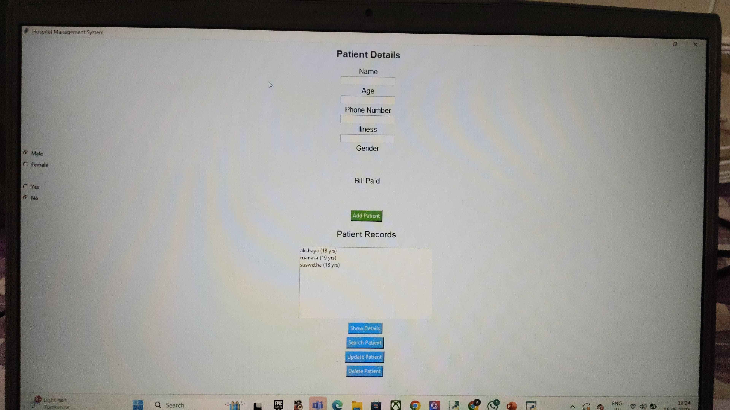
Output results:

Slide 12
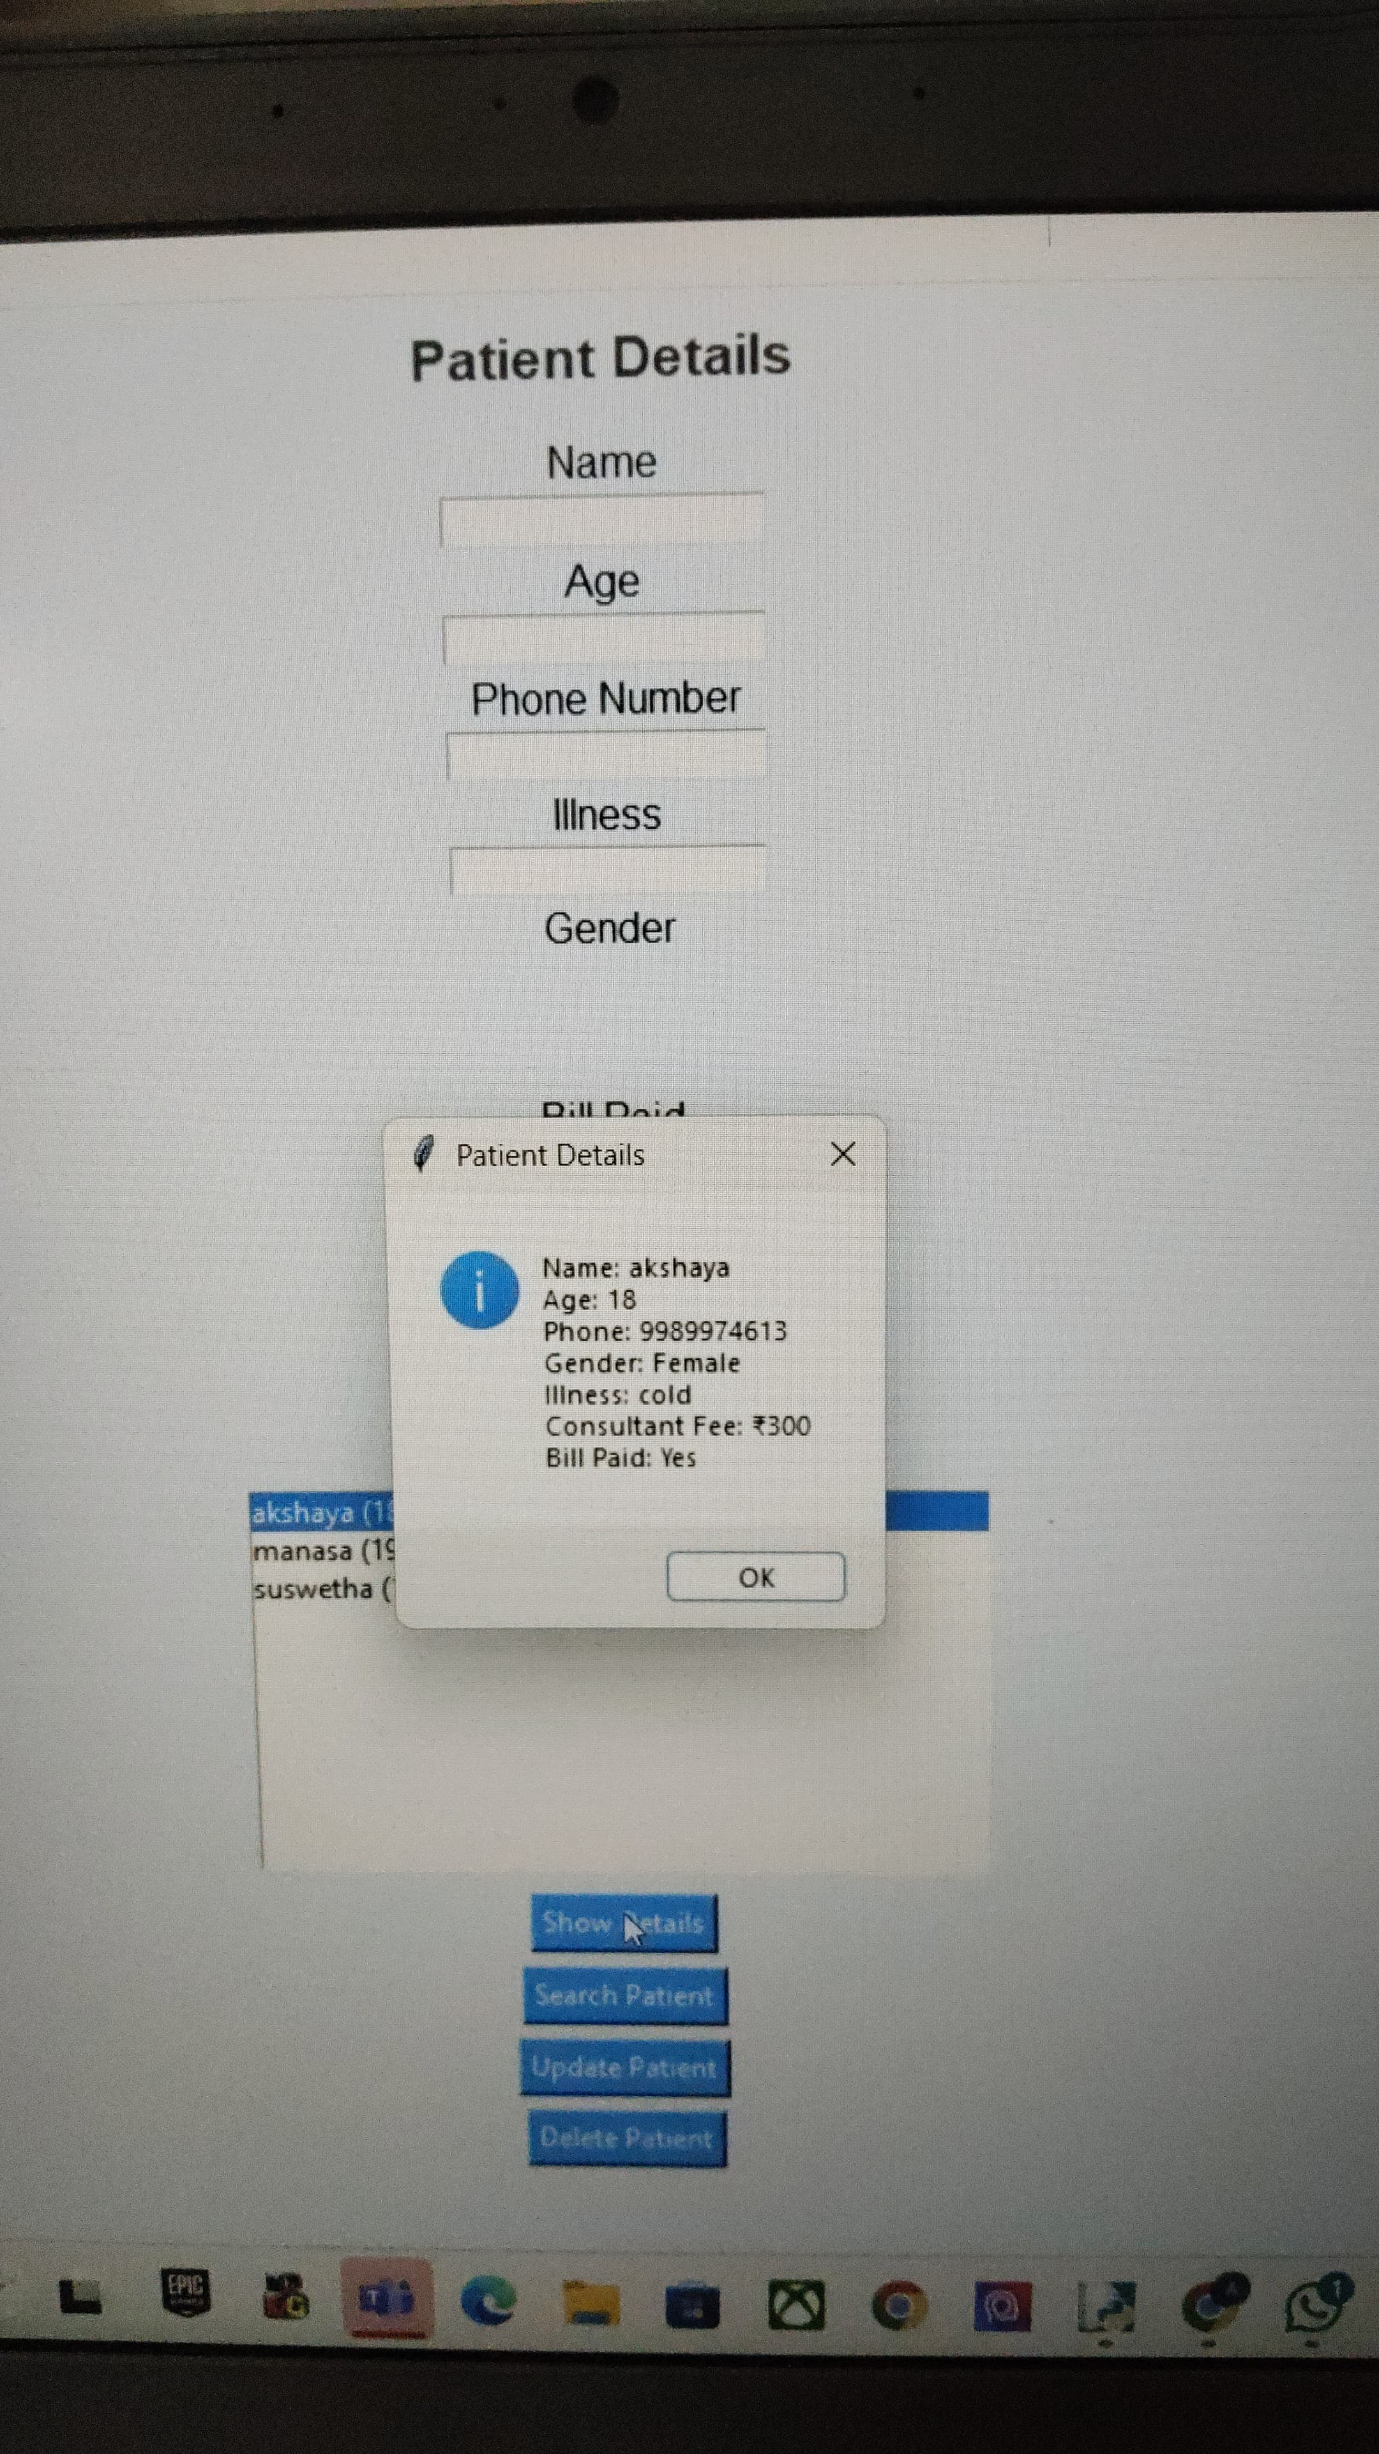
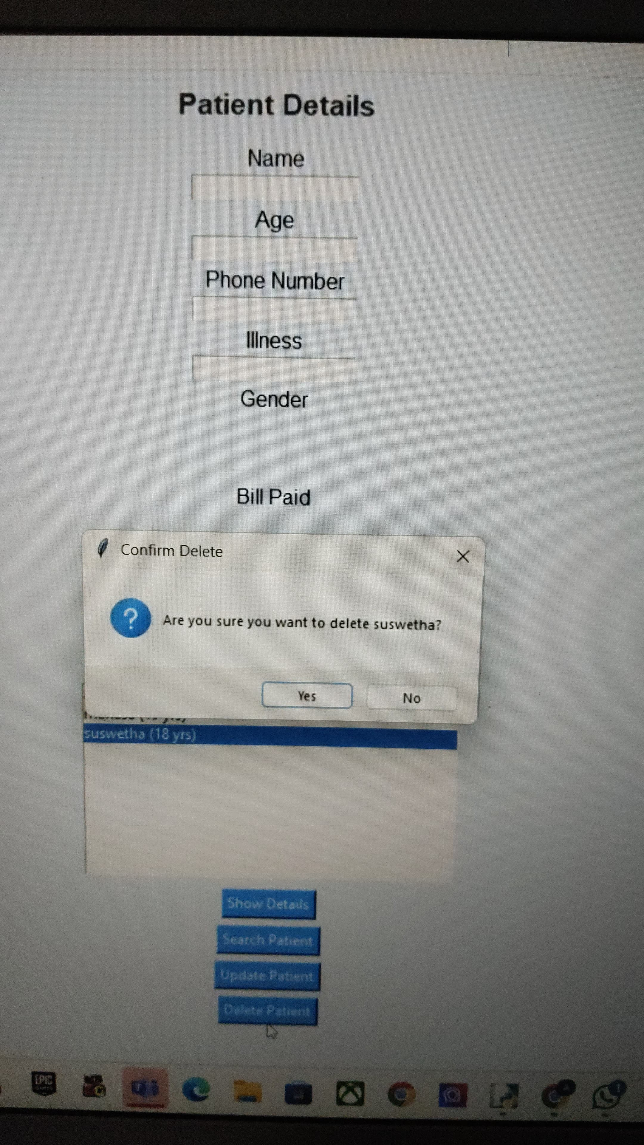

Slide 13
Conclusion: The Hospital Management System developed using Python and Tkinter successfully addresses the need for a basic yet functional patient record-keeping solution. It allows for seamless management of patient data, including adding, updating, viewing, searching, and deleting patient records through a simple and intuitive graphical user interface. By storing data in a text file, it eliminates the need for complex database setups, making it lightweight and suitable for small clinics, personal use, or educational purposes. The modular design and clean layout make the application user-friendly and easy to maintain or upgrade in the future. Overall, the project demonstrates the practical use of Python for solving real-world problems in healthcare administration at a small scale. Applications : 1. Small Clinics & Dispensaries: 2. Home-based Healthcare Providers 3. Medical Students & Interns 4. Mobile Health Camps 5. Personal Use for Health Tracking 6. Administrative Training Tool.

