Slide 1


ACE
ENGINEERING COLLEGE
An Autonomous Institution
DEPARTMENT OF INFORMATION TECHNOLOGY
SMART CANTEEN SYSTEM
Internal Guide
Mrs . V.Swetha
Assistant Professor
Project Coordinator
Mr. M .Siva Kumar
Assistant Professor
Presented By
G. Akshaya 24AG1A1221
G. Saketh 24AG1A1220
K. Varun 24AG1A1227

Slide 2
ABSTRACT
The Smart Canteen System is a frontend-based application designed to digitalize and automate the food ordering process in a college canteen. The system allows students to log in, view the available menu, place food orders, choose a payment mode, and select a preferred pickup time. Each order is stored securely in a local storage and assigned a token based on the payment which helps in easy identification and faster service. This reduces long queue, saves time for students, and improves overall efficiency in canteen operations. This system also provides a manager dashboard to monitor all orders in real-time manage order status, and handle cancellations based on predefined rules. Automated scheduling is used to update order status before pickup time, ensuring timely preparation and packing of food. By integrating database management, scheduling, and user-friendly interfaces, the Smart Canteen System minimizes manual work, avoids confusion during peak hours, and enhances the overall canteen management experience.

Slide 3
INTRODUCTION
Students can log in securely using their credentials.
Digital menus display with available food items and prices.
Online food ordering with preferred pickup time selection.
Multiple payment modes(Online/cash).
Automatic token generation based on payment method.
Orders stored securely in a local storage.
Manager dashboard to monitor and manage orders in real time.
Order status tracking and automated scheduling to update order status before pick up time
Reduces queues and saves time for students.

Slide 4
Problem Statement
Inefficient Manual Ordering System: The traditional canteen ordering process relies on manual methods, leading to long queues and delays during peak hours. This results in time wastage for students and difficulty for staff in managing multiple orders efficiently.
Lack of Order Management and Coordination: There is no proper system to track orders, payment status, and pickup timing, causing confusion and errors. This leads to mismanagement, incorrect orders, and reduced overall efficiency in canteen operations.

Slide 5
📄 Literature Survey
S.No | Year | Authors | Title | Publication & Link
1 | 2023 | Prathamesh Auti, Mohit Bawankar, Pranav Bochare et al. | Smart Canteen System | IJRASET – 🔗 Click Here
2 | 2022 | Sujata Joshi, Bivek Kasaju, Pratik Karki et al. | Smart Canteen Management System | IJRASET – 🔗 Click Here
3 | 2021 | Harshada Menewar, Siya Bhandari, Prajakta Mahajan et al. | Smart Canteen and Cafeteria Management System using RFID & IoT | IJRASET – 🔗 Click Here

Slide 6
Existing System:
Current system is mostly manual or semi-digital
Students stand in queues to place orders
Payments are often done manually (cash-based)
No proper order tracking system
High chances of errors and delays
Time-consuming during peak hours

Slide 7
Applications of the Project Useful in college canteens Can be used in restaurants and cafes Offices & Corporate Companies Schools &Food Courts & Malls Railway Stations & Airports Industrial Canteens

Slide 8
Proposed System
A canteen website where users can order food online
Users can:
view menu items
Add items to cart
Place orders easily
Admin can:
Add/update food items
Manage orders
Features:
User login system
Real-time order updates
Simple and responsive UI
Reduces waiting time and improves efficiency

Slide 9
Software and Hardware Details Software Requirements : Frontend: HTML, CSS, JavaScript Database: Local storage Tools : VS Code / Browser (Chrome). HardwareRequirements: Computer/Laptop Minimum 4GB RAM Internet connection Server (local or online hosting)

Slide 10
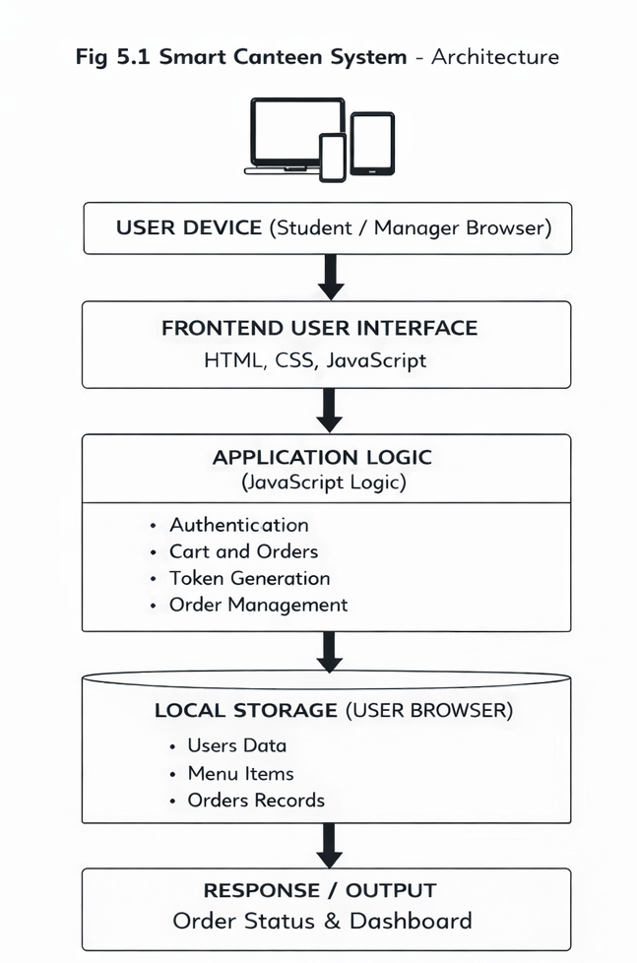

Slide 11
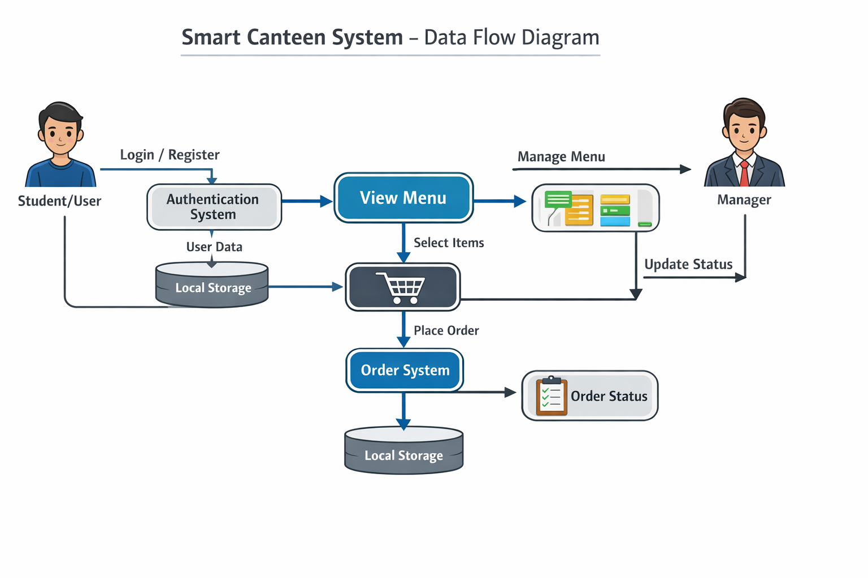

Slide 12
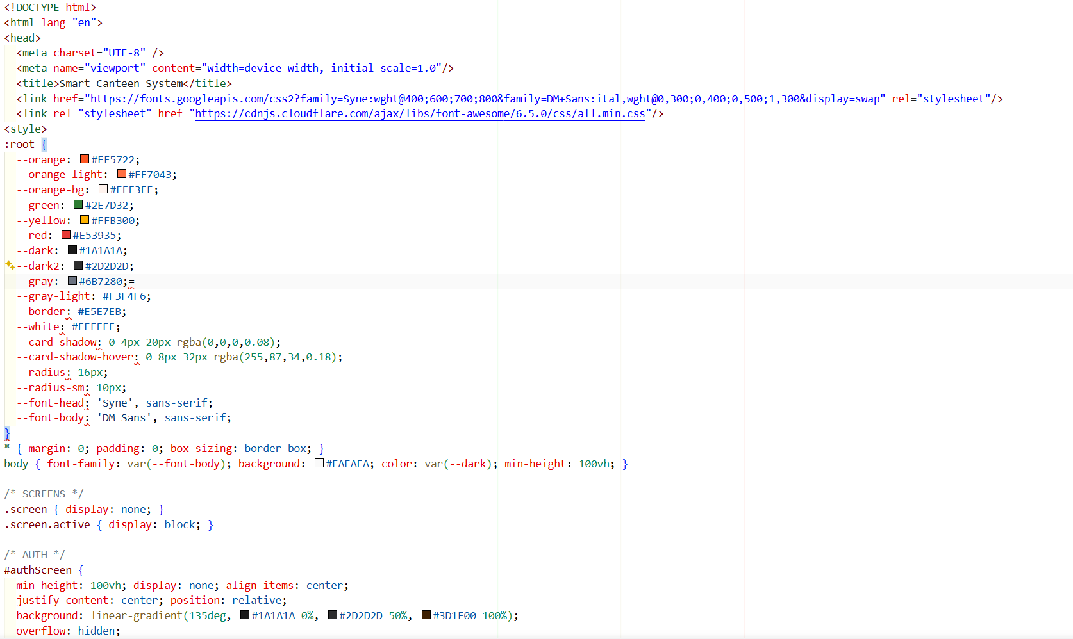
Sample code:

Slide 13
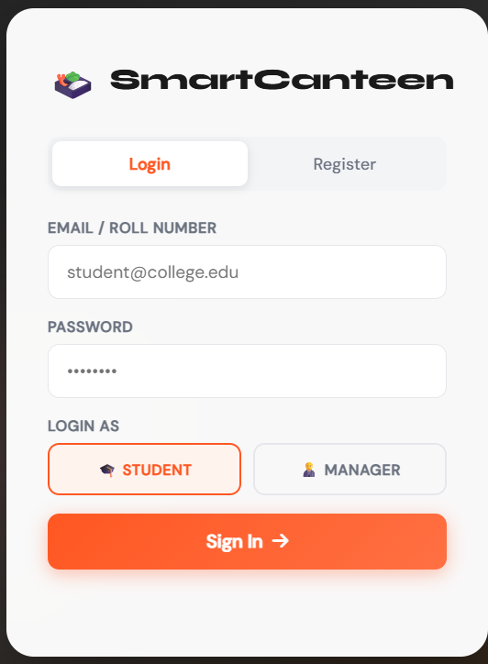
Screenshots of Output Login/Register page :

Slide 14
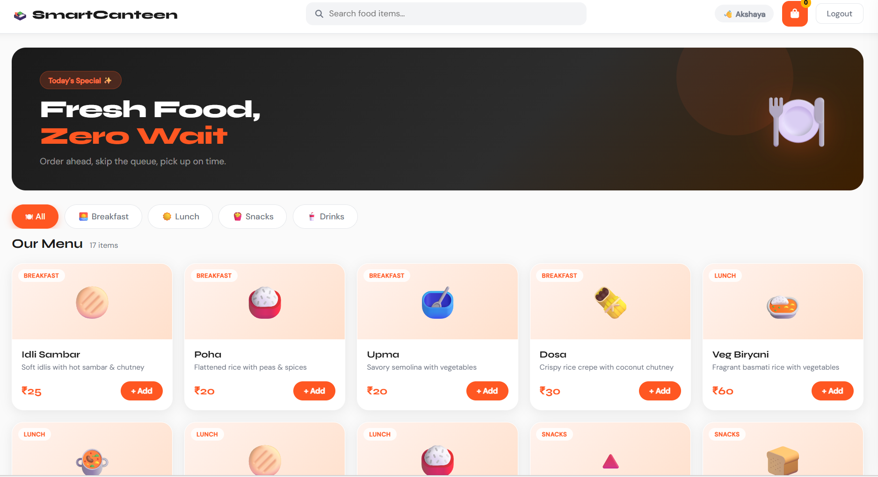
Menu:

Slide 15
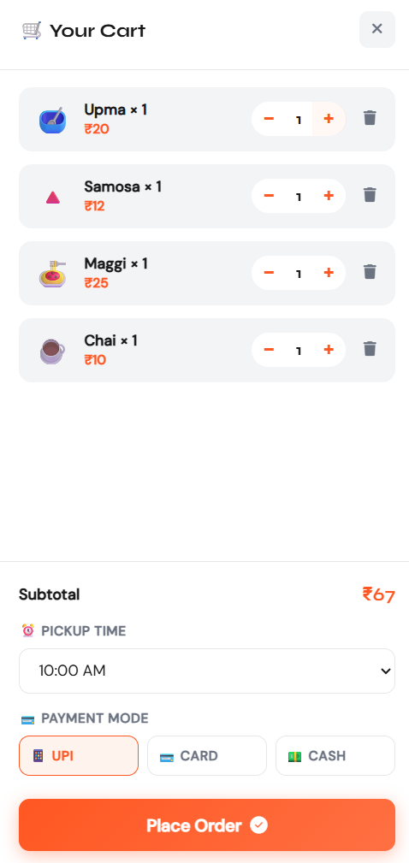
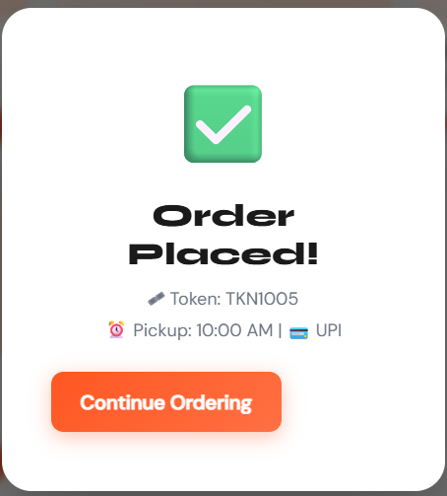
Cart page: Order placed page:

Slide 16
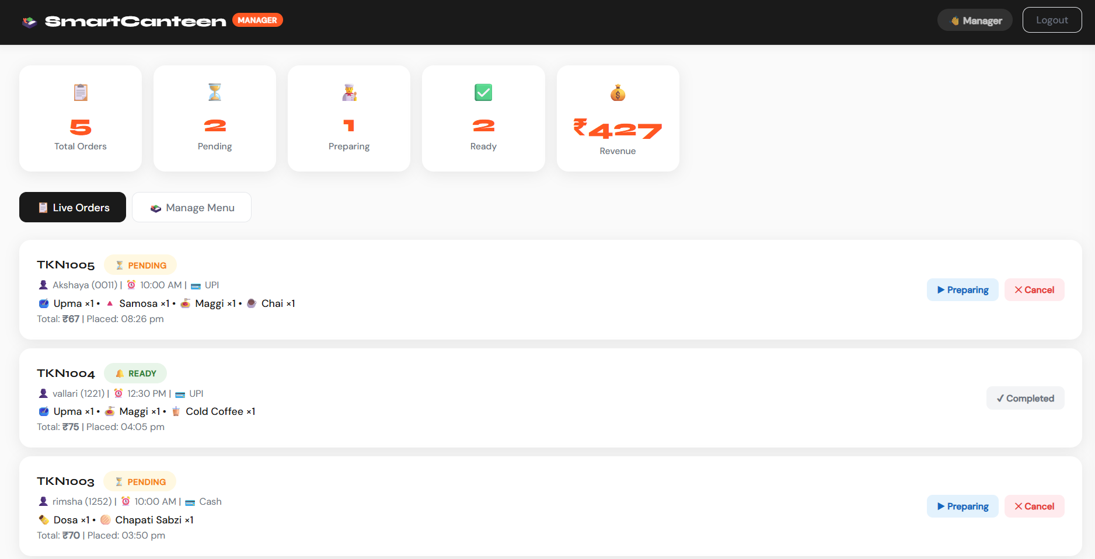
Admin dashboard:

Slide 17
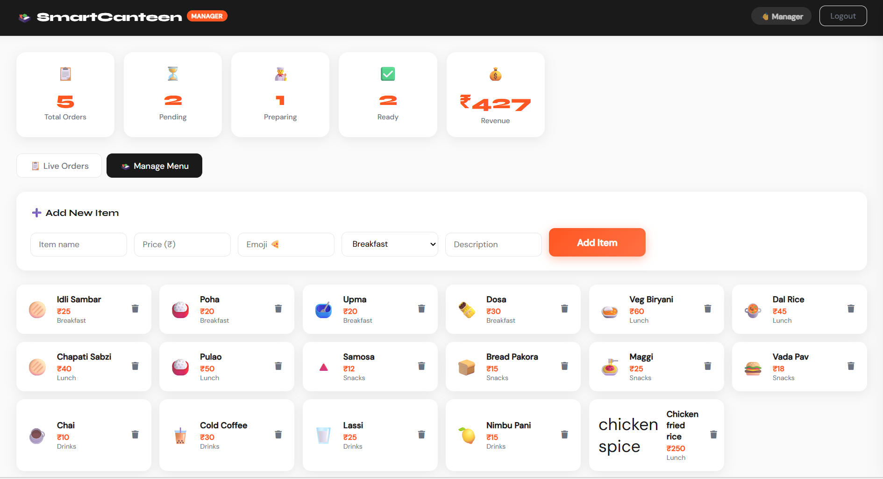
add item:

Slide 18
Conclusion: The canteen website successfully reduces waiting time Provides easy and fast ordering system Improves efficiency and user experience Meets all project objectives Works effectively in real-time environment

Slide 19
Future Enhancement: Add online payment integration (UPI, cards) Mobile app version Notifications (SMS/Email) Backend Connection Out of stock updation AI-based food recommendations

Slide 20
References: [1] Sujata Joshi, Bivek Kasaju, Pratik Karki, et al., "Smart Canteen Management System", International Journal for Research in Applied Science & Engineering Technology (IJRASET), 2022. Available: https://ieeexplore.ieee.org/abstract/document/9971803 [2] Prathamesh Auti, Mohit Bawankar, Pranav Bochare, Vaibhav Harane, Nitisha K. Rajgure, "Smart Canteen System", International Journal for Research in Applied Science & Engineering Technology (IJRASET), 2021. DOI: https://doi.org/10.22214/IJRASET.2021.34840 [3] Harshada Menewar, Siya Bhandari, Prajakta Mahajan, Prof. Kiran Dange, "Smart Canteen and Cafeteria Management System using RFID & IoT", International Journal for Research in Applied Science & Engineering Technology (IJRASET), 2022. DOI: https://doi.org/10.22214/ijraset.2023.51975

Slide 21
THANK YOU

